Slide 1



Digi-workshop
Transkribus: getting started.
The basics.
By Dr. C.A. (Annemieke) Romein
(Huygens ING)
with Johanna Walcher (READ-COOP)
Digital workshop, 21 April 2020
1 PM CEST

Slide 2
Start
Upload of the sources.
Buttons
Lay-out analysis (manual and automatic).
Transcribe
Theory
Models and export
Abbreviations, italics, conventions…
How to use an existing model or create one, language models and dictionaries?
The basic principles behind HTR(+) vs OCR.
Registration and Installation (already done…!)
What is the purpose of all these buttons.
Where and how to transcribe?
Desktop version and webversion.
How to export files?
What does Transkribus?
How to search files? (KWS/ SOLR)
How to collaborate?
  More on the READ-COOP (guest speaker)

Slide 3
Theory
In this section you will learn more about READ/ Transkribus.

Slide 4
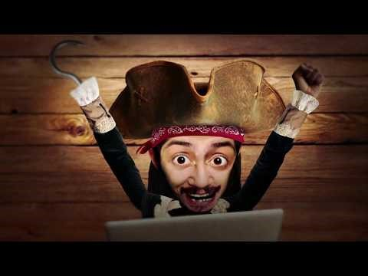
By Kris Kobes and Rick Companje
https://www.youtube.com/watch?reload=9&v=gS3GvvelN4o&feature=youtu.be

Slide 5
Transkribus
ARCHIVES
LIBRARIES
Theory
Digitise documents
Recognised documents
Start
Transcribe, train, recognize, search
measure
TRANS-
KRIBUS
Data
Competitions
HUMANITIES SCHOLARS
STORAGE HOSTING
COMPUTER SCIENTISTS
&
TECHNOLOGYE PROVIDERS
Buttons
EXPERT
INTERFACE
TRAINING
RECOGNITION
SEARCH
Technology Metrices
Results
WEB INTERFACE
Transcribe
Digitise
Search
Contribute
Results
Models and export
PUBLIC
CROWD

Slide 6


ScanTent And DocScan
https://readcoop.eu/scantent/

Slide 7
Why do I use Transkribus
I do not (yet) know how to program.
  So I can’t program Tesseract or Kraken.
I do like the GUI – it is difficult at first, but grows on you.
The webversion is easy for crowd-projects.
There are many features you can use, it is not “just” HTR (but also Lay-Out Analysis).
The servers in Innsbruck have a HUGE… no MASSIVE amount of data, which has made them very cleaver and effective in text-recognition.

Slide 8
Theory
In this section you will learn about
the basic principles behind HTR(+) and OCR.

Slide 9
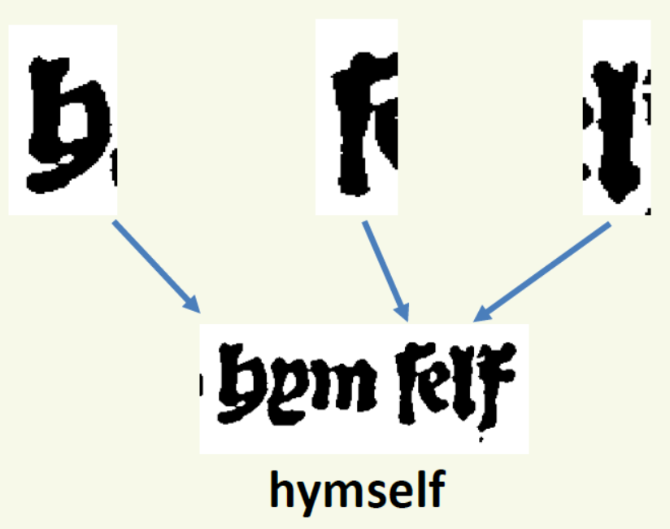
Theory
Start
Buttons
Transcribe
Models and export

Slide 10


Automated Text Recognition?
Theory
Start
Buttons
Transcribe
Models and export
Notes:
Reconnaisance des Textes Automatiques
Fraktur = Lettre noire
Au contraire du OCR (optical character recognition)
Reconnaisance en base des lignes („contextualisation“)
10

Slide 11
OCR/ HTR/ ATR
Theory
Start
OCR works because printed texts often have: standard font, finite no. of characters, clear background
Handwritten Text Recognition (HTR)
Transcribe and search documents of any date, language, style
For handwritten ánd printed texts
Based on Machine Learning
Recurrent neural networks (retraining; N-Grams)
Not just Character based (OCR) but line based (context)
Mathematical data → human readable textual information (best-guesses, alternatives and confidence ratings)
Buttons
Transcribe
Models and export

Slide 12
HTR(+)-Model Training
Theory
Start
Trainingsdata: Image + ready transcriptions
Start with ca. 50-75 pages (without basemodel) *)
Efficient testing **)
Correction *)
Coding
Searching *)
Exporting *)
*) more later this webinar; **) advanced
Buttons
Transcribe
Models and export

Slide 13

Benefits of a good HTR Model?
Theory
Start
Quicker and efficient transcriptions!
Apply your model to other pages from the
same collection – transcribe and search in seconds.
Experienced transcriber transcribes:
± 5 pages an hour (but max. 6h) = ± 30 pages
Transkribus needs training but… then: ± 1 page every 30seconds with an HTR-model.
Buttons
Transcribe
Models and export

Slide 14
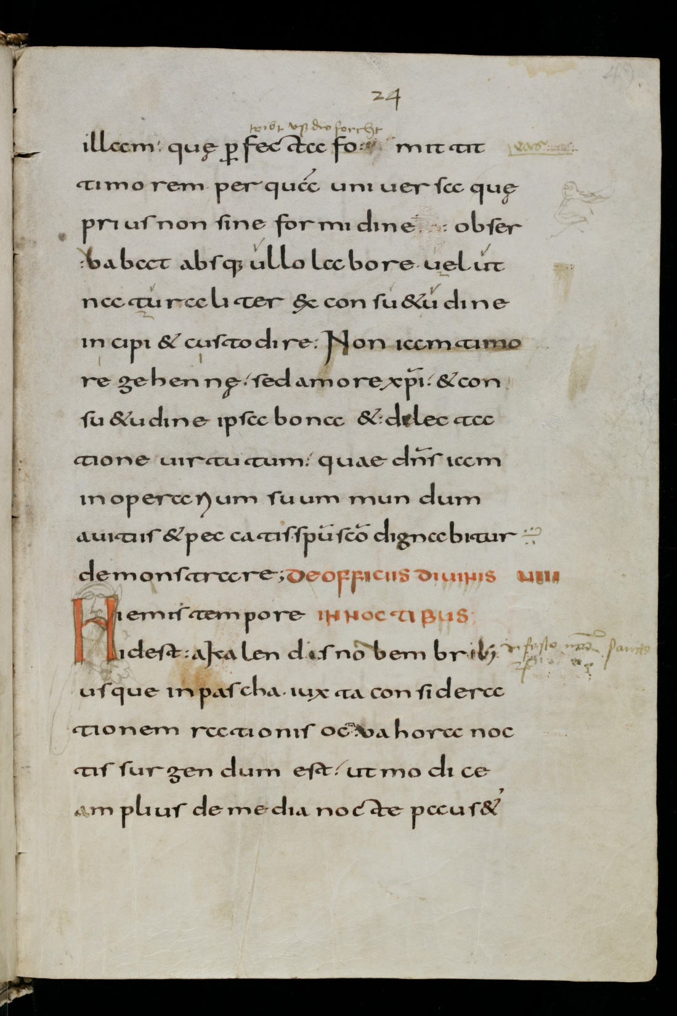

Text Recognition:
Karolingische Minuskel
Theory
Start
5'000 Words, 1'000 Lines:
7% CER
Buttons
Transcribe
Models and export

Slide 15
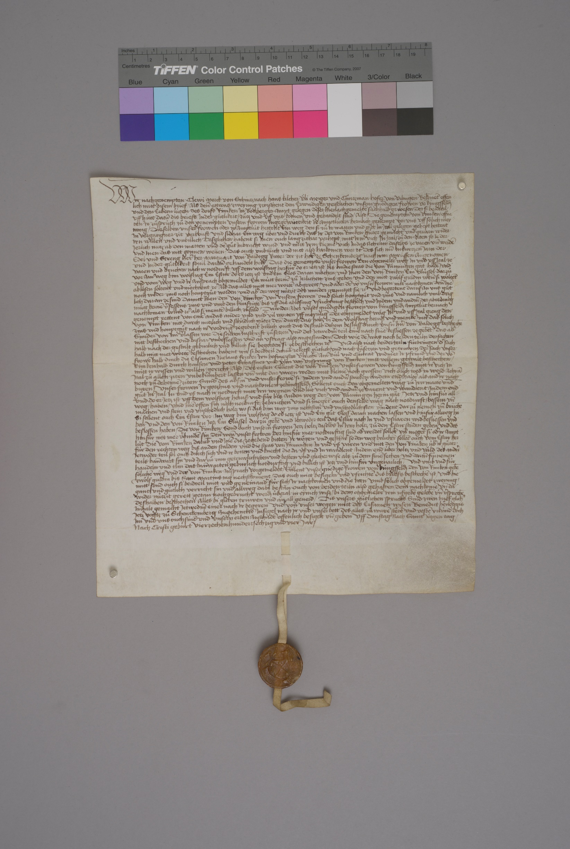
Text Recognition:
Medieval Charters
Theory
Start
77'000 Words, 3'500 Lines:
4,8% CER
Buttons
Transcribe
Models and export

Slide 16
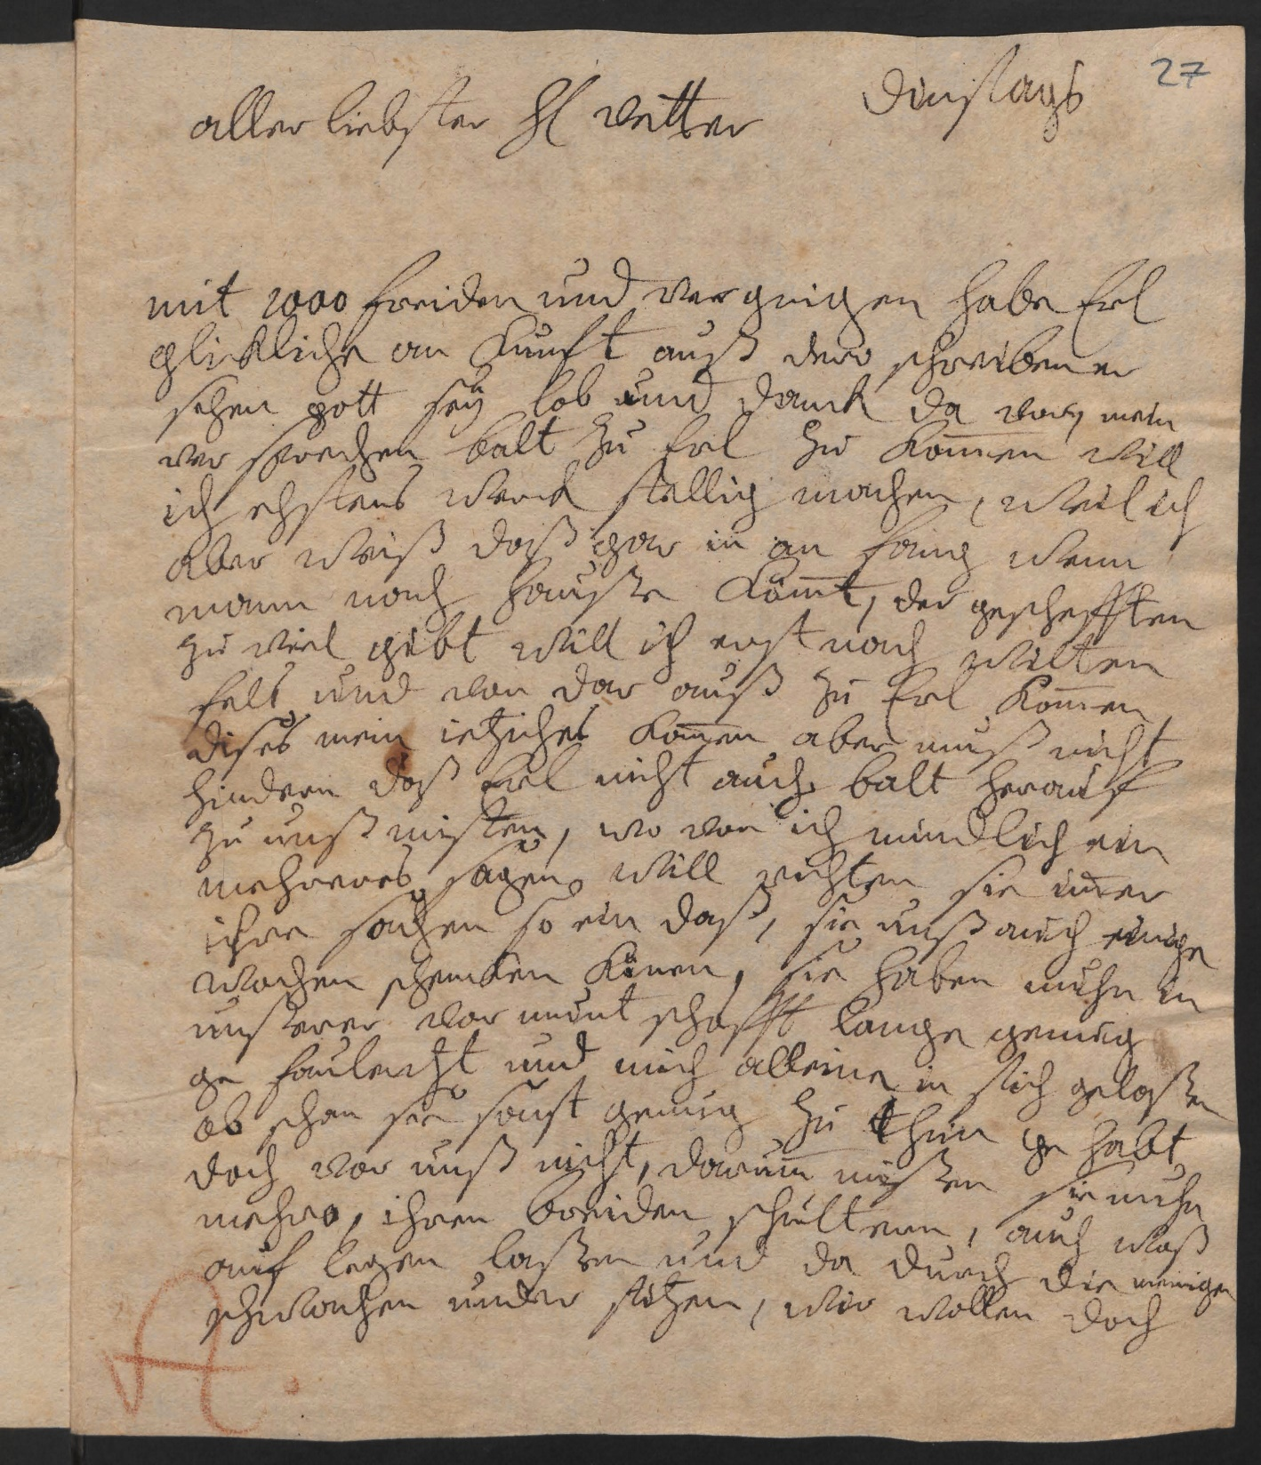
Text Recognition:
Early Modern Letters
Theory
Start
48'000 Words, 6'450 Lines:
2,5% CER
Buttons
Transcribe
Models and export

Slide 17
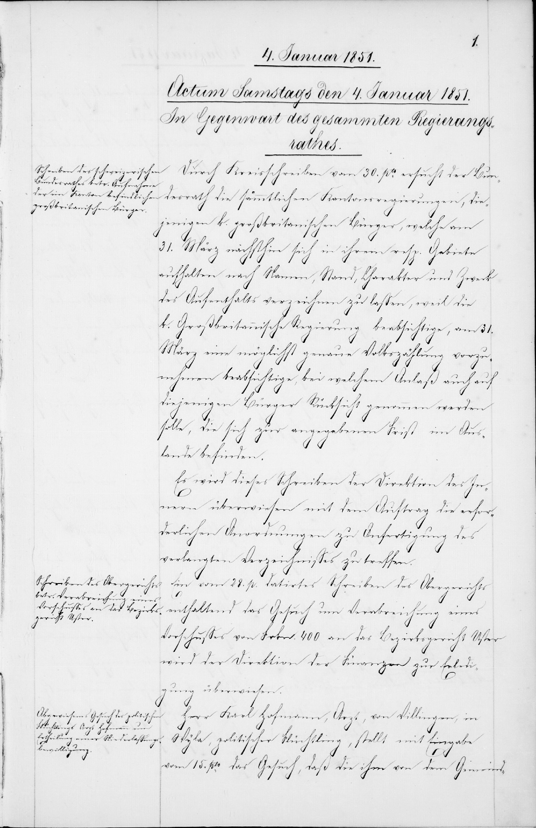
Text Recognition:
Protocols (19th C.)
Theory
Start
148'000 Words, 31'000 Lines:
2,5% CER
Buttons
Transcribe
Models and export

Slide 18

Theory
Start
Buttons
Transcribe
Models and export

Slide 19
Recognising printed text
Theory
Start
Neural networks can also process printed text – with less training data!
Transcribe documents or use OCR engine (ABBYY) in Transkribus
Use these transcripts to train a model
Results with <1-2% CER are possible.
Buttons
Transcribe
Models and export

Slide 20
Start
Registration
Installation
Upload
Text-segmenting
Transcription
Registration and Installation (already done…!)
Upload of the sources.
Desktop version and webversion.

Slide 21
Start
Registration
Installation
Upload
Text-segmenting
Transcription
In this section we will first talk a bit more about the registration and the installation.
(It is assumed that you have already completed this.)

Slide 22
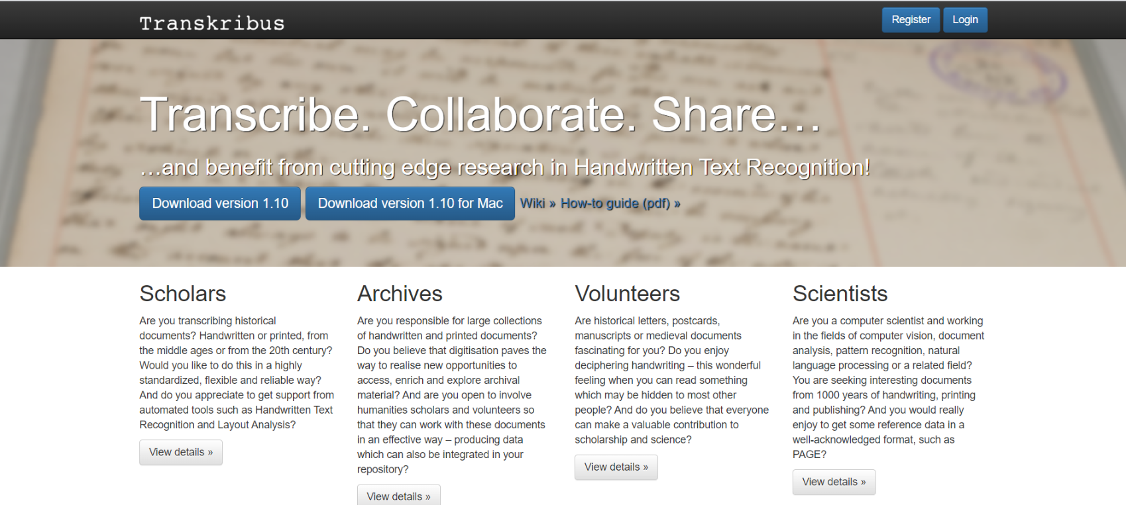
www.transkribus.eu
Theory
Start
Buttons
Transcribe
Models and export

Slide 23
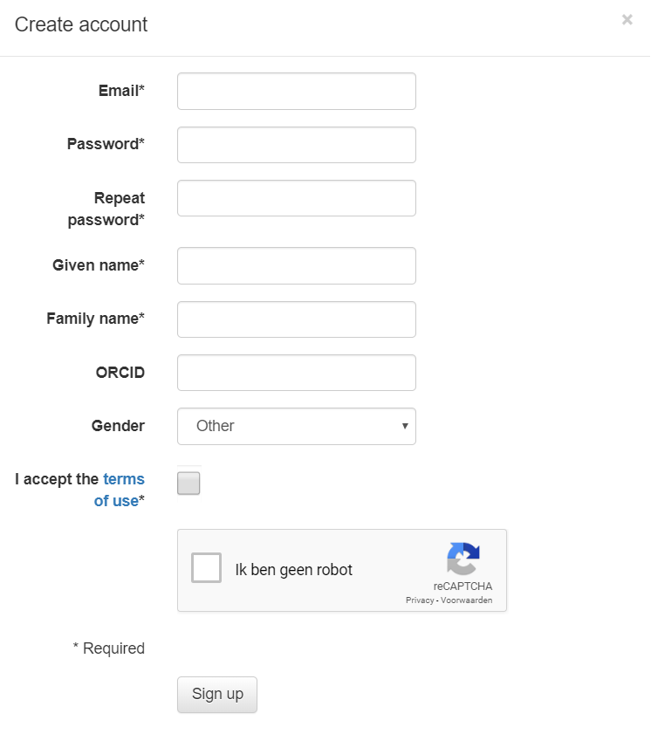
Create an Account
Theory
Start
Register your account
  ORCID is meant to credit
  you if you start making and
  sharing models *future*.
After you register, you can
download the latest version.
Buttons
Transcribe
Models and export

Slide 24
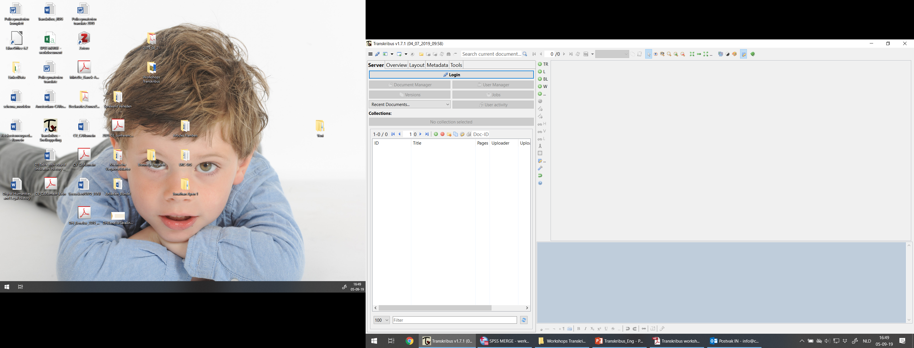
Theory
Start
Sample documents
Buttons
Transcribe
Models and export

Slide 25
Login to your account!
Theory
Start
First you need to login with the account you have previously created! (left-side, “server tab”).
Your uploads will be stored on the Innsbruck server; but are ‘private’ by default.
Buttons
Transcribe
Models and export

Slide 26
First practices
Theory
After the first login, a few testdocuments will appear in your private collection.
Start
Buttons
collections
Transcribe
documents
Sample documents
Models and export

Slide 27
Start
Registration
Installation
Upload
Text-segmenting
Transcription
In this section you will learn more about how to upload files of different types.

Slide 28
Theory
Start
Sample documents
Buttons
Transcribe
Models and export

Slide 29
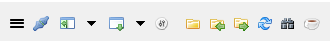
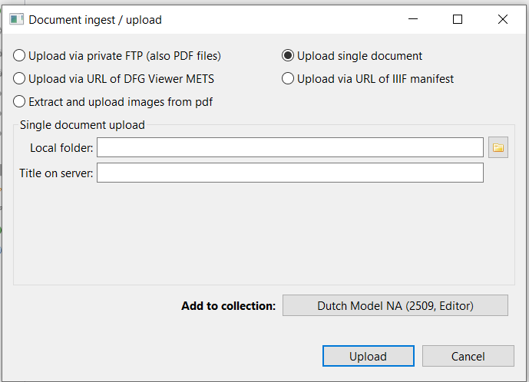
Upload
Theory
Start
Minimum quality
300dpi
JPG, PNG, TIFF (not JP2!)
You upload per folder
not per photo!
You can also upload
pfds or URLs/ IIIF. (Pdfs will be unpacked by Transkribus)
Buttons
Transcribe
Models and export

Slide 30
Start
Registration
Installation
Upload
Text-segmenting
Transcription
In this section we will talk about the different versions of Transkribus.

Slide 31
Versions of Transkribus
Theory
Start
Desktop version (you’ve installed this one).
    Very detailed.
    Basically everything is possible.
Webversion: reached through https://transkribus.eu/r/read/login/
    Very basic.
    Only transcriptions and few tagging options.
    No distractions!
Server API (Google/ Python)
    Bulky activities
Buttons
Transcribe
Models and export

Slide 32
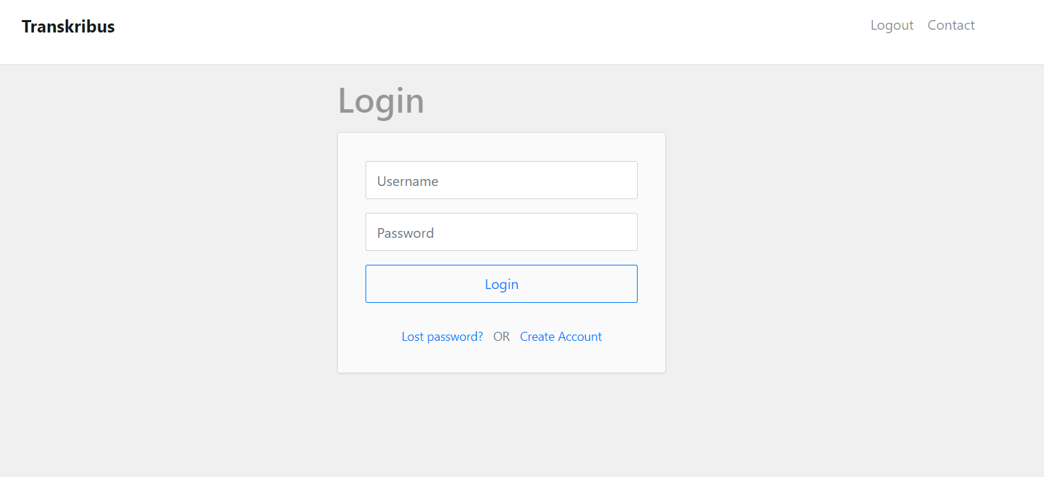
https://transkribus.eu/r/read/login/
Theory
Start
Buttons
Transcribe
Models and export

Slide 33
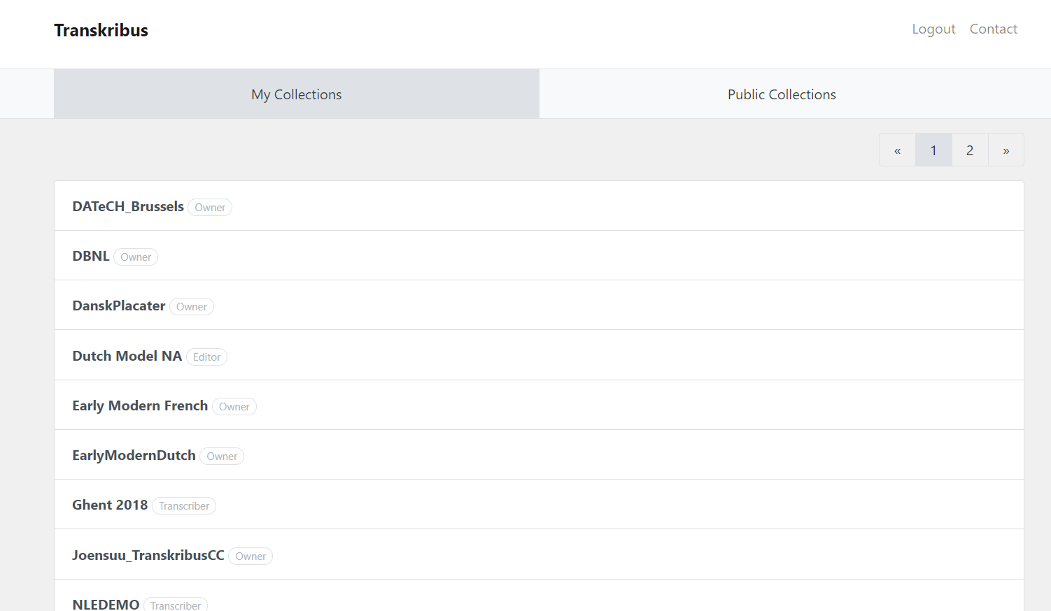
Theory
Start
Buttons
Transcribe
Models and export

Slide 34
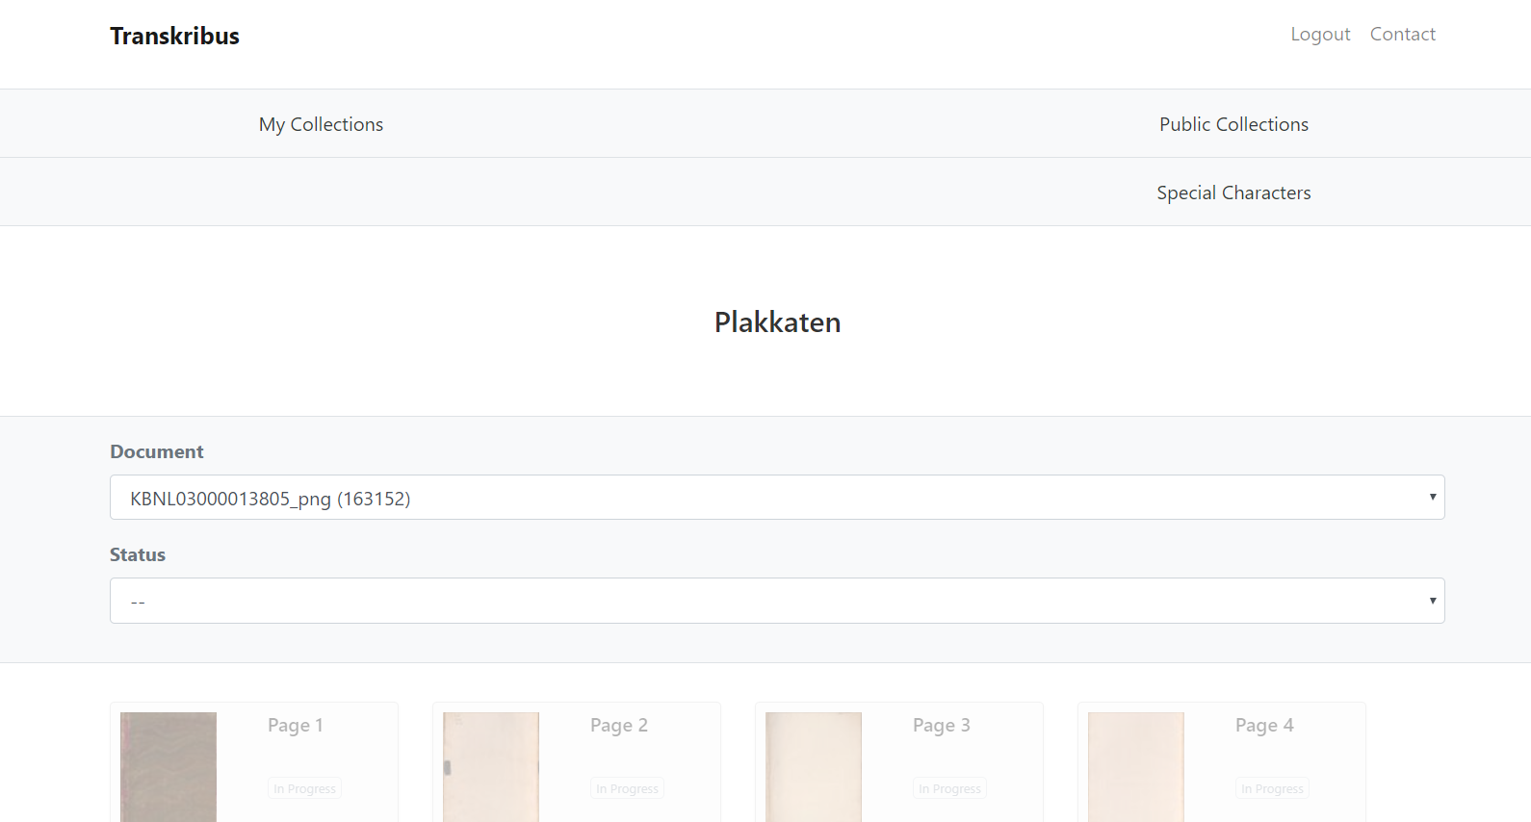
Theory
Start
Buttons
Transcribe
Models and export

Slide 35
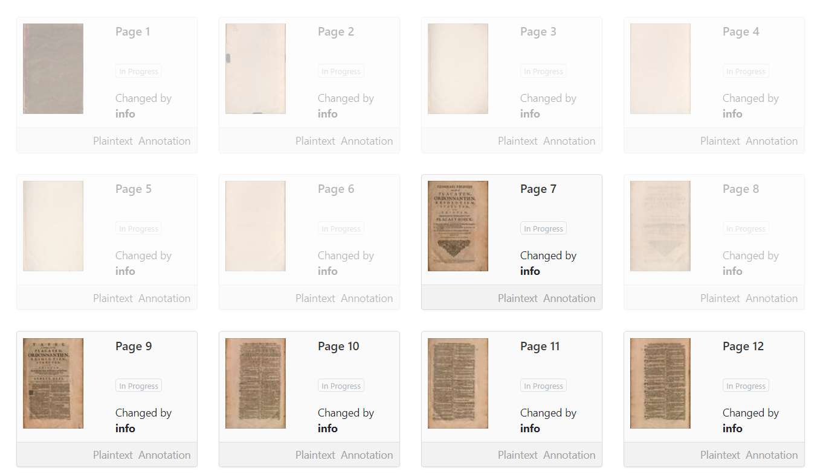
Theory
Start
Buttons
Transcribe
Models and export

Slide 36
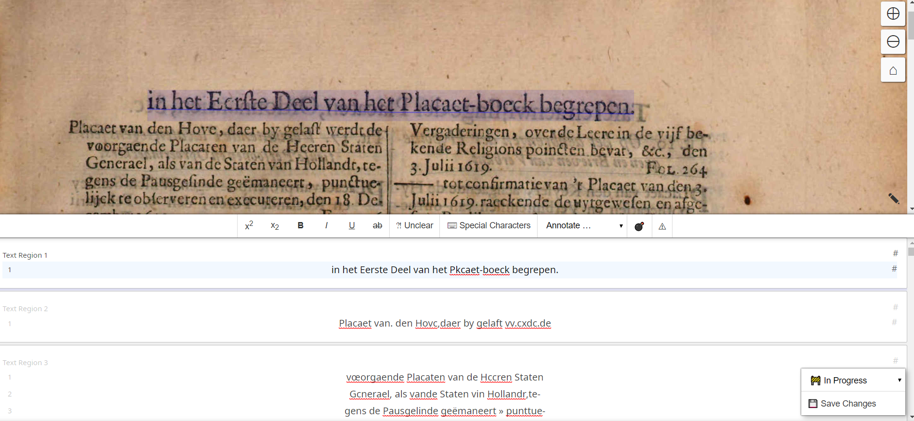
Just (guided) transcriptions…
Theory
Start
Buttons
Transcribe
Models and export

Slide 37
Buttons
What is the purpose of all these buttons.
Lay-out analysis (manual and automatic).

Slide 38
Buttons
In this section you will learn about the various buttons that Transkribus has.

Slide 39
Theory
Start
Buttons
Transcribe
Models and export

Slide 40
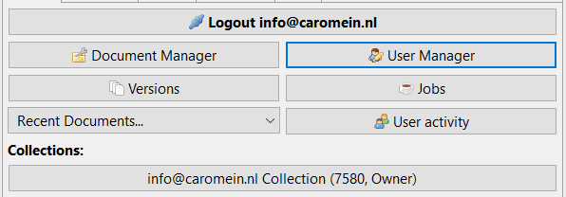
Server tab
Theory
Versions: you can always go back to a previous version!
User Manager: if you want to add people to your collection (don’t do that to your private documents!)
User activity: what has recently changed (status) in the document.
Jobs: if you have set things in motion, you can monitor them.
Collections: various sets of images you are part of.
Start
Buttons
Transcribe
Models and export

Slide 41
Theory
Start
Buttons
Transcribe
Models and export

Slide 42

Theory
1 2 3 4 5 6 7 8 9 10 11
Start
From left to right:
1) Main menu; 2) Login;
3) View/Hide menu docking state;
4) View/ hide transcription docking state;
5) profiles <which fields are shown>;
6) open local document (on pc); 7) import documents;
8) export documents; 9) refresh page;
10) KeyWord Spotting; 11) show (ongoing) jobs
Buttons
Transcribe
Models and export

Slide 43
Theory
Start
Buttons
Transcribe
Models and export

Slide 44
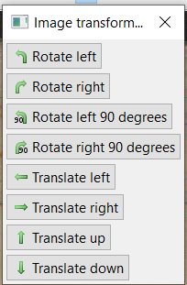
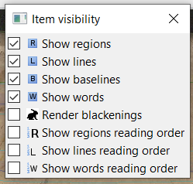
Theory
1 2 3 4 5 6 7 8 9 10 11 12 13 14 15 16 17 18
Start
From left to right
1) Version of the page (status can be changed);
2) show versions; 3) XMLviewer (transcript source);
4) pointer 5) chose visibility (various options);
6 t/m 13 self-explanatory;
14) image type view;
15+16 colour schema/contrast;
17) show edit toolbar (!);
18) bug report/ feature request
Buttons
Transcribe
Models and export
Notes:
Always put ‘show edit toolbar’ on!

Slide 45
Buttons
In this section we will work on Lay-out analysis (manual and automatic).

Slide 46
Theory
← Edit Toolbar = necessary for Lay-Out Analysis
Start
Buttons
Transcribe
Models and export

Slide 47

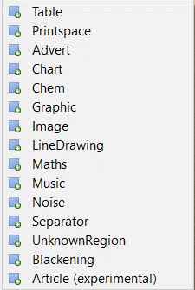
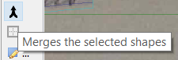
Edit Toolbar
Theory
  TR: TextRegion;
  L: Line;
  BL: Baseline;
  W: individual word;
  …: other specific shapes;
  delete
Start
Buttons
Transcribe
Models and export

Slide 48
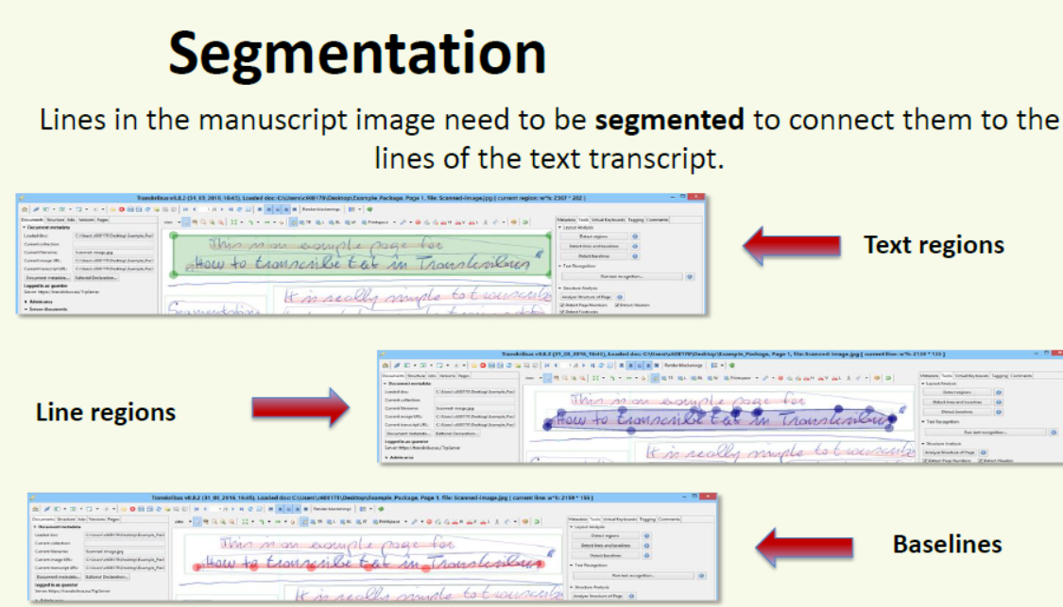
Theory
Start
  Draw boxes for the TextRegions (one click to start, one click to finish).
  One click (left) – double click (right).
Buttons
Transcribe
Models and export

Slide 49
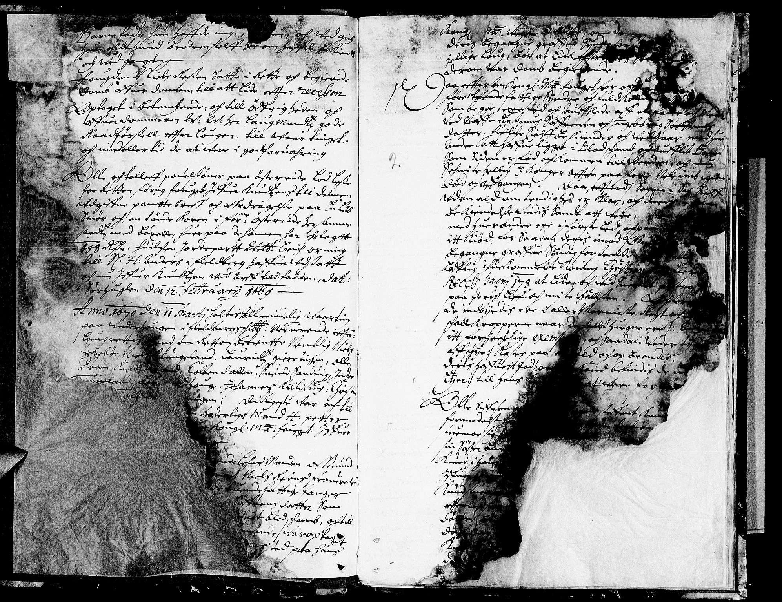
Theory
Start
Buttons
Transcribe
Models and export
  https://media.digitalarkivet.no/view/28488/4

Slide 50
Theory
Start
Yes…
LA can be done automatically
Buttons
Transcribe
Models and export

Slide 51
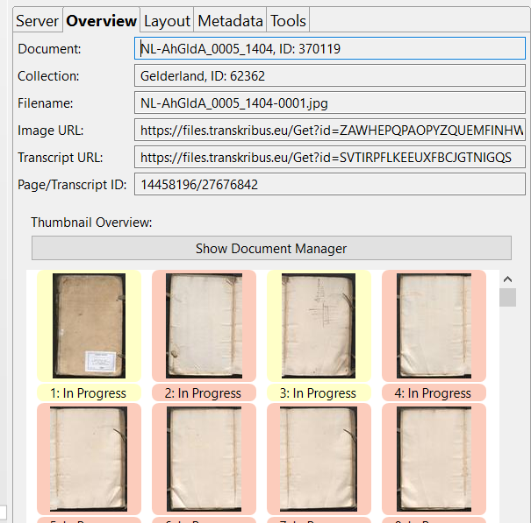
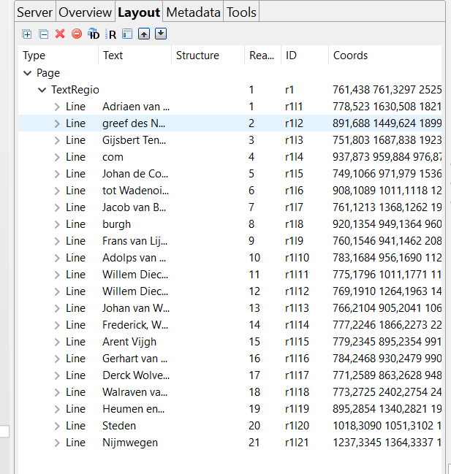
Theory
Start
Buttons
Transcribe
Models and export

Slide 52
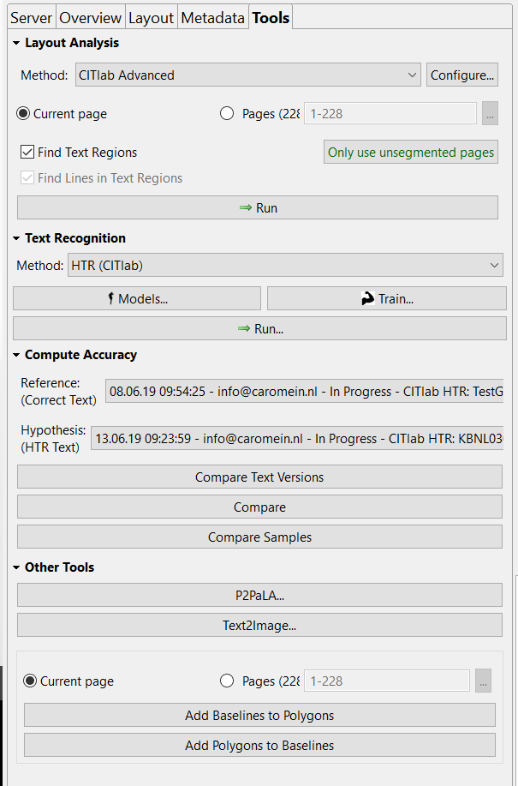
Tools tab
Theory
Start
Tab-menu, click on Tools.
Here you can have Transkribus do
the LA (CITlabAdvanced)
  Short-cut: you do the TextRegions
  then undo the √ in front of
  ‘Find text regions’ and have
  Tr. draw the lines.
Buttons
Transcribe
Models and export

Slide 53
Brief summary!
You first upload your files into the server in Innsbruck.
You perform LA (manual or automatic).
* Advanced LA needs to be done now, if necessary.
You can start transcribing now: be accurate, don’t change the text (except for abbreviations).
If you have a number of pages, you can start making a model.

Slide 54
Transcribe
Where and how to transcribe?
How to collaborate?
Abbreviations, italics, conventions…

Slide 55
Transcribe
In this section we will look at Transkribus and talk about where and how you to transcribe?

Slide 56
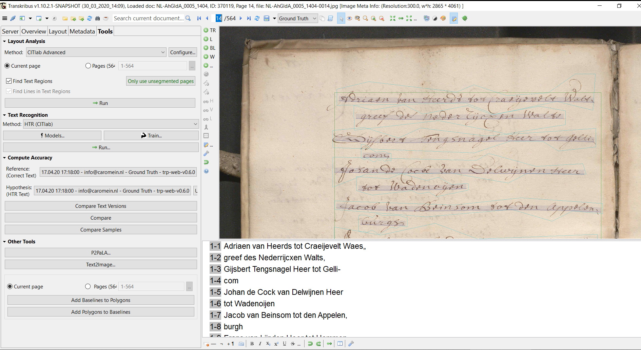
Theory
Start
Buttons
Transcribe
Models and export

Slide 57
Transcription Toolbar
Theory
Start
1 2 3 4 5 6 7 8 9 10 11 12 13 14 15 16 17
Buttons
From left to right:
1) Delete shape; 2) Long dash; 3) dash for the end of the line; 4) toggle paragraph on a line; 5) virtual keyboard; 6 to 11: self explanatory/ exploratory; 12: font preference; 13: undo; 14: redo; 15: text-orientation; 16: move transcription field to the right; 17: transcription settings
Transcribe
Models and export

Slide 58
Transcribe
In this section we will talk about how to collaborate within Transkribus?

Slide 59
Basics in how to work on same documents
Theory
Start
Everyone needs an individual account!
Does everyone need to have the ability to do LA, apply/ work on models? Yes: then work with desktop version; No: then use web-interface for those doing transcriptions.
Share folder to everone who needs this!
If you need multiple people work on one doc: create a shared doc and note who is doing which page… working on the same page will result in double work!
Have a list of conventions (how to deal with abbr. &c.)
If you have ‘helpers’ with different levels of experience: create multiple folders depending on source-complexity.
Buttons
Transcribe
Models and export

Slide 60
Theory
Start
Buttons
Transcribe
Models and export

Slide 61
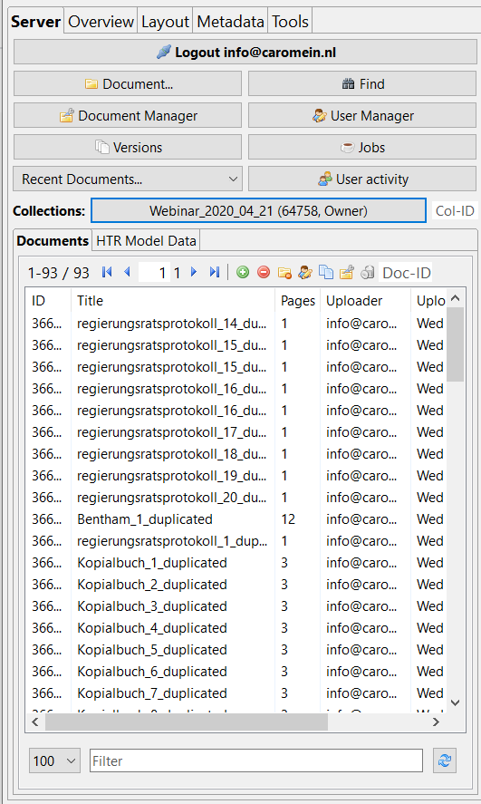
Multiple users
Theory
Start
Don’t do this to your private collection!
Add people to a seperate collection
(click “collections” and you can create a
new one).
Click “User Manager” when you want to
change/ add people to the folder.
Buttons
Transcribe
Models and export

Slide 62
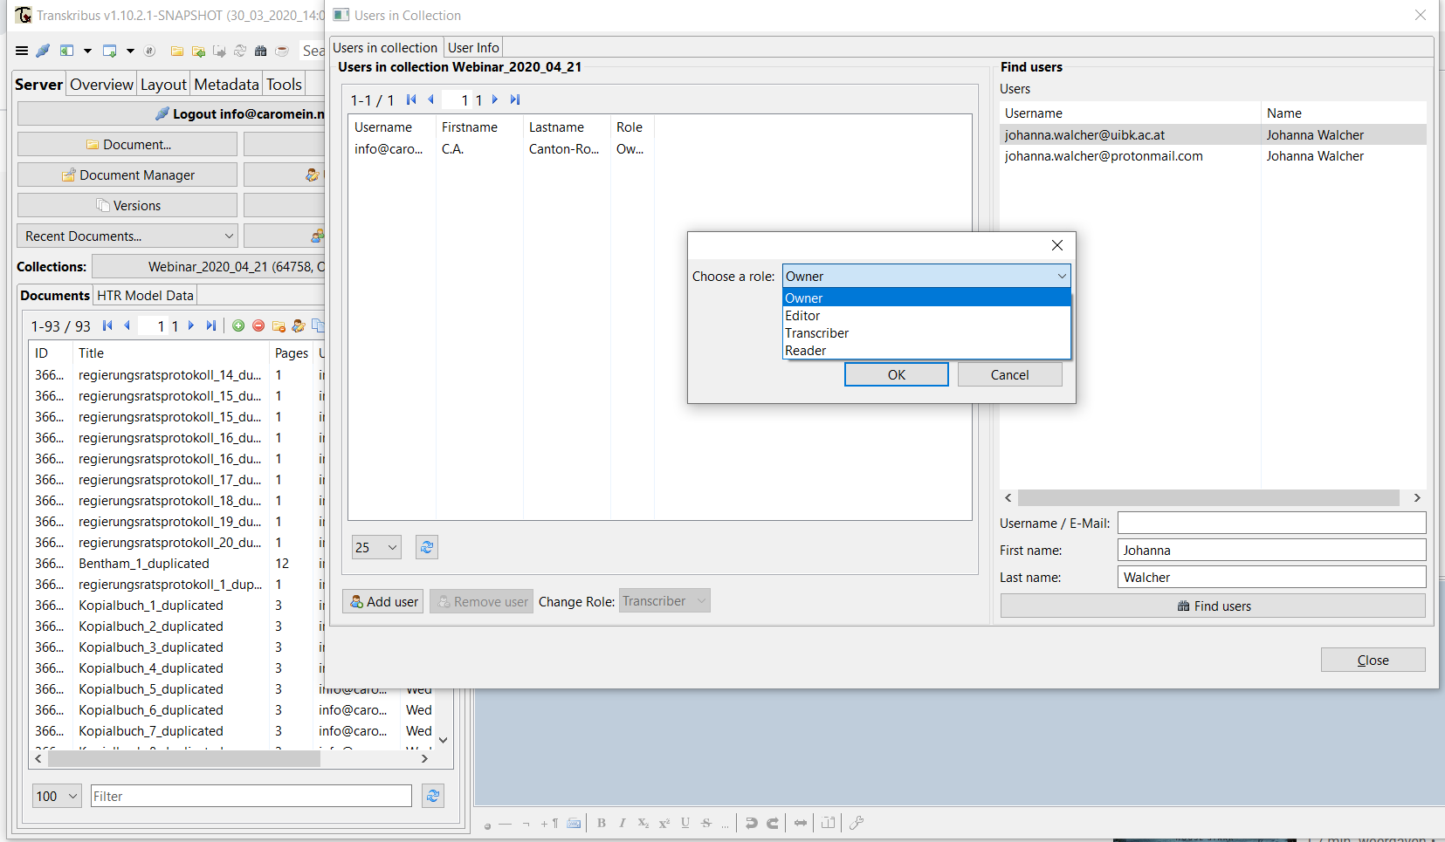
Theory
Start
Buttons
Transcribe
Models and export

Slide 63
Transcribe
In this section abbreviations, italics, conventions are addressed.

Slide 64
Transcription agreements
Theory
Start
A diplomatic transcription with minimal or no editorial intervention or interpretation.
Special characters? Use Unicode!
Abbreviations: pref. keep them abbr.! (to train the model) – otherwise indicate it!
Roman numerals: KEEP THEM! X = 10 would result in “SE10” (instead of SEX).
Italics: ☹ the models don’t understand this (currently).
Buttons
Transcribe
Models and export

Slide 65
Models and export
How to use an existing model or create one, language models and dictionaries?
How to create a model?
How to export files?
How to search files? (SOLR/ KWS)

Slide 66
Models and export
In this section you will learn how to use an existing model or create one, language models and dictionaries?

Slide 67
Theory
Start
Buttons
Transcribe
Models and export

Slide 68
Theory
Start
Buttons
Transcribe
Models and export

Slide 69
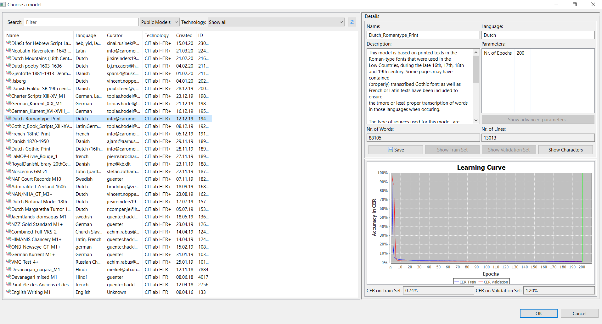
Theory
Start
Buttons
Transcribe
Models and export

Slide 70
Theory
Start
Buttons
Transcribe
Models and export

Slide 71
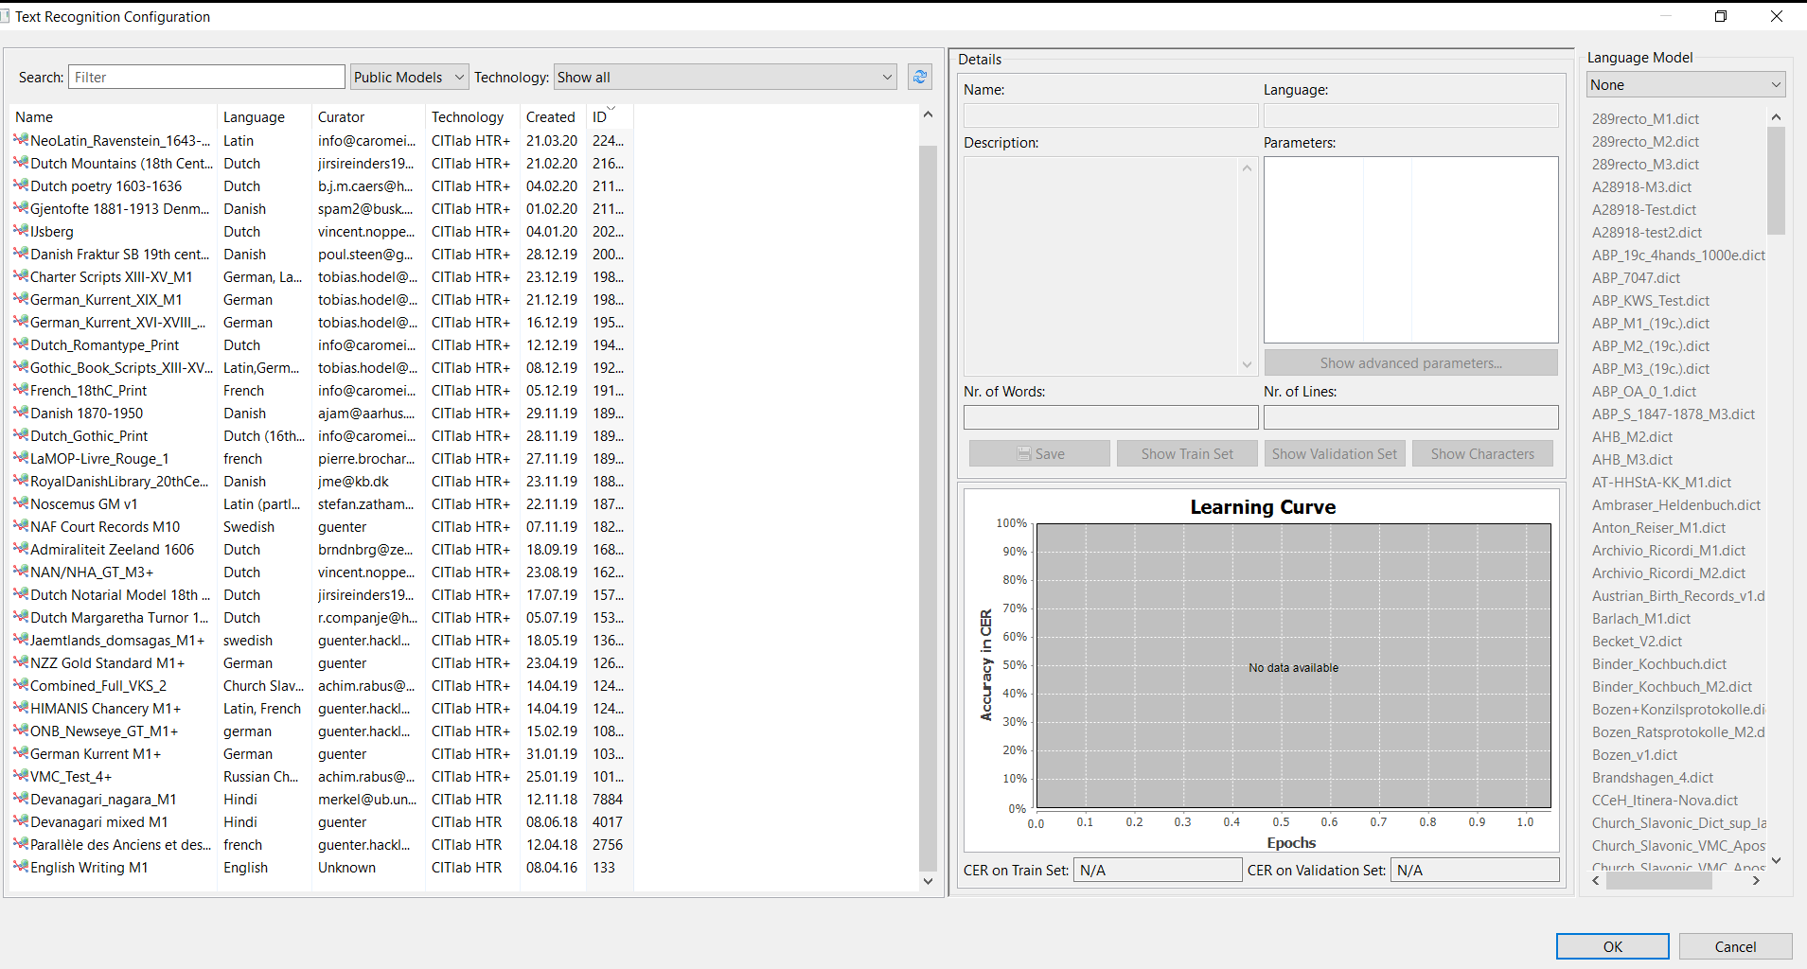
Theory
Start
Buttons
Transcribe
Models and export

Slide 72
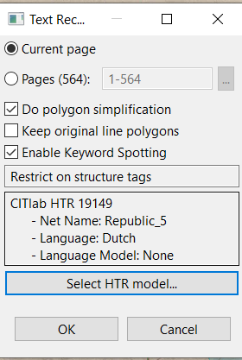
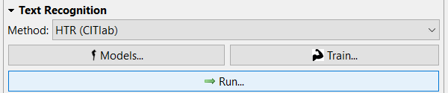
How to choose/ run a model
Theory
Start
Buttons
Transcribe
Models and export

Slide 73
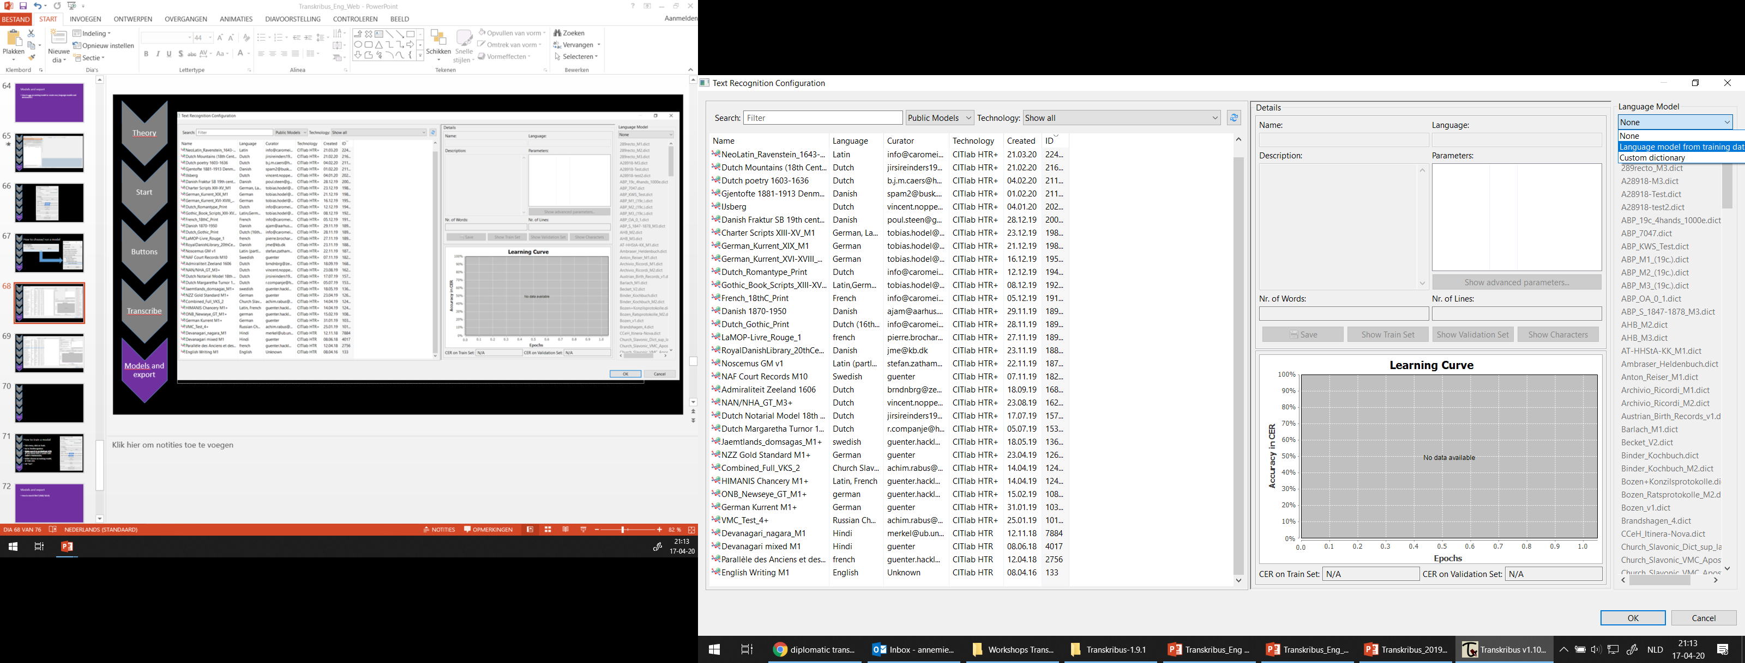
Theory
Start
Buttons
Transcribe
Models and export

Slide 74
Language model…
Theory
Start
None is an option…
Language model from training data
  This means that certain words may get
  corrected according to what is known in a
  model!
  Don’t do this with small models or
  when you are testing… it needs to fit!
Custom dictionary
  Can’t be implemented by you, need
  help from Innsbruck.
Buttons
Transcribe
Models and export

Slide 75
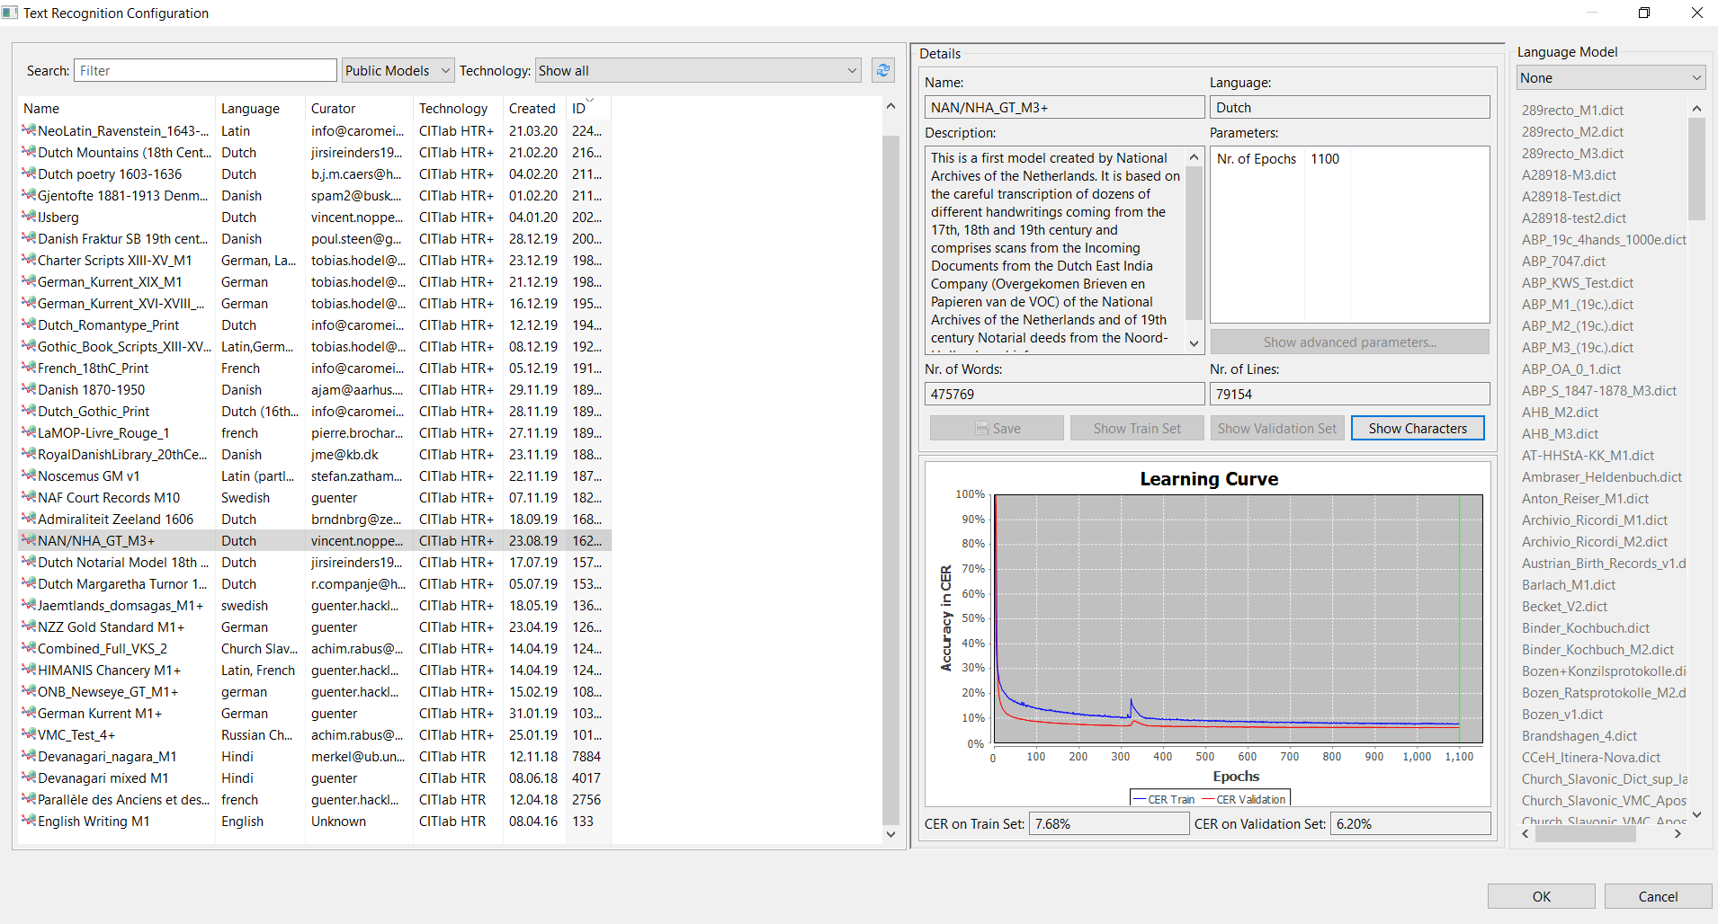
Theory
Start
Buttons
Transcribe
Models and export

Slide 76
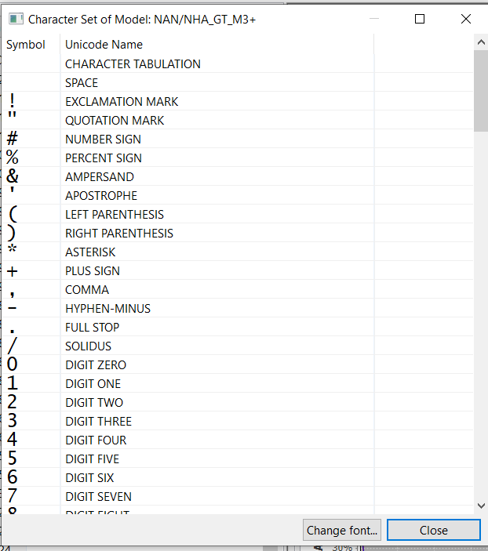
Character set
Theory
Start
Shows you which characters
are (already) recognised within
this particular model.
Buttons
Transcribe
Models and export

Slide 77
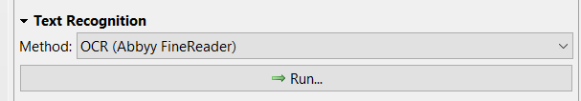
Where do I find OCR?
Theory
Start
Tab-menu, click on Tools.
Go to Text Recognition
Change method from HTR to OCR
Hit “run”.
Buttons
Transcribe
Models and export

Slide 78
Models and export
In this section you will learn how to create a model?

Slide 79
To train a model…
Theory
Start
You need the “Train” button.
You need to request this info@readcoop.eu
(May take a few days.)
Why? Not everyone will be using this…
Buttons
Transcribe
Models and export

Slide 80
Theory
Start
Buttons
Transcribe
Models and export

Slide 81
How to train a model
Theory
Start
Tab-menu, click on Tools.
Go to Text Recognition
Hit “train”.
Buttons
Transcribe
Models and export

Slide 82
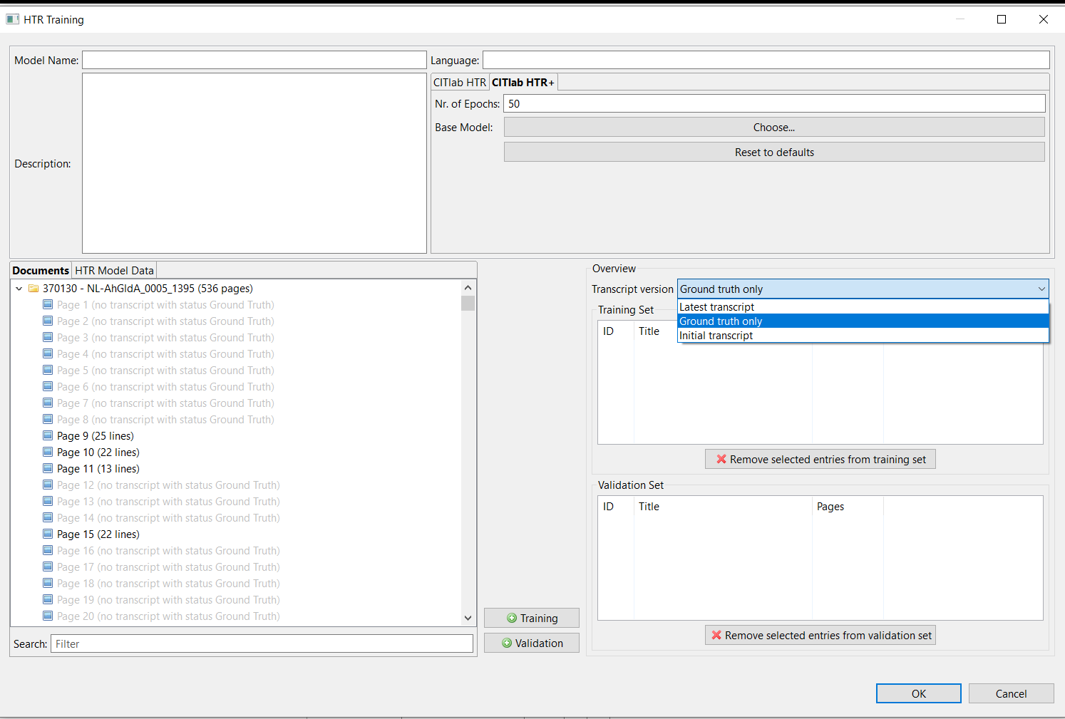
Theory
Start
Buttons
90%
Transcribe
10%
Models and export

Slide 83
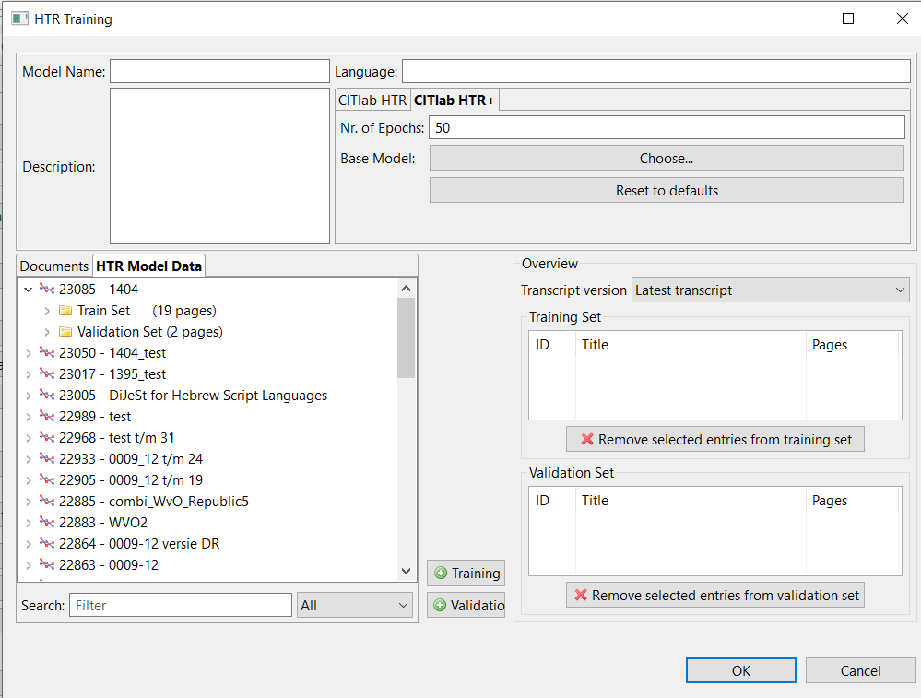
To continu with an existing (stable) model
Theory
You can use it as a base-model and just add the new pages. The ‘old’ model will be used as “fixed” “truth”.
+ As Base Model makes a new
model much quicker (handy!)
- You won’t know the exact
number of words/lines it is
based on (but you can mention
this in the description)
Or, you can use the data by
clicking on “HTR Model Data”
and add this to Training and
Validation.
(=Complete new training)
Start
Buttons
Transcribe
Models and export

Slide 84
Models and export
In this section you will learn how to export files?

Slide 85
Theory
Start
Buttons
Transcribe
Models and export

Slide 86
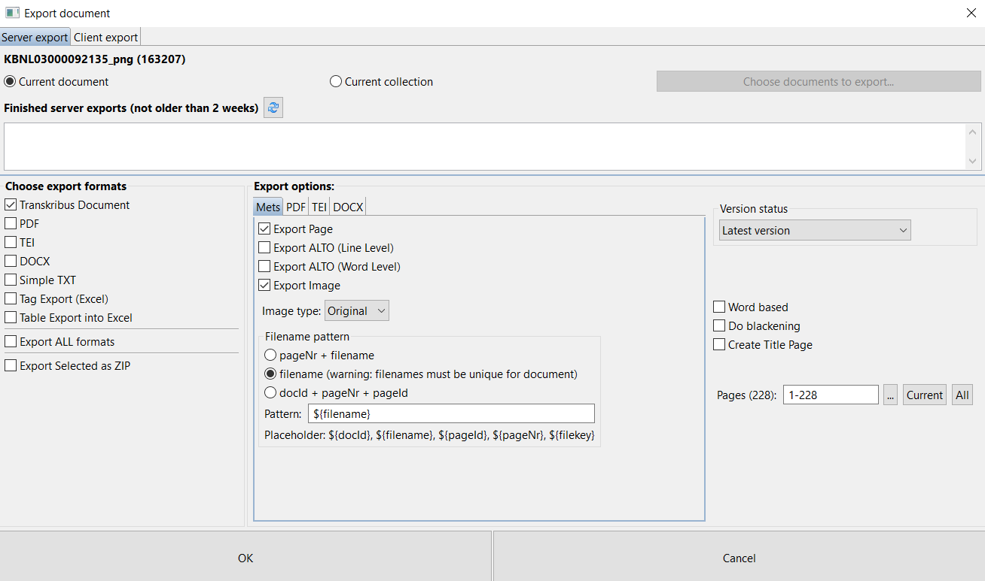
Theory
Start
Buttons
Transcribe
Models and export
Notes:
Many options, depending on your needs!
E.g. layered pdfs (text behind photo so you do see the original)

Slide 87
Models and export
In this section you will learn how to search files? (KWS/ SOLR)

Slide 88
Theory
Start
Buttons
Transcribe
Models and export

Slide 89
Theory
1 2 3 4 5 6 7 8 9 10 11
Start
Full word search (SOLR) and KeyWord Spotting (KWS)
Buttons
Transcribe
Models and export

Slide 90
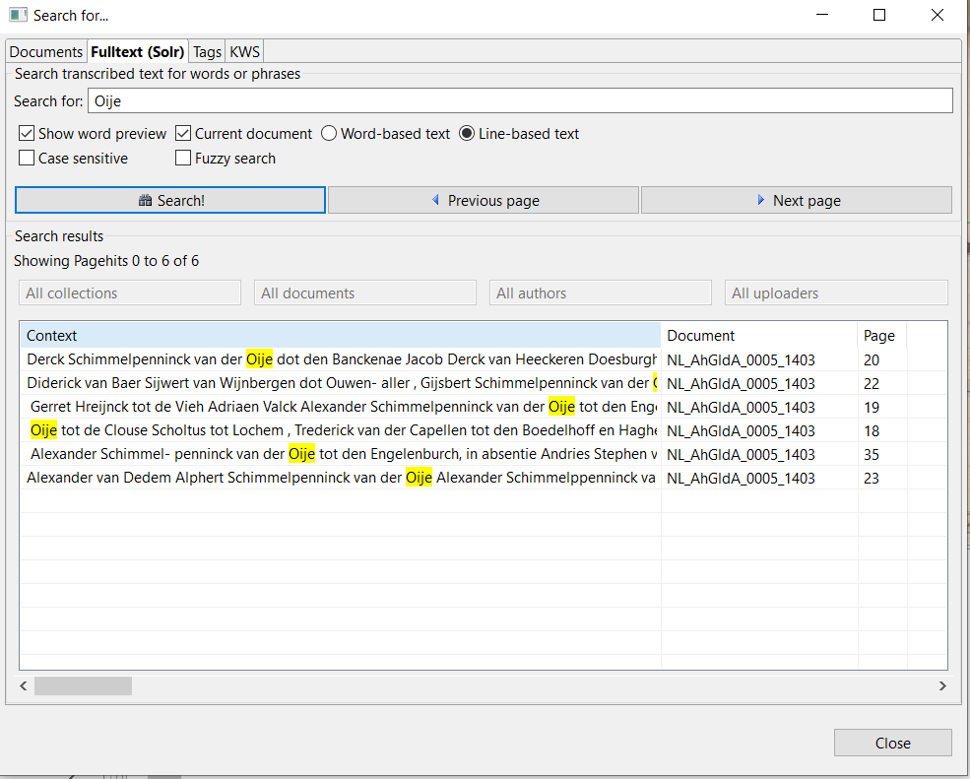
Theory
Start
Buttons
Transcribe
Models and export

Slide 91
What does KWS
Theory
Some KWS examples can be found at:
NL Amsterdam Notarial Archives: www.transkribus.eu/r/notarial
Finland Kansallisarkisto: https://transkribus.eu/r/kansallisarkisto/
UK Bentham: http://prhlt-carabela.prhlt.upv.es/bentham/
Technology to find words in the images.
Based on the image (and bit on HTR)
Up to a 30% CER
Depiction:
  Sorted on Confidence Value (probability)
  Can always be shown
Start
Buttons
Transcribe
Models and export

Slide 92
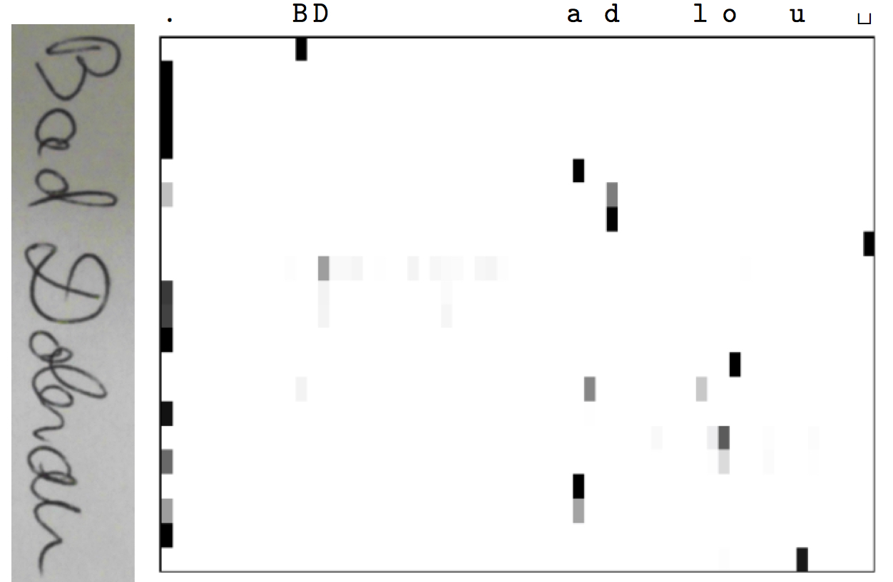

Slide 93
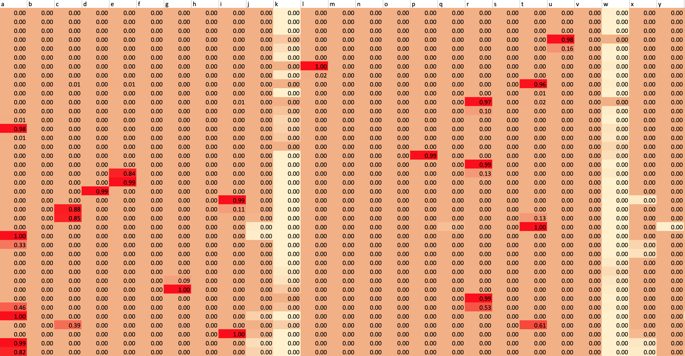

Slide 94
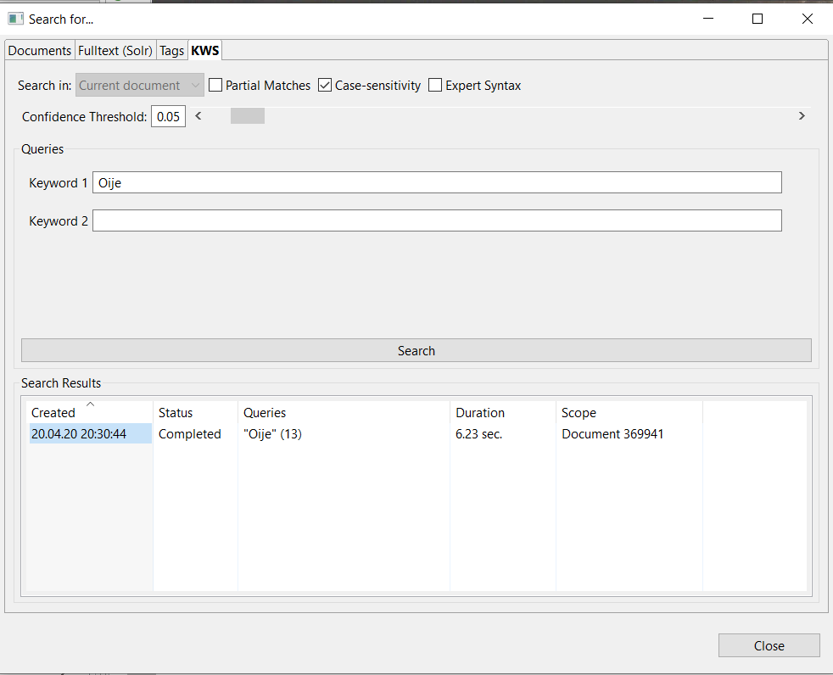
Theory
Start
Buttons
Transcribe
Models and export

Slide 95
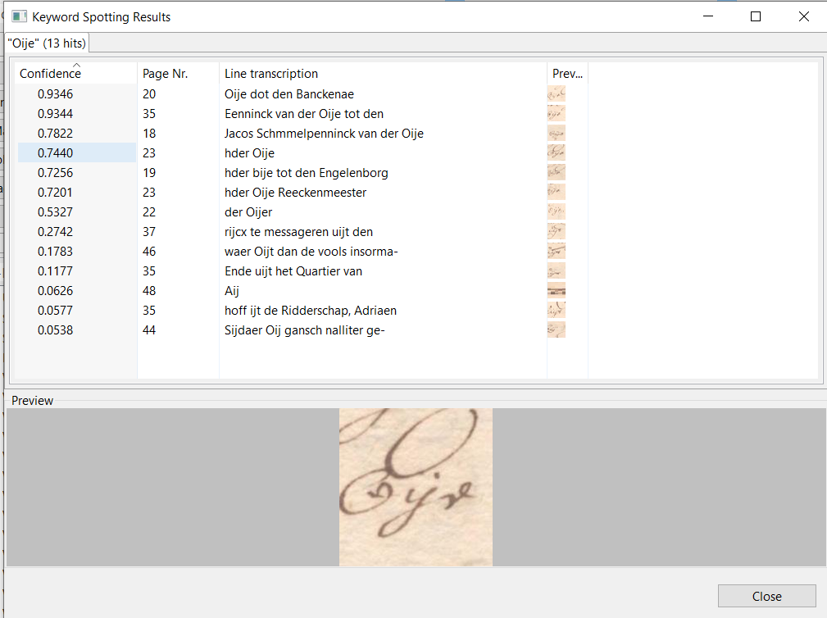
Theory
Start
Buttons
Transcribe
Models and export

Slide 96
READ COOP – by Johanna Walcher
These slides are not available here.

Slide 97

Extra information
Manuals:
https://transkribus.eu/wiki/index.php/How_to_Guides
Youtube Channel and Tutorials:
https://www.youtube.com/channel/UC-txVgM31rDTGlBnH-zpPjA
Facebook:
@Transkribus Users (user based)
Web-Interface:
https://transkribus.eu/r/read/projects/
DocScan and ScanTent:
https://readcoop.eu/scantent/
READ and Transkribus:
https://read.transkribus.eu/
https://transkribus.eu/
E-Learning:
https://learn.transkribus.eu/
Contact:
info@readcoop.eu

