Slide 1

Proxy, historical, instrumental and model re-analysis climate records in the NW North Atlantic and adjacent Canada during the last 2 ka
Simon van Bellen¹, Anne de Vernal¹, Estelle Allan¹, René Audet¹, Étienne Boucher¹, Guillaume Dueymes¹, Myriam Fillion¹, Bianca Fréchette¹, Philippe Gachon¹, Michelle Garneau¹, Gaëlle Gilson², Hugues Goosse², Claude Hillaire-Marcel¹, Nicolas Houde¹, René Laprise¹, Nicholas Ogden³, Marie-Michèle Ouellet-Bernier¹ and Bruno Tremblay⁴
¹U. du Québec à Montréal, ²U. catholique de Louvain, ³Public Health Agency of Canada, ⁴McGill University
CANQUA/AMQUA 2018, Ottawa, 11 August 2018

Slide 2

ClimHuNor Project
(FRQSC\FNRS)
The study area: 43-80°N & 40-100°W
The main goals:
determine pre-industrial baseline climate conditions
assess the regional effects of recent climate changes related to increasing greenhouse gas concentrations
quantify their impact on northern ecosystems
evaluate the impact of climate changes on human health, notably with regard to the development of zoonotic diseases
The means: to develop an inventory and database of climate records
www.climate.be/php/users/klein/ClimHuNor/project.html

Slide 3
A database of climate records
Proxy reconstruction
1000
100
Average time step (yr)
10
1
Historical
Instrumental
0.1
10
100
1000
10 000
Model re-analyses
Year CE

Slide 4
Climate(-related) variables: availability
Variables | Type of data
 | Instrumental | Historical | Proxy | Re-analysis
Temperature (air) | YES | YES | YES | YES
Temperature (sea) | YES | NO | YES | YES
GDD0 & GDD5 | YES | NO | YES | YES
Precipitation | YES | NO | YES | YES
Sea ice cover | YES | YES | YES | YES
Wind speed | YES | NO | NO | YES
Cloud cover | YES | NO | NO | YES
…
River discharge | NO | NO | YES | NO
Peatland water-table | NO | NO | YES | NO

Slide 5
Instrumental data: temperature and GDD0/5
3590 records
2437 from Environment Canada
1144 from Ministère de l’environnement du Québec
8 from NCDC-NOAA
1 from Greenland Climate Network
Median: 26 years

Slide 6
Instrumental data: precipitation
213 records from Environment Canada
Median: 84 years

Slide 7
Historical records: 18th - 20th century
Moravian missionaries (Labrador)
  Temperature
  Sea ice
  Atmospheric pressure
Hudson Bay Company (HBC)
  Temperature
  Sea ice
  Humidity
HBC ship’s log-books
Kaplan & Woollett (2000)

Slide 8
Model re-analyses
NSIDC: sea ice concentration (1978-2017) (Cavalieri et al., 1996)
20CR (NOAA)
CERA-20C (ECMWF): multiple variables (1901-2010)
spatial resolution at 0.3º : 24 666 grid points
1901 - 2010
January-December
hours: 0:00 – 6:00 – 12:00 – 18:00
10 members
68 variables

Slide 9
Proxy reconstructions
327 records
Median length: 6635 years

Slide 10
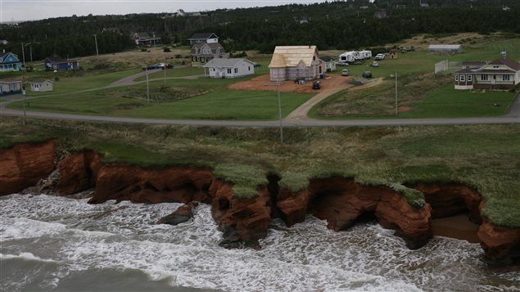
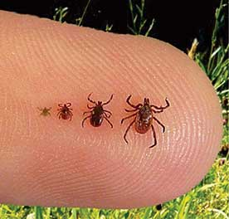
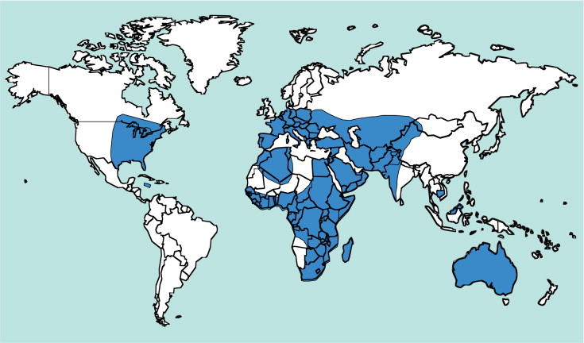
Utility of the database
Understanding and modelling coastal erosion
Spread of Lyme disease
Photo: UQAR
Photo: Ottawa Public Health
Presence of West Nile virus
(Campbell et al., 2002)

Slide 11
Defining the « Dark Ages Cold Period »
« DACP », timing estimated between ~400 and ~765 CE (114 paleoclimate papers analyzed by Helama et al., 2017)
« Late Antique Little Ice Age », between ~536 and ~660 CE, forcing by volcanic eruptions possibly with influence of solar minima, and sea-ice/ocean feedback mechanisms (Büntgen et al., 2016)
Late 530s:
  recurring incidence of plague across Eurasia;
  migratory movements across Eurasia;
  breakdown and transformation of major sociopolitical systems, including the development of the early Arab-Islamic empire (Haldon, 2016)

Slide 12

DACP: criteria for the selection of records
Each record…
327 records
…covers (at least) the 350-950 CE period
…has at least 2 ¹⁴C datings (²¹⁰Pb dates count for 1) for the last 2000 years and a 3rd between 1540 and 3000 cal a BP
181 records
43 records
…has at least 2 samples between 1540 and 1175 cal a BP
33 records

Slide 13
DACP: record characteristics
27 records retained

Slide 17
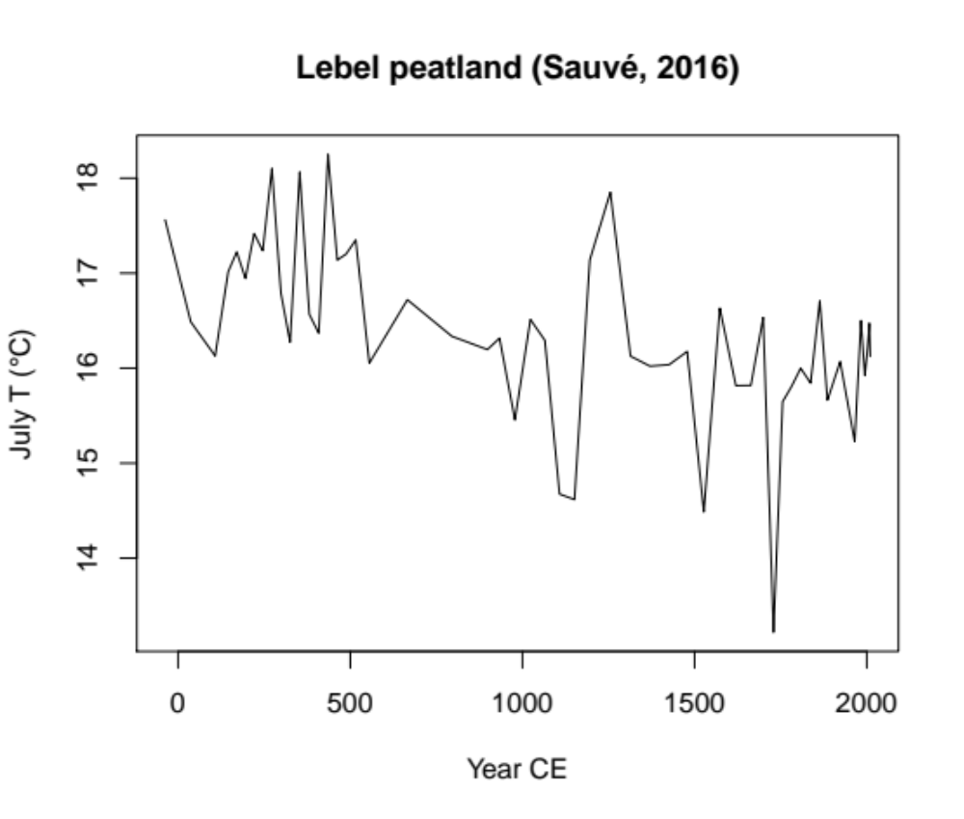
Changepoint analyses (package ‘changepoint’; Killick, 2016)
~555 CE: transition from mixed to coniferous forest

Slide 18
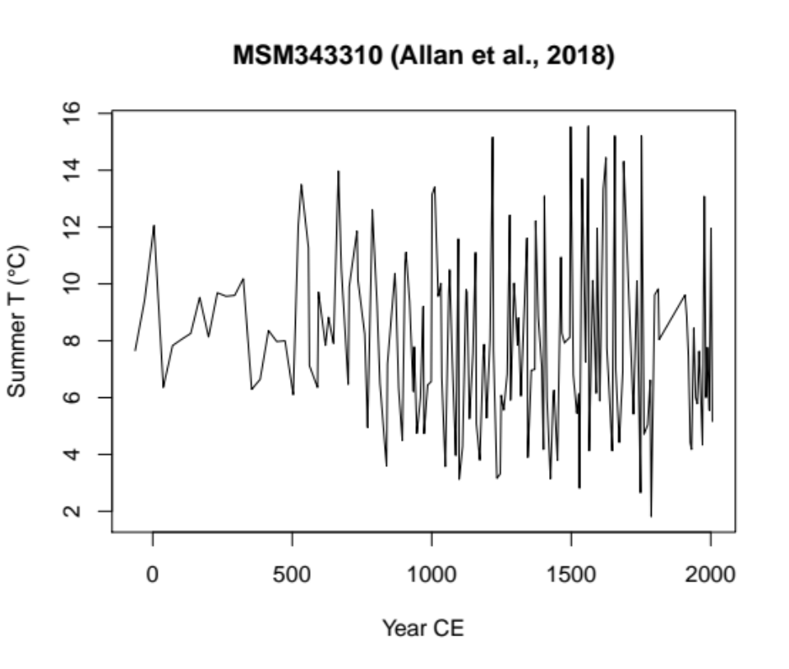
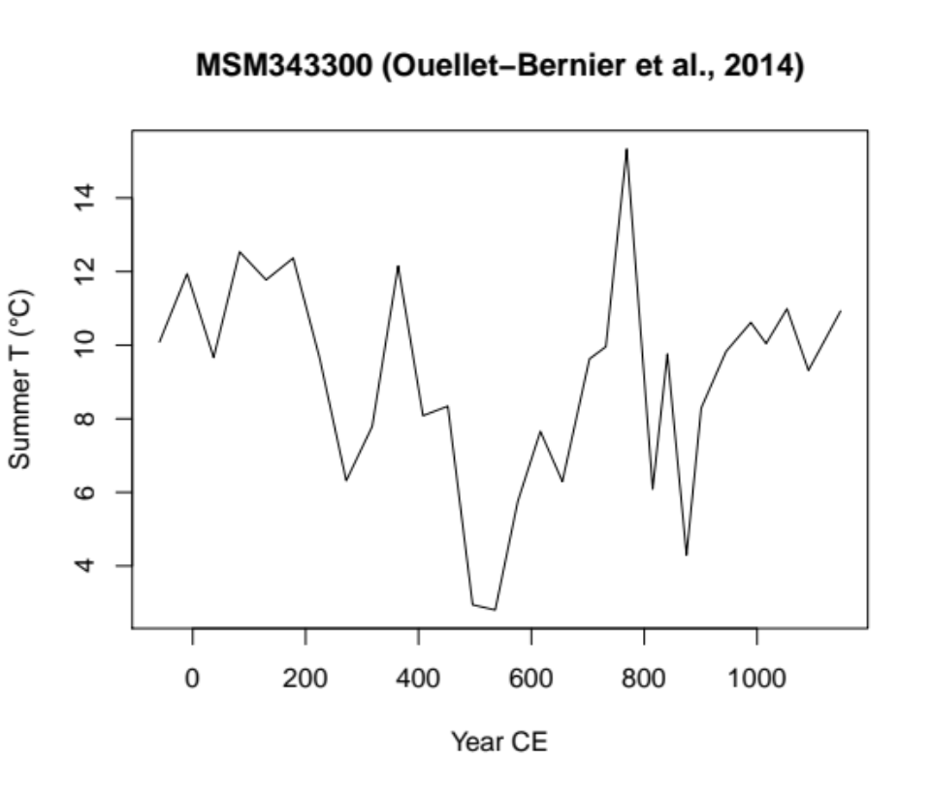
Dinocyst records
Change in variance
Changes in mean values

Slide 19
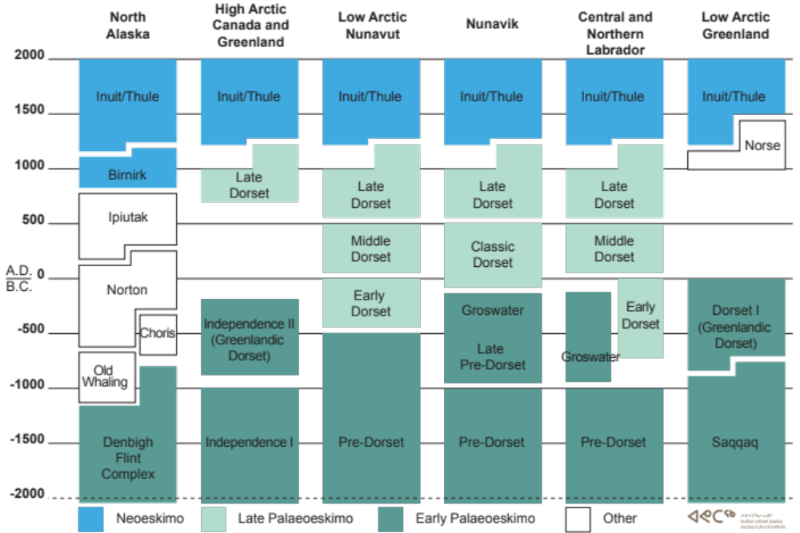
DACP and human activity
DACP?
Dorset: cooling of Labrador current, sea ice expansion and southward migration of marine fauna. Dorset migrated southward to current Newfoundland (Fitzhugh, 1976).
Adapted from Avataq Cultural Institute, 2015, Arctic Chronology
www.avataq.qc.ca/en/Institute/Departments/Archaeology/Discovering-Archaeology/Arctic-Chronology

Slide 20
DACP in NW Atlantic/Eastern Canada?
11 of the selected records, out of 27, show a change that may be associated with a DACP event (~400 and ~765 CE)
Of those records, identified trends are divergent:
  3 records suggest cooling
  1 record suggests warming
  1 record suggests increase in ocean T variance
  peatland water-table reconstructions show either wetter, drier conditions, or no change

Slide 21
DACP: not unequivocally detected in NW Atlantic/Eastern Canada
More high-temporal resolution records (e.g. tree-ring) are necessary, especially in the central-northern regions of Québec-Labrador
Additional ¹⁴C dating of already published records could increase the usefulness of the dataset
The current selection does not allow to clearly identify the Medieval Climate Anomaly or the Little Ice Age
Environmental records (e.g. glacier, peatland palsa, forest fires) and archeological data may provide additional, yet rather qualitative, information

Slide 22
Data suggestions?
→ van_bellen.simon@uqam.ca
Please share your data through:
your institutional repository
www.ncdc.noaa.gov
www.pangaea.de
www.neotomadb.org
…
Allan et al., 2018. Paleoceanography and Paleoclimatology 33, 227-243
Büntgen et al., 2016. Nature Geoscience 9, 231-236
Cavalieri, D. et al., 1996. National Snow and Ice Data Center, Digital Media, Boulder, CO, USA
Fitzhugh, W. W., 1976. Chapter in Eastern Arctic Prehistroy: Palaeoeskimo Problems. Washington. 139-149.
Fréchette & de Vernal, 2009. Climate of the Past 5, 347-359
Haldon, 2016. History: Nature Geoscience 9, 191-192
Helama et al., 2017. The Holocene 27, 1600-1606
Kaplan & Woollett, 2000. Arctic, Antarctic, and Alpine Research 32, 351-359
Killick, 2016. Methods for Changepoint Detection. R package.
Kobashi et al., 2017. Scientific Reports 7, 1441
Neil et al., 2014. Quaternary Research 81, 203-212
Ouellet-Bernier et al., 2014. The Holocene 24, 1573-1583
Sauvé, 2016. MSc thesis, Université du Québec à Montréal, Dép. de géographie, Montréal, Canada
Vinther et al., 2009. Nature 461, 385-388

