Slide 1
Computational Stylometry
Lorentz Workshop 2020
Processing Ancient Text Corpora
Leiden, 20 February 2020
Pierre Van Hecke

Slide 2
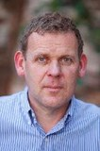
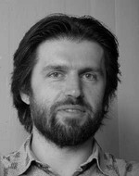
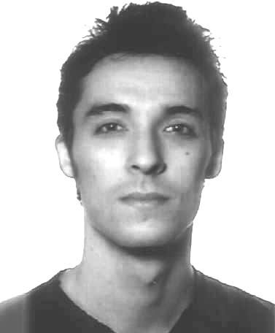
Background
KU Leuven-funded Research Projects
  A Corpus Linguistic Approach of Classical Hebrew:
  a Pilot Project
  (Tigchelaar, Van Hecke)
  Genes of Genre
  (Tigchelaar, Speelman, de Joode, Van Hecke)

Slide 3
Methodological Problem
Text Classification: major problem in Hebrew Studies
  - diachrony
  - authorship – redaction
  - scribe/scribal school
  - sociological background
Linguistic Arguments for Classification of Texts
  Selection?
  Weighing?
Notes:
Select features in terms of the argument you want to make

Slide 4
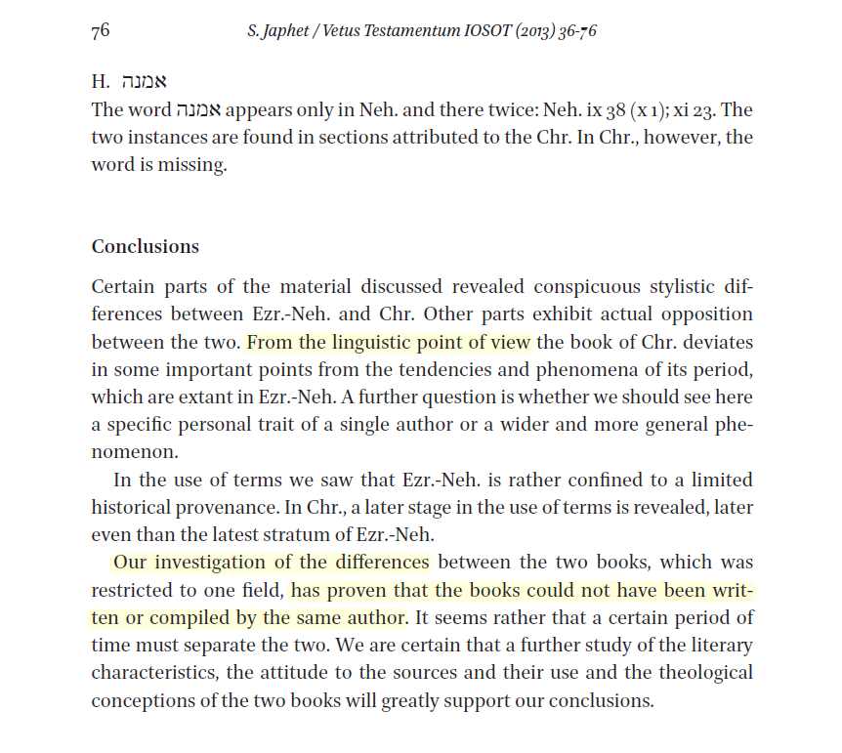
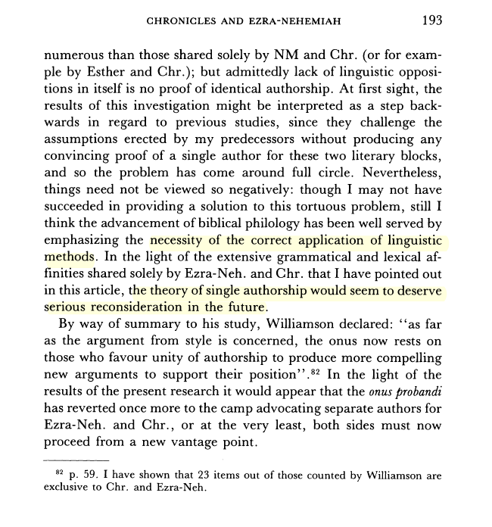
S. Japhet vs. D. Talshir on Chron – Ezr/Neh

Slide 5
Hypothesis and methodology
Developments in computational stylistics will help solve these issues in a quantitative way
Computational stylistics
  Define feature types (character trigrams)

Slide 6
Character trigrams
“This is an example”
Thi
his
is_ (2)
s_i
_is
s_a
_an
an_
n_e
...

Slide 7
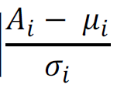
Hypothesis and methodology
Developments in computational stylistics will help solve these issues in a quantitative way
Computational stylistics
  Define feature types (character trigrams)
  Select features (300 most frequent, 0%)
  Measure weight of each feature
  Calculate pair-wise distances between all documents
  Visualize
Stylo Library for R (Eder, Rybicki, Kestemont)

Slide 8
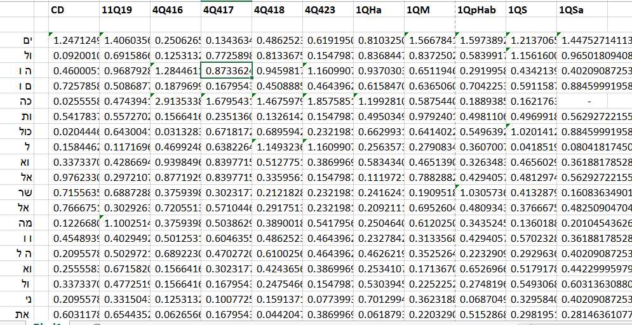
Weighing of features

Slide 9
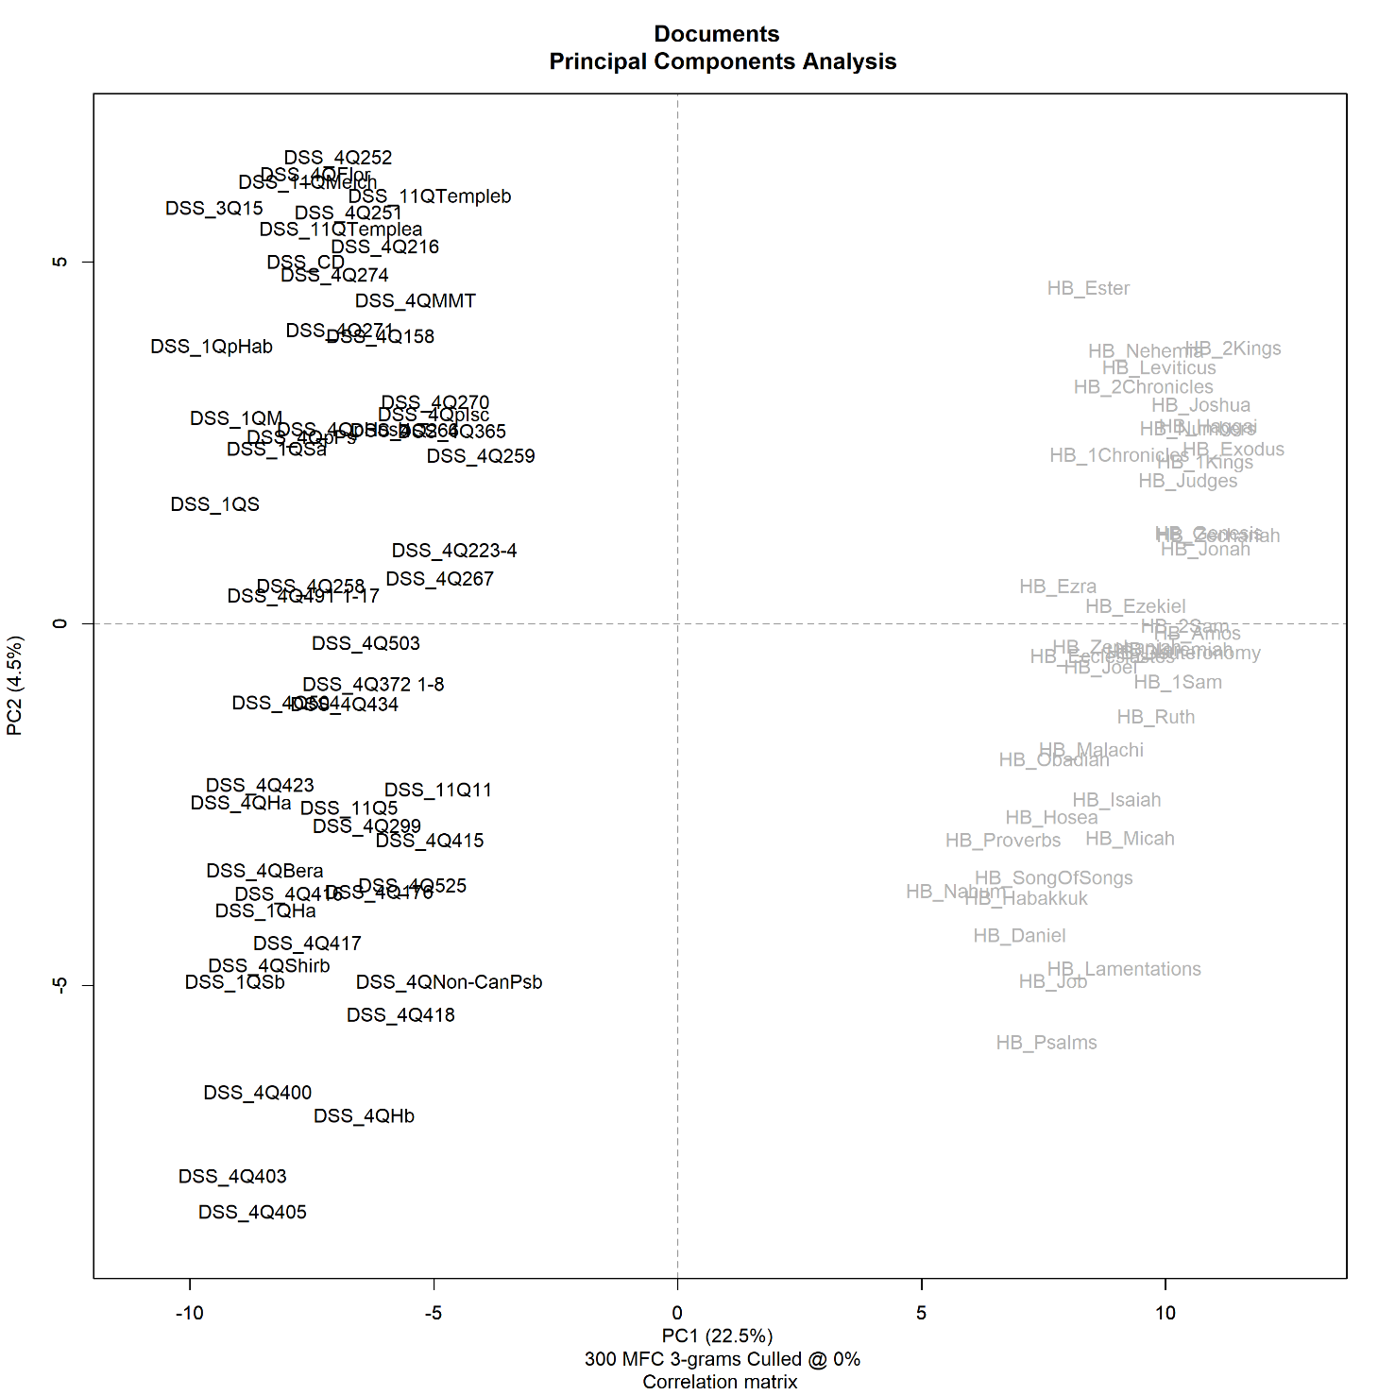
PCA
whole corpus
Notes:
Tests

Slide 10
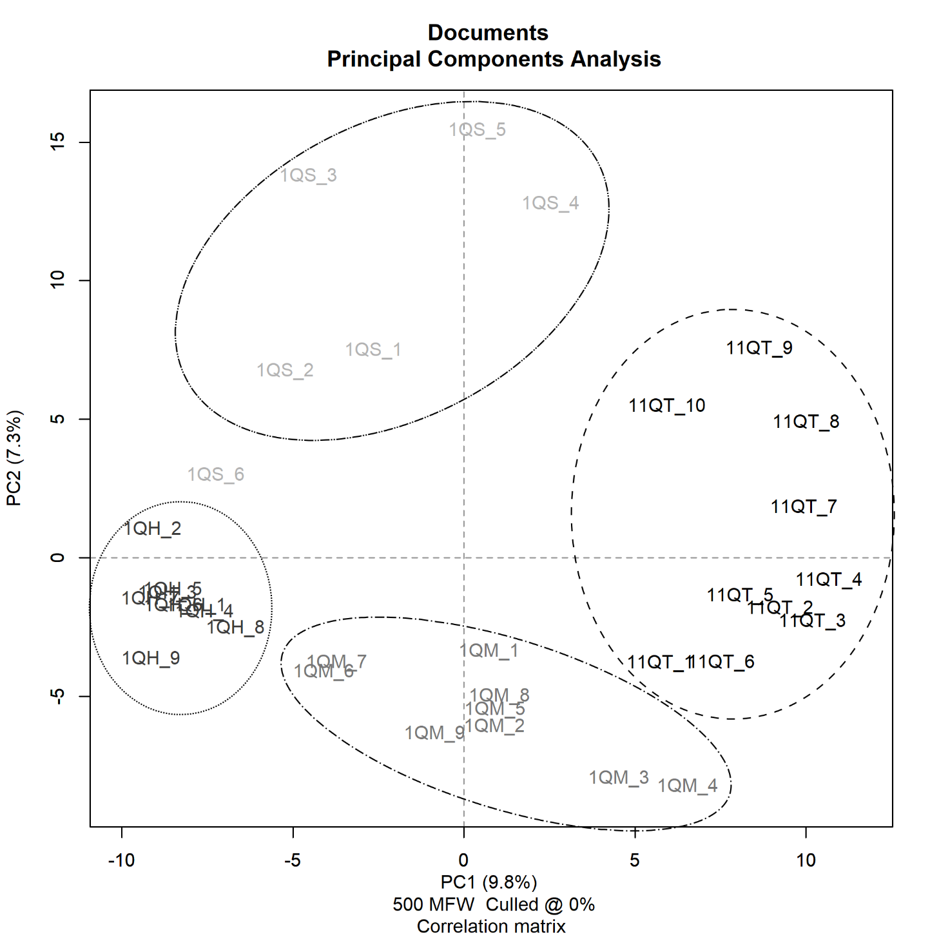
PCA
non-overlapping
samples of
4 documents

Slide 11
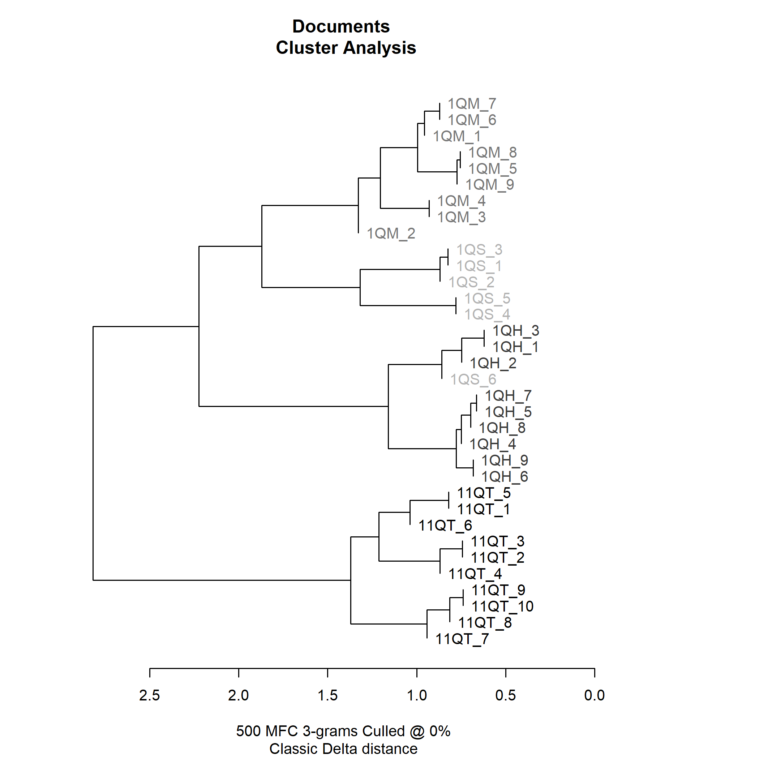
Dendrogram
non-overlapping
samples of
4 documents

Slide 12
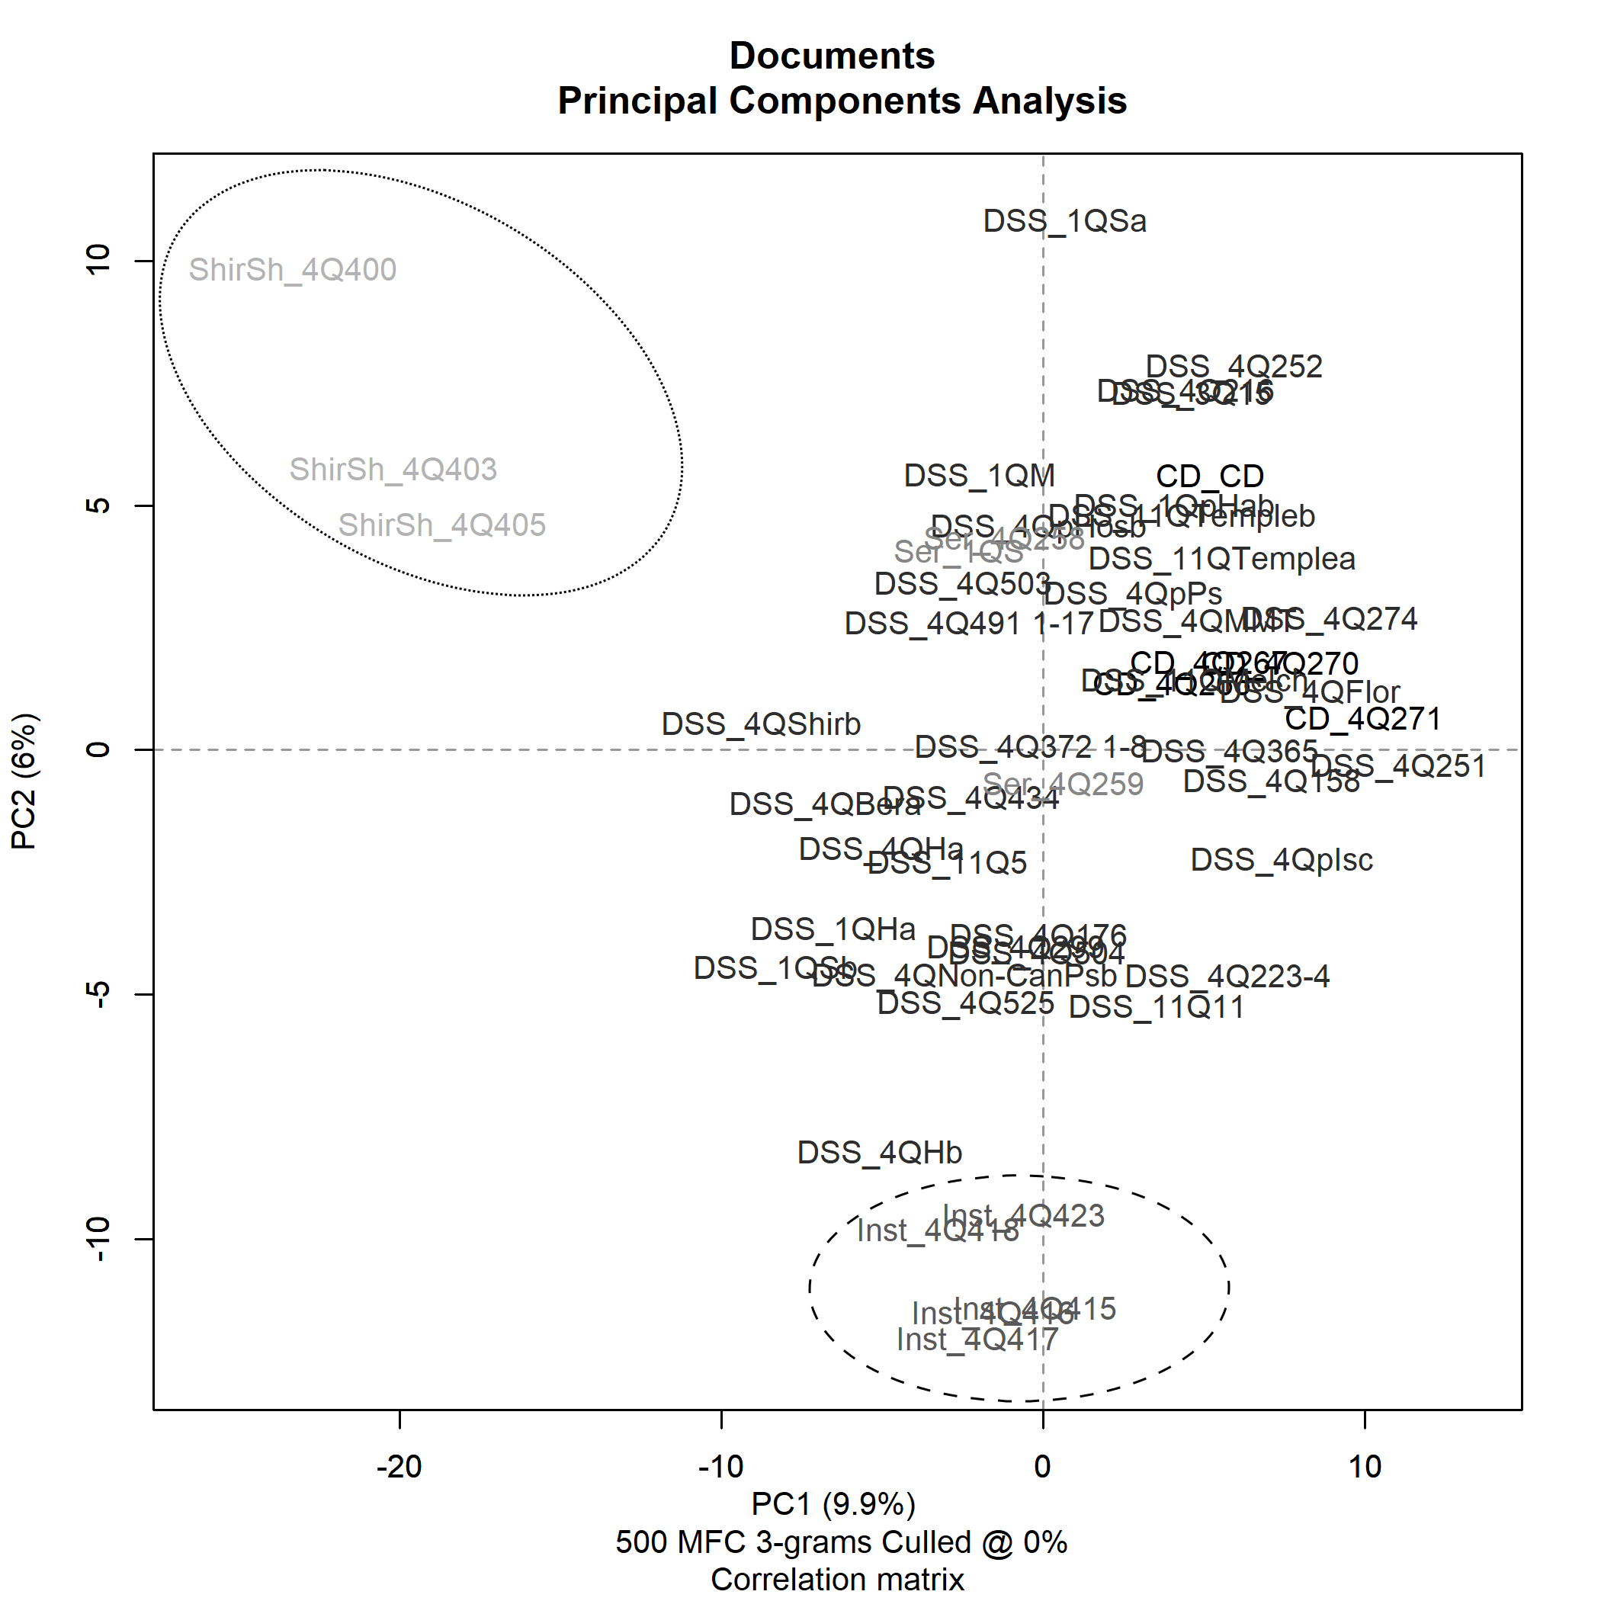
PCA
Dead Sea Scrolls

Slide 13
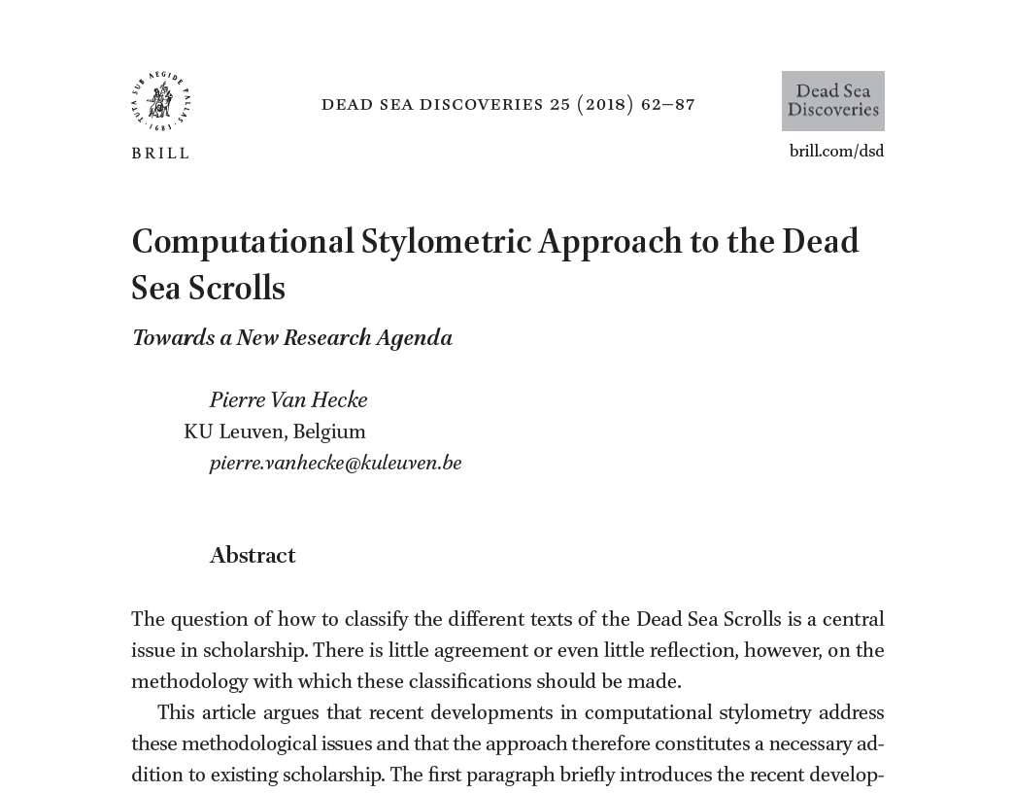
see:

Slide 14
Explaining the results?
Authorship/Provenance?
Fragmentation?
Feature Selection?
Orthography?
Genre?
Topic?

Slide 15
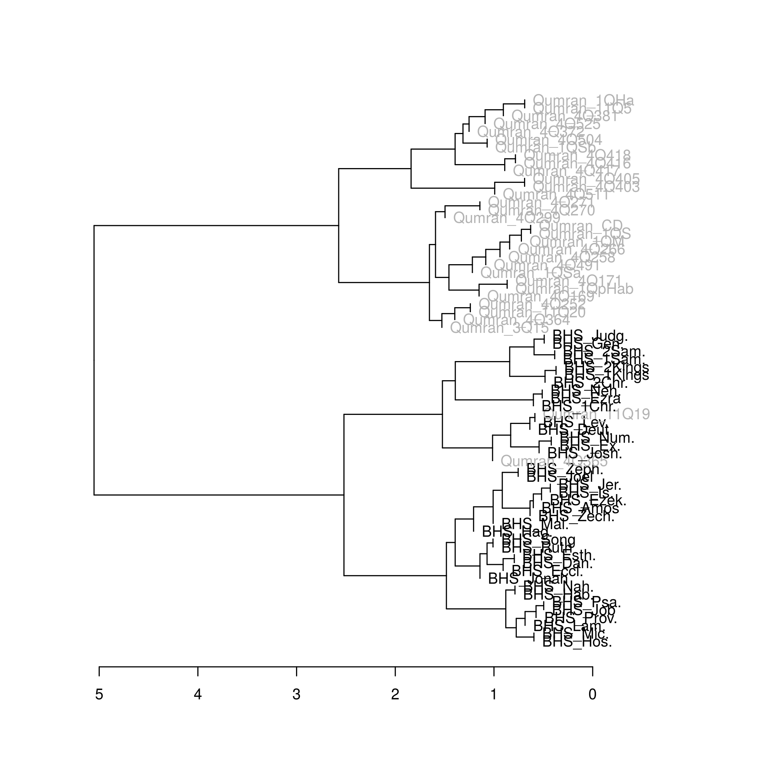
Accounting for
orthography
300 MFC; 20%
Notes:
Orthography
Lemma + morphology combination
“organize + indicative present 3 pers singular” = organizes + organises
Change

Slide 16
see:
Pierre Van Hecke and Johan de Joode, “Promises and Challenges in Designing Stylometric Analyses for Classical Hebrew.” In: Fassberg S. (Ed.), Proceedings of the Eight International Symposium on the Hebrew of the Dead Sea Scrolls and Ben Sira (Studies on the Texts of the Desert of Judah). Leiden: Brill, forthcoming.

Slide 17
Quantifying Tov’s Qumran Scribal Practice
 | 1QIsaa_I | 1QIsaa_II | 11Q19 | 1QHa_I | 1QHa_II | 1QS | 1QM | 4Q491 | 11Q5 | 1Q8 | Mur88 | 4Q51 | 4Q418 | 1QpHab | 4Q266 | 4Q22
P01_הוא | 60 | 2 | 33 | 3 | 7 | 0 | 1 | 0 | 5 | 6 | 5 | 6 | 5 | 8 | 4 | 4
P01_הוא_alt | 0 | 30 | 1 | 0 | 0 | 14 | 4 | 3 | 1 | 0 | 0 | 0 | 1 | 1 | 1 | 0
P02_היא | 6 | 3 | 10 | 0 | 1 | 0 | 0 | 0 | 0 | 2 | 3 | 5 | 2 | 1 | 2 | 0
P02_היא_alt | 0 | 4 | 1 | 0 | 2 | 5 | 4 | 0 | 0 | 0 | 0 | 0 | 0 | 0 | 2 | 0
P03_אתם | 0 | 0 | 0 | 0 | 0 | 0 | 2 | 0 | 0 | 2 | 2 | 1 | 1 | 0 | 0 | 1
P03_אתם_alt | 2 | 15 | 2 | 0 | 0 | 0 | 2 | 0 | 0 | 0 | 0 | 0 | 0 | 0 | 0 | 0
P04_הם | 0 | 0 | 0 | 1 | 4 | 0 | 1 | 0 | 0 | 2 | 0 | 1 | 2 | 0 | 2 | 3
P04_הם_alt | 3 | 18 | 16 | 0 | 6 | 0 | 8 | 0 | 1 | 2 | 1 | 1 | 1 | 8 | 2 | 0
P05_N_S23P | 75 | 56 | 13 | 11 | 91 | 77 | 96 | 1 | 27 | 61 | 48 | 14 | 18 | 29 | 21 | 21
P05_N_S23P_alt | 6 | 108 | 139 | 0 | 0 | 0 | 6 | 10 | 5 | 0 | 0 | 0 | 5 | 0 | 1 | 0
P06_P_S23P | 24 | 8 | 2 | 4 | 6 | 17 | 21 | 1 | 9 | 18 | 24 | 9 | 2 | 9 | 6 | 17
P06_P_S23P_alt | 14 | 48 | 62 | 0 | 0 | 1 | 4 | 6 | 5 | 0 | 0 | 0 | 0 | 1 | 1 | 0
P07_יקטלו | 11 | 10 | 0 | 1 | 1 | 2 | 4 | 0 | 3 | 10 | 5 | 2 | 4 | 1 | 1 | 1
P07_יקטלו_alt | 8 | 23 | 11 | 0 | 11 | 5 | 43 | 0 | 3 | 0 | 0 | 0 | 0 | 2 | 0 | 1
P08_יקטלנו | 5 | 12 | 4 | 0 | 9 | 4 | 0 | 0 | 4 | 8 | 2 | 3 | 1 | 2 | 0 | 0
P08_יקטלנו_alt | 0 | 0 | 5 | 0 | 2 | 2 | 0 | 0 | 5 | 0 | 0 | 0 | 0 | 1 | 0 | 0
P09_קטלתם | 13 | 0 | 0 | 0 | 0 | 0 | 2 | 0 | 0 | 3 | 5 | 2 | 2 | 0 | 0 | 0
P09_קטלתם_alt | 3 | 13 | 13 | 0 | 0 | 0 | 1 | 0 | 0 | 0 | 0 | 0 | 1 | 0 | 0 | 0
P10_מאד | 1 | 1 | 0 | 0 | 0 | 0 | 0 | 0 | 1 | 2 | 0 | 2 | 1 | 0 | 0 | 2
P10_מאד_alt | 1 | 7 | 2 | 0 | 1 | 1 | 2 | 0 | 10 | 0 | 0 | 0 | 3 | 0 | 0 | 1
P11_זאת | 0 | 0 | 1 | 1 | 1 | 0 | 0 | 0 | 0 | 5 | 6 | 3 | 1 | 0 | 0 | 1
P11_זאת_alt | 17 | 26 | 18 | 0 | 4 | 4 | 0 | 2 | 2 | 0 | 0 | 0 | 0 | 0 | 0 | 0

Slide 18
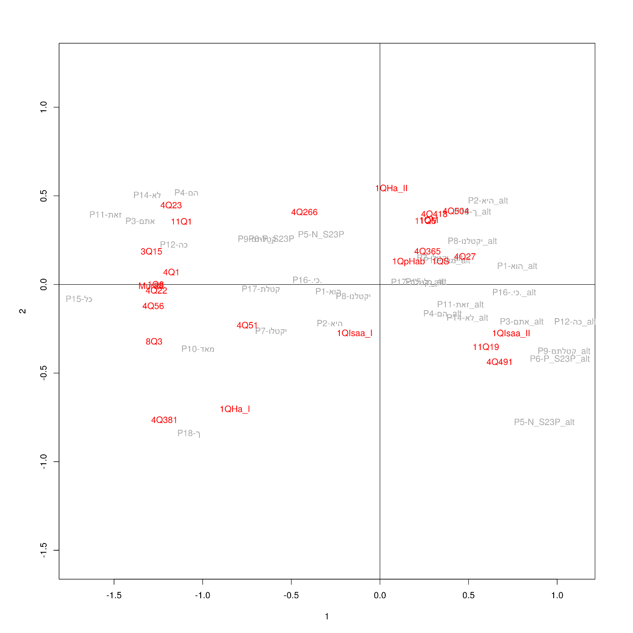

Slide 19
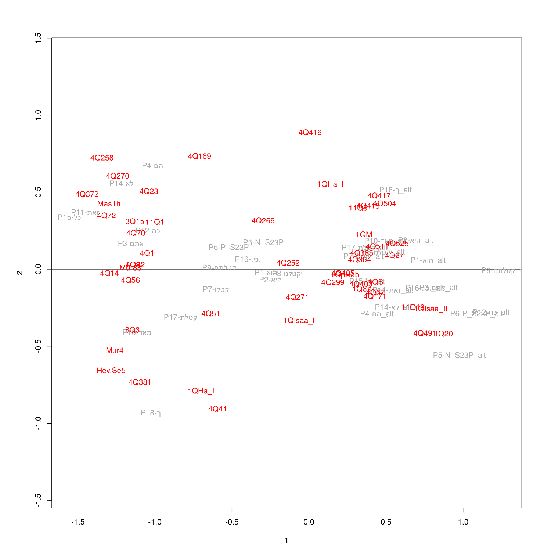

Slide 20
For ongoing computational research on orthography, see:
Johan de Joode, “Digital Masorah: Toward an Index of Orthographic and Morphological Variation at the Lexical Level”, Journal for Semitics, forthcoming.
Johan de Joode and Dirk Speelman, “The Orthographic Variability of the Hebrew Bible and the Larger Dead Sea Scrolls: A Computational Approach”, Journal for Semitics, forthcoming.

Slide 21
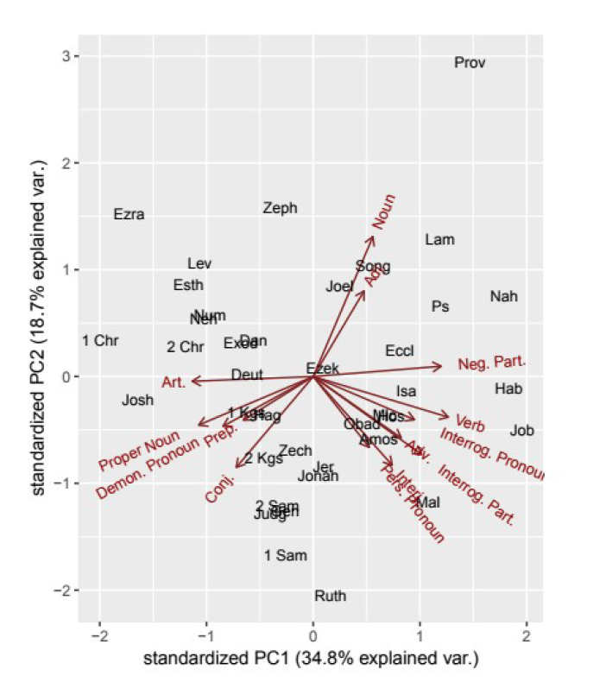
POS - Genre

Slide 22
For ongoing computational research on genre, see:
Johan de Joode, “The Distribution of Parts of Speech in the Literary Genres of the Hebrew Bible: A Digital Stylistic Approach”, Journal for North-West Semitic Languages, forthcoming.

Slide 23
Questions and remarks?
pierre.vanhecke@kuleuven.be

