Slide 1
How to find a middle ground between philology and coding
Processing Ancient Textual Corpora
Monday 17 February 2020

Slide 2
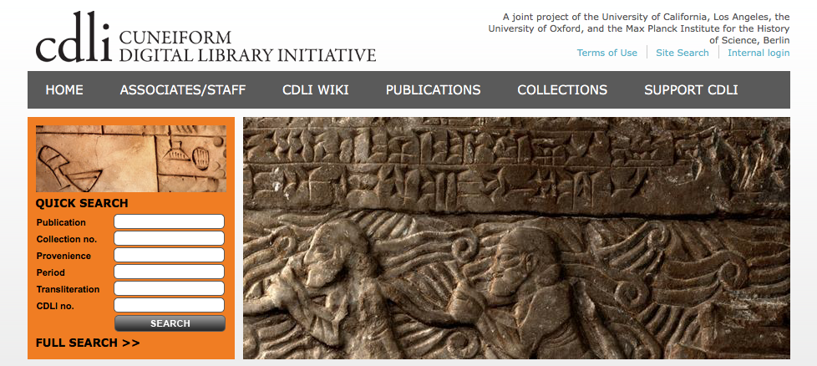

CDLI combines metadata, tablet photos/copies with transliterations
Robert K. Englund

Slide 3
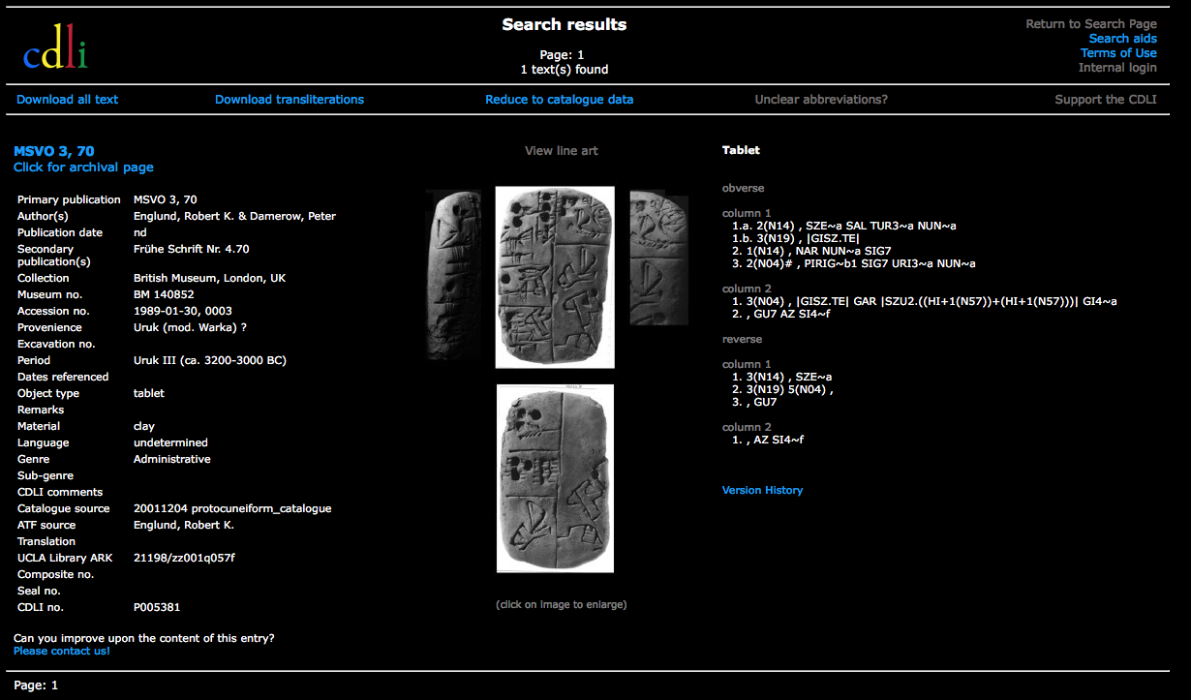
Proto-cuneiform tablet on CDLI

Slide 5
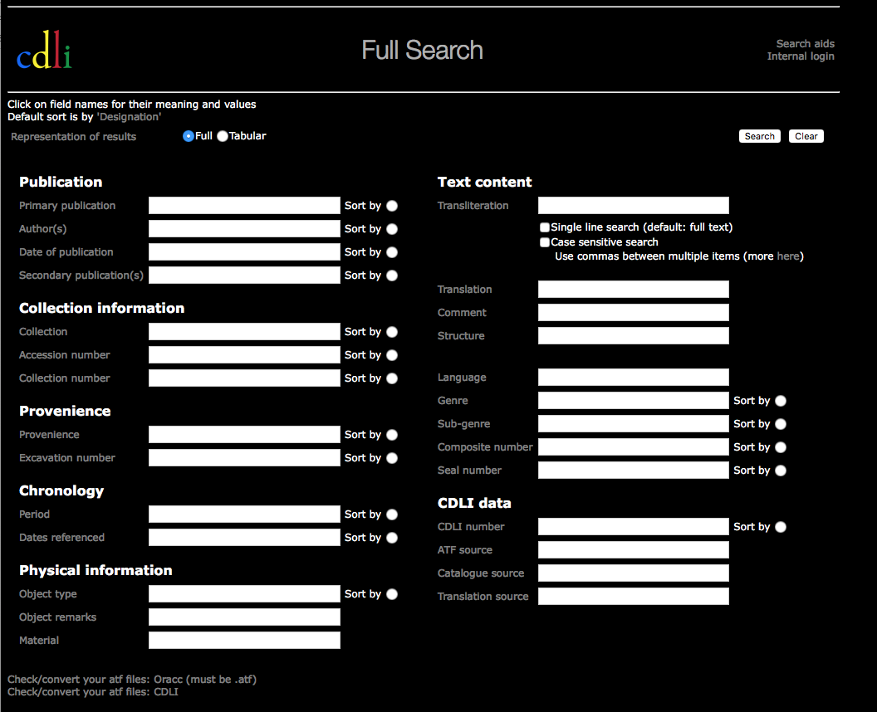

Slide 6
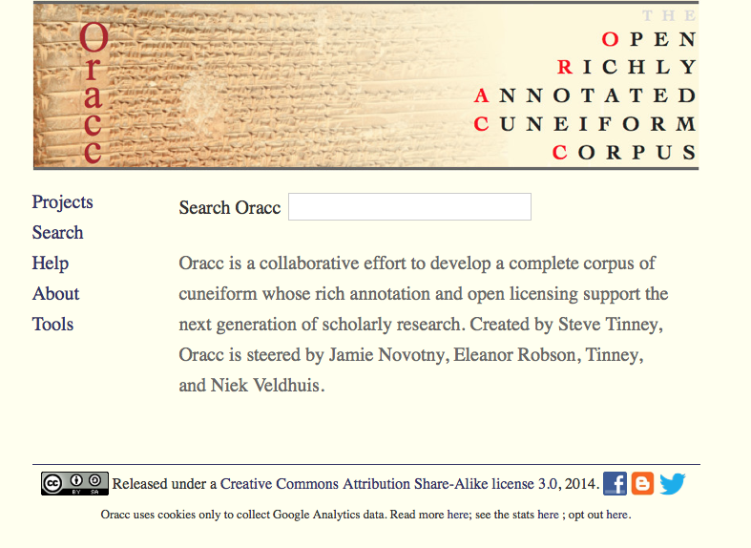

Efforts to move beyond raw data and metadata storage
Steve Tinney

Slide 7
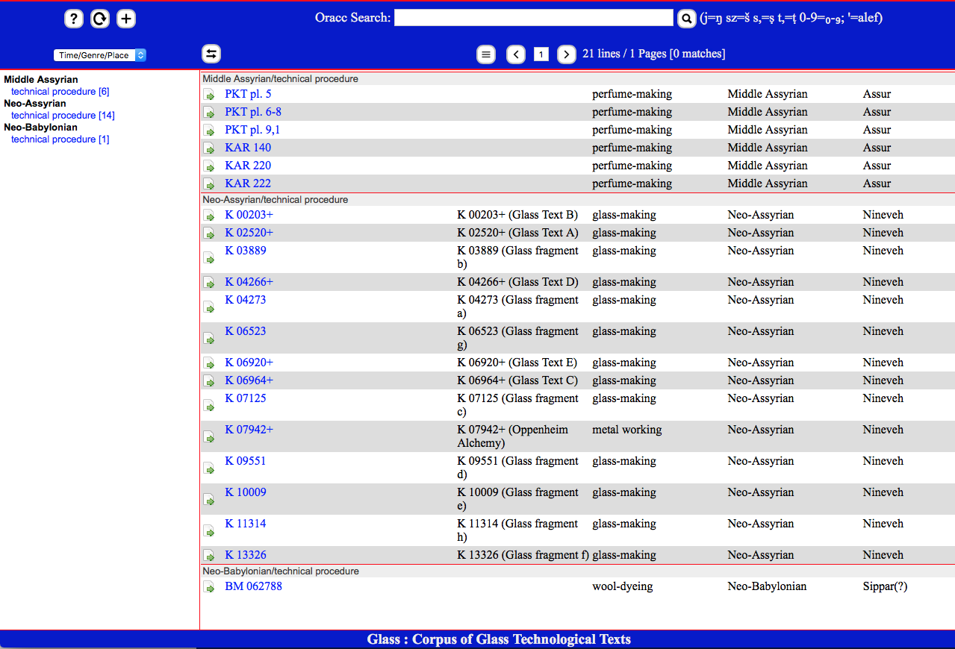
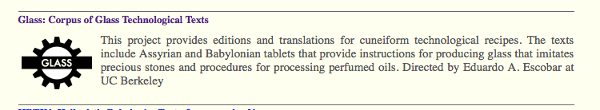

Slide 8
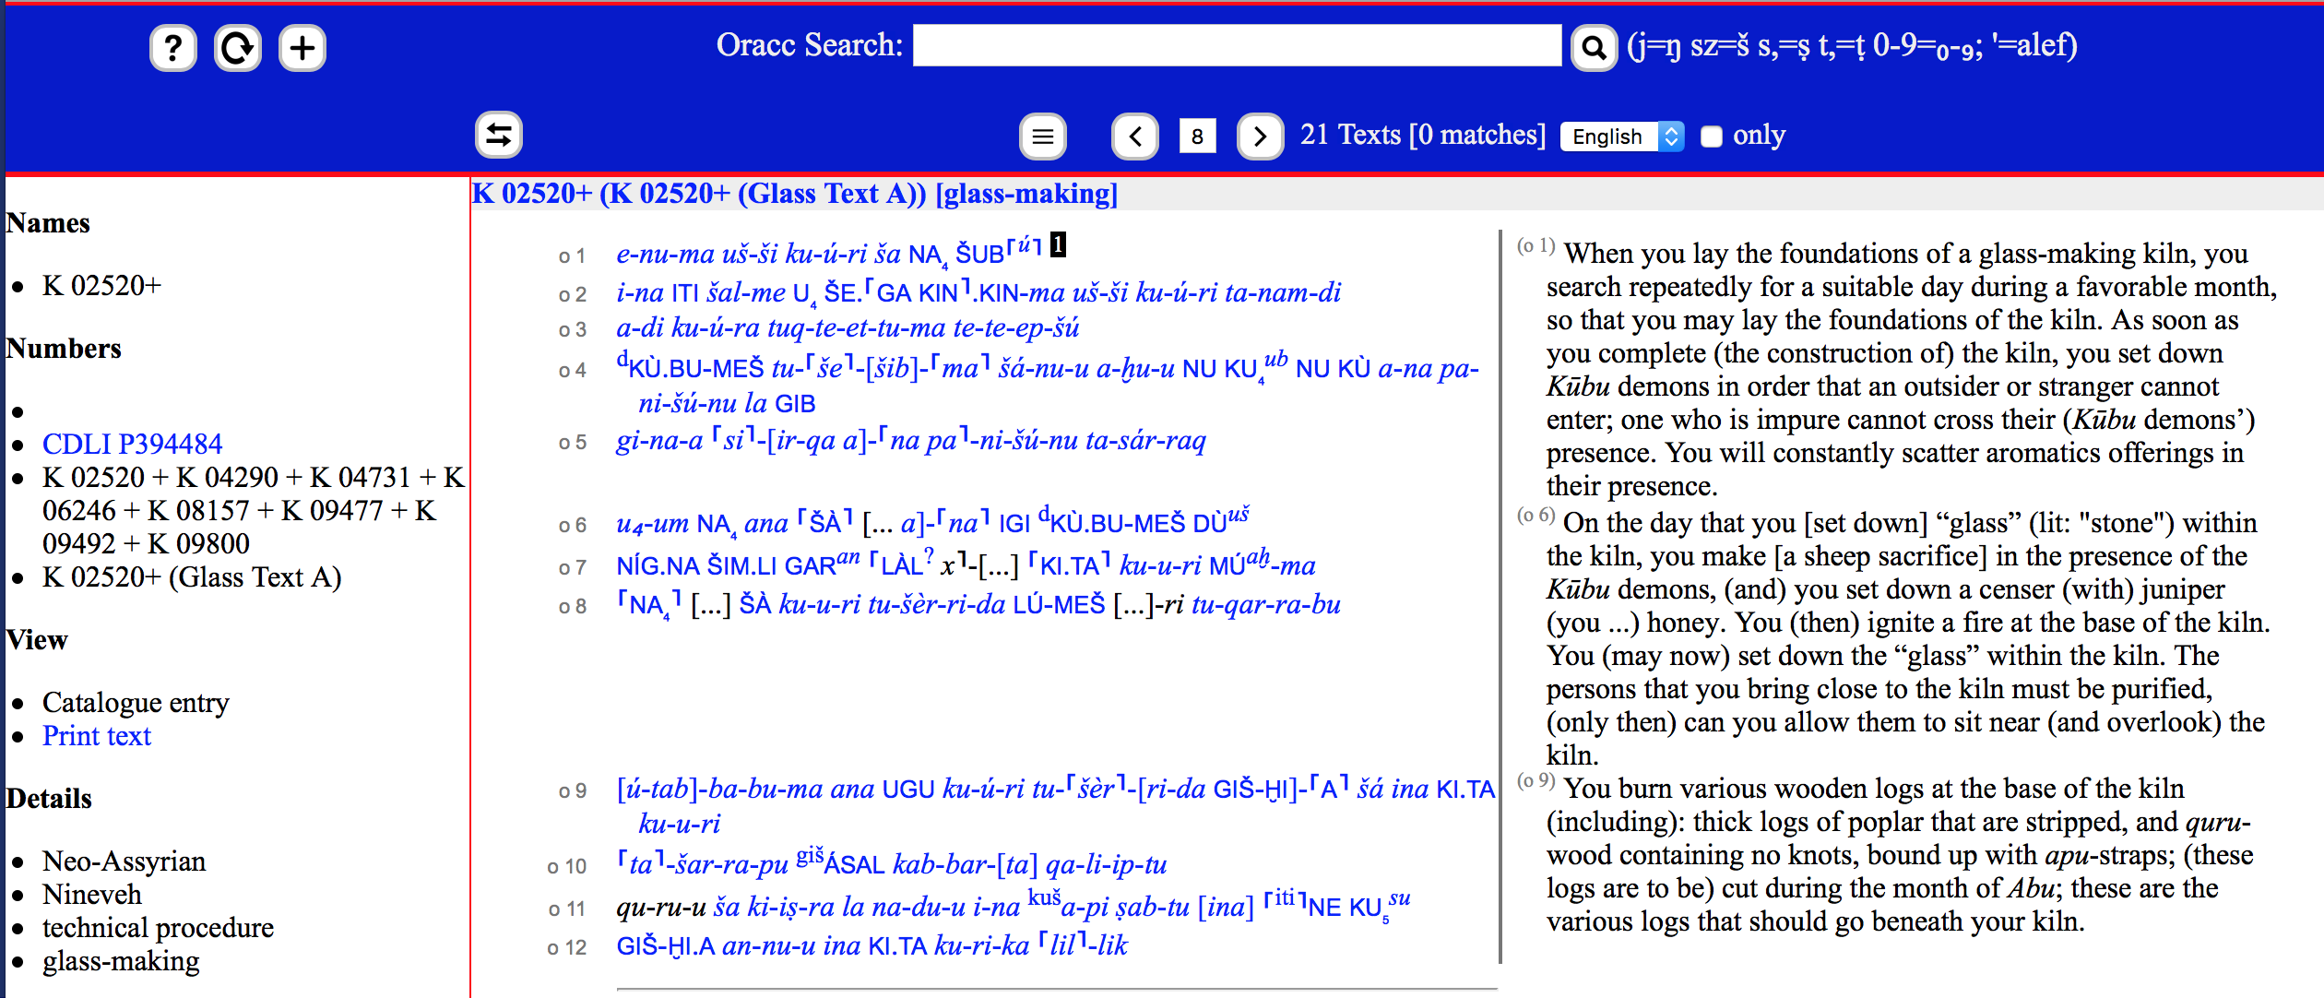
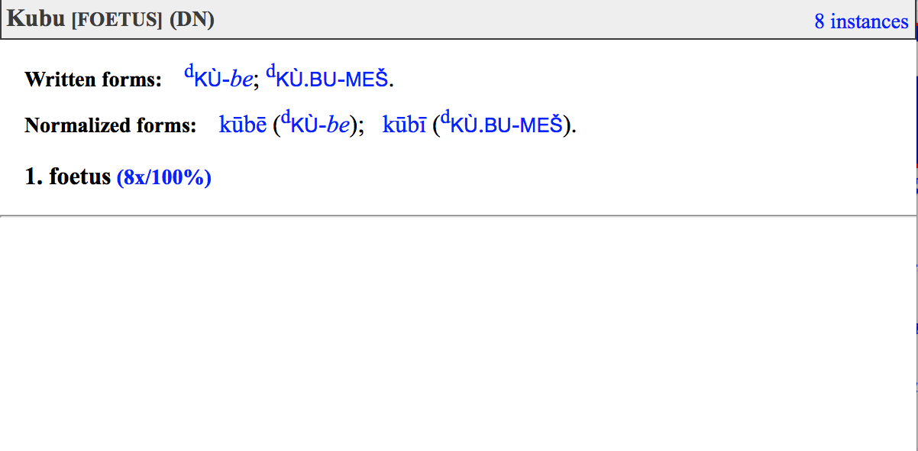

Slide 9
Virtues of and/or problems with ORACC projects:
Tools are all server-side, written in C++, only available through stand-alone websites
Lemmatization is available, but most Assyriologists find it difficult to use. Almost all lemmatization is carried out by pre-docs and post-docs hired for this purpose. Not a part of regular Assyriological practice
This has led to the employment of individual postdocs or small groups of postdocs who devote most of their time to ORACC lemmatization

Slide 10
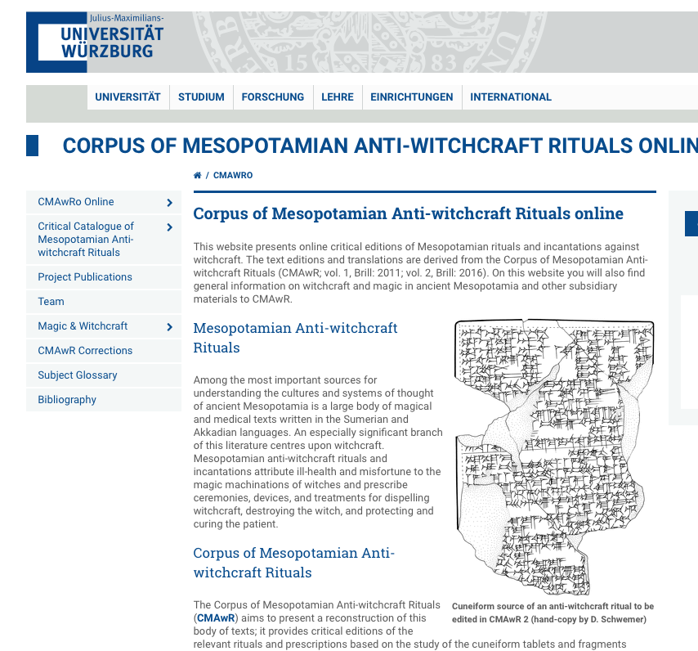
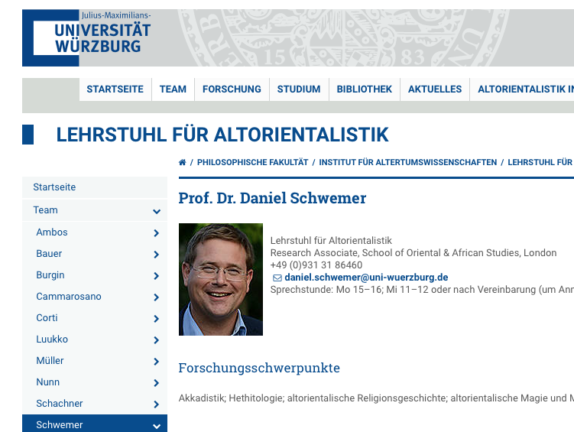
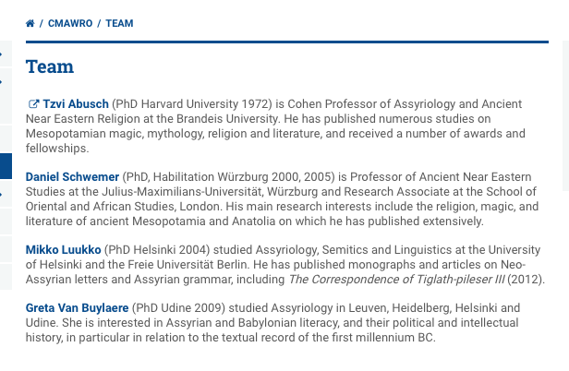

Slide 11
Three current approaches:
Caroline Waerzeggers (Leiden) — Persia and Babylonia (ERC Consolidator, 2017–2022)
Saana Svärd (Helsinki) — Ancient Near Eastern Empires (Centre of Excellence, 2018–2025)
Émilie Pagé-Perron (Toronto, PhD candidate) — Machine Translation and Automated Analysis of Cuneiform Languages (T-AP Digging into Data Challenge from the DFG, NEH and SSHRC)

Slide 12
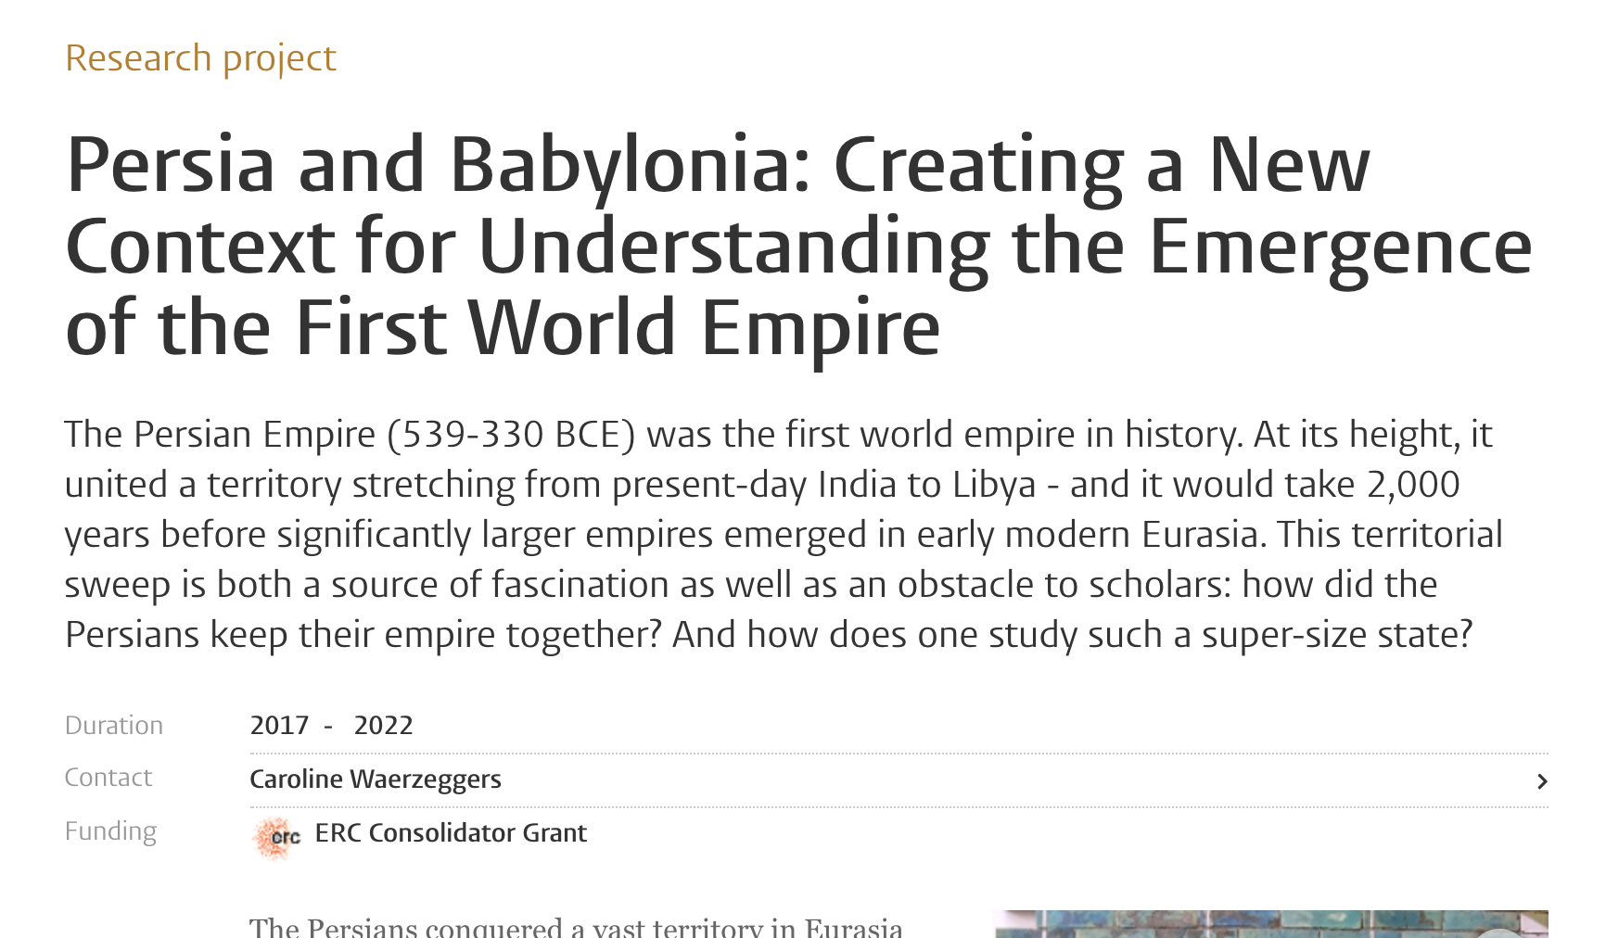
Caroline Waerzegger

Slide 13
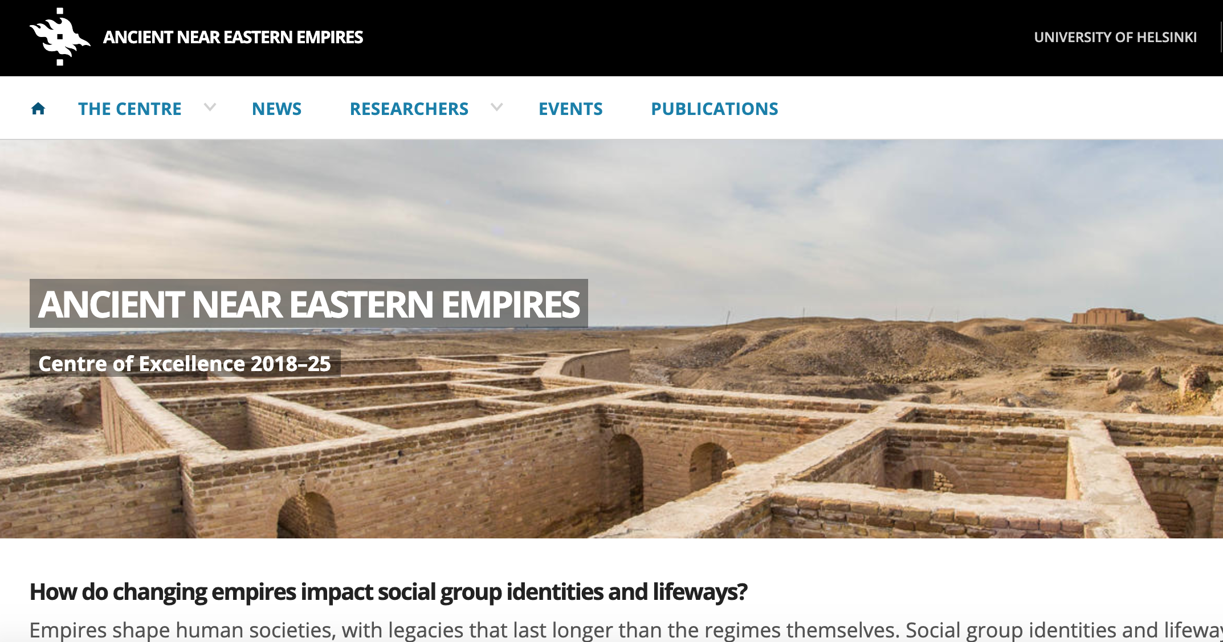
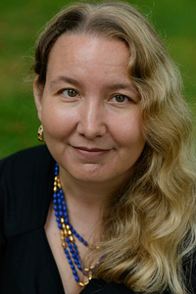
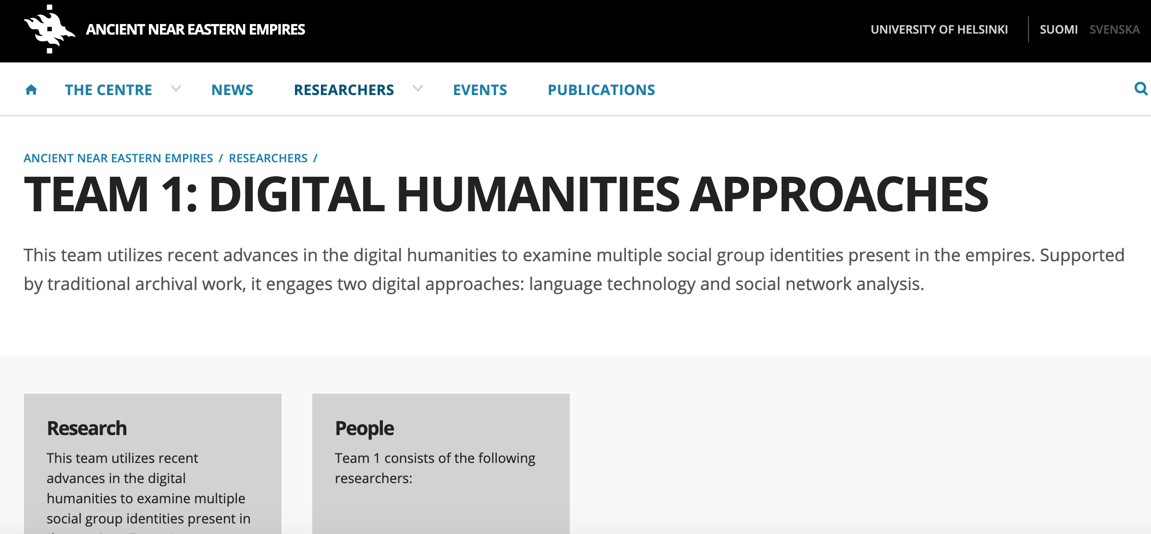
Saana Svärd

Slide 14
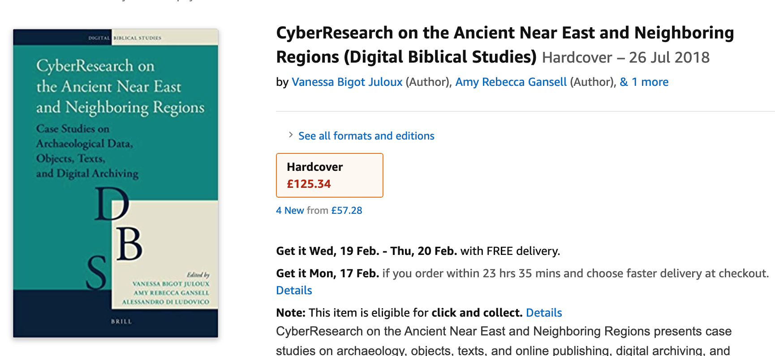
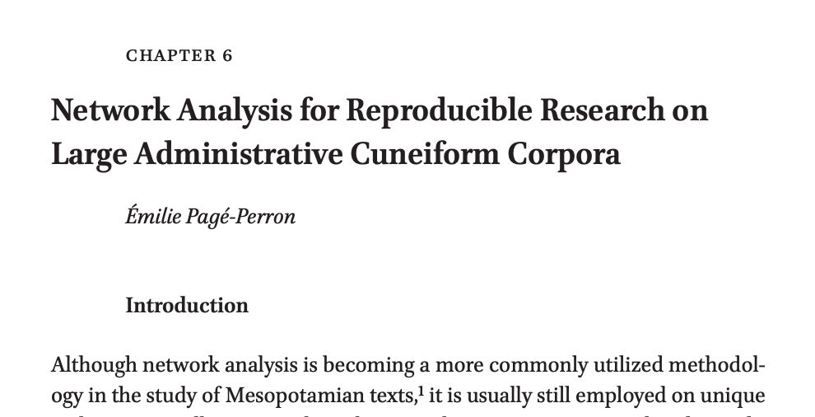
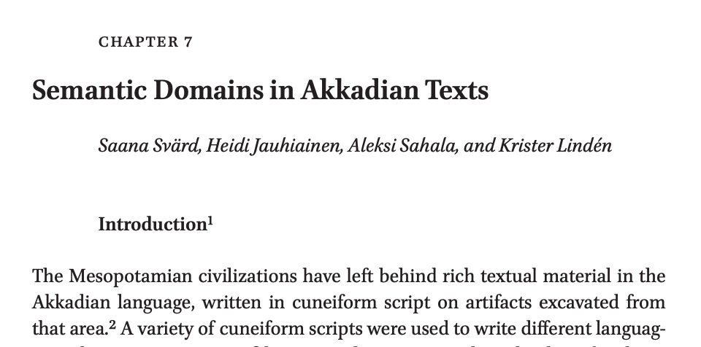

Slide 15
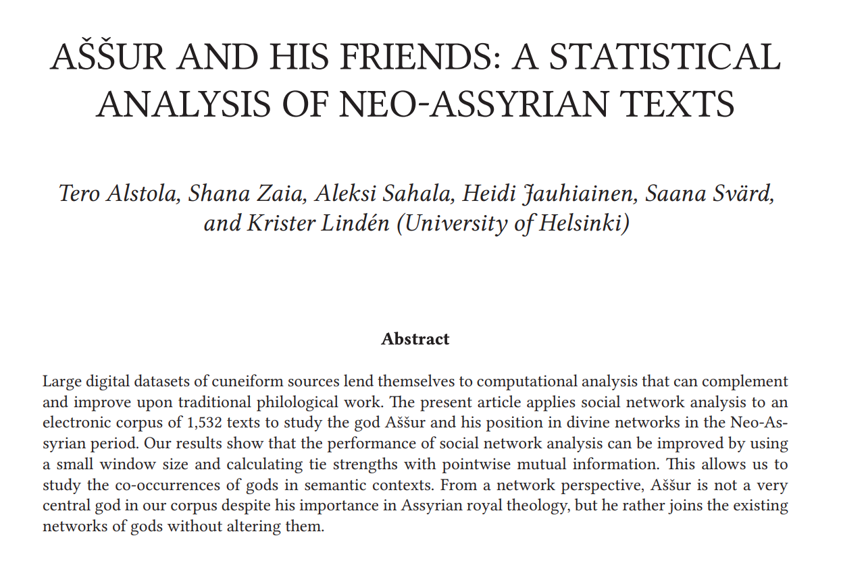
Journal of Cuneiform Studies 71 (2019)

Slide 16
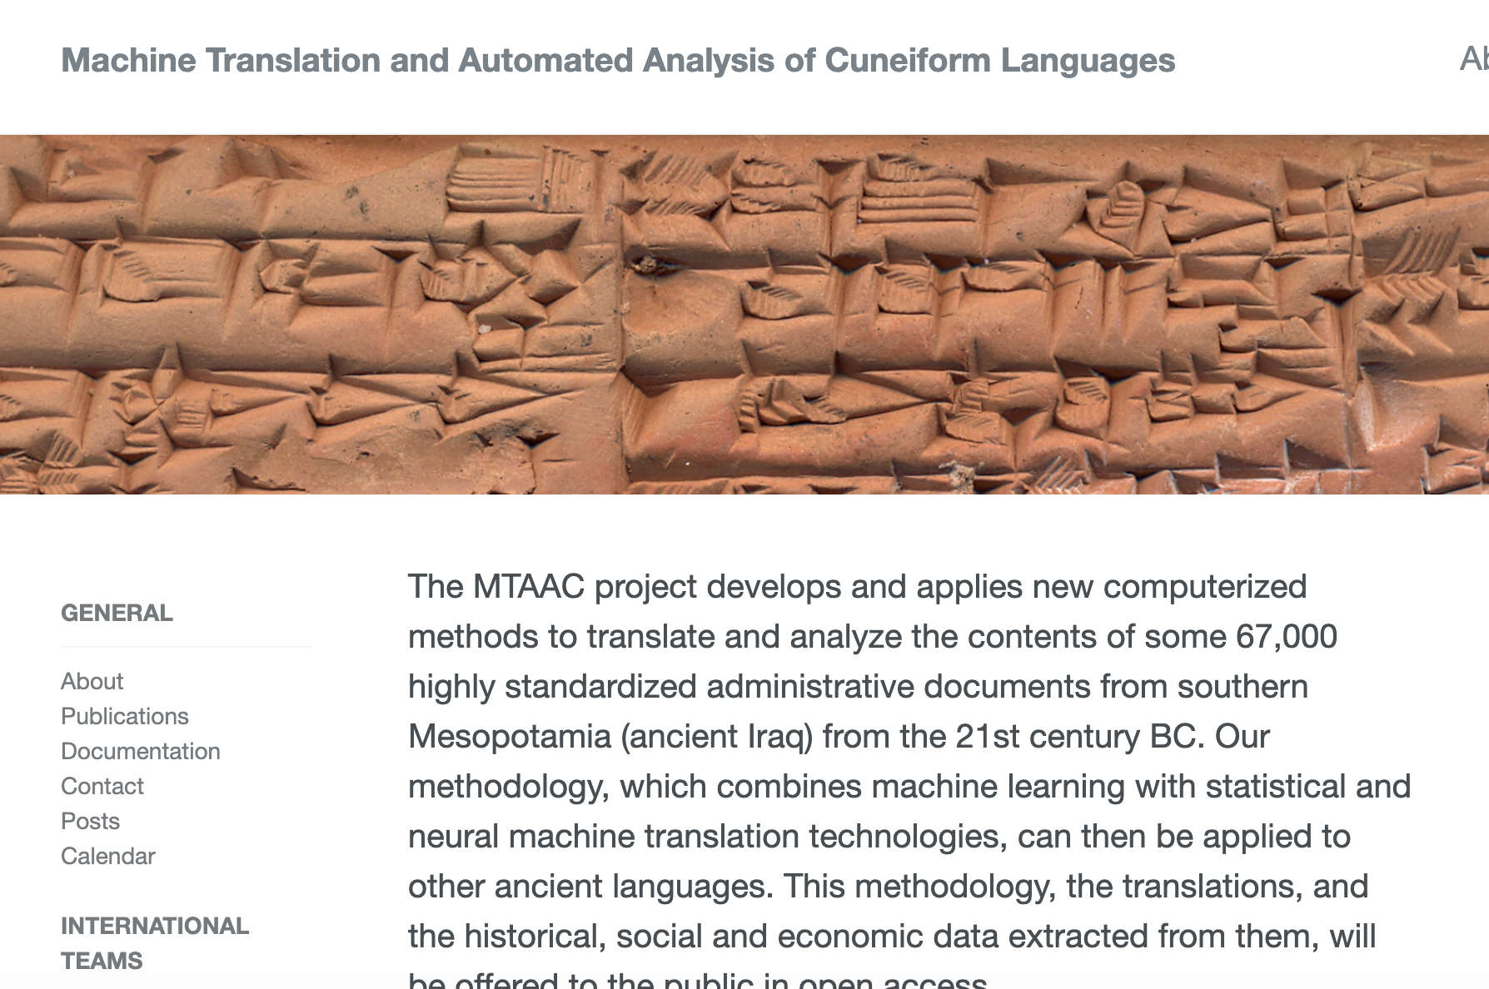
Émilie Pagé-Perron

Slide 17
To DIY or not to DIY

Slide 18
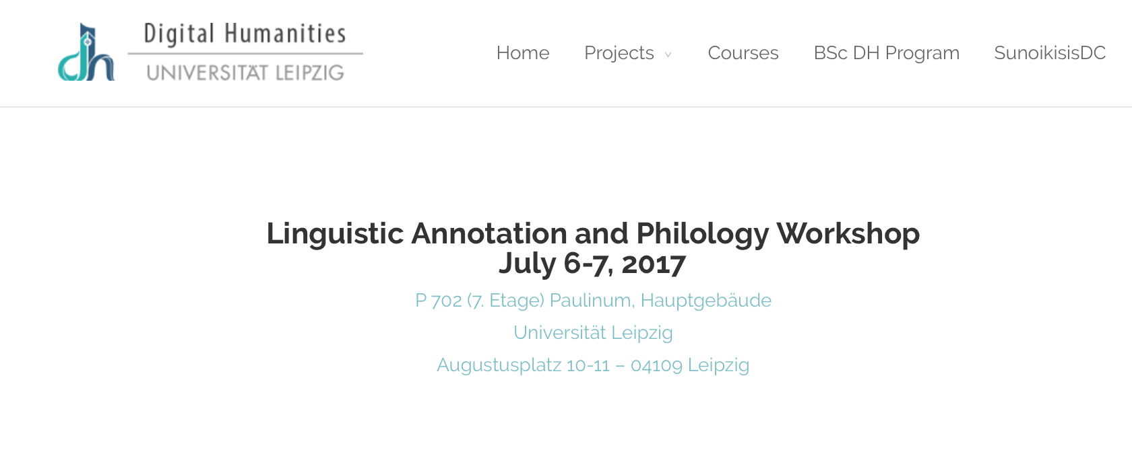
Dirk Roorda and I met and started talking about a better way to work on cuneiform at the Leipzig Annotation Workshop a few years ago.
An approach that used Text-Fabric in Jupyter Notebooks, encouraged a DIY DH work by Assyriologists and an approach that could be used within pedagogical contexts

Slide 19
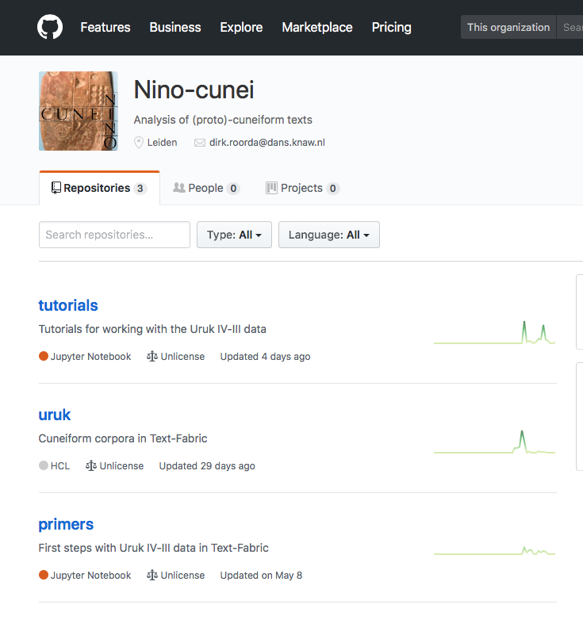
Nino-cunei is the first effort to use Text-Fabric/Jupyter Notebooks on cuneiform texts
We have taken the eariest texts, so-called proto-cuneiform, as our point of departure

Slide 20
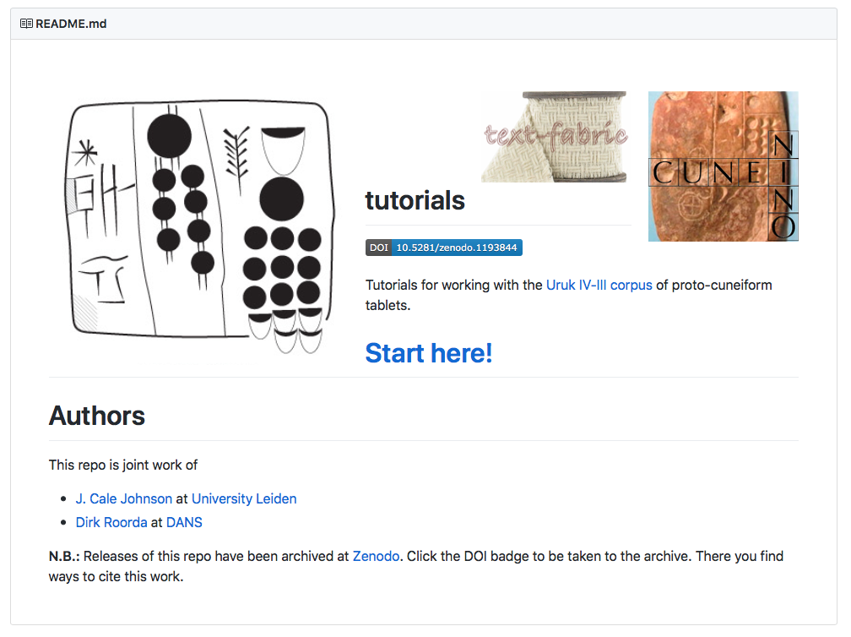

Slide 21
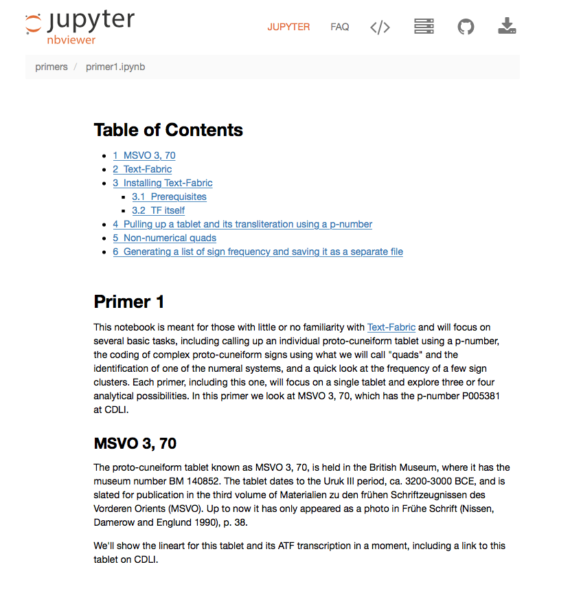
Tutorial and primers are oriented to different users (tutorials for IT specialists, primers for Assyriologists)

Slide 22
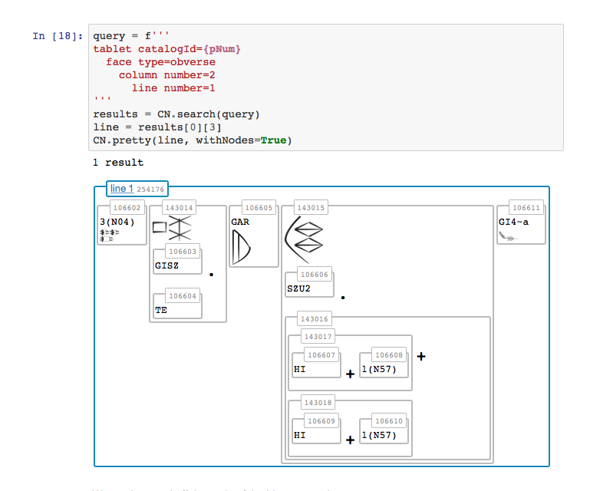
Complex sign decomposition in TF

Slide 23
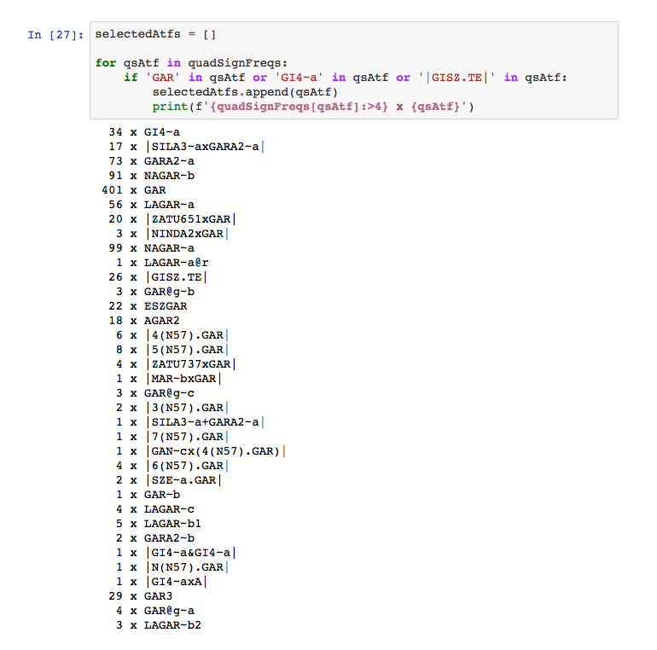
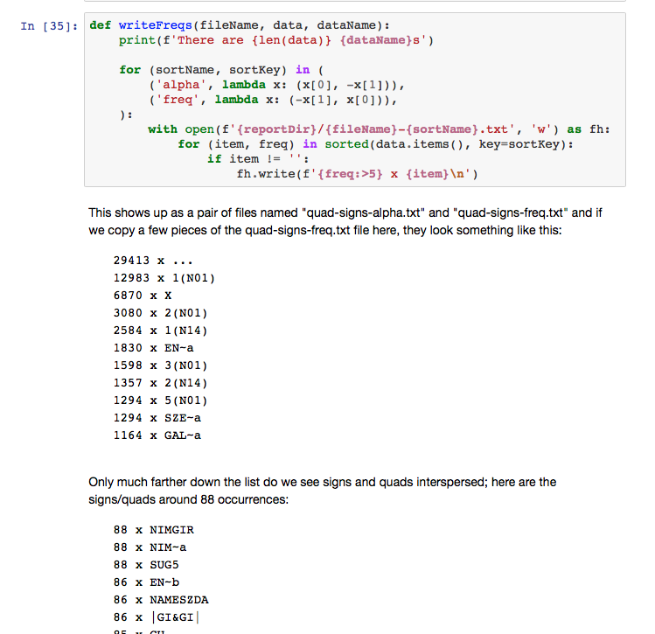
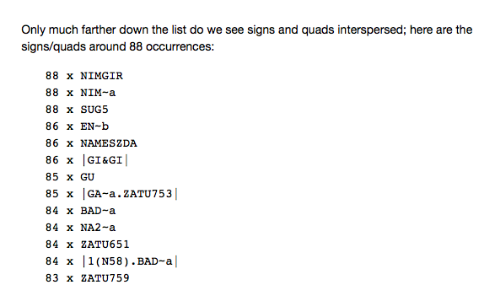
Frequency counts of signs and clusters

Slide 24
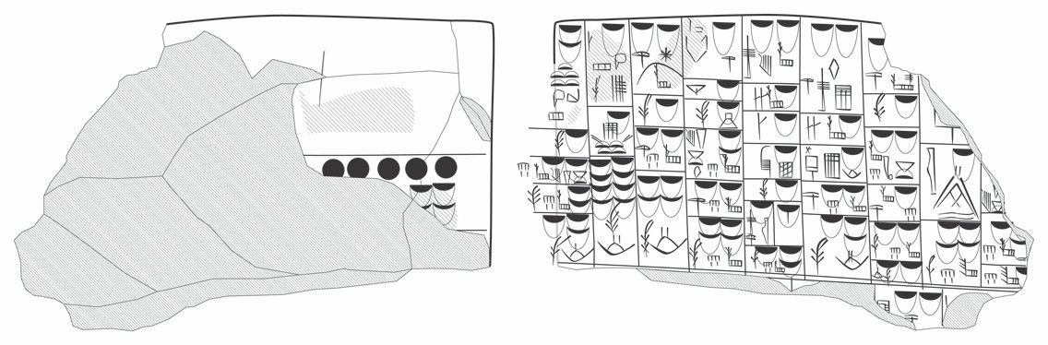
Schematic subcategorization in a staff list
Each column represents the staff in a particular bureau
Subcasing in proto-cuneiform codes hierarchy or categorization

Slide 25
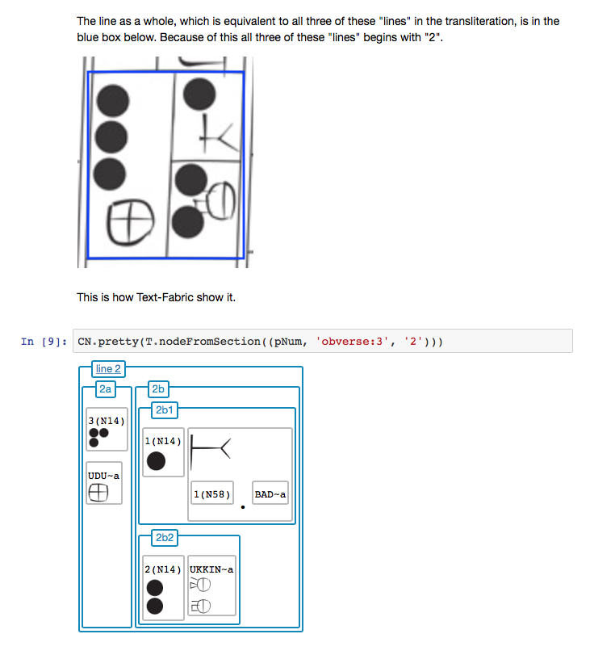
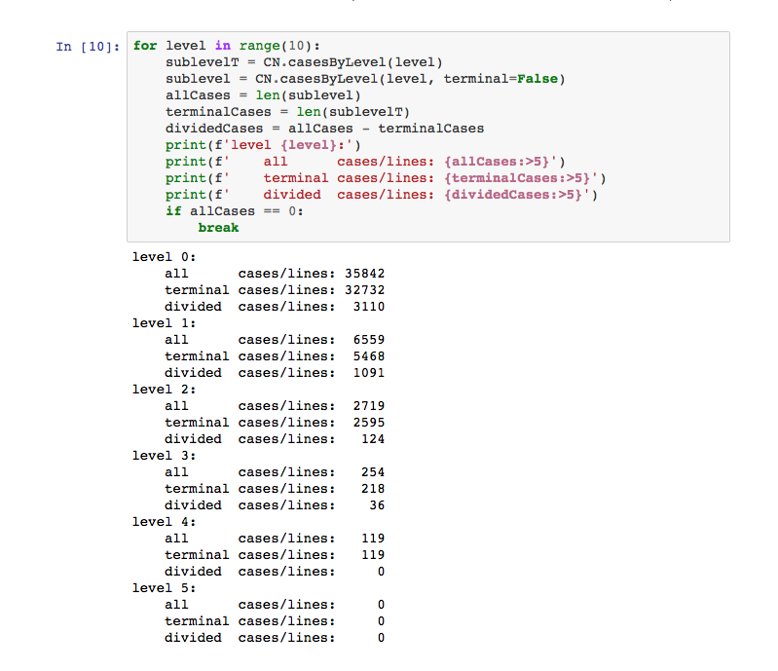
Sign frequencies in subcases in primer2

Slide 26
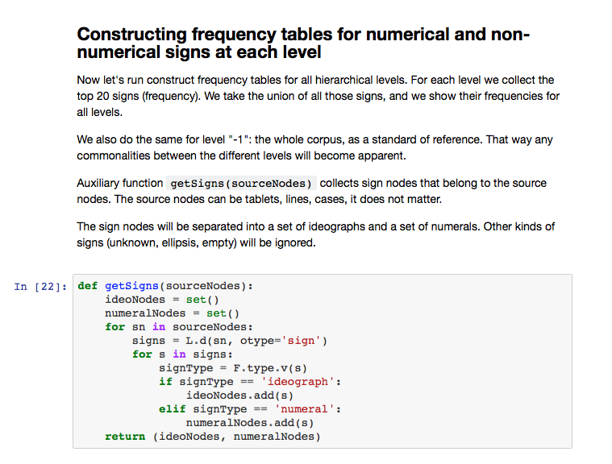

Slide 27
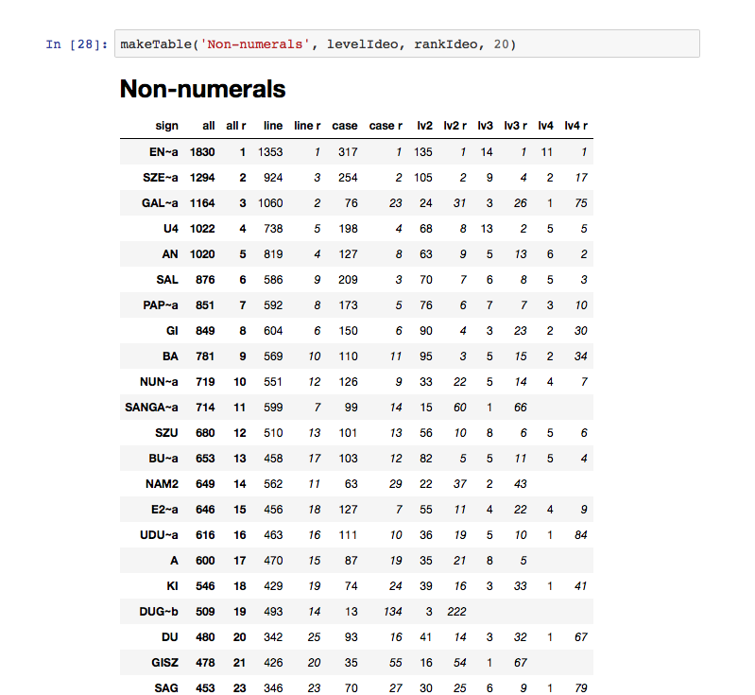

Slide 28
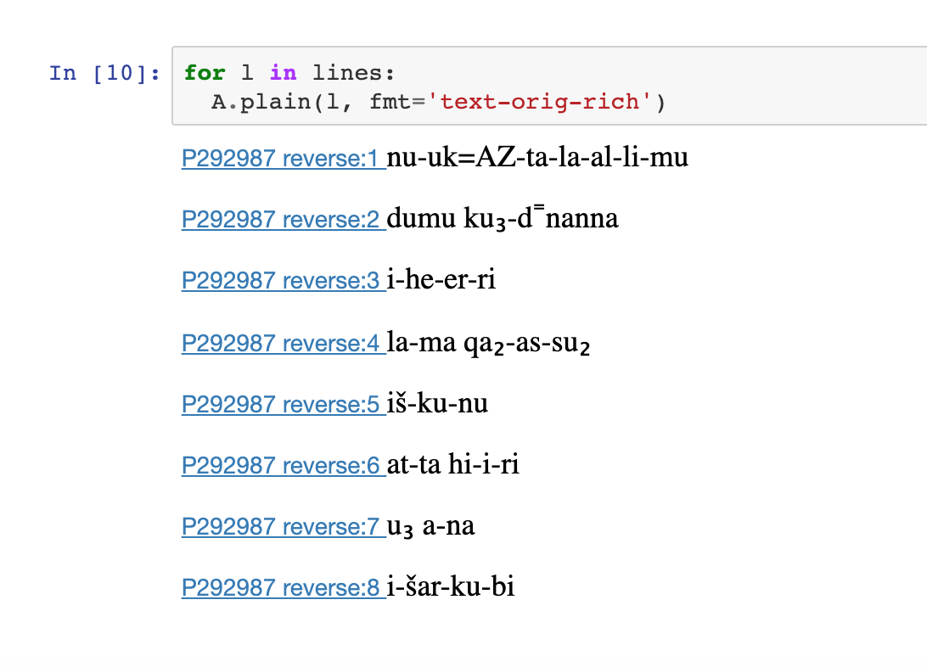
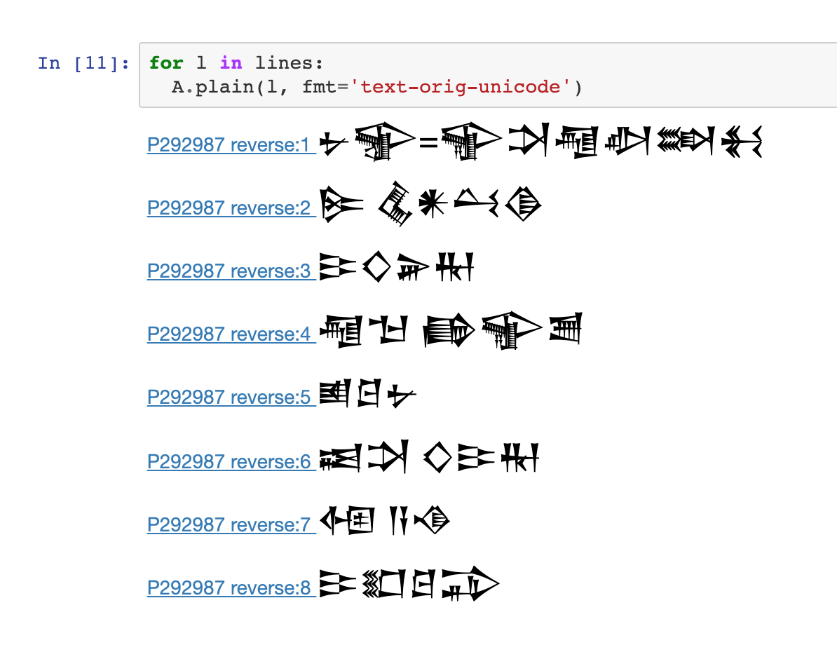
The Old Babylonian letter (AbB) corpus)

Slide 29
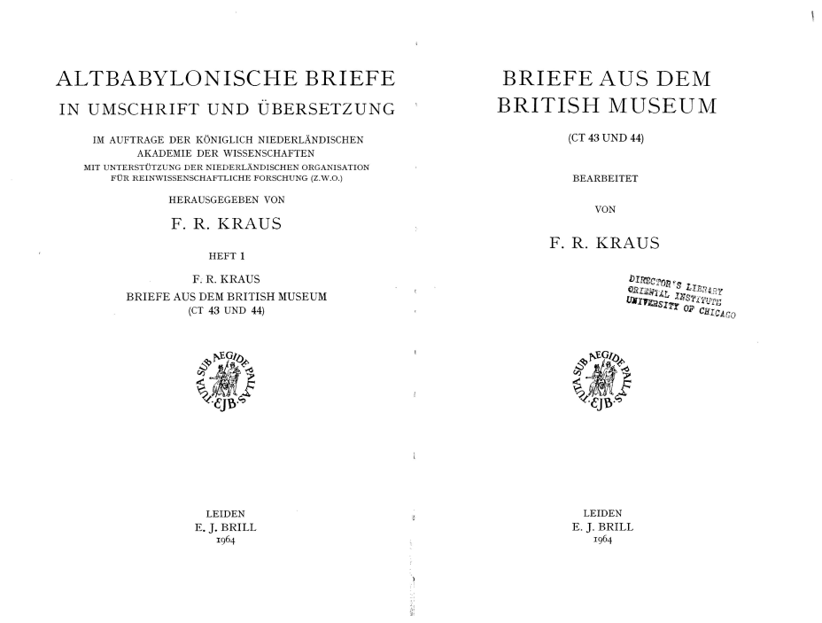
AbB = Altbabylonische Briefe in Umschrift und Übersetzung
First of 14 volumes published 1964-2005, largely in Leiden
AbB 1 = 142 letters
AbB 2 = 182
AbB 3 = 116
AbB 4 = 166
AbB 5 = 278
AbB 6 = 221
AbB 7 = 189
AbB 8 = 158
AbB 9 = 279
AbB 10 = 211
AbB 11 = 194
AbB 12 = 200
AbB 13 = 200
AbB 14 = 226
Total = 2762 letters

Slide 30
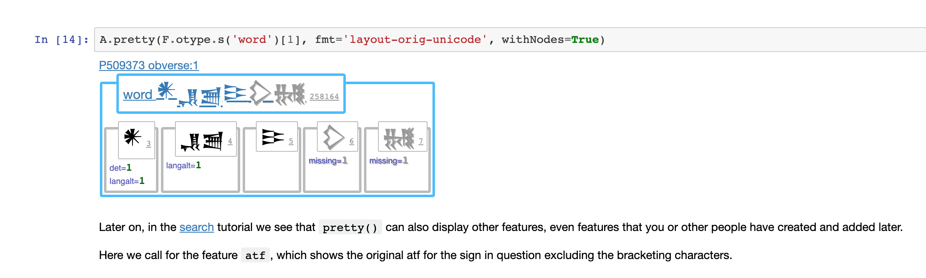
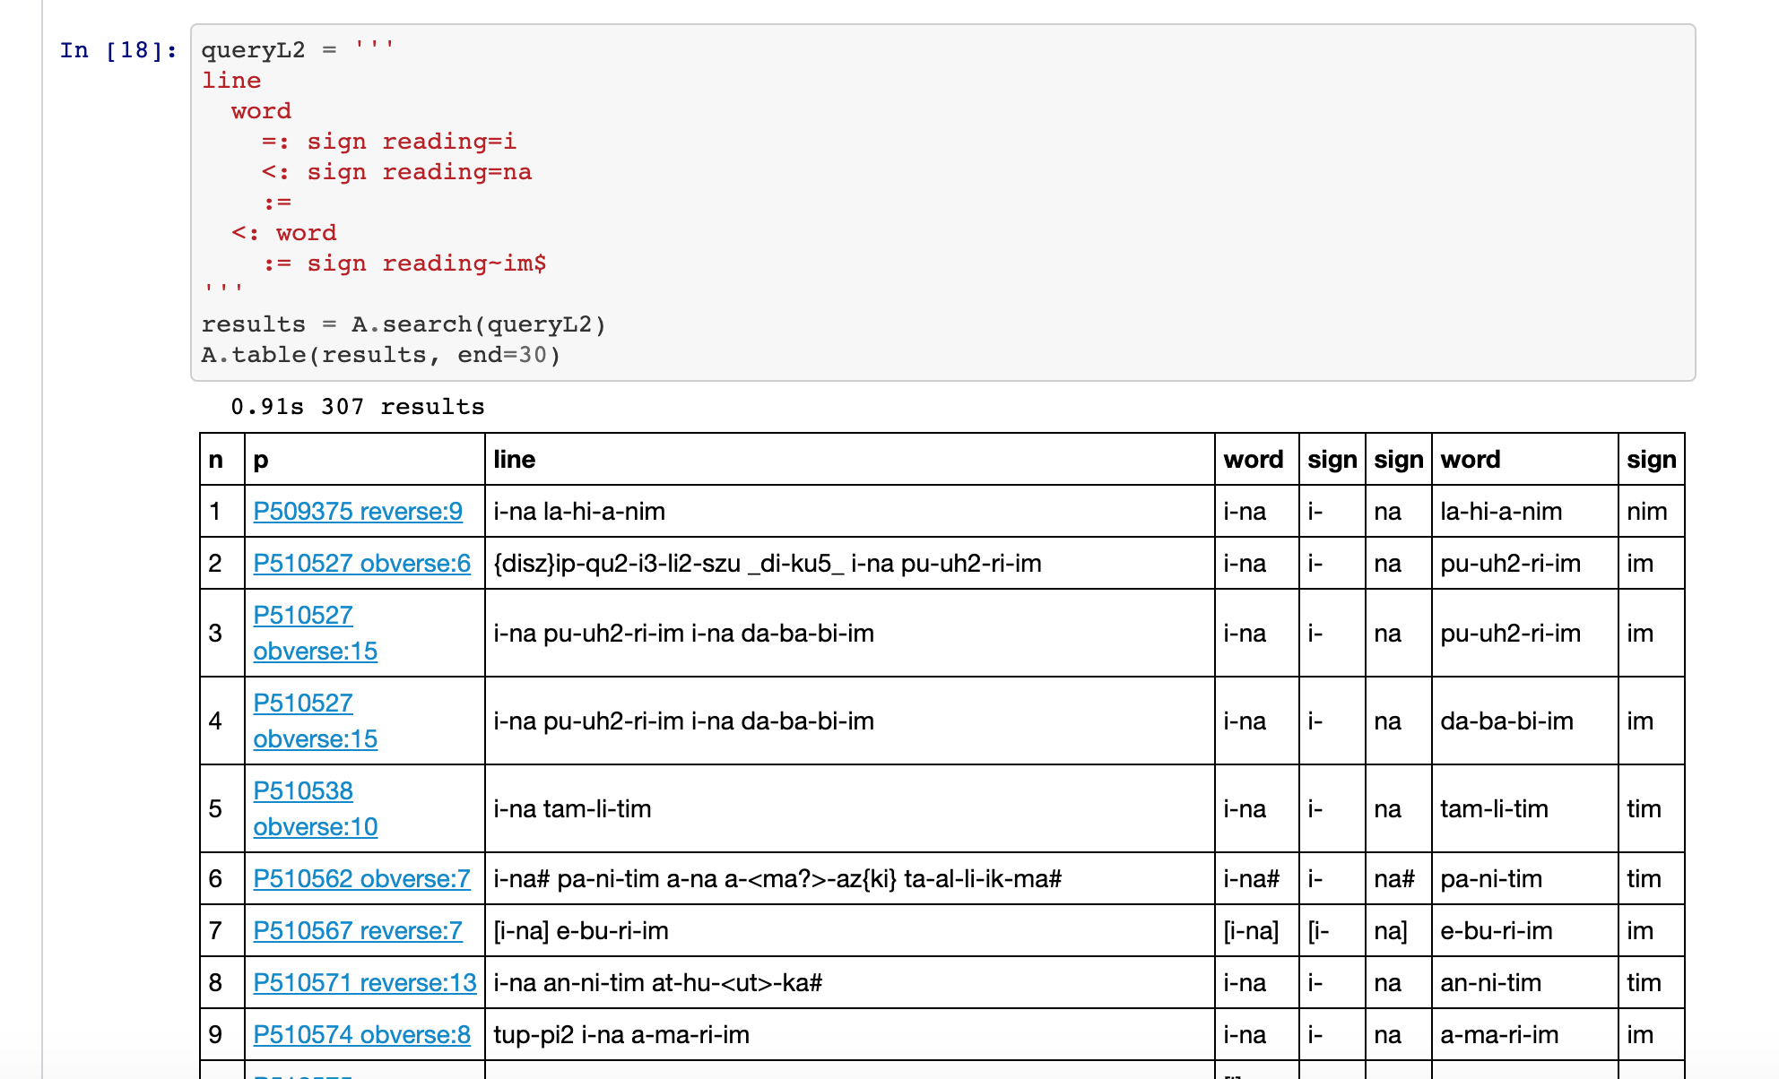

Slide 31
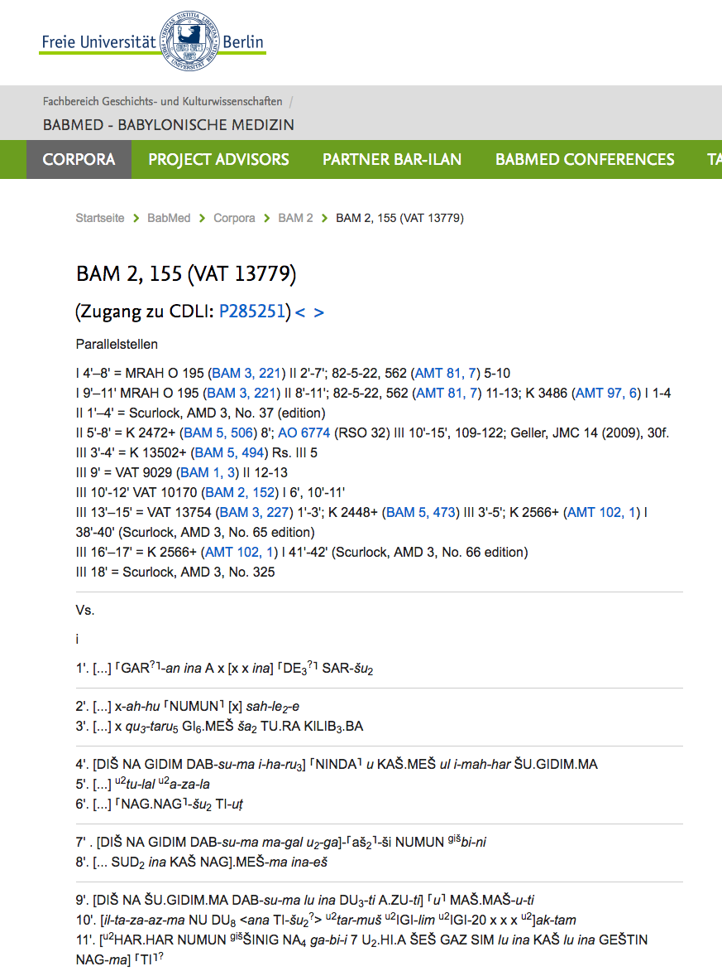
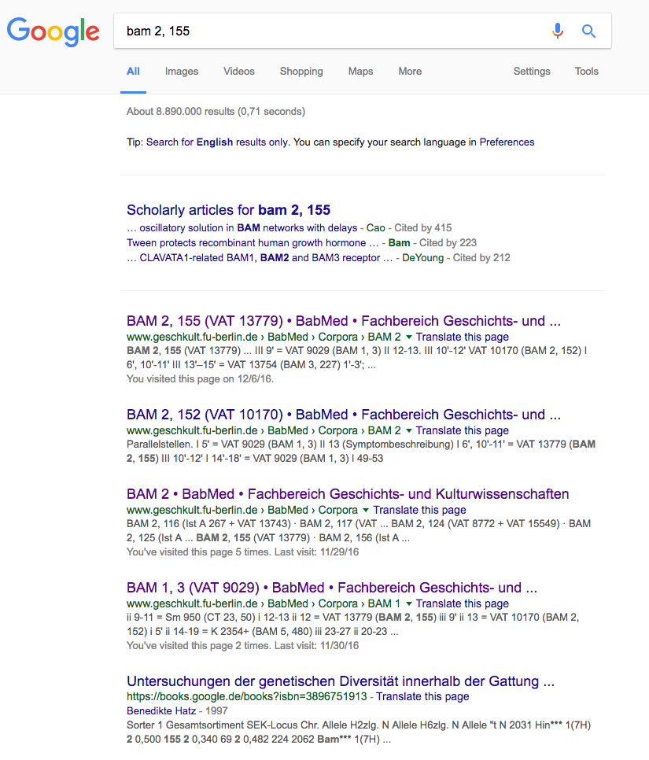
Building a corpus where standard editions do not yet exist = Babylonian Medicine

Slide 32
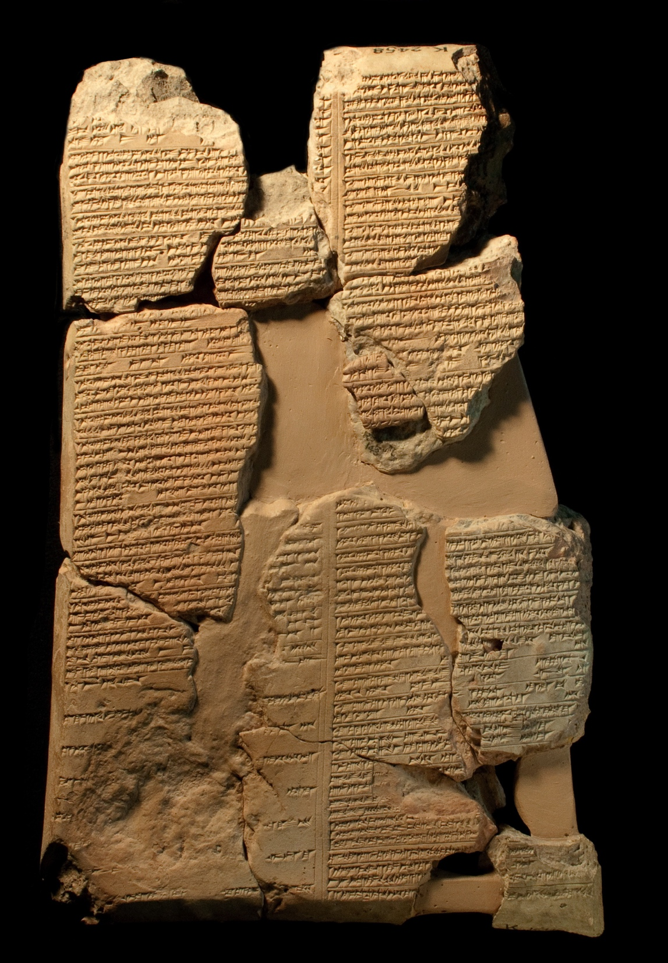
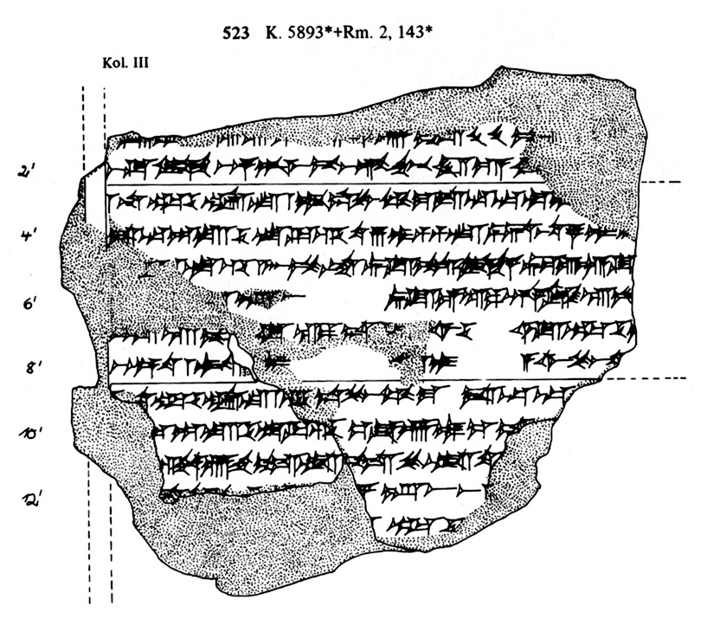
In 1980, when Köcher published his last volume of BAM, the two pieces in the green box (BAM 523) had been joined, but Köcher did not have time to make a new copy. It is now clear that BAM 523 belongs to the SA.GU₂ subcorpus.

Slide 33
Once on the BabMed page, you should be able to:
go directly to parallel passages
go to BabMed transliterations on CDLI
go to other projects such as ORACC, SEAL or CCP dealing with the same materials

Slide 34
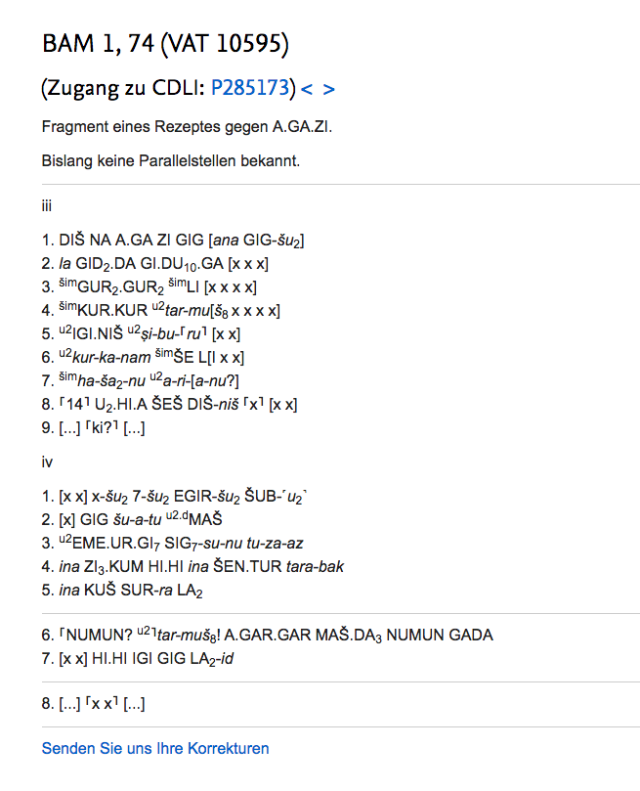
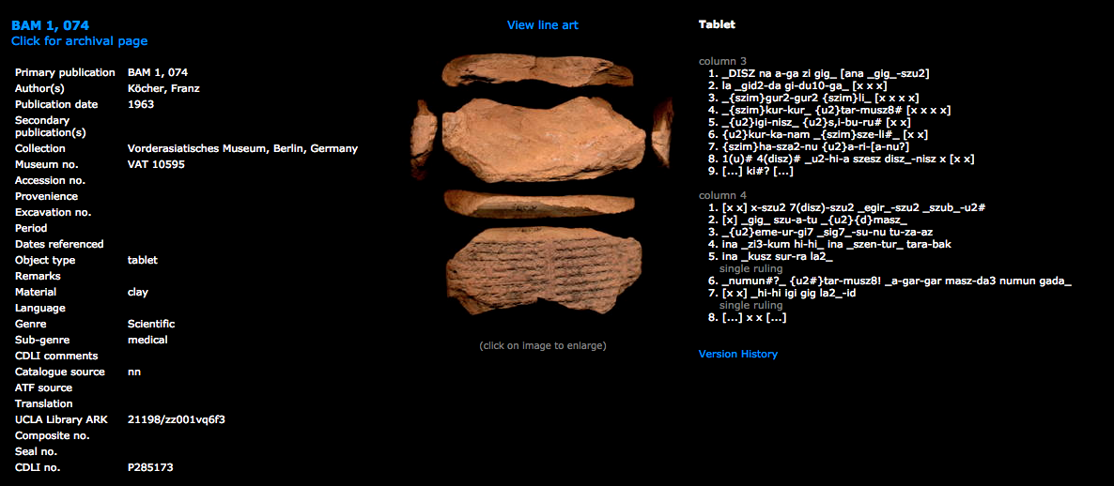
BabMed transliterations converted into CDLI format

Slide 35
As of today, we have:
831 texts online
24,776 lines
ca. 100,000 words
This represents all published Babylonian medical texts

Slide 36
