Slide 1


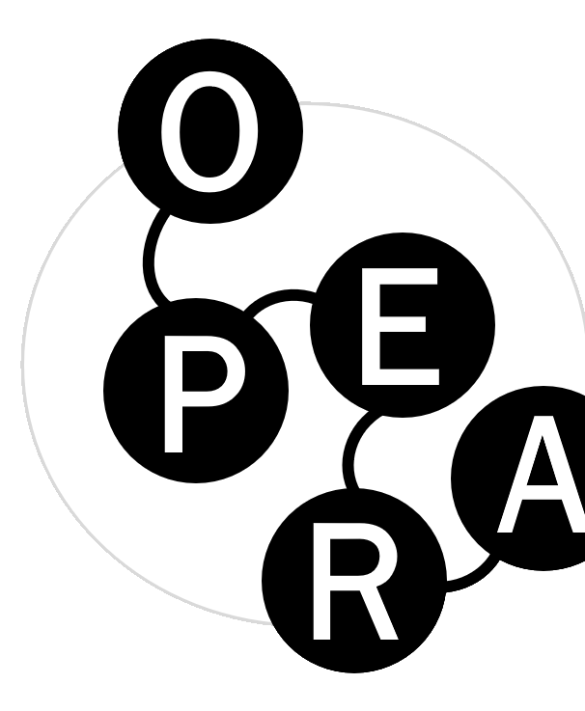
PIDs in the OPERA Project
https://zenodo.org/communities/pidapalooza20/
Nikoline Dohm Lauridsen, DTU
Poul Melchiorsen, AAU
Notes:
Nikoline

Slide 2
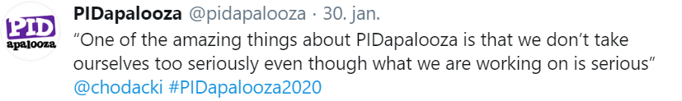
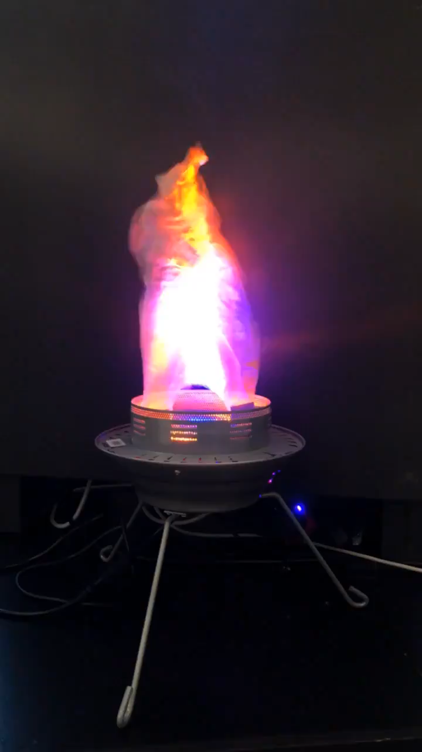

Agenda
PIDapalooza:
Take-home messages
The Use of PIDs in Research Assessments
Dirty PIDs
Notes:
Nikoline

Slide 3
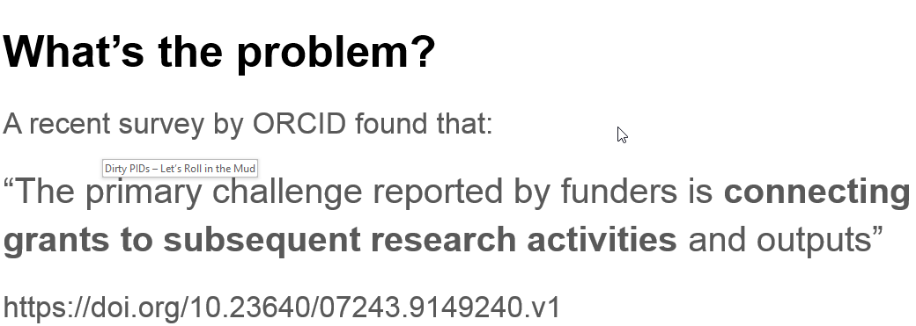
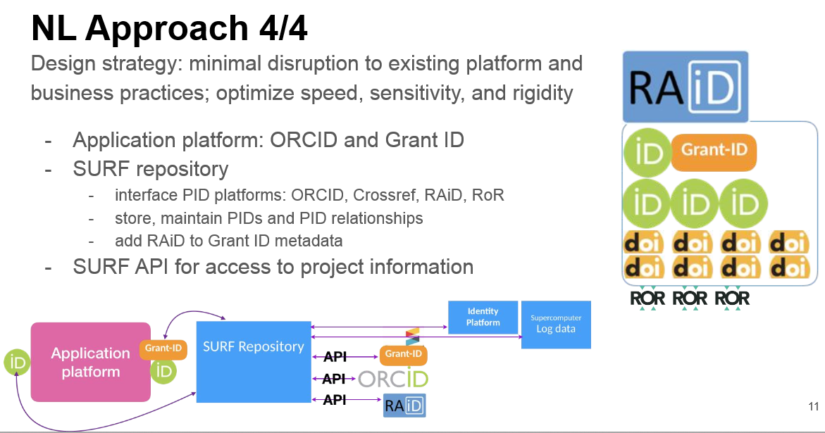
Infrastructure ID: when 3 IDs are better than 1
C. Thatum, SURF/CWTS
J. Brown, Independent
https://doi.org/10.5281/zenodo.3632958
Notes:
Poul

Slide 4
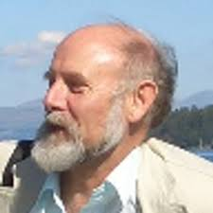
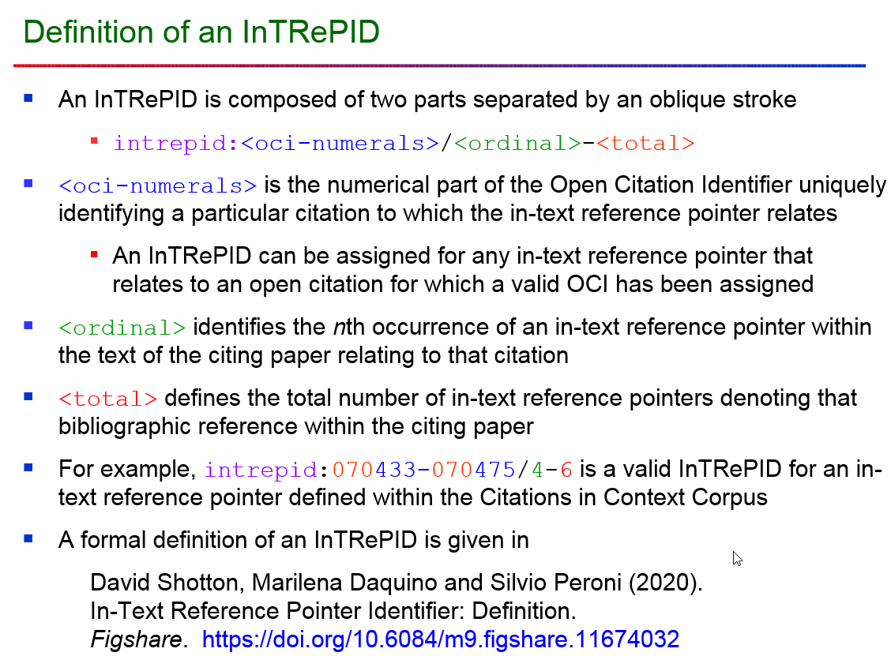
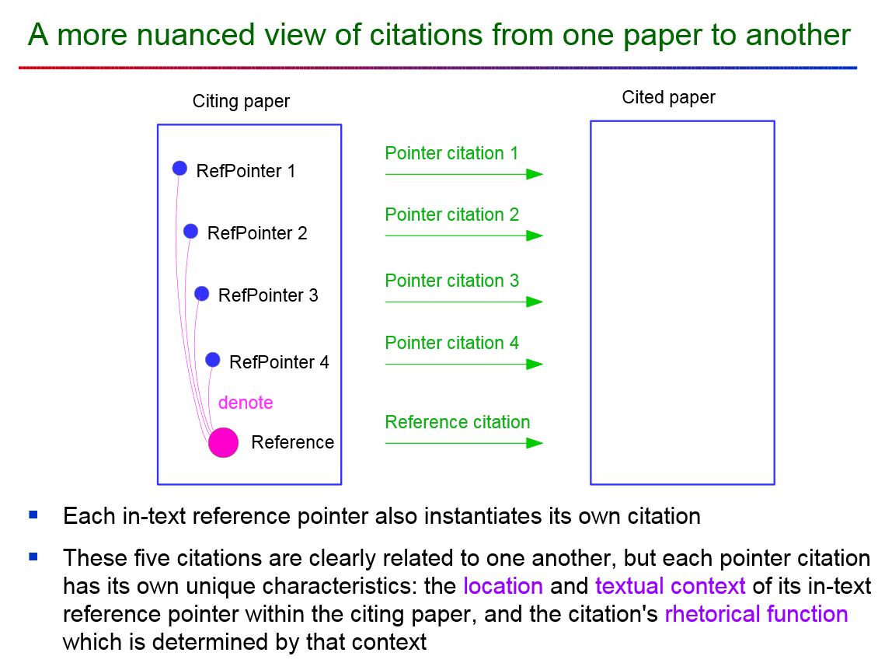
A new PID? - InTRePID
Workshop On Open Citations and Open Scholarly Metadata 2020
https://workshop-oc.github.io/
David Shotton, University of Oxford
https://doi.org/10.5281/zenodo.3632922
Notes:
Nikoline

Slide 5
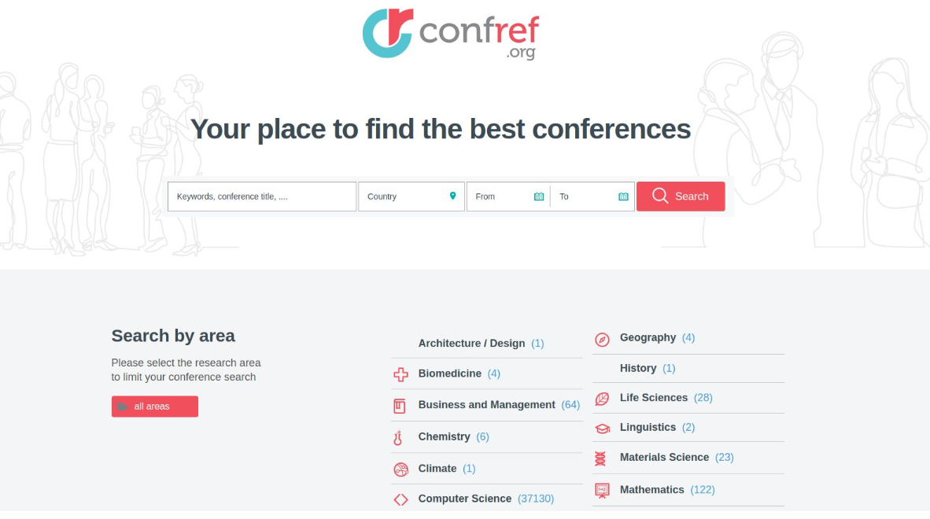
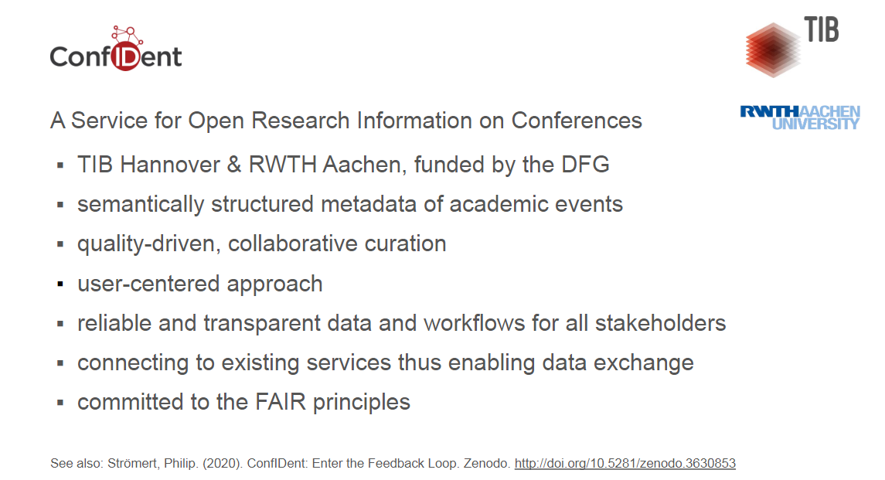

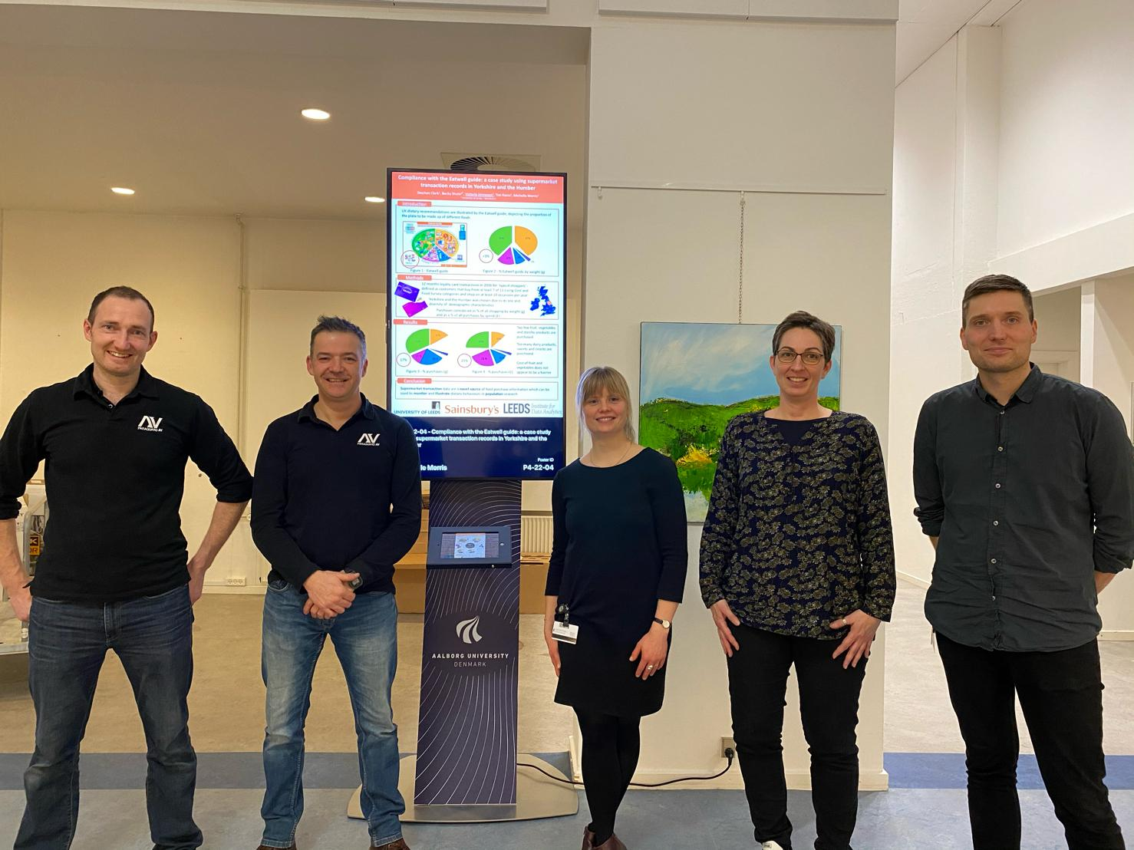
Conference Identifiers, the story so far and how to proceed
J. Franken, TIB; P. Strömert, TIB;
K. Eckert, Confref.org; S. Benchekroun, Morressier
https://doi.org/10.5281/zenodo.3653755
Notes:
Poul

Slide 6

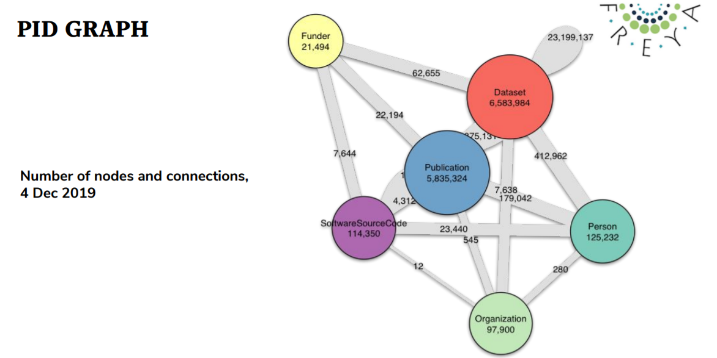
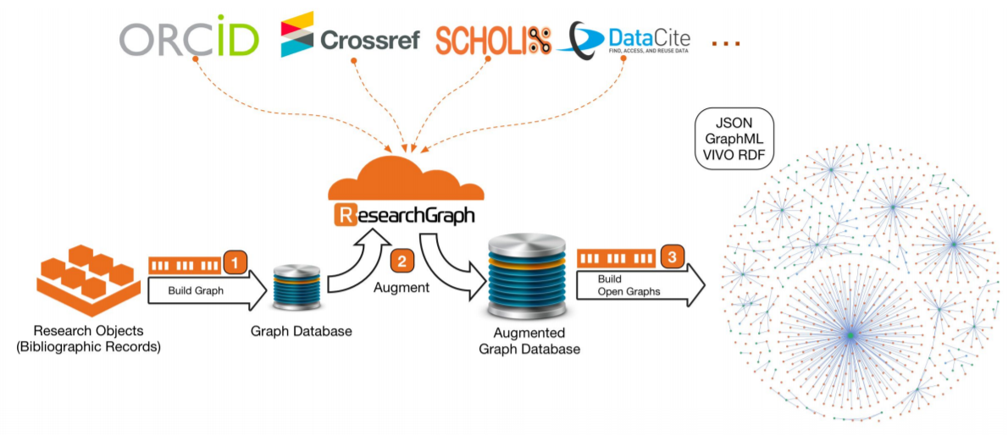
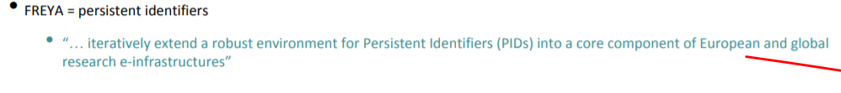
Building ORCID Collaboration Networks – PID graphs
Data source: https://api.datacite.org/graphql
Visualisation: https://github.com/datacite/pidgraph-notebooks-r/blob/master/kpi/r-kpi.ipynb
https://www.project-freya.eu/en
https://zenodo.org/record/3630235#.XkZs6mhKiF4
Notes:
Nikoline

Slide 7
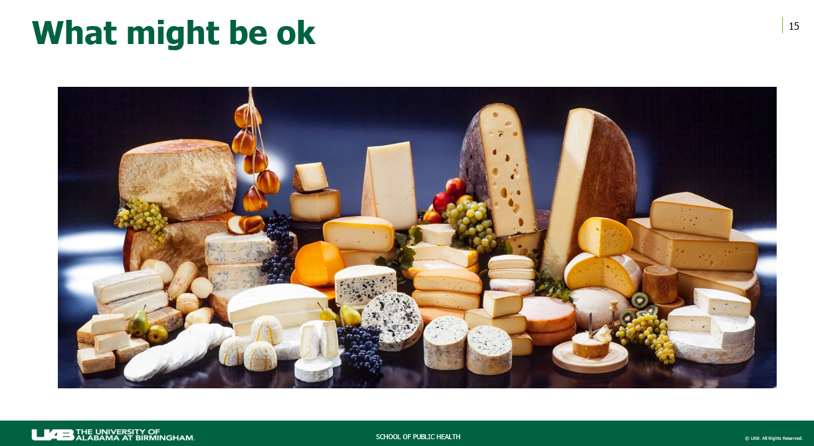
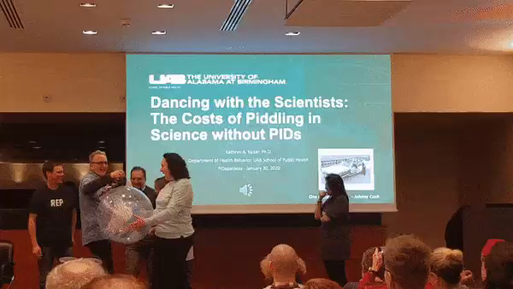
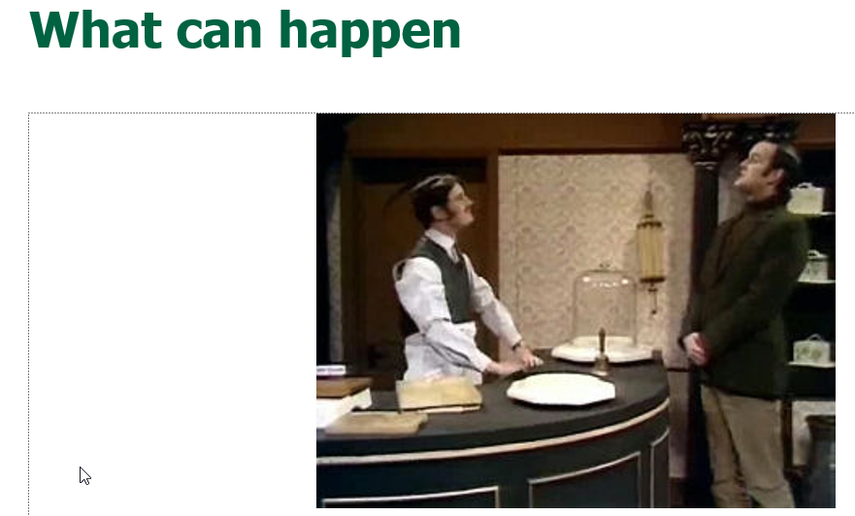

Dancing with the Scientists: The Costs of Piddling in Science without PIDs
K. Kaiser, University of Alabama at Birmingham https://doi.org/10.5281/zenodo.3631989
Notes:
Poul

Slide 8
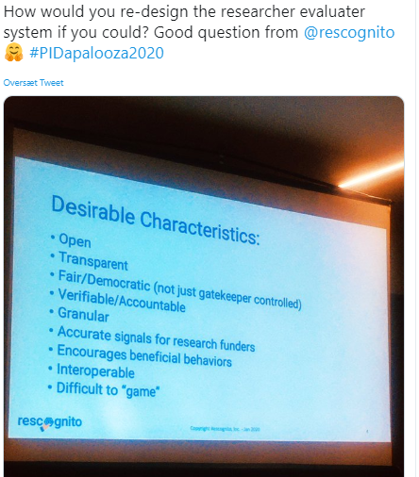
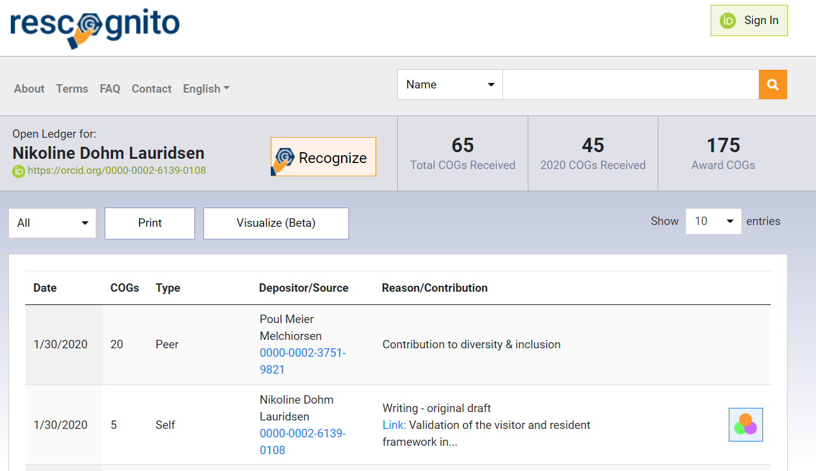
rescognito.com
An open environment where researchers and research professionals are recognized for a wide range of behaviors and contributions that benefit the Open Research ecosystem.
Notes:
Nikoline

Slide 9
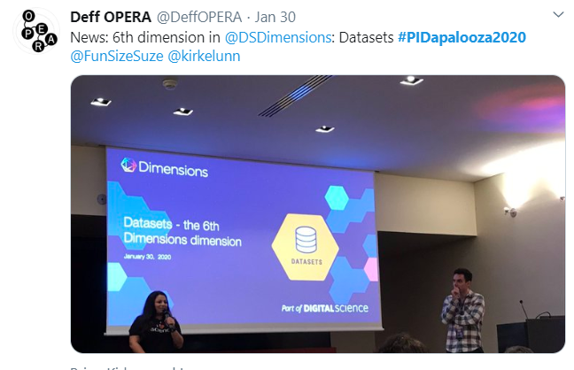
6th dimension in Dimensions - Datasets
Notes:
Poul

Slide 10
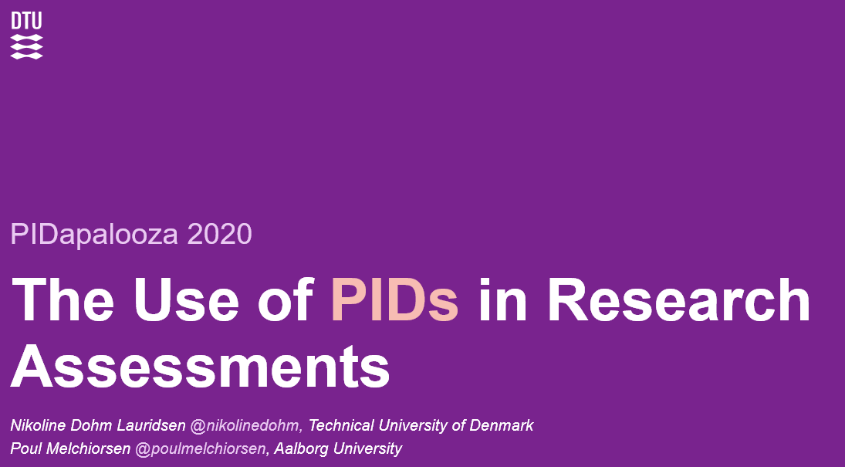
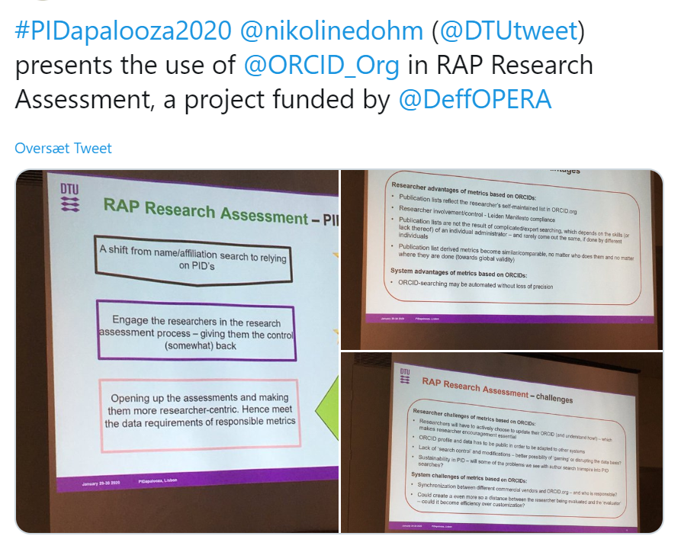
The Use of PIDs in Research Assessments
Nikoline Dohm Lauridsen, DTU
Poul Melchiorsen, AAU
https://doi.org/10.5281/zenodo.3632355
Notes:
Nikoline

Slide 11
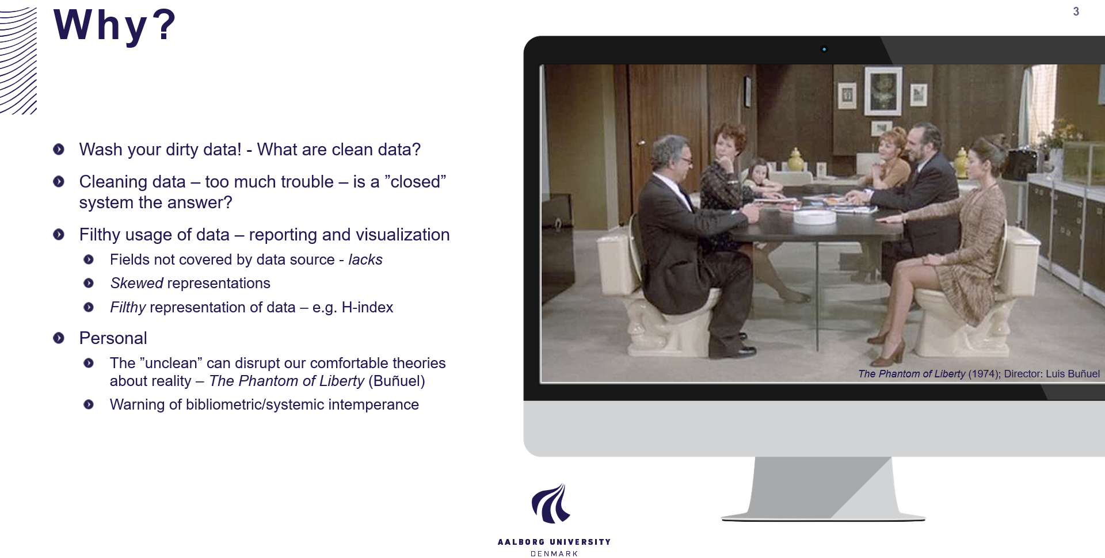
Dirty PIDs – Let’s Roll in the Mud
Poul Melchiorsen, AAU
Nikoline Dohm Lauridsen, DTU
https://doi.org/10.5281/zenodo.3628310
Notes:
Poul

Slide 12
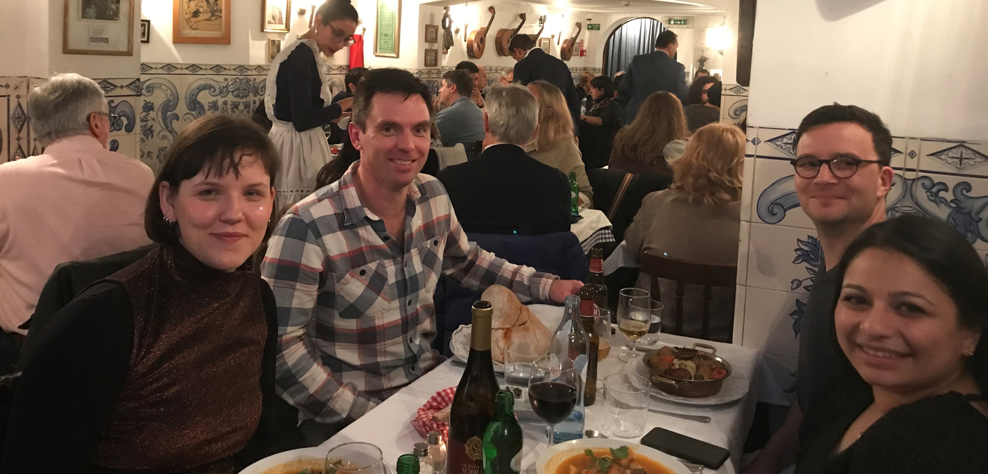
Notes:
Poul

Slide 13
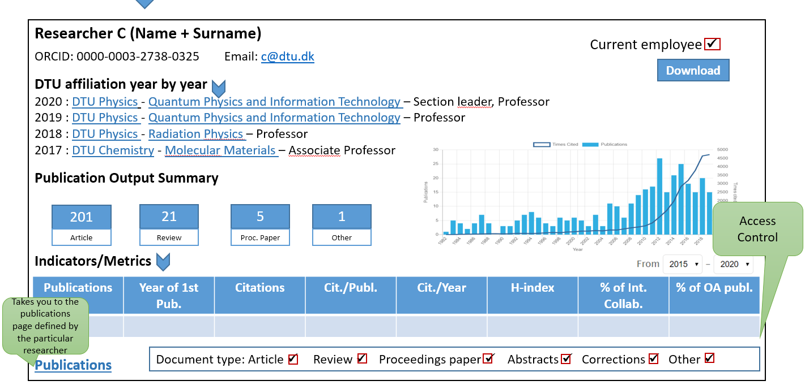
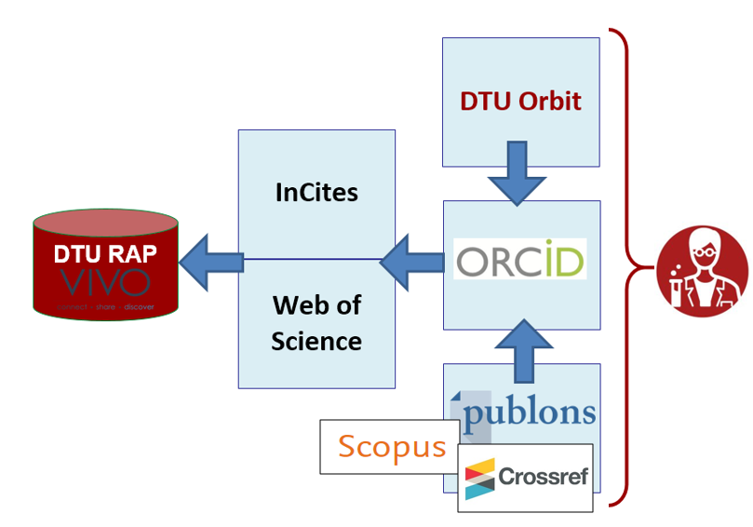
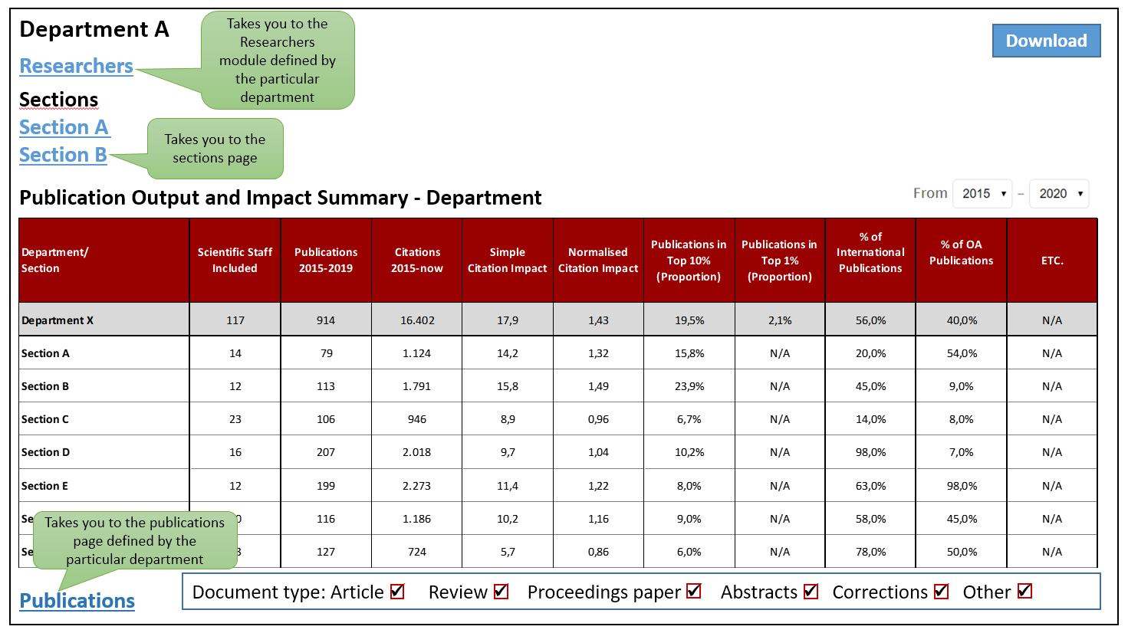
The Use of PIDs in Research Assesments
Notes:
Nikoline

Slide 14
Research Assessments Today
Research assessment at universities is often a combination of quantitative analytical metrics and qualitative judgement by scientific peers.
To generate and communicate such metrics well is quite a task – very human resource intensive.
For example
At DTU, we only generate certain in-depth metrics for researchers, their groups and departments, every five years – when a department is up for research assessment by international expert peers of its field.
Based on data from closed and comercial vendors
Based on advanced but very static author/ affiliation searches
Hierarchical approach – management checks publication lists
DISCLAIMER
From the perspective of a technical university
Notes:
The assessment of research outputs and impacts is a core contribution to many planning and decision processes in universities. However these assessment are often characterized by closedness and little involvement by the actual researchers being assessed.

Slide 15
Responsible Research Assessments – it starts with data!
Be open and transparent by providing data and methods used to calculate all metrics
DORA, San Francisco Declaration on Research Assessment
The range of data sources and indicators available to practitioners are constantly changing (…)
Introducing SCOPE – a process for evaluating responsiby (The Bibliomagician)
Data sources should be clearly understood, accurate, up to date and have sufficient coverage for the purpose intended
Principle for the use of indicators in research assessment and management, St. Andrews University
Allow those evaluated to verify data and analysis
Leiden Manifesto for Research Metrics, Principle 5
How underlying data are collected and processed – and the extent to which they remain open to interrogation – is crucial.
The Metric Tide

Slide 16
RAP Research Assessment – motivation
A shift from name/affiliation search to relying on PID’s
A shift from a very human resource intensive task, to a more automated one
Engage the researchers in the research assessment process – giving them the control (somewhat) back
Making research assessment more flexible and hereby meeting the different needs of various scopes and stakeholders
Opening up the assessments and making them more researcher-centric. Hence meet the data requirements of responsible metrics
A more sustainable approach to research assessments also allocates resources to meet other perspectives of research assessment and impact

Slide 17


RAP Research Assessment – PID motivation
A shift from name/affiliation search to relying on PID’s
Engage the researchers in the research assessment process – giving them the control (somewhat) back
    Bottom-up approach
      → from affiliations to individuals
    Relying on PID’s
      → ORCID-based
Opening up the assessments and making them more researcher-centric. Hence meet the data requirements of responsible metrics
Notes:
To do such metrics well, you must build them bottom-up
From publication lists of individual researchers
Author name challenge
Adding knowledge of the university’s research organization
Challenge of organizational dynamics
To do such metrics with integrity, you must comply with the Leiden Manifesto
Principle 5: Allow those evaluated to verify data and analysis

Slide 18


Dynamic Research Assessments – bottom up data?
A University Research Analytics Platform
Creating an assessment module where the researcher is involved more directly
To do assessment metrics well, you must build them bottom-up
  From publication lists of individual researchers
    Author identity challenge
  Adding knowledge of the university’s research organization
    Organizational dynamics challenge
To do such metrics with integrity, you must comply with the Leiden Manifesto
  Principle 5: Allow those evaluated to verify data and analysis
➔ Here’s what we’re planning for the next year
Notes:
Data – Web of Science (could be other citation databases (but mainly used at DTU)
ORCID – Why this researcher ID? Because it is well integrated with all other relevant systems (Pure, Scopus, Crossref, etc. )
What is VIVO?: – An Open Source Software/Frame work for research discovery and analysis

Slide 19


RAP Research Assessment – setup
Single
Researcher
Info & Indicators
Single
Researcher
Publication
List
Research Group
Info & Indicators
Depart. Section
Info & Indicators
Depart-ment
Info & Indicators
Univer-
sity
Info & Indicators
5
Pull indicators from InCites using WoS IDs
4
Pull researcher affiliations from staff base/CRIS system
3
Pull publications from WoS using ORCIDs
2
Pull researcher ORCIDs from staff base/CRIS system
1
Notes:
The Concept (with DTU as a ‘case-uni and WoS as a case data set)
Pull ORCID + affiliation data from local systems
Pull publications from WoS using the ORCIDS pulled from 1)
Pull indicators from InCites using the publications from 2)

Slide 20
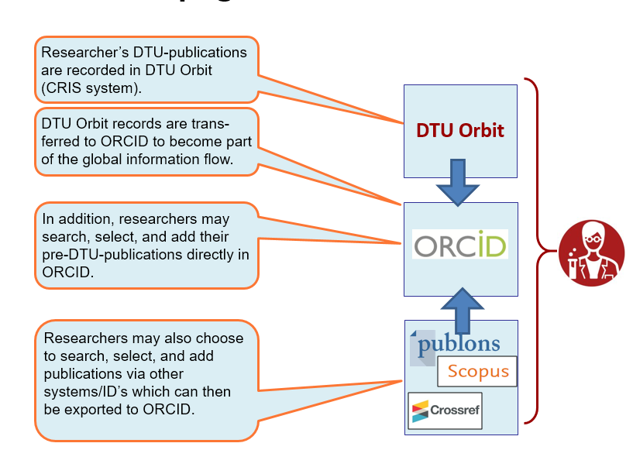
RAP Research Assessment – setup (ORCID)
5
Pull indicators from InCites using WoS IDs
4
Pull researcher affiliations from staff base/CRIS system
3
Pull publications from WoS using ORCIDs
2
Pull researcher ORCIDs from staff base/CRIS system
1

Slide 21
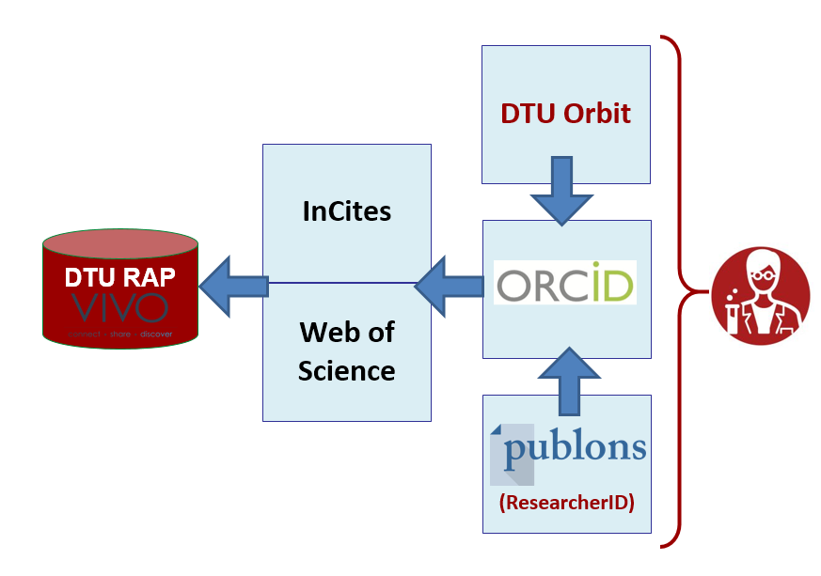


RAP Research Assessment – setup (ORCID)
5
Pull indicators from InCites using WoS IDs
4
Pull researcher affiliations from staff base/CRIS system
3
Pull publications from WoS using ORCIDs
2
Pull researcher ORCIDs from staff base/CRIS system
1

Slide 22
RAP Research Assessment – where are we now?
1st test on selected departments:
ORCID – coverage in Web of Science
ORCID – identification and grouping of possible issues
2nd test looking in to indicators from InCites/API options
Load data and see how we can work with the data in the RAP Assessment system
Test of ORCID search via WoS API vs. manual search in WoS
Publication Year: | All Years
Organization-Enhanced: | All Organizations
Overview Tab:
Creates an overview of the total no. of publications, citations and (if possible) h-index per ORCID requested.
OI=ORCID
ORCID Tabs:
Each 'ORCID Tab' represents a publication list found via the API for each ORCID represented in the 'Overview Tab'.
AU=Authors
TI=Title
SO=Source (journal title)
DT=Document Type
C1=Adress
OI=ORCID
TC=Times Cited (in WoS Core Collection)
PY=Publication Year
DI=DOI
UT=Accession Number

Slide 23

RAP Research Assessment – where are we now?
1st test on selected departments:
ORCID – coverage in Web of Science
ORCID – identification and grouping of possible issues
2nd test looking in to indicators from InCites/API options
Load data and see how we can work with the data in the RAP Assessment system
Test of ORCID search via WoS API vs. manual search in WoS
Publication Year: | All Years
Organization-Enhanced: | All Organizations
Overview Tab:
Creates an overview of the total no. of publications, citations and (if possible) h-index per ORCID requested.
OI=ORCID
ORCID Tabs:
Each 'ORCID Tab' represents a publication list found via the API for each ORCID represented in the 'Overview Tab'.
AU=Authors
TI=Title
SO=Source (journal title)
DT=Document Type
C1=Adress
OI=ORCID
TC=Times Cited (in WoS Core Collection)
PY=Publication Year
DI=DOI
UT=Accession Number
Results when looking at the departments being evaluated in 2019:
Retrieving a researcher’s publications using ORCID gives the same result using the Web of Science UI as the Web of Science API.
ORCID searches using the Web of Science API covers approx. 90% of the publication found by using advanced name- and affiliation searches in the Web of Science UI
Most missing results is because an ORCID profile is empty or incomplete (researcher motivation is important!)
Synchronization issues between ORCID→Web of Science is often because of poor metadata in ORCID or bad title match between the two systems

Slide 24
RAP Research Assessment – advantages
Researcher advantages of metrics based on ORCIDs:
Publication lists reflect the researcher’s self-maintained list in ORCID.org
Researcher involvement/control - Leiden Manifesto compliance
Publication lists are not the result of complicated/expert searching, which depends on the skills (or lack thereof) of an individual administrator – and rarely come out the same, if done by different individuals
Publication list derived metrics become similar/comparable, no matter who does them and no matter where they are done (towards global validity)
System advantages of metrics based on ORCIDs:
ORCID-searching may be automated without loss of precision

Slide 25
RAP Research Assessment – challenges
Researcher challenges of metrics based on ORCIDs:
Researchers will have to actively choose to update their ORCID (and understand how!) – which makes researcher encouragement essential
ORCID profile and data has to be public in order to be adapted to other systems
Lack of ‘search control’ and modifications – better possibility of ‘gaming’ or disrupting the data basis?
Sustainability in PID – will some of the problems we see with author search transpire into PID searches?
System challenges of metrics based on ORCIDs:
Synchronization between different commercial vendors and ORCID.org – and who is responsible?
Could create a even more so a distance between the researcher being evaluated and the ‘evaluator’ – could it become efficiency over customization?
Notes:
– is it easier to game the PIDs?

Slide 26
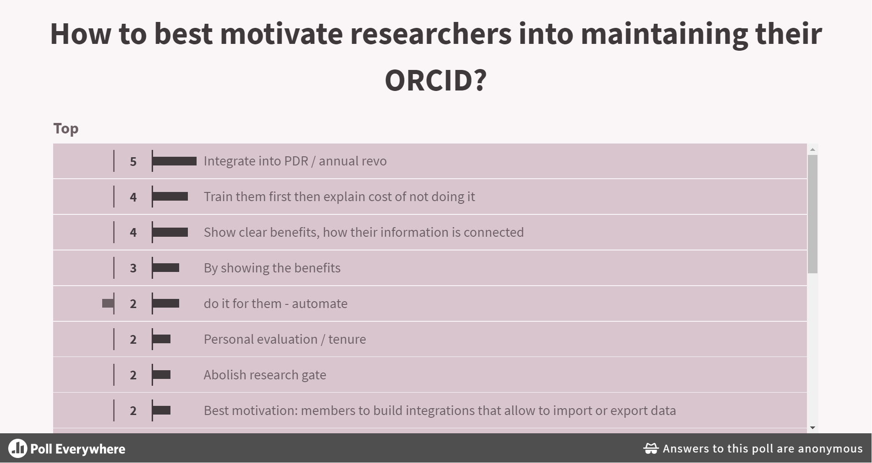
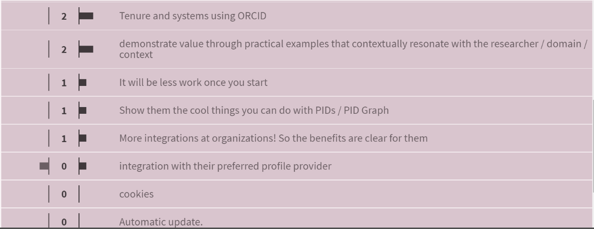
Notes:
Poll Title: How to best motivate researchers into maintaining ORCID?
https://www.polleverywhere.com/discourses/DvQDwg8LzSMQ9TMmaG17k

Slide 27
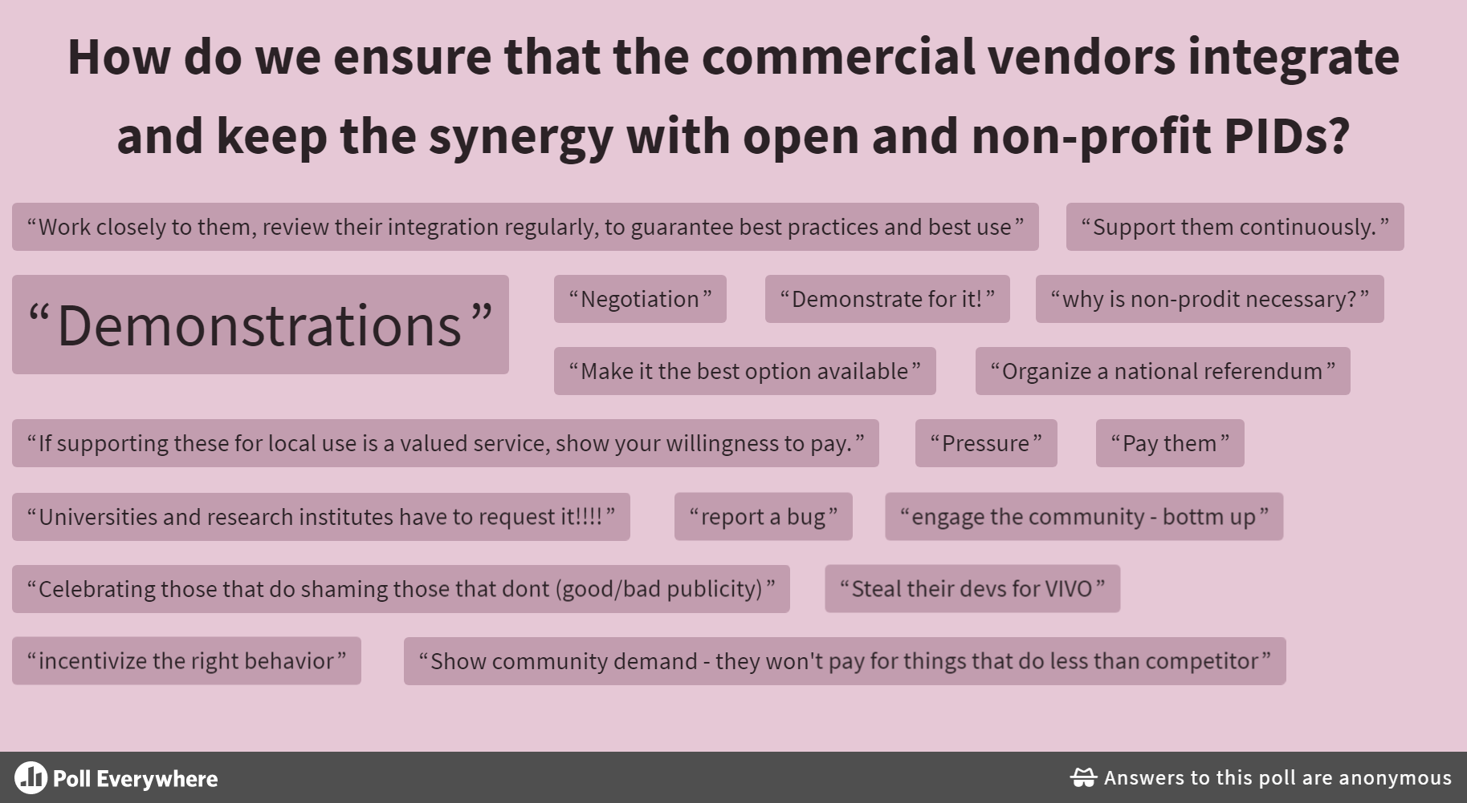
Notes:
Poul: Husk HUM og SAMF!

Slide 28
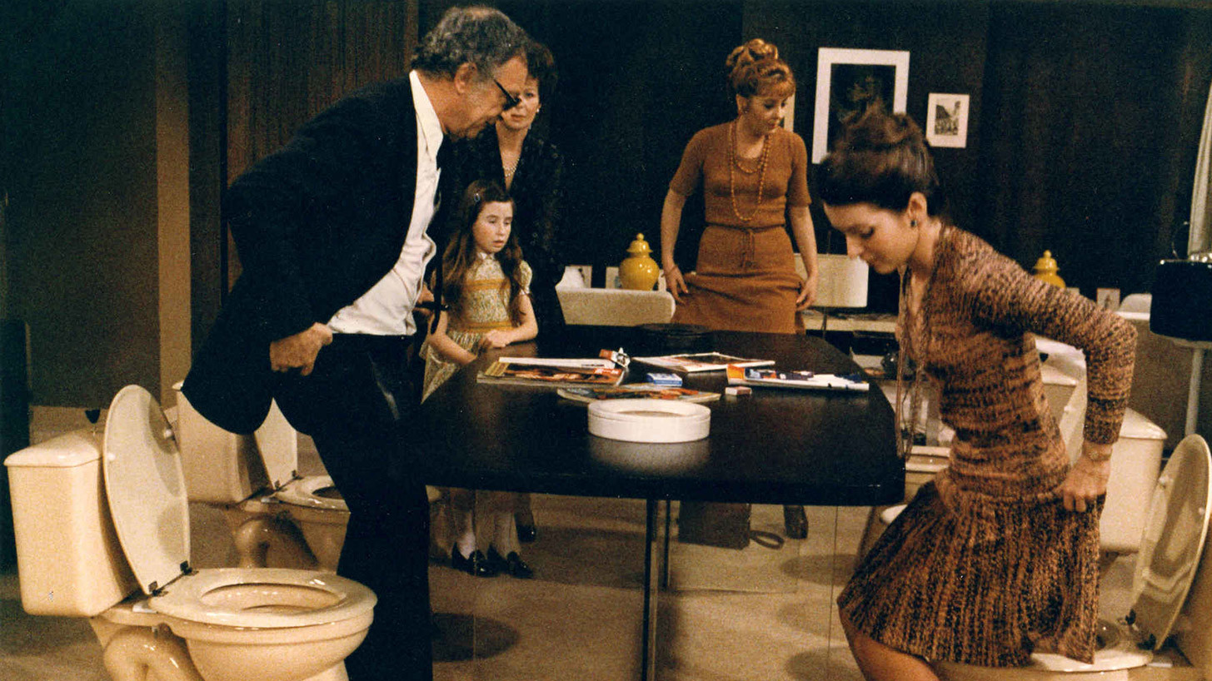
Dirty PIDs – Let’s Roll in the Mud
Notes:
Poul

Slide 29

Theory of Abjection – The Discarded/Refused
Anthropological tradition – revelation through relativity. In short, some concepts are relative to culture and therefore must have another, deeper description
Dirt is not an essential characteristic of objects
Dirt depends on power relations (forbidden)
Kristeva: Conceptualization of the world - everything is not presented in the meaningful system – our cultural world:
The other/the abject/that which disgusts us/the taboo/prohibition to touch (Freud)… and the holy (fear and love)
Conclusion: Dirt is rejected… …!
Julia Kristeva: The Powers of Horror (1982)
This Photo by Unknown Author is licensed under CC BY

Slide 30
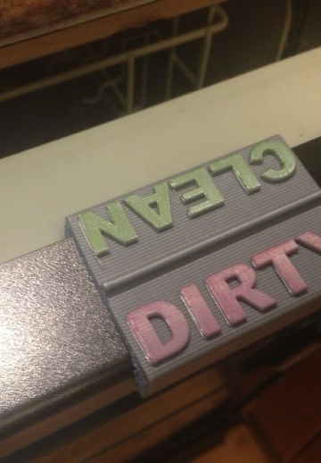
Dirty and clean – distinctions (Lagerspetz)
Master and additive/host and contact item
  something is added to the host
  quality of the underlying object is diminished (‘messy’, ‘damaged’, ‘wet’)
Cleaning – uncover underlying form
  the master is valuable
  dirt ruins and pollutes the dirty object
  care for the dirty item (implies understanding of the teleologies of the item)
Distance seems important
  How to polish an atom or a galaxy? – Who is in charge?
  Condition of dirt: responsiblity
Conclusions
  dirt gets its meaning in relation to its host
  dirt defined teleologically (ex dirty CD cannot fulfill its goal), ‘needs to be cleaned – worth cleaning’
  clean/dirty always tied up with context (ex teacup – real change)
Olli Lagerspetz: A Philosophy of Dirt (2018)
This Photo by Unknown Author is licensed under CC BY

Slide 31
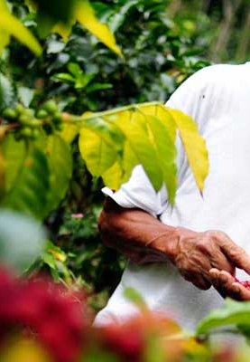
Lagerspetz concludes: Stewardship of objects
Our relations to objects are determined by care and responsibility – ‘needs cleaning’ presupposing care and responsibility
The distinction between clean and dirty presupposes a world of culture, a world where we are in charge
Human cleanliness expresses the idea of a responsible relation towards the environment
This Photo by Unknown Author is licensed under CC BY-SA

Slide 32

Dirty Data – what have we learnt?
Data stewardship
We have an eye for dirt – we care and feel responsible
Distance
Through a system (ex: SciVal) – data may be clean, but when you get closer, you may find dirt. Details are often messy.
Contextuality
Cleaning data is many things. Great care and responsibility is necessary in order to spot the right ways to clean the data.
Ex: ORCID contains ‘versions’ or ‘duplicates’
Host and additive
Ex: A tree may not be dirty as such, but if a girl climbs the three in her Sunday best, the tree may be dirty and soil the girl’s dress.
Data may be nice and clean – but when they are used for evaluating research throughout a university, they may be messing up research evaluation at that university!
This Photo by Unknown Author is licensed under CC BY

Slide 33
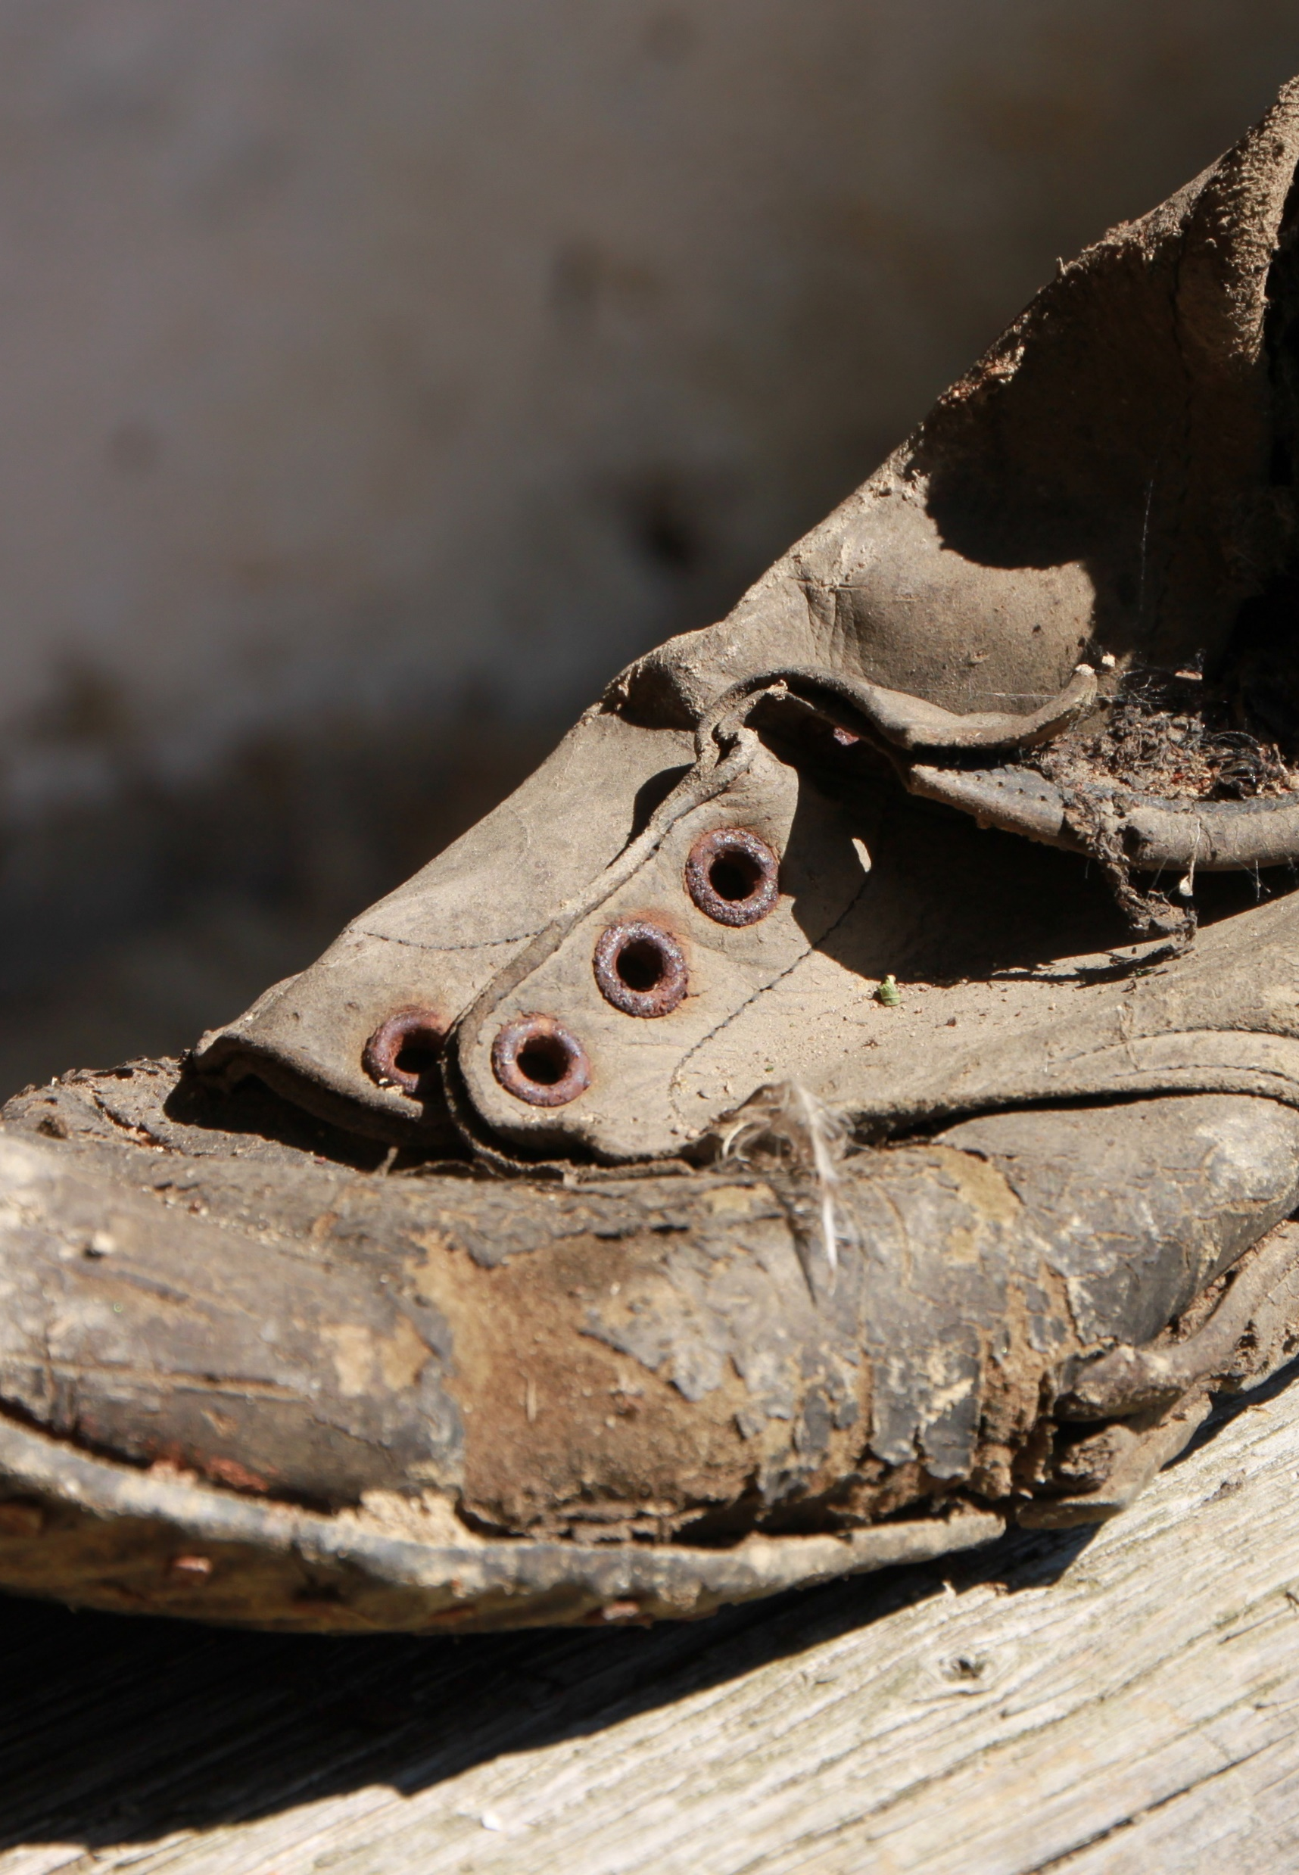
Dirt is not nothing
Imagine unspoiled nature: Rocks, decaying leaves, grass, clay… Is the mud that ruins my shoe dirty? If it is, was it so before I came there? One is tempted to say that human presence makes the ground dirty.
That may be a weird conclusion and Lagerspetz says:
“The crucial change, I suggest, consists of the introduction of possible questions that would have no application in conditions of untouched nature – for example, ‘Can I walk here without ruining my shoes?’” (teleological change)
Olli Lagerspetz: A Philosophy of Dirt (2018)

Slide 34
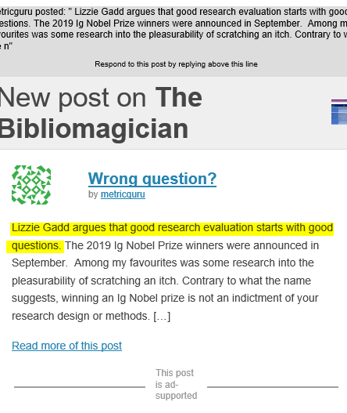
Dirty data is not nothing
Research administrators, evaluators, developers, bibliometricians, PID system suppliers and much more… use data. When we want to use specific data, we may experience dirtiness in the data.
Were the data dirty before the context of use?
Maybe not important. What is important is the questions that now have application.
We should ask the right ones.
In what context should the data be used, and how should they be cleaned or supplemented to make up for messiness?

Slide 35

Three examples of trying to clean up skewed/messy/dirty representations of science
OPEn Research Analytics (OPERA): https://deffopera.dk
REsponsible impACT (ReAct) - taxononmy:
https://www.communication.aau.dk/research/Research+Projects/react/
ORCID Academia & Beyond Task Force: https://orcid.org/content/academia-beyond-task-force
This Photo by Unknown Author is licensed under CC BY-SA-NC
Notes:
Nikoline:
Nu er vi ved at forsøge at lave noget ved DTU hvor vi gør rent i vores data – kan I ikke bare gøre det samme hos jer?

