Slide 1

European Data Policies:
Current Practice, Future Development
Kevin Ashley
Digital Curation Centre
www.dcc.ac.uk
@kevingashley
Kevin.ashley@ed.ac.uk
Original reports by Martin Donnelly, Joy Davidson, Thordis Sveinsdottir and other staff at the
Digital Curation Centre
The DCC is supported by the University of Edinburgh, the European Commission H2020 programme and other income sources
Reusable with attribution: CC-BY

Slide 2
Some background
DCC has been conducting funder policy analysis for over 10 years
For the last 4 years, we’ve been working with SPARC Europe to monitor national data policy in Europe
This presentation updates one I did in 2017 on our first report – now on our 4th update

Slide 3
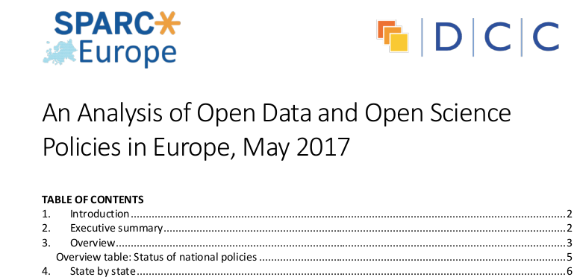
The report
V4, August 2019
Released May 2017
Complete listing
Grouping – using policy & intention
Comparison of those with policies
Focus is national, not funder, policy

Slide 4
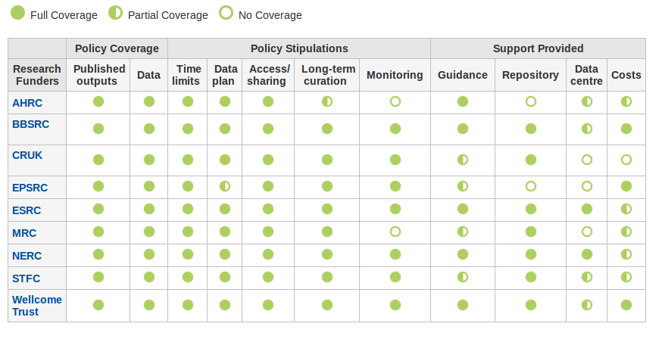

Context
Builds on DCC monitoring of funder policies – as standalone service & to support DMPOnline™
Part of 3-year agreement with SPARC-Europe
Some fully-commissioned work, some co-funded
Includes briefing papers such as “The open data citation advantage”
Last work like this was in 2013 – much has changed since
Other work either looked at government data or open access publication

Slide 5
The making
Began with listing & description of policies – EU + some ERA states (Iceland, Norway, Switzerland,…)
Not all policies available in accessible (to us) languages
  Local contacts assisted
  Two (Estonia & Cyprus) available in English as a direct result
Next step was analysis, grouping
Criterion for inclusion – ‘significant state-funded research activity’

Slide 6
Findings
‘Policies’ have many forms – roadmaps, laws, concordats, Codes, funder policies
11 EU member states have national policy relating to research data
  ERA: 2 have policy, 1 (Iceland) has active plans
9 more have known plans or intentions
Primarily driven by research funders

Slide 7
Findings – policy age
Policy Exists | Work underway | No policy & no known work
BE, CY, DK, EE, FR, FI, DE, LT, NL, PT, UK, NO, CH | AT,BG,HR, IE, IT, PL, SI, ES, SE, IS | CZ, EL, HU, LV, LU, MT, RO, SK,
Mainly new – only 2 pre-date 2014
Open public data policies often precede these
Later policies influenced by earlier ones – H2020 & UK particularly
Policy Exists | Work underway | No policy & no known work
AT, BE, CY, CZ, DK, FR, FI, DE, LT, NL, PT, SI, ES, UK, NO, CH, IS, RS | BG,EE, GR, HR, IE, IT, LU, PL, RO, SK, SE | LV

Slide 8
More findings
Roughly 50% also cover open access/open science; others are data-specific
Small majority are prescriptive/imperative
Monitoring of compliance, penalties not yet common
Ethical research policies often key – Belgian example is illustrative
Much more in the report….
Prescriptive | Advisory
FI, FR, DE, LT, UK, CH, BE, DK, EE | CY, NL, PT, NO,

Slide 9
Changes over time
2017 2019
11 EC national policies
2 ERA policies
9 more countries with activity or declared intentions
14 EC national policies
4 ERA policies
14 more countries with activity or declared intentions
1 EC member state with no national policy & no known plan to have one.

Slide 10
Next steps
Further work with SPARC Europe
  Some case studies in 2017 & 2018
  We updated report 4 more times
Some more detailed work with ERC
  National policy on research products
  Focussed on ERC researchers
Related work in context of H2020 FAIR’s FAIR project
Engagement with funders
  remove needless difference
  bring all to the standard of the best?

