Slide 1
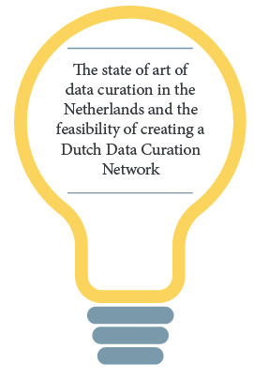
INVESTIGATING A DUTCH DATA
CURATION NETWORK
IDCC 2020, Dublin
Mijke Jetten, PhD (Radboud University Library)
https://orcid.org/0000-0001-9114-2896
With cooperation of
Inge Slouwerhof, Christina Elsenga, Boudewijn van den Berg, Nynke de Groot,
Marcel Ras, Marjan Grootveld, Richard Visscher, Lena Karvovskaya,
Madeleine de Smaele & Ingeborg Verheul
The Netherlands

Slide 2
Background
Following a US initiative, in 2019, a Dutch task group investigated the interest, necessity and feasibility of a Data Curation Network in the Netherlands
The task group focused on the following activities
Use the US Data Curation Network CURATE(D) model to make an inventory of data curation practices in the Netherlands
Carry out a survey among Dutch organisations involved in data curation, via the National Coordination Point Research Data Management (LCRDM)
Report: https://doi.org/10.5281/zenodo.3466632

Slide 3
The CURATE(D) model
Conclusions on the CURATE(D) model for the Netherlands
With minor adjustments, the CURATE(D) model proves to be useful as an assessment model for Dutch data curation practices
Having organisations (n=10) describe their practices in terms of the CURATE(D) model, results in a rich, diverse overview that can well serve as good practice or use case study
It’s a bit early for standardisation of data curation practices in the Netherlands, as many organisations are just starting to formalise workflows and procedures

Slide 4
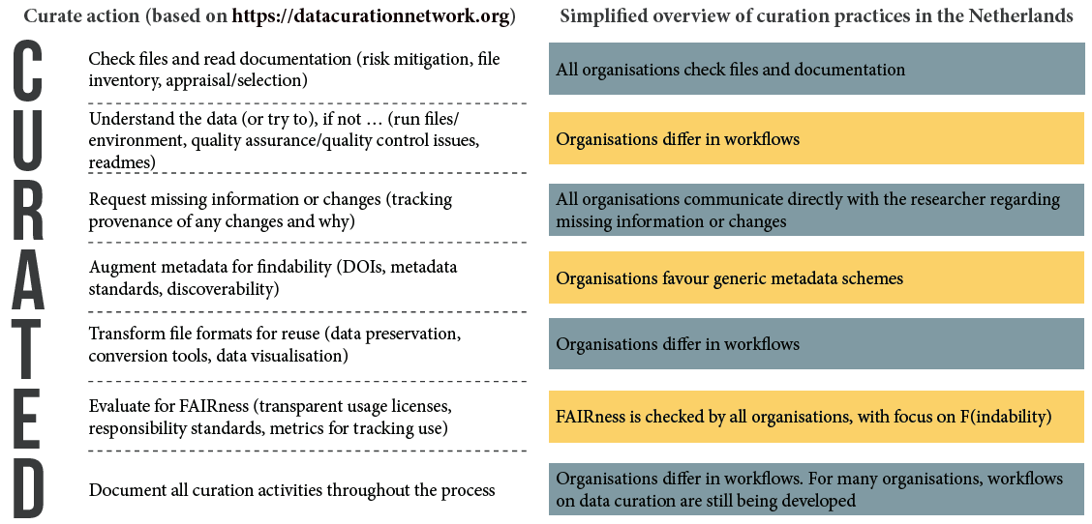
The CURATE(D) model

Slide 5
Curation survey (n=98)
Conclusions on curation in the Netherlands
Based on the survey, three main challenges in data curation in the Netherlands were identified: what’s in it for me, procedures and quality (of for instance metadata)
Creating a Dutch Data Curation Network is said to be beneficial for three main reasons: reuse guidance, create guidance and good practices
Clear guidelines may be considered a prerequisite for benchmarking and training researchers, as these two benefits were ranked lower

Slide 6
Recommendations
Recommendations on investigating a Data Curation Network in the Netherlands
Initiate a Dutch Data Curation Network (with goals, stakeholders & challenges)
Explore the further use of the CURATE(D) model
(as framework for training, shared guidance, and standardisation)
Create an overview of current curation practices of Dutch organisations
(at the LCRDM website)
The overview could serve as a good practice for Dutch organisations to professionalise data curation (incl. benchmarking)
For individual organisations: exchange experiences, initiatives and efforts taken in data curation, and become (stay) involved in national initiatives on data curation

Slide 7
INVESTIGATING A DUTCH DATA
CURATION NETWORK
QUESTIONS?
Check out Zenodo
https://doi.org/10.5281/zenodo.3466632
Connect to me via
m.jetten@ubn.ru.nl

