Slide 1



A good TACTIC for lexicographical work: football terms encoded in TEI Lex-0
Ana Salgado & Rute Costa
NOVA CLUNL, Faculdade de Ciências Sociais e Humanas, Universidade NOVA de Lisboa
Lisboa, Portugal
anasalgado@campus.fcsh.unl.pt
rute.costa@fcsh.unl.pt

Slide 2




Acknowledgements
This research has been financed by:
Portuguese National Funding through the FCT – Fundação para a Ciência e Tecnologia as part of the project Centro de Linguística da Universidade NOVA de Lisboa - UID/LIN/03213/2019
European Union’s Horizon 2020 research and innovation programme under grant agreement No 731015 (ELEXIS)
Salgado & Costa – TOTH Conference 2019

Slide 3

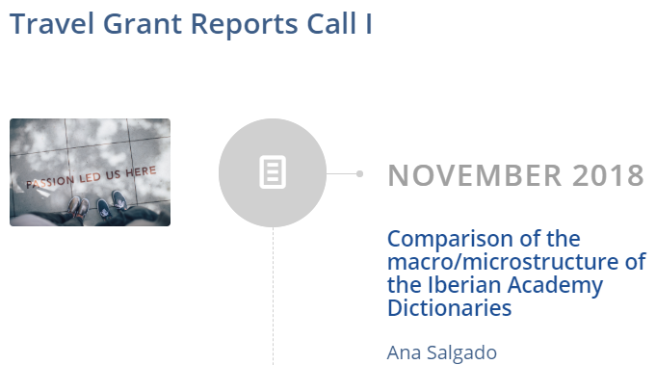





TEI Training
Encoding Dictionaries with
TEI – Toma Tasovac
Comparison of the macro/microstructure of the Iberian Academy Dictionaries
Converting the Academy of Sciences Portuguese Dictionary to TEI Lex-0
XML-TEI document encoding, structuring, rendering and transformation
Salgado & Costa – TOTH Conference 2019

Slide 4
Outline
Tactic project: aims
Lexicographic corpus
Football: domain under analysis
Methodology
TEI – Text Encoding Initiative & TEI Lex-0
Conclusions and future work
Salgado & Costa – TOTH Conference 2019

Slide 5

TACTIC project: aims
The aim of the project is threefold:
to design a method to include terms in a language dictionary in order to systematize the information regarding a single domain;
to apply and test the later version of the TEI Lex-0 guidelines;
to contribute to the work developed by the DARIAH-ERIC Lexical Resources group.
Salgado & Costa – TOTH Conference 2019

Slide 6
Lexicography and Terminology
The importance of the terminology method to undertake lexicographic work
In the domain under analysis, the conceptual organization allows:
  Enhanced dictionary consistency
  Increased lexicographer’s productivity
Expert validation – Federação Portuguesa de Futebol
Salgado & Costa – TOTH Conference 2019

Slide 7
Lexicographic corpus
Portuguese | Spanish | French
Salgado & Costa – TOTH Conference 2019

Slide 8
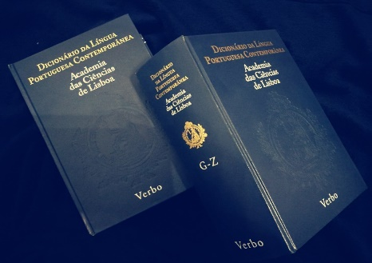
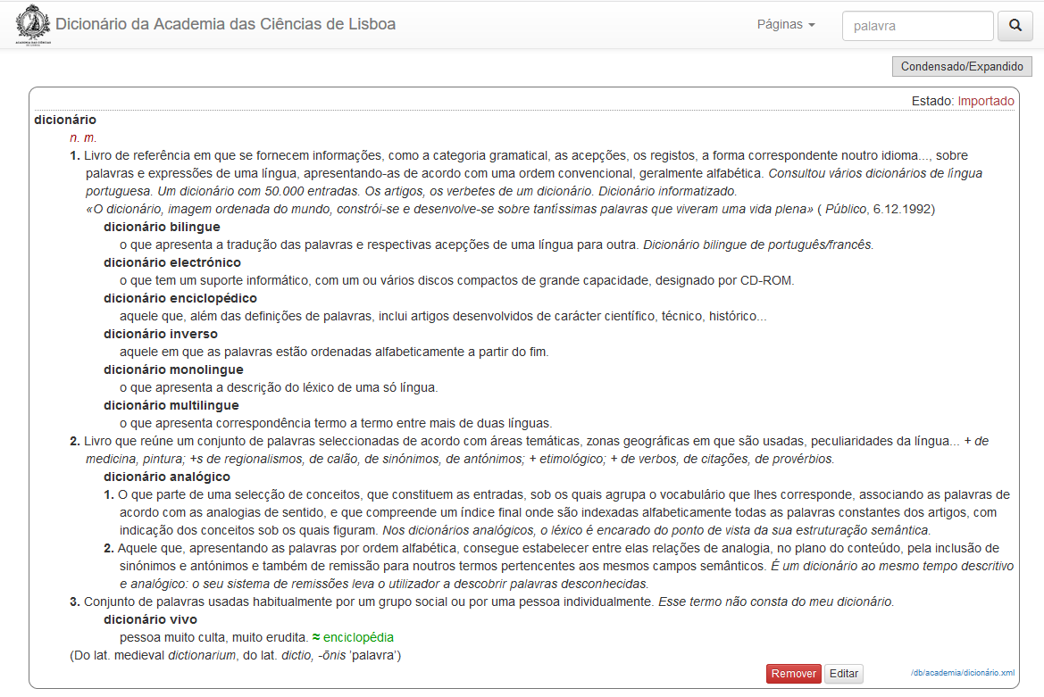
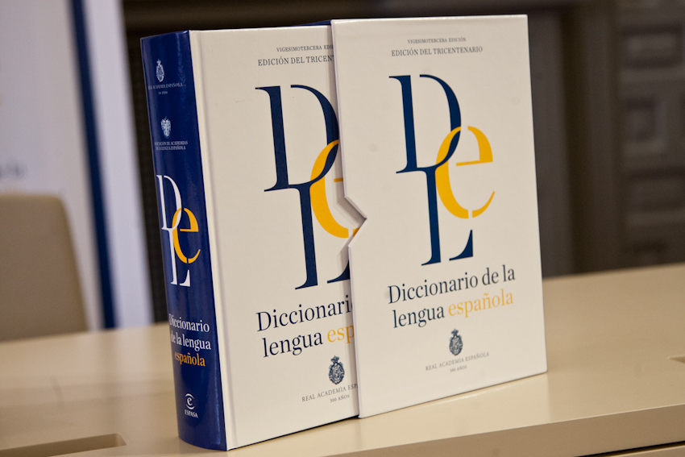
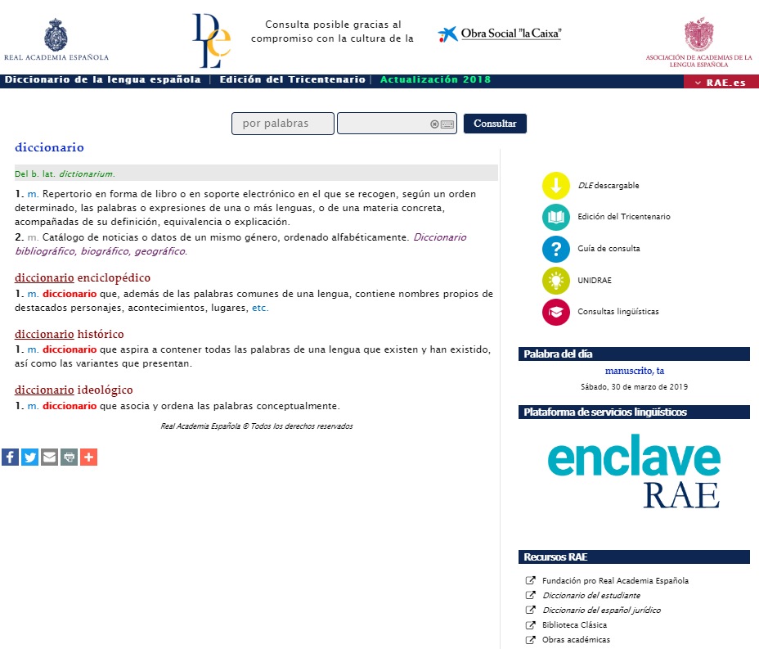
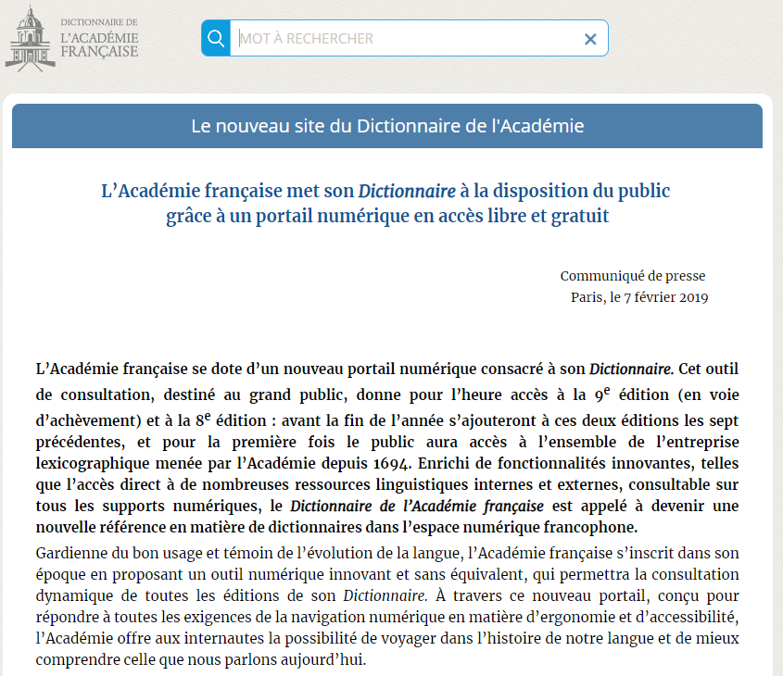
Lexicographic corpus
Portuguese
Paper version
Online version
Spanish
Paper version
Online version
French
Online version
Salgado & Costa – TOTH Conference 2019

Slide 9
Portuguese Academy Dictionary
69 426 entries, 167 556 senses
Salgado & Costa – TOTH Conference 2019

Slide 10
Lexicographic corpus
Portuguese
Paper version
Online version
Spanish
Paper version
Online version
French
Online version
Salgado & Costa – TOTH Conference 2019

Slide 11
Spanish Academy Dictionary
95 410 entries, 198 176 senses
Salgado & Costa – TOTH Conference 2019

Slide 12
Lexicographic corpus
Portuguese
Paper version
Online version
Spanish
Paper version
Online version
French
Online version
Salgado & Costa – TOTH Conference 2019

Slide 13
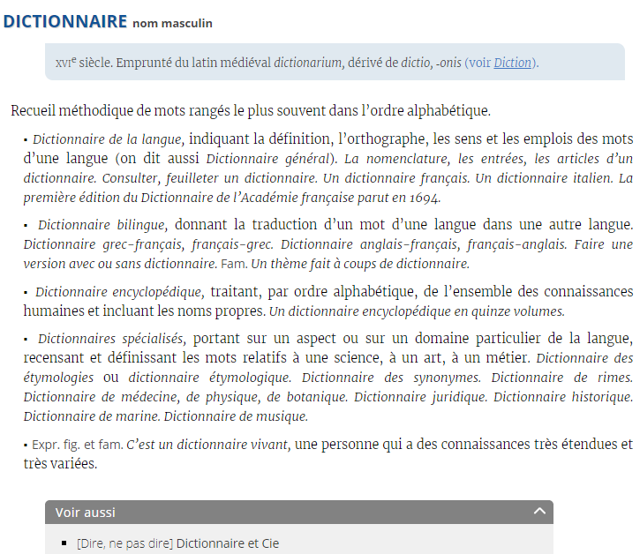
French Academy Dictionary
44 000 entries (from letters A to S)
Salgado & Costa – TOTH Conference 2019

Slide 14
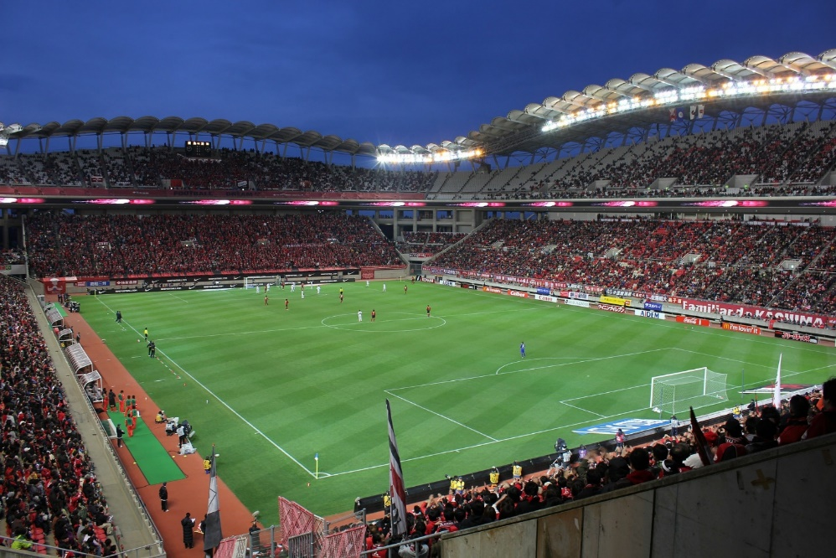
Football: domain
A “popularized” domain
Many football terms are also words in general language
Salgado & Costa – TOTH Conference 2019

Slide 15

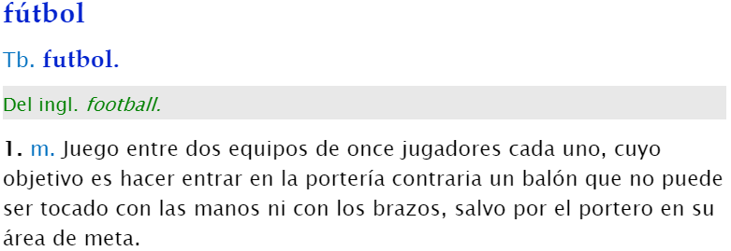
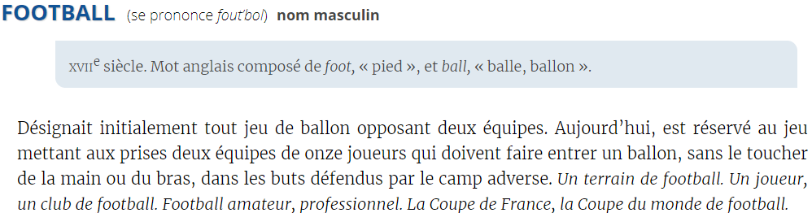
Football = 11-player football
DLPC > > > > > > >
DLE > > > > > > >
DAF > > > > > > >
Salgado & Costa – TOTH Conference 2019

Slide 16
football
Football: domain
is a
game
played between
two teams
constituted by
eleven players
that occupy
positions on the field
Salgado & Costa – TOTH Conference 2019

Slide 17
football
Football: domain
is a
game
played between
two teams
constituted by
eleven players
that occupy
positions on the field
Salgado & Costa – TOTH Conference 2019

Slide 18
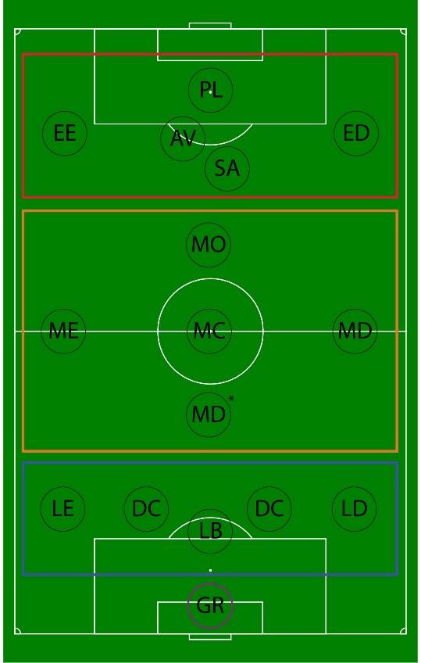
Players’ positions
Guarda-redes (goalkeeper)
GR guarda-redes (goalkeeper)
Defesa (defender)
LD lateral direito (right-back)
LE lateral esquerdo (left-back)
DC defesa central (centre-back)
LB líbero (sweeper)
meio-campo (midfielder)
MD* médio defensivo (defensive midfielder)
MD médio direito (right midfielder)
ME médio esquerdo (left midfielder)
MC médio-centro (centre midfielder)
MO médio ofensivo (attacking midfielder)
Ataque (attacker)
AV avançado (forward)
SA segundo-avançado (second striker)
PL ponta de lança (striker)
ED extremo-direito (right winger)
EE extremo-esquerdo (left winger)
Positions of football players on the field
Salgado & Costa – TOTH Conference 2019

Slide 19
Players’ positions
Guarda-redes (goalkeeper)
GR guarda-redes (goalkeeper)
Defesa (defender)
LD lateral direito (right-back)
LE lateral esquerdo (left-back)
DC defesa central (centre-back)
LB líbero (sweeper)
meio-campo (midfielder)
MD* médio defensivo (defensive midfielder)
MD médio direito (right midfielder)
ME médio esquerdo (left midfielder)
MC médio-centro (centre midfielder)
MO médio ofensivo (attacking midfielder)
Ataque (attacker)
AV avançado (forward)
SA segundo-avançado (second striker)
PL ponta de lança (striker)
ED extremo-direito (right winger)
EE extremo-esquerdo (left winger)
Positions of football players on the field
Salgado & Costa – TOTH Conference 2019

Slide 20
Players’ positions
Guarda-redes (goalkeeper)
GR guarda-redes (goalkeeper)
Defesa (defender)
LD lateral direito (right-back)
LE lateral esquerdo (left-back)
DC defesa central (centre-back)
LB líbero (sweeper)
meio-campo (midfielder)
MD* médio defensivo (defensive midfielder)
MD médio direito (right midfielder)
ME médio esquerdo (left midfielder)
MC médio-centro (centre midfielder)
MO médio ofensivo (attacking midfielder)
Ataque (attacker)
AV avançado (forward)
SA segundo-avançado (second striker)
PL ponta de lança (striker)
ED extremo-direito (right winger)
EE extremo-esquerdo (left winger)
Positions of football players on the field
Salgado & Costa – TOTH Conference 2019

Slide 21
Players’ positions
Guarda-redes (goalkeeper)
GR guarda-redes (goalkeeper)
Defesa (defender)
LD lateral direito (right-back)
LE lateral esquerdo (left-back)
DC defesa central (centre-back)
LB líbero (sweeper)
meio-campo (midfielder)
MD* médio defensivo (defensive midfielder)
MD médio direito (right midfielder)
ME médio esquerdo (left midfielder)
MC médio-centro (centre midfielder)
MO médio ofensivo (attacking midfielder)
Ataque (attacker)
AV avançado (forward)
SA segundo-avançado (second striker)
PL ponta de lança (striker)
ED extremo-direito (right winger)
EE extremo-esquerdo (left winger)
Positions of football players on the field
Salgado & Costa – TOTH Conference 2019

Slide 22
Players’ positions
Guarda-redes (goalkeeper)
GR guarda-redes (goalkeeper)
Defesa (defender)
LD lateral direito (right-back)
LE lateral esquerdo (left-back)
DC defesa central (centre-back)
LB líbero (sweeper)
meio-campo (midfielder)
MD* médio defensivo (defensive midfielder)
MD médio direito (right midfielder)
ME médio esquerdo (left midfielder)
MC médio-centro (centre midfielder)
MO médio ofensivo (attacking midfielder)
Ataque (attacker)
AV avançado (forward)
SA segundo-avançado (second striker)
PL ponta de lança (striker)
ED extremo-direito (right winger)
EE extremo-esquerdo (left winger)
Positions of football players on the field
Salgado & Costa – TOTH Conference 2019

Slide 23
Identified terms
in the trilingual
corpus for each
of the positions
Abbrev. | Portuguese | French | Spanish | English [literal translation] | DLPC | DAF | DLE
Guarda-redes (guardien de but, portero, goalkeeper)
GR | guarda-redes | gardien de but | portero | goalkeeper | ✓ | ✓ | ✓
Defesa (defense, defensa, defender)
LD | lateral direito | arrière latéral droit | lateral derecho | right-back | — | — | —
LE | lateral esquerdo | arrière latéral gauche | lateral izquierdo | left-back | — | — | —
DC | defesa central | défenseur central | defensa central | centre-back | — | — | —
LB | líbero | Libéro | líbero | sweeper | ✓ | — | ✓
meio-campo (centro del campo, milieu du terrain, midfield)
MD* | médio defensivo | milieu défensif | volante de corte | defensive midfielder | — | — | —
MD | médio direito | milieu droit | volante externo derecho | right midfielder | — | — | —
ME | médio esquerdo | milieu gauche | volante externo izquierdo | wide midfielder | — | — | —
MC | médio-centro | milieu central | volante central | centre miedfielder | — | — | —
MO | médio ofensivo | milieu offensif | volante ofensivo | attacking midfielder | — | — | —
Ataque (ataque, attaque, attack)
AV | avançado | avant | delantero | centre forward | ✓ | — | ✓
SA | segundo-avançado | deuxième avant | segundo delantero | second striker | — | — | —
PL | ponta de lança | buteur | punta | striker | ✓ | — | ✓
ED | extremo-direito | aillier droit | extremo derecho | right winger | — | — | —
EE | extremo-esquerdo | aillier gauche | extremo izquierdo | left winger | — | — | —
Salgado & Costa – TOTH Conference 2019

Slide 24
Methodology
familiarisation with the domain (football): websites, radio and television programs, expert communities.
constitution of the lexicographic corpus: 3 Academy dictionaries.
processing the lexicographic corpus: analysing the domain label concept; introductions; identification and manual collection of terms related to football and field players’ positions and analysis of their linguistic description.
tei encoding: lexicographic articles in TEI Lex-0 format with a strict description of the structural elements.
Salgado & Costa – TOTH Conference 2019

Slide 25
TEI – Text Encoding Initiative
TEI Lex-0
Salgado & Costa – TOTH Conference 2019

Slide 26
TEI – Text Encoding Initiative
TEI
Dictionary encoding
TEI is a de facto standard in digital edition or text annotation projects.
It is frequently used in Digital Humanities as the basis for a large number of current lexicographic projects.
TEI has a specific module for encoding dictionaries.
But…
TEI Guidelines contain multiple encoding possibilities for the same element.
Salgado & Costa – TOTH Conference 2019

Slide 27
TEI Lex-0
a streamlined version of the TEI Guidelines, simplified
and enhanced for regular use to improve interoperability
given its (still) non-standard nature, it can be changed in order to accommodate relevant dictionary structures
we have been participating in the TEI Lex-0 discussion during the Portuguese Academy Dictionary encoding: https://github.com/DARIAH-ERIC/lexicalresources/tree/master/Schemas/TEILex0
the advantage of applying TEI Lex-0 lies in the fact that lexicographers and terminologists are currently making efforts to apply TEI to the ongoing revision of ISO LMF (Romary, 2015)
TEI Lex-0
TEI Lex-0 will not replace the Dictionaries Chapter in the TEI Guidelines.
It is being discussed as a target format that will standardize the existing heterogeneously encoded lexical resources.
Salgado & Costa – TOTH Conference 2019

Slide 28

Aims and objectives
to present arguments
in favour of using TEI Lex-0 dictionary encoding
HOW?
1) analysing and comparing the terms used to identify the players’ positions on the football field:
Dicionário da Língua Portuguesa Contemporânea (DLPC), ACL
Diccionario de la lengua española (DLE), RAE
Dictionnaire de l’Académie Française (DAF), DAF
2) presenting a consistent encoding and description of the microstructural elements of lexicographic entries, exemplifying the representation of lexicographic content using the term “defesa” (defence)
Salgado & Costa – TOTH Conference 2019

Slide 29
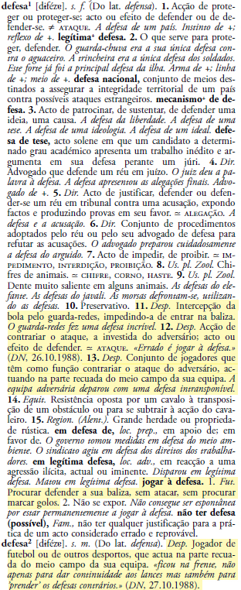
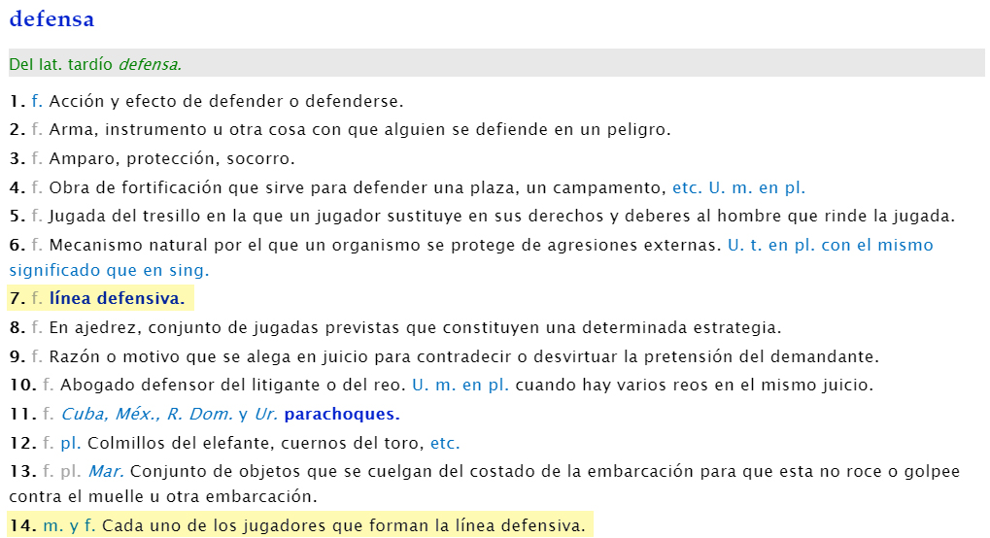
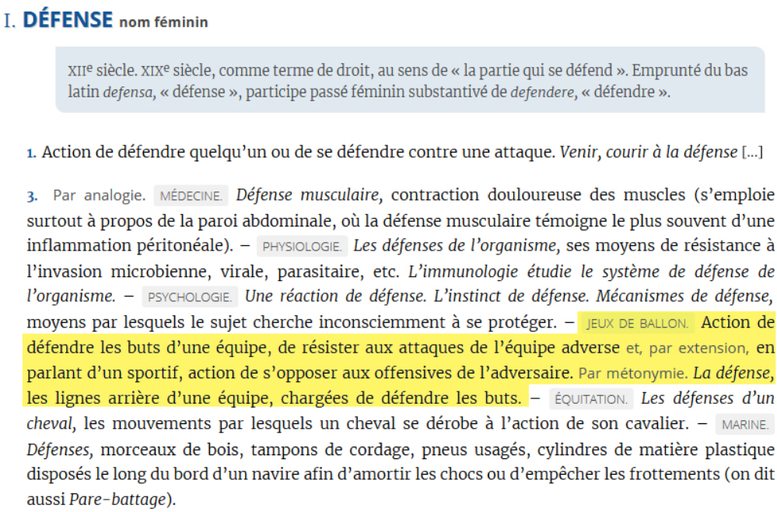
“defesa” [defence] (DLPC)
“defensa” [defence] (DLE)
“défense” [defence] (DAF)
Salgado & Costa – TOTH Conference 2019

Slide 30
DLPC
<entry xml:id="defesa" xml:lang="pt">
<form type="lemma">
<orth>defesa</orth>
</form>
<gramGrp>
<gram type="pos" ud:norm “NOUN”>n.</gram>
<gram type="gen">f.</gram>
</gramGrp>
[…]
DLE
<entry xml:id="defensa" xml:lang="es">
<form type="lemma">
<orth>defensa</orth>
</form>
<gramGrp>
<gram type="gen">f.</gram>
</gramGrp>
[…]
DAF
<entry xml:id="défense" xml:lang="fr">
<form type="lemma">
<orth>défense</orth>
</form>
<gram type="pos" ud:norm “NOUN”>nom</gram>
<gramGrp>
<gram type="gen">féminin</gram>
</gramGrp>
[…]
entry
@xml:id
@xml:lang – code (BCP 47)
always start with a lemma (headword), a canonical form
gram type element
part-of-speech of the entry and further specifications
@norm attribute – values from the Universal Dependencies Part-of-Speech: https://universaldependencies.org/u/pos/
Salgado & Costa – TOTH Conference 2019

Slide 31
DLPC
<sense xml:id="defesa" n="11">
<usg type="domain">Desp.</usg>
<def>Intercepção da bola pelo guarda-redes, impedindo-a de entrar na baliza.</def>
<cit type="example"><quote>O guarda-redes fez uma defesa incrível.</quote></cit>
</sense>
<sense xml:id="defesa" n="12">
<usg type="domain">Desp.</usg>
<def>Acção de contrariar o ataque, a investida do adversário; acto ou efeito de defender.</def>
<xr type="antonym"><ref type="sense">ataque</ref></xr>
<cit type="example"><quote>Errado é jogar à defesa.</quote>
<bibl><title>DN</title><date>26.10.1988</date></bibl></cit>
</sense>[…]
DLE
<sense xml:id="defensa" n="7">
<def>línea defensiva>
[…]
<sense xml:id="defensa" n="14">
<gram type="gen">m.</gram><lbl>y<lbl><gram type="gen">f.</gram>
<def>Cada uno de los jugadores que forman la línea defensiva.</def>
</sense>
DAF
<sense xml:id="defesa" n="3">
<usg type="domain">JEUX DE BALLON</usg>
<def>Action de défendre les buts d’une équipe, de résister aux attaques de l’équipe adverse et, par extension, en parlant d’un sportif, action de s’opposer aux offensives de l’adversaire.</def>
<usg type="meaningType">Par métonymie.>
<cit type="example"><quote>La défense.<quote></cit>
<def>les lignes arrière d’une équipe, chargées de défendre les buts.</def>
</sense>
Salgado & Costa – TOTH Conference 2019

Slide 32
Conclusions and future work
Our research has lexicographical purposes; but we apply Terminology’s methods to the selection and definitions of terms.
Considering that football is a very popular sport, one single conceptual organization of the domain will permit to use a multilingual approach.
TEI-Lex0 focuses on choosing a certain consistent path across the variety of choices offered by the TEI Guidelines. Since TEI is a standardization recommendation, it would be interesting to present identical solutions for all academic dictionaries under analysis.
An agreement between academies would be desirable to systematize and optimize a new type of lexicography that can provide a better representation of common lexicographical heritage.
A future combination of SKOS, SKOS-XL and Ontolex-Lemon is our future work!
Salgado & Costa – TOTH Conference 2019

Slide 33

Thank you for your attention.
Merci pour votre attention.
Obrigada pela vossa atenção.

