Slide 1

Open Research, Open Access
Beyond compliance...

Slide 2
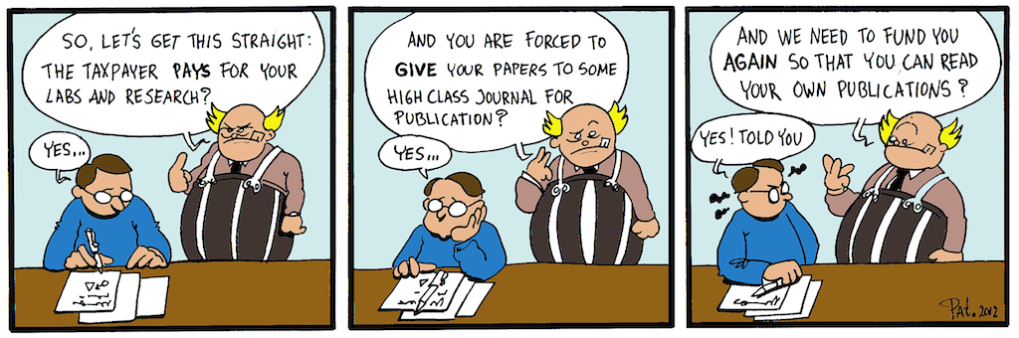
YES! I told you. The story of open access by Patrick Hochstenbach
CC-BY https://openaccess.be/2012/10/24/yes-i-told-you-an-open-access-cartoon/

Slide 3

Open Access REF compliance is:
REF outputs
Articles and conference proceedings
  ... with an ISSN
Accepted after 1/4/16
Embargo of up to 12 or 24 months
Author accepted manuscript
Licensed under a Creative Commons Attribution Non-Commercial Non-Derivative (CC BY-NC-ND)

Slide 4

Open Research is:
Information and data that is freely available to others who can use and share it easily.

Slide 5

What makes research open?
Findable, Accessible, Interoperable, Reusable (for humans and machines)
Open throughout the research cycle (e.g. methodology, software, code along with instructions for using it)
Open outputs – articles, monographs, chapters, performances, data (translational work)
Open review – pre registration, pre prints, peer review, open funding

Slide 6

Open research is not...
A universally applicable ‘To do’ list
About compliance
Unthinking – there are some circumstances where it is inappropriate
Impossible

Slide 7

What is Research Data?
Recorded information, regardless of format or type, that supports or validates research observations, findings or outputs.
They can be
  any media and any format
  created at any stage
  any level of derivation
    raw
    manipulated
    converted
    cleaned
They must be
  genuine
  transparent
  useful
  reproducible

Slide 8

What is Open Data?
“Open data and content can be freely used, modified, and shared by anyone for any purpose”
http://opendefinition.org/
F. A. I. R.
Findable – Accessible
Interoperable - Reusable

Slide 9

Why open data?
shows the work's integrity
verifies the work
can create opportunities for further research to be carried out on your findings
data citation
(compliance)

Slide 10

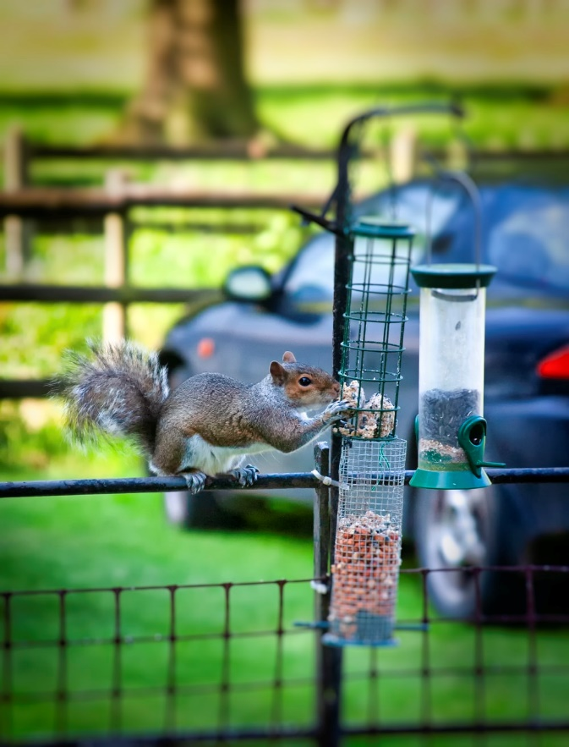
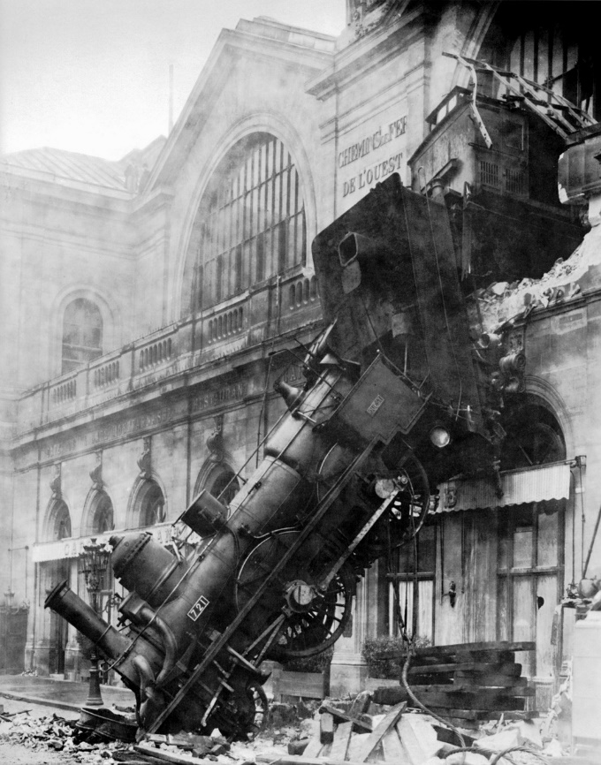

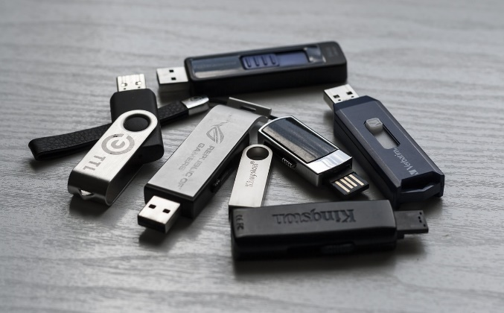

Managing data (for making open)
Planning will make things much easier:
  Data protection
  Ethical consideration
  How/What/Where/Format etc.
Readme files
Persistent identifiers
Embargos
Damage
Corruption
Confusion
Theft
Unexpected accident
Why didn’t I…???

Slide 11

A moment on copyright
Using other people’s work in your own research outputs
Author retains copyright
Creative Commons licences
Funder and publisher requirements
More on the Kent Copyright website

Slide 12

And another on accessibility
Accessible by design is easier than adding it in afterwards, and can be helpful for everyone.
Accessible should be the default
Accessible outputs shouldn’t alter the content
If it works for screen readers, it works for machines
There is lots of information and support available at Kent
We know digital rights management sucks....

Slide 13
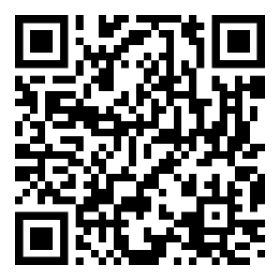
ORCiD
What's an ORCID iD for?
Your unique ORCID iD will belong to you throughout your scholarly career. It's a persistent identifier to:
distinguish you from other researchers
ensure consistent, reliable attribution of your work
You can use it for:
collating existing research in one location
submitting to journals
grant applications
professional society membership
linking with other identifiers and profiles
displaying on your CV
web page, social media and more
An ORCID iD is a persistent identifier that allows you to distinguish yourself by tying all your research together in one place.
An example ORCID page

Slide 14
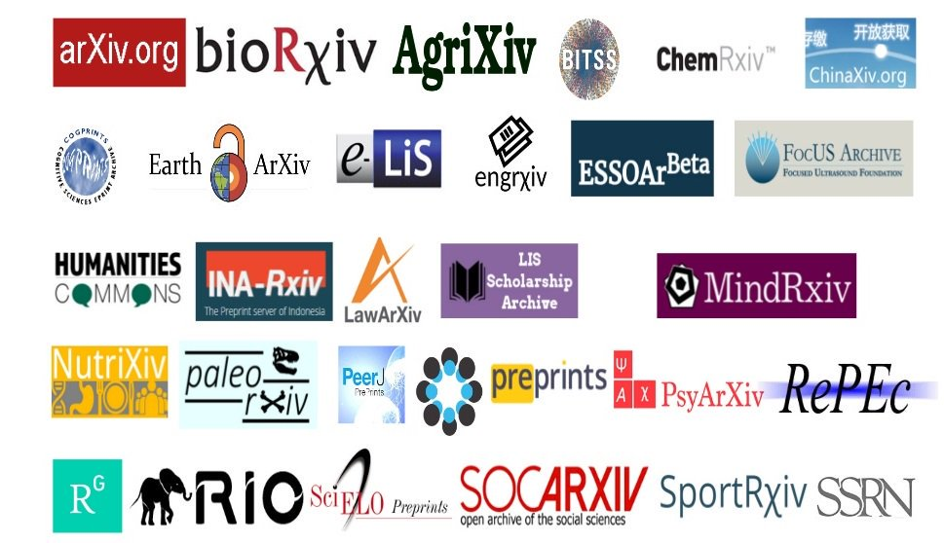
Pre Registration & Pre Prints?
Background:
What are they?
What are the benefits?
What are the challenges?
Specifics:
How does the process work?
Why publish this research openly?
What next?

Slide 15
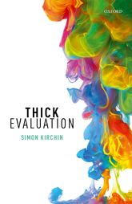
Publishing an open monograph
Why open monographs?
What are the benefits?
What are the challenges?
Why publish this openly?
How does the process work?

Slide 16

Other elements to open research
open methodologies
open lab books
practice based research (including digitisation)
open peer review
open funding
open futures (systems, standards, metrics)

Slide 17
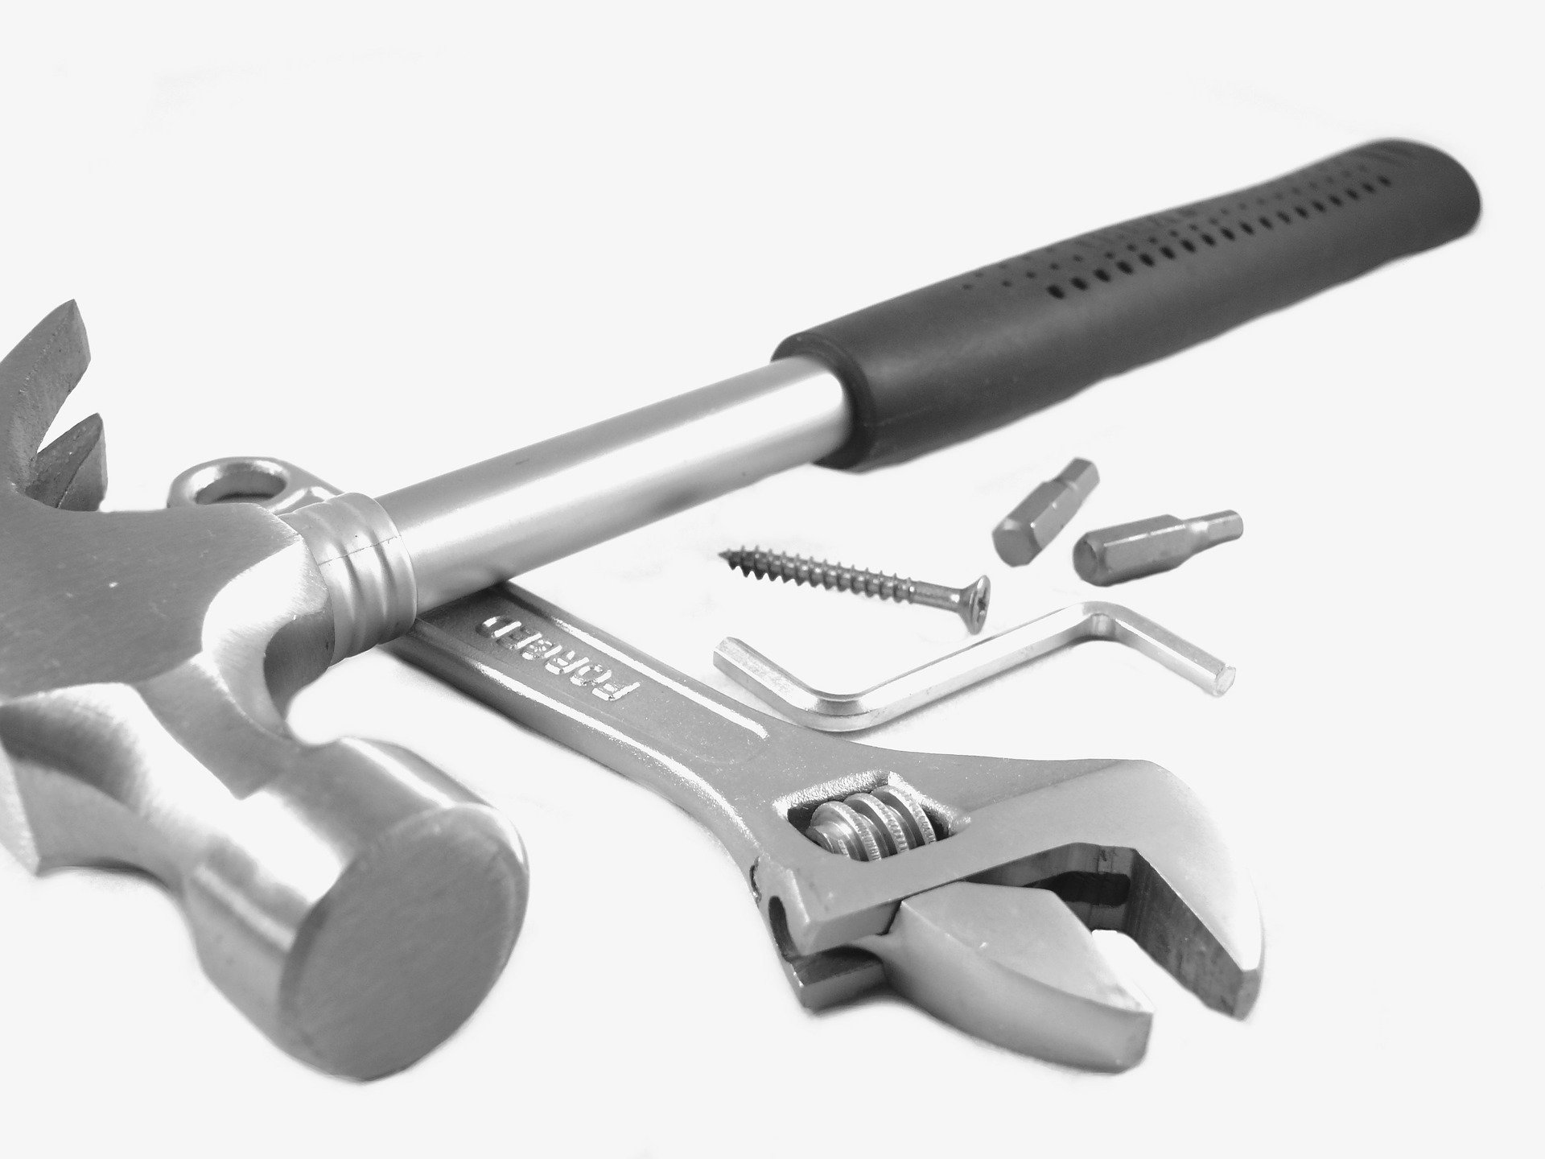
Tools
Kudos: Tracking dissemination
Unpaywall: Findable open research
Re3Data: Finding a data repository
Metrics Toolkit: Helping you use metrics responsibly
Jobs.ac.uk: Research Publications Planner
Digital Curation Centre: How to Develop a Data Management and Sharing Plan
101 Innovations in scholarly communication: New systems for open research communication

Slide 18

Contact
@headunikentosc
S.E.Slowe@kent.ac.uk
osc@kent.ac.uk

