Slide 1
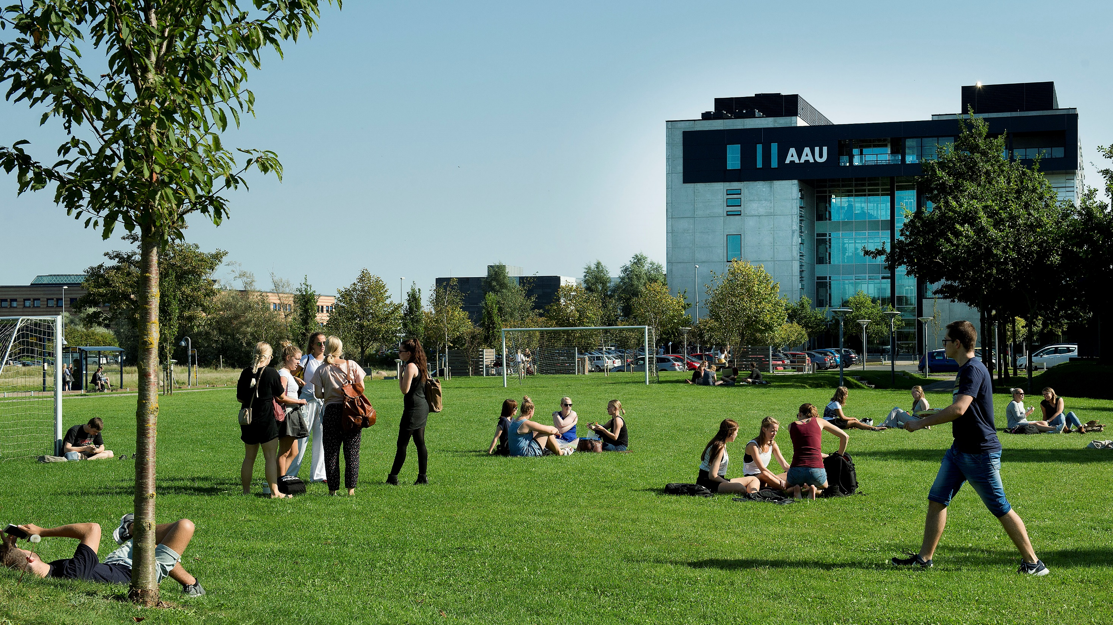
Dirty PIDs
Let’s Roll in the Mud
-
Poul Melchiorsen, Aalborg University Library

Slide 2
Agenda
Why this presentation?
What is ‘dirt’? A philosophical approach
What are dirty data?

Slide 3
Why?
Wash your dirty data! - What are clean data?
Cleaning data – too much trouble – is a ”closed” system the answer?
Filthy usage of data – reporting and visualization
  Fields not covered by data source
  – skewed representation
  Filthy representation of data – e.g. H-index
Personal
  The ”unclean” can disrupt our comfortable theories about reality – The Phantom of Liberty (Buñuel)
  Warning of bibliometric/systemic intemperance
The Phantom of Liberty (1974); Director: Luis Buñuel

Slide 4
History: Plato
Plato: ‘doxa’ (opinion) and ‘episteme’ (real knowledge)
Real knowledge → forms, ideas – essense
Ex: We try to draw a perfect circle
Socrates: ‘All things have forms’
Parmenides: ‘Also dirt?’
Essence contains telos, a purpose
‘Dirt’ is a difficulty in this scheme:
Soiling is where perfection and purpose is lost or diminished

Slide 5
History: Alchemy
Purification of elements – find pure gold
Parallel:
Purification of the soul – wash away all sins
Personal development mirrored in natural processes
But not everything would turn into gold
Vice would not mutate into virtue
Skilled work should be performed to purify the right elements

Slide 6
History: Renaissance – New Science
Platonic Academy of Florence 15th century:
Purification of souls with rational thinking –
wash away the filth of ignorance
Experience is created in carefully organized settings: Immediate thinking vs. ‘unnatural’ experimental settings
An expression of that: Primary and secondary qualities
Nature ‘in itself’/’objective’, primary qualities – weight, form and speed…
Secondary qualities: colour, sound, taste and temperarature – sensations in the human subject
Dirt as a ‘tertiary’ quality – a psychological reaction to secondary qualities
Conclusion:
Dirt is not really dirt – but something else!

Slide 7
A contemporary view:
When we live – between facts and practices
Meaning of ‘dirt’ – two answers:
  Reductionist answer
  Naïve realist answer: Dirt is a real quality of the world – things are dirty, because they are
Double-minded relation to the world:
“In our heads we no longer believe in the enchantment of the world, but in our hearts and bodies we still live it.”
We believe in facts but live in practice
Either our perception of meaning in the physical world is an illusion or meaning is mysteriously infused
Problem: the assumption of ‘the world in itself’
We and objects are always, already in a practice
Ex: We identify a jug as a milk jug and not just generally as a hollow object
Olli Lagerspetz: A Philosophy of Dirt (2018)

Slide 8
Dirty and clean – distinctions (Lagerspetz)
Master and additive/host and contact item
  something is added to the host
  quality of the underlying object is diminished (‘messy’, ‘damaged’, ‘wet’)
Cleaning – uncover underlying form
  the master is valuable
  dirt ruins and pollutes the dirty object
  care for the dirty item (implies understanding of the teleologies of the item)
Distance seems important
  How to polish an atom or a galaxy? – Who is in charge?
  Condition of dirt: responsiblity.
Conclusions:
  dirt gets its meaning in relation to its host
  dirt defined teleologically (ex dirty CD cannot fulfill its goal), ‘needs to be cleaned – worth cleaning’
  clean/dirty always tied up with context (ex teacup – real change)

Slide 9
Pure and impure – more distinctions
(Lagerspetz)
Purity = ‘homogeneity’
  Ex: Dirty and mixed water – ‘pure’ water is free of dirt or unmixed
  Ex: Pure gold may be dirty
‘Pure’ may also stand for undisturbed
Whereas ‘clean’ is brought by someone
‘Dirty’ is between two unsullied extremes:
The undisturbed and the cleaned
I can’t help think, what does “pure” mean in the context of CRISs?

Slide 10
Other contemporary
‘dirt theorists’:
Two kinds of reductionism – hygenic and antrophological
‘Dirt’ is not really dirt – but something else
The ‘real’ world is described in science
– no dirt here
  Dirt is really about hygiene – dirt carries diseases
  Ex: The dirty shirt? Is it a health risk?
Cleaning activities are not all demonstrably good for physical health – could they be a symbolic representation of something else?
  ‘Dirty’ resembles ‘forbidden’
  Our ‘inner perceptions’ throw a veil of emotional colouring of naked physical reality (Freud)

Slide 11
Theory of Abjection – The Discarded/Refused
Anthropological tradition – revelation through relativity. In short, some concepts are relative to culture and therefore must have another, deeper description
Dirt is not an essential characteristic of objects
Dirt depends on power relations (forbidden)
Kristeva: Conceptualization of the world - everything is not presented in the meaningful system – our cultural world:
The other/the abject/that which disgusts us/the taboo/prohibition to touch (Freud)… and the holy (fear and love)
Conclusion: Dirt is rejected… …!
Julia Kristeva: The Powers of Horror (1982)

Slide 12
Lagerspetz concludes: Stewardship of objects
Our relations to objects are determined by care and responsibility – ‘needs cleaning’ presupposing care and responsibility
The distinction between clean and dirty presupposes a world of culture, a world where we are in charge
Human cleanliness expresses the idea of a responsible relation towards the environment

Slide 13
Dirty Data – what have we learnt?
Data stewardship
We have an eye for dirt – we care and feel responsible
Distance
Through a system (ex: SciVal) – data may be clean, but when you get closer, you may find dirt. Details are often messy.
Contextuality
Cleaning data is many things. Great care and responsibility is necessary in order to spot the right ways to clean the data.
Ex: ORCID contains ‘versions’ or ‘duplicates’
Host and additive
Ex: A tree may not be dirty as such, but if a girl climbs the three in her Sunday best, the tree may be dirty and soil the girl’s dress.
Data may be nice and clean – but when they are used for evaluating research throughout a university, they may be messing up research evaluation at that university!

Slide 14
Dirt is not nothing
Imagine unspoiled nature: Rocks, decaying leaves, grass, clay… Is the mud that ruins my shoe dirty? If it is, was it so before I came there? One is tempted to say that human presence makes the ground dirty.
That may be a weird conclusion and Lagerspetz says:
“The crucial change, I suggest, consists of the introduction of possible questions that would have no application in conditions of untouched nature – for example, ‘Can I walk here without ruining my shoes?’” (teleological change)
Olli Lagerspetz: A Philosophy of Dirt (2018)

Slide 15
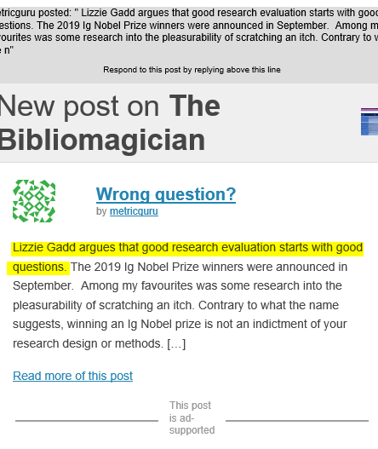
Dirty data is not nothing
Research administrators, evaluators, developers, bibliometricians, PID system suppliers and much more… use data. When we want to use specific data, we may experience dirtiness in the data.
Were the data dirty before the context of use?
Maybe not important. What is important is the questions that now have application.
We should ask the right ones.
In what context should the data be used, and how should they be cleaned or supplemented to make up for messiness?

Slide 16
Three examples of trying to clean up skewed/messy/dirty representations of science
OPEn Research Analytics (OPERA): https://deffopera.dk
REsponsible impACT (ReAct) - taxononmy:
https://www.communication.aau.dk/research/Research+Projects/react/
ORCID Academia & Beyond Task Force: https://orcid.org/content/academia-beyond-task-force

Slide 17
Let’s Make Some Dirty Bibliometrics! Ask the Right Questions!
3-4 or more teams – each team elects a spokesperson
10 minutes
You get a question from the field of research evaluation and bibliometrics
(10 questions in total)
Each team discusses if it is the ‘right’ question:
If it is not the right question, come up with a better one!
First team with a better question gets a point – Nikoline will be the judge!
The team with most points wins a prize!

Slide 18
Question 1
What is the average h-index for your department?

Slide 19
Question 2
What is your h-index?

Slide 20
Question 3
What impact have you had among peers?

Slide 21
Question 4
What proportion of your organization’s journal articles are written in English?

Slide 22
Question 5
Have you started publishing in journal articles and not in books and conference proceedings yet?

Slide 23
Question 6
What is the average of the Journal Impact Factors of the journals, that you publish in?

Slide 24
Question 7
Have you tried gaming the research analytical metrics?

Slide 25
Question 8
What is your societal impact?

Slide 26
Question 9
How many of the UN Sustainable Development Goals have your university covered?

Slide 27
Question 10
How many publications do your organization have without a ‘d’ in the title?

