Slide 1
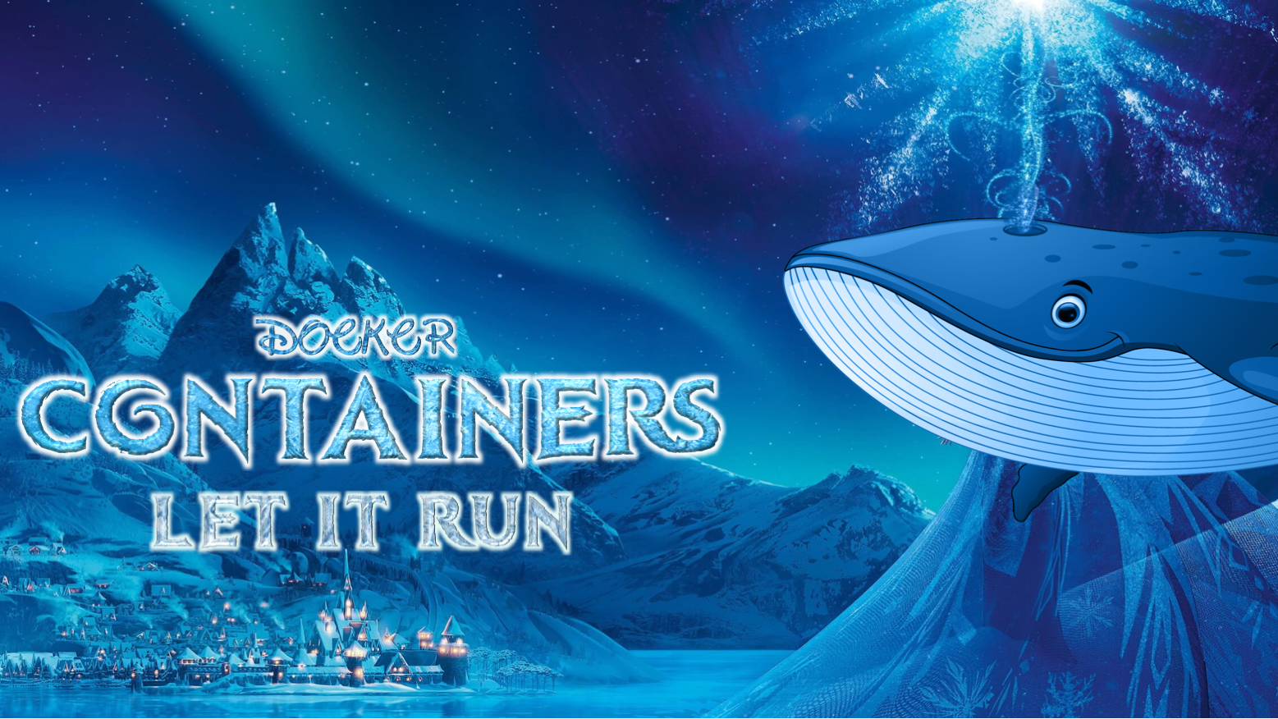
It is a kingdom of isolation
And looks like you are coding
Agah Karakuzu

Slide 2
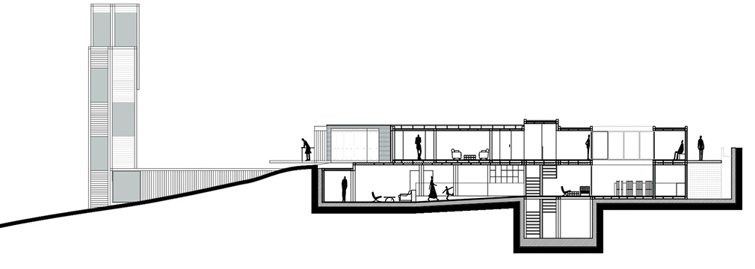
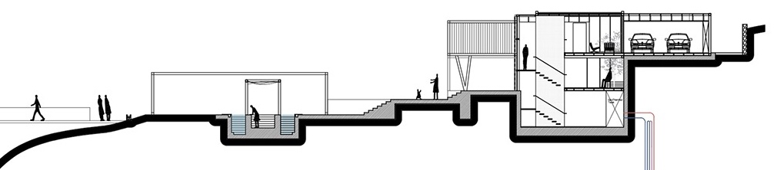
We are creatures of habits.
When our environment changes…
We can still function, but may behave differently.
We understand the importance of being in a familiar living environment to feel comfortable.

Slide 3
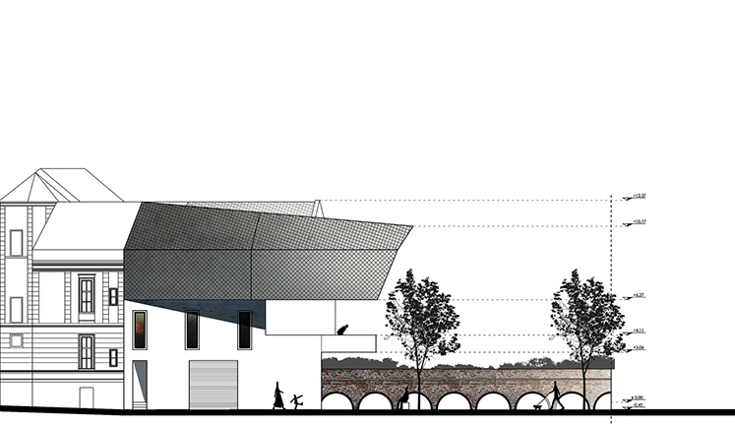
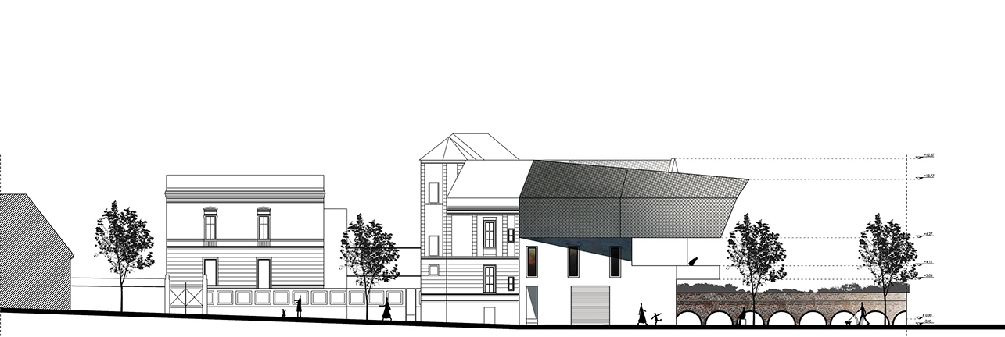
Software are creations of consistency.
In the face of changes to their environments…
Software may yield unexpected results, or may not function at all.
Their functionality and behavior depend on being in a familiar environment.

Slide 4
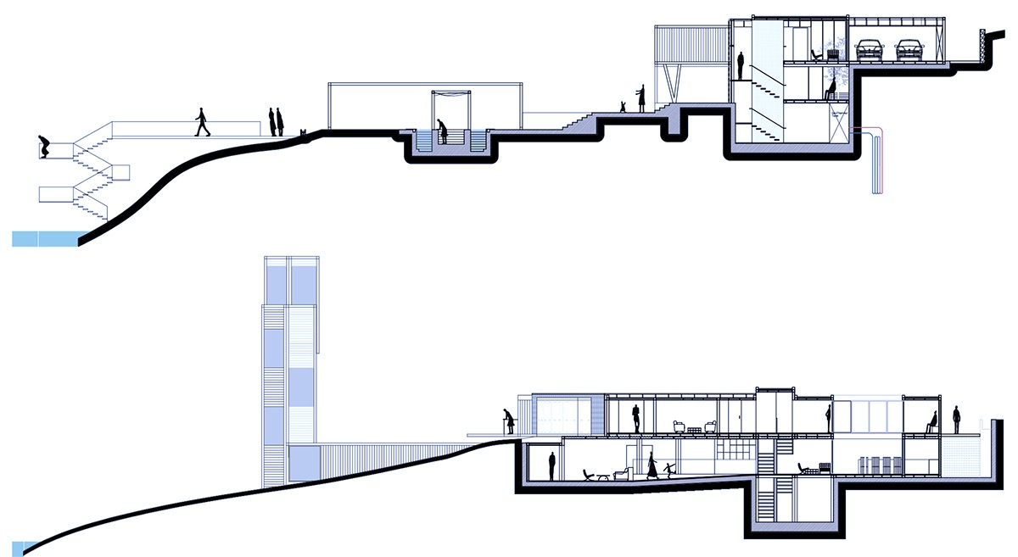
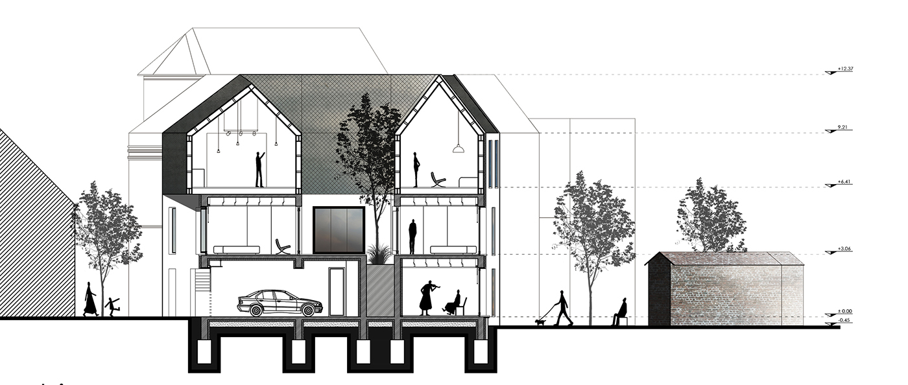
This is the reason why developers
test how the software behave
in
MULTIPLE
ENVIRONMENTS

Slide 5

However, buying an entire environment whenever you want to test a software is
expensive and not sustainable.

Slide 6
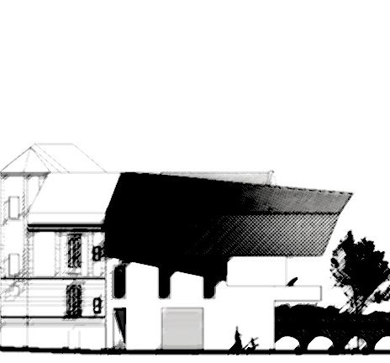
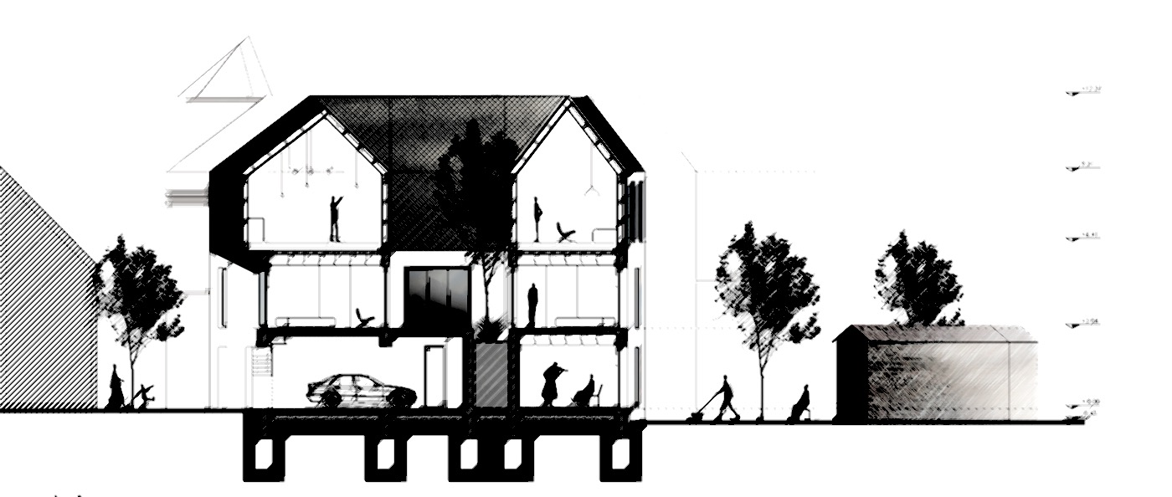
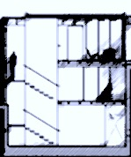
What if there were a foundation
that can be flexibly reshaped to mimic multiple environments?

Slide 7
This is what Virtual Machines (VM) do!
The foundation is your host operation system.
Let’s say OSX.

Slide 8
VM creates a connection between OSX and your hardware
Hypervisor*
Macbook hardware
* There are two types of hypervisors. Bare-metal and hosted. This one is a hosted (type-2) hypervisor.
CPU
Storage
RAM

Slide 9
Hypervisor allocates some hardware for GUEST operating systems
Hypervisor
CPU
Storage
RAM

Slide 10
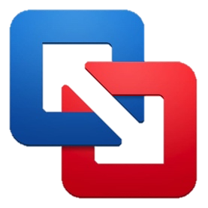




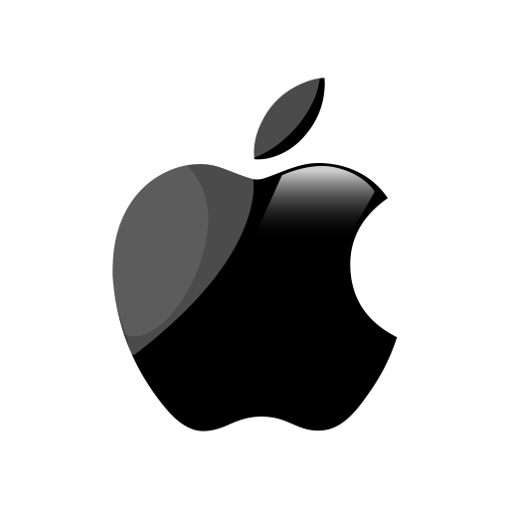
Abstraction happens at the hardware level.
VMs virtualize your hardware.
Guest Ubuntu 18.04
Guest Linux Mint
Fusion
Guest WIN10
Host Mac-OSX
* WMware fusion is a Type-2 hypervisor.
CPU
Storage
RAM

Slide 11
Back to the default state.
Here is your kingdom of isolation.
Guest Ubuntu 18.04
Guest Linux Mint
Guest WIN10
Host Mac-OSX
Now you can test if your software gets along well with 4 operating systems having only 1 hardware.
These operating systems are isolated from each other.
Assume that WIN10 got infected by a malware.
You just destroy it. Your OSX won’t be affected by the malware.

Slide 12
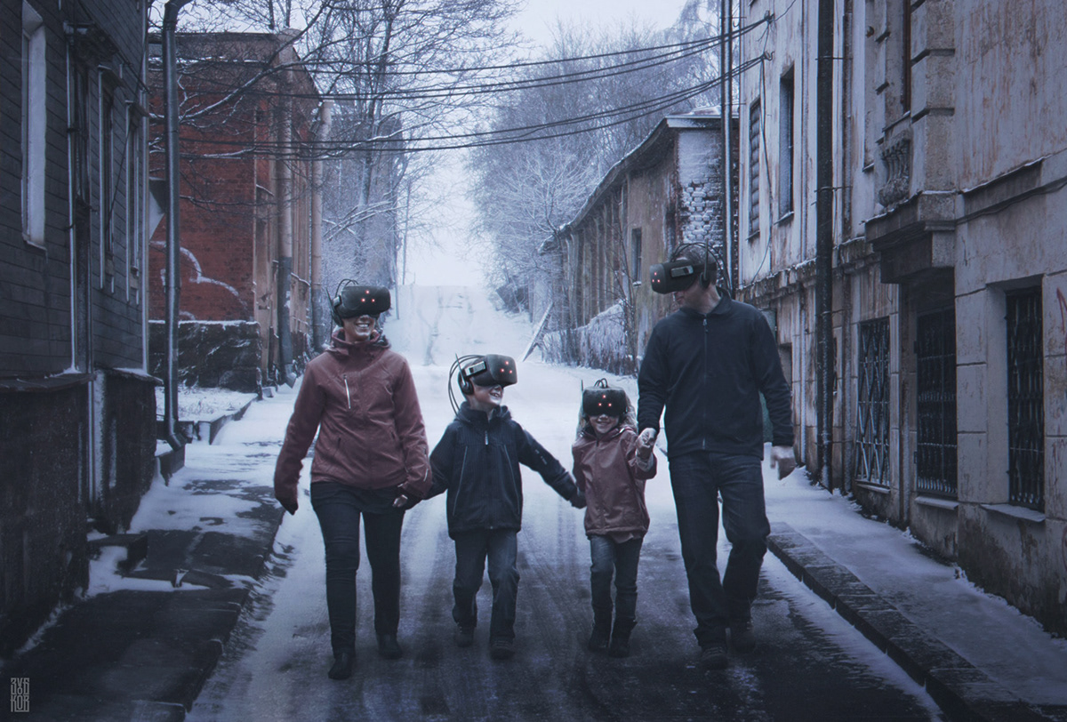
Let's take a small walk-through the basics steps to get a Virtual Machine to your computer.

Slide 13

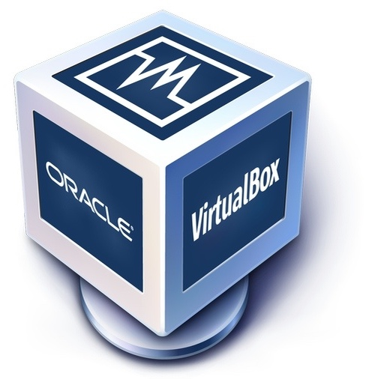

1
Install a software hypervisor
Paid
Free (selected)
Fusion
store.wmware.com
www.virtualbox.org

Slide 14
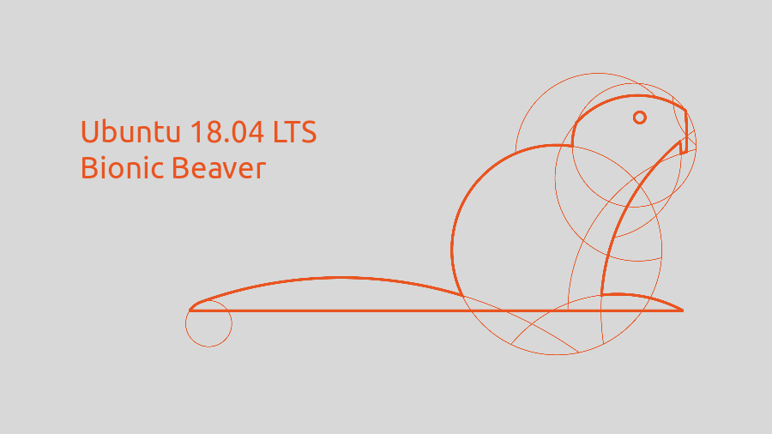
2
Download Ubuntu 18.04 OS image (*.iso)
releases.ubuntu.com/18.04/
~2GB

Slide 15
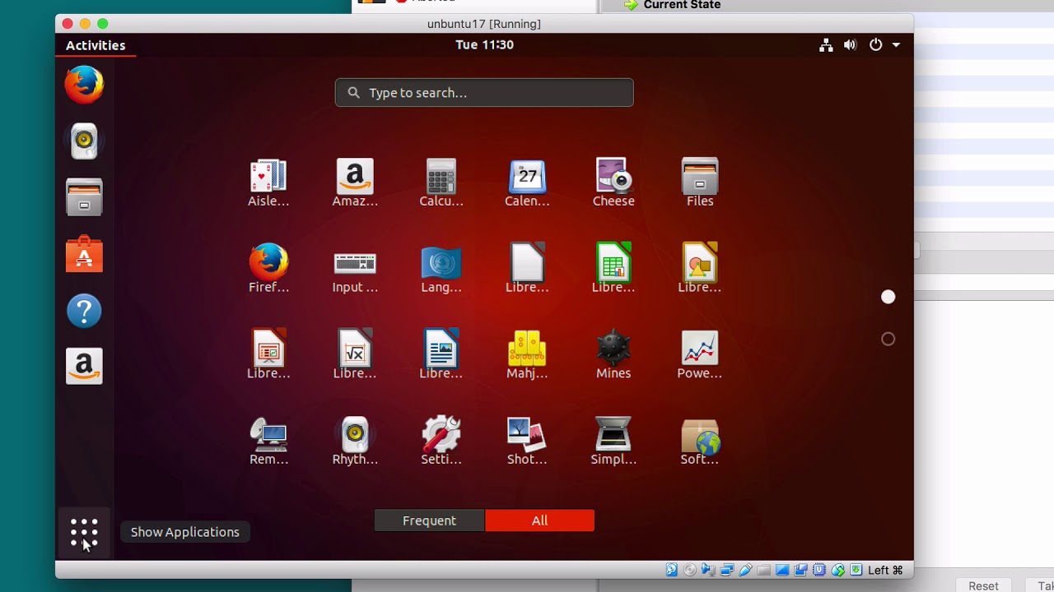
3
Install Ubuntu on Virtual Box
https://brb.nci.nih.gov/seqtools/installUbuntu.html
Now you can test if your software runs on Ubuntu 18.04 as well!

Slide 16
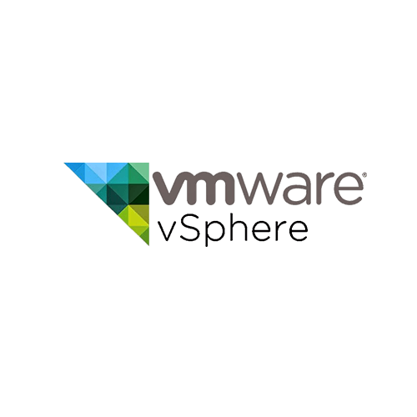
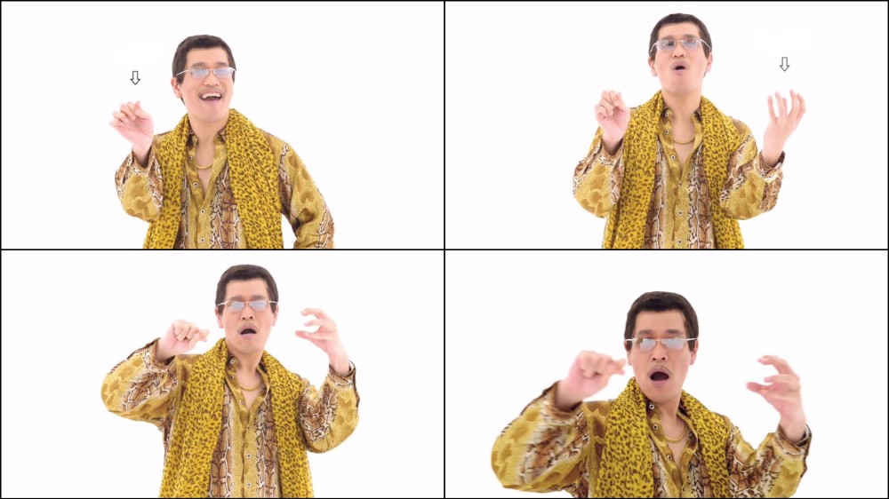

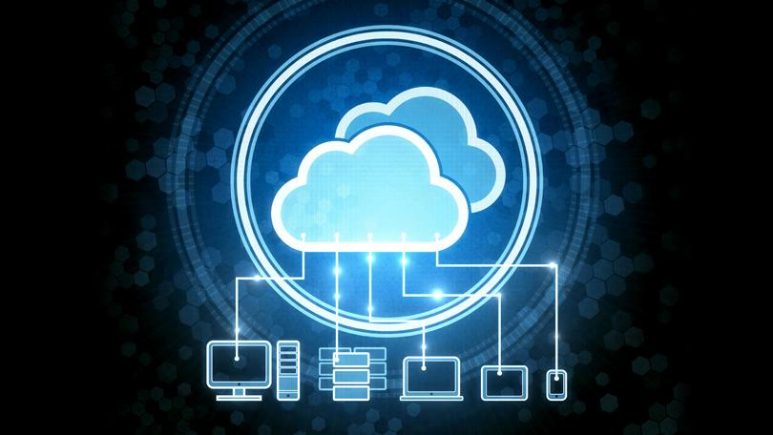
Of course, VMs are not just for testing software.
Warning: Meme ahead!
I have hypervisors
I have internet & servers
Uh
Cloud computing
* WMware sphere is a bare-metal hypervisor.

Slide 17
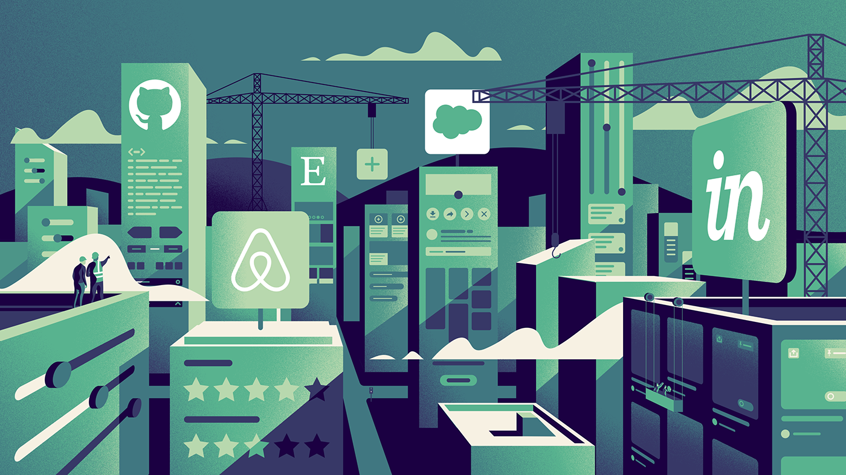


Cloud has changed the landscape of the tech market forever.
BUSINESSES
BOTH FOR
USERS

Slide 18

Soon after, virtual machines have became go-to residential buildings for the industry software.
But, these buildings are heavy!
They take up several GBs.
They contain a complete OS
and applications.
Running VMs are resource
Intensive.
Provisioning a WM takes long

Slide 19
Yet, moving a software to one of the VM buildings
can be advantageous depending on the application.
See how
a real-estate advertisement for VMs
would be!

Slide 20
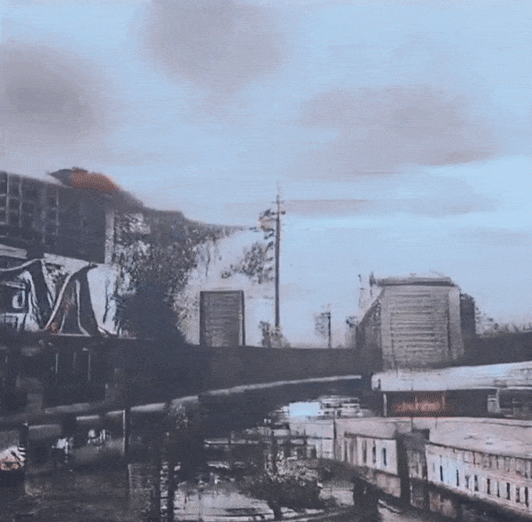
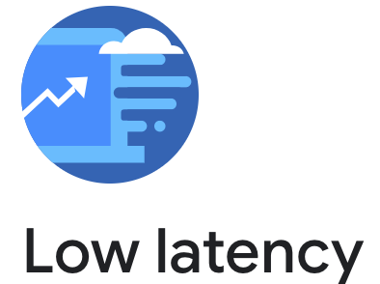
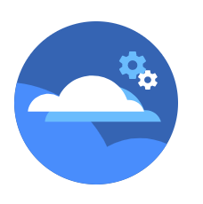

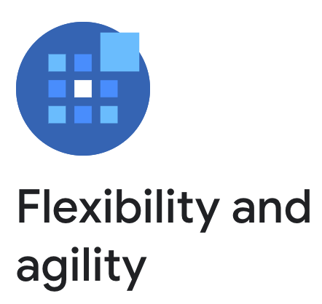
REAL
ESTATE
proudly presents
High security
Embrace the vibrancy of elastic buildings.
buildings
http://bit.ly/2M3WUdh

Slide 21
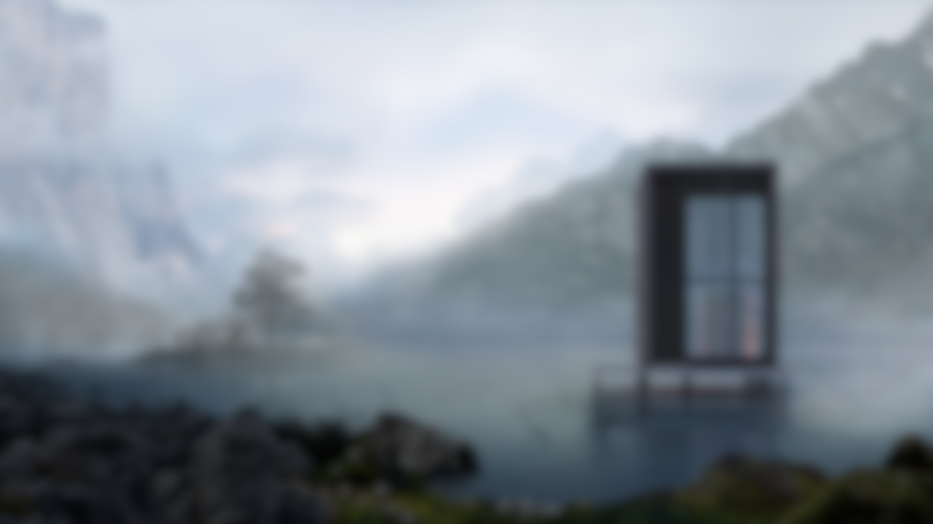
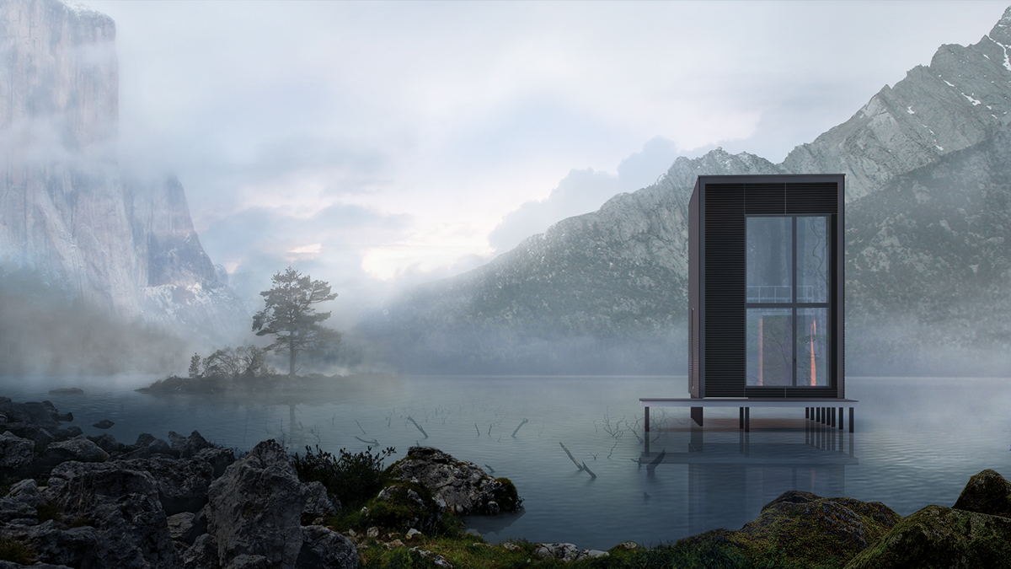
What if
software would live in
Such as…
smaller spaces ?
CONTAINERS

Slide 22
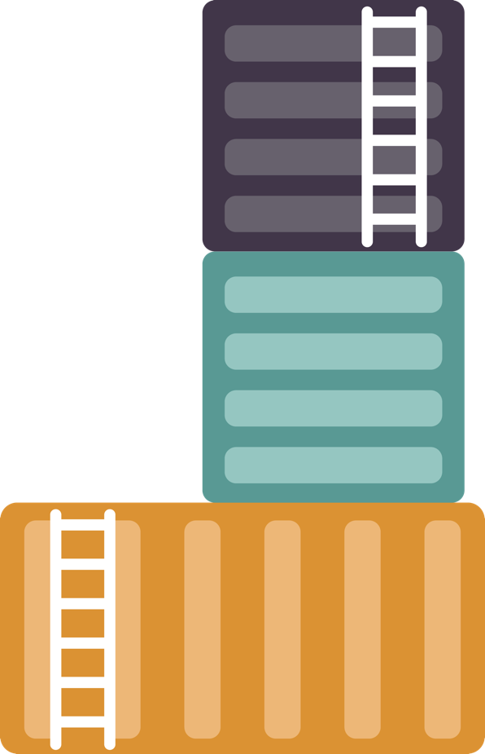


Let’s go back to the foundation
Containers are minimalist environments.
on which, we can place containers.
but this time, it won’t reshape.
instead, we’ll use a special dock.

Slide 23
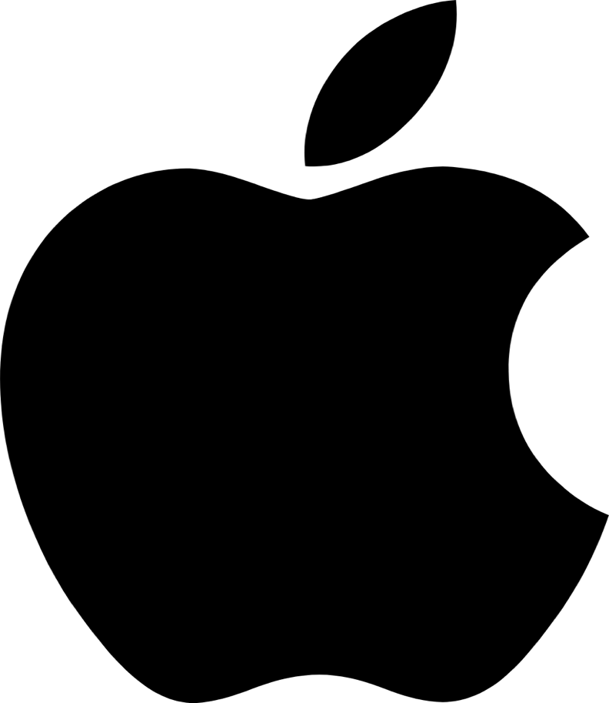


Instead, the dock connects to the kernels of your OS.
Unlike VMs, they don’t allocate resources on your hardware.
CPU
Storage
RAM

Slide 24



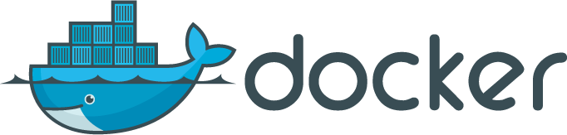
Containers virtualize underlying OS.
Inside, we usually put a few executables.
These executables go by the name of microservices.
And this dock is called, well…

Slide 25

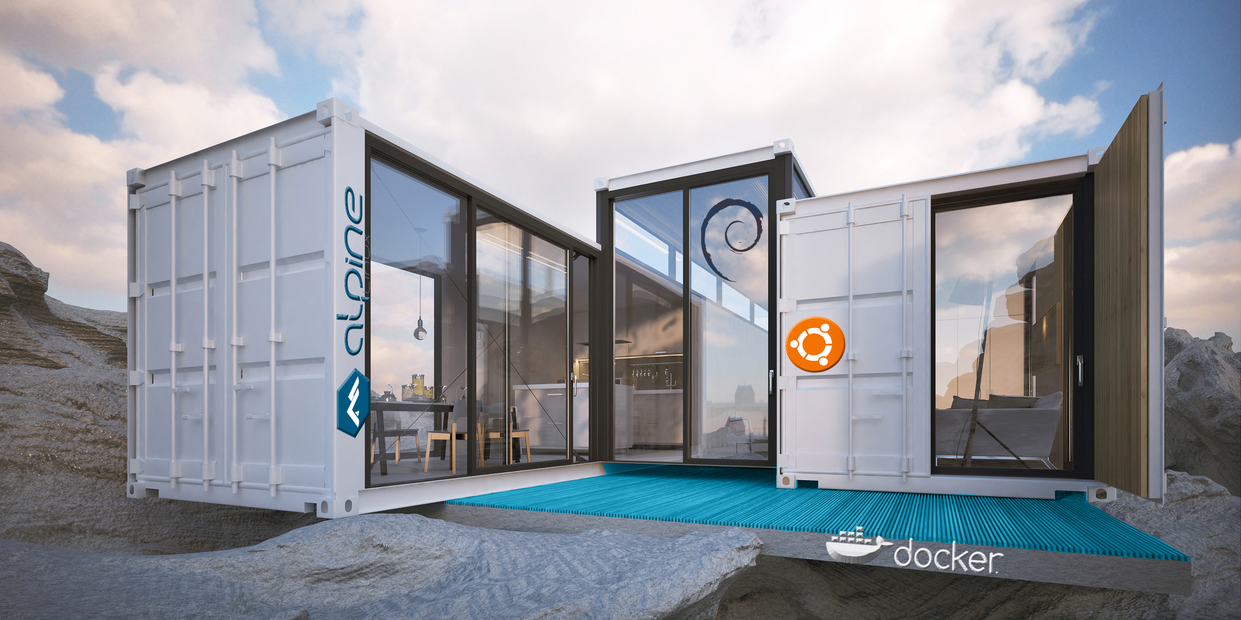
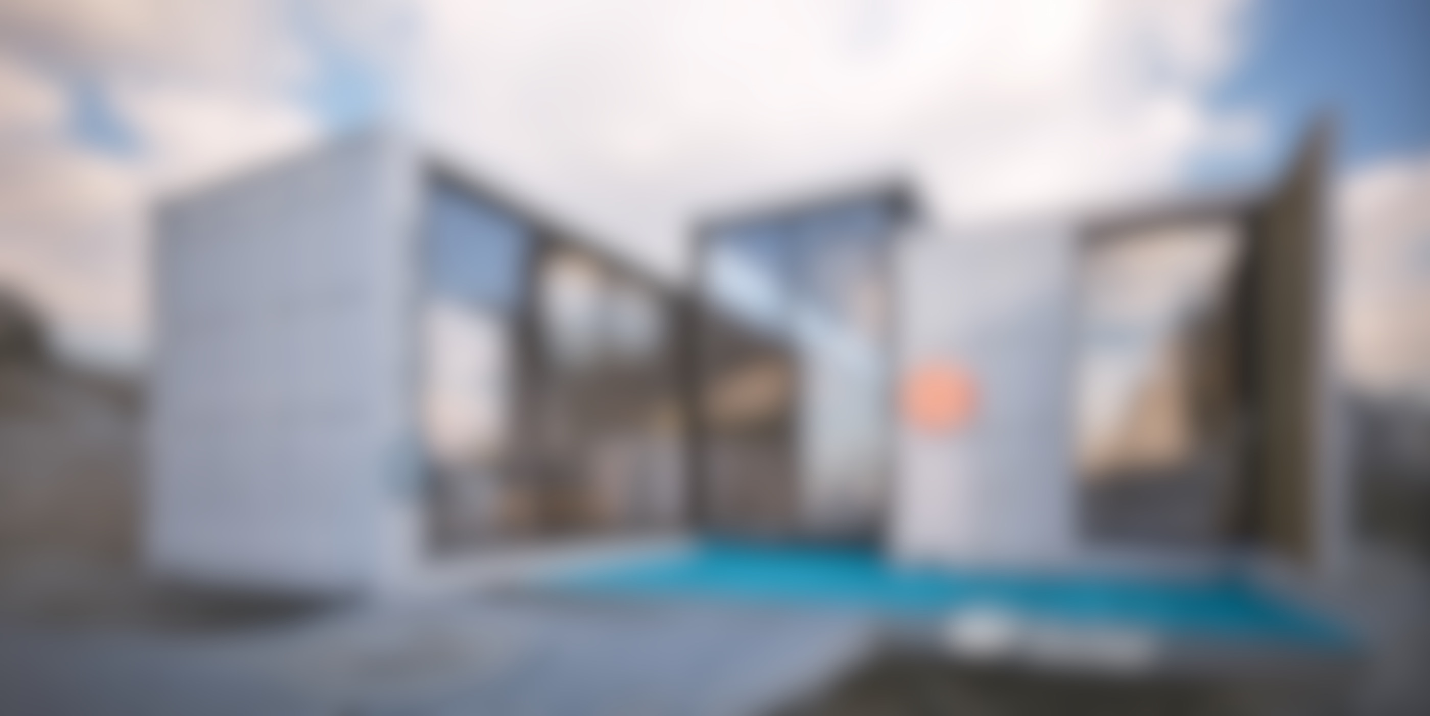

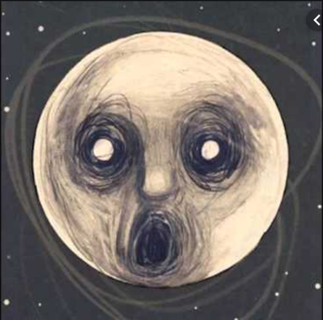
Containers clear away
All the jetsam in your envs
And ease the load
They can run your apps
And spawn quickly
You can design them
So they are home
Average container size is in the range of tens of MB.
Servers can host much more containers than VMs.
Let’s see a real-estate commercial for containers ☺
Drive Home
Steven Wilson

Slide 26
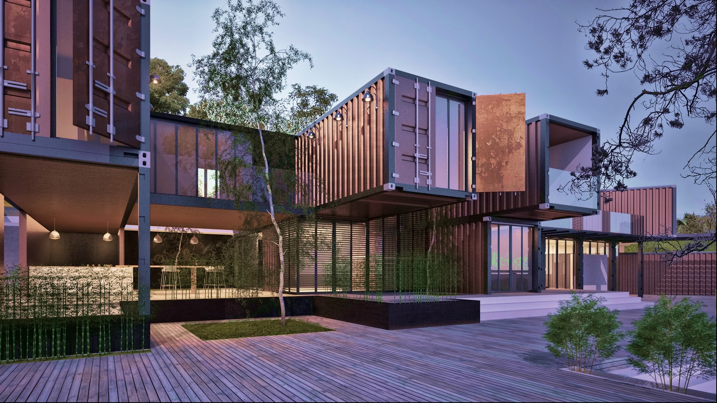
PORTABLE
MINIMALISTIC
ISOLATED
CHEAP
Résidence de la
CONTAINERS
Your software matters.
Make them feel home.

Slide 27
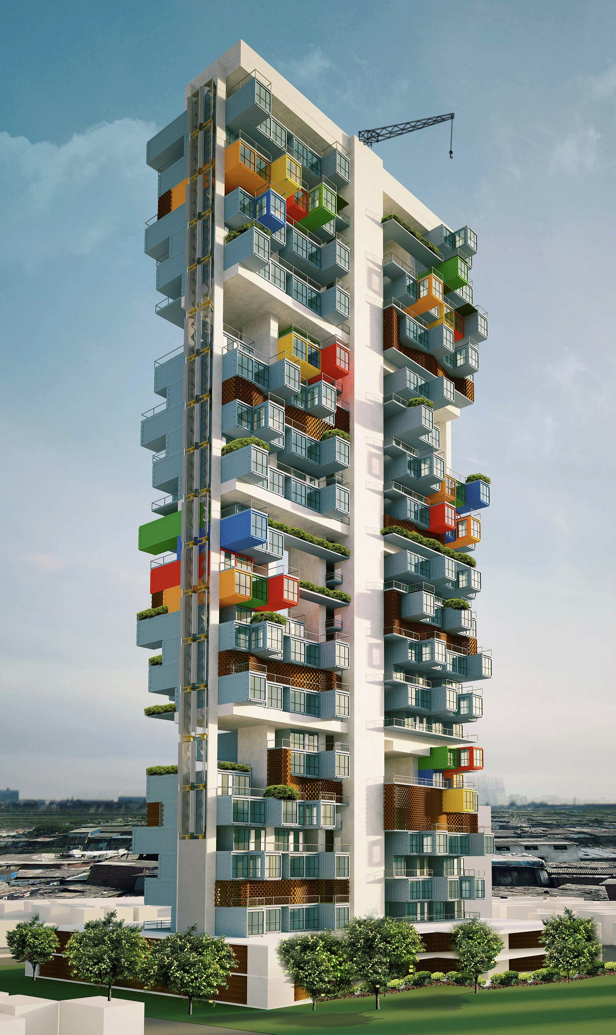
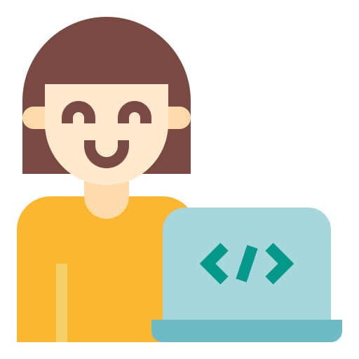
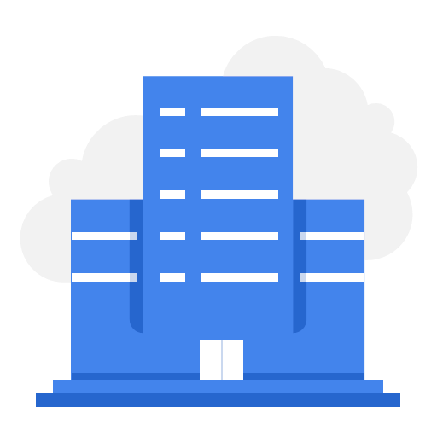
Disruptive technology. Containers have changed the game of virtualization.
For developers
They solved “works on my machine” problem efficiently for testing, DevOps and continious deployment.
For tech business
They decreased operating and development cost.

Slide 28
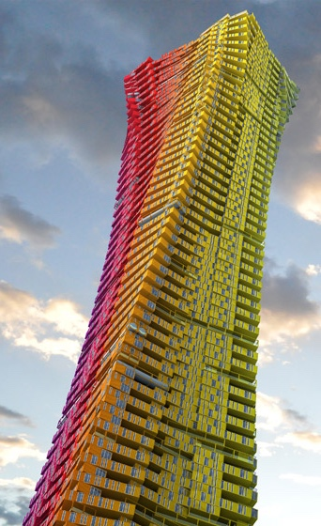

Guess how many containers are launched just by
in a week ?
2 BILLIONS!

Slide 29
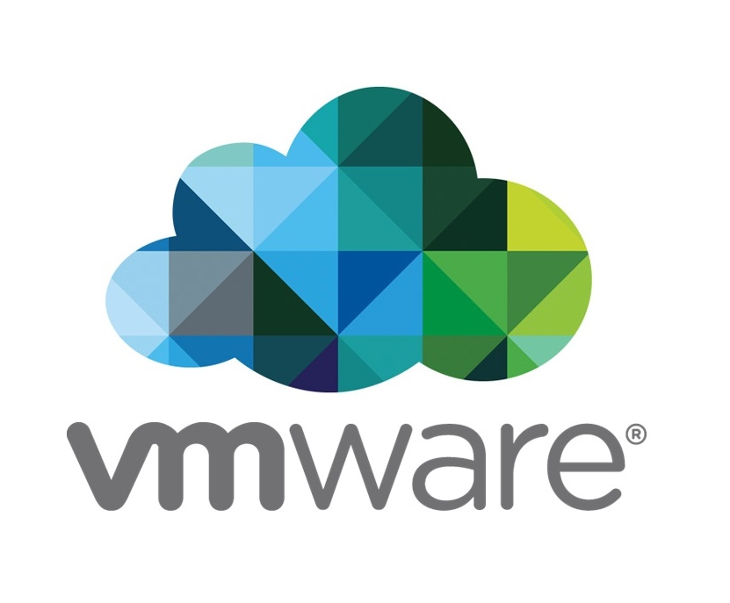

By the way
do not exclude
Containers did not eradicate VMs at all. They have different use cases.
For example
runs containers on VMs.

Slide 30

How would
computational researchers like to use containers?
For them, being able to repeat an analysis they put in a publication is the crux of the matter.

Slide 31
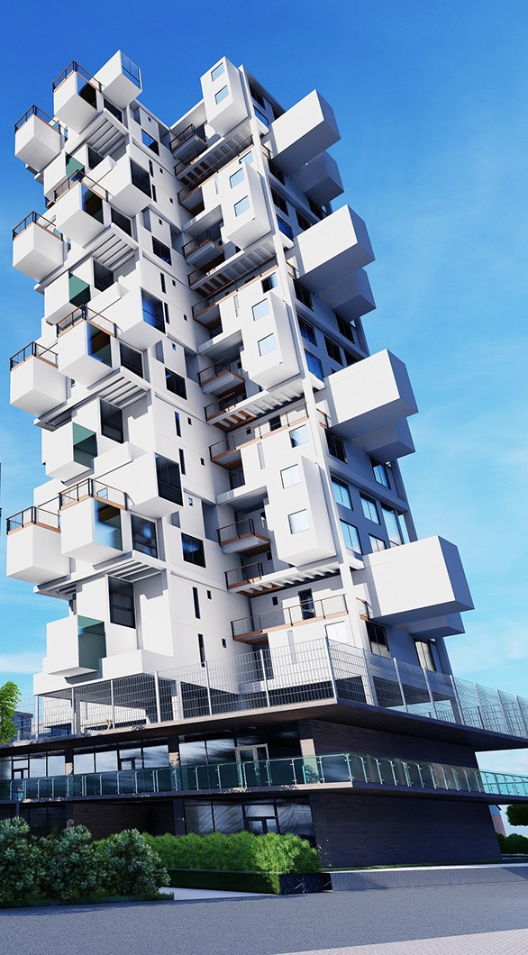
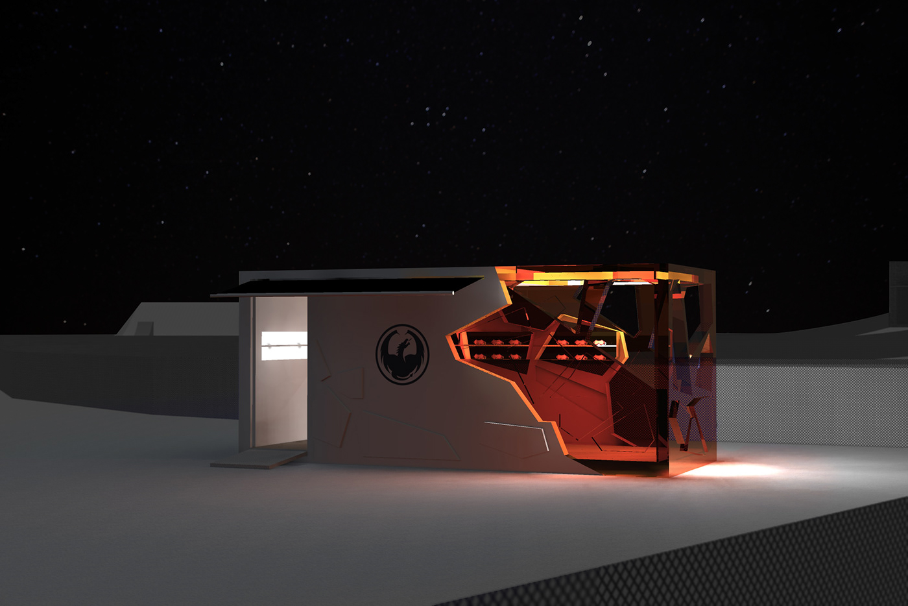
For a typical computational scientific work, we are not talking about a swarm of orchestrated containers, providing a service.
A fancy single container that can repeat our precious analyses or run our academic software.
Scientific workflows may use multiple containers. Still, when we hear Docker, we mostly imagine something like…

Slide 32
BASICS OF CREATING A CONTAINER
Let’s start with a small glossary.

Slide 33

Dockerfiles are written instructions to build
blueprints from which containers are instantiated.
As a developer, you need write down a Dockerfile.
Docker Engine can create a container blueprint based on your Dockerfile.
Dockerfile

Slide 34
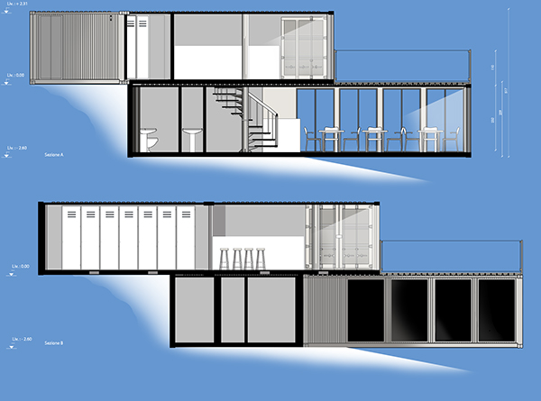
Docker images are blueprints
of containers.
When you need a Docker Image, you can:
Build your image from a Dockerfile
Find an already built image
Docker Image

Slide 35
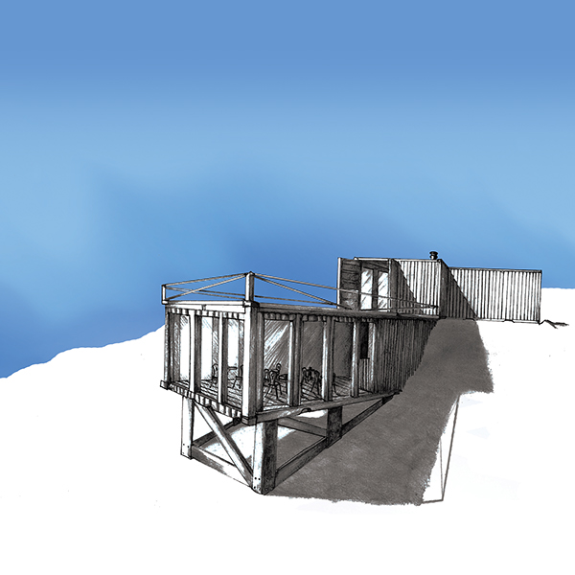
Docker containers are
realized instances of Docker images.
Docker containers are
run.
You can interact with them.
Or make containers do a task, then remove themselves.
Docker Container

Slide 36
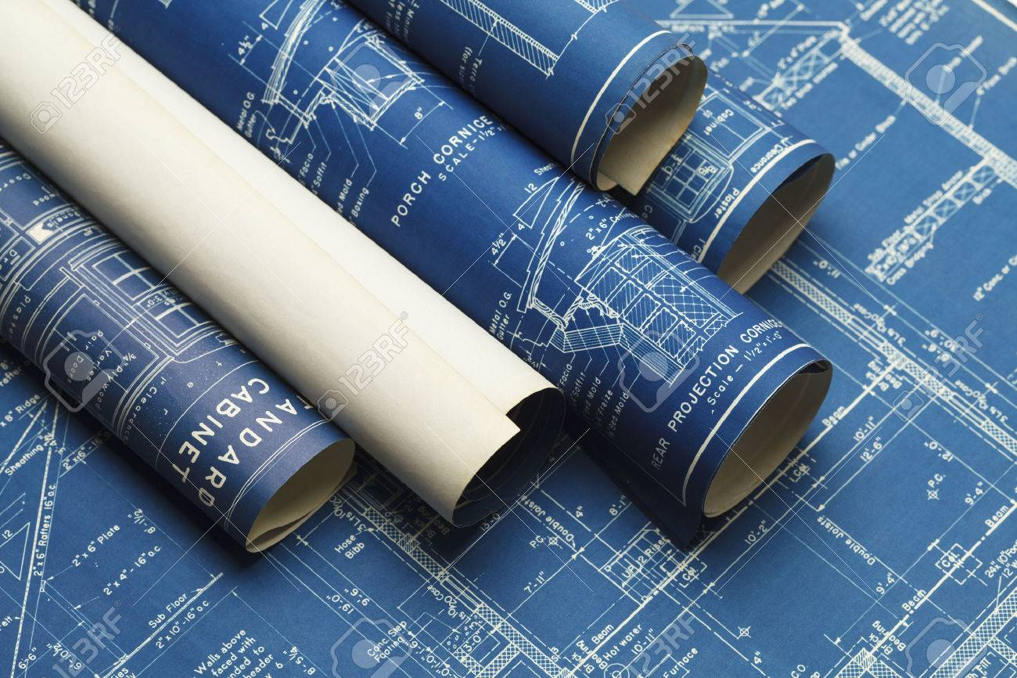
A bazaar for Docker images.
You can pull a Docker image to your computer FROM this bazaar.
You can also push your images to the bazaar and share them with the world.
Docker Image Registry
http://hub.docker.com

Slide 37
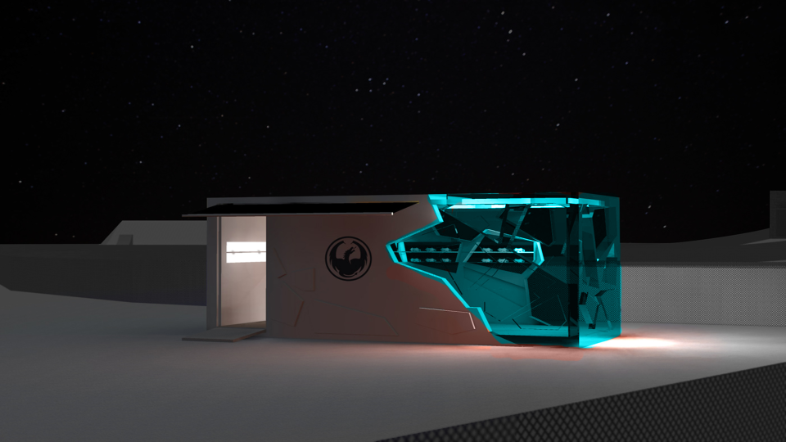
LET’S RUN A CONTAINER
Alpine Linux

Slide 38
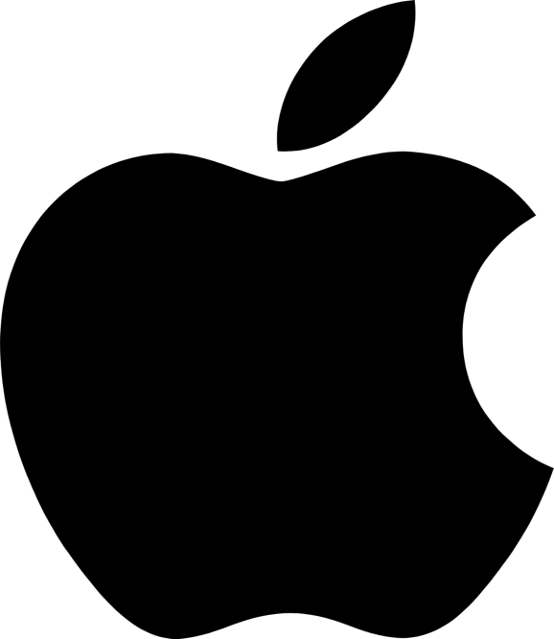

1
Install Docker Desktop
(Tricky)
http://docs.docker.com

Slide 39
2
Pull Alpine Linux Docker image
docker pull alpine
Alpine Docker image is just 6MB! See for yourself:
docker images

Slide 40
2
Run Alpine Linux container
docker run –it alpine
Now you are inside the Alpine container! (bash)
echo “Hello from Alpine”

Slide 41
3
Run Alpine Linux container
Your container has been started in interactive mode because of the –it flag you passed.
docker run –it alpine
You can exit by simply
exit

Slide 42
4
Run Alpine Linux container
You can run containers without interactive mode
docker run alpine echo “hello”
Now you don’t have to exit. List containers:
docker ps -a

Slide 43
4
Delete Alpine linux Docker image
First, list your Docker images
docker images
Delete image:tag
docker rm alpine:latest

Slide 44
5
Docker can give you GUI ☺
Pull a Jupyter Docker image (190MB)
docker pull jupyter/base-notebook
Start container and forward it to your port 8888:
docker run –it –p 8888:8888 jupyter/base-notebook
Go to your web browser:
localhost:8888

Slide 45
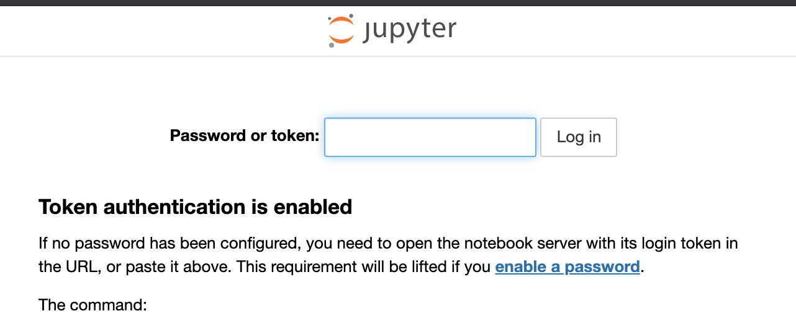
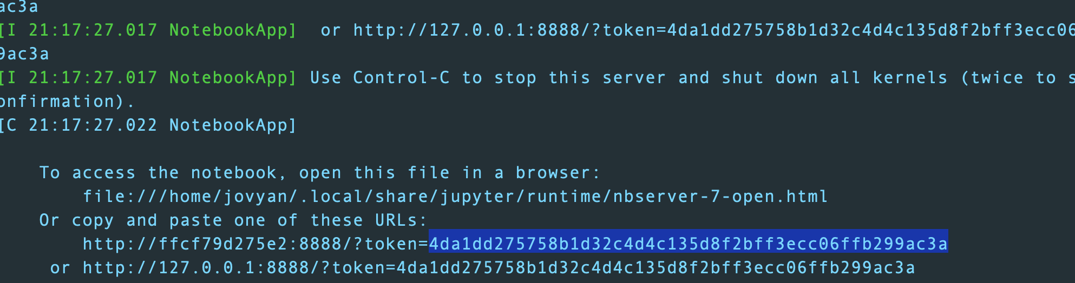

Slide 46




Some super cool stuff
Repo2docker
https://github.com/jupyter/repo2docker
https://osf.io/
Turn a GitHub repository into a
Docker image.
OSF is a free, open platform to support
your research.
BinderHub
https://mybinder.org/
https://github.com/
Run your code in the cloud.
This is where it all happens.

Slide 47
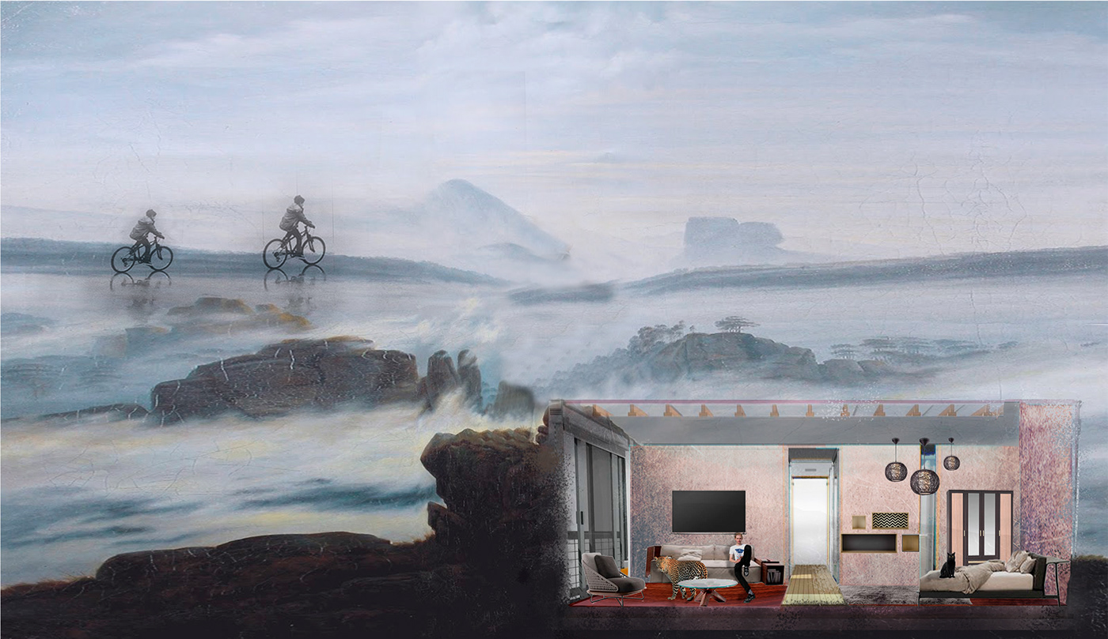
Some useful links
https://docs.docker.com/glossary/
http://bit.ly/2sMjaBy
https://github.com/wsargent/docker-cheat-sheet
https://learnk8s.io/blog/smaller-docker-images
https://docs.docker.com/storage/volumes/
https://singularity.lbl.gov/
Advanced
https://docs.docker.com/machine/overview/
https://kubernetes.io/
https://github.com/GoogleContainerTools/distroless

Slide 48

Alexandru Grindeanu, Jack Daley, Evgeny Zubkov, Lena Zubkova, MXD project
Hannah Dudchenko, Patrizio Rovere, Alexey Golbraykh, Sebastien Gobert, Celia Ruiz.
https://www.behance.net/gallery/61685009/Russia-2046?tracking_source=search%7Cvirtual%20box
https://www.behance.net/gallery/41712999/Wanderlust-Alphabet-A-E
https://www.behance.net/gallery/38320767/House-on-the-Lake?tracking_source=search%7Cminimalist%20space%20
https://www.behance.net/gallery/17654785/Container-Mountain-Bar?tracking_source=search%7Clightweight%20container
https://www.behance.net/gallery/48771379/Tiny-container-house?tracking_source=project_owner_other_projects
https://www.behance.net/gallery/9099257/Container-Ephemere-2012?tracking_source=search%7Ccontainer
Creative artwork used in this presentation is featured on behance.net

