Slide 1


Reusing Distributed Computing Software and Patterns for Midscale Collaborations
Benedikt Riedel
On behalf of the OSG Science Collaboration Support Team
CHEP 2019
Adelaide
November 5, 2019

Slide 2
Motivation & Background
In Open Science Grid we support science at all scales
Large scale science
  Significant software and computing teams
  Experiment-specific workload and data management systems
Individual investigators across many domains
  Usually can be supported one-on-one to facilitate distributed high-throughput computing

Slide 3
Midscale challenge
A number of collaborations fall in between - “Midscale”
  In terms of scale - dozens of researchers and institutions, multiples of petabytes,
  “Small” scale continuous production with CPU needs driven by episodic campaigns
But typically have less personpower - Scientists rather than professionals
Existing distributed infrastructure and services often present too high a barrier for their intermediate scale and immediate use

Slide 4
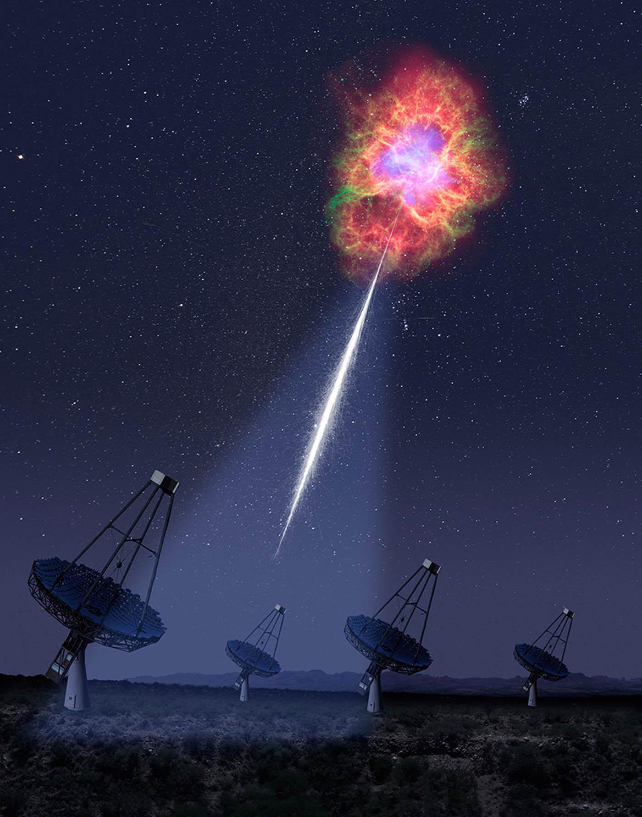
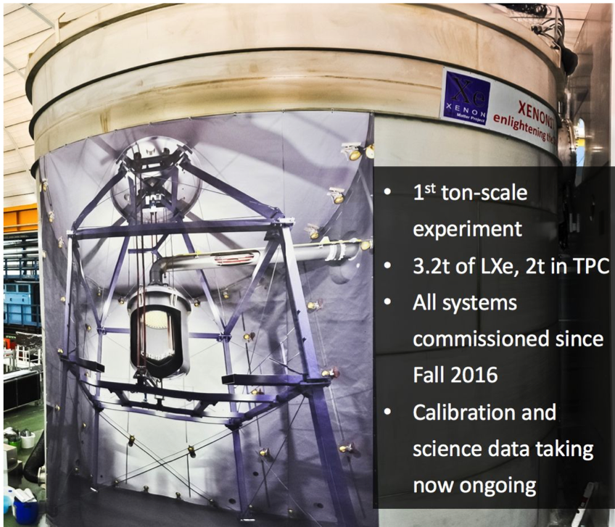
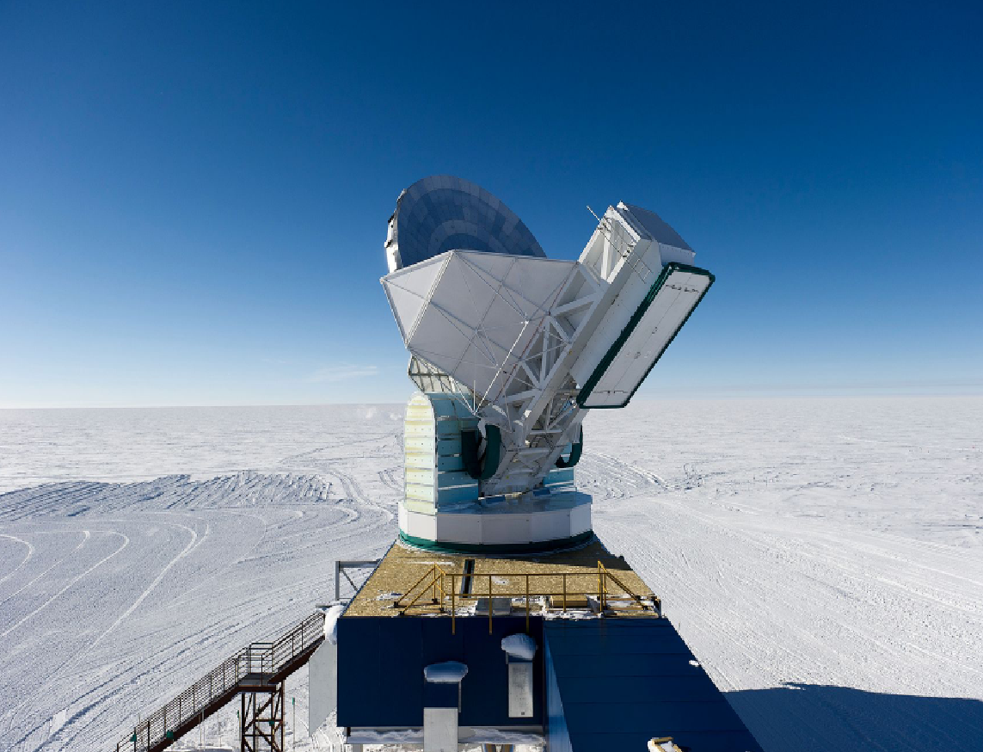
Example mid-scale collaborations
VERITAS:
4 12m Cerenkov telescopes for
gamma ray astronomy: Arizona, USA
XENON1T:
Dark matter detector at Gran Sasso National Laboratory, Italy
South Pole Telescope:
Microwave-millimeter telescope
Notes:
SPT, XENON,

Slide 5

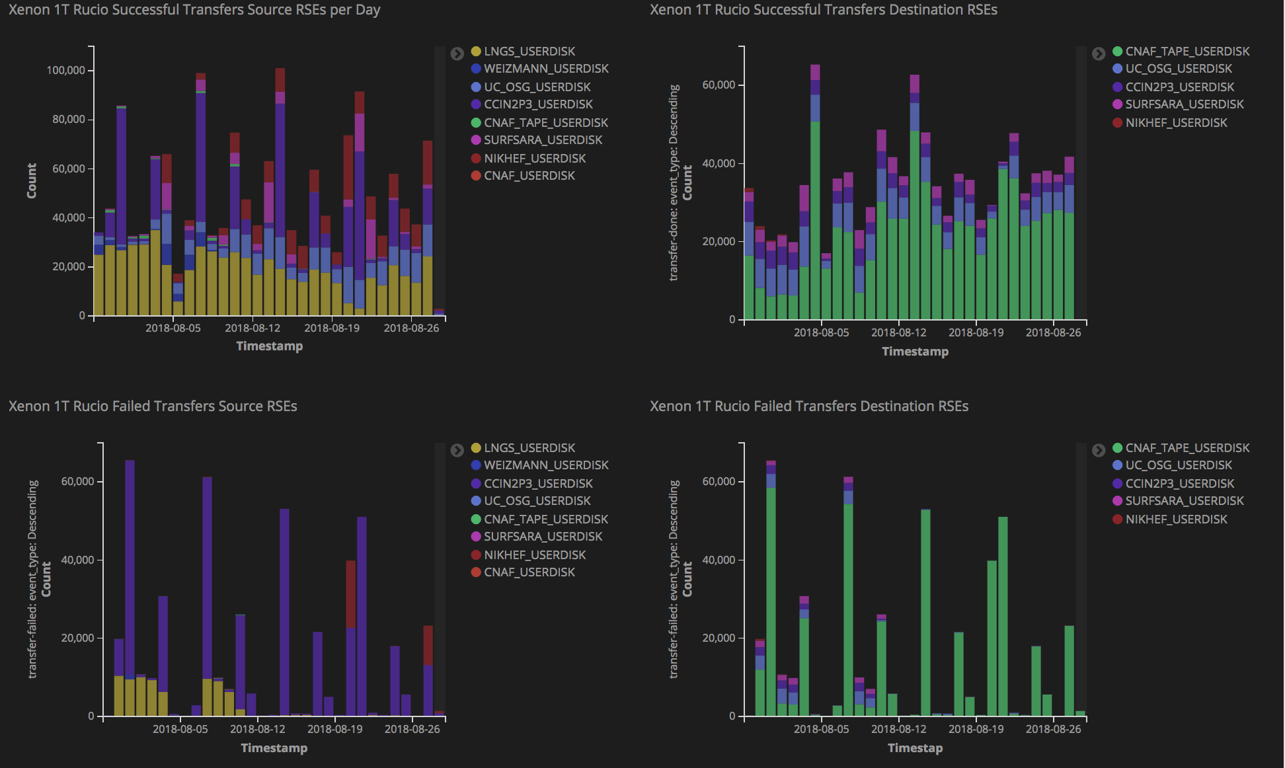
Reusing Cyberinfrastructure
DATA - Rucio and FTS
  XENON currently has 9 storage endpoints defined in the US, Europe and Israel
  One of the first production deployments outside of ATLAS
  Catalyst for the Rucio open source community (c.f. Mario's plenary)
Software - CVMFS
Job Workload - HTCondor, Pegasus
  tools for OSG and EGI submission

Slide 6
XENON1t Experiment
Searching for dark matter candidates
PATTERN REUSE: data intensive
processing, simulation, analysis

Slide 7
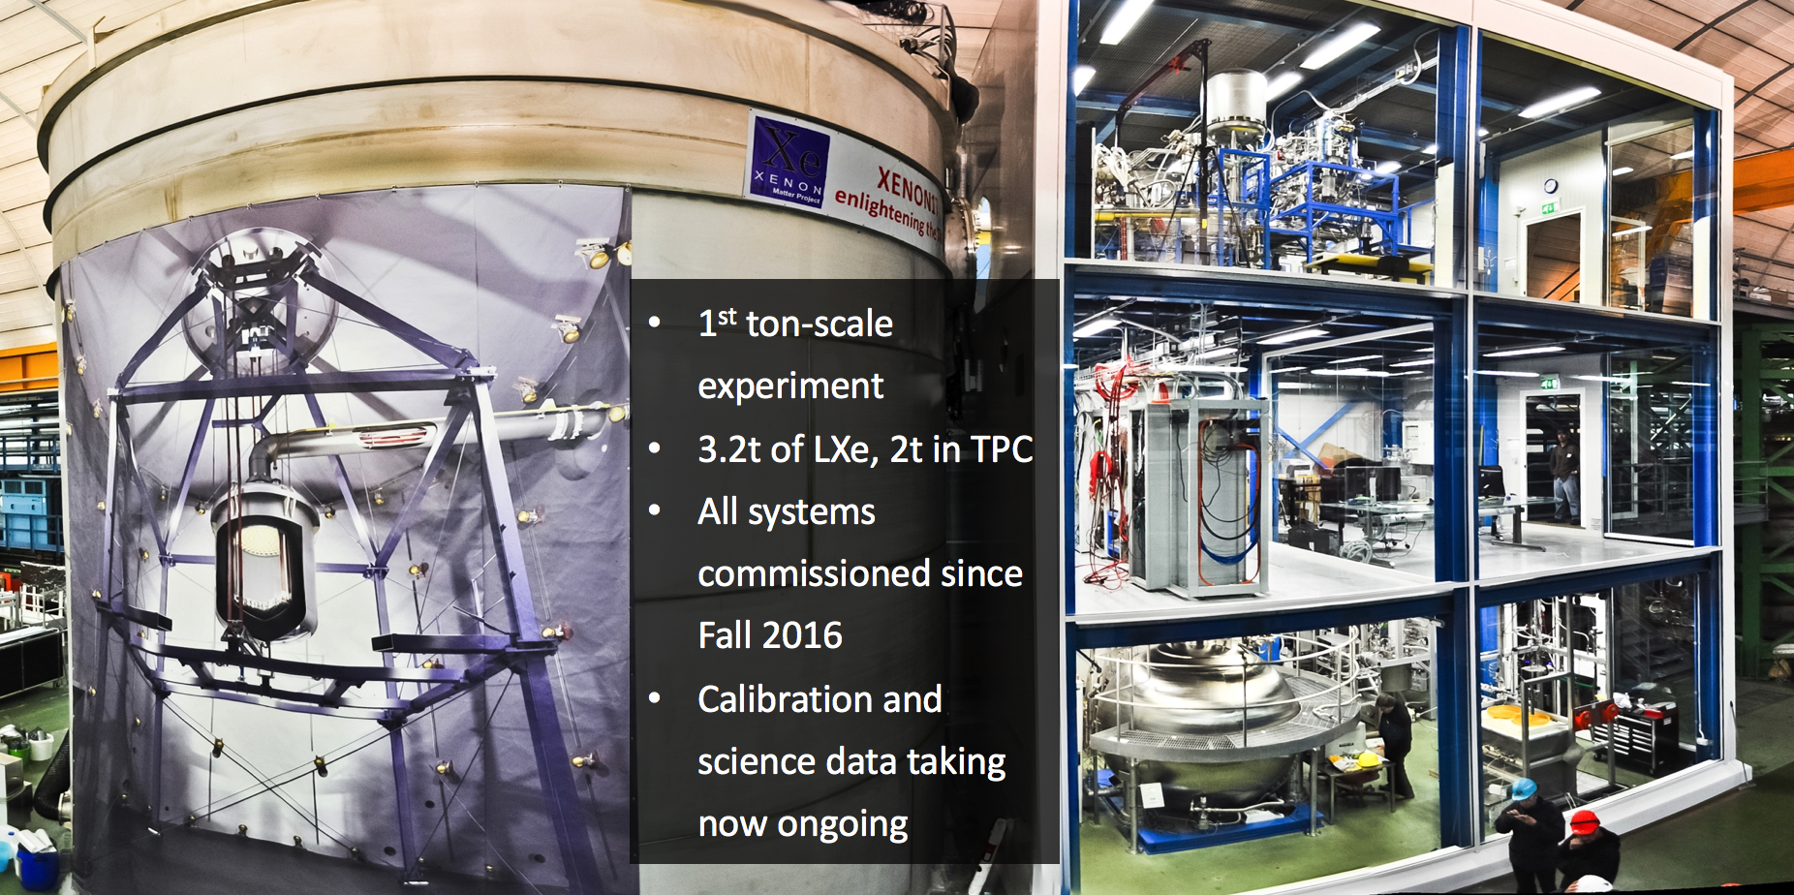

Slide 8
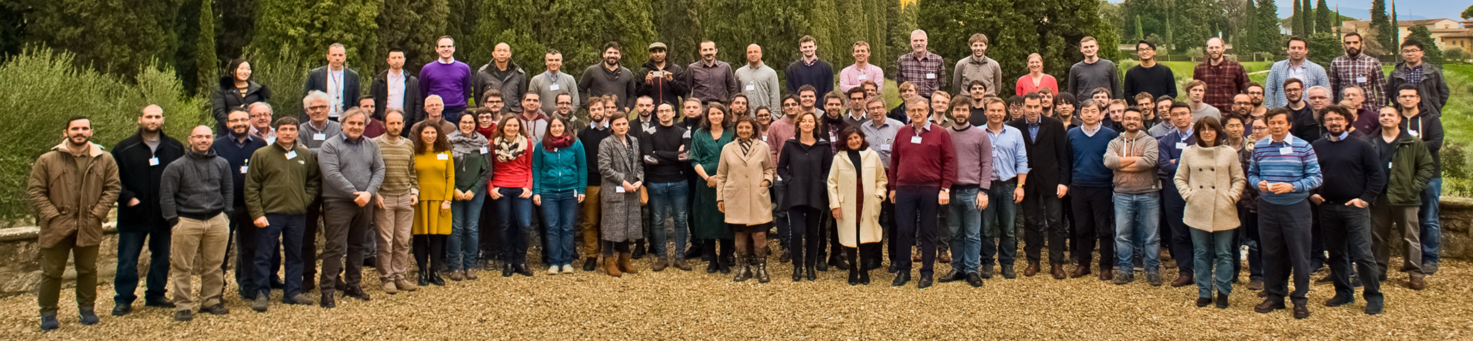
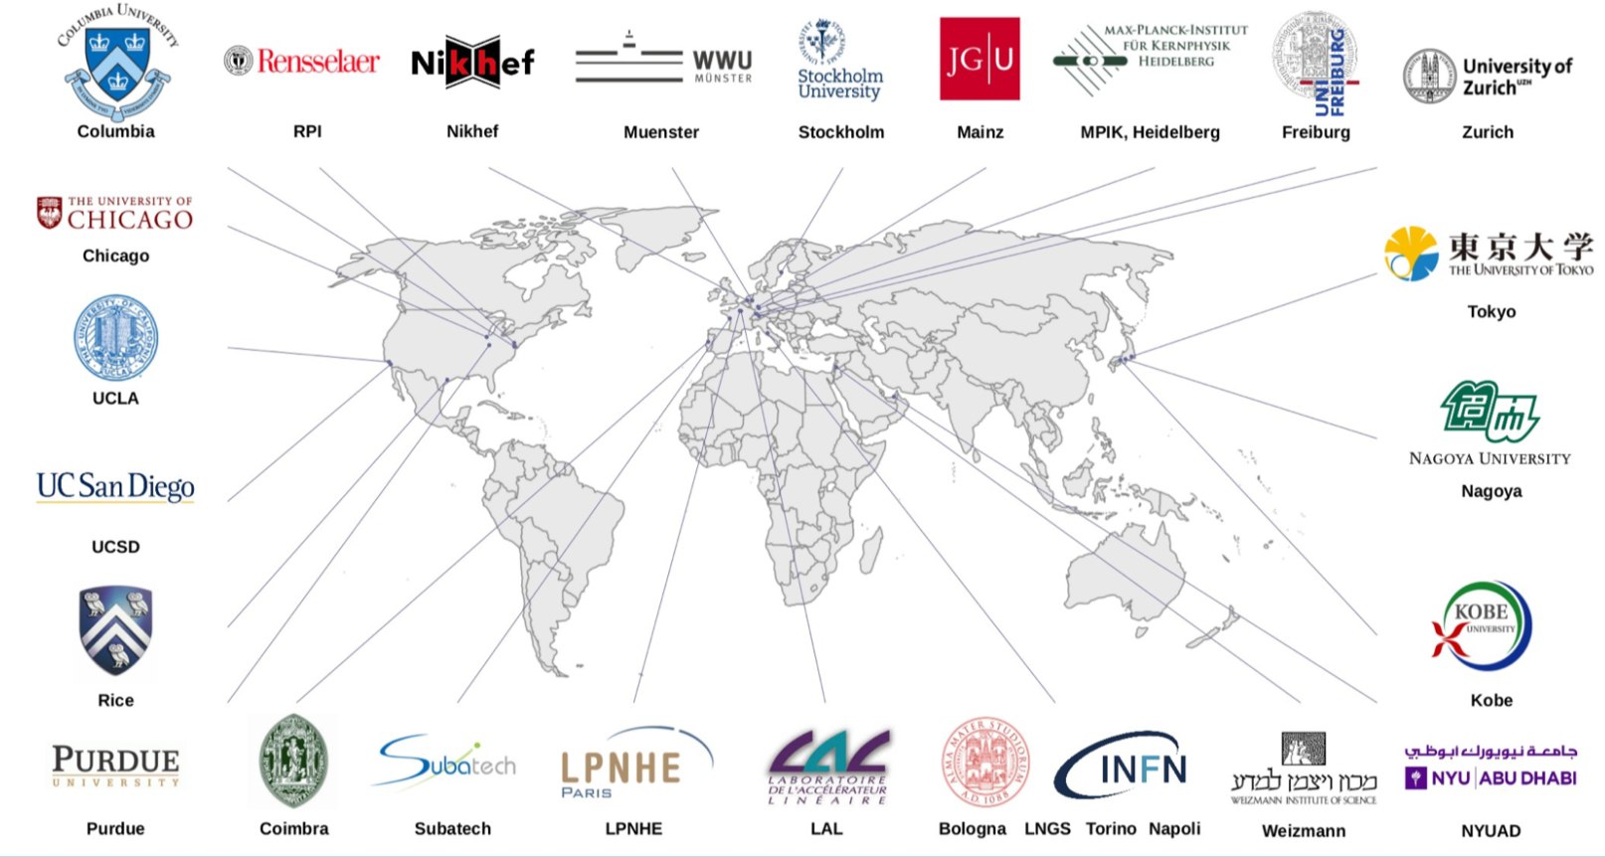
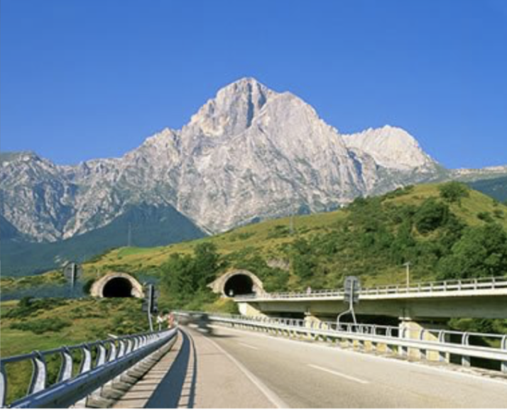
Experiment located at the Laboratori Nazionali del Gran Sasso (LNGS), Italy
165 scientists, 25 institutions, 11 countries

Slide 9
Experiment located at the Laboratori Nazionali del Gran Sasso (LNGS), Italy
165 scientists, 25 institutions, 11 countries
Multi-institution
International scope
Resource providers from two grids

Slide 10
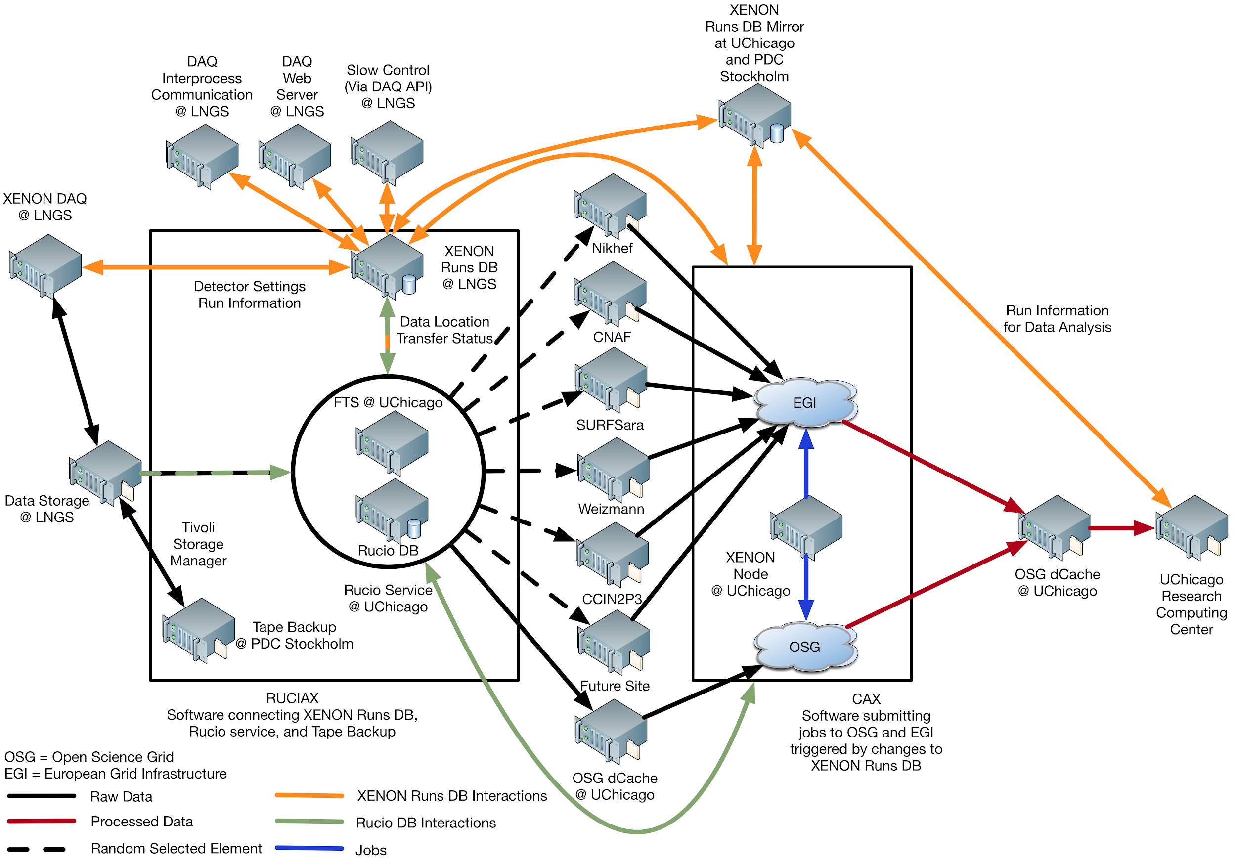
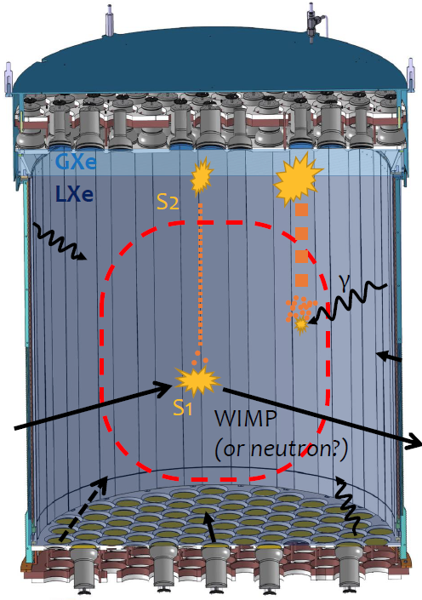

Global data & processing platform
EU & US storage
EU & US processing
Job management with HTCondor & workflow pipeline tools

Slide 11
South Pole Telescope
Job submission infrastructure with OSG tools
Managed data transfer and management
  South Pole, Chicago, and archival in Berkeley
Software distribution via CVMFS
OSG flocking

Slide 12
SPT Data flow
Local /buffer
Cori
HPSS
spt-trac
spt-buffer
USAP.gov CO
UChicago
NERSC
CephFS spt/
amundsen
scott
White Sands NM
HPC
RCC/Midway
OSG/MWT2
Raw data
South Pole
XSEDE
Production data

Slide 13
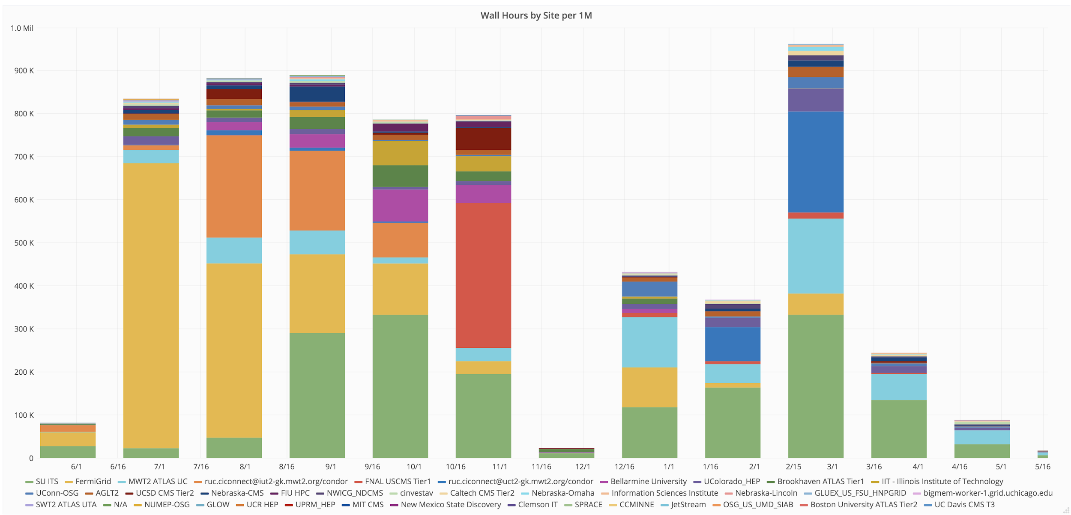
VERITAS
Job submission infrastructure based on Pegasus WMS
CVMFS for software distribution
Ceph storage and pre/post job processing
RADOS gateway as an interface to AWS S3 RESTful API

Slide 14
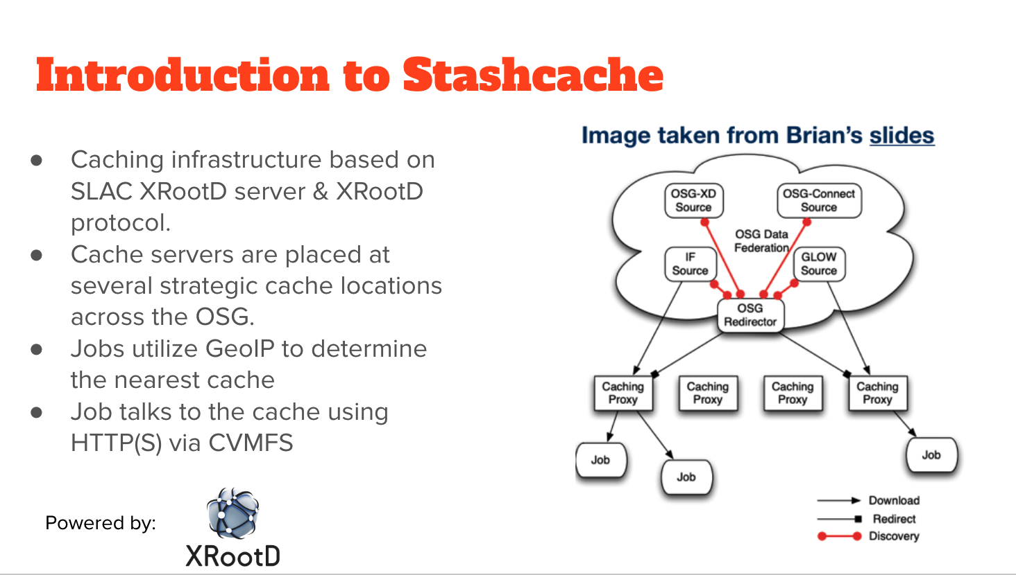
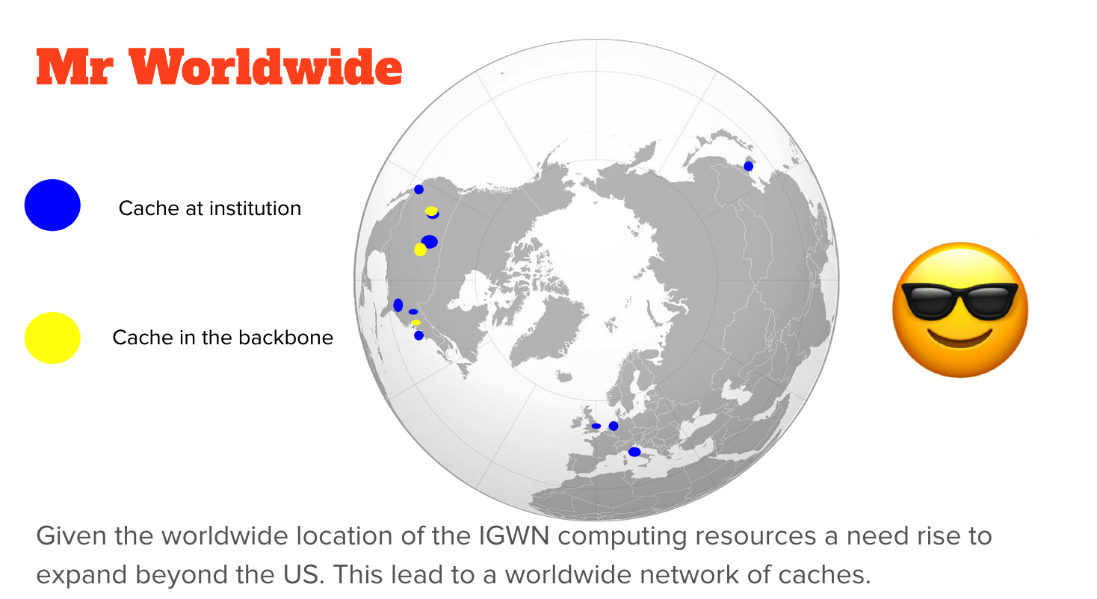
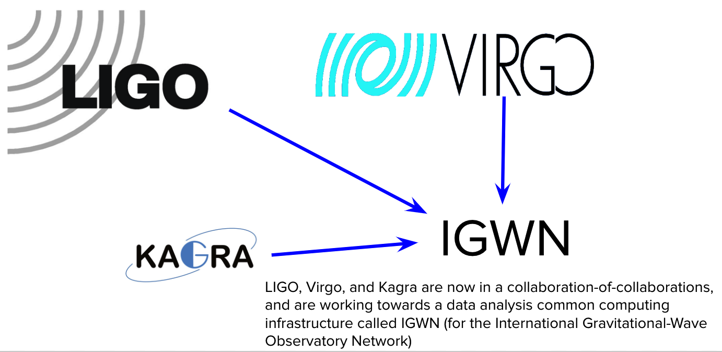
Another successful effort - Creating Science Caching Networks
c.f. "Creating a content delivery network for general science on the backbone of the Internet using XCache(s)" I.Sfligoi

Slide 15
Summary & going forward
Re-use of software infrastructure, services and tools built for the LHC can be repurposed
  there is significant demand for this
  comes with particular challenges - technical and cultural
CVMFS, Rucio, FTS, XrootD/Caching, OSG, EGI infrastructure re-used
Going forward - keeping multi-domain & reuse can pay dividend down the road
“Midscale” experiments a new focus in US

