Slide 1

Research Management: The Game
Bonus and Disaster cards for round one
Find out more at 10.5281/zenodo.3584128
© Research Consulting 2019
This work is licensed under a Creative Commons Attribution 4.0 International License.

Slide 2


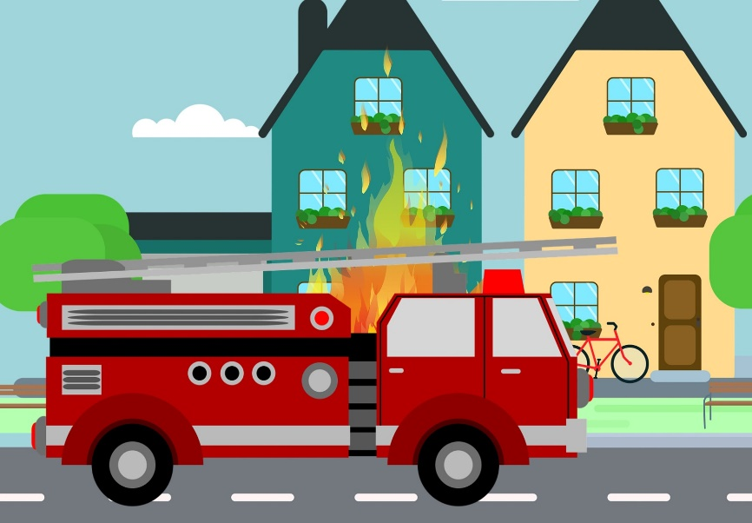








A Life Sciences professor leaves with her research team for another institute.
There has been an increase in funding awarded to Arts and Social Sciences.
There has been a fire in your Engineering building.
The Government adopts new impact agenda.
The Government cuts your funding for Arts and Social Sciences.
Give all of your Life Sciences counters to the team with the most counters in this area. If multiple teams have the same number, choose 1 team.
If you have counters in Arts and Social Sciences, your allocated amount triples.
If you have fewer than 3 counters allocated to Buildings, lose all Engineering and Buildings counters. Otherwise, there is no change.
The government triples any counters allocated to Policy & Impact.
Lose all counters allocated to Arts and Social Sciences.
You start a Centre of Excellence in digital research.
A new national strategy has been introduced focusing on Science and Engineering.
There has been an increase in funding awarded to Life Sciences.
There is increased competition for funding.
New funding has been introduced for interdisciplinary research.
The government triples your allocation to IT & Specialist Equipment.
If you have 2 counters in both Science and Engineering categories, you receive 4 counters. If you have 3 or more, you receive 8 counters.
If you have counters in this area, your allocated amount doubles.
If you have 2 or more counters in Pre and Post-award, you receive 8 counters. If you have less than 2 counters in Pre and Post-award, you lose 4 counters.
If you have at least 2 counters in Interdisciplinary Fund, the government triples your allocated amount. Otherwise, you miss out on this funding.

Slide 3
Research Management: The Game
Bonus and Disaster cards for round two
Find out more at 10.5281/zenodo.3584128
© Research Consulting 2019
This work is licensed under a Creative Commons Attribution 4.0 International License.

Slide 4










One of your academics develops a new wonder drug.
There has been an increase in funding awarded to Life Sciences.
You recently submitted a major proposal.
Investment into responsible research and innovation pays off.
Smart specialisation bonus.
Your university is based in a region with a strong biotechnology business cluster.
If you have 6 or more counters allocated to Research Management, gain 12 counters. If you have less than 6 counters, get nothing.
If you have counters in this area, your allocated amount doubles.
If you have 2 or more counters in Pre and post-award, gain 8 counters. If you have fewer than 2 counters in this category, lose 3 counters.
Gain 5 counters if you have invested at least one counter in every academic research area and at least one counter in Policy and Impact.
Double your counters in Life Sciences.
Funder requirements for research data management have been increased.
There is a lack of investment in science. Professor Rhodium leaves and takes his research group with him.
Supporting the University’s new Research Strategy needs a lot of time from the Research Management team.
Rewards for investment in STEM – you poach a research team from another university.
Your collaboration strategy pays off.
Gain 5 counters if you have invested over 6 counters across Libraries and
IT and Specialist Equipment.
Give 3 counters from Science to a team of your choice. If you have less than 3 counters in Science, give any 4 counters to a team of your choice.
Gain 10 counters if you have invested more than 10 counters in Research Management. Lose 3 counters (from anywhere) if you haven’t.
If you have more than 10 counters across Engineering, Life Sciences and Science, take up to 6 counters in these areas from another team of your choice.
Choose ONE team and ONE research area. If your combined counters in that subject area total more than 15, gain 5 counters each.

Slide 5
Research Management: The Game
Bonus and Disaster cards for round three
Find out more at 10.5281/zenodo.3584128
© Research Consulting 2019
This work is licensed under a Creative Commons Attribution 4.0 International License.

Slide 6










Billionaire philanthropists wish to support the Arts and Social Sciences.
An Arts and Social Sciences professor leaves with her research team for another institute.
There is a visit from European auditors.
You start a Centre of Excellence in Life Sciences.
The Government starts a scheme to upgrade ageing research infrastructure.
If you have two or more counters allocated to the Arts and Social Sciences, receive 12 counters.
Give all of your Arts and Social Sciences counters to the team with the most counters in this area. If multiple teams have the same number, choose one.
If you have no counters in pre and post-award, lose 10. If you have 1 counter, lose 5. If you have 2 counters, lose 3. If you have 3 or more counters, no change.
The government doubles your existing allocation to Life Sciences.
If you have fewer than 5 counters across Research Facilities, you receive 10. If you have 5 or 6 counters, you receive 5. If you have 7 or more, no change.
Government efficiency drive.
Your country decides to leave the European Union.
You receive a donation from a wealthy benefactor.
The Government introduces a mandatory open science policy.
The European Commission implements a mission-driven approach to funding.
Lose 6 counters from any categories.
Lose 10 counters.
This donation doubles your allocation to Science.
If you have 3 or more counters in Libraries & specialist infrastructure, gain 5. If you have 2 counters, no change. If you have fewer than 2, lose 5.
If you have fewer than 3 counters allocated to interdisciplinary activity, lose 5. If you have 3 or 4 counters, gain 5. If 5 or more counters, gain 10.

Slide 7
Thanks for playing!
Download your copy of this game at 10.5281/zenodo.3584128
Find out more at 10.5281/zenodo.3584128
© Research Consulting 2019
This work is licensed under a Creative Commons Attribution 4.0 International License.

