Slide 1
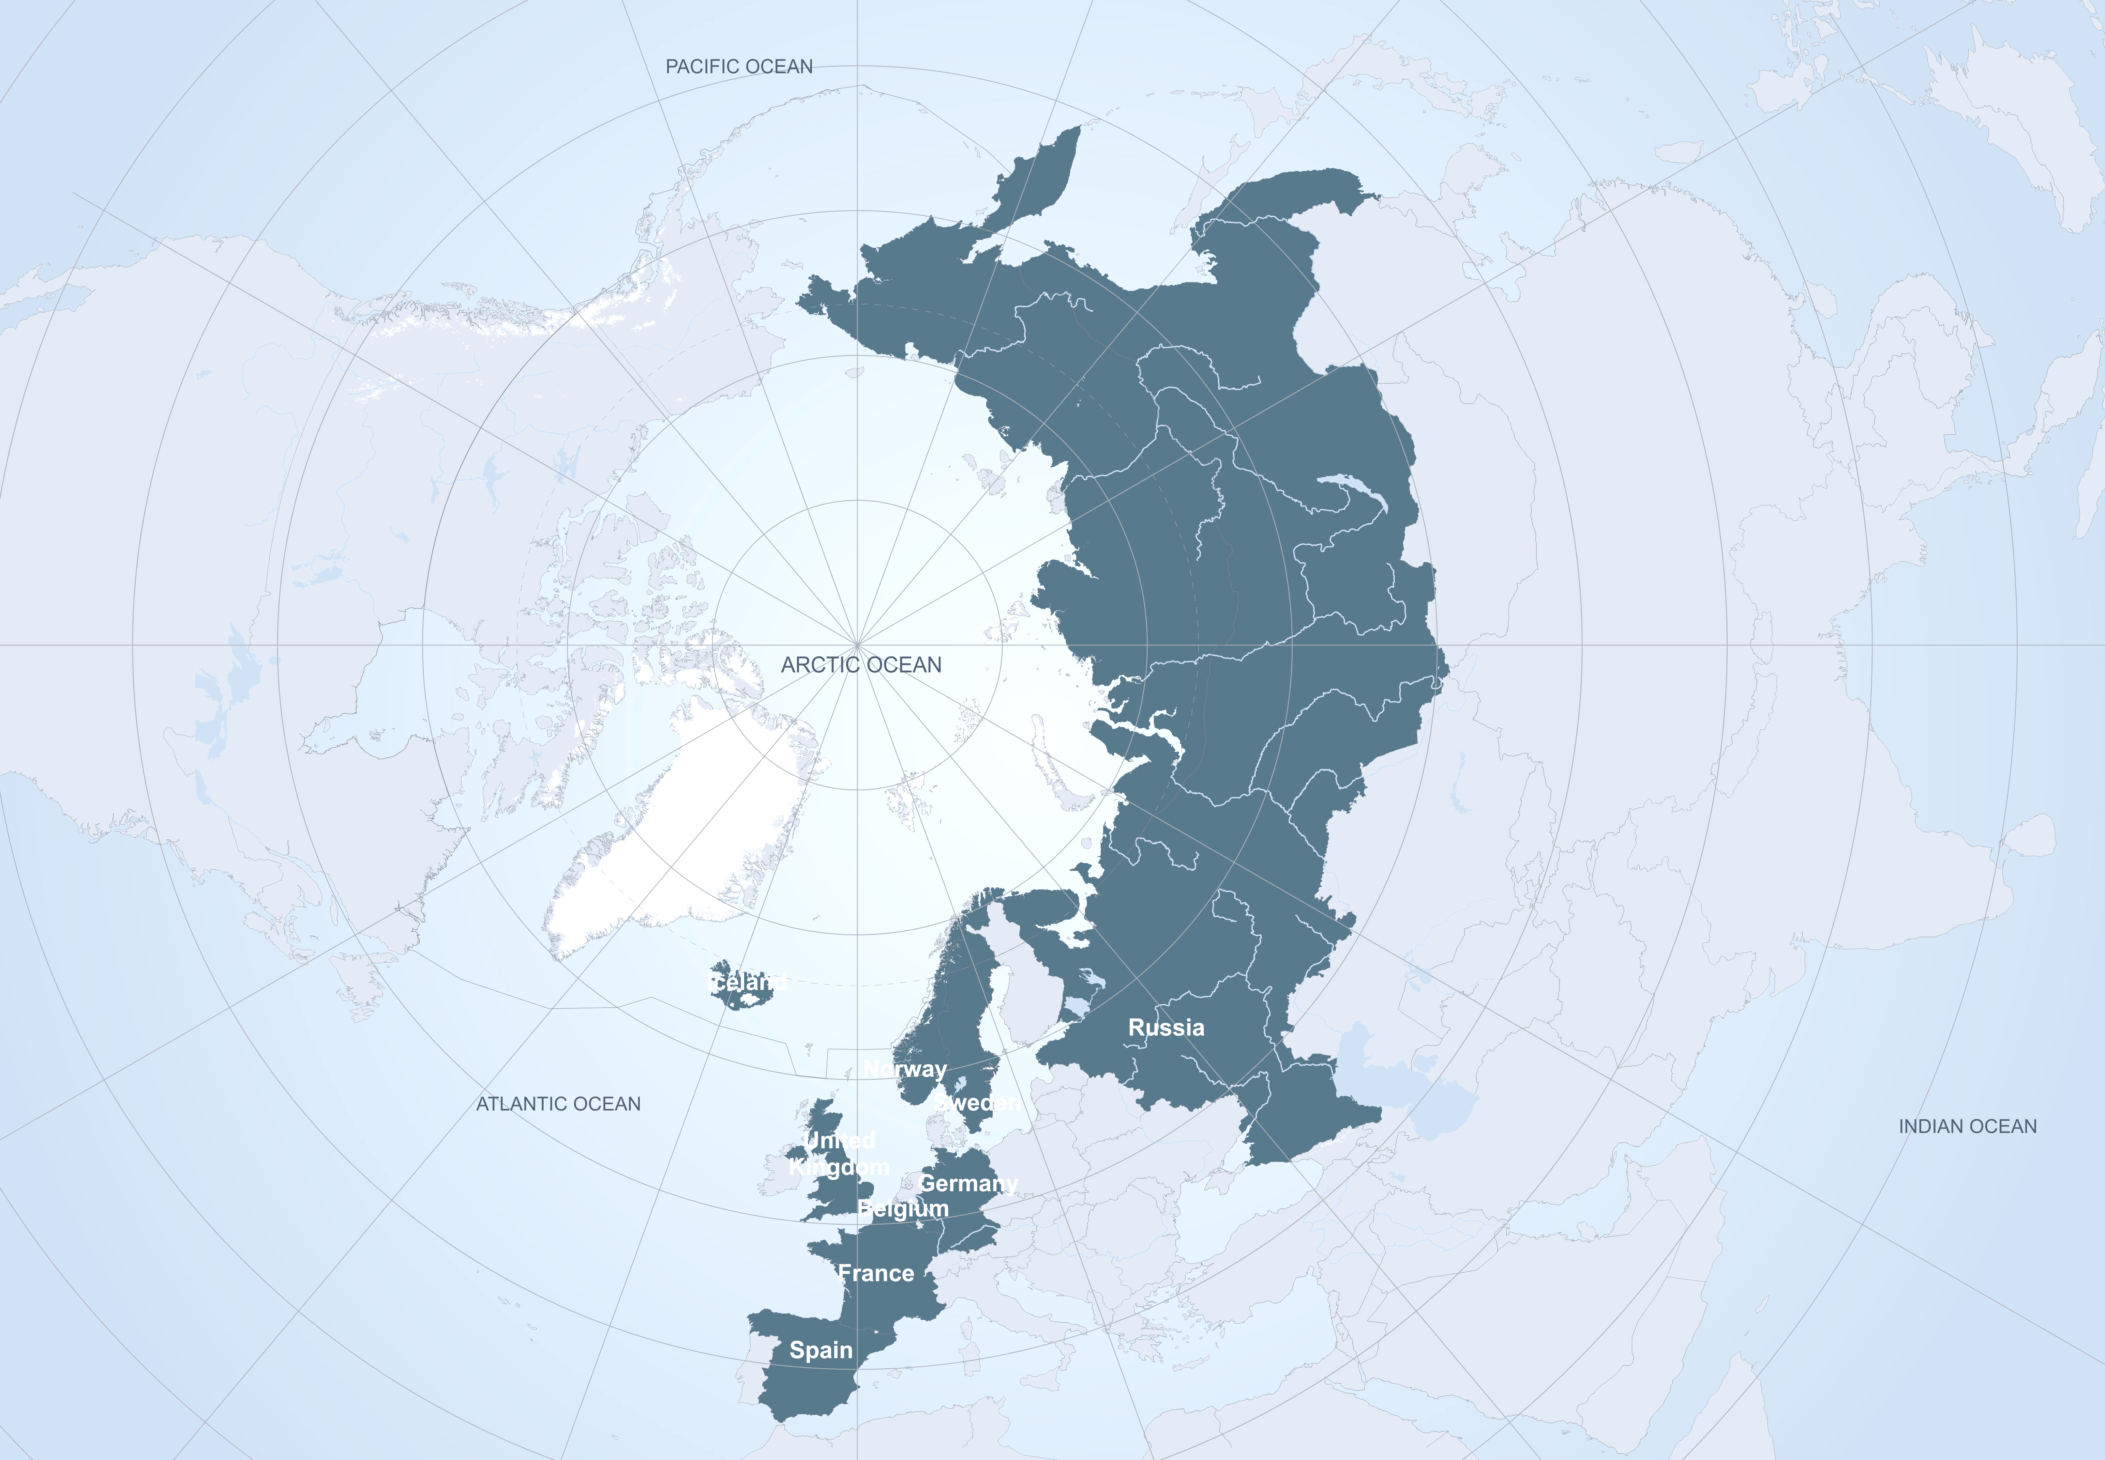


APPLICATE
Advanced Prediction in Polar regions and beyond: Modelling, observing system design, and LInkages associated with a Changing Arctic ClimATE
Thomas Jung (coordinator)
Alfred Wegener Institute (AWI), Germany
APPLICATE project has received funding from the European Union´s Horizon 2020 research and innovation programme under grant agreement No 727862.
The content of the document is the sole responsibility of the organizer and it does not represent the opinion of the European Commission and the Commission is not responsible for any use that might be made of the information contained.
www.applicate.eu

Slide 2
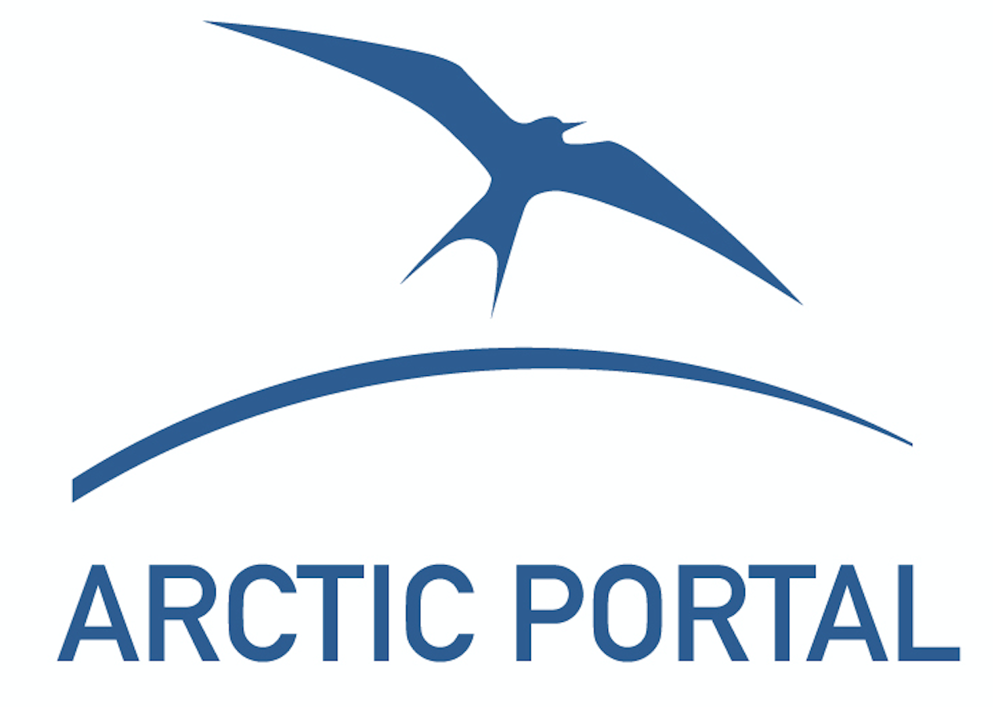

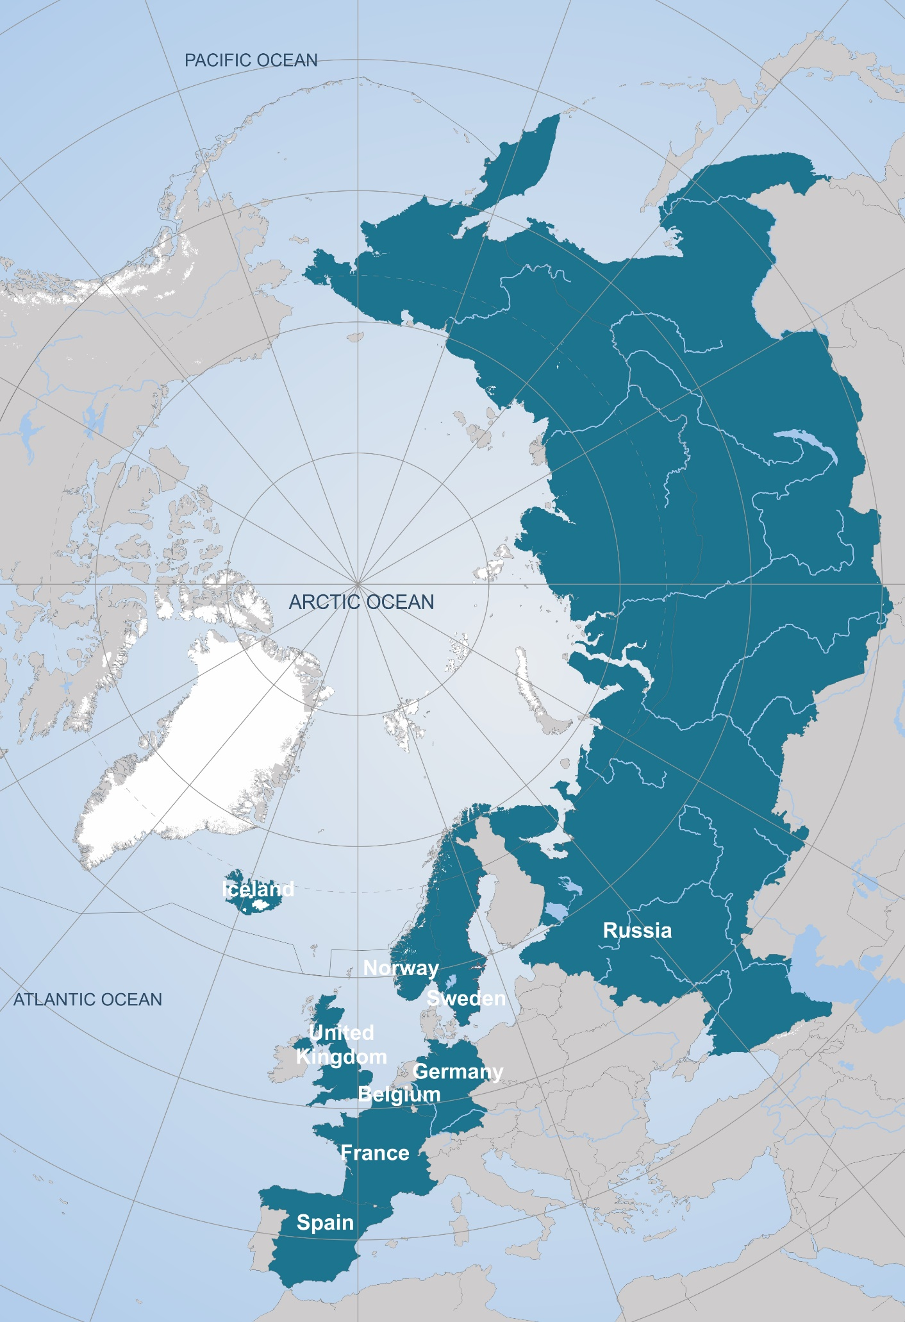










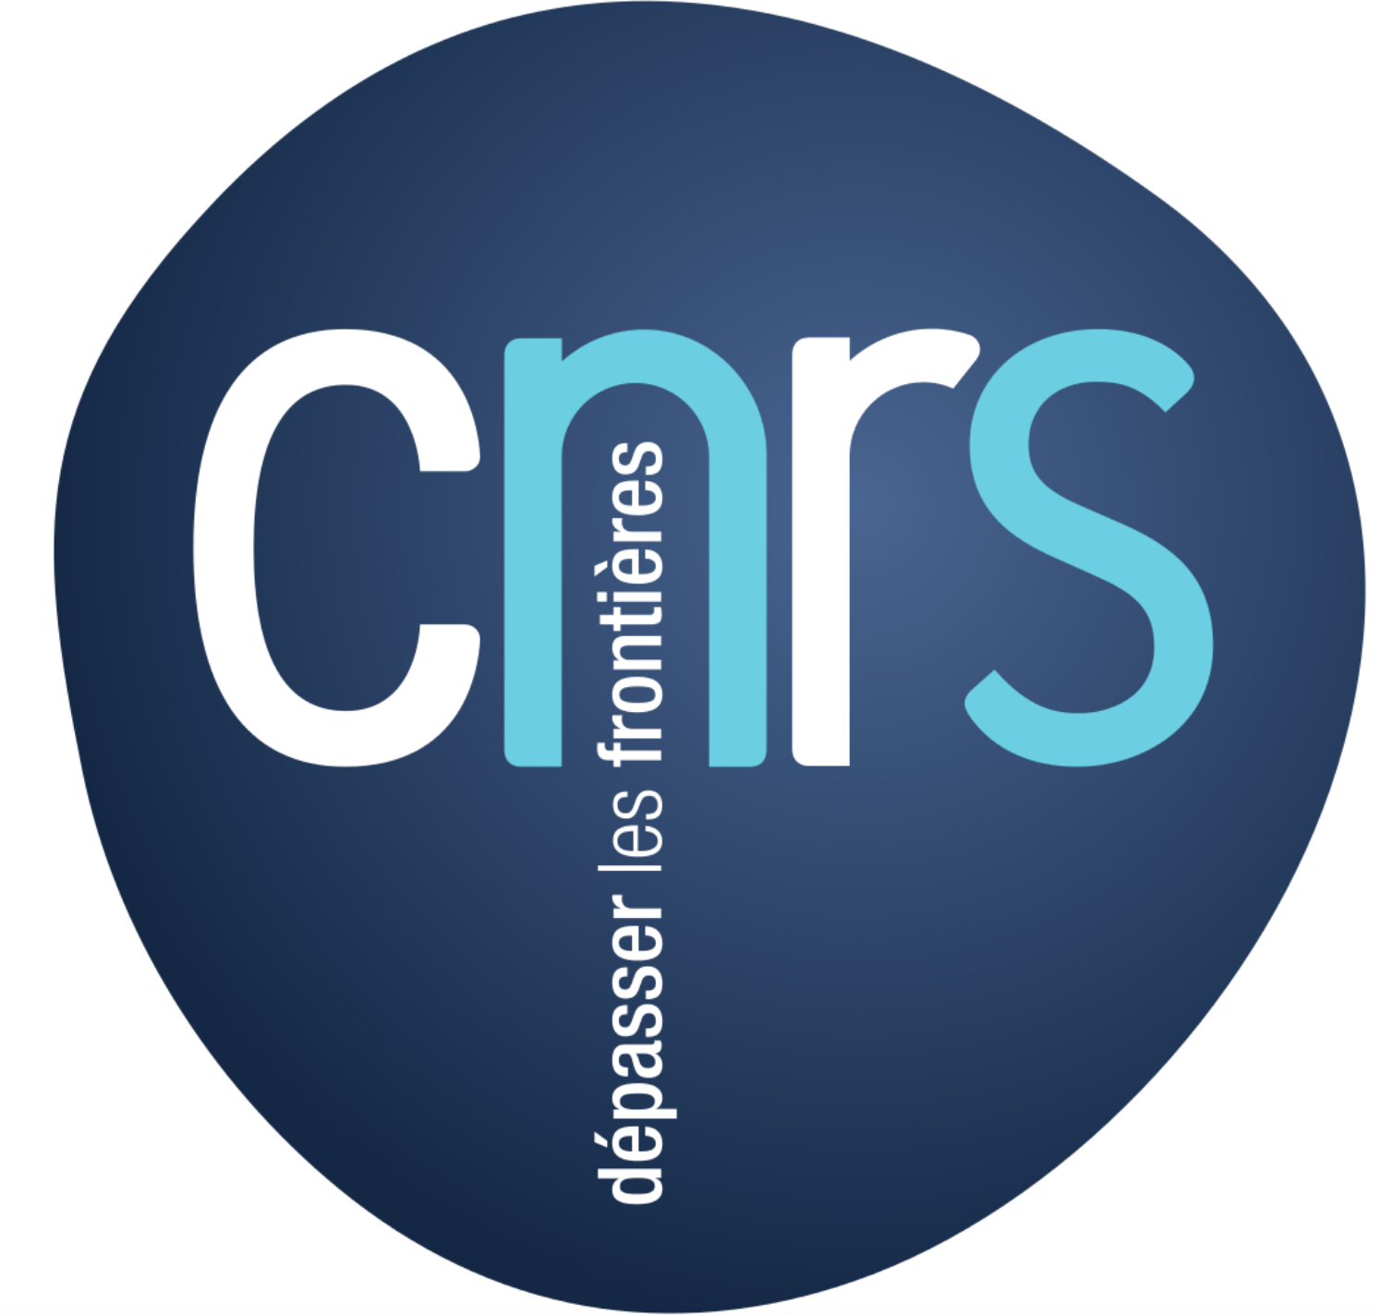




16 partners from nine countries
... and many collaborators!

Slide 3
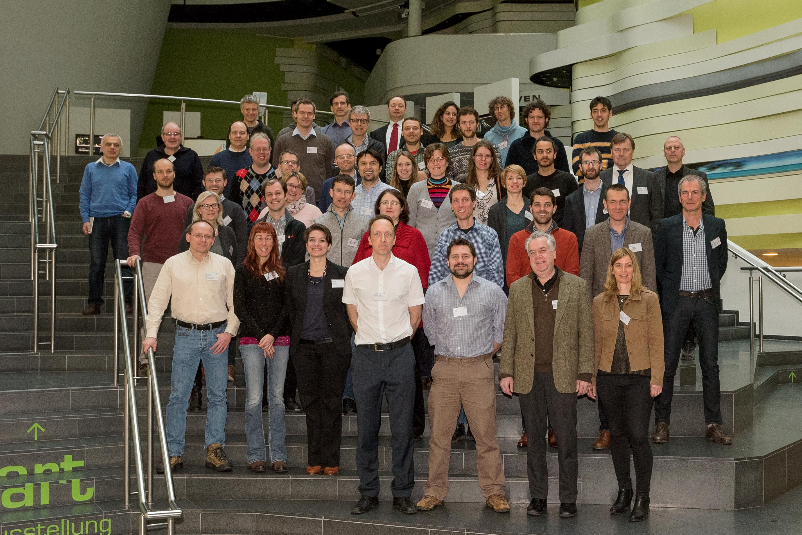
16 partners from nine countries
APPLICATE Kick-off Meeting, Bremerhaven, Germany, 8–9 Feb 2017
... and many collaborators!

Slide 4
Budget and duration
Budget: € 8 Mio + separate Russian contribution
1st November 2016–31st October 2020 (4-years)

Slide 5
Mission statement
Develop enhanced predictive capacity for weather and climate in the Arctic and beyond, and determine the influence of Arctic climate change on Northern Hemisphere mid-latitudes, for the benefit of policy makers, businesses and society.

Slide 6
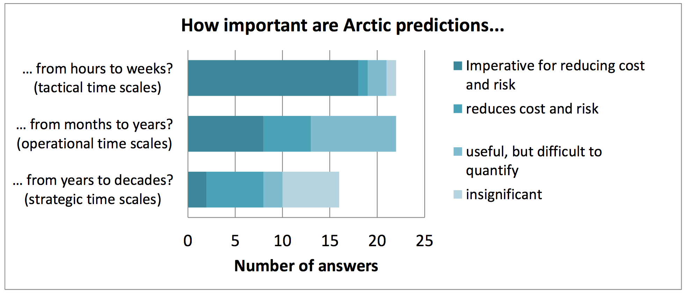
General approach
Bringing together the NWP and climate communities
Survey: EC-PHORS Services Task Team

Slide 7
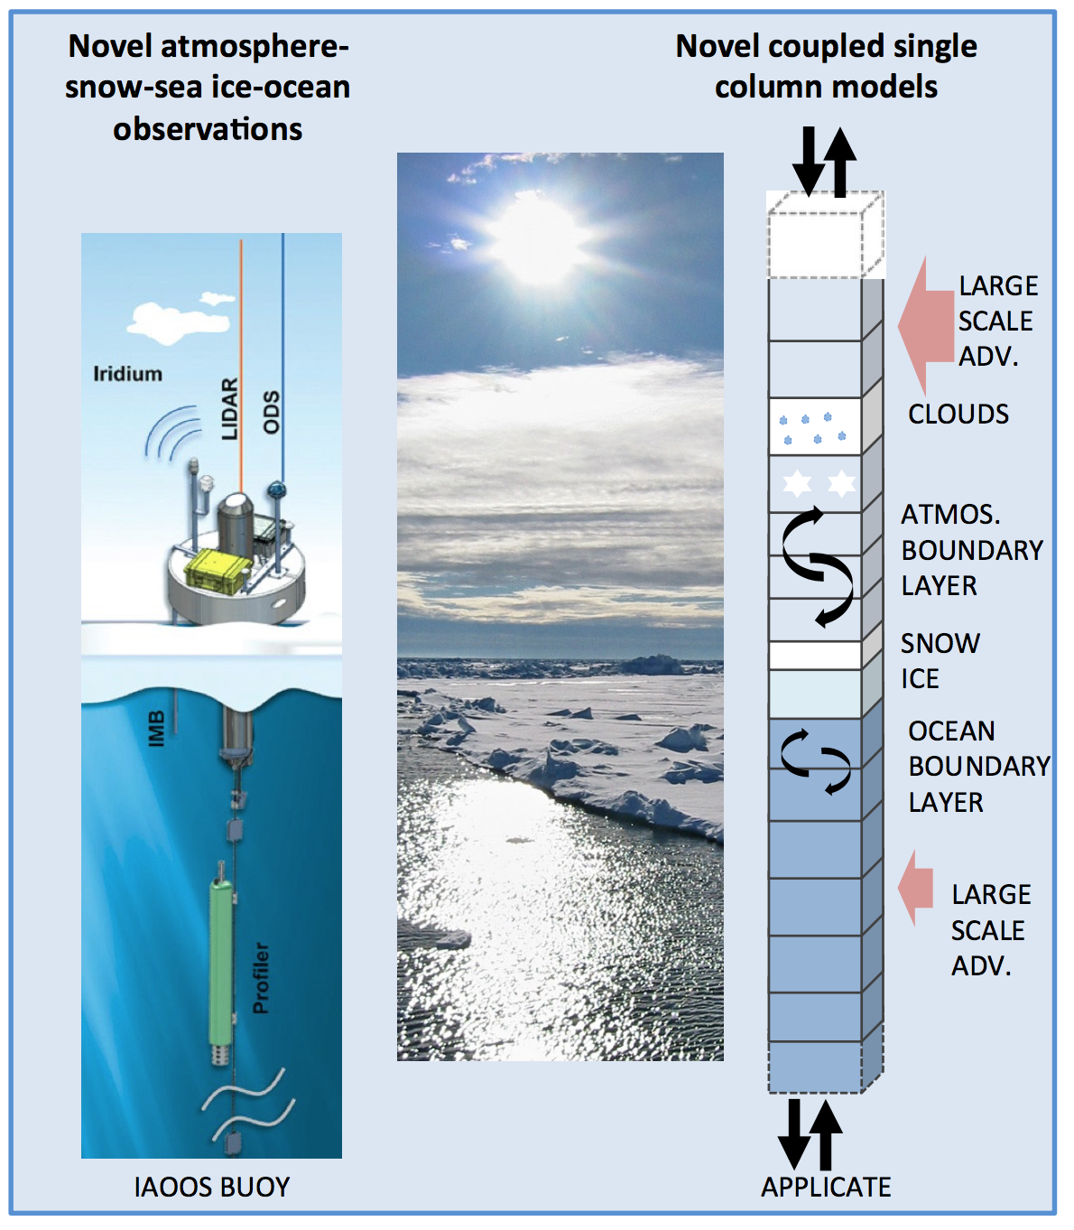
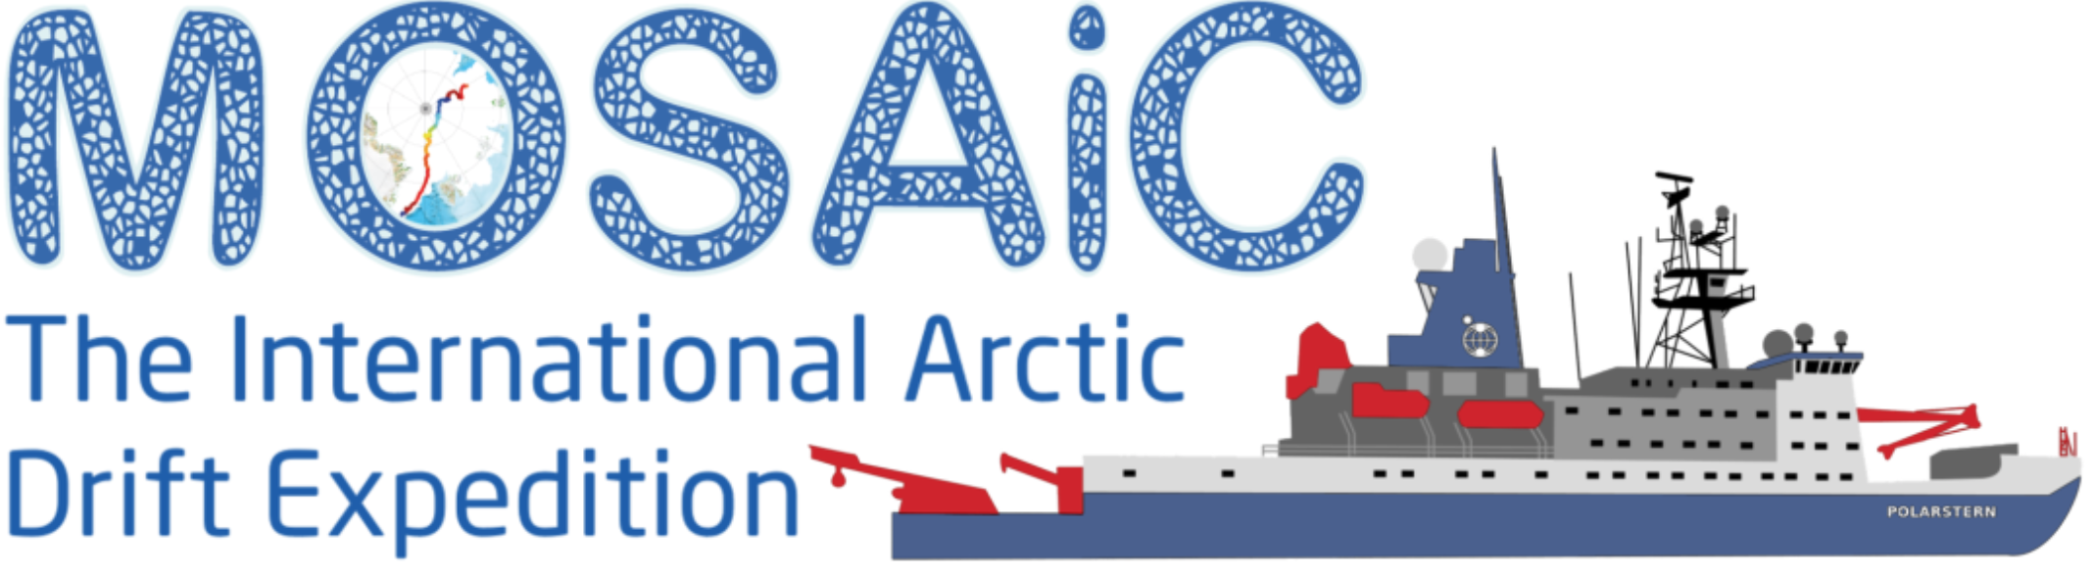
General approach
Bringing together the NWP and climate communities
Involving experts on the Arctic and midlatitudes
Engaging operational centres for maximizing impact
Effectively combining models and observations

Slide 8
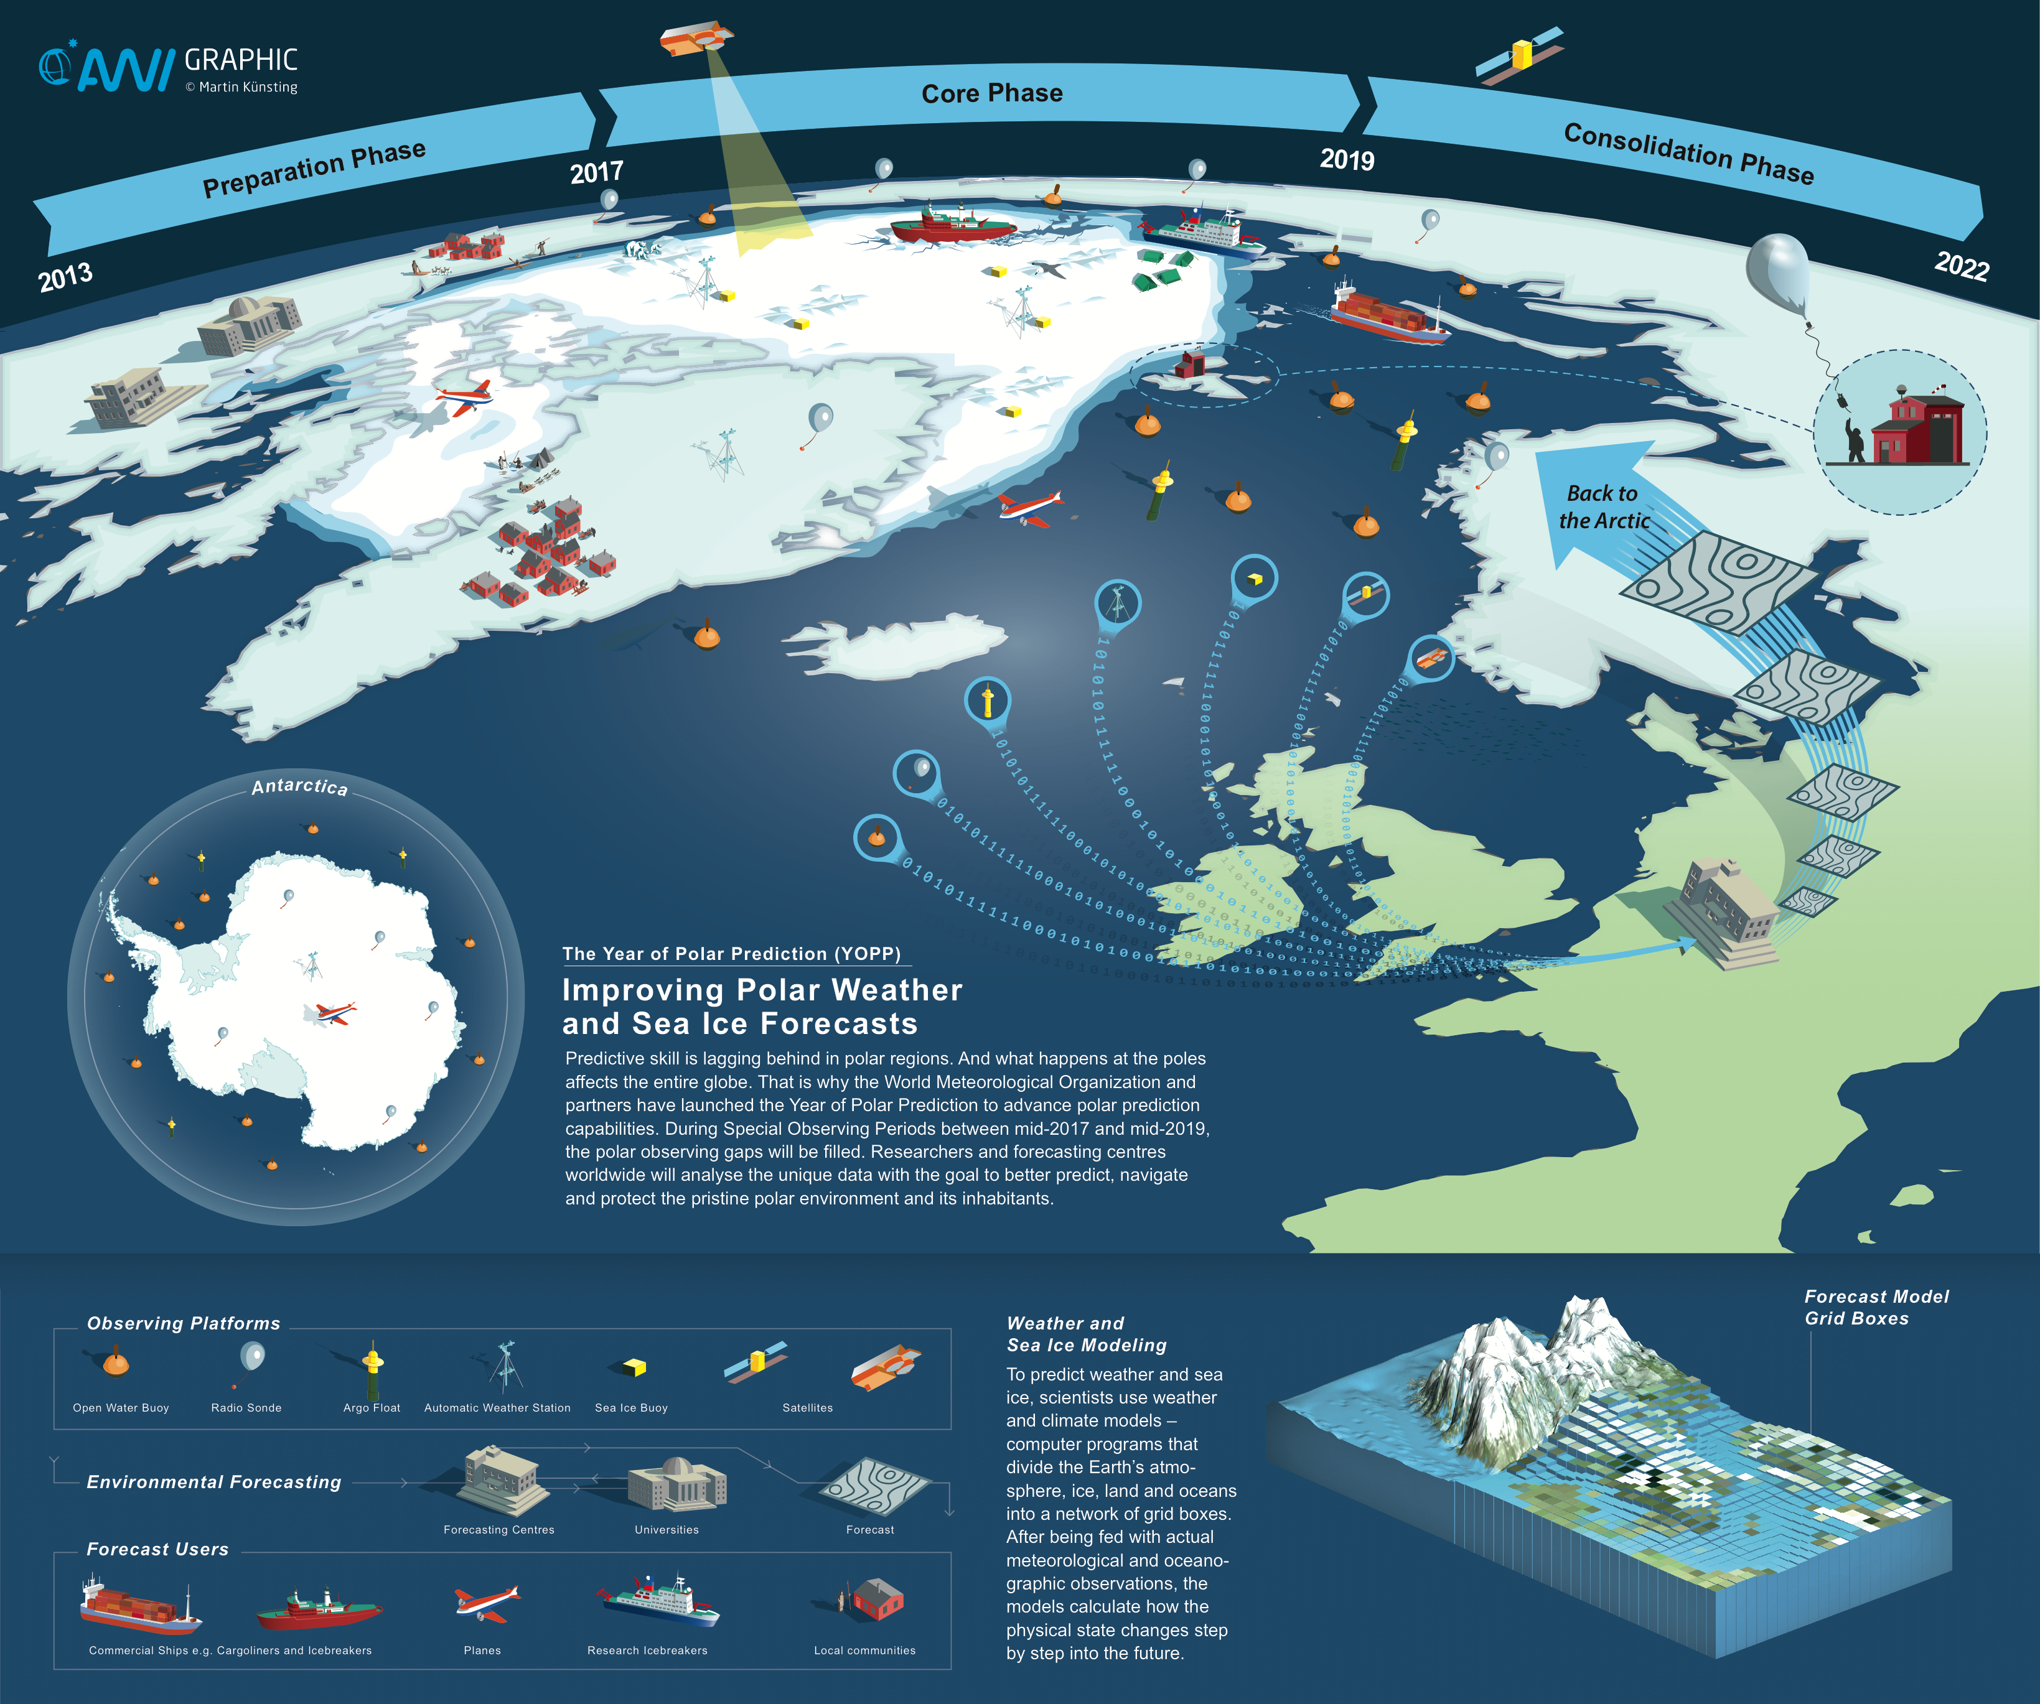
General approach
Bringing together the NWP and climate communities
Involving experts on the Arctic and midlatitudes
Engaging operational centres for maximizing impact
Effectively combining models and observations
Year of Polar Prediction (YOPP)

Slide 9
General approach
Bring together the NWP and climate communities
Involve experts on the Arctic and midlatitudes
Engage operational centres for maximizing impact
Effectively combine models and observations
Exploit European and international collaboration (e.g. Blue-Action, WMO and US-CLIVAR WG)

Slide 10
Strategy
Delivering enhanced predictions
Establish
Baseline
Develop Enhancements
Test Enhancements
Make Recommen-dations
Enhanced Predictions
New metrics and diagnostics
NWP
Subseasonal to seasonal prediction
CMIP5/6
Enhanced models
Optimized Arctic observing systems
Improved initial and boundary conditions
Enhanced NWP
Enhanced Subseasonal to Seasonal Prediction
Enhanced CMIP6
Presentations
Reports
Publications
Contribution to assessment reports
CMIP6-Interim and CMIP7
Enhanced operational:
NWP
Subseasonal to Seasonal Prediction
Interannual to Decadal Prediction

Slide 11
Strategy
Understanding of Arctic-midlatitude linkages
Coordinated multi-model approach
Employ atmosphere-only and coupled models
Study linkages also from a short-term prediction perspective
Repeat with enhanced models
Polar Amplification Model Intercomparison Project (PAMIP)
(seeking CMIP6 endorsement)

Slide 12
Strategy
Knowledge exchange
Focus on three key areas:
  User engagement
  Dissemination
  Training
Experienced partners taking the lead:
  Arctic Portal
  Barcelona Supercomputing Centre
  Association of Polar Early Career Scientists
Exploiting exisiting “channels“ from APPLICATE partners

Slide 13
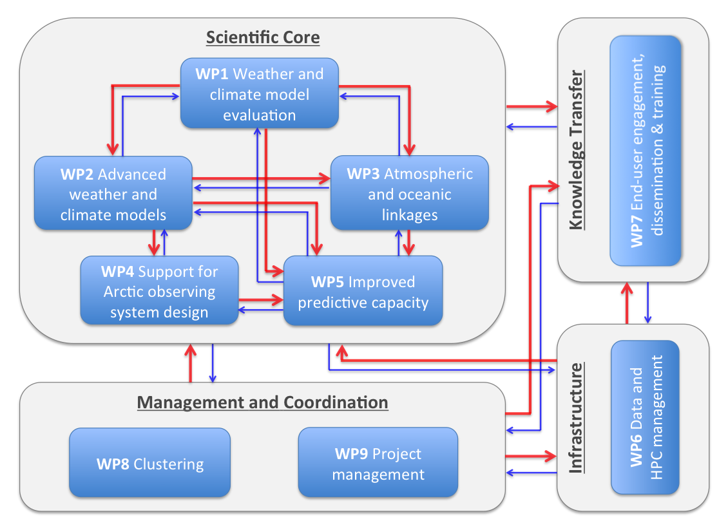
WP structure

Slide 14
What APPLICATE can do for EU-PolarNet?
Provide input to the development of an integrated European research programme
Collaborate on strengthening European and international cooperation (e.g. joint events)
Contribute to establishing an inventory of modelling programmes

Slide 15
Summary—APPLICATE will...
Advance predictive capacity in polar regions and beyond
  Develop models with enhanced representation of Arctic processes
  Contribute to developing the Arctic observing system
Enhance our understanding of Arctic-midlatitude linkages (also from a prediction perspective)
Bring different communities closer together
Work closely with users and stakeholders
Foster international collaboration
Educate the next generation of scientists
www.applicate.eu

Slide 16
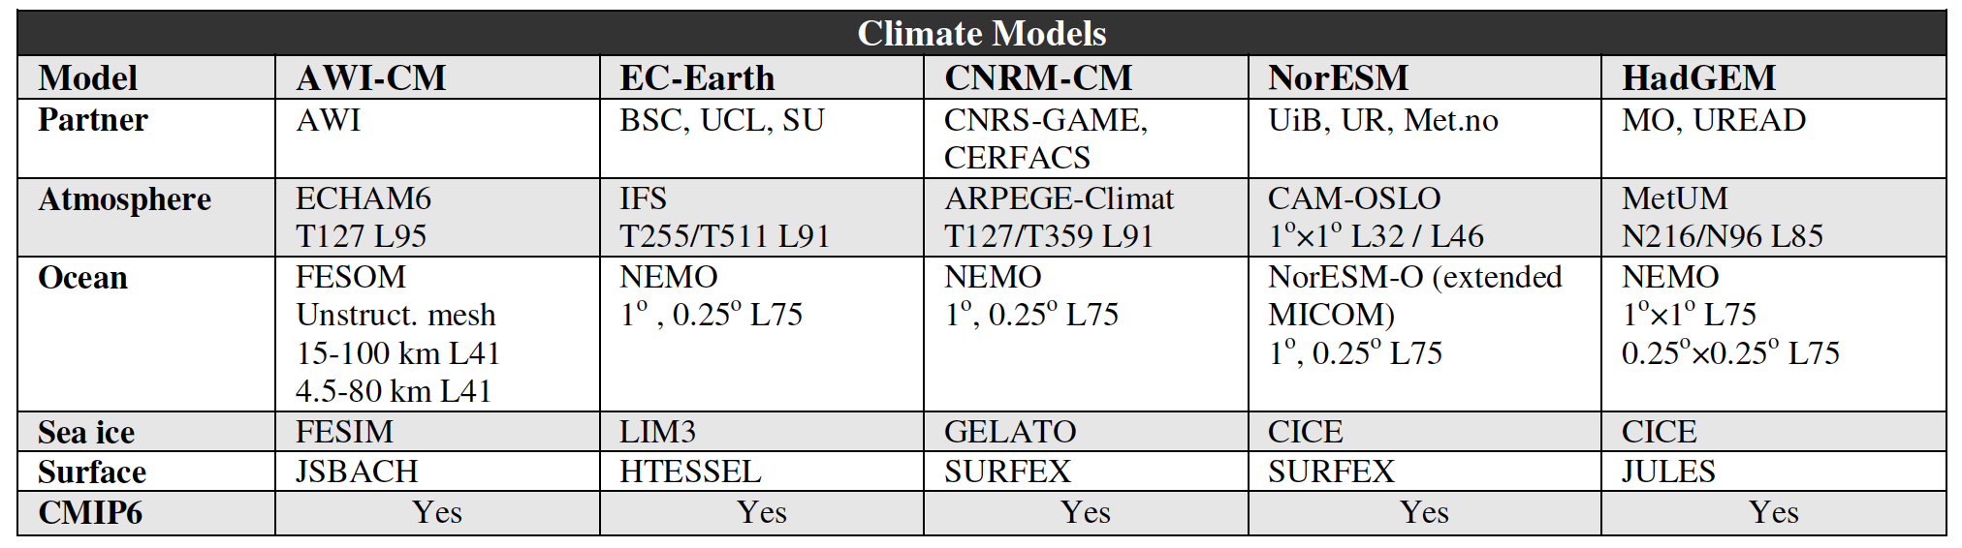
Participating climate models

Slide 17
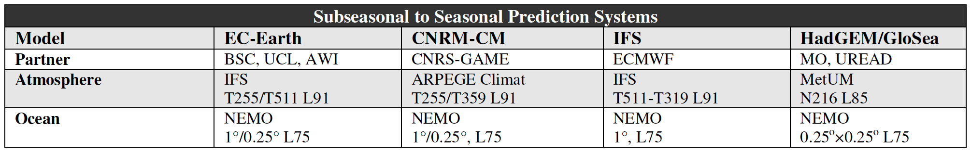
Participating S2S models

Slide 18
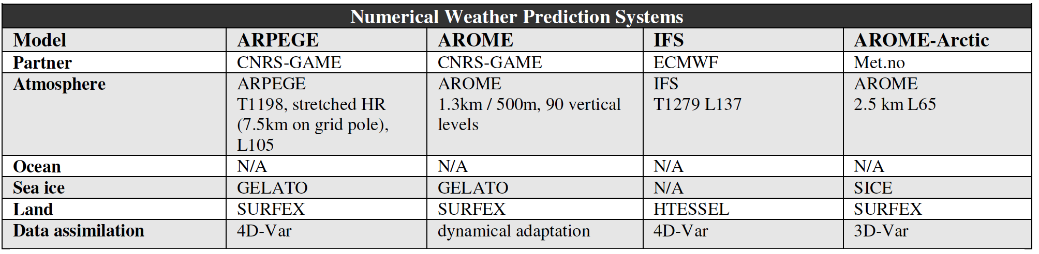
Participating NWP models

Slide 19
APPLICATE Advisory Board
Name | Area of expertise | Country
Cecilia Bitz | Model developent and sea ice prediction | USA
Gilbert Brunet | Weather and climate prediction | Canada
Clara Deser | Arctic-midlatitude linkages | USA
Veronika Eyring | Model evaluation and CMIP | Germany
Inger Hansen-Bauer | Climate and weather services | Norway
Jean-Noel Thepaut | Copernicus Climate Change Services | UK
Tero Vauraste | Stakeholder representative | Finland

