Slide 1
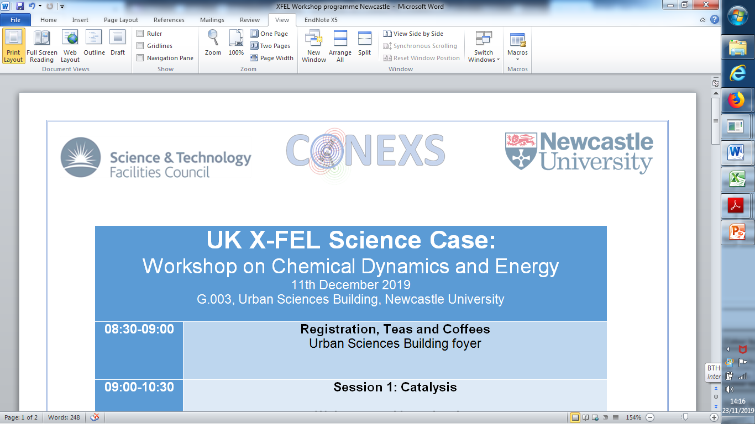
“What is the structural chemistry of the living organism at its temperature and pressure?”
John R Helliwell
University of Manchester

Slide 2
Already in 1997 cryo to RT protein structure comparisons showed “cryo artefacts”
Deacon et al 1997 J Chem Soc Faraday 93(24), 4305-4312 compared the RT and 100K structures of concanavalin A (both from SR X-ray) and noted in its Section 3.9:-
  Side chains eg Asp82, Ser117 and Thr196 moved and their bound waters moved with them
  Reassuringly there were no significant differences in or around the saccharide-binding site

Slide 3

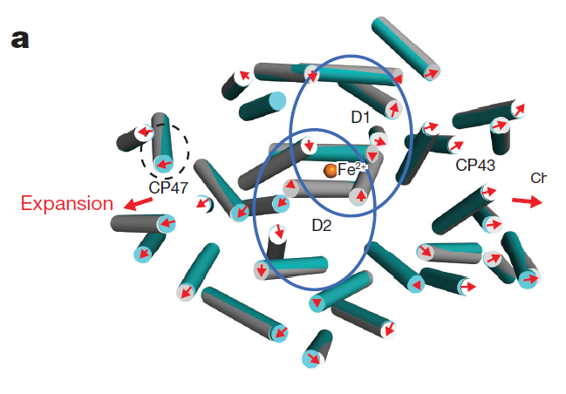
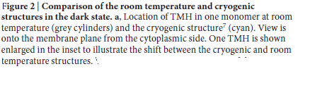
Spin off of XFEL serial fsec crystallography and neutron protein crystallography : increasingly large number of RT structures!
LCLS example Young et al Nature 2016 540, 453-457:-
Both from XFEL, cryo and RT.
“Range of shifts: 0.5-0.9Å……
The structural layout of the PSII oxygen evolving complex (OEC) was
however not affected by the cryo temperature.”
Neutron example>>>>>

Slide 4
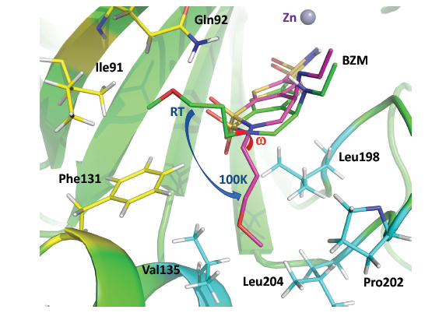
The ligand binding site in hCA II-BZM complex, showing BZM conformations: RT neutron (i.e. X+n) structure (green carbons) & the 100K X-ray structure (magenta carbons)
[Kovalevsky et al., 2018, Structure 26, 383–390]
“The flexible ether group of BZM (the clinically used drug brinzolamide) occupies a sub-site lined by Ile91,
Gln92 and Phe131 in the RT structure, but is observed in a more hydrophobic sub-site lined up by Val135,
Leu198, Pro202 and Leu204 in the 100K structure.”

Slide 5
The physical chemist Bertil Halle got interested and published his article with the title:-
“Biomolecular cryocrystallography: Structural changes during flash-cooling”
PNAS (2004) 101, 4793–4798
“analysis indicates that many degrees of freedom in a flash-cooled protein crystal are quenched at temperatures near 200 K, where local conformational and association equilibria may be strongly shifted toward low-enthalpy states .” [See next slide>>>>>]
“Such cryo-artifacts should be most important for
strongly solvent-coupled processes, such as hydration of nonpolar cavities and surface regions, conformational switching of solvent exposed
side chains, and weak ligand binding.”

Slide 6
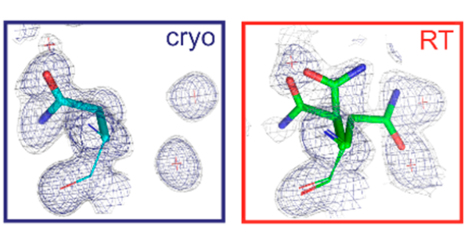
Darby et al’s very recent article:-
“Water Networks Can Determine the Affinity of Ligand Binding to Proteins”
J. Am. Chem. Soc. 2019, 141, 15818−15826:-
Both cryo and RT from SR X-ray
“Notably, at RT we observe three alternate conformations of residue A11N, which are not visible in the cryogenic electron density maps, and refined to 34%, 24%, and 42% occupancy
Consequently, the positions of their bound waters W2, W3, and W4 co-varied with their respective side chain conformers.”…….These changes are close to the bound ligand sialic acid.

Slide 7
We need to prioritise beamtime for measuring biological macromolecules at close to physiological temperatures
So, we need to expand access to XFELs for determining more static structures as well as fsec dynamics studies
The UK XFEL will give UK structural biologists an extra edge in this strategically important area of physiologically relevant structures
So, this is another reason to get the UK XFEL funded.
UK can help create a whole field of research to answer “What is the structural chemistry of the living organism at its temperature and pressure?”

