Slide 1

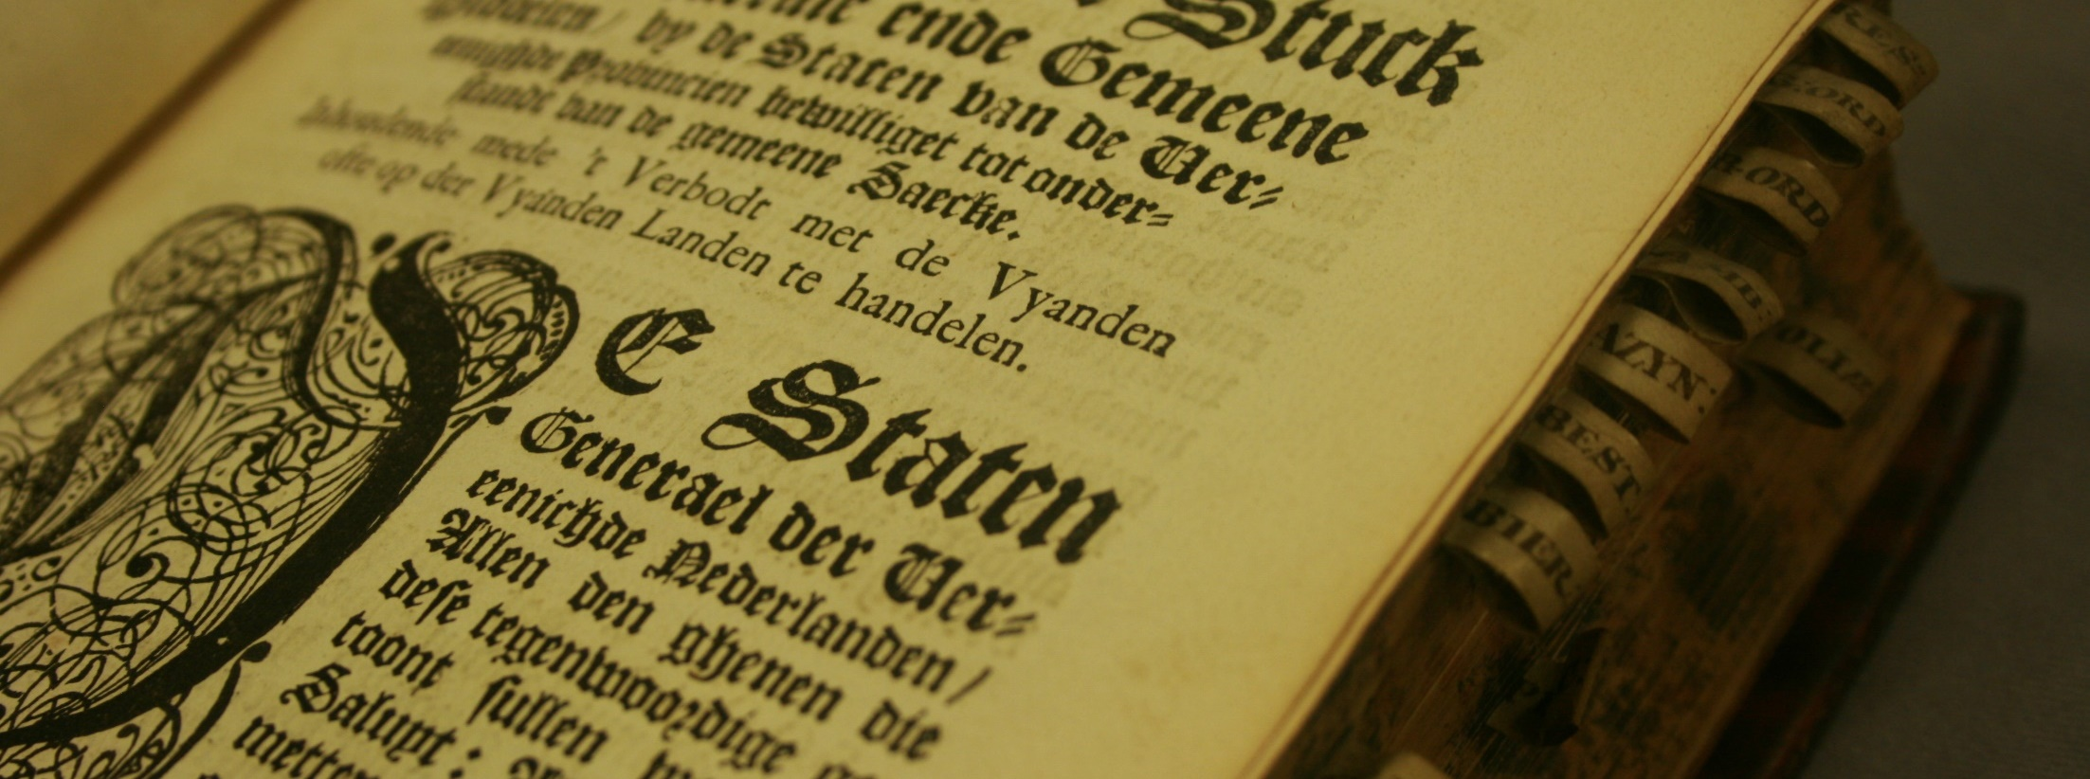


Kan je de computer de wet laten herschrijven?
Het ‘Entangled histories’-PRoject
Annemieke Romein
Sara Veldhoen
Michel de Gruijter

Slide 2
Inhoud
Deel 1. De samenleving controleren. (± 10 minuten)
  Vragen (± 5 minuten)
Deel 2. Computertechniek. (± 10 minuten)
  Vragen (± 5 minuten)

Slide 3
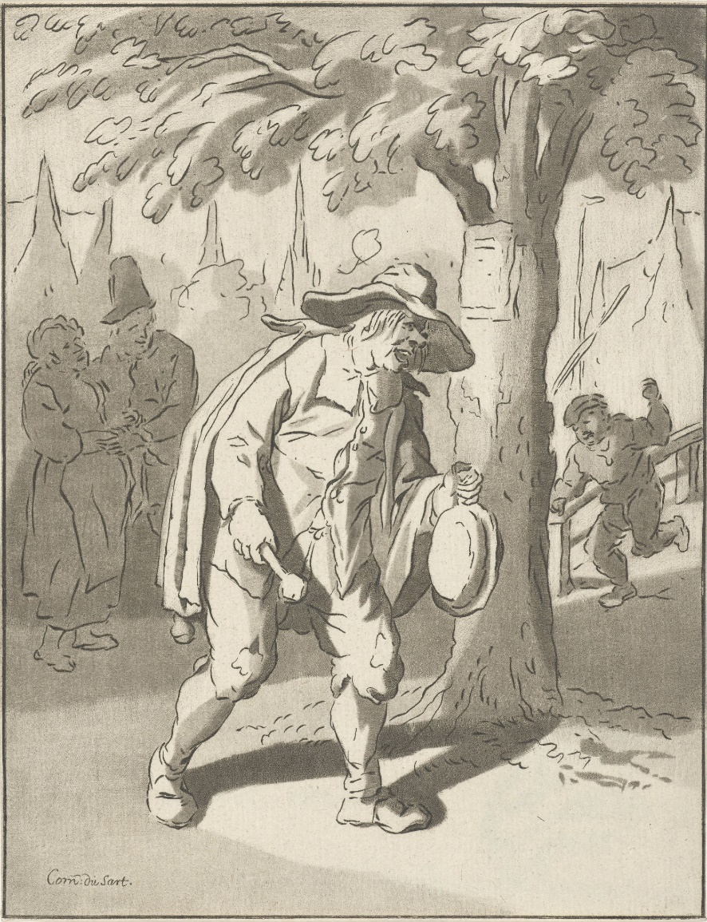
De Samenleving controleren
Deel 1.
Vroegmoderne wet- en regelgeving (±1500-1800)

Slide 4
Verandering in politiek denken en handelen (±1500)
Functie-georiënteerde interpretative van regelgeving én de rol van de bestuur.
Als gevolg van 1: verandering van een overheid die over haar onderdanen bestuurde, feodale system wordt vervangen (Vazallen met rechten/plichten naar hun leenheer).
Ontstaan van een meer en meer afgesproken/ gefixeerde geografische ruimte.
Deze drie ontwikkelingen gaan samen met een nieuw type regelgeving: politia (actief-preventieve regels/ sturende maatregelen).
R.v.Friedeburg, Luther’s Legacy (Cambridge, 2017),

Slide 5
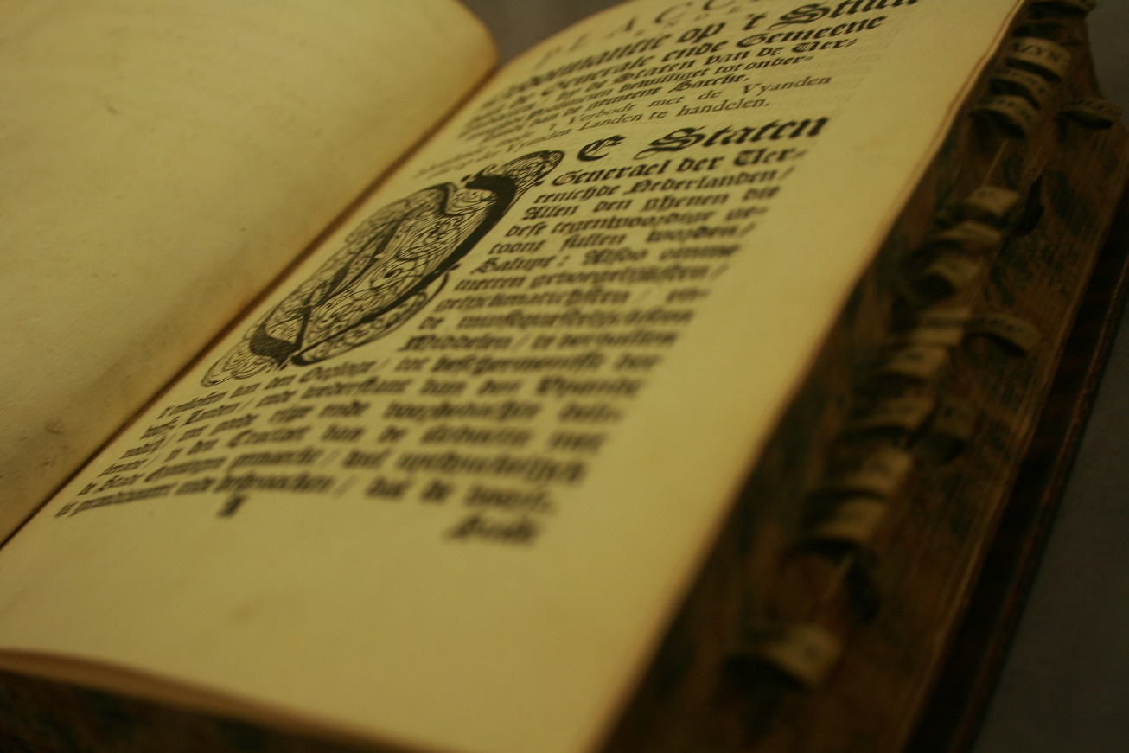
Onderwerpen binnen ‘Politia’ (NL: politie)?
Administratief recht/ voluntaristische wetgeving (ordonnanties) om de samenleving te ‘sturen’.
Hoofdcategorieën
  Sociale Orde en Religie
  Publieke Veiligheid en Justitie
  Onderwijs, Cultuur en Wetenschap
  Economisch handelen en bedrijvigheid
  Infrastructuur
  Subcategorieën. (Hiërarchische structuur)

Slide 6
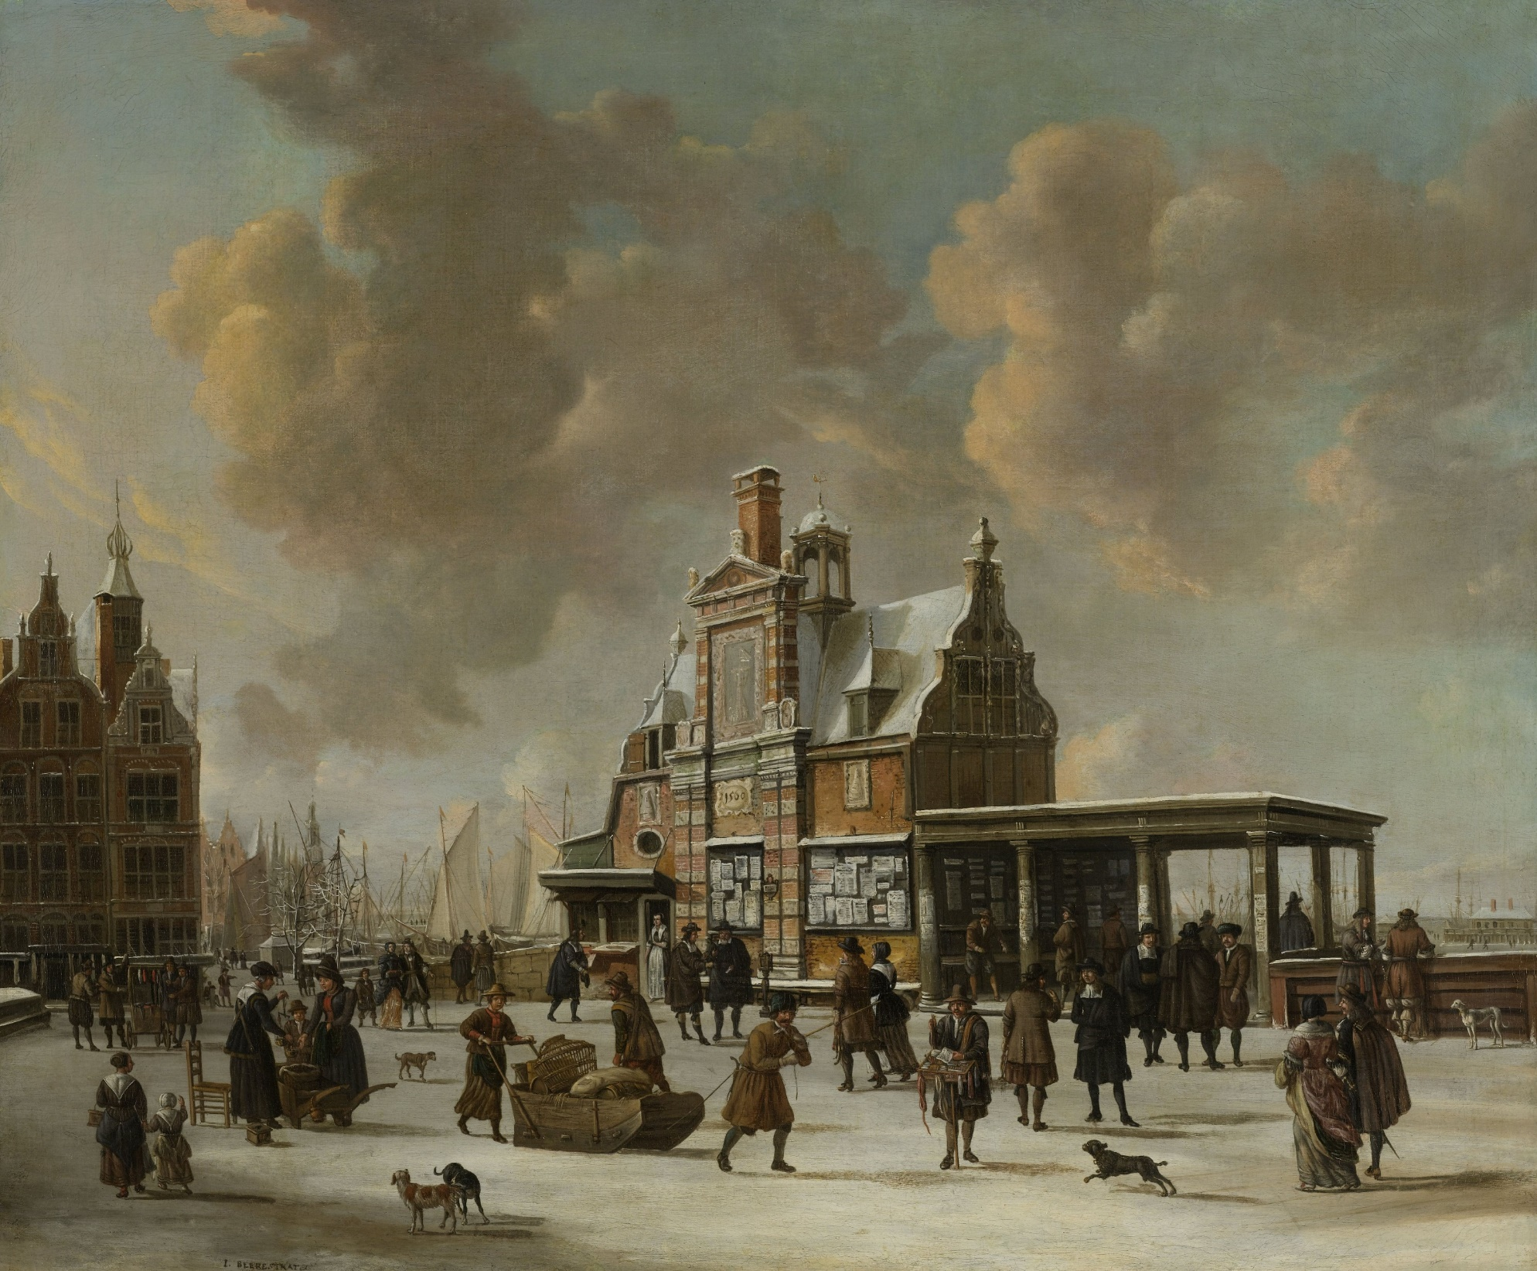
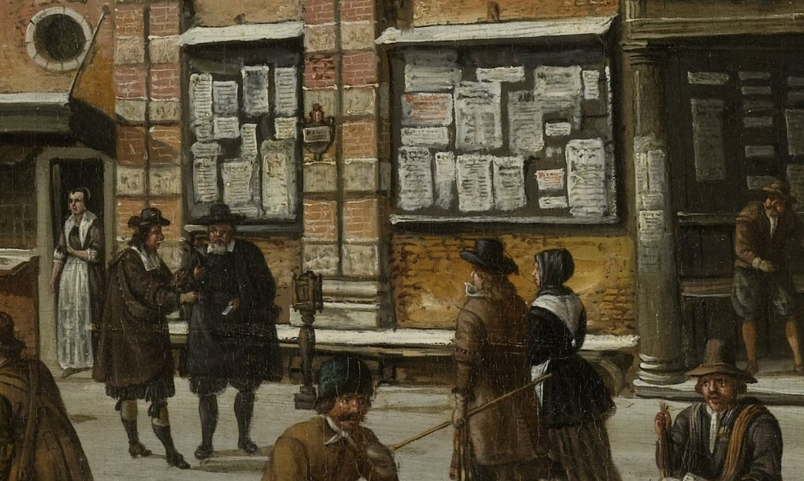

Slide 7
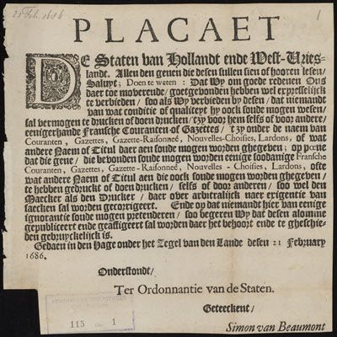
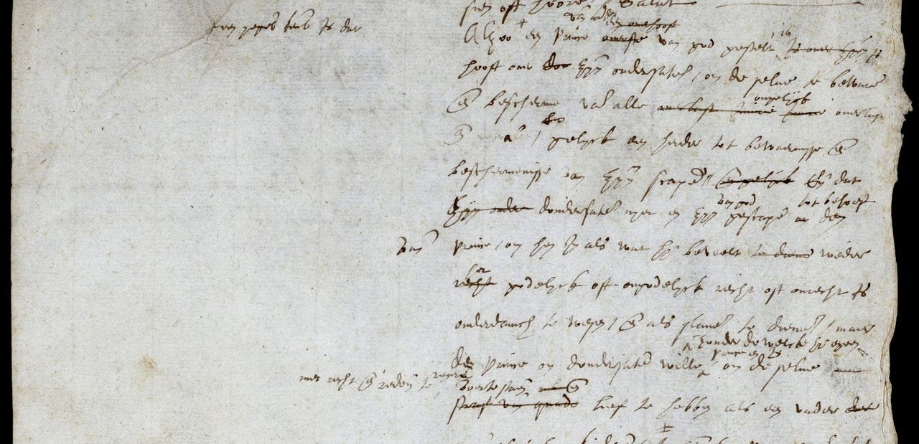
Verschijningsvormen:
Links: https://library.maastrichtuniversity.nl/collections/databases/digitale-plakkaatzoeker/
Rechts: Plakkaat van Verlatinghe, pagina 1 (NA)

Slide 8
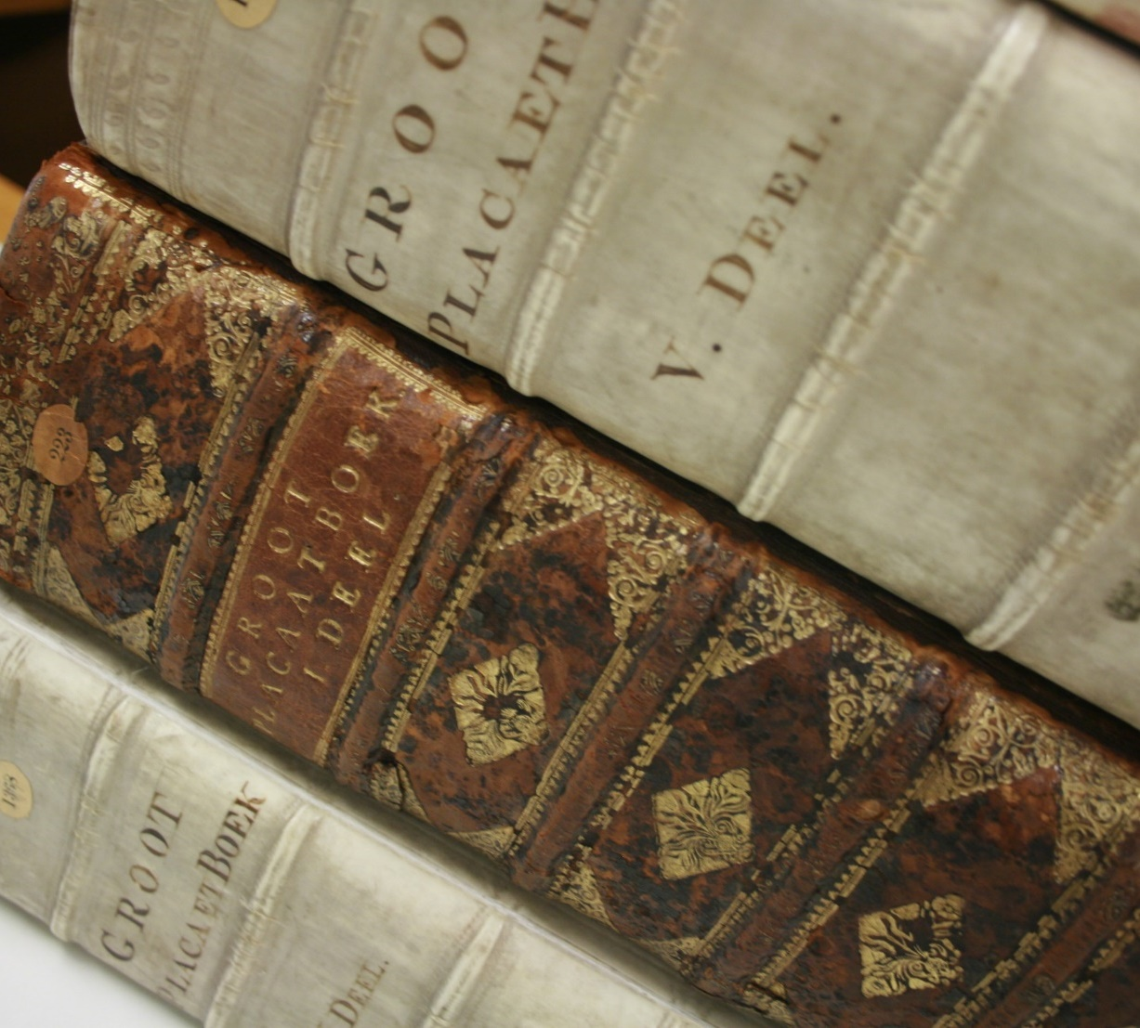
Wie wat bewaard,…
Provinciale wetgeving (en soms stedelijke ‘costumen’) werden gebundeld.
Selectie.
Grote variatie in onderwerpen.

Slide 9
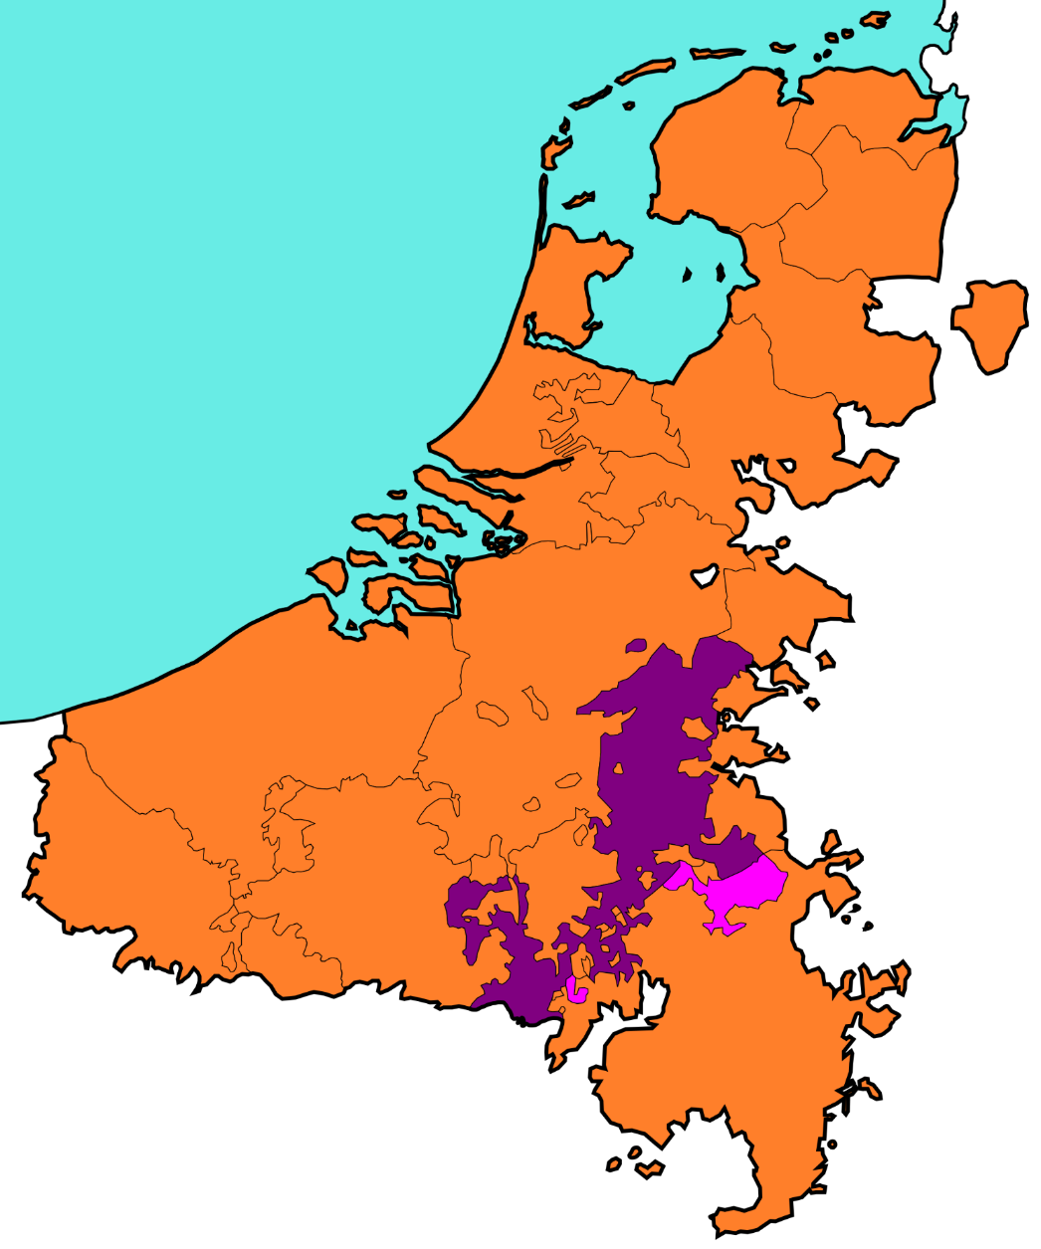
Hypothesis
Vroegmoderne staten zagen zich vaak geconfronteerd met problemen.
Omdat het voortbestaan op het spel stond, moesten ze snel en adequaat handelen.
Zodoende was het ontzettend belangrijk om wet- en regelgeving te kopiëren, aan te passen en te implementeren – wanneer deze in andere gebieden al succesvol bleken te zijn!
Notes:
Let us first give you some context regarding our project ‘Entangled Histories’ at the KB National Library of the Netherlands.
I (Annemieke) applied for the researcher-in-residence position about a year ago. This is a fully funded part-time function to use the KB collection to answer a specific research question.
My focus is on early modern legislation. Since the Low Countries – or, 17 Provinces – were small, they seemed to have to cope with a lot. In my BA, years ago, I encountered legislation against beggars and vagrants stating that they needed to leave within a week, or else they would be chased down. But where did they go? I assumed that, when they crossed the border another area would end up with the same troubles. Hence, I came up with the following hypothesis: ‘Early Modern European states struggled for survival, making it impossible to ‘reinvent the wheel’ each time a problem arose. Hence, it was of tremendous importance to copy, adapt and implement normative rules (aka legislation) that were already proven succesful elsewhere.’ This hypothesis is broader than the Low Countries, but within this project, we do “narrow it down” to the 17 provinces to test it.
It may be interesting to know that early modern legislation was announced by the city crier and then stuck to ‘known places’ around the cities and towns. Here you see a part of a painting that shows such a ‘known place’ in Amsterdam (the Paalhuis).

Slide 10
ComputerTechniek
Deel 2.
Leesbaarheid, segmenteren en categoriseren

Slide 11
Bronnen:
Bronnen# 108
Lettertype 88 romein, 20 gotisch
Taal 67 NL, 26 FR, 1 Lat, 14 mix
Pagina’s #75.000
Tekens# 550 mln
Publicatiedatum 17e en 18e eeuw
Regio 17 gewesten
Notes:
Provincial estates decided they wanted what they perceived to be the most important texts to be collected in volumes: placaetboeken. These are the basis of our project. We have collected 108 of these books. This is not the full collection of what has once been printed, but it is what is currently digitised.
Here are some numbers, to give you a bit of an overview.

Slide 12
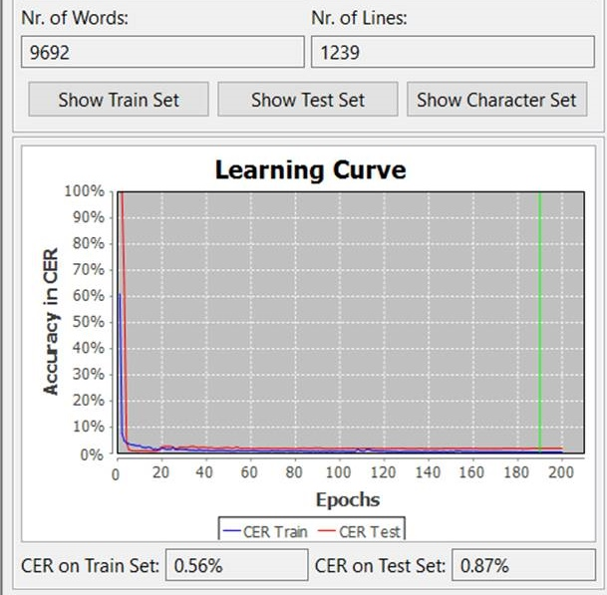
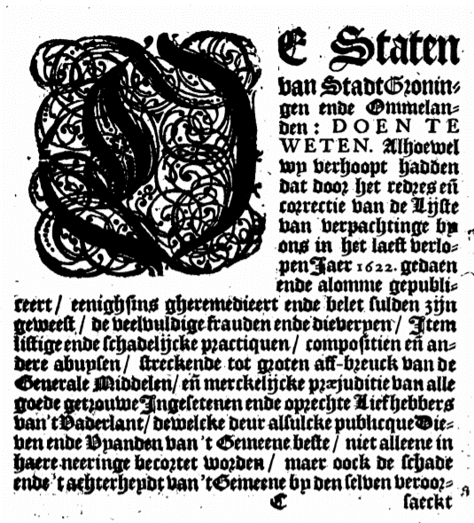
Verbeteren OCR dmv HTR+
&# Staten ban éotabt(5toning gen embe CPntmelana ijen : D O EN T E AS toirectie van de ijſte #V j, ban uerpachtinge bn g;&#Zº ong in het latft berlo reert/ tenighſing ghertmebieert embt belet fulben 3ijn gemeeſt/ be beeluulnige frauben enige bieberpen/ #ſtem liſtige en beſchabelijcke p?artiquen/ compoſitien eiſiana bere abupſen/ ſtrerkenbt tot groten af-breuck banne €5enerale Taibbelen/eimerchtlijcke plajubitiebanalle goebe getroume ingeſetenen en de oprechte liefhebberg ban't13abetlant/bemeltke beur alfulcke publicque&Dit benen.be 13pamben ban't berncene beſte/ niet alleene in WETEN. 2 Iſjoemel hun berijoopt ljabijen bat boo? ſjet reb?eg ciï rt. t pen3aer 1622.
Notes:
When I, as a researcher, look through the Google-book version of these books of ordinances… it proves very difficult to search them. The google OCR is quite pityful, which makes it impossible to really search for keywords throughout. <Placcaet, resolutie, generale ordonnantie, mitsgaders ordre van verpachtinge ende procederen, item particuliere ordonnantien ende instructien op't collecteeren ende innen van de generale middelen van stadt Groningen ende Ommelanden, Volume 1 (Groningen, 1652).>
Hence, within this project, we have uploaded all of these 108 books in Transkribus and I am transcribing these books and creating models to improve readability. I am using the HTR+ option (which can go up to 200 episodes) to create models and apply these to other books as well. It is not possible to create only one Gothic model and apply this to all books in Gothic as printers had their own significant features and the quality goes down. However, there are several book series – printed within the same province – that can be worked on with the same model.
Books with mixed languages prove challenging, as Transkribus works with an N-Gram in the back remembering ‘logical character order’; but this seems to work terribly on a combination of Dutch and French as “e” and “c” tend to get mixed up within the other’s language. Training more, or specific training of a model on a specific language per page could be the solution.

Slide 13
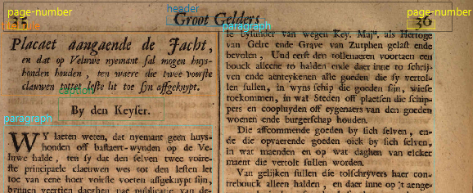
Segmentatie
Visueel: P2PaLA (Transkribus/Valencia); lettertype grootte
Tekstgebaseerd: keywords/ LSTM (NaverLab)
Notes:
P2PaLa is a lay-out analysis tool incorportated within Transkribus. It has been created by the Technical University of Valencía (Spain). One can tag the text-regions with metadata such as page-number, paragraph and header, as is shown on the slide. It does need a lot of training-data to create a model. Best not to do it with to many tags, as this can tick the system off.

Slide 14
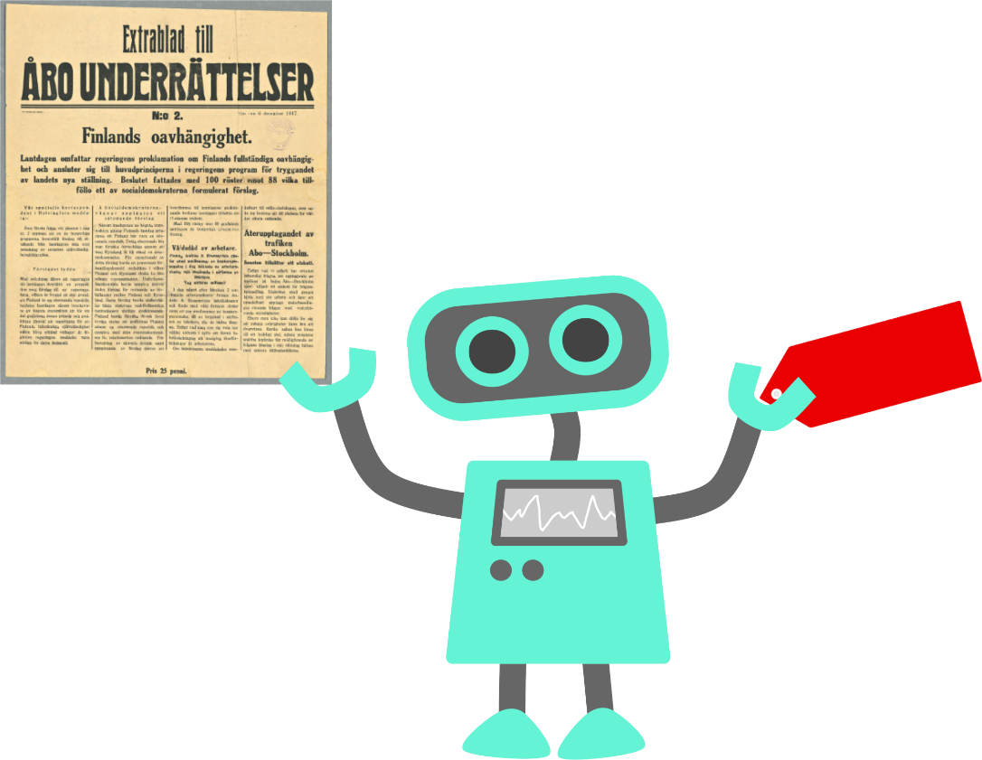
Automatische metadata
  Handmatig gelabeld ±3000 wetten.
  Hiërarchische categorieën – 4 lagen (MPIeR).
  Automatische indexatie d.m.v.: Annif.
Annif (annif.org)
Library of Finland
Notes:
Annemieke has worked with several of the books of Ordinances within her previous study (BA/MA) and other research project (Rubicon). She has manually labelled approximately 3000 laws according to a categorisation that has been set up by the German Max-Planck-Institute for European Legal History. Their categorisation has been applied to over 15 early modern European states (Sweden, Denmark, German principalities and city states and two Swiss Cantons).
This categorisation is hierachical, with first 5 categories ranging from Social Order and Religion, to Justice, Schooling, Economic Affairs and Infrastructure; each of these categories has been subdivided into several other subcategories and those have been received two deeper layers, making it 4 hierarchical layers that are indeed quite distinguishable until at least level three. (For within Social order and Religion, one would find Mariage/Morality but also Religion; within Mariage/Morality one would find specific rules on how to get married, or what to do in case of cheating.) Since it is legislation we are dealing with, texts are rather unambigious. This can mean that several topics are dealt with, within one tekst, but these are still pretty straight forward.
We use Annif….

Slide 15
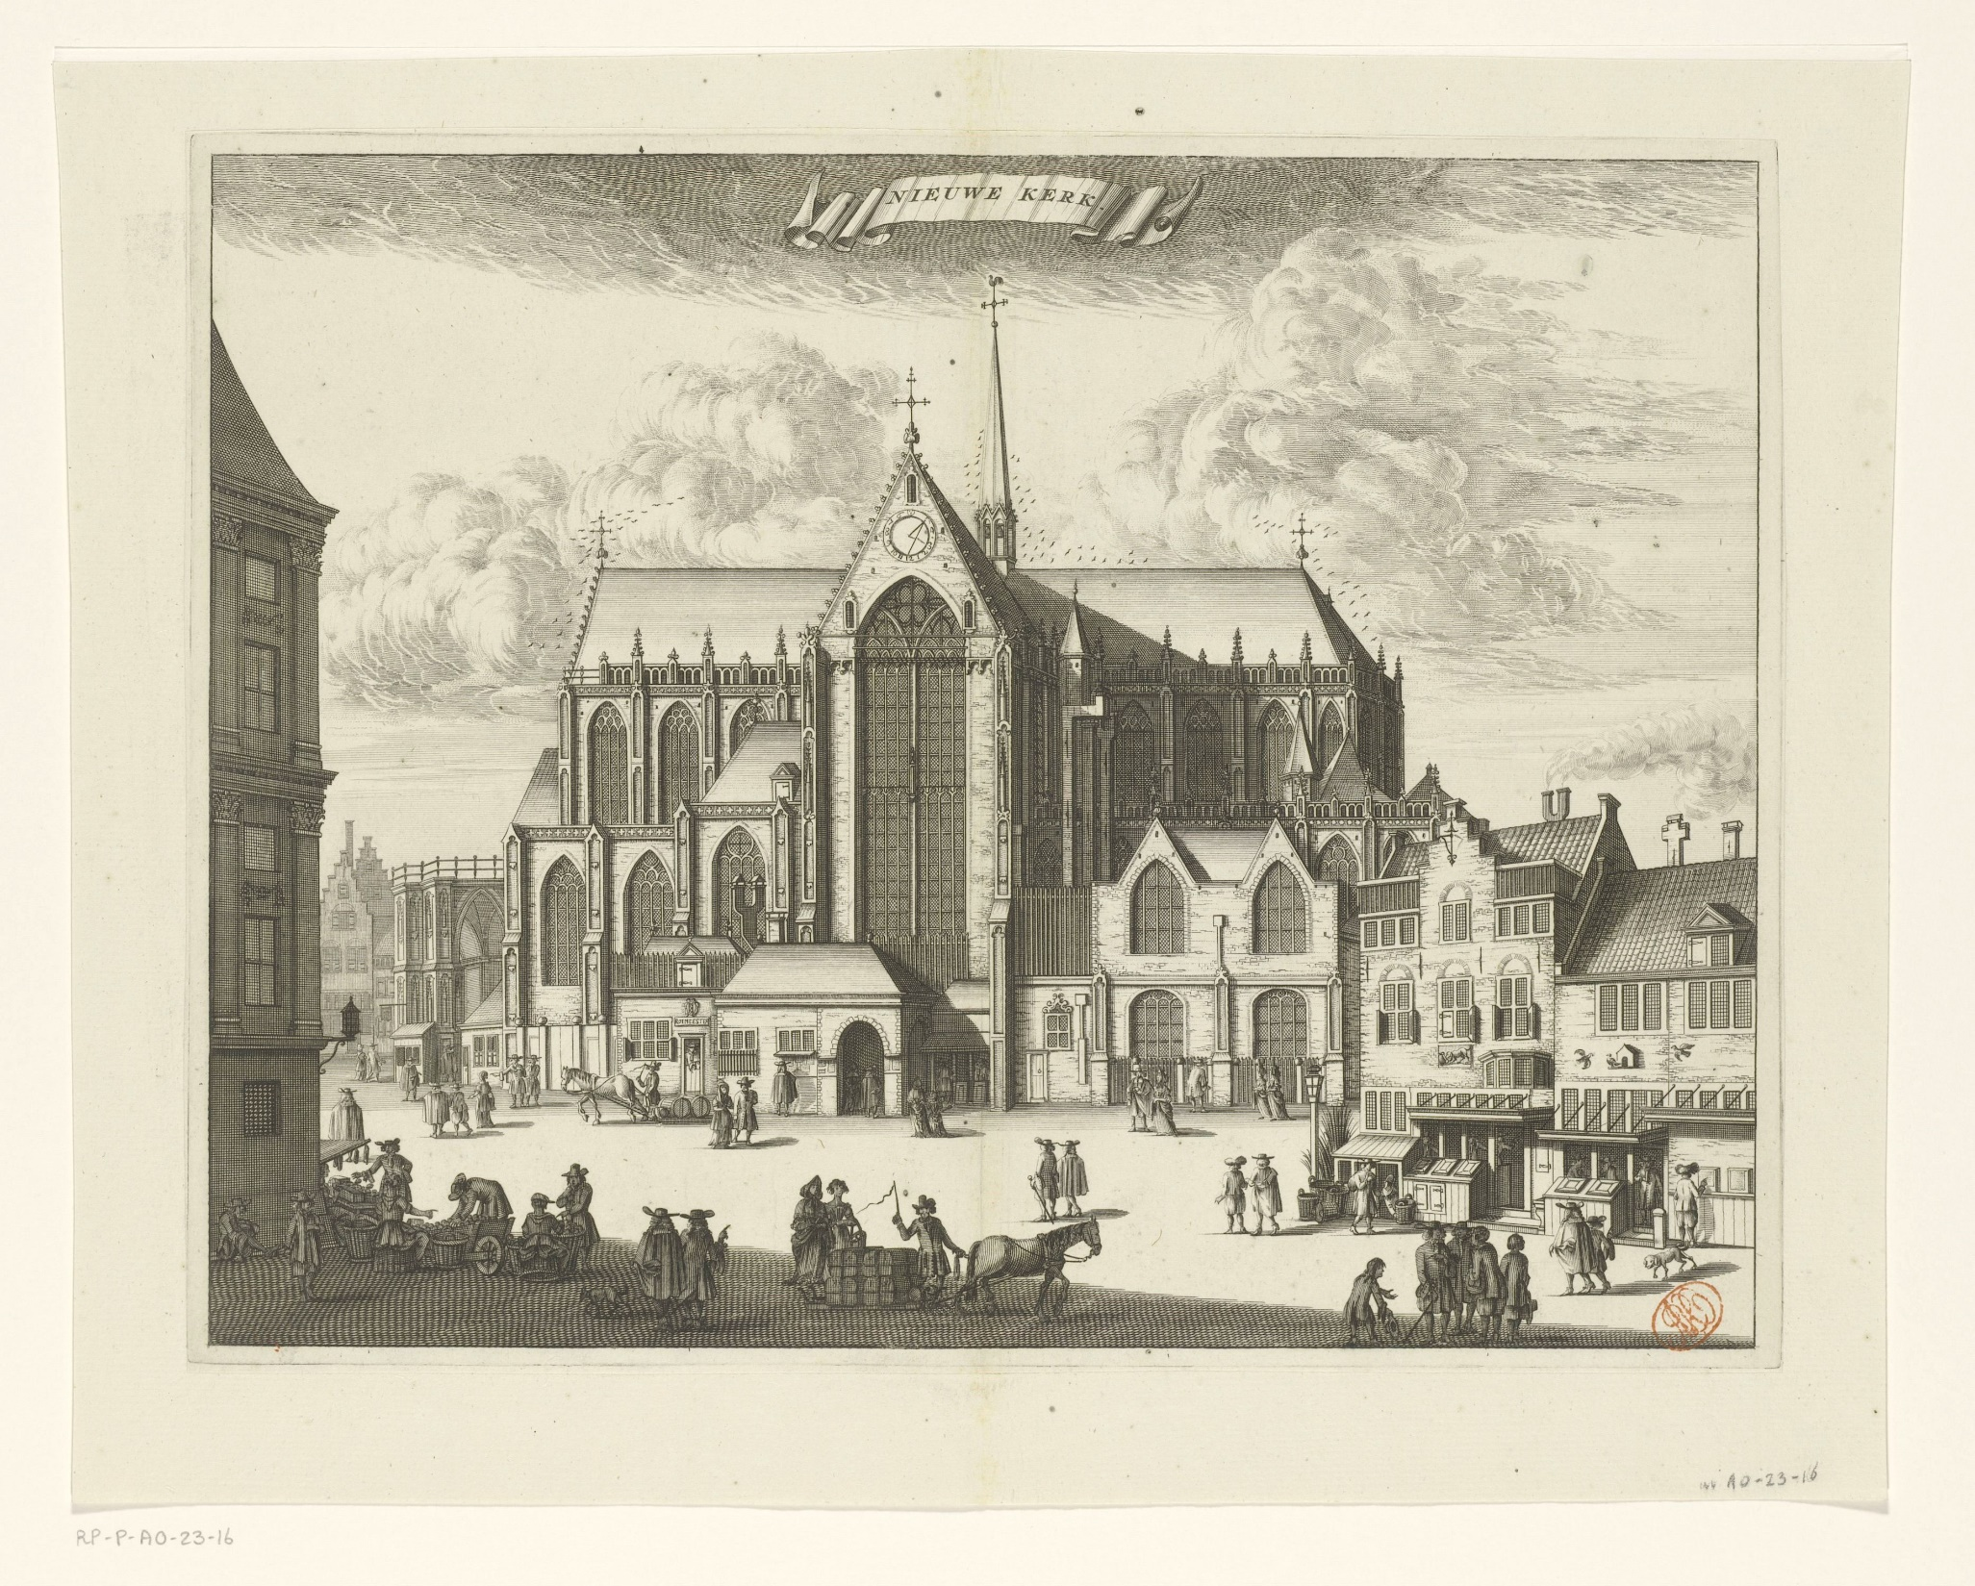
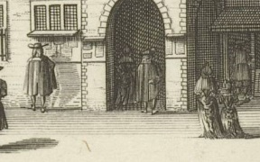
Notes:
We would like to thank you for your attention. Are there any suggestions or questions?

