Slide 1
Micromechanical investigation of glass fibre vinyl ester interface using the microbond test
P. G. Jenkins, J.L. Thomason

Slide 2
Overview
Background – the microbond test and its application
Experimental details
Challenges in applying microbond testing to vinyl ester resin systems
  Oxygen inhibition effect
  Achieving proper cure
  Diluent evaporation
Experimental results & discussion
Conclusion

Slide 3
1. Background
Microbond test is commonly used in characterisation of interfacial adhesion for fibre-polymer systems
Apparent interfacial shear strength (IFSS) indicates level of adhesion
Advantages of test include relative speed of sample prep and testing, low raw material consumption
Disadvantages – application to new material systems often introduces issues which must be solved before valid data can be obtained

Slide 4
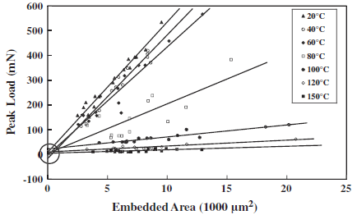
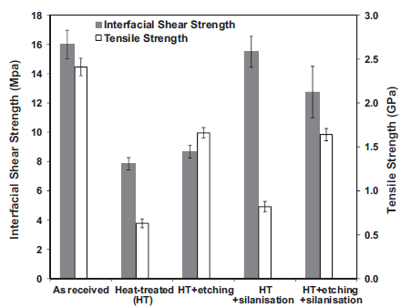
1. Background – previous applications
Temperature dependence of glass fibre-epoxy
Adhesion improvement of chemically treated recycled glass fibre (PP matrix)
Thomason & Yang 2014 CST
Yang et al. 2015 Composite Part A

Slide 5
2. Experimental
Materials
Glass fibres with vinyl ester compatible sizings
  s-ref – commercially available fibre
  s001 – improved adhesion formulation
  s002 – film former alteration
Resin: DGEBA based vinyl ester
  1260 – baseline VE resin
  1263 – rubber-modified VE resin
  1264 – epoxy-modified VE resin
  1256 – high elongation VE resin
  Same multi-component peroxide based initiator for all resins, added ~2.5wt%

Slide 6

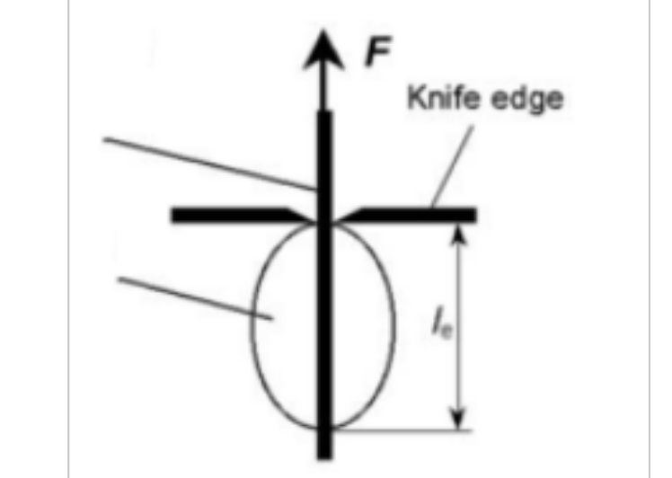
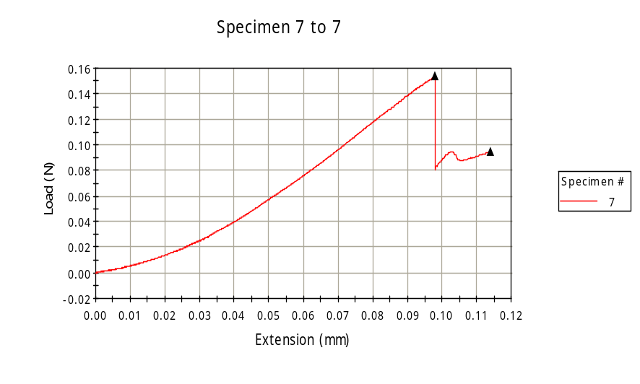
2. Experimental
Single fibre-matrix droplet test (very low material consumption)
Droplets deposited and then cured on fibres
To test:
  Knife blades are adjusted to individual fibre diameter
  Load applied to fibre while droplet is restrained
  Test ends after interface has de-bonded

Slide 7
3. Challenges – oxygen inhibtion
Oxygen in resin can act as copolymer
May slow rate of reaction or lead to incomplete cure
Micro-droplets particularly susceptible due to high surface area to volume ratio
Solution – must cure in low/zero oxygen environment
Purge oven using vacuum then fill with nitrogen
24 hours at room temperature under inert gas

