Slide 1
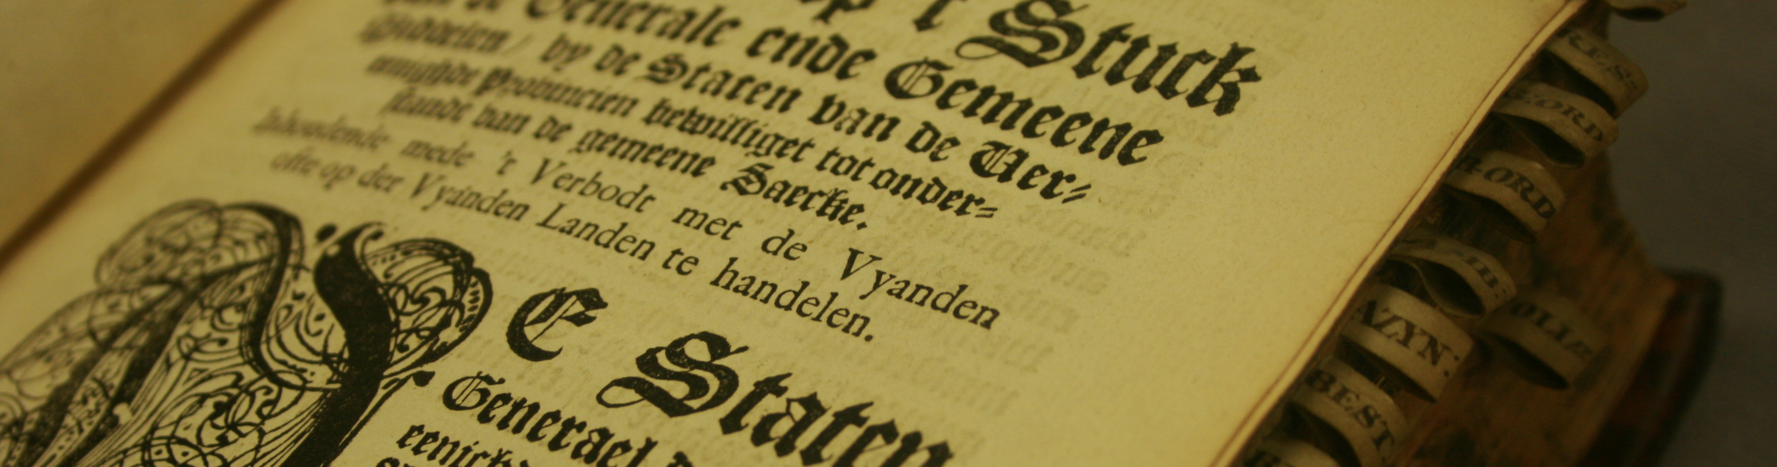
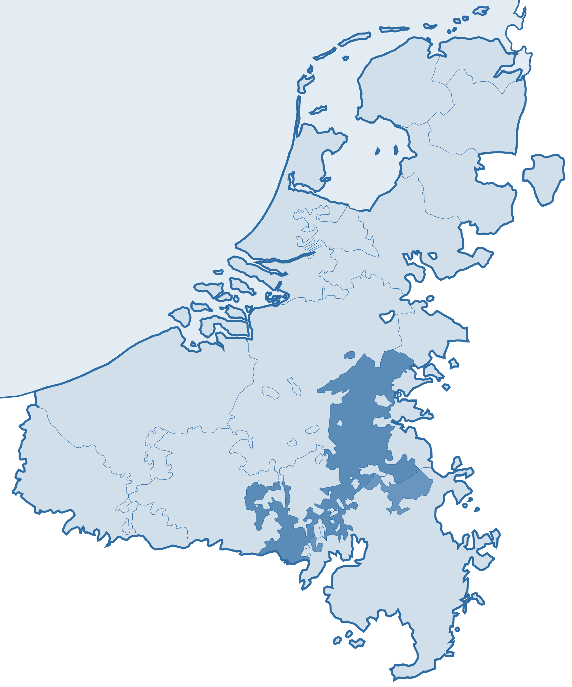
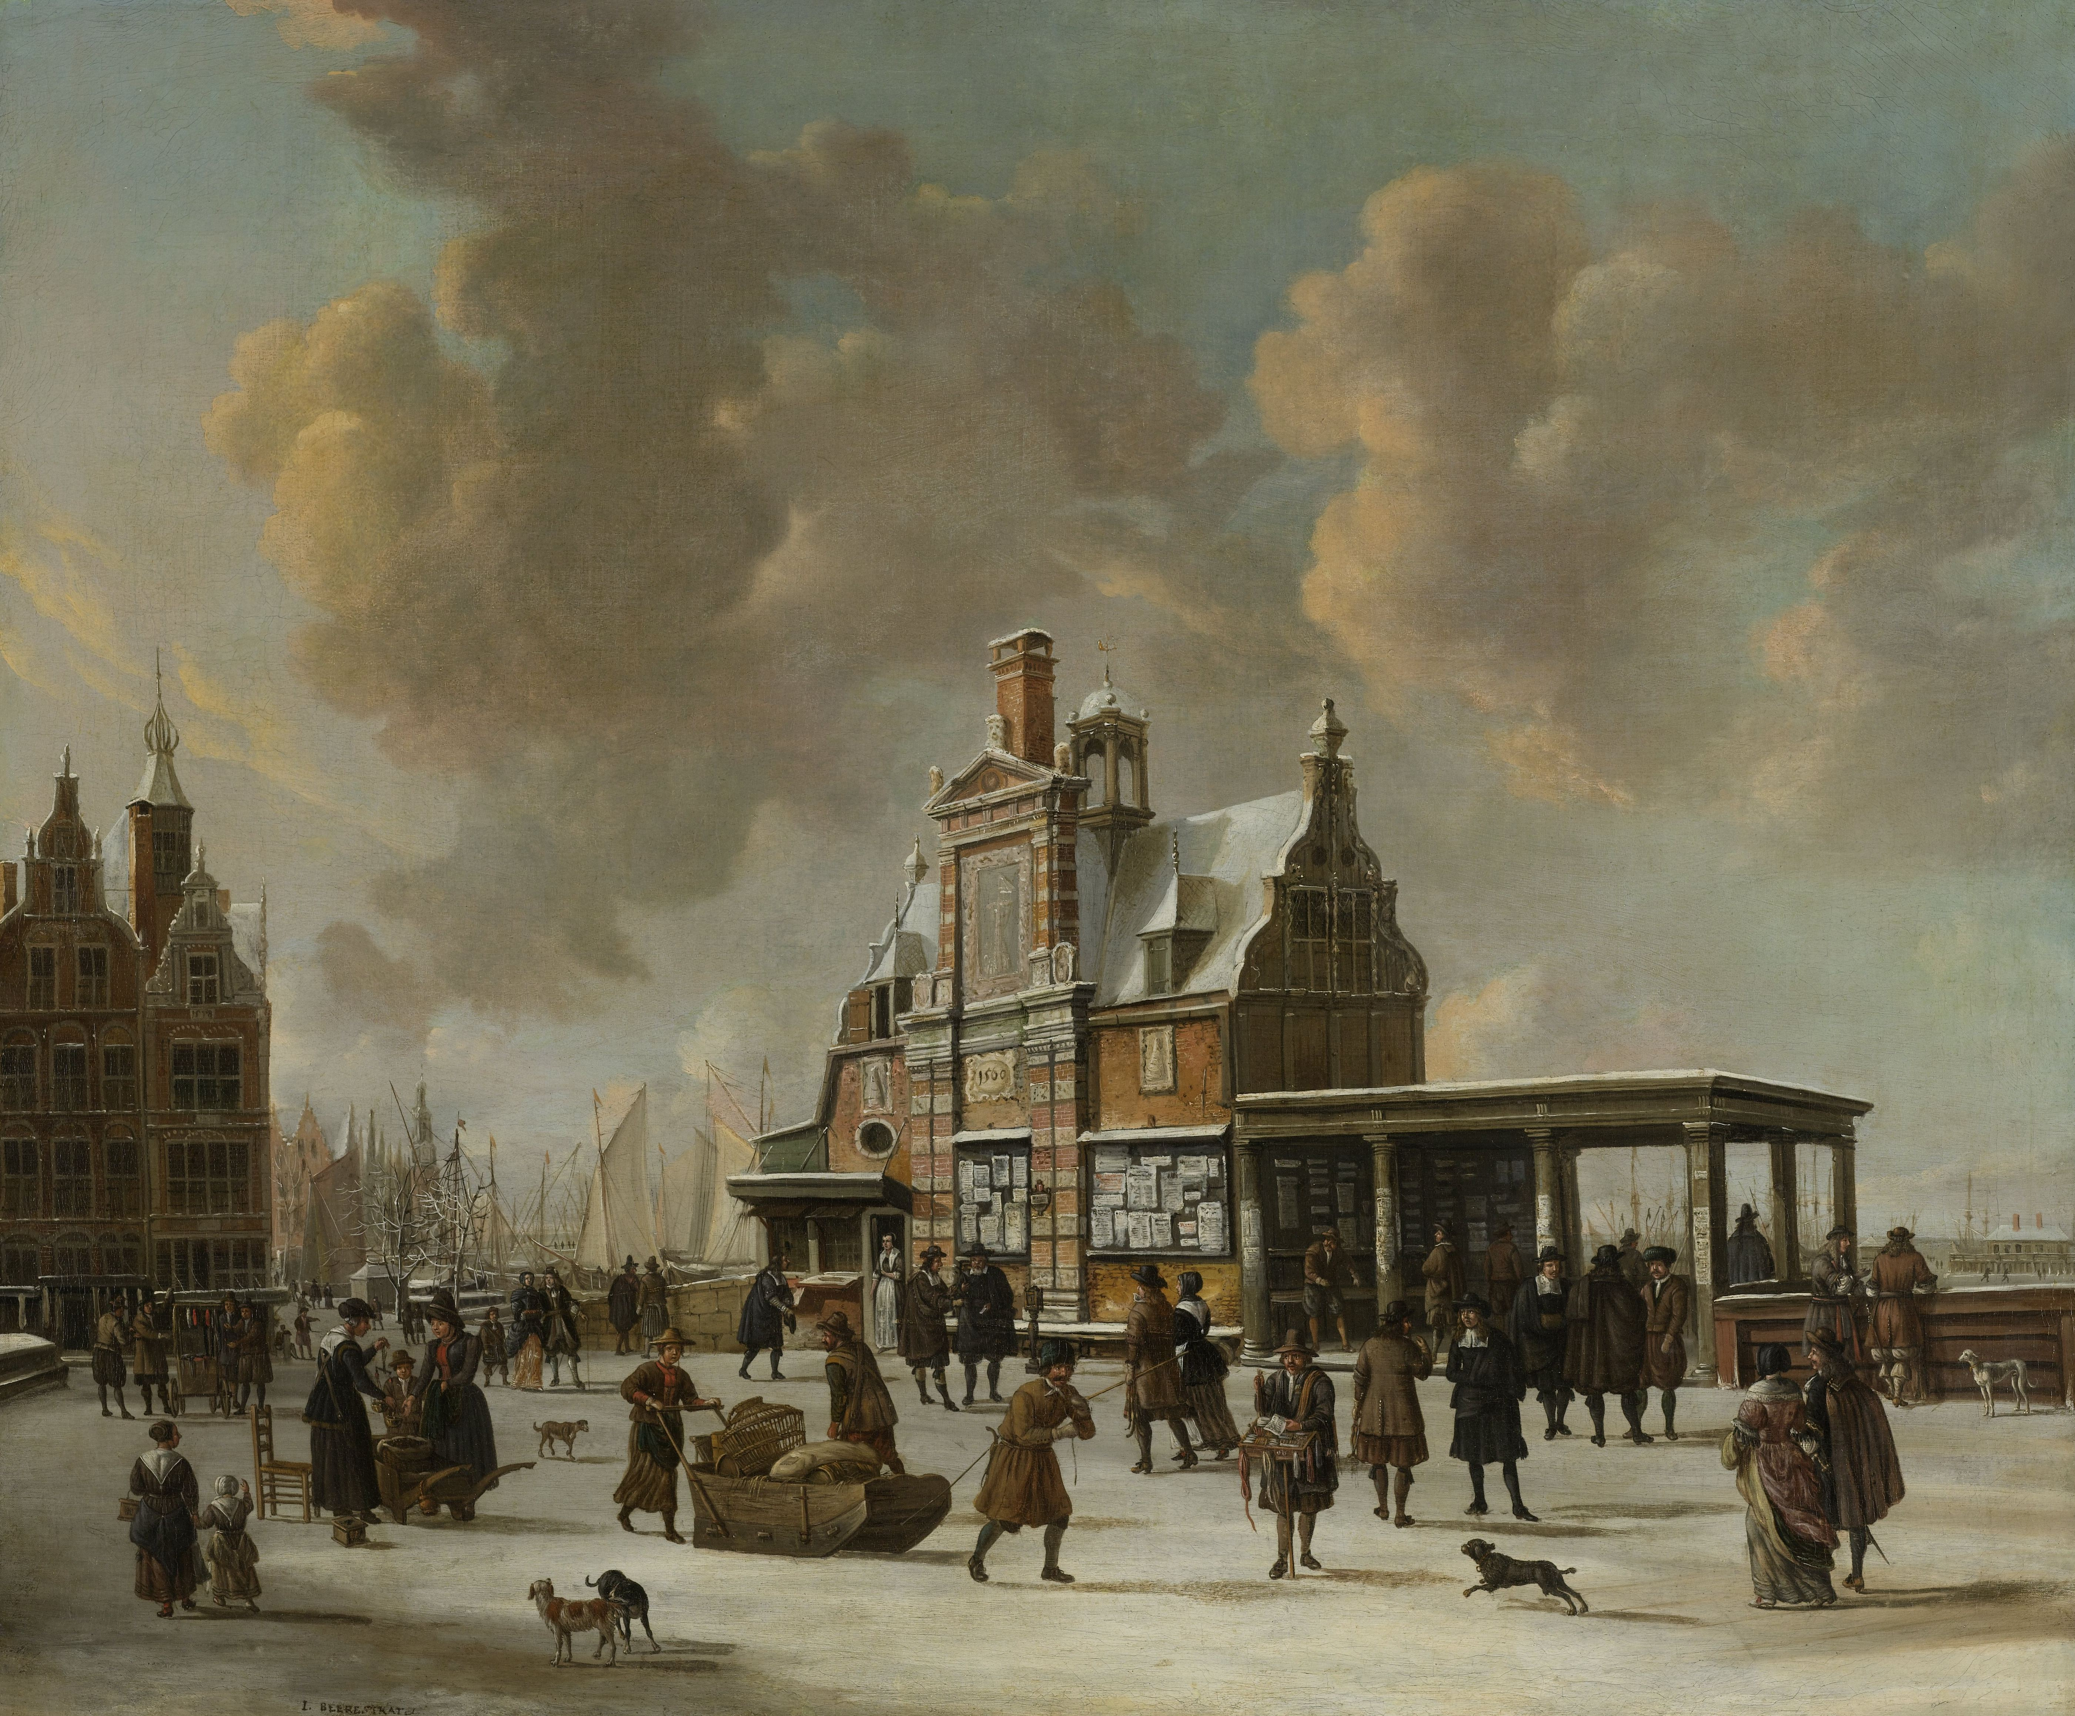
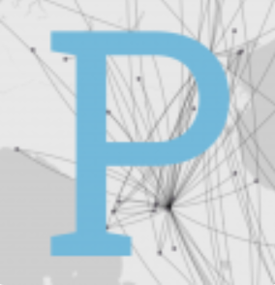
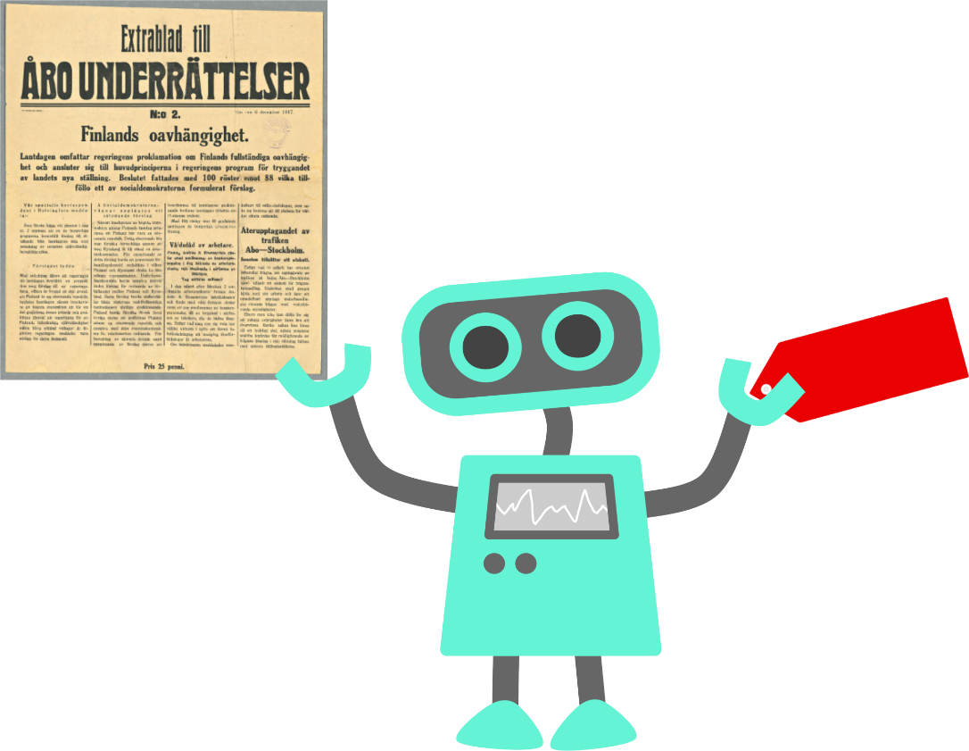
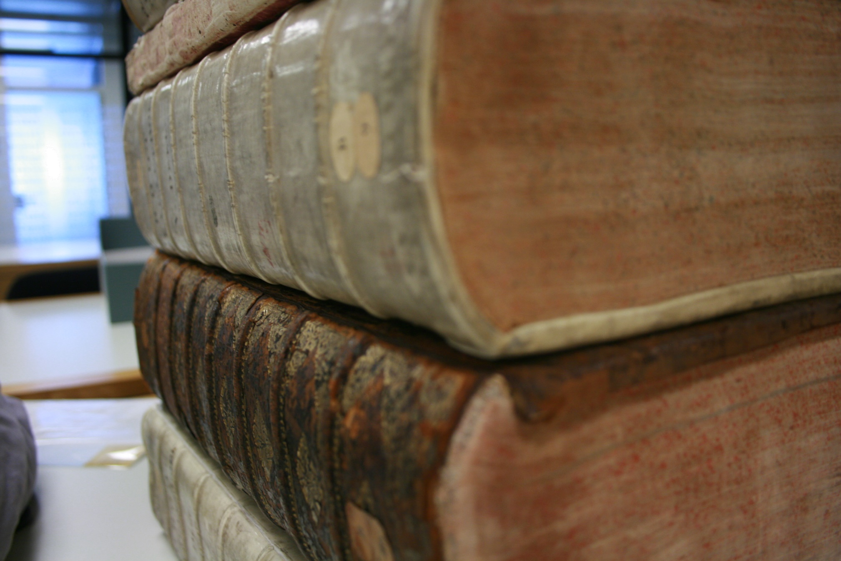
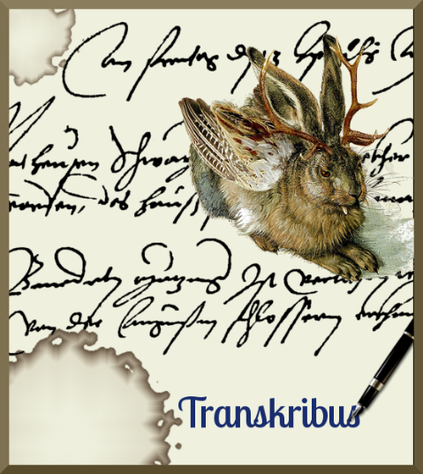
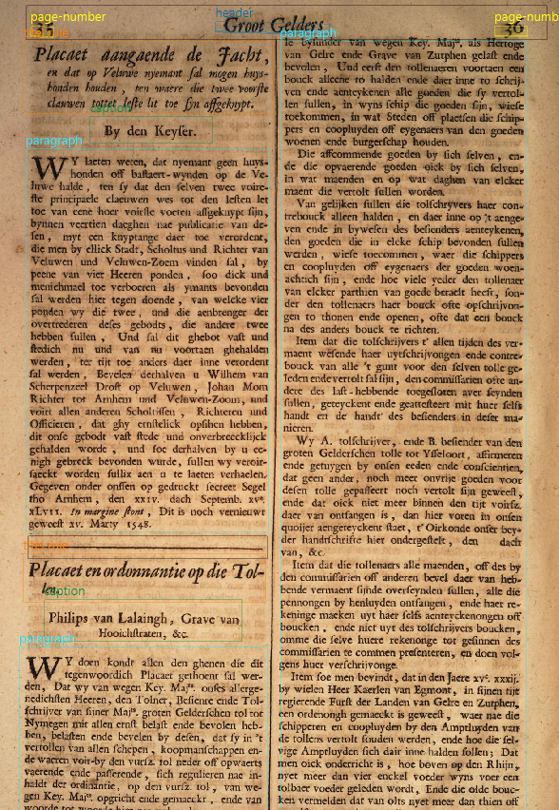

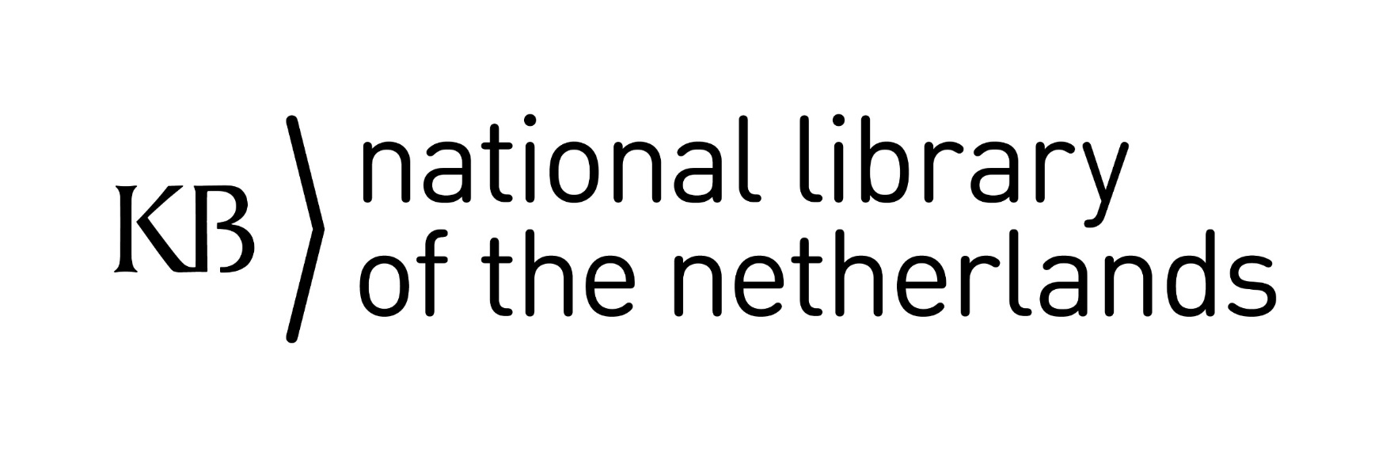

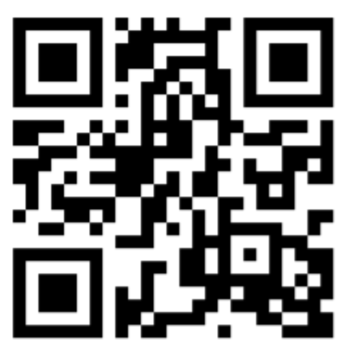

The Low Countries’ Plakkaatboeken:
Entangled Histories between ±1500-1800?!
Text-segmentation and machine-learned meta-dating.
#DHOxSS2019
C.A. (Annemieke) Romein
When problems arose, small ‘states’ had to act swiftly. Governments may have adopted – parts of – successful legislation from neighbouring areas. Hence ‘entangled histories’.
The project uses printed books of ordinances from the Low Countries (1500-1800s) to answer this hypothesis.
Lay-out analysis
Handwritten Text Recognition-models
- language (Dutch/French)
- font (roman/gothic/variations)
- character Error Rate <5%
Machine-learning categorisation
- hierarchical categories created by the
MPI für europäische Rechtsgeschichte
(1800 in total)
- per individual law
- based on manually labelled data
http://hdl.handle.net/10934/RM0001.COLLECT.5966
Data presentation
- visualisation: plot on map
- searchable data
Early modern ordinances affixed to ‘known places’ and proclaimed by the city cryer. (Paalhuis c.1660).
e.g. Palladio - Stanford
Annif
(annif.org)
Each of the provinces collected their (most) important ordinances in ‘books of ordinances’, these are now digitised and available online.
107 Books:
font:
  roman 87
  gothic 20
language:
  Dutch 66
  French 26
  Latin 1
  Mixed 14
pages: 75.372
words: ± 550 mln.
Transkribus
Project-team National Library (NL)
Michel de Gruijter – Project Advisor
Annemieke Romein – Primary Investigator
Sara Veldhoen – Research Software Engineer
Contact
Annemieke.Romein@UGent.be
KB-Lab

