Slide 1
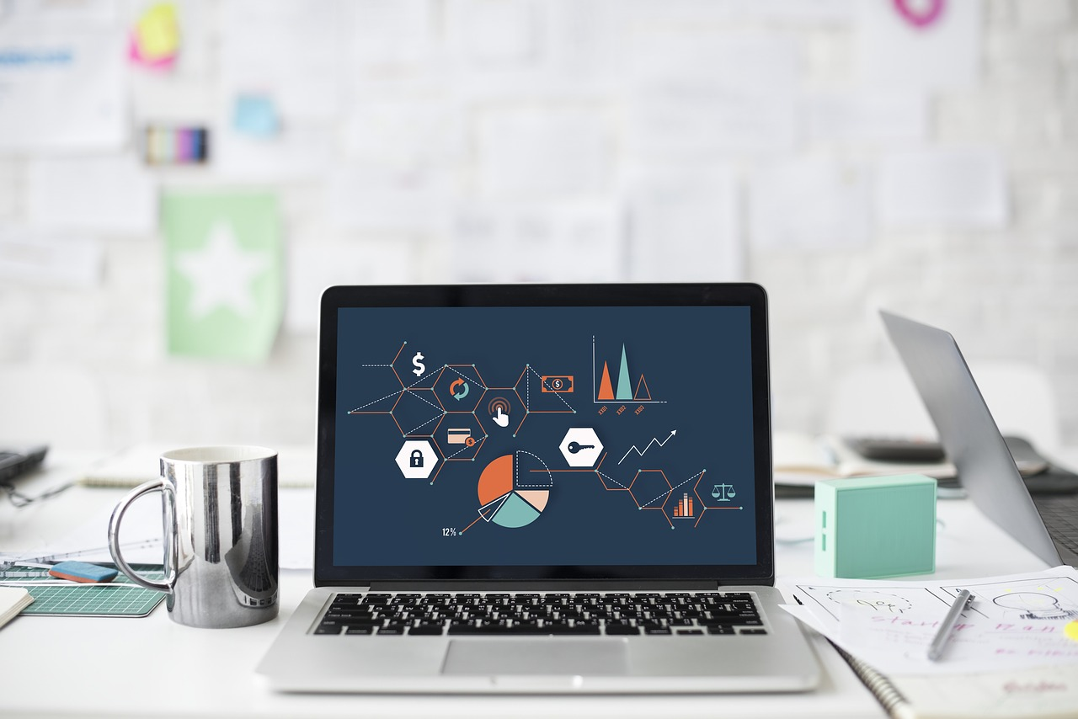
Research Data Management
Why and How?
Yasemin Turkyilmaz-van der Velden, Nicolas Dintzer & Esther Plomp
Data Stewards @ TU Delft Faculties of 3mE, TPM and TNW
y.turkyilmaz-vandervelden@tudelft.nl, N.J.R.Dintzner@tudelft.nl, E.Plomp@tudelft.nl
Slides are available: https://doi.org/10.5281/zenodo.3537598

Slide 2







Who are we?
Data Steward @ TU Delft
www.tudelft.nl/library/datastewardship/
Secure data storage, data sharing, citation
For data management in grant proposals
Advice and templates
Workshops, information sessions
Advice
Archiving
Costs
Compliance
Data
Management
Plans
Tools
Training
4TU.Centre for Research Data or disciplinary repositories
With funders' and journals’ policies
For data and software management

Slide 3

Data
descriptive/numerical information
considered for reference or analysis
notebooks
survey responses
software and code
measurements
  laboratory/field equipment
images (photographs, scans)
audio/video recordings
physical samples
Notes:
https://pixabay.com/illustrations/matrix-technology-technique-data-3407242/

Slide 4
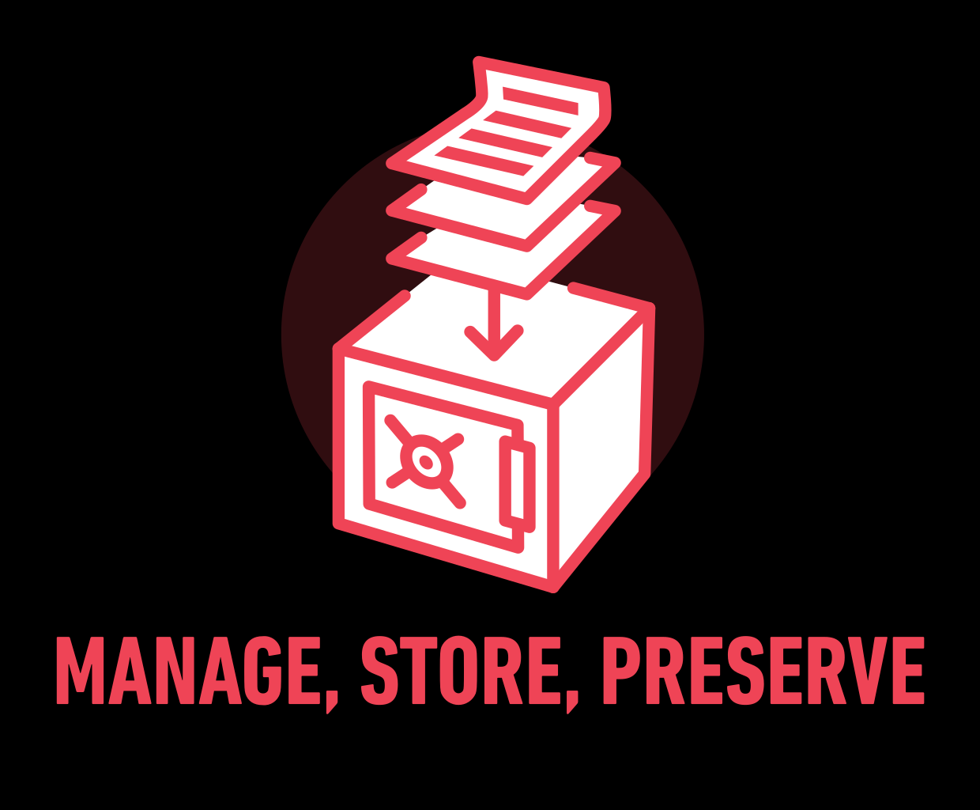
Research Data Management
The organisation of data throughout the research project
everyday management of research data
  storage, file naming, documentation
preservation and sharing of data after the project is completed

Slide 5
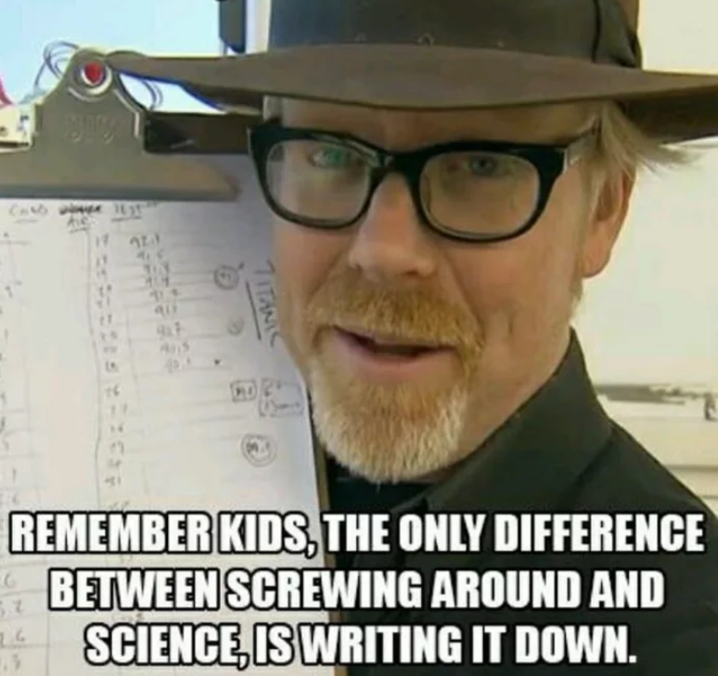
For today

Slide 6

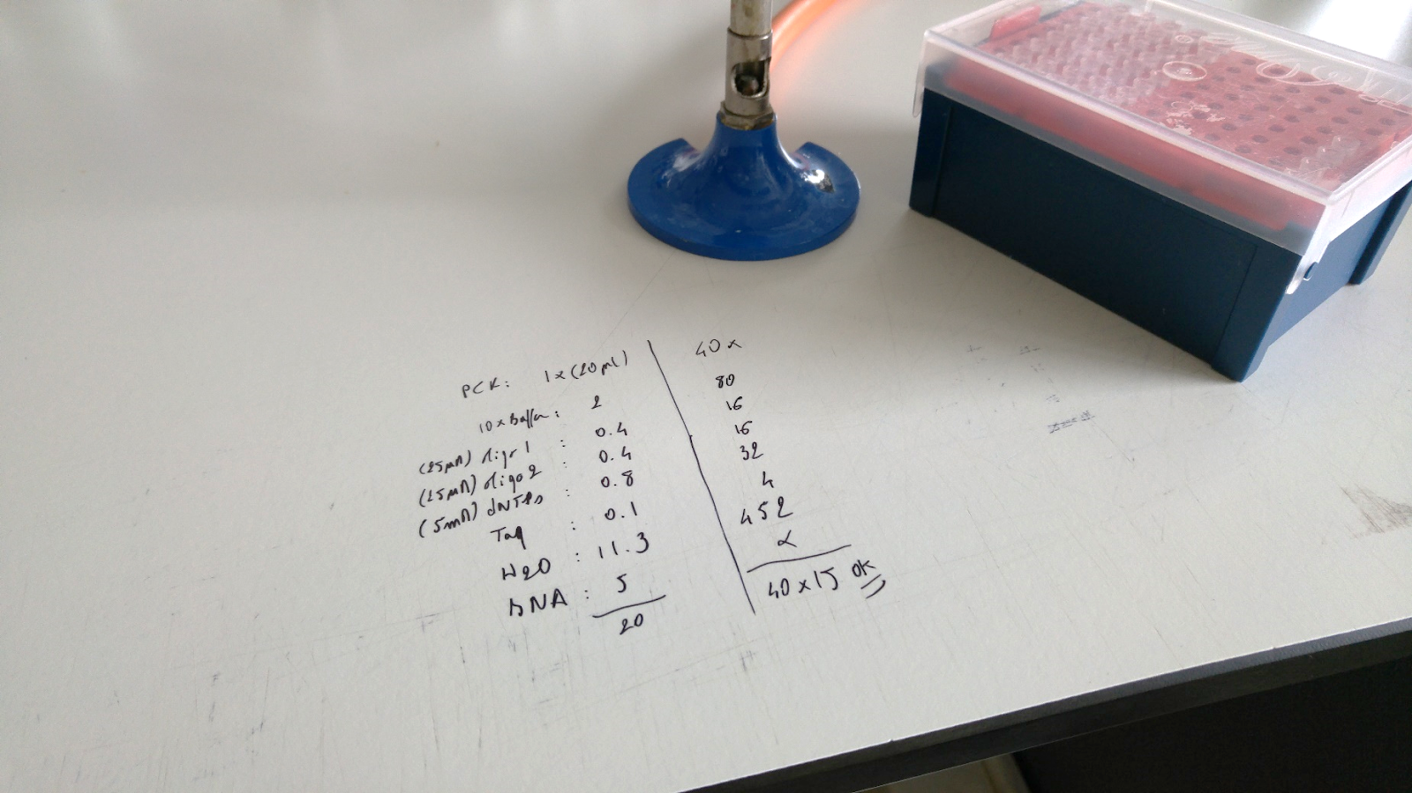
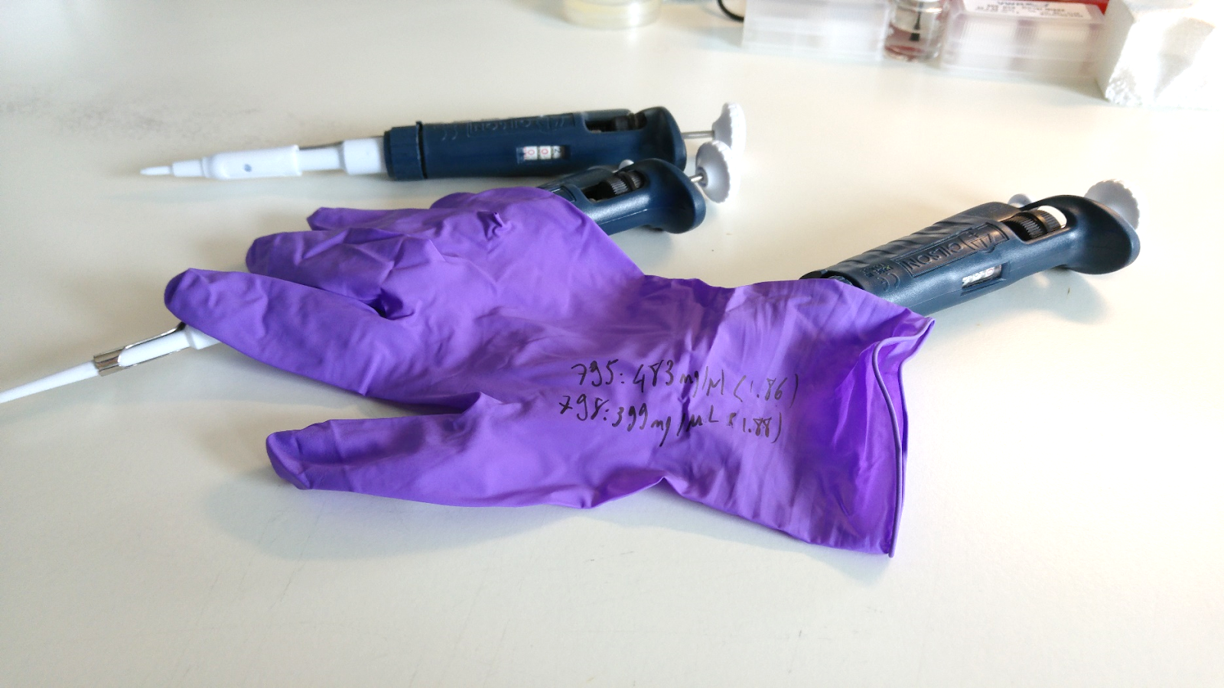
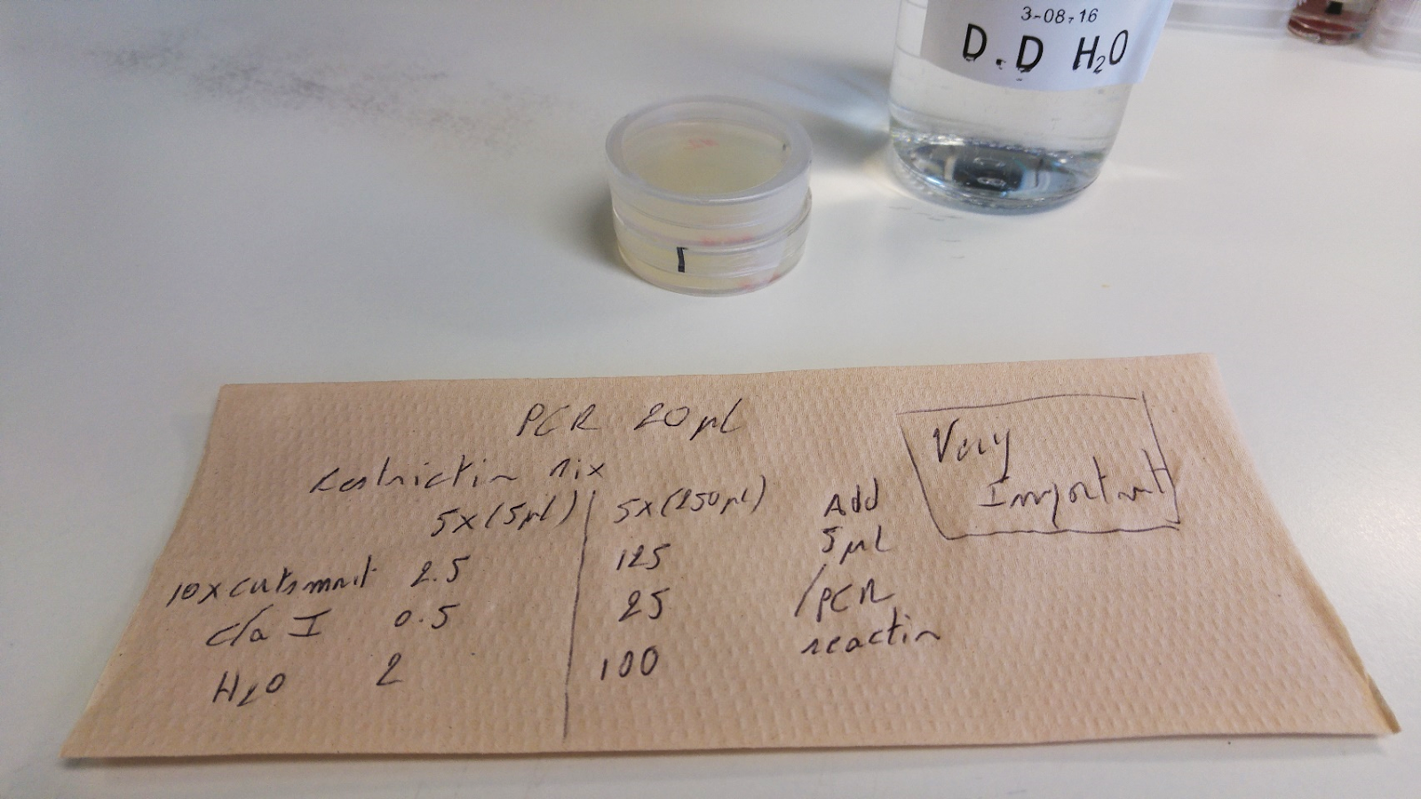
First things first...
Pictures:
Vincent Gaggioli
Data collection protocols – where does your data come from, and how are you keeping track of it ?
Notes:
Mentions of notes, in general, for research and lectures. Mentions interview notes as well.
It’s all Chaos! (with a big C)

Slide 7
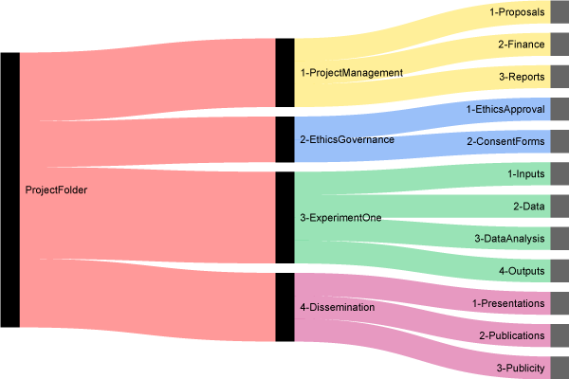
Advice 1: don’t lose your stuff,
“organize it”
Copyright: http://nikola.me/folder_structure.html

Slide 8
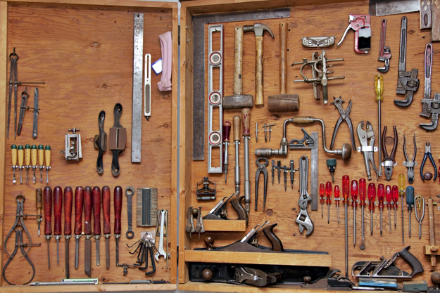
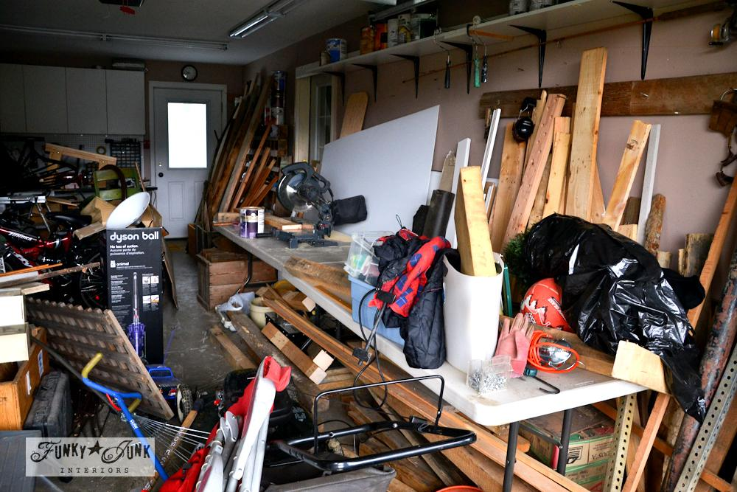
Organized / Dumped ?

Slide 9
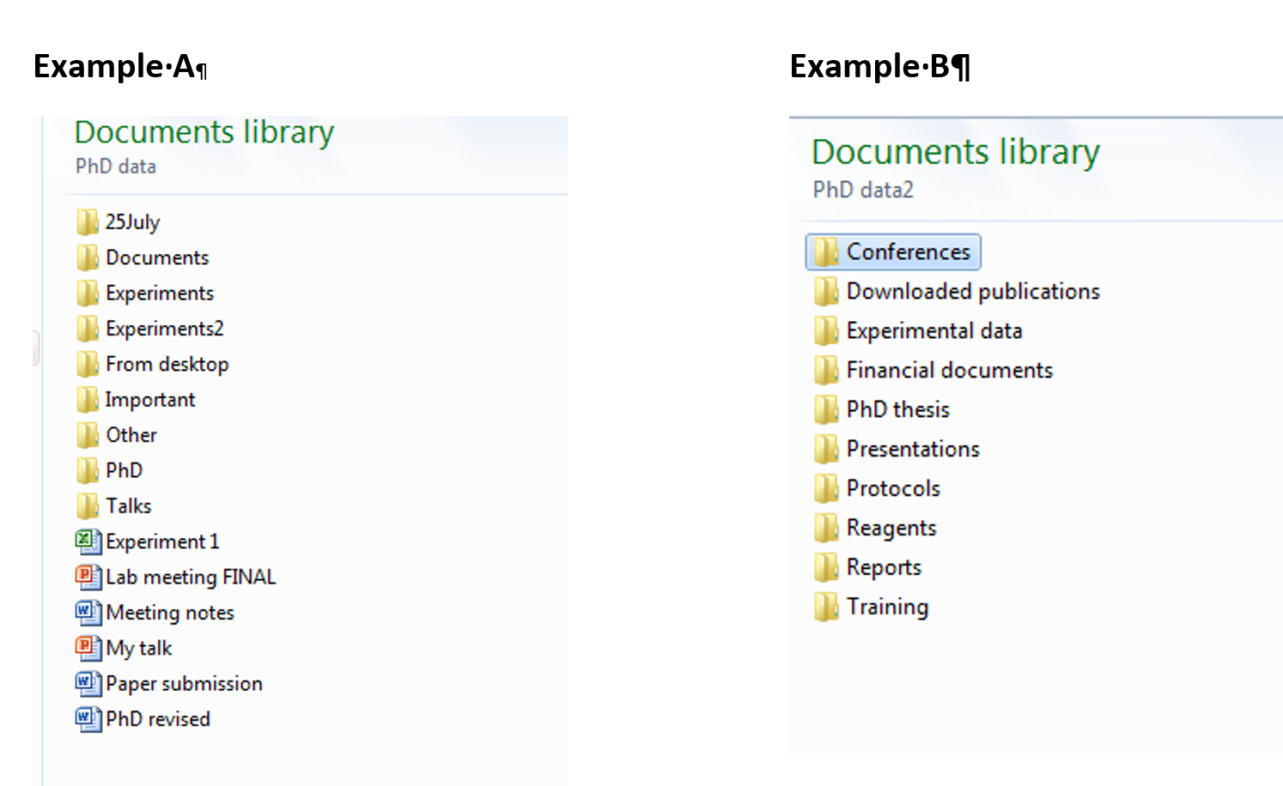
Practical example

Slide 10
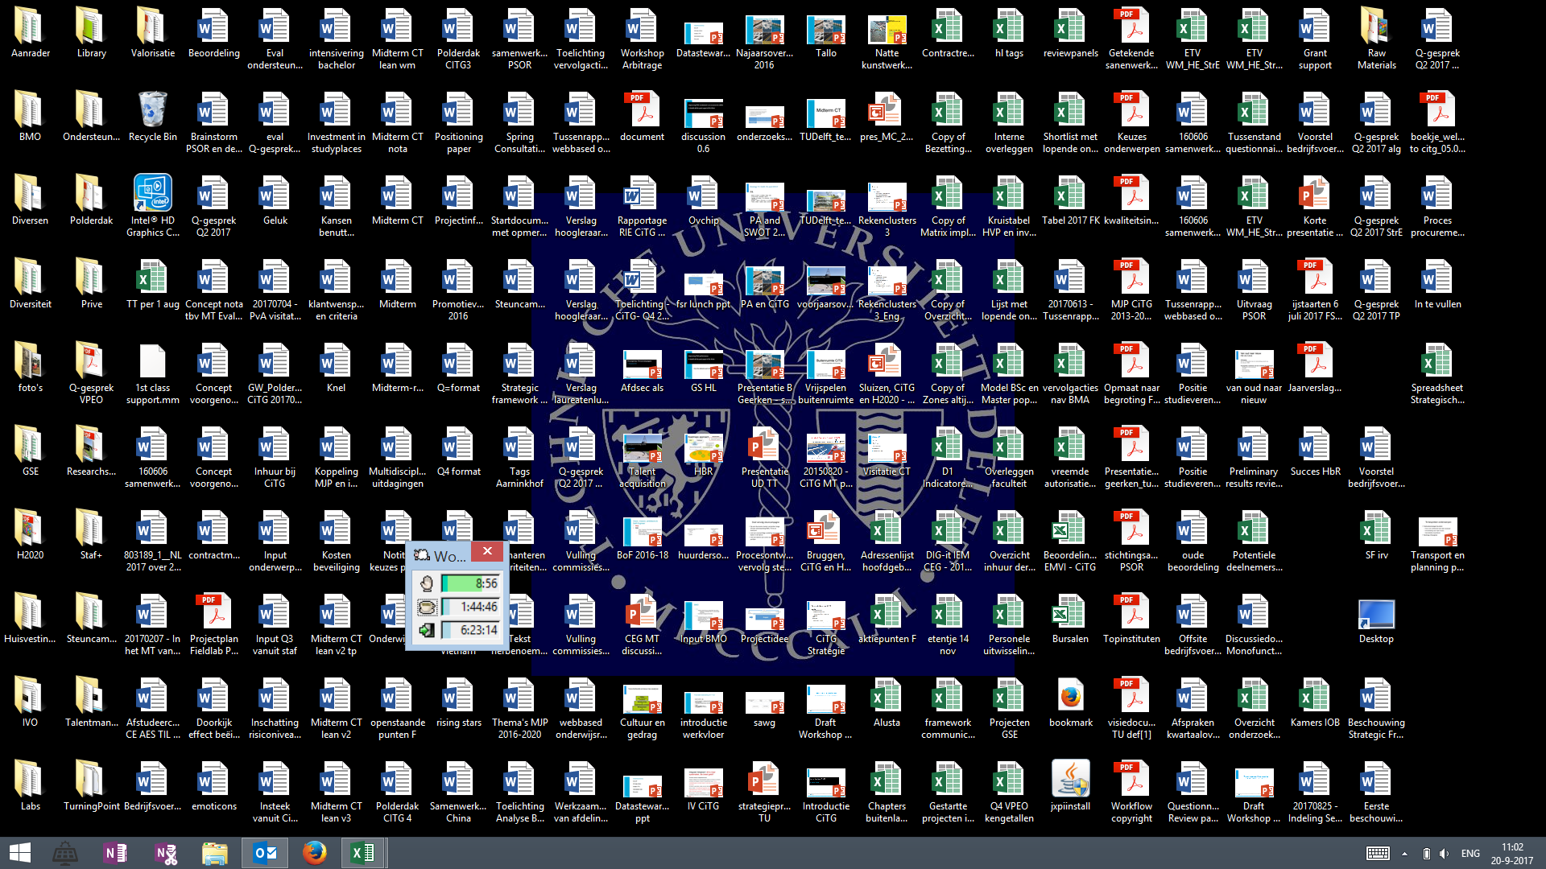
Organized / Dumped ?
Consistent
Meaningful to you and your colleagues
Allow you to find files easily
[Project] / [Experiment] / [Instrument or Type of file] / [Date]
https://libraries.mit.edu/data-management/store/organize/
Notes:
Critical if you need to share your working directory/workspace with others. You might understand this, but who else ?

Slide 11
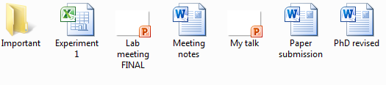
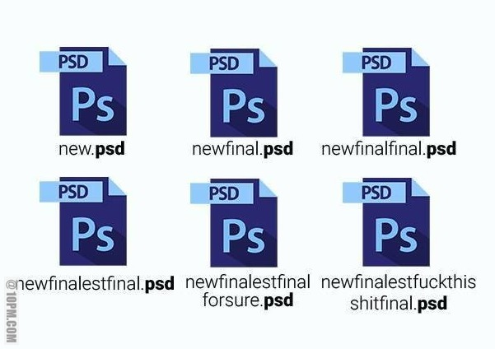
File naming
In 3 years time would you know what these are?
Copyright: http://10pm.com/

Slide 12
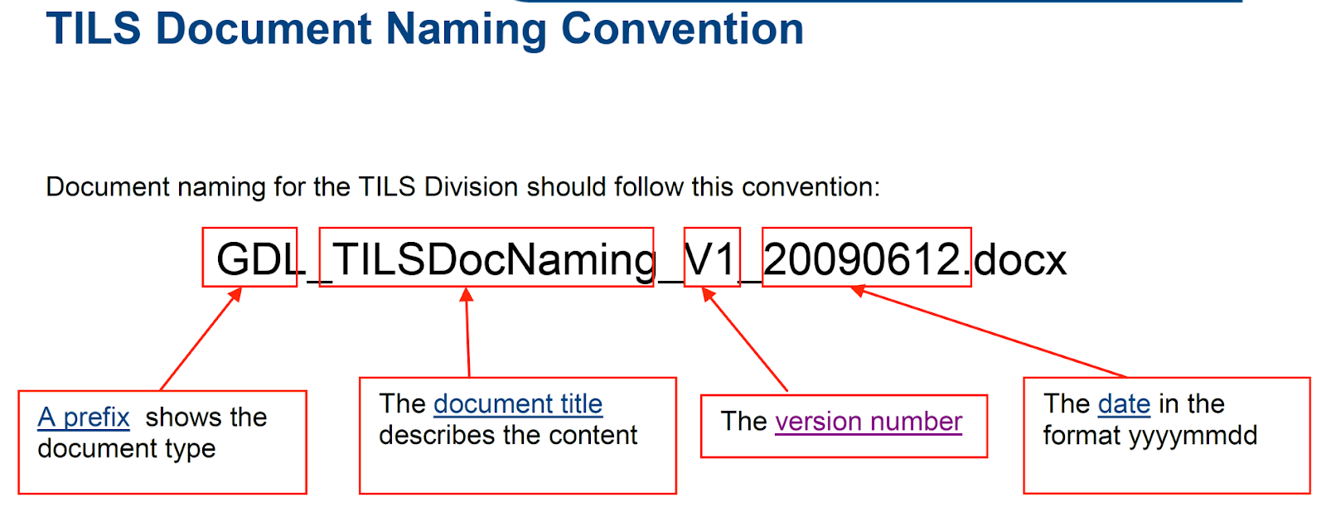
Advice 2: don’t lose your stuff, Name it
Date or date range of experiment: YYYYMMDD
File type ( “lab_report”, “Lecture_X-assignment-1”...)
Researcher name/initials
Version number of file
Don’t make file names too long
Avoid special characters and spaces
Include a README.txt file to explain the naming convention

Slide 13
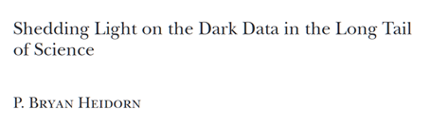
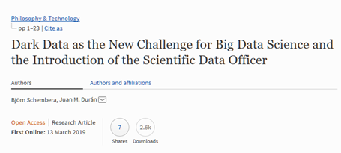
But then...
“Dark data” is data that we know is here, but lack of knowledge about it makes it useless

Slide 14
Devil is in the details
Name | Date | Location | Position
... | ... | ... | ...
Name : interviewee
Date: date of the interview
Location: company where the interview took place
Position: position of the interviewee in the company
Name: bob
Date: 10/10/2010
Location: ABN Paris
Position: cyber security manager
Name : car owner
Date: date of the recorded accident
Location: location of the accident
Position: position on the road of the car at the moment of the accident
Name: bob
Date: 10/10/2010
Location: A2 - km 55
Position: middle lane

Slide 15
Vocabulary: how to say ‘female’
18-day pregnant females
2 yr old female
400 yr. Old female
Adult female
Asexual female
Castrate female
Cf.female
Cystocarpic female
Dikaryon
Dioecious female
Diploid female
F
Famale
Femail
Female
Female – worker
Female (alate sexual)
Female (calf)
Hen
Female (lactating)
Female (pregnant)
Female (outbred
Female parent
Female plant
Female with eggs
Female worker
Female, 6-8 weeks old
Female, virgin
Female, worker
Female(gynoecious)
Femele
Female, pooled
Femalen
Females
Females only
Gynoecious
Healthy female
Probably female (morphology)
Individual female
Igb*cc females
Mare
Female (worker)
Monosex female
Ovigerous female
Oviparous sexual females
Worker bee
Female enriched
Pseudohermaprhoditic female
Remale
Semi-engorged female
Sexual oviparous female
Sterile female worker
Strictly female
Tetraploid female
Thelytoky
Female (gynoecious)
Worker caste ‘female’
Sex female
Female, other
Female child
Femal
3 female
Female (phenotype)
Female mice
Female, spayed
Femlale
Metafemale
Sterile female
Normal female
Sf
Vitellogic replate female
Worker
Hexaploid female
Female (f-o)
Slide adapted from Christine Staiger
https://doi.org/10.5281/zenodo.2585691
Notes:
This happens if you come from the same field but do not agree on standards
In red: those that look like typos
‹#›

Slide 16
Advice 3: don’t lose you stuff, document it!
Meta data – data about your data
Spreadsheet example – for each column
  What is it supposed to contain ?
  Format / units ?
  Vocabulary ?
Located in:
  The spreadsheet itself
  README file
For spreadsheets, scripts / code , ...
Notes:
Example for threshold: “obesity” yes/no. Which exact weight / MBI value? (relevant for “indicators”)

Slide 17
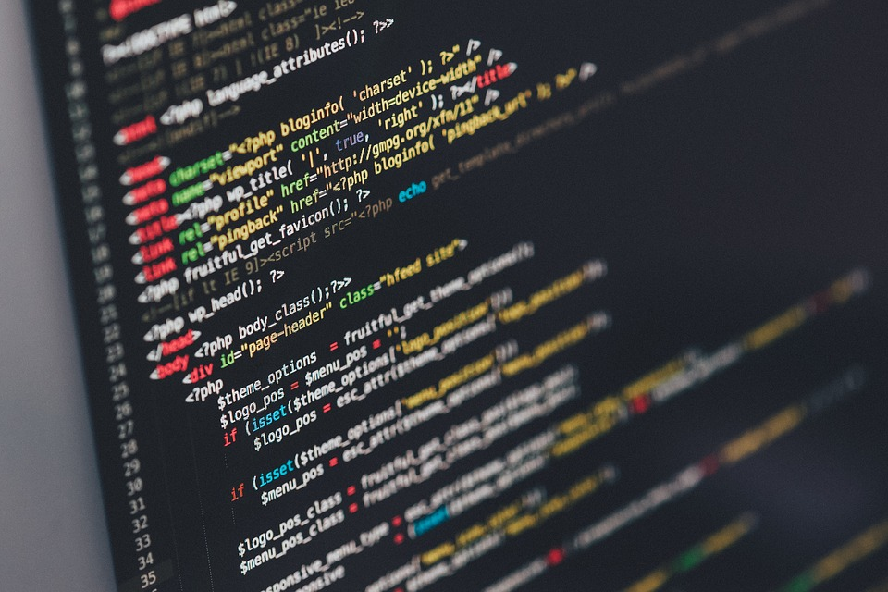

The special case of software code
https://github.com/fogleman/Minecraft/blob/master/main.py#L195
File name
  Should help you to know what is inside !
Function:
  Name : what it does
  Document the function (more info on what it does)
  Document its input and output
Variable names:
  T is time or temperature ?
  What it is - be clear!
  x,y,z ?

Slide 18
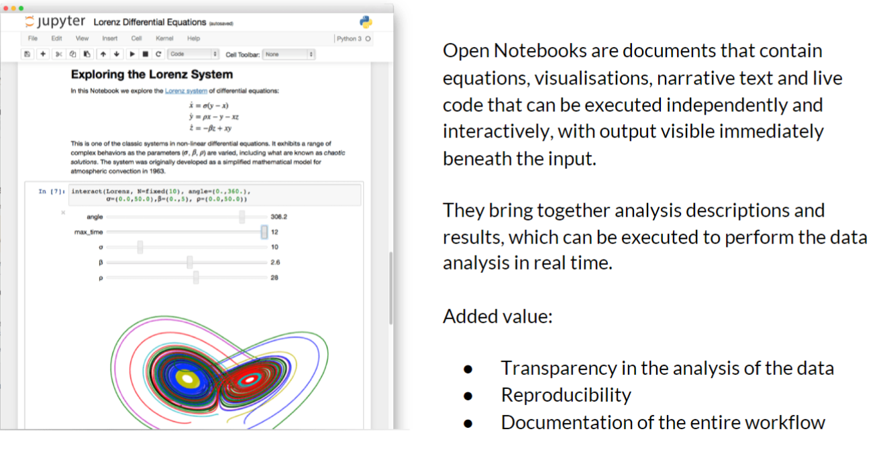
Open notebooks such as Jupyter & Rstudio
Ainsworth, Rachael. (2018, October). Reproducibility and Open Science. Zenodo. http://doi.org/10.5281/zenodo.1464853

Slide 19
So far, so good ?
Don’t lose your stuff!
  Organize it
  Name it
  Document it
... Are we good ?

Slide 20
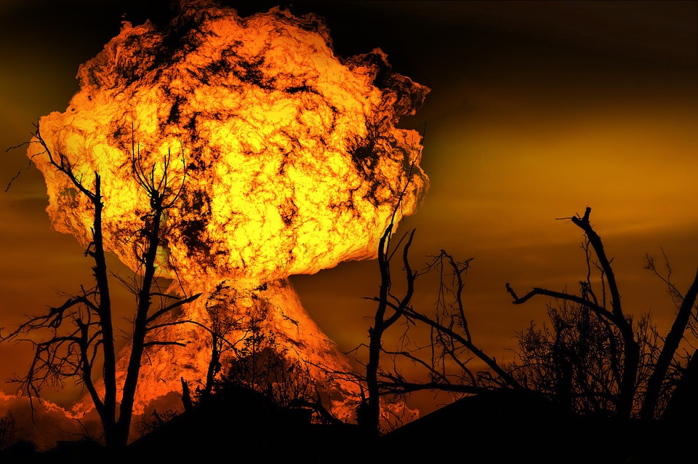
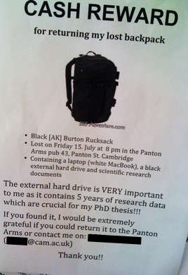
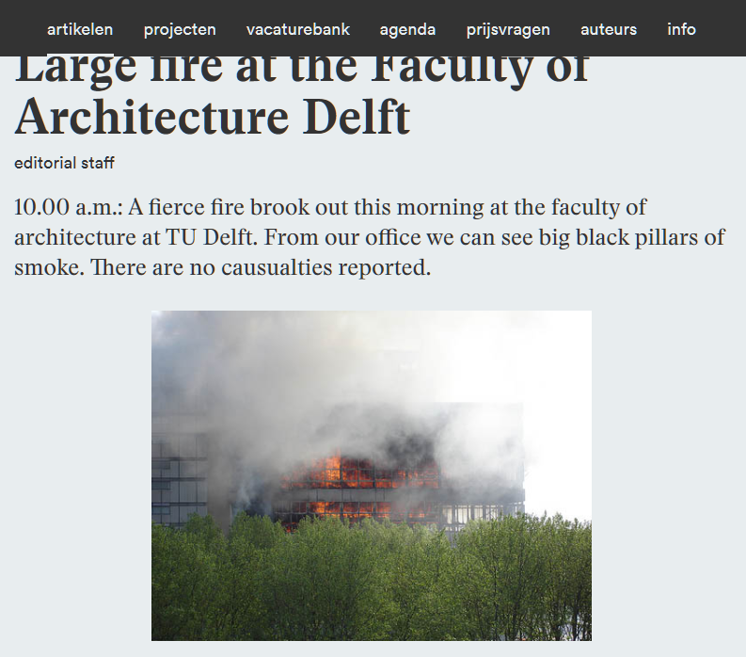

Slide 21
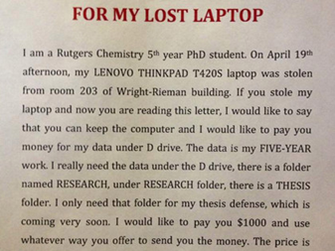

Would you lose data if…?
your laptop/notebook got stolen or lost
your lab burnt down
you lost your USB stick
your portable hard drive got damaged
your files on Dropbox / Googledrive disappeared
original slide by Marta Teperek
Notes:
Update pic. With the one from TPM

Slide 22
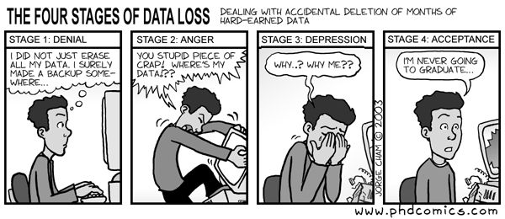
You will survive
But barely...

Slide 23
To avoid data loss:
Backup your data regularly and preferably automatically
Create, at a minimum, 2 copies of your data
Store data at multiple trusted locations
Use reliable backup solutions
Avoid data storage on hard disks, USB's, and personal computers without backup
https://www.dataone.org/best-practices/backup-your-data

Slide 24

Not all storage born are equal
“Sensitive data”
Personal data, company data, …

Slide 25
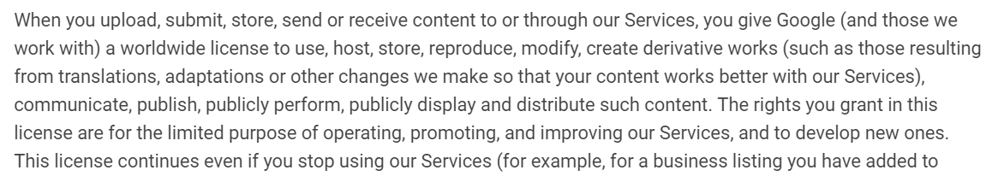
Always read the small print…
Google services Terms of Use:
https://www.google.com/intl/en/policies/terms/

Slide 26
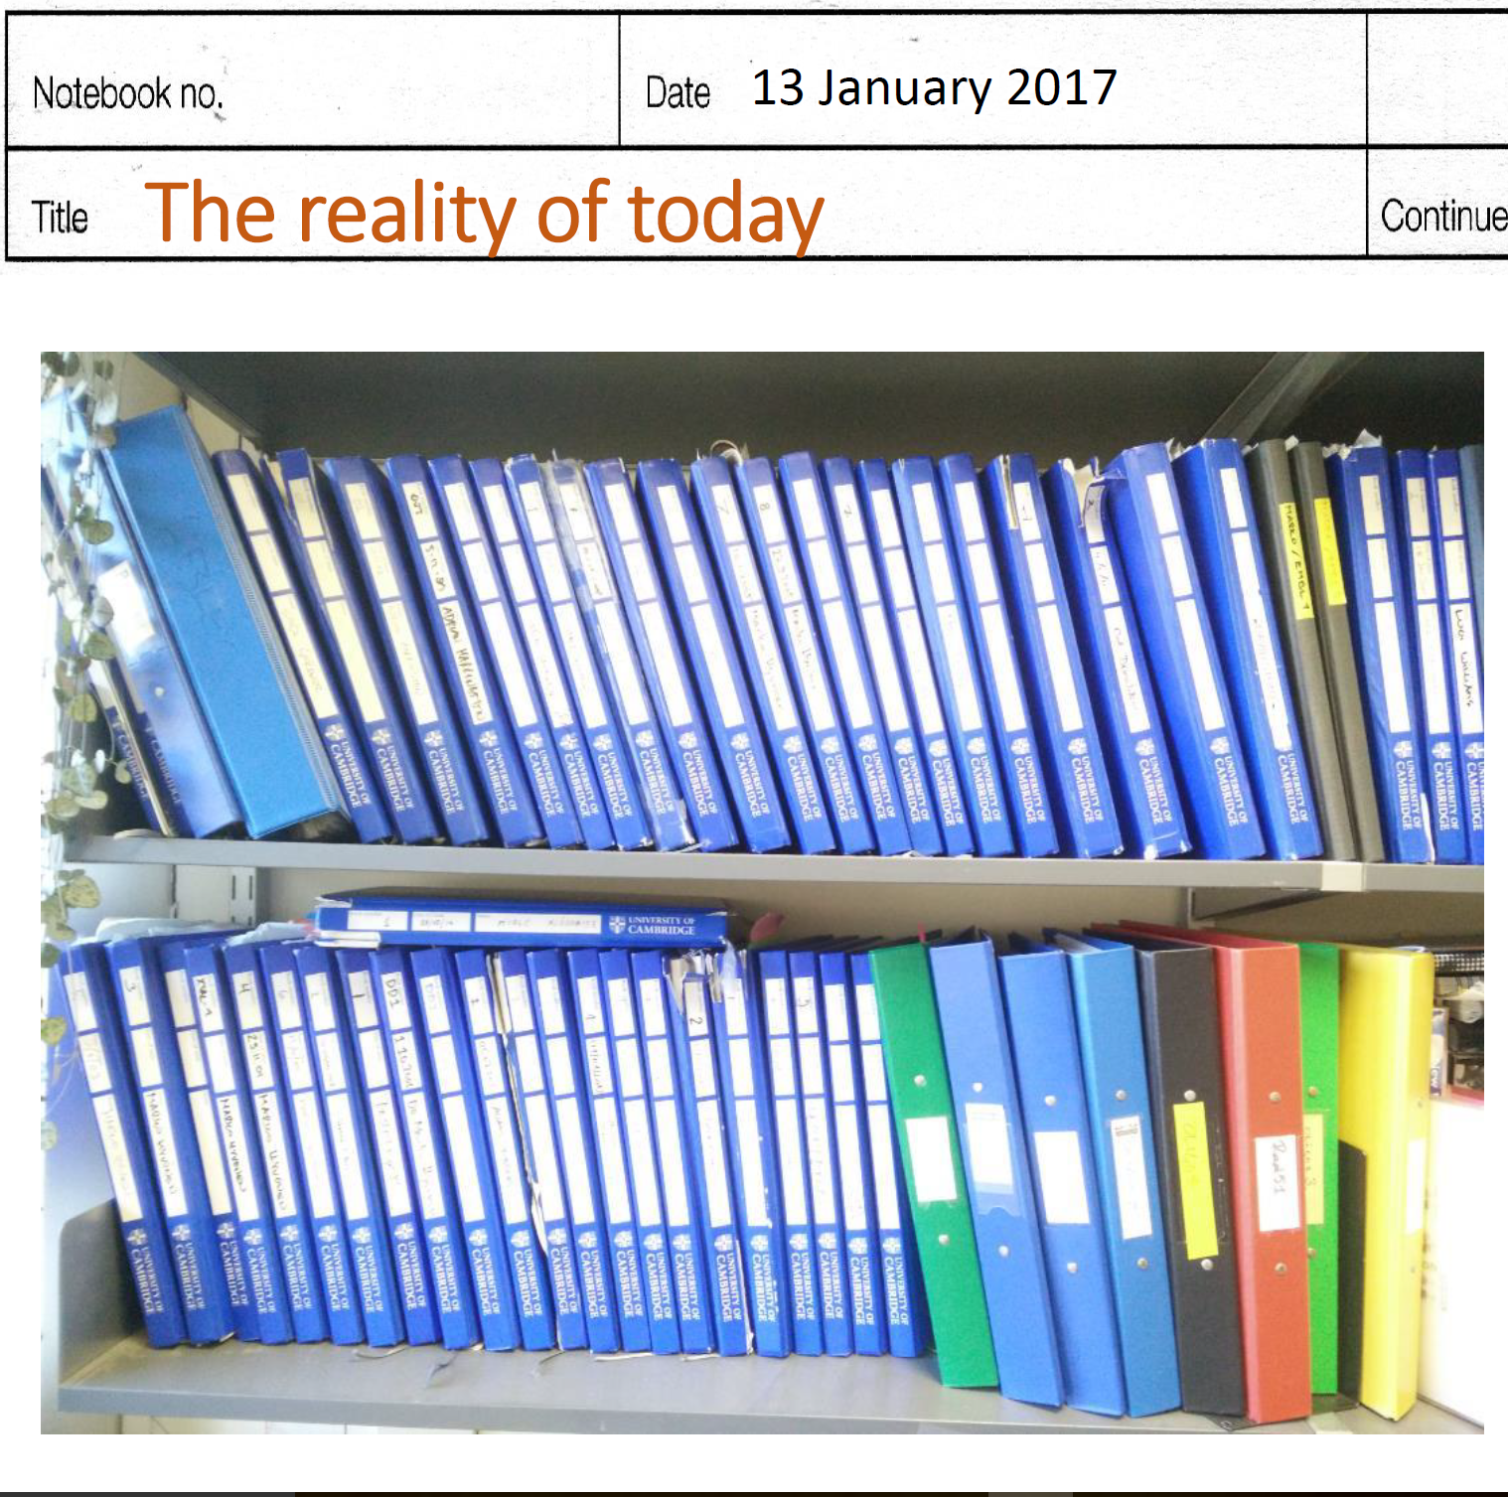
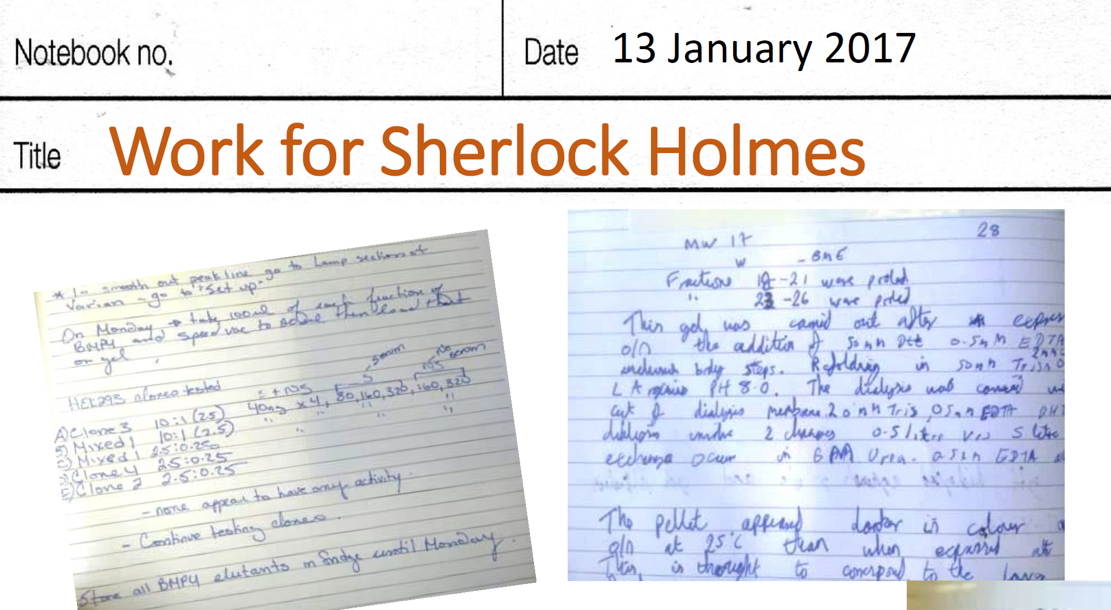
Experimental notes
Presentation by Dr Marko Hyvonen
https://doi.org/10.17863/CAM.7217

Slide 27
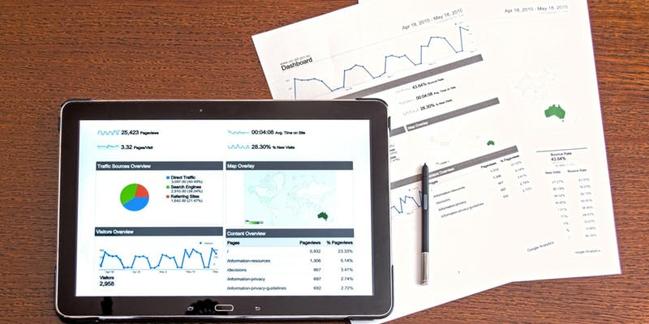
Electronic Lab Notebooks
Digital documentation, categorization and linking of
  Raw, intermediate and final data
  Experimental and measurement parameters
  Physical samples
Searchable
Traceable (version control) & fraud-proof
Questions about the ELN trial? Contact Esther or Yasemin

Slide 28
Storage space your work
Course work: your choice - be safe
When in doubt:
  Ask to your supervisor
  Go to your data steward
Notes:
Course work: assignment, lecture notes, …

Slide 29

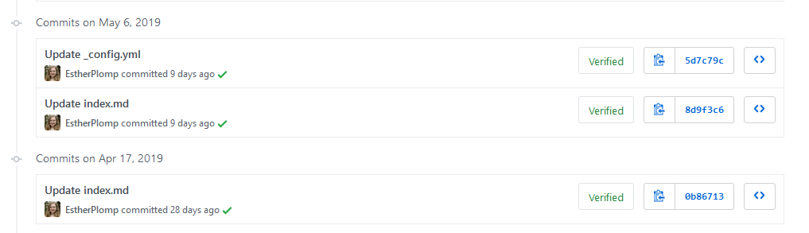
Version control software
Notes:
Go and check the software carpentry material -
This is THE way of managing software code

Slide 30
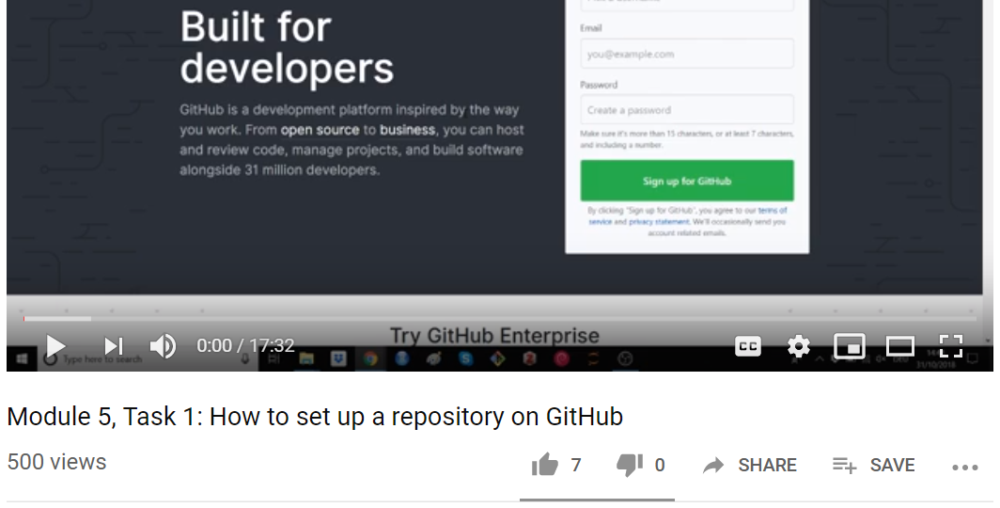
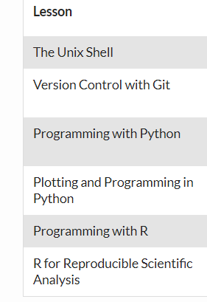

Working with GitHub
https://www.youtube.com/watch?v=AnftV9HBPSc
https://software-carpentry.org/lessons/

Slide 31
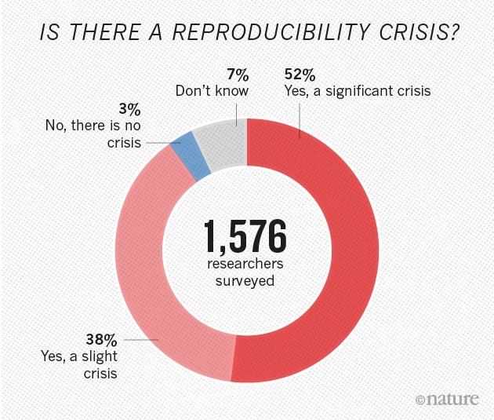
More challenges ahead
Nature 533, 452–454 (26 May 2016) doi:10.1038/533452a

Slide 32
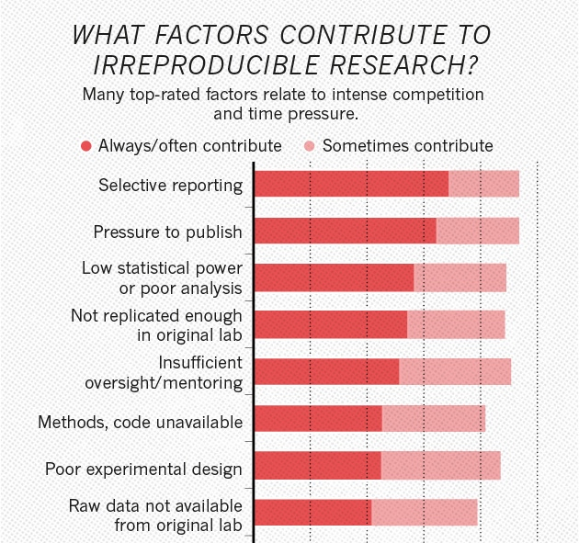
Nature 533, 452–454 (26 May 2016) doi:10.1038/533452a

Slide 33
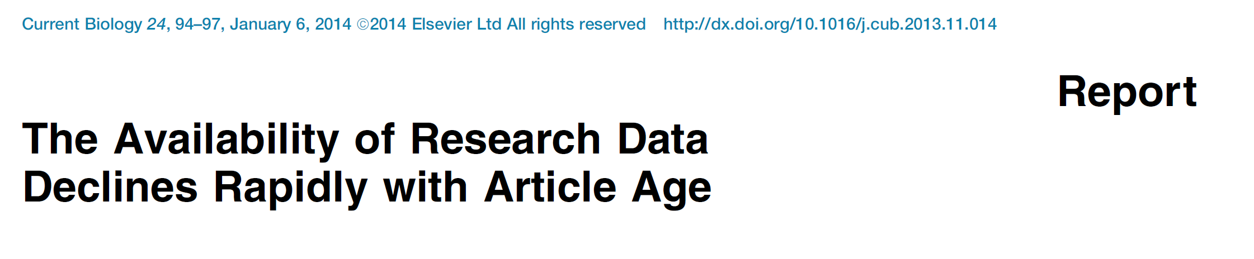
Datasets available ‘on request’ are not available
Data availability decreases by 17% per year
Chance of email address working decreases by 7% per year
http://dx.doi.org/10.1016/j.cub.2013.11.014

Slide 34
Datasets available ‘on request’ are not available
Data availability decreases by 17% per year
Chance of email address working decreases by 7% per year
What’s the alternative to sharing ‘on request’?
http://dx.doi.org/10.1016/j.cub.2013.11.014

Slide 35

Archiving in a repository
  A place where things can be stored and shared

Slide 36

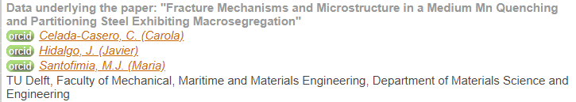
Repositories for data
Digital Object Identifier
https://doi.org/10.4121/uuid:67e93016-8a24-4381-880c-073975797eac

Slide 37

Repositories for data
Digital Object Identifier
https://doi.org/10.4121/uuid:67e93016-8a24-4381-880c-073975797eac

Slide 38

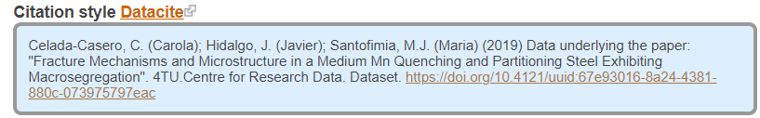
Repositories for data
Digital Object Identifier
https://doi.org/10.4121/uuid:67e93016-8a24-4381-880c-073975797eac

Slide 39
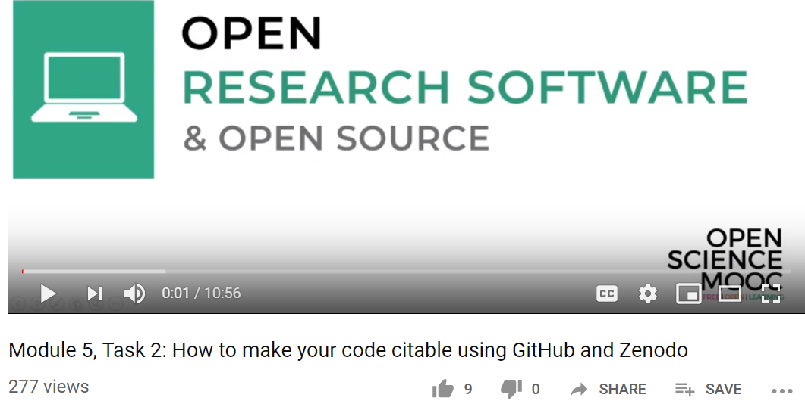


Repositories for software
+
https://www.youtube.com/watch?v=pjsbBQYOOaE&t=1s
https://guides.github.com/activities/citable-code/

Slide 40
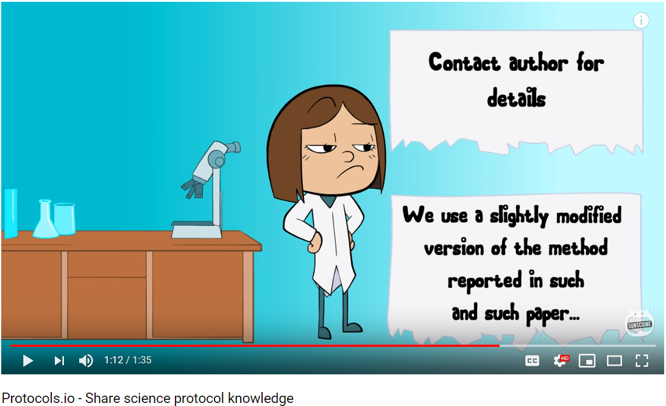
Repositories for protocols
https://www.youtube.com/watch?v=84B8P6BAOgM
https://www.protocols.io/

Slide 41
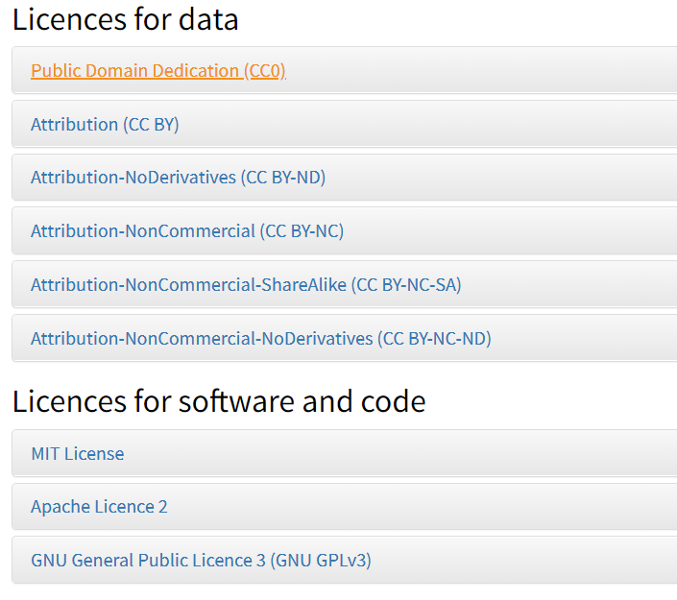
https://researchdata.4tu.nl/en/use-4turesearchdata/archive-research-data/upload-your-data-in-our-data-archive/licencing/

Slide 42
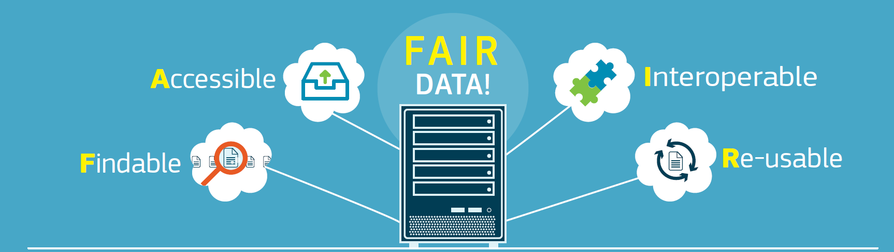
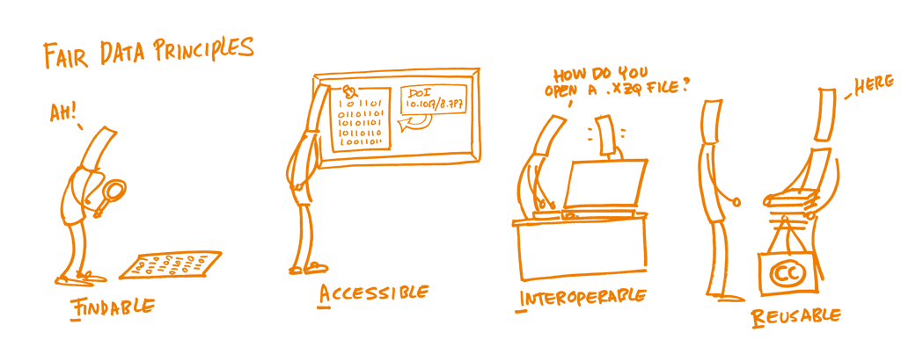
Funders’ & Publisher requirements
http://ec.europa.eu/research/press/2016/pdf/opendata-infographic_072016.pdf#view=fit&pagemode=none
Notes:
FAIR applies to research data, but also to all type of data, at all time (not just at the end).

Slide 43

Thank you
Questions?
Slides are available:
https://doi.org/10.5281/zenodo.3537598

