Slide 1

Open and transparent leadership in academia
Kirstie Whitaker
Pronouns: she/her
#CurateYourStory @kirstie_j
https://doi.org/10.5281/zenodo.3532649
Notes:
TIMING: 0

Slide 2
Open and transparent leadership in academia
I have no idea what I’m doing:
Kirstie Whitaker
Pronouns: she/her
#CurateYourStory @kirstie_j
https://doi.org/10.5281/zenodo.3532649
Notes:
TIMING: 0

Slide 3




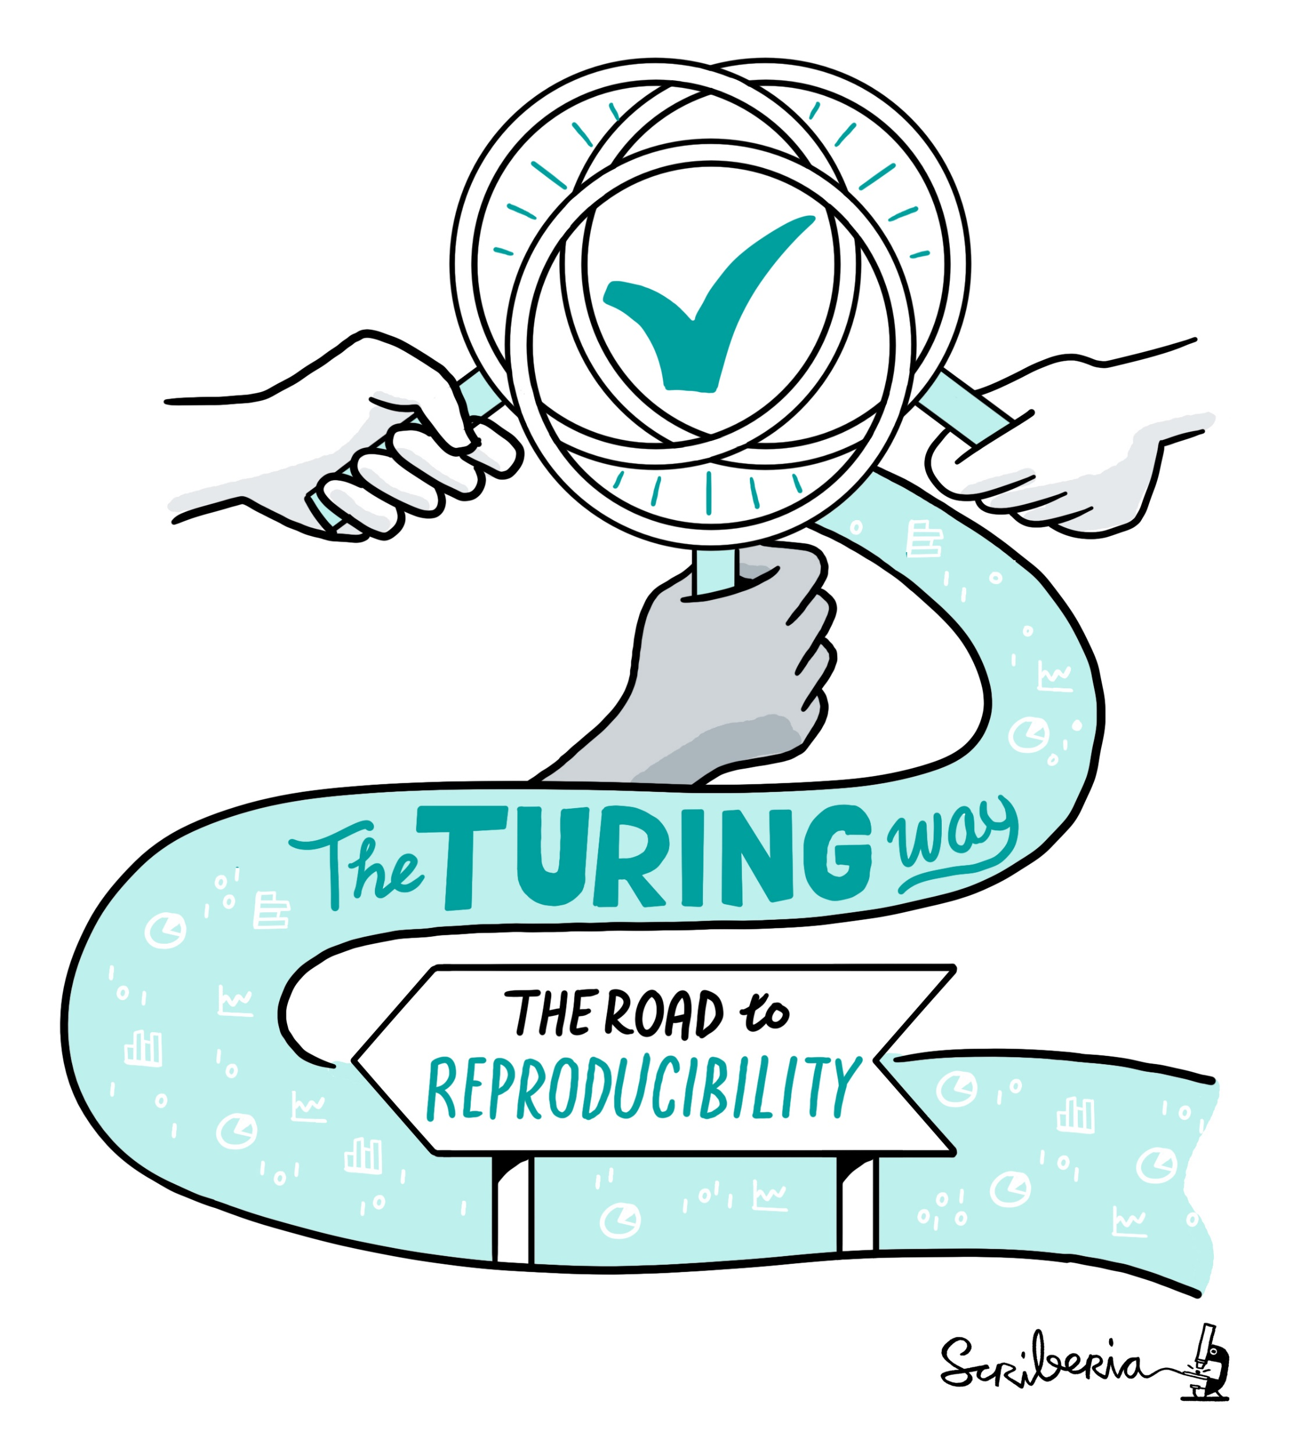
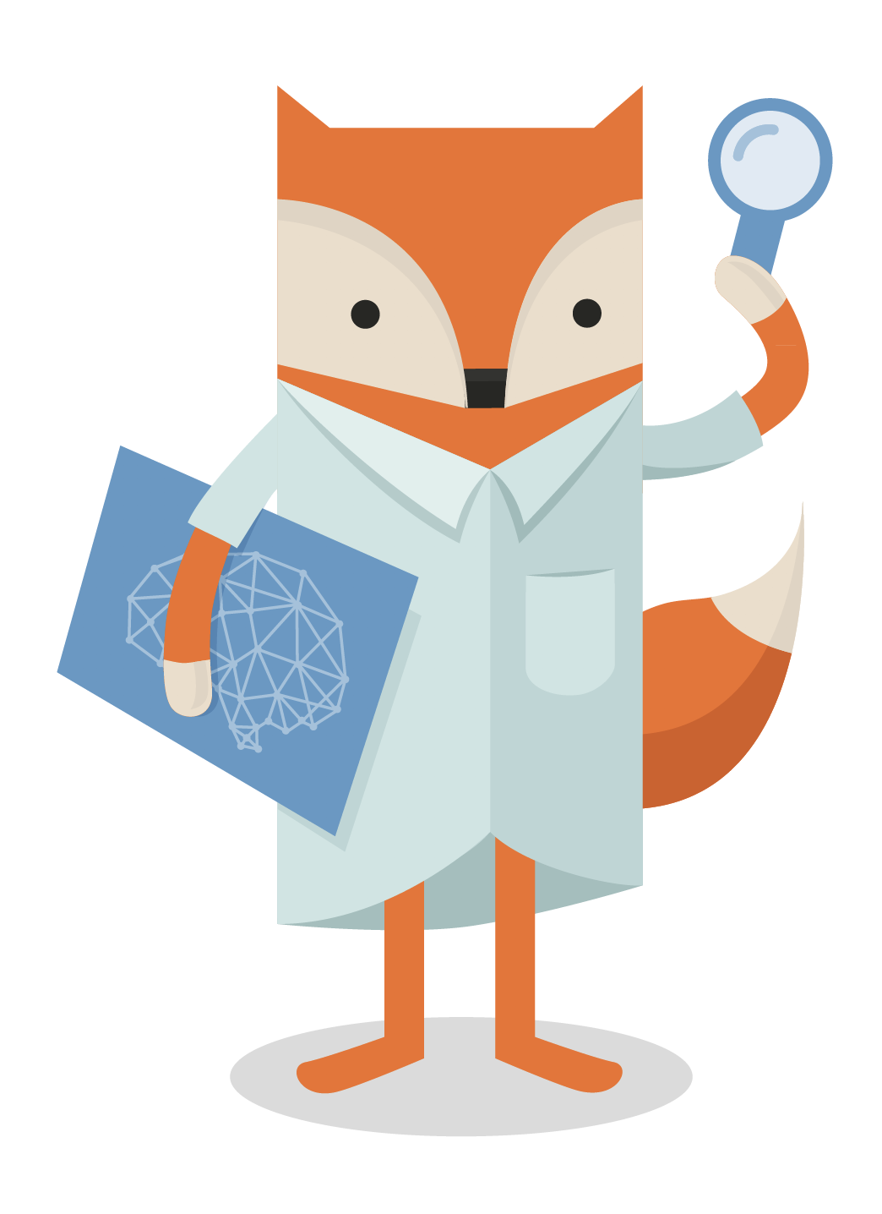
Thank you to my incredible colleagues
Konrad Adler-Wagstyl
Sophie Adler-Wagstyl
Georgia Aitkenhead
Louise Bowler
Elizabeth DuPre
Sarah Gibson
Yini He
Patricia Herterich
Ang Li
Malvika Sharan
Isla Staden
Yo Yehudi
#CurateYourStory @kirstie_j
https://doi.org/10.5281/zenodo.3532649

Slide 4
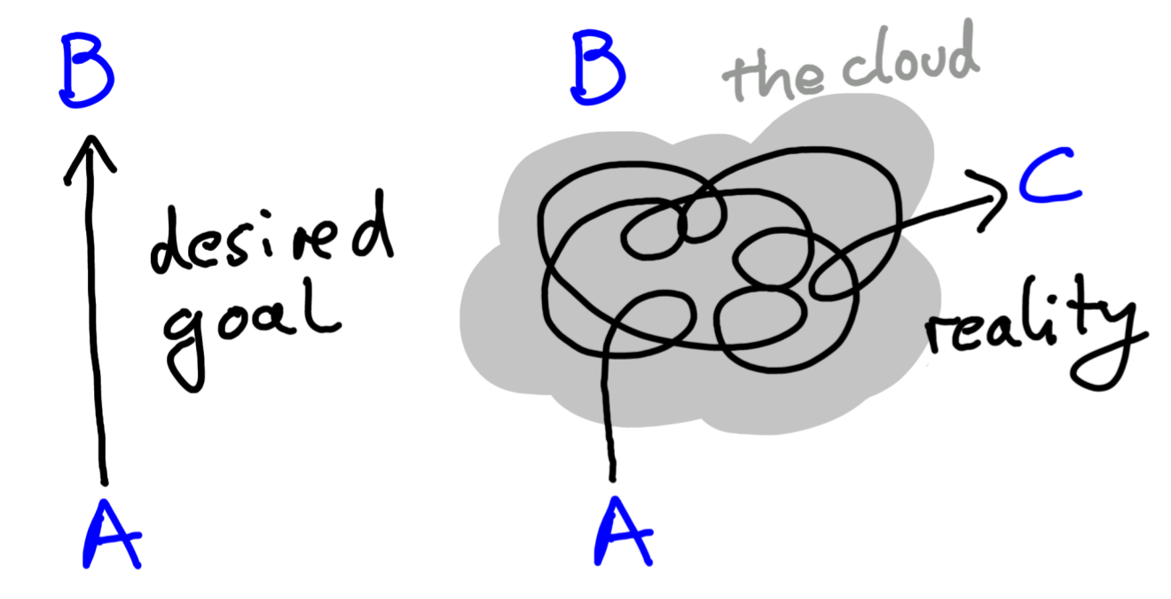
#CurateYourStory @kirstie_j
https://doi.org/10.5281/zenodo.3532649
https://www.ted.com/talks/
uri_alon_why_truly_innovative_science_demands_a_leap_into_the_unknown
Alon, 2009, 10.1016/j.molcel.2009.09.013

Slide 5
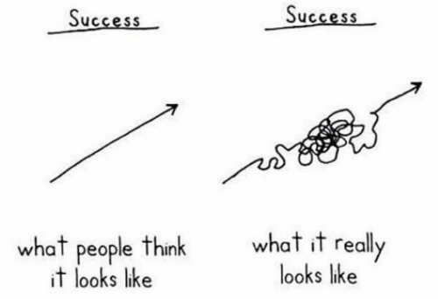
#CurateYourStory @kirstie_j
https://doi.org/10.5281/zenodo.3532649

Slide 6
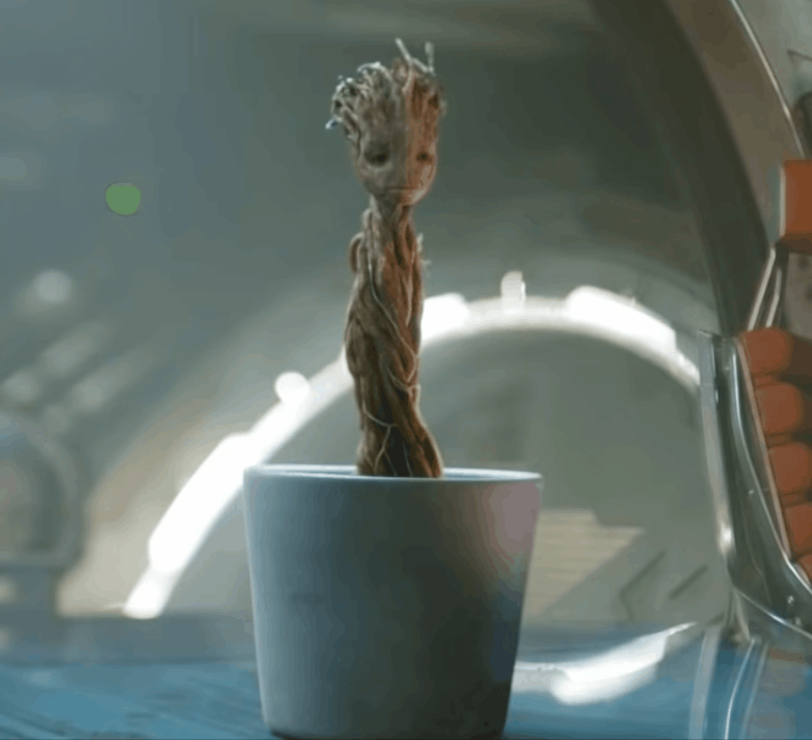
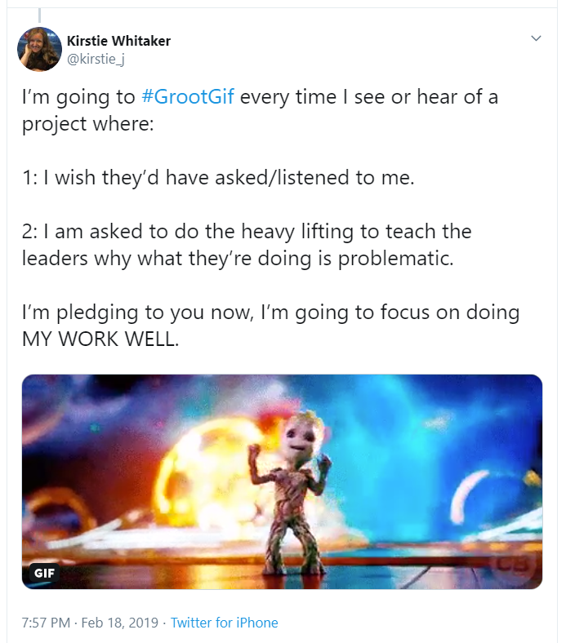
#GrootGif
#CurateYourStory @kirstie_j
https://doi.org/10.5281/zenodo.3532649

Slide 7
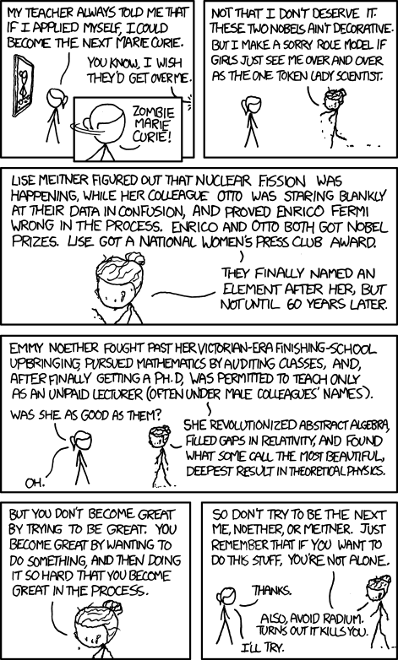
#CurateYourStory @kirstie_j
https://doi.org/10.5281/zenodo.3532649
https://xkcd.com/896

Slide 8
#CurateYourStory @kirstie_j
https://doi.org/10.5281/zenodo.3532649
https://xkcd.com/896

Slide 9
Curate your story
#CurateYourStory @kirstie_j
https://doi.org/10.5281/zenodo.3532649

Slide 10
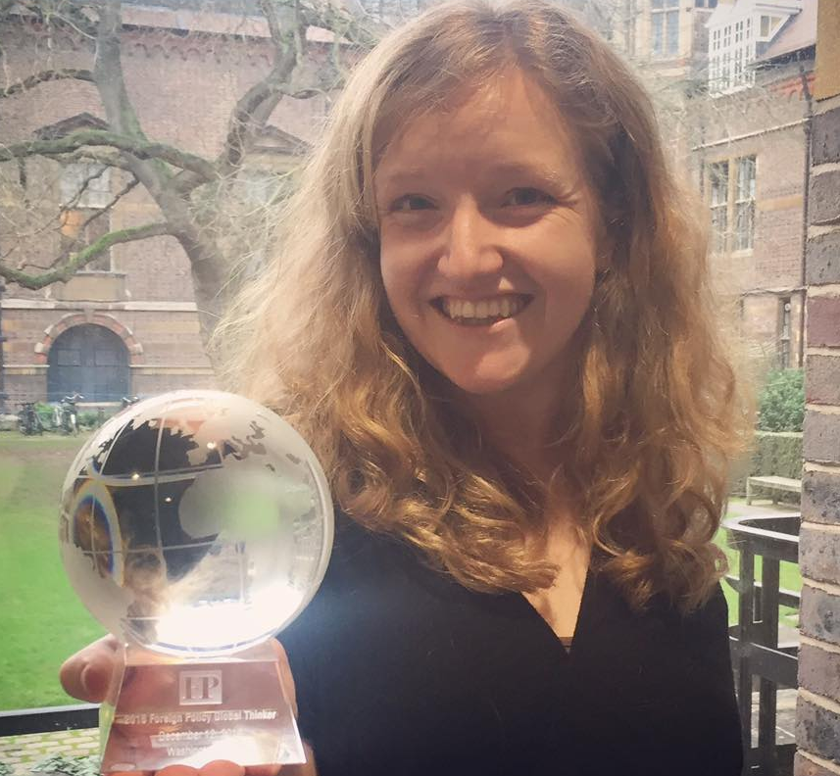
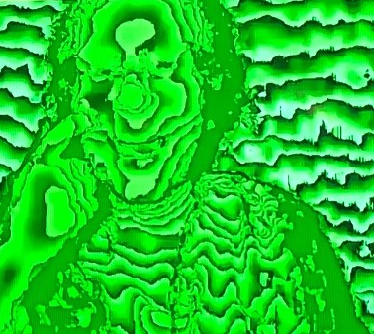
I’m a physicist who knows how MRI machines work and uses them to understand the developing brain as a network.
#CurateYourStory @kirstie_j
https://doi.org/10.5281/zenodo.3532649

Slide 11
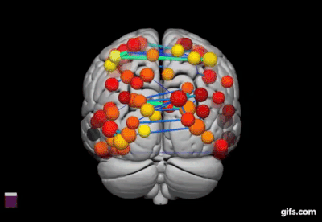
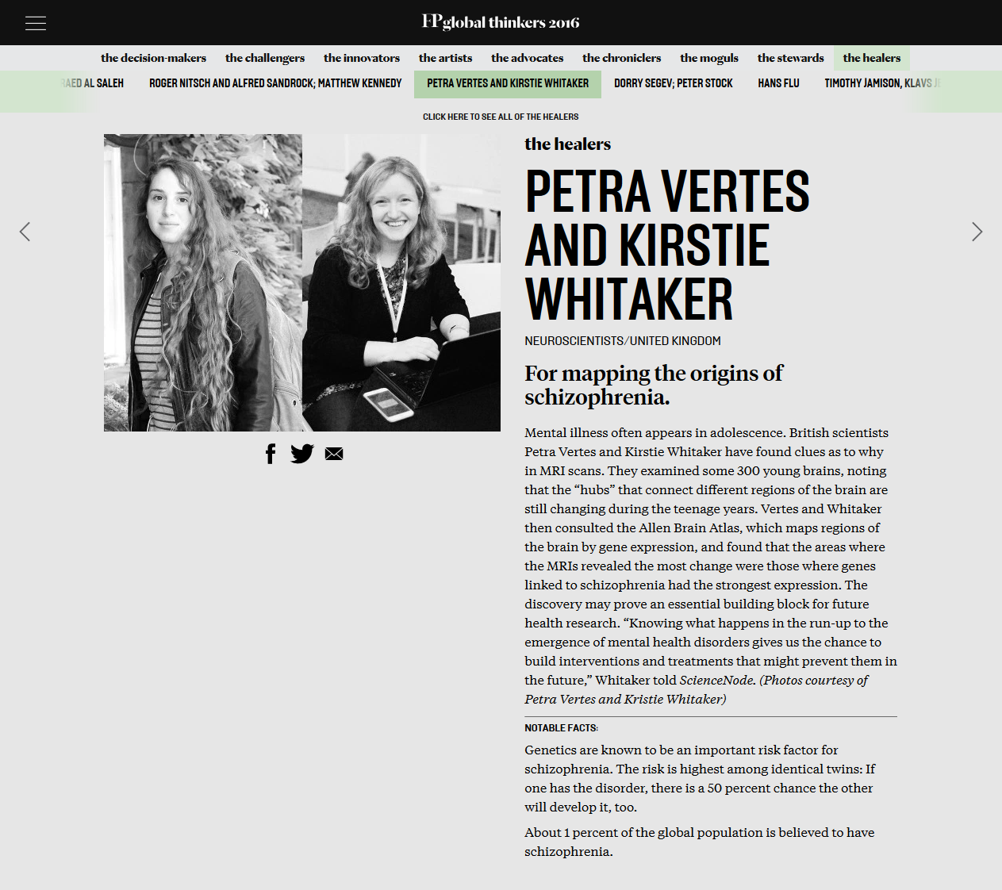




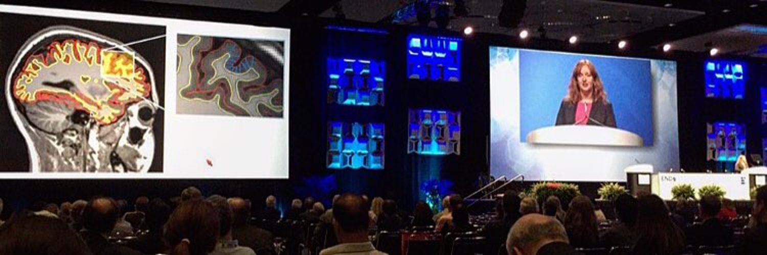
#CurateYourStory @kirstie_j
https://doi.org/10.5281/zenodo.3532649
https://2016globalthinkers.foreignpolicy.com/2016/profile/
petra-vertes-and-kirstie-whitaker

Slide 12
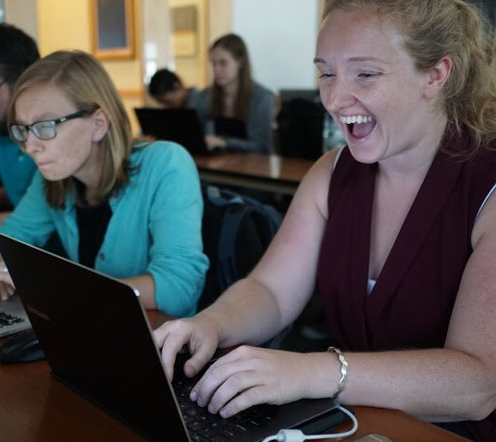
I’m a neuroscientist frustrated by the publication bias in my field who builds data standards and training materials to make it easier for others to share their hard work.
Picture credit: Chris Gorgolewski
#CurateYourStory @kirstie_j
https://doi.org/10.5281/zenodo.3532649

Slide 13
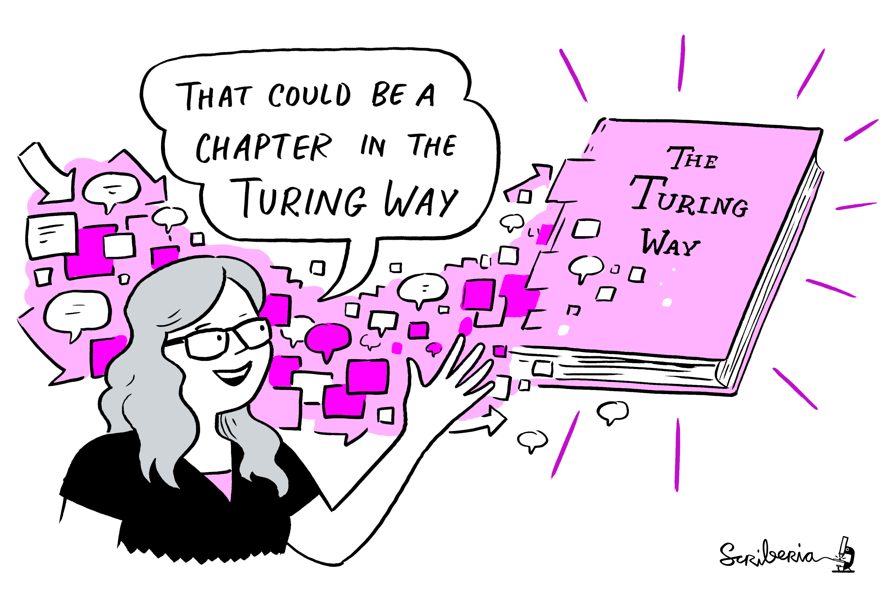
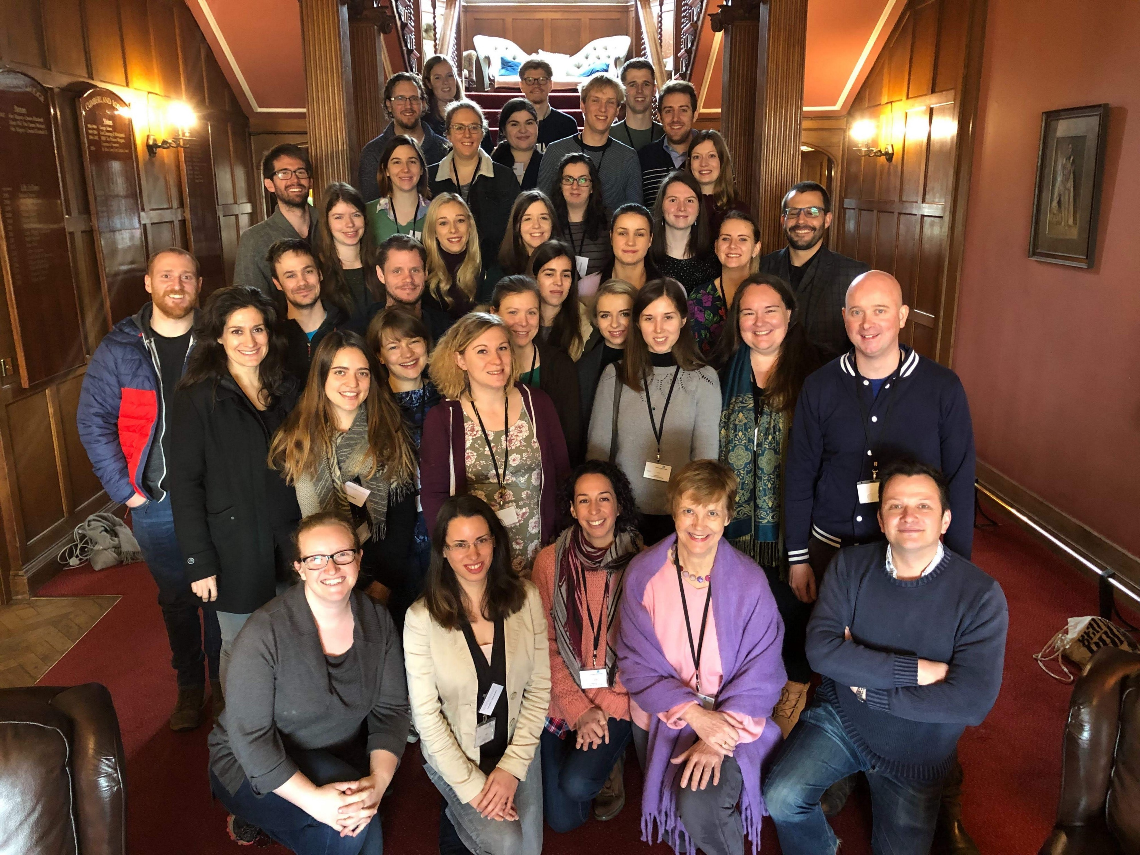
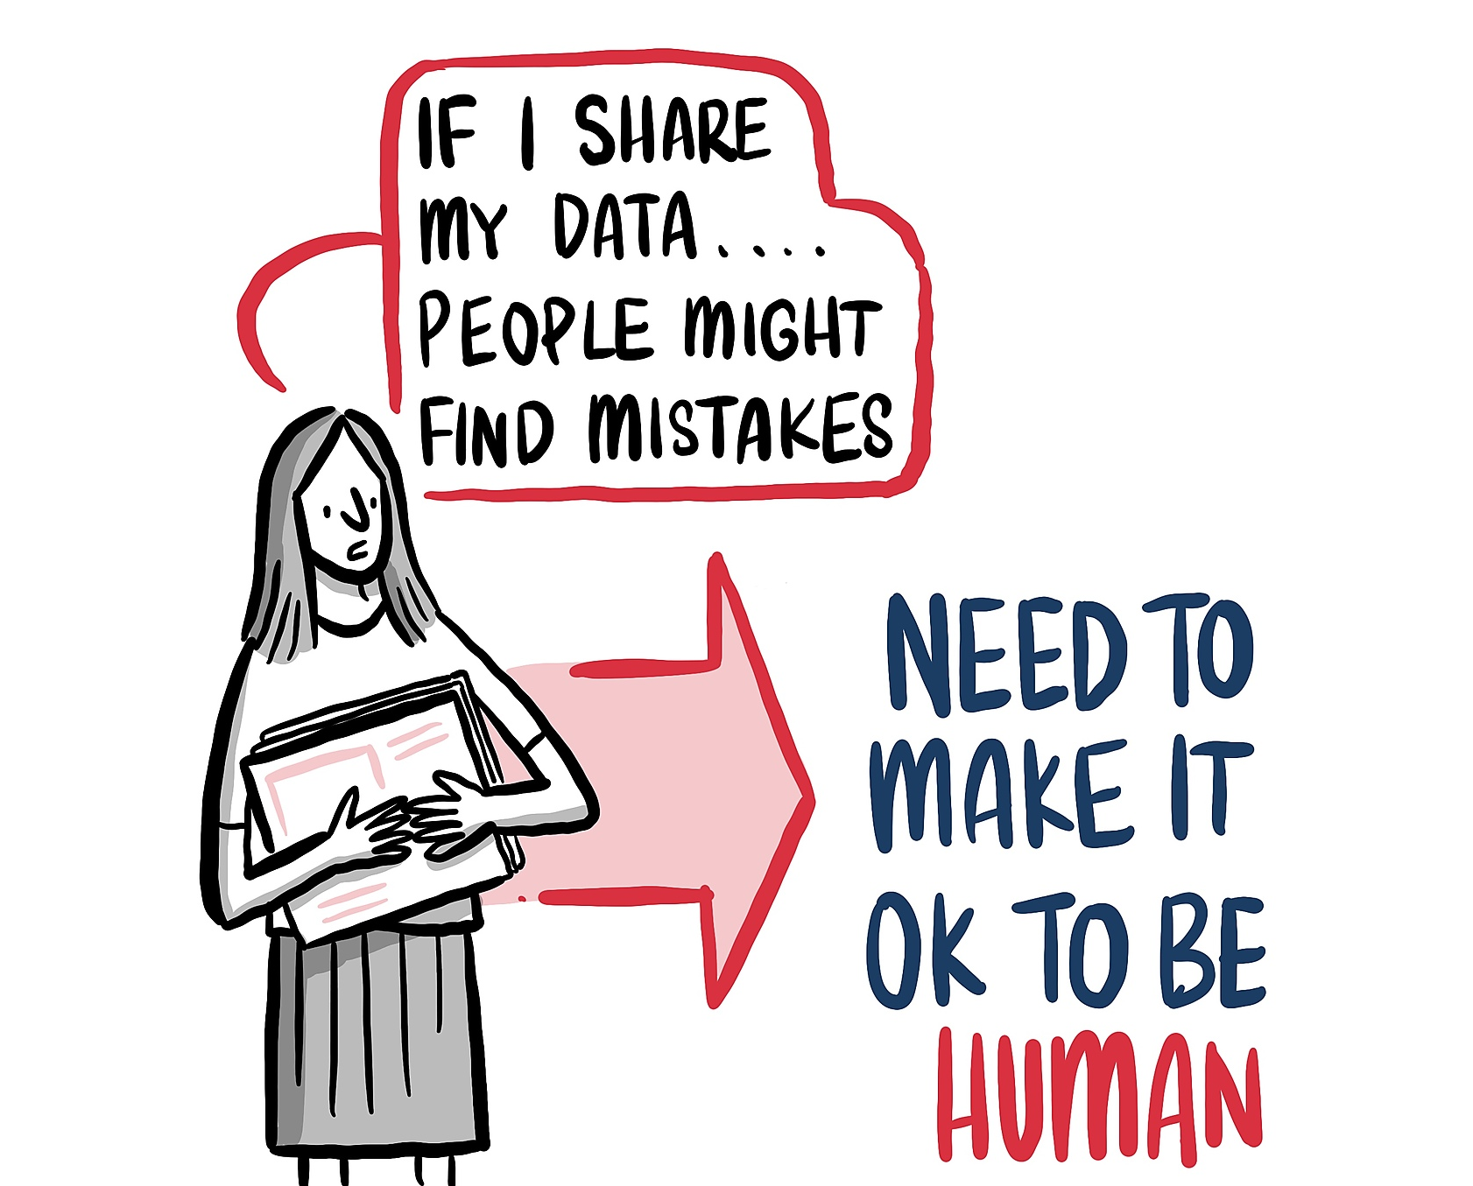
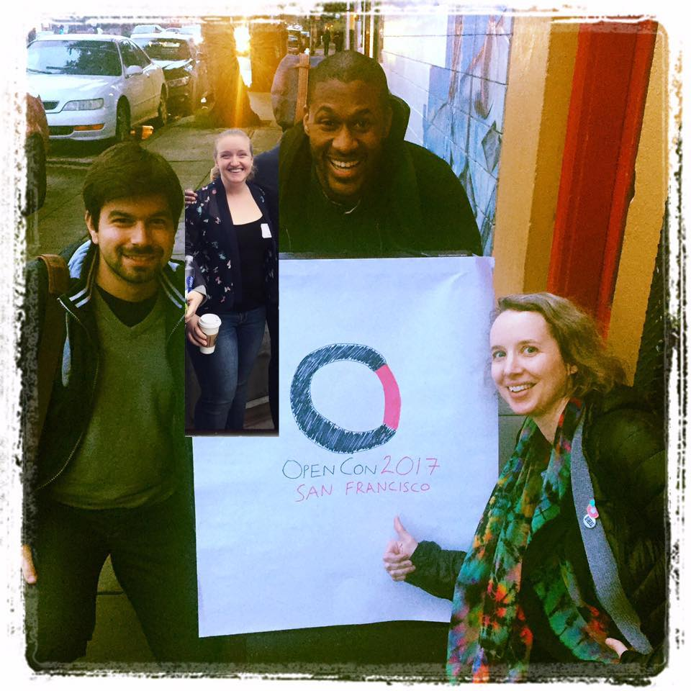
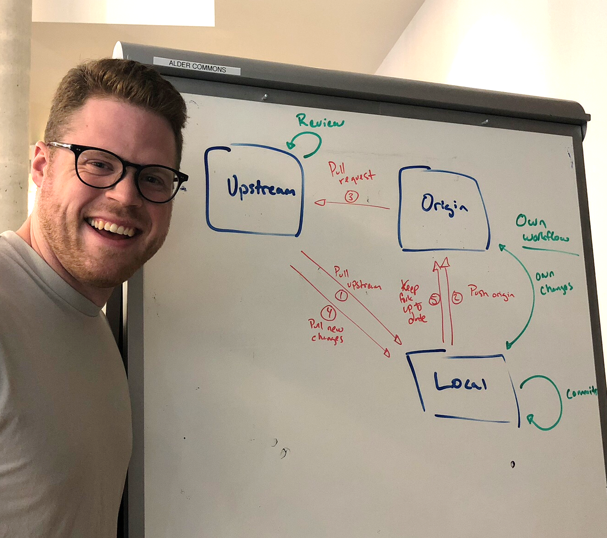
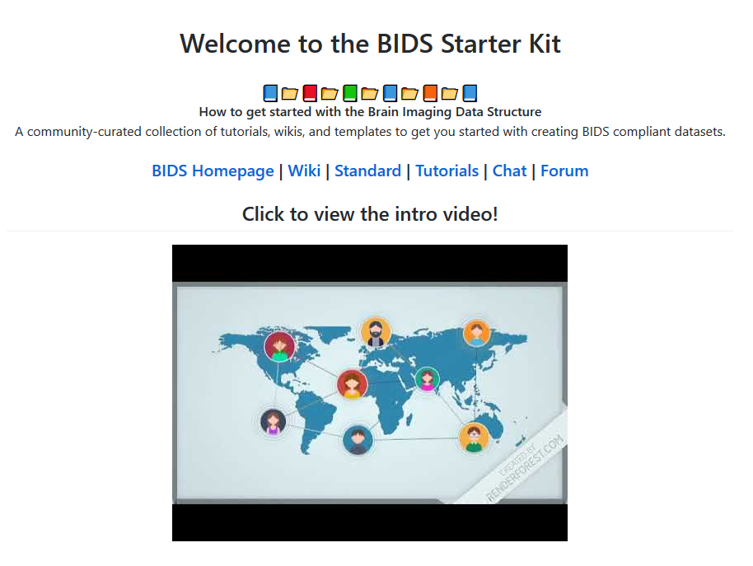
#CurateYourStory @kirstie_j
https://doi.org/10.5281/zenodo.3532649

Slide 14
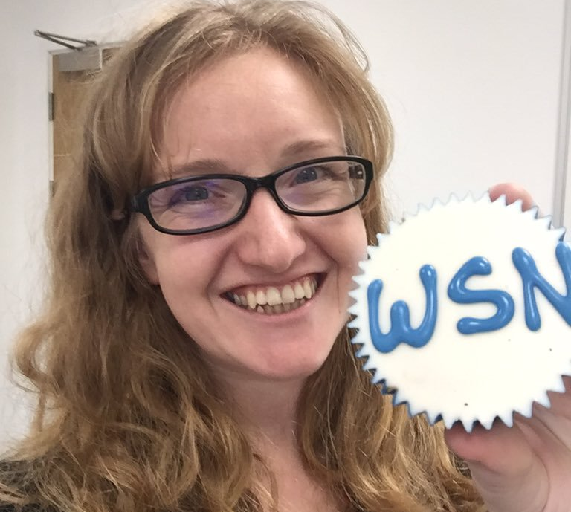
I’m an advocate for equity and inclusion who wants everyone to have the opportunity to do what they love, be paid appropriately, and to live long, happy, healthy lives.
#CurateYourStory @kirstie_j
https://doi.org/10.5281/zenodo.3532649

Slide 15
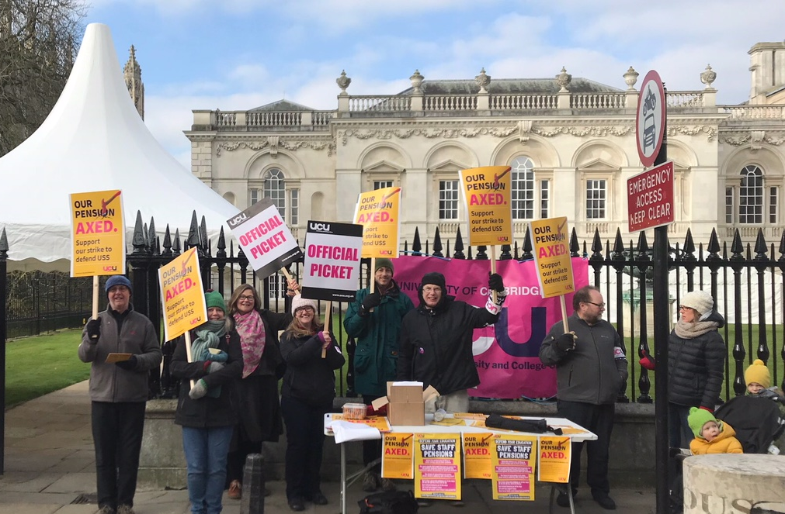
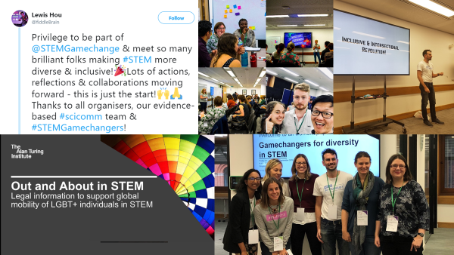
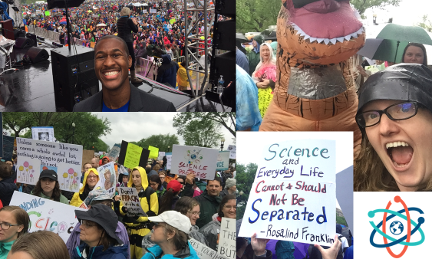
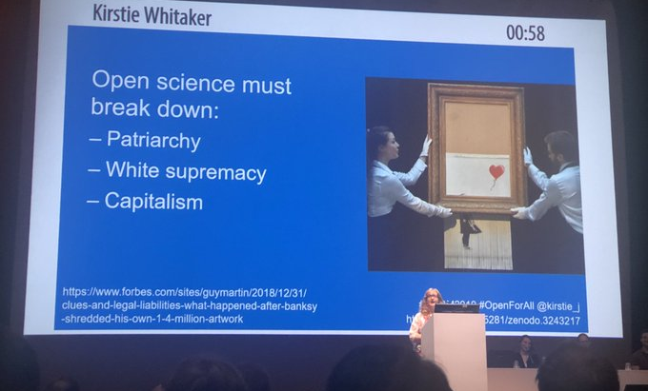
#CurateYourStory @kirstie_j
https://doi.org/10.5281/zenodo.3532649

Slide 16
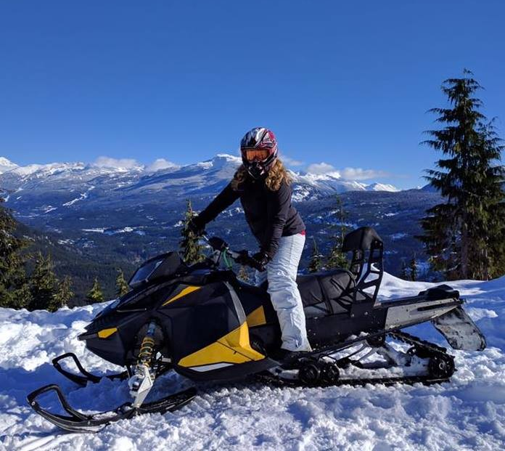
I’m an aunt, a partner, a dog owner, a sister, a daughter, an ex-ex-pat (an ex-immigrant), a rider, a runner, a feminist, a learner and a leader.
#CurateYourStory @kirstie_j
https://doi.org/10.5281/zenodo.3532649

Slide 17
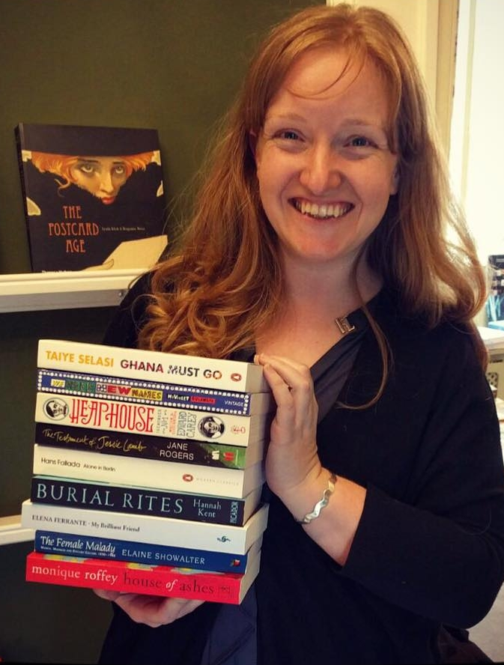
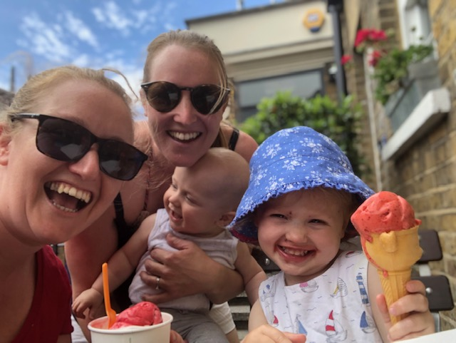
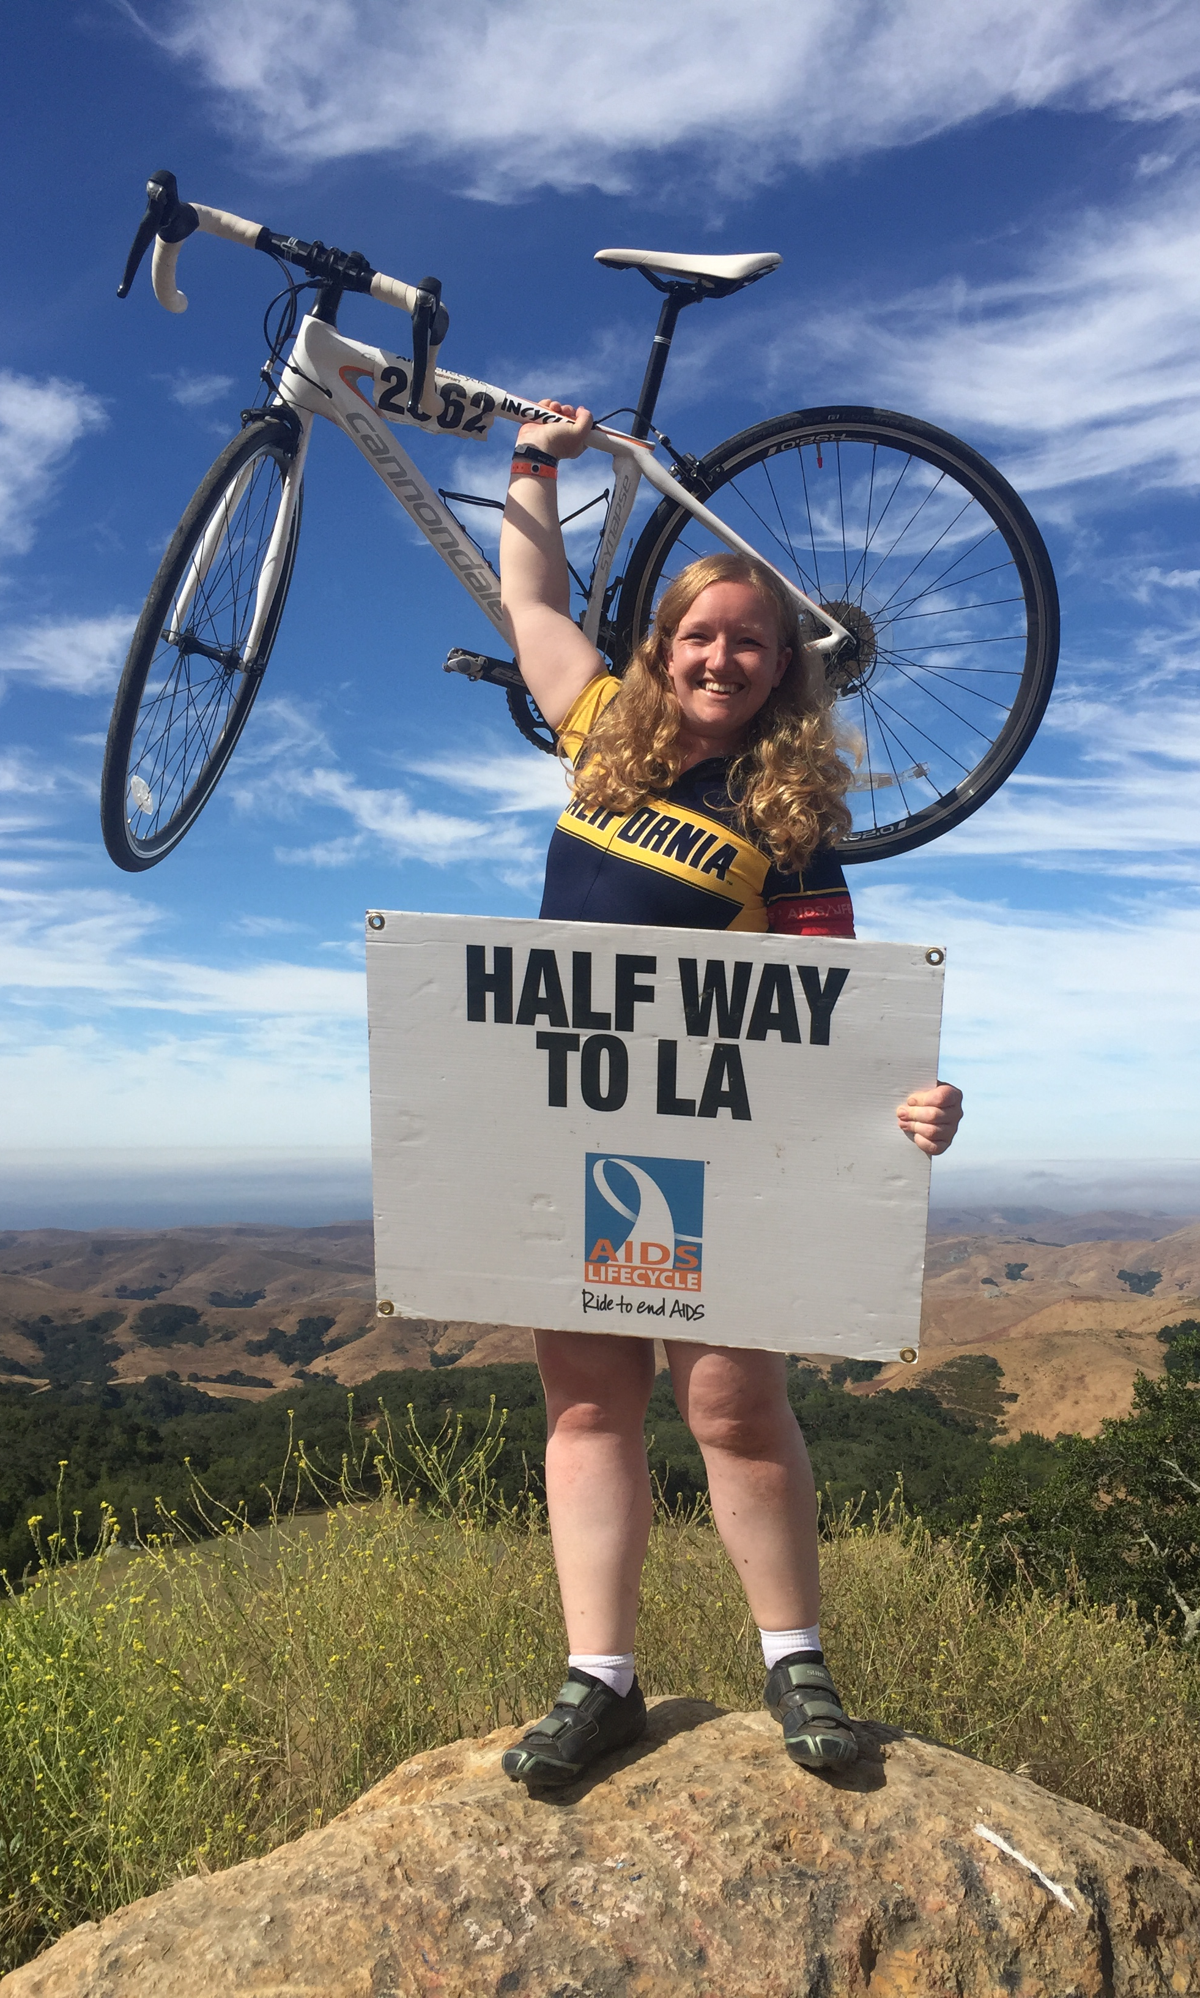
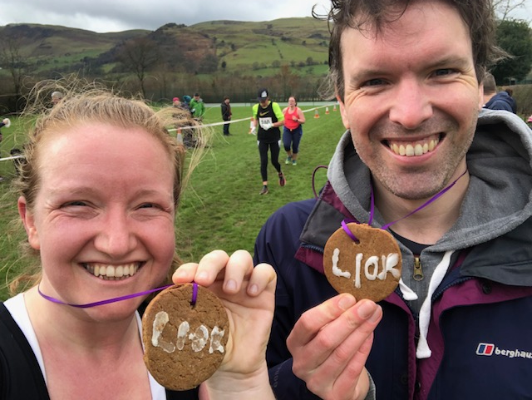
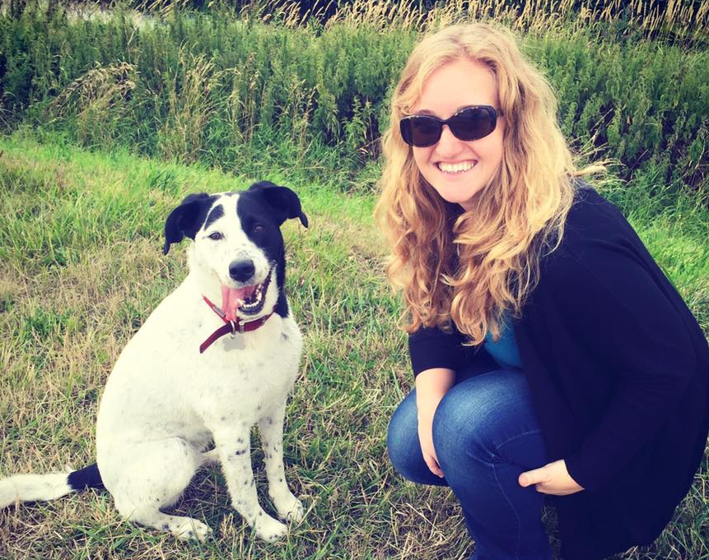
#CurateYourStory @kirstie_j
https://doi.org/10.5281/zenodo.3532649

Slide 18
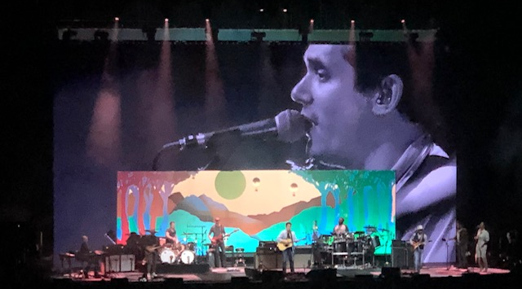
#CurateYourStory @kirstie_j
https://doi.org/10.5281/zenodo.3532649

Slide 19
There’s no greater high than contributing your gift or talent to something that immediately gives back to the room so that everyone says
“This is really great”
#CurateYourStory @kirstie_j
https://doi.org/10.5281/zenodo.3532649

Slide 20
#CurateYourStory @kirstie_j
https://doi.org/10.5281/zenodo.3532649

Slide 21
#CurateYourStory @kirstie_j
https://doi.org/10.5281/zenodo.3532649

Slide 22
#CurateYourStory @kirstie_j
https://doi.org/10.5281/zenodo.3532649

Slide 23
#CurateYourStory @kirstie_j
https://doi.org/10.5281/zenodo.3532649
https://2016globalthinkers.foreignpolicy.com/2016/profile/
petra-vertes-and-kirstie-whitaker

Slide 24
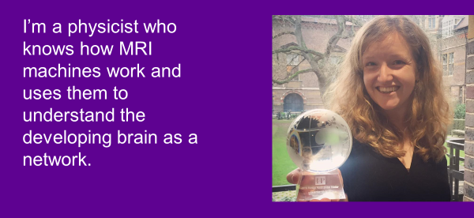
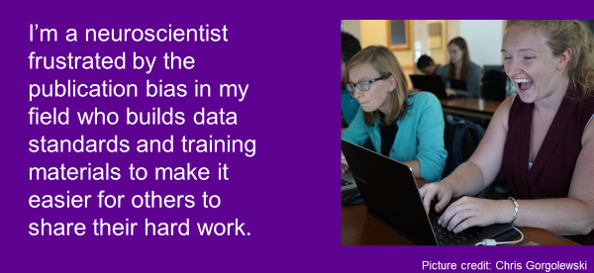
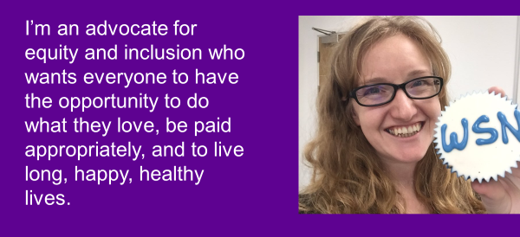
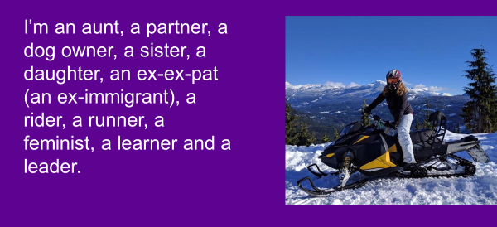
#CurateYourStory @kirstie_j
https://doi.org/10.5281/zenodo.3532649

Slide 25
Curate your story
#CurateYourStory @kirstie_j
https://doi.org/10.5281/zenodo.3532649

Slide 26
You are not the leaders of tomorrow, you are the leaders of today
#CurateYourStory @kirstie_j
https://doi.org/10.5281/zenodo.3532649
Quote: Heather Joseph, Washington DC, OpenCon 2017
https://twitter.com/hjoseph
https://twitter.com/open_con

Slide 27
Tell your story to change the world
Inspire young people (and the young at heart) to learn to code, conduct experiments, follow the scientific method
#CurateYourStory @kirstie_j
https://doi.org/10.5281/zenodo.3532649

Slide 28
Tell your story to change the world
Inspire young people (and the young at heart) to learn to code, conduct experiments, follow the scientific method
Educate current researchers (early & late – no one knows what they’re doing) with the skills to make research more efficient
#CurateYourStory @kirstie_j
https://doi.org/10.5281/zenodo.3532649

Slide 29
Tell your story to change the world
Inspire young people (and the young at heart) to learn to code, conduct experiments, follow the scientific method
Educate current researchers (early & late – no one knows what they’re doing) with the skills to make research more efficient
Advise policy makers on the best way to spend tax payer or donor money – they only have published papers to go on
#CurateYourStory @kirstie_j
https://doi.org/10.5281/zenodo.3532649

Slide 30
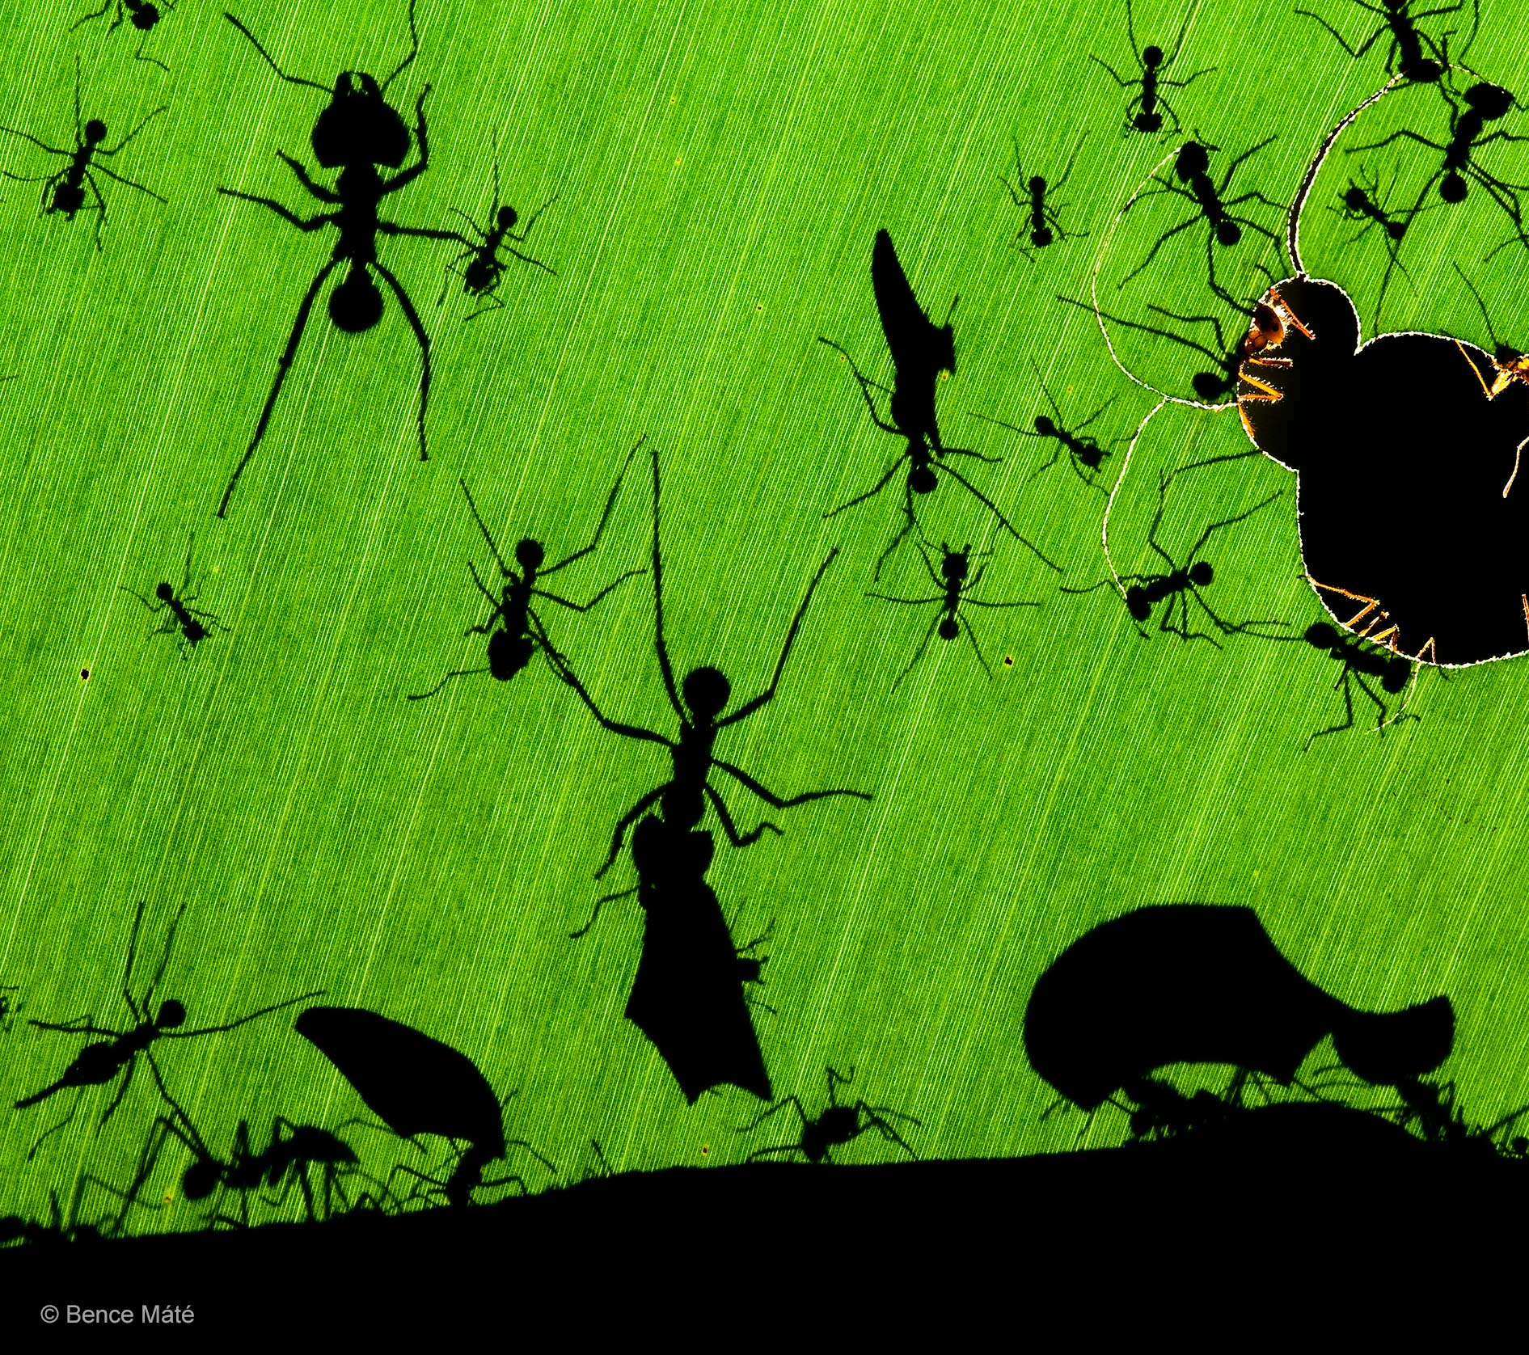
In academia we do not reward collaboration
Who gets money?
Who chooses how it is spent?
Who sets the agenda?
#CurateYourStory @kirstie_j
https://doi.org/10.5281/zenodo.3532649
https://www.nhm.ac.uk/visit/wpy/gallery/2010/images/
eric-hosking-portfolio-award/4372/a-marvel-of-ants.html

Slide 31
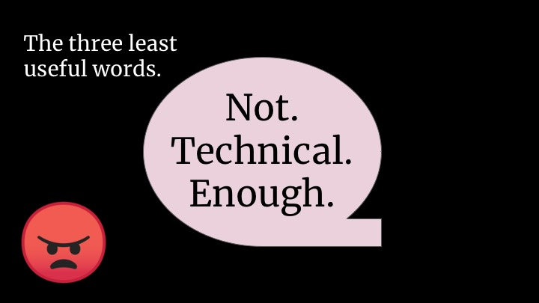
#CurateYourStory @kirstie_j
https://doi.org/10.5281/zenodo.3532649
Source: Tania Reilly, Being Glue
https://twitter.com/whereistanya
https://www.youtube.com/watch?v=KClAPipnKqw

Slide 32




Open Leadership Principles
Understanding
You make the work accessible and clear
Sharing
You make the work easy to adapt, reproduce, and spread
Participation & Inclusion
You build shared ownership and agency to make the work inviting and sustainable for all.
Read more
https://mozilla.github.io/olm-whitepaper
#CurateYourStory @kirstie_j
https://doi.org/10.5281/zenodo.3532649

Slide 33
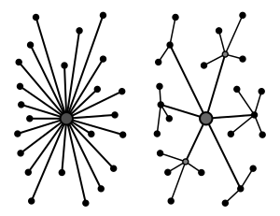
Build trust to build capacity
Everyone has something to learn
Everyone has something to share
Decentralise
Listen
@kirstie_j
https://doi.org/10.5281/zenodo.3532649
https://github.com/WhitakerLab/Onboarding/
blob/master/Lab-meetings.md

Slide 34
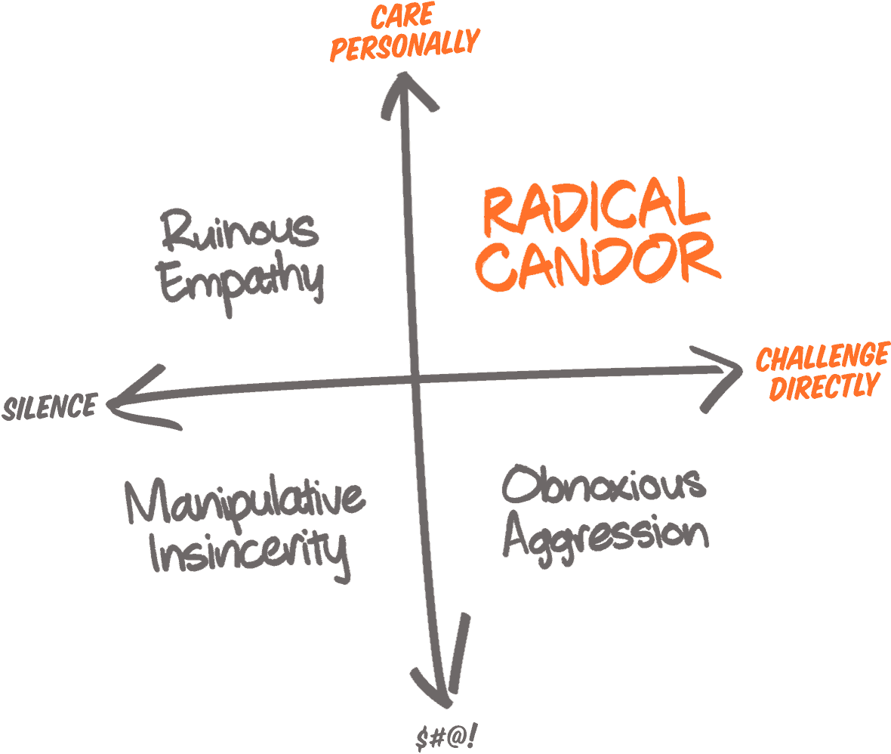
Don’t be afraid
There’s a difference between being kind and never saying anything bad
Surprise criticism is awful: don’t do it
If you never give any feedback, no one can learn from you
@kirstie_j
https://doi.org/10.5281/zenodo.3532649
https://smile.amazon.com/Radical-Candor-Revised-Kick-Ass-Humanity/
dp/1250235375

Slide 35
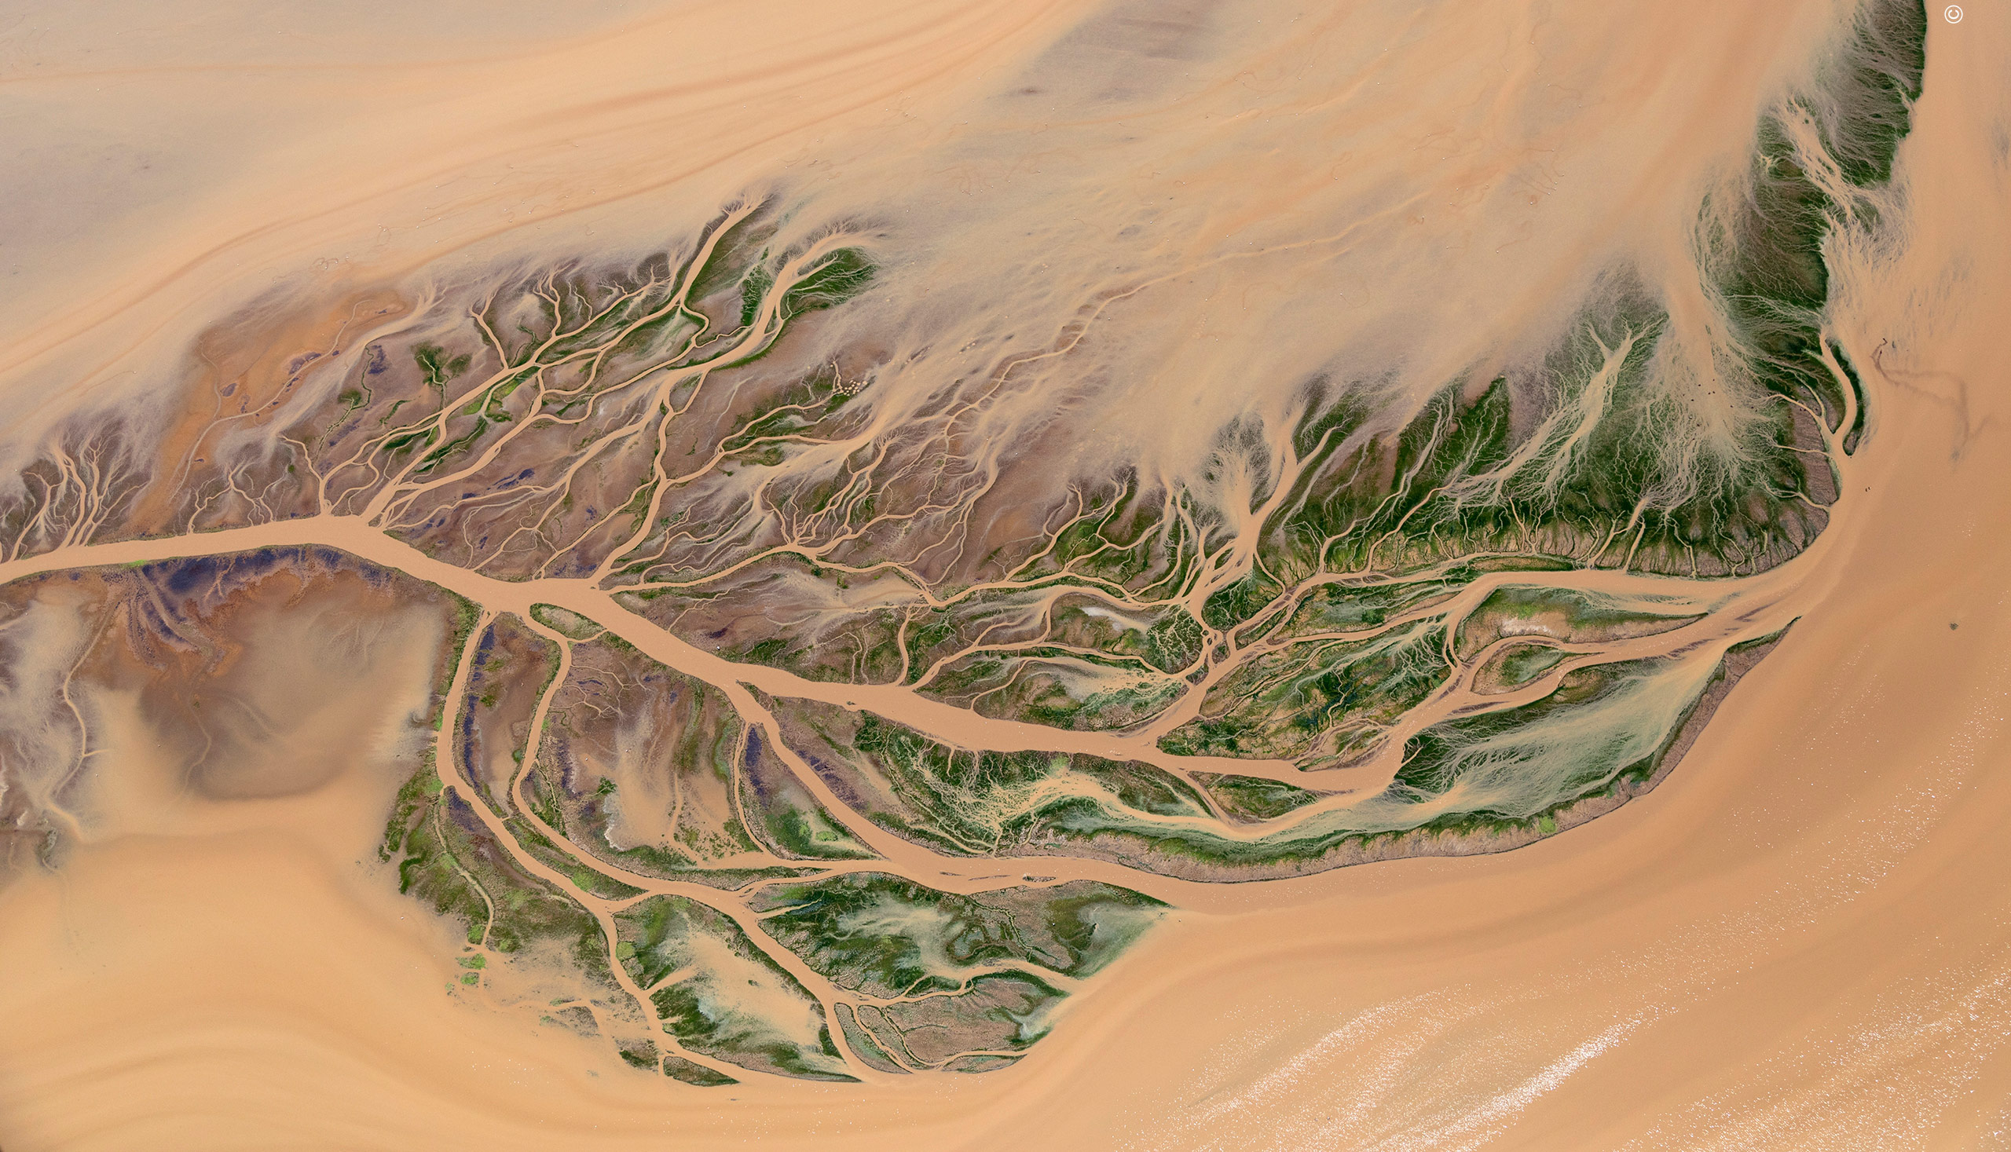
@kirstie_j
https://doi.org/10.5281/zenodo.3532649
Image credit: Paul Mckenzie
https://www.nhm.ac.uk/visit/wpy/gallery/2018/images/
earth-s-environments/5368/delta-design.html

Slide 36
Small is good, small is all
(The large is a reflection of the small)
Change is constant
(Be like water)
@kirstie_j
https://doi.org/10.5281/zenodo.3532649
Image credit: Paul Mckenzie
https://www.nhm.ac.uk/visit/wpy/gallery/2018/images/
earth-s-environments/5368/delta-design.html
Emergent Strategy, adrienne maree brown
https://www.akpress.org/emergentstrategy.html

Slide 37
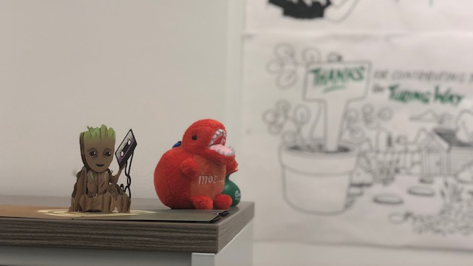
If you are not kind to yourself, you can not be kind to others
And if you are not kind, none of the other stuff matters
#GrootGif
#CurateYourStory @kirstie_j
https://doi.org/10.5281/zenodo.3532649
Incredible card from Elizabeth DuPre

Slide 38
Thank you to my incredible colleagues, family & friends
Konrad Adler-Wagstyl
Sophie Adler-Wagstyl
Georgia Aitkenhead
Louise Bowler
Elizabeth DuPre
Sarah Gibson
Yini He
Patricia Herterich
Ang Li
Malvika Sharan
Isla Staden
Yo Yehudi
#CurateYourStory @kirstie_j
https://doi.org/10.5281/zenodo.3532649

