Slide 1


Towards Buddhist Sanskrit Corpus Linguistics
A new segmentation approach to non-classical Sanskrit
International Corpus Linguistics Conference, Cardiff, July 2019
Ligeia Lugli
ligeia.lugli@kcl.ac.uk
This presentation and the segmenter described here have been funded by the British Academy through a Newton International Fellowship (NF161436)
Thanks to King's College Digital Lab for training and testing the seq2seq segmented discussed here
Thanks to Louis Dominique Dubeau for testing and reporting on the Sanskrit Tagger

Slide 2
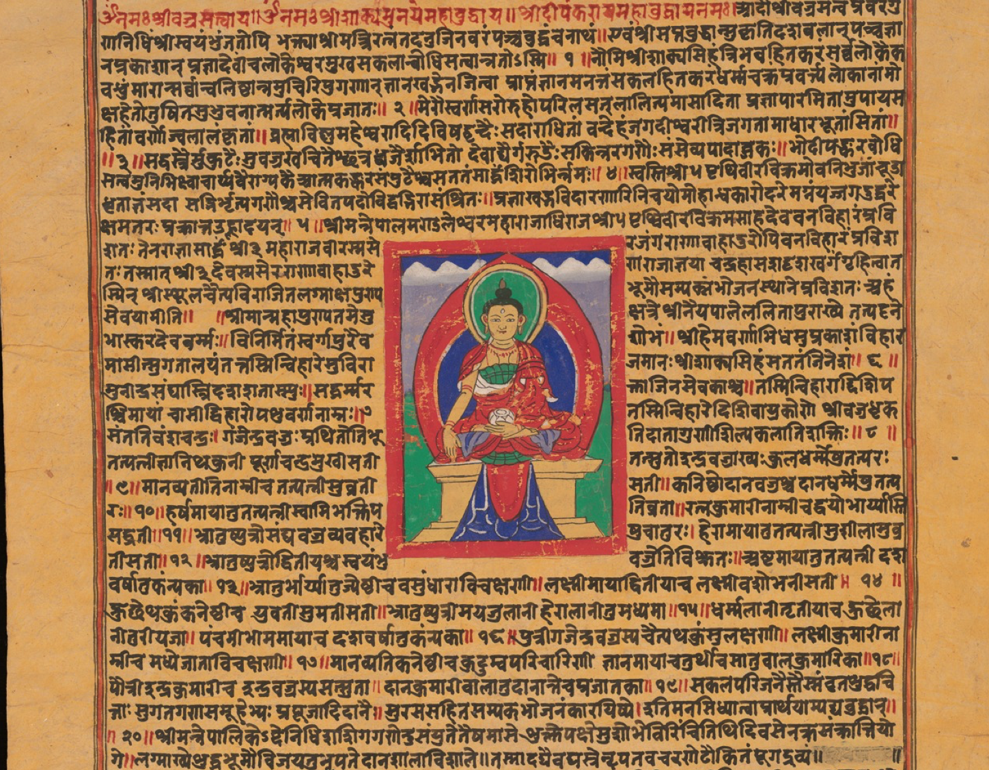
The problem
For corpus linguistics
we need corpora divided into words.
Sanskrit
has no division between (most) words
Reasons:
Sandhi (euphonic syllabic mergers)
Compounding

Slide 3
citta + vṛtti + nirodha = cittavṛttinirodha
yogaḥ + citta. = yogaścitta
bhagavataḥ + antika. = bhagavato 'ntika / BHS*: bhagavatontika
*BHS = Buddhist Hybrid Sanskrit, a non-classical variety of Sanskrit (see Edgerton 1953)
compounding
sandhi

Slide 4
rūpākāra
1. rūpa+ākāra,
2. rūpa+a (privativum) + ākāra,
3. rūpa + akāra,
4. rūpa+a (privativum) + akāra,
5. rūpa+a (privativum) + kāra,
6. rūpā+ ākāra,
7. rūpā+a (privativum) + ākāra,
8. rūpā+ akāra,
9. rūpā+a (privativum) + akāra,
10. rūpā+a (privativum) + kāra.
Multiple splits are often possible
  Lexically, most string allow for multiple splits
  Semantically, only a few splits are possible
  Domain expertise required to identify correct split

Slide 5
Factors that complicate Segmentation
of Sanskrit Buddhist Texts

Slide 6
Very long compounds
svacittavividhavivekavihāreṇacittodadhipravṛttitaraṃgavijñānalakṣaṇasukhasamāpattimanaso

Slide 7
Very long compounds
svacittavividhavivekavihāreṇacittodadhipravṛttitaraṃgavijñānalakṣaṇasukhasamāpattimanaso
irregular sandhi
bhavagavato 'ntika => bagavatontika

Slide 8
Very long compounds
svacittavividhavivekavihāreṇacittodadhipravṛttitaraṃgavijñānalakṣaṇasukhasamāpattimanaso
irregular sandhi
bhavagavato 'ntika => bagavatontika
spalling variation
prapañca, prapaṃca, prapaṃṃca

Slide 9
Very long compounds
svacittavividhavivekavihāreṇacittodadhipravṛttitaraṃgavijñānalakṣaṇasukhasamāpattimanaso
irregular sandhi
bhavagavato 'ntika => bagavatontika
spalling variation
prapañca, prapaṃca, prapaṃṃca
inconsistent editorial conventions
mahāsattvametadavocat OR mahāsattvam etad avocat

Slide 10
Very long compounds
svacittavividhavivekavihāreṇacittodadhipravṛttitaraṃgavijñānalakṣaṇasukhasamāpattimanaso
irregular sandhi
bhavagavato 'ntika => bagavatontika
spalling variation
prapañca, prapaṃca, prapaṃṃca
inconsistent editorial conventions
mahāsattvametadavocat OR mahāsattvam etad avocat
extremely rich morphology
72 inflectional realisations per adjective

Slide 11
Problems with existing tools

Slide 12
Available tools for Sanskrit segmentation
Key people and projects tool requirements
Inria Sanskrit Reader
Anusaarika
Recursive system on Inria
Stochastic Sanskrit Tagger
RNN
Seq2seq Segmenter
Perfectly regular
spelling, sandhi & morphology
Huet, Kulkarni, UoH tools
Huge amounts of
manually annotated data
Hellwig, DSC

Slide 13
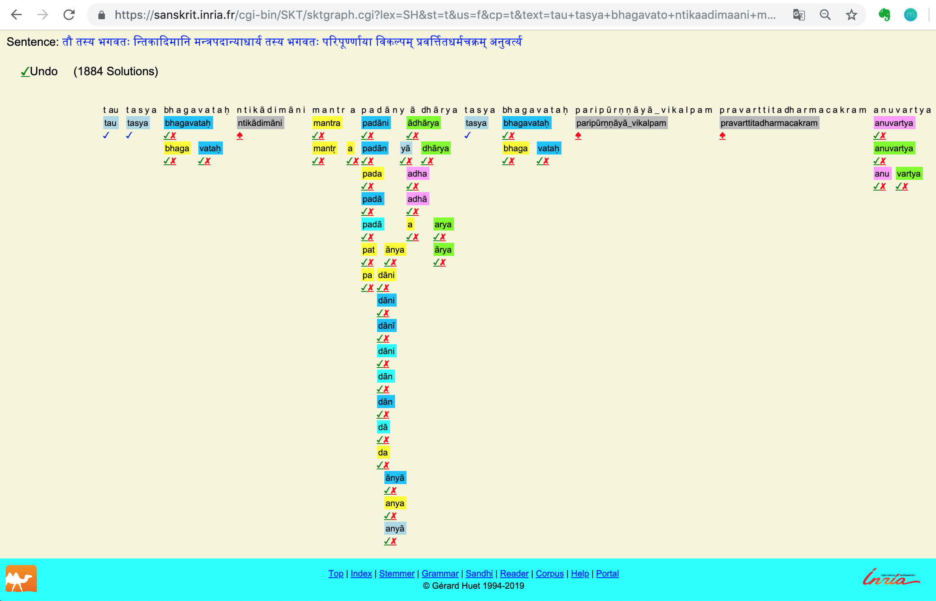
Inria
Sanskrit
Reader
cannot
handle
non-classical
sandhi
and
spelling
variation

Slide 14
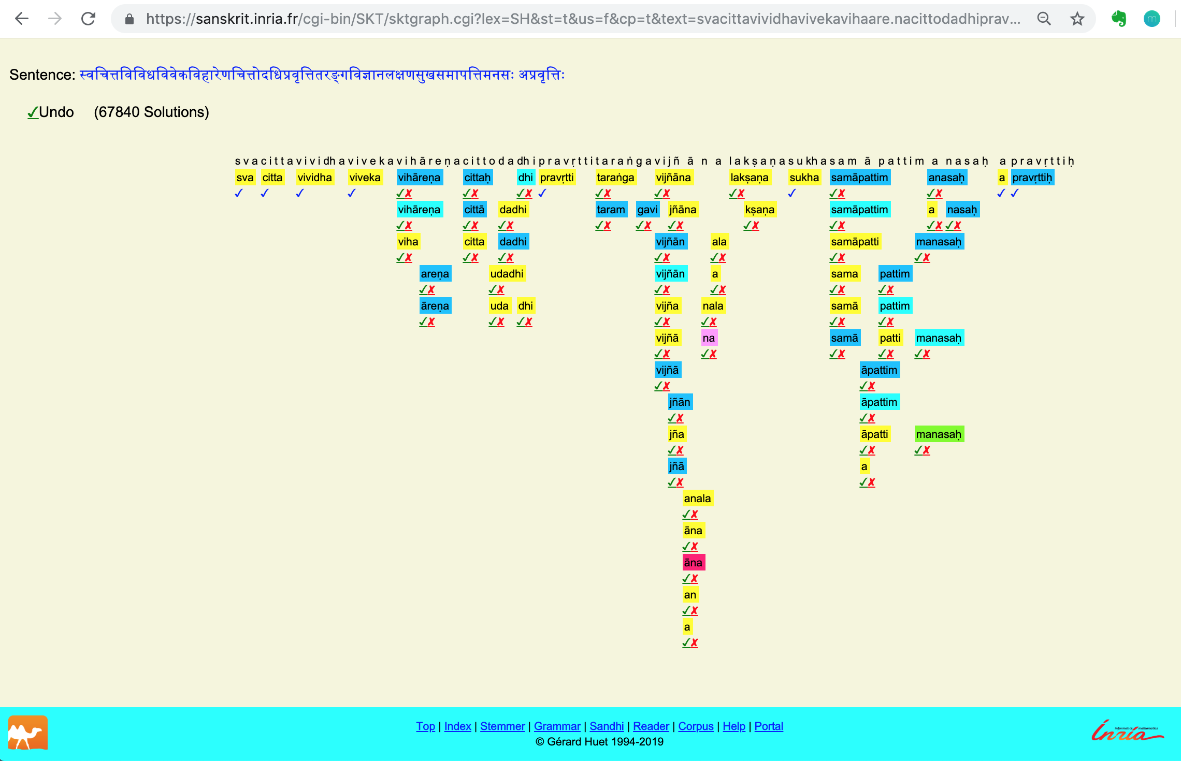
Classical Sandhi
but
Long compound

Slide 15
Trained on: 100000 sentences from DCS tokenised with a 8000 term-vocabulary
Tested on : 268 sentences out of 405, because 197 too long for seq2seq segmenter
Loss: 3.50
Precision: 38.81%
Recall: 39.29%
F1_score: 39.05%
Accuracy: 1.95%
Format, for each sentence:
Input
Desired ouput
Output
seq2seq
segmenter
(Krishna et al. 2018)
tIrTyadfzwyA ca rUpyasamatikramaRaakzaRaM deSayati
tIrTya dfzwyA ca rUpya samatikramaRa akzaRaM deSayati
tIrTa adwyA ca
Test carried out by King’s College Digital Lab

Slide 16
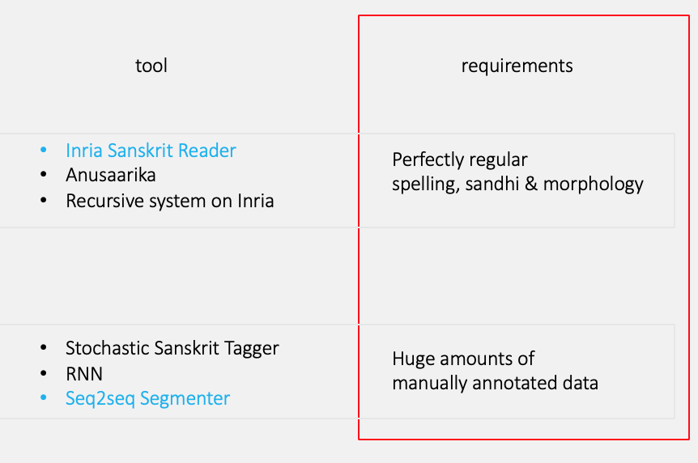
What we have
To segment irregular Sanskrit
Without having to annotate comparable material manually
What we need

Slide 17
A simple solution

Slide 18
ngram based
longest match
stem identification

Slide 19
Ngram based Stem identification
string = bodhisattvena
match against stemmed wordlist
sorted by decreasing length:
bodhisattv
sattv
bodh
n = 4
bodh, dhis, attv, tven, odhi, satt, ttve, hisa, isat
n=5
bodhi, odhis, dhisa, ttven, tvena, isatt, hisat, attve, sattv
…..
n = 10
hisattvena, dhisattven, odhisattve, bodhisattv
n=11
odhisattven, bodhisattve
….. up to n = 19

Slide 20
svacittavividhavivekavihāreṇacittodadhipravṛttitaraṃgavijñānalakṣaṇasukhasamāpattimanaso 'pravṛttiḥ
[1] "svacittavividhavivekavihāreṇacittodadhipravṛttitaraṃgavijñānalakṣaṇasukha-SAMĀPATT-imanaso 'pravṛttiḥ
[1] "svacittavividhavivekavihāreṇacittodadhi-PRAVṚTT-itaraṃgavijñānalakṣaṇasukha-SAMĀPATT-imanaso '-PRAVṚTT-iḥ "
[1] "-SVACITT-avividhavivekavihāreṇacittodadhi-PRAVṚTT-itaraṃgavijñāna-LAKṢAṆ-asukha-SAMĀPATT-imanaso '-PRAVṚTT-iḥ "
[1] "-SVACITT-avividhavivekavihāreṇacittodadhi-PRAVṚTT-itaraṃga-VIJÑĀN-a-LAKṢAṆ-asukha-SAMĀPATT-imanaso '-PRAVṚTT-iḥ "
[1] "-SVACITT-a-VIVIDH-avivekavihāreṇacittodadhi-PRAVṚTT-itaraṃga-VIJÑĀN-a-LAKṢAṆ-asukha-SAMĀPATT-imanaso '-PRAVṚTT-iḥ "
[1] "-SVACITT-a-VIVIDH-avivekavihāreṇacittodadhi-PRAVṚTT-i-TARAṂG-a-VIJÑĀN-a-LAKṢAṆ-asukha-SAMĀPATT-imanaso '-PRAVṚTT-iḥ "
[1] "-SVACITT-a-VIVIDH-aviveka-VIHĀR-eṇacittodadhi-PRAVṚTT-i-TARAṂG-a-VIJÑĀN-a-LAKṢAṆ-asukha-SAMĀPATT-imanaso '-PRAVṚTT-iḥ "
[1] "-SVACITT-a-VIVIDH-aviveka-VIHĀR-eṇacittodadhi-PRAVṚTT-i-TARAṂG-a-VIJÑĀN-a-LAKṢAṆ-asukha-SAMĀPATT-i-MANAS-o '-PRAVṚTT-iḥ "
[1] "-SVACITT-a-VIVIDH-a-VIVEK-a-VIHĀR-eṇacittodadhi-PRAVṚTT-i-TARAṂG-a-VIJÑĀN-a-LAKṢAṆ-asukha-SAMĀPATT-i-MANAS-o '-PRAVṚTT-iḥ "
[1] "-SVACITT-a-VIVIDH-a-VIVEK-a-VIHĀR-eṇacitt-ODADH-i-PRAVṚTT-i-TARAṂG-a-VIJÑĀN-a-LAKṢAṆ-asukha-SAMĀPATT-i-MANAS-o '-PRAVṚTT-iḥ "
[1] "-SVACITT-a-VIVIDH-a-VIVEK-a-VIHĀR-eṇa-CITT--ODADH-i-PRAVṚTT-i-TARAṂG-a-VIJÑĀN-a-LAKṢAṆ-asukha-SAMĀPATT-i-MANAS-o '-PRAVṚTT-iḥ "
[1] "-SVACITT-a-VIVIDH-a-VIVEK-a-VIHĀR-eṇa-CITT--ODADH-i-PRAVṚTT-i-TARAṂG-a-VIJÑĀN-a-LAKṢAṆ-a-SUKH-a-SAMĀPATT-i-MANAS-o '-PRAVṚTT-iḥ "
Final output from segmenter
[1] " svacitta-vividha-viveka-vihāreṇa citt^odadhi-pravṛtti-taraṃga-vijñāna-lakṣaṇa-sukha-samāpatti-manaso ' pravṛttiḥ "
Output for ‘gramrels’, a set of rules to infer syntactic dependencies and take advantage of word sketches in Sketch Engine
[1] " SVACITT -a @ VIVIDH -a @ VIVEK -a @ VIHĀR -eṇa CITT - @ ODADH -i @ PRAVṚTT -i @ TARAṂG -a @ VIJÑĀN -a @ LAKṢAṆ -a @ SUKH -a @ SAMĀPATT -i @ MANAS -o ' PRAVṚTT -iḥ "

Slide 21
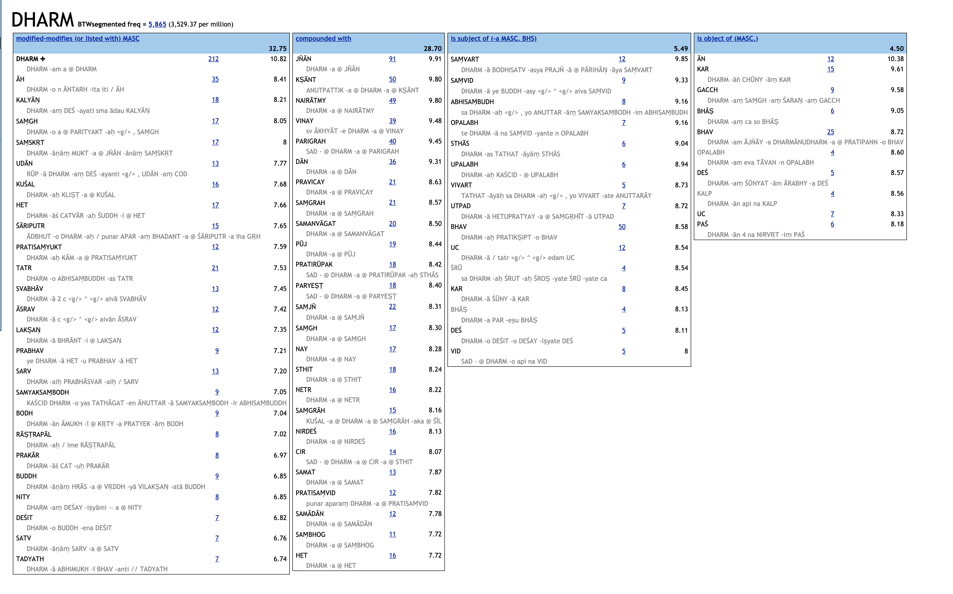

Slide 22
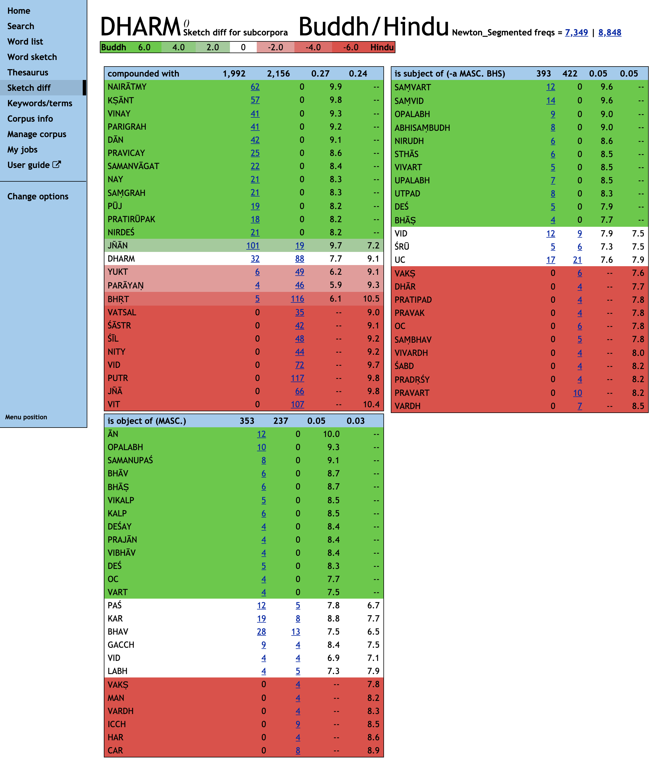
compare usage of the word Dharma
in Buddhist and Hindu sources
with the Sketch Engine's SketchDiff feature
For best results output
should be normalized and lemmatised

Slide 23
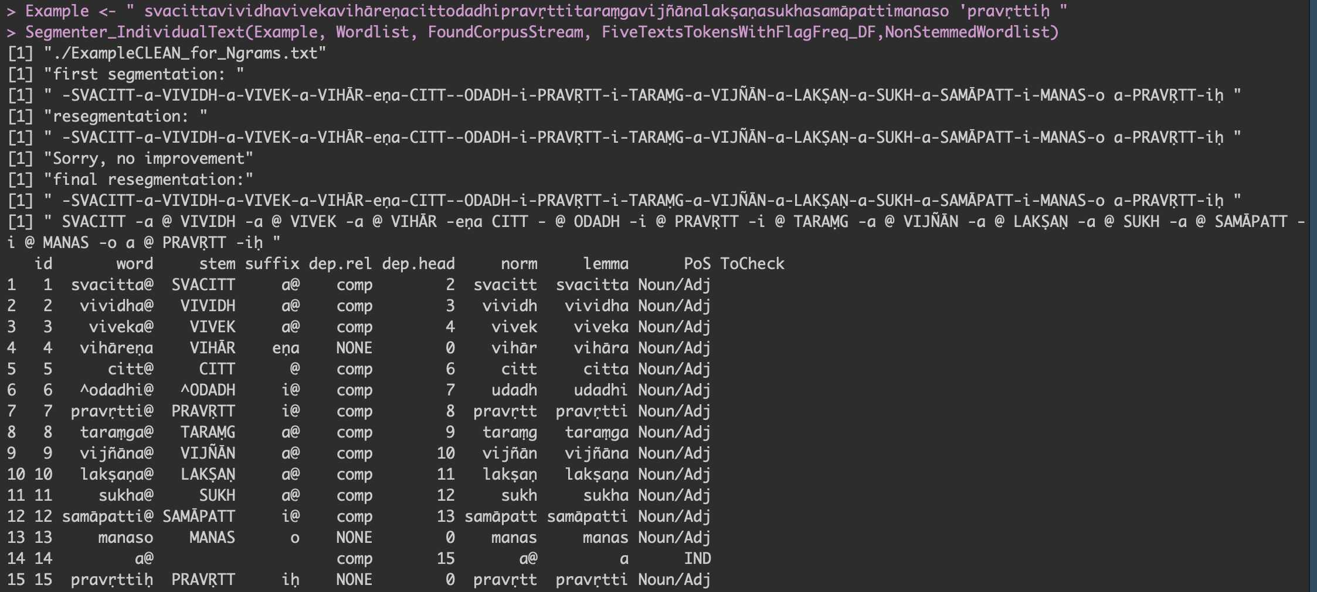
Lemmatisation and Normalisation

Slide 24
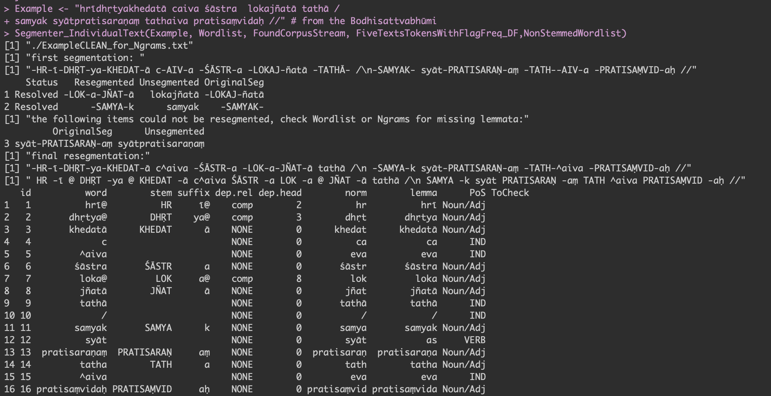
Resegmentation of likely errors through likely correct Stem frequencies

Slide 25
Evaluation

Slide 26
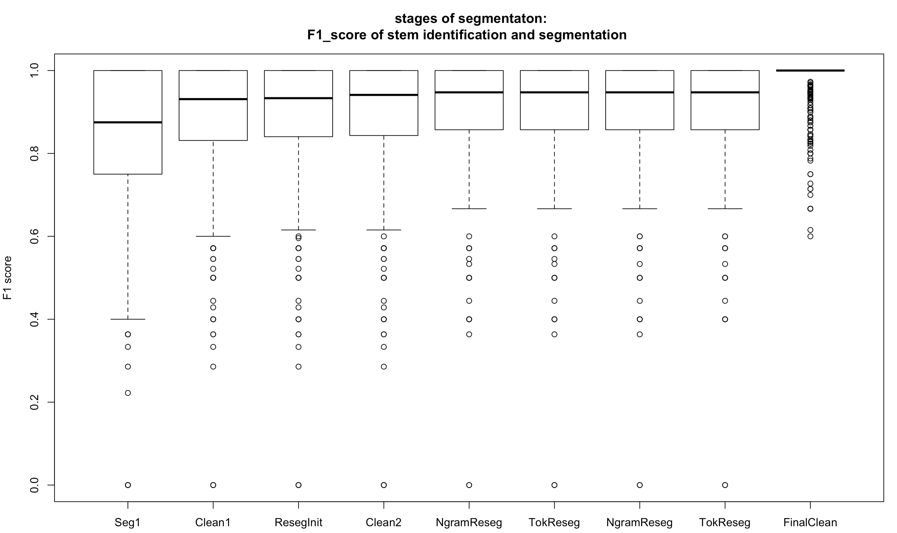
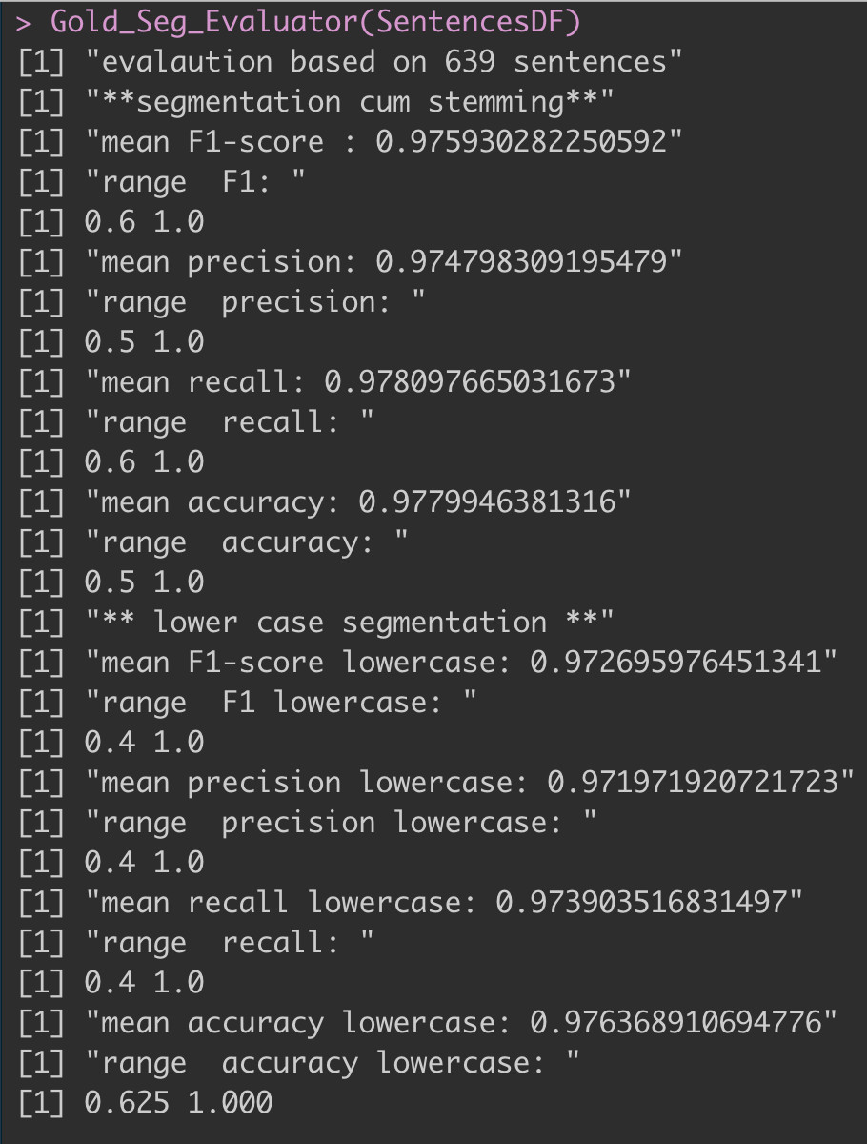
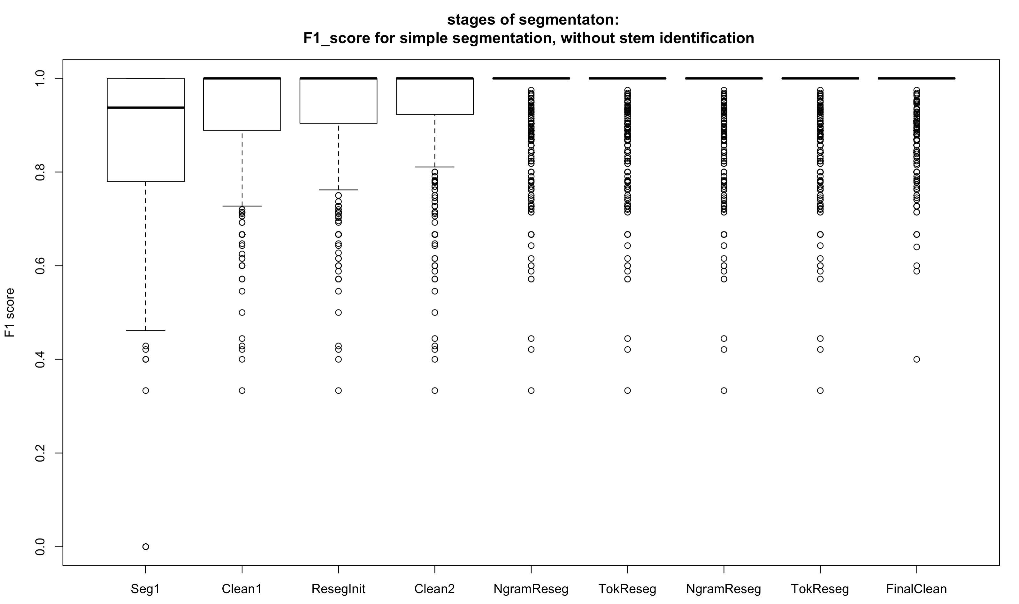


Segmenter evaluated on:
639 sentences from 13 Buddhist text (9 sūtras, 4 śāstra)
max sentence length: 82 words
total words: 7463
97%

Slide 27
the lemmatiser and Pos tagging functions are still under development
evaluation of the current beta version on 1780 words gives:
F1-score= .87
accuracy= .89

