Slide 1
Kick-Off:
IG RDM in Engineering
Daniela Hausen (1), Paula Martinez-Lavanchy (2), Nikola Vasiljevic (3), Shaun de Witt (4),
Sibylle Hermann (5), Peter Cornwell (6)
(1) RWTH Aachen University
(2) TU Delft
(3) Technical University of Denmark (DTU), DTU Wind Energy
(4) UK Atomic Energy Authority
(5) University of Stuttgart
(6) Data Futures LBG, University of Westminster, ENS-Lyon

Slide 2
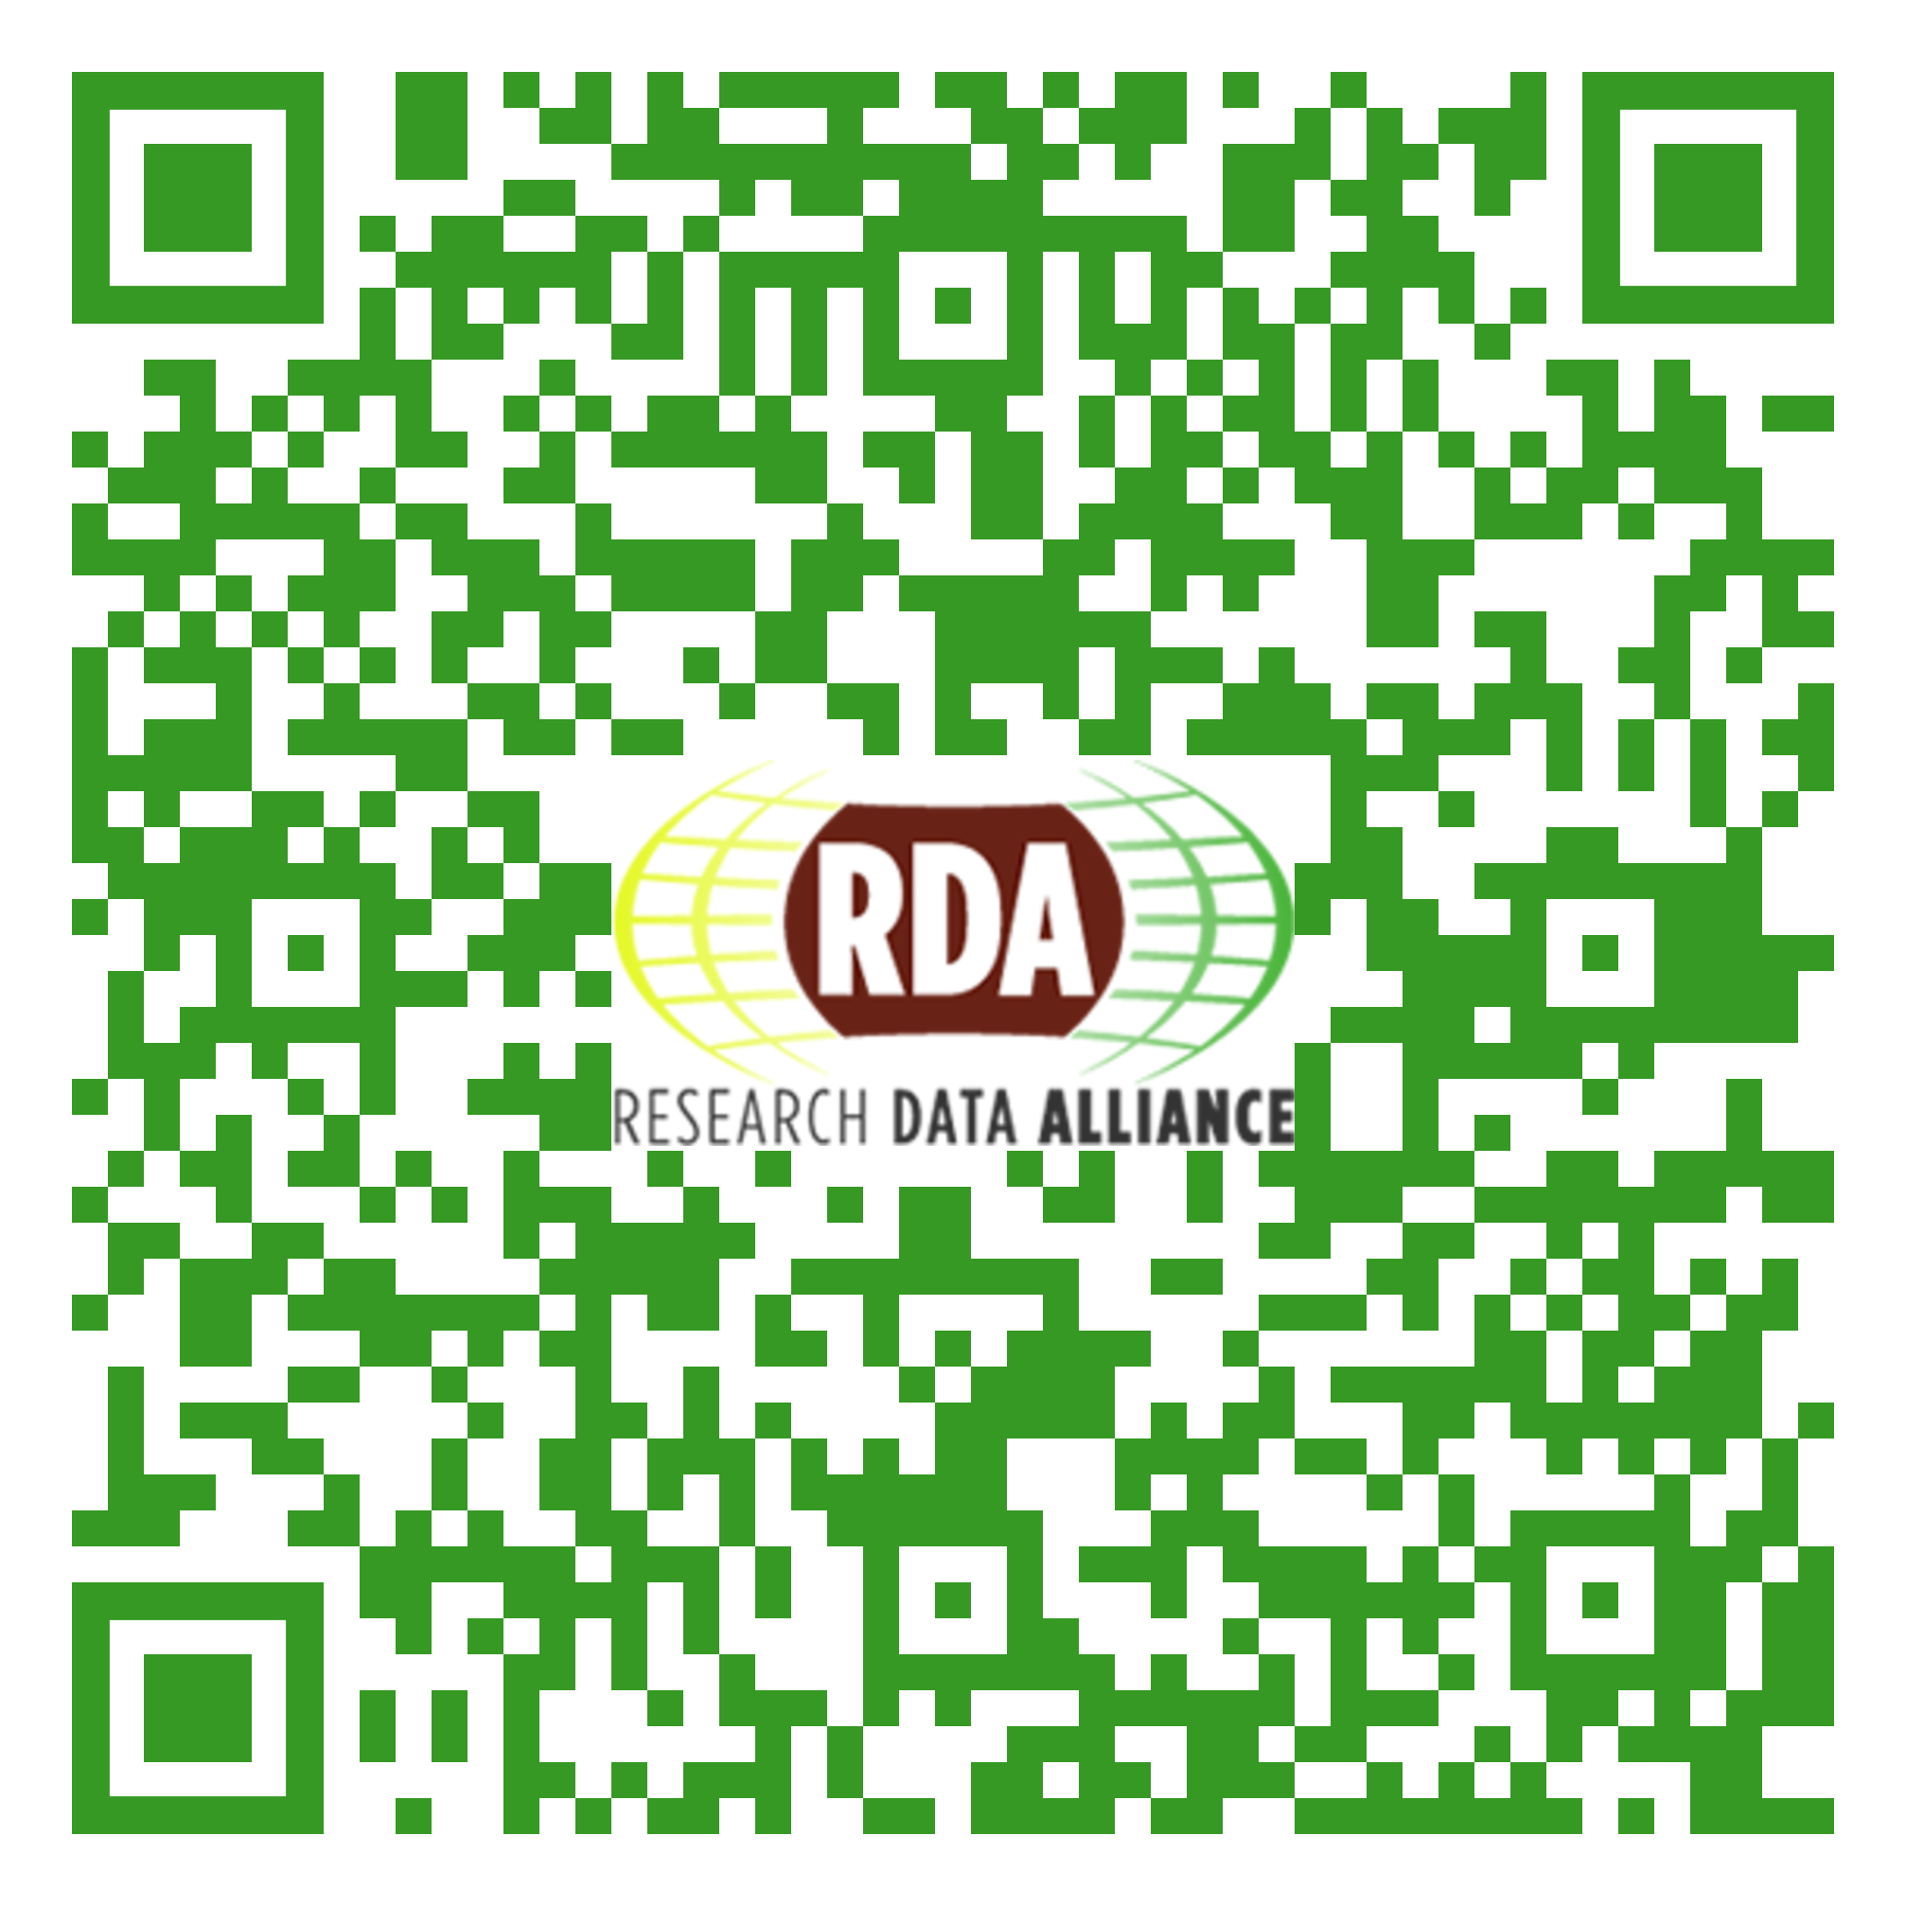
Meeting Notes:
http://bit.ly/2oRhvcu
24/10/2019

Slide 3
Agenda
Introduction & comments on reviewed charter
Engineering research and open science
Engineering-specific DMP template
Wind energy data annotations
Metadata scheme EngMeta and Software management
Group work and discussion
Meeting notes: http://bit.ly/2oRhvcu
24/10/2019

Slide 4
Go to: www.menti.com
Code: 42 57 78
Meeting notes: http://bit.ly/2oRhvcu
24/10/2019

Slide 5
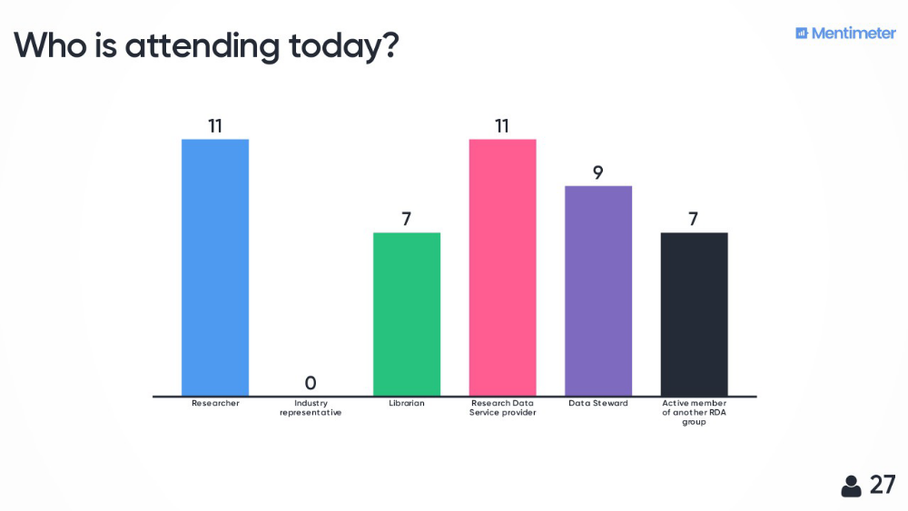
Results of the mentimeter - audience
24/10/2019

Slide 6



Current status
First BoF meeting at P12 in Botswana
IG RDM4Eng Charter is finalized and handed in by End of January 2019
IG Meeting at P13 -> working and correcting comments on the charter
Endorsed and recognised since the end of August 2019
35 group members
Meeting notes: http://bit.ly/2oRhvcu
24/10/2019

Slide 7
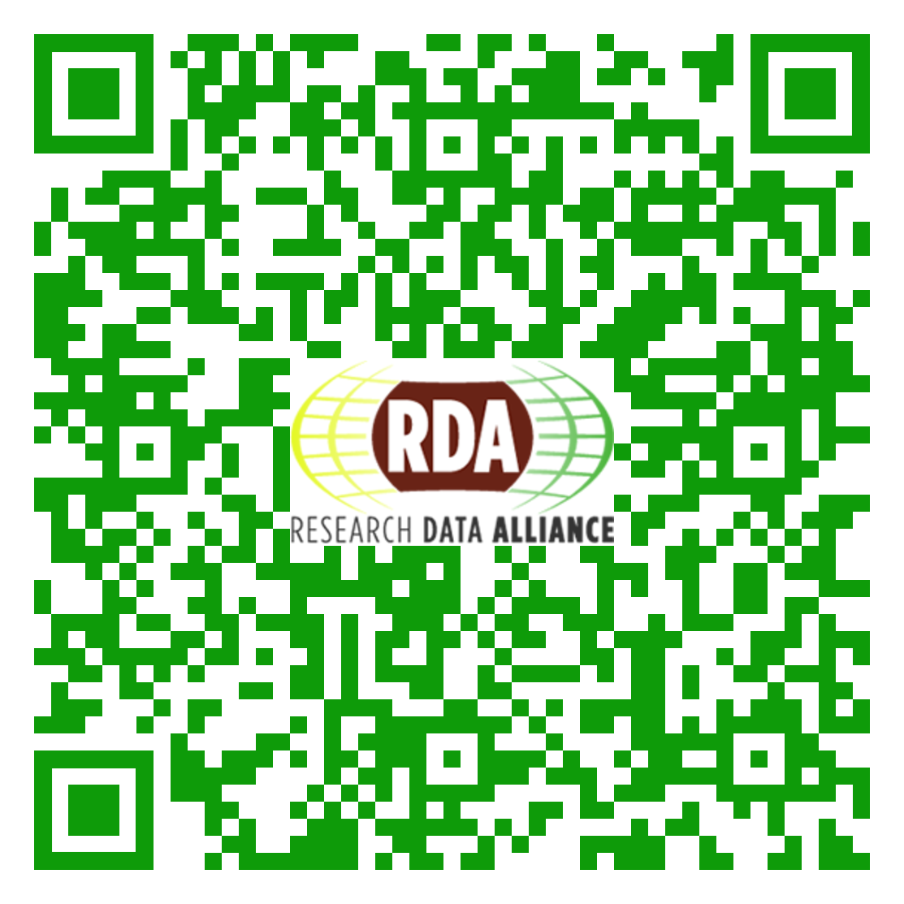
RDA IG Research Data Management in Engineering
https://www.rd-alliance.org/groups/research-data-management-engineering-ig
Meeting notes: http://bit.ly/2oRhvcu
24/10/2019

Slide 8
TAB Review
Focus and Fit
concrete items of the use cases
breath of topics should be improved
Capacity
engineers are underrepresented
only a small fraction of sub disciplines are represented
engineers could be involved as customers of services or tools or in workflows
Meeting notes: http://bit.ly/2oRhvcu
24/10/2019

Slide 9
Engineering Research and Open Science
Shaun de Witt
UK Atomic Energy Authority
RDMinEng-IG

Slide 10
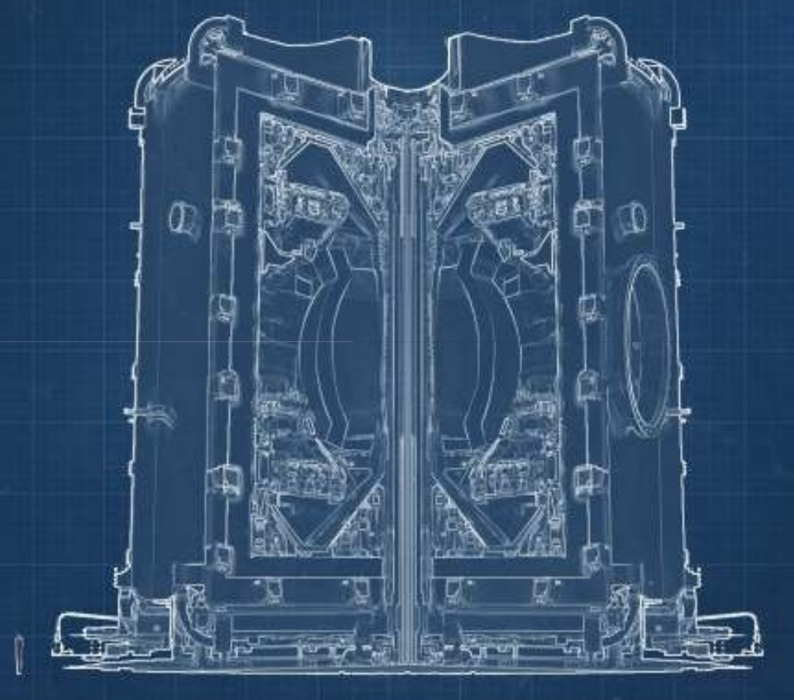
Engineering Research and Open science
STEP (Spherical Tokamak for Energy Production) is a 5 year program to develop a credible concept design for an early (2040) start ST power plant.
  > 1 MW m⁻² neutron wall loading
  ~ 1 GW Fusion Power
  Demonstrate tritium self sufficiency
Key demonstrator of technologies
  Robotic Maintenance
  Decadal plant lifetime
Build fusion supply chain
Collaboration between Public and Private Sectors (~ 15 research organisations, ~20 industrial partners)
Meeting notes: http://bit.ly/2oRhvcu
24/10/2019

Slide 11
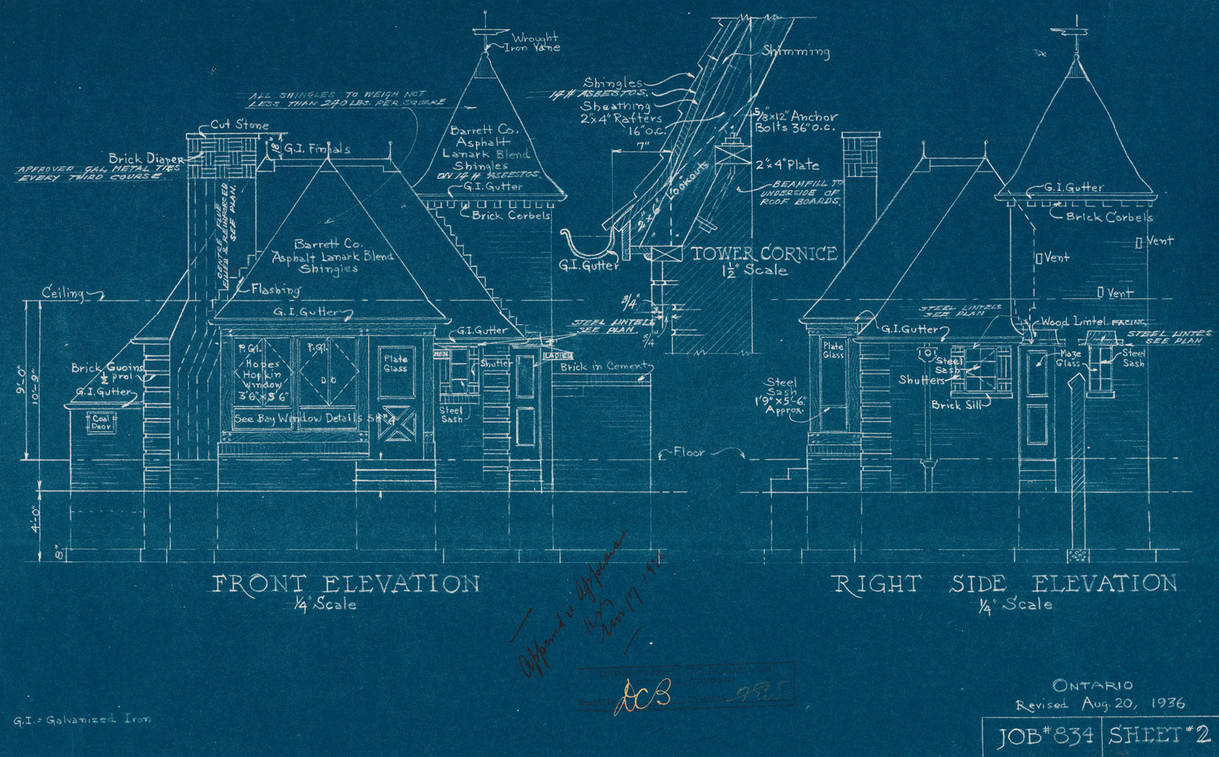
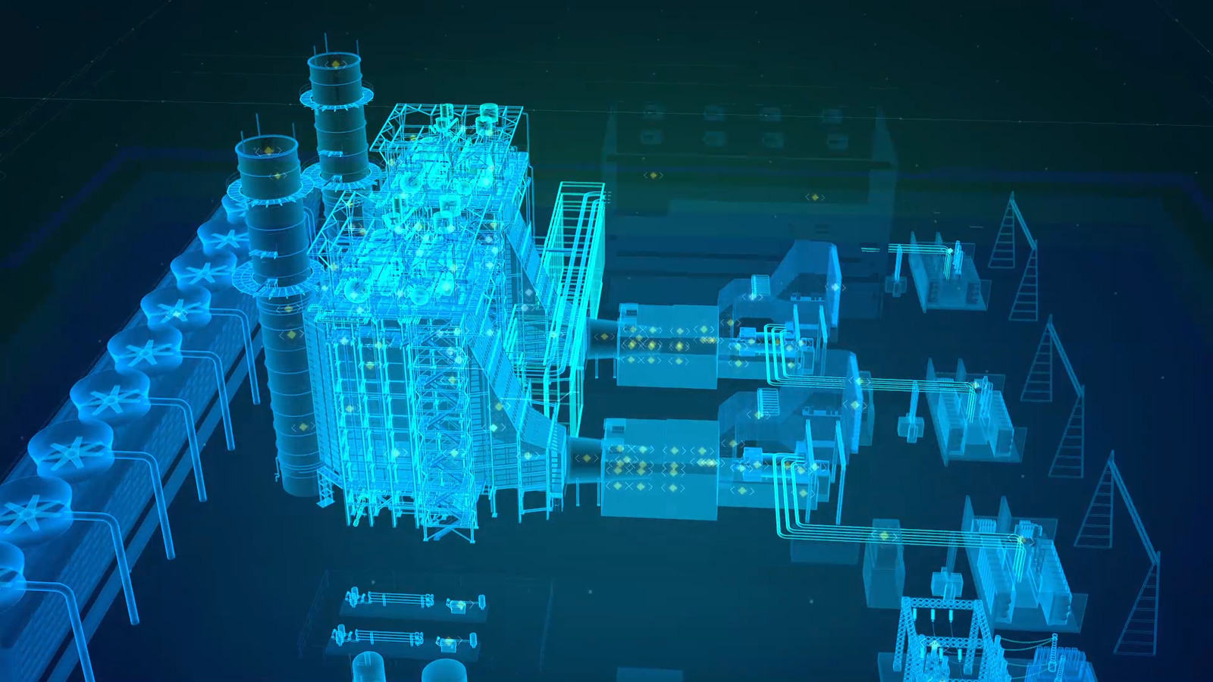
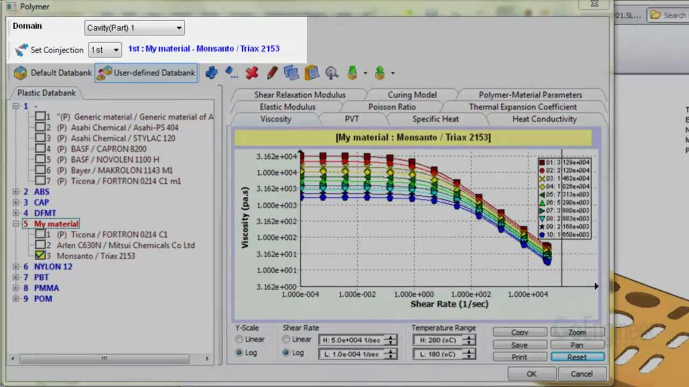
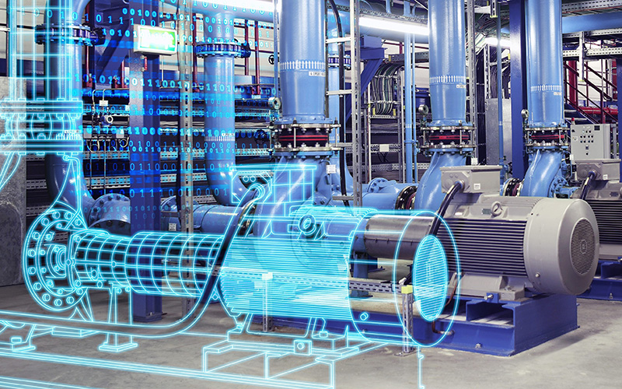
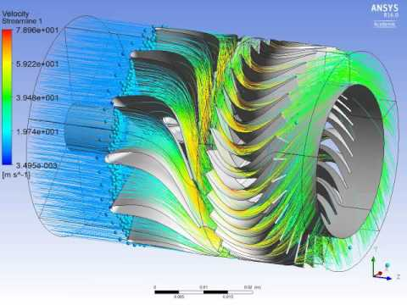
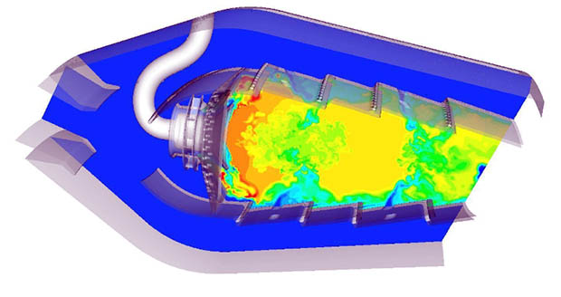
Engineering Research and Open science
Aim - not to just have a final design, but understand the design process so that changes can be better addressed
Meeting notes: http://bit.ly/2oRhvcu
24/10/2019

Slide 12
Engineering Research and Open science
Relevant WG/IG
RDM in Engineering
Data Versioning, Persistent Identification of Instruments,Preserving Scientific Annotation, Chemistry Research Data, Research data needs of the Photon and Neutron Science community
Federated Identity Management
Software Source Code identification, PTTP
Metadata - pretty much anything!
Missing WG/IG
RDM for Modelling and Simulations
L(o)D… but i may just have missed that
Meeting notes: http://bit.ly/2oRhvcu
24/10/2019

Slide 13
Engineering Research and Open science
At the end of STEP, we want a design with a story, the twists and turns of the design-analysis ‘washing machine’, and specifically the why of design
  Part of this is RDM or in this case EDM (Engineering Data Management) including; CAD, metadata, mesh, simulation input & output
  Would like to tie the state of design (versioning) to decisions supported by full EDM traceability
  This would allow simulation data to be queried for staleness, and ideally autom(agically)atically rerun the required simulation stack to update the results for the current version
Maybe AI can query the simulation data for similarity (high dimension simulation - hero runs) to interpolate between runs
During the design process, several 10’s of thousands of large scale simulations are likely to be done, large data asset
Needs to be FAIR (Findable, Accessible, Interoperable, Reusable) & Repeatable
Meeting notes: http://bit.ly/2oRhvcu
24/10/2019

Slide 14
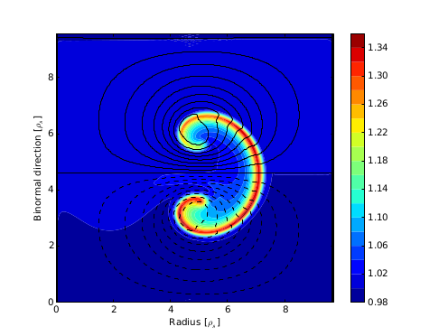
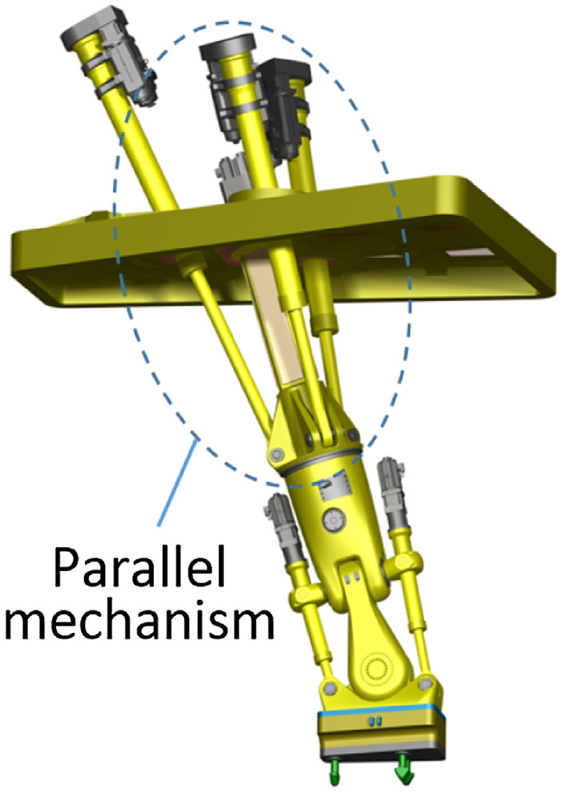
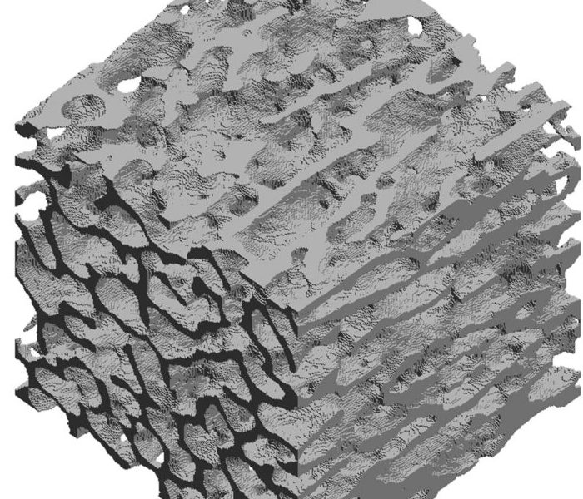
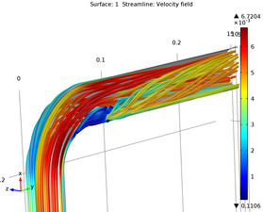
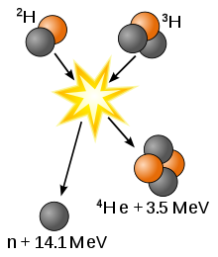
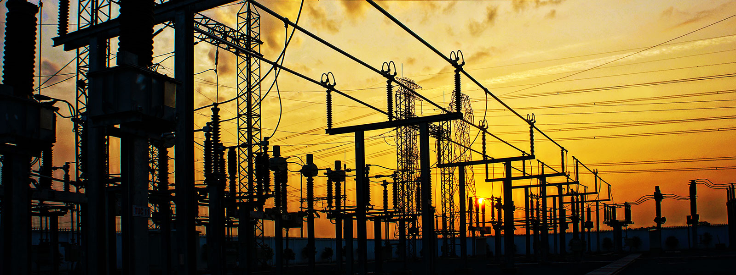
Engineering Research and Open science
Multi disciplinary
  Mechanical and Structural engineering
  Fluid Dynamics
  Plasma Physics
  Materials Science
  Social science
  Electronic and Electrical Engineering
  Robotics
  Thermodynamics
Multi Scale
  Neutron bombardment
  Component creep and stress
  ~40m diameter plasma
  Many kilometers of cabling and ducting
Meeting notes: http://bit.ly/2oRhvcu
24/10/2019

Slide 15
Engineering-specific Data Management Plan template
Daniela Hausen
RWTH Aachen University
RDMinEng-IG

Slide 16

Data Management Planning in Engineering
Call of ideas for „research in the digital change period“ from the research center Jülich
Funded by German Federal Ministry of Education and Research
Project in 2018
Meeting notes: http://bit.ly/2oRhvcu
24/10/2019

Slide 17

engineer-specific DMP
Starting position
Both universities work with RDMO
Cooperation within NFDI4Ing
Idea -> working on engineer-specific context
Hypothesis
DMPs can guide to good research data management in projects
Adoption of DMP template is necessary
  To tailor the researchers needs
  To make the concept of DMPs attractive to the researchers
Aim
DMP template or checkliste for research planning in mechanical engineering
Meeting notes: http://bit.ly/2oRhvcu
24/10/2019

Slide 18
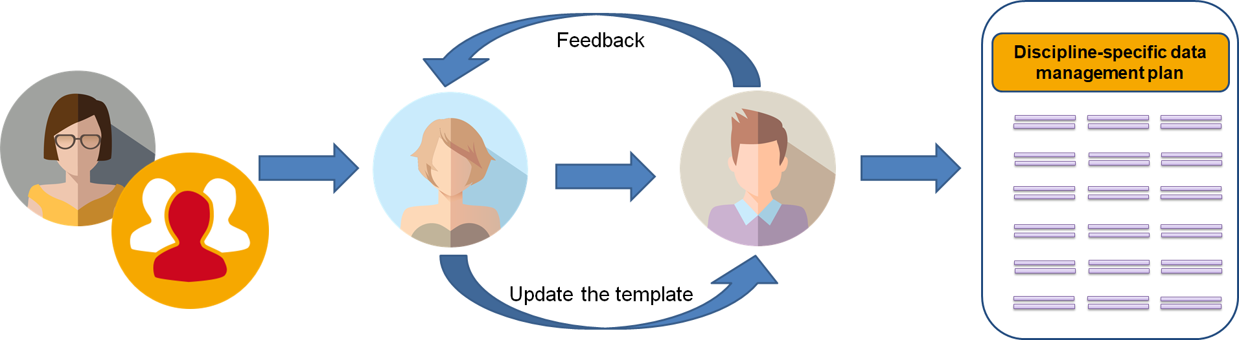
engineer-specific DMP
https://doi.org/10.5281/zenodo.2598796
1-day workshops with engineers
    1 x Aachen, 1 x Darmstadt
    10 to 12 participants
Information on generic RDM and DMP concept
Reflection and exchange of experiences
World Café to work on the generic template to make it more engineering-specific
Meeting notes: http://bit.ly/2oRhvcu
24/10/2019

Slide 19
Results of the DMP-workshops
meets the researchers`desire for general RDM information and exchange of experiences
heterogeneous group -> hard to work on more detailed information
196 notes of the generic RDMO template
127 notes could be included
    14 notes on questions
    30 notes on answer options
    83 notes on help texts
Meeting notes: http://bit.ly/2oRhvcu
24/10/2019

Slide 20
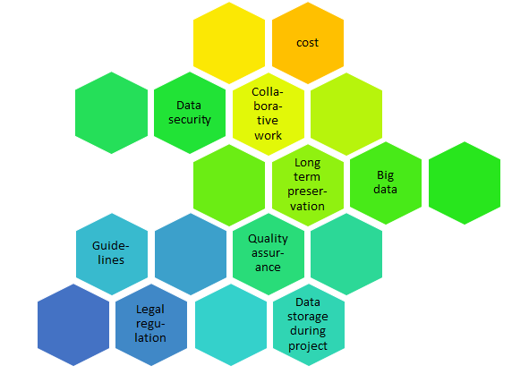
Results of the DMP-workshops
Meeting notes: http://bit.ly/2oRhvcu
24/10/2019

Slide 21
Conclusions
First steps to engineering- and institutional-specific DMP templates
More a vision than a living document
Processes, standards and guidelines for data management and quality control has to be coordinated by the engineering community
given time frame was too small
Discrepancy between formal DMPs from funders and DMP as a tool for science in terms of quality assurance and process support
engineering and institutional specific templates are published at the RDMO GitHub
Meeting notes: http://bit.ly/2oRhvcu
24/10/2019

Slide 22
Annotation of Engineering Research Data
Peter Cornwell
Preservation Tools Techniques and Policies IG (PTTP-IG)
Nikola Vasiljevic
RDM-IG

Slide 23
improving analysis efficiencies and re-use of engineering
research data using annotation
automated instruments generate large volumes of data over extended periods in many engineering research activities … currently catalogued and stored
often datasets are not analyzed for months or years, and even after preliminary evaluation, full use may involve multiple organizations
annotation promotes sharing of cumulative expertise between distributed researchers involved in such extended activities, by making it easy for identification and description of features of interest to be communicated to the community; overcoming repetitive preprocessing and the need to ‘find out for yourself, all over again’
Meeting notes: http://bit.ly/2oRhvcu
24/10/2019

Slide 24
preservation of scientific annotation
three distinct modes in which annotation can be accomplished:
embedding annotation metadata in dataset
independent, ‘stand-off’ metadata maintained and accessible separately
web-annotation of digital resource presenting dataset
embedded annotation leads to problems with scalability and access control; preservation of web annotation is challenging
there are now robust preservation solutions for stand-off annotation, but they are recent: historically, annotations have become vulnerable as technologies and organizations evolve
Meeting notes: http://bit.ly/2oRhvcu
Meeting notes: http://bit.ly/2oRhvcu
24/10/2019

Slide 25
preservation of scientific annotation
annotation metadata resides not only in separate files, but often on different infrastructures or even in different organizations compared with annotated data resources
varying formats, preservation policies and investment cycles have led to widespread loss of research investment using annotation
RDA Preservation Tools Technologies and Policies (PTTP) IG has pursued preservation of annotated datasets since early 2018 through its Preserving Scientific Annotation WG (PSA-WG), and led development of PID mechanisms for annotation
Meeting notes: http://bit.ly/2oRhvcu
24/10/2019

Slide 26
preservation of scientific annotation
three persistent identifiers need to be implemented and linked to preserve stand-off annotations:
research activity identifier at workgroup or overall project level
PIDs identifying data resources annotated,
contributor identifier - ORCID
annotations represented in a form independent of the creating application or workflow/infrastructure … must be technology-agnostic
W3C Web Annotation Data Model (WADM) e.g. JSON
Annotation Collection (AC), comprising Annotation Lists
Meeting notes: http://bit.ly/2oRhvcu
24/10/2019

Slide 27
persistent identifier scheme for preservation of annotations targeting digital resources
• annotated digital resources - e.g. ARK, DOI, URN
• original contributor identifiers - ORCID
• research activity (RA) - for example DOI via Zenodo API, PresQT
Annotation Collection data resource type, e.g. comprising:
    annotation list 1 —> URNa, ORCIDb
      annotation list 2 —> URNa, ORCIDq
    • • • • • •
    annotation list n —> URNx, ORCIDy
Meeting notes: http://bit.ly/2oRhvcu
24/10/2019

Slide 28
wind turbine LIDAR data annotation
LIDAR uses light doppler anemometry techniques with back-scatter from air-born particulate
provides extractable energy and turbulence history … important for planning wind generation investment
• collaboration between DTU-Wind Energy, Copenhagen & Data Futures LBG
Nikola Vasiljevic <niva@dtu.dk>
Peter Cornwell <p.cornwell@data-futures.org>
even simple manual annotation between acquisition and archival significantly increases efficiency of selection and analysis
reduces duplication of effort; enables discovery—essential for FAIR use
Meeting notes: http://bit.ly/2oRhvcu
24/10/2019

Slide 29
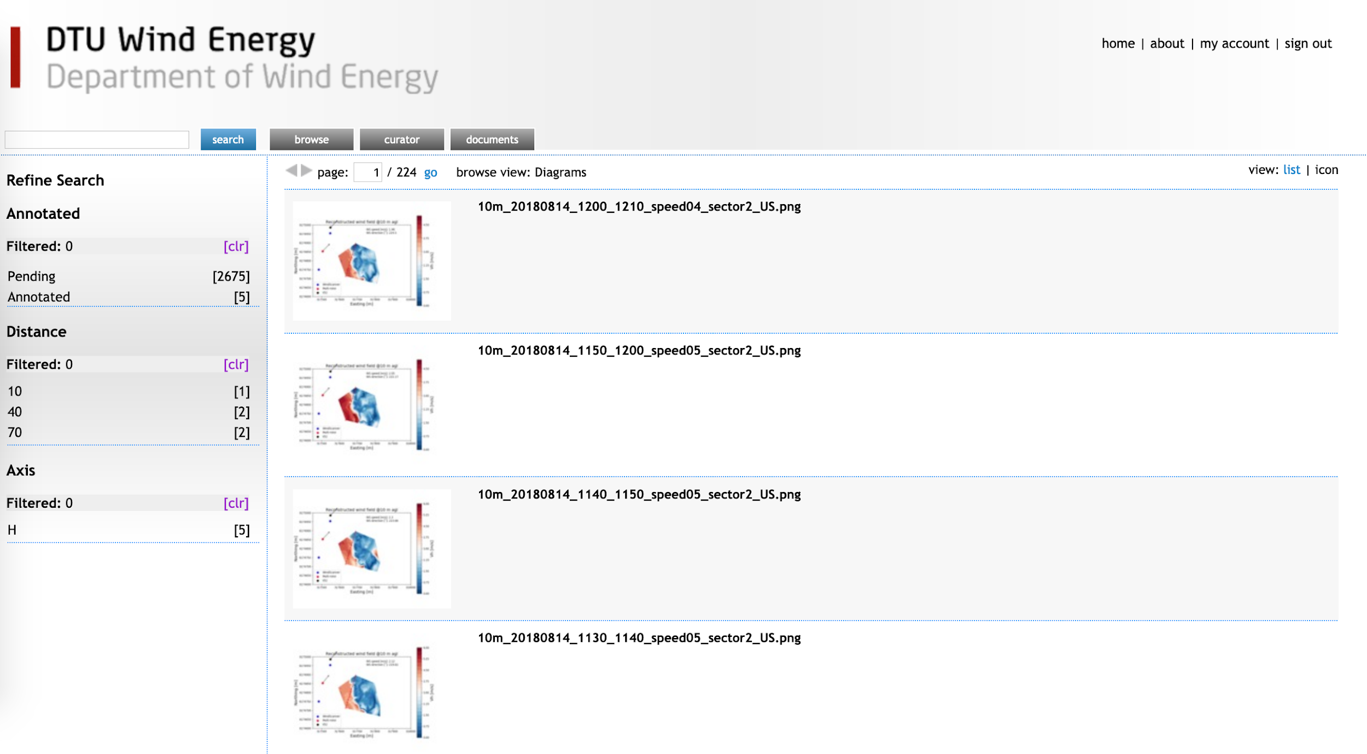
Meeting notes: http://bit.ly/2oRhvcu
24/10/2019

Slide 30
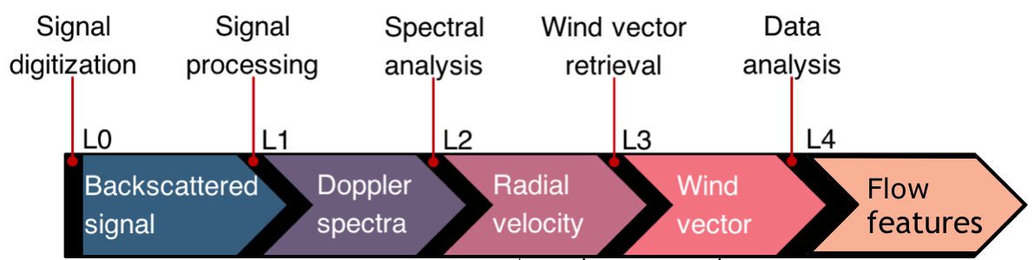
wind LiDAR data-sets from DTU
real-time
preparation
annotation
large data-sets annotated using trained machine intelligence for better navigation and discovery by subsequent users
Meeting notes: http://bit.ly/2oRhvcu
24/10/2019

Slide 31
wind turbine LIDAR data annotation
annotation store enables creation of WADM using plug-in applications such as Mirador (Harvard-Stanford); links digital resource and contributor PIDs; builds annotation collection, and makes respository deposit .. use cases from multiple domains at hasdai.org
demo at https://dtu-wind-energy.freizo.org/m/book.cgi?catno=12736 invites ORCID authentication to view or create new manual annotations
machinic annotation has enormous potential for enriching engineering datasets and improving accessibility and reuse, as well as analysis preservation
Meeting notes: http://bit.ly/2oRhvcu
24/10/2019

Slide 32
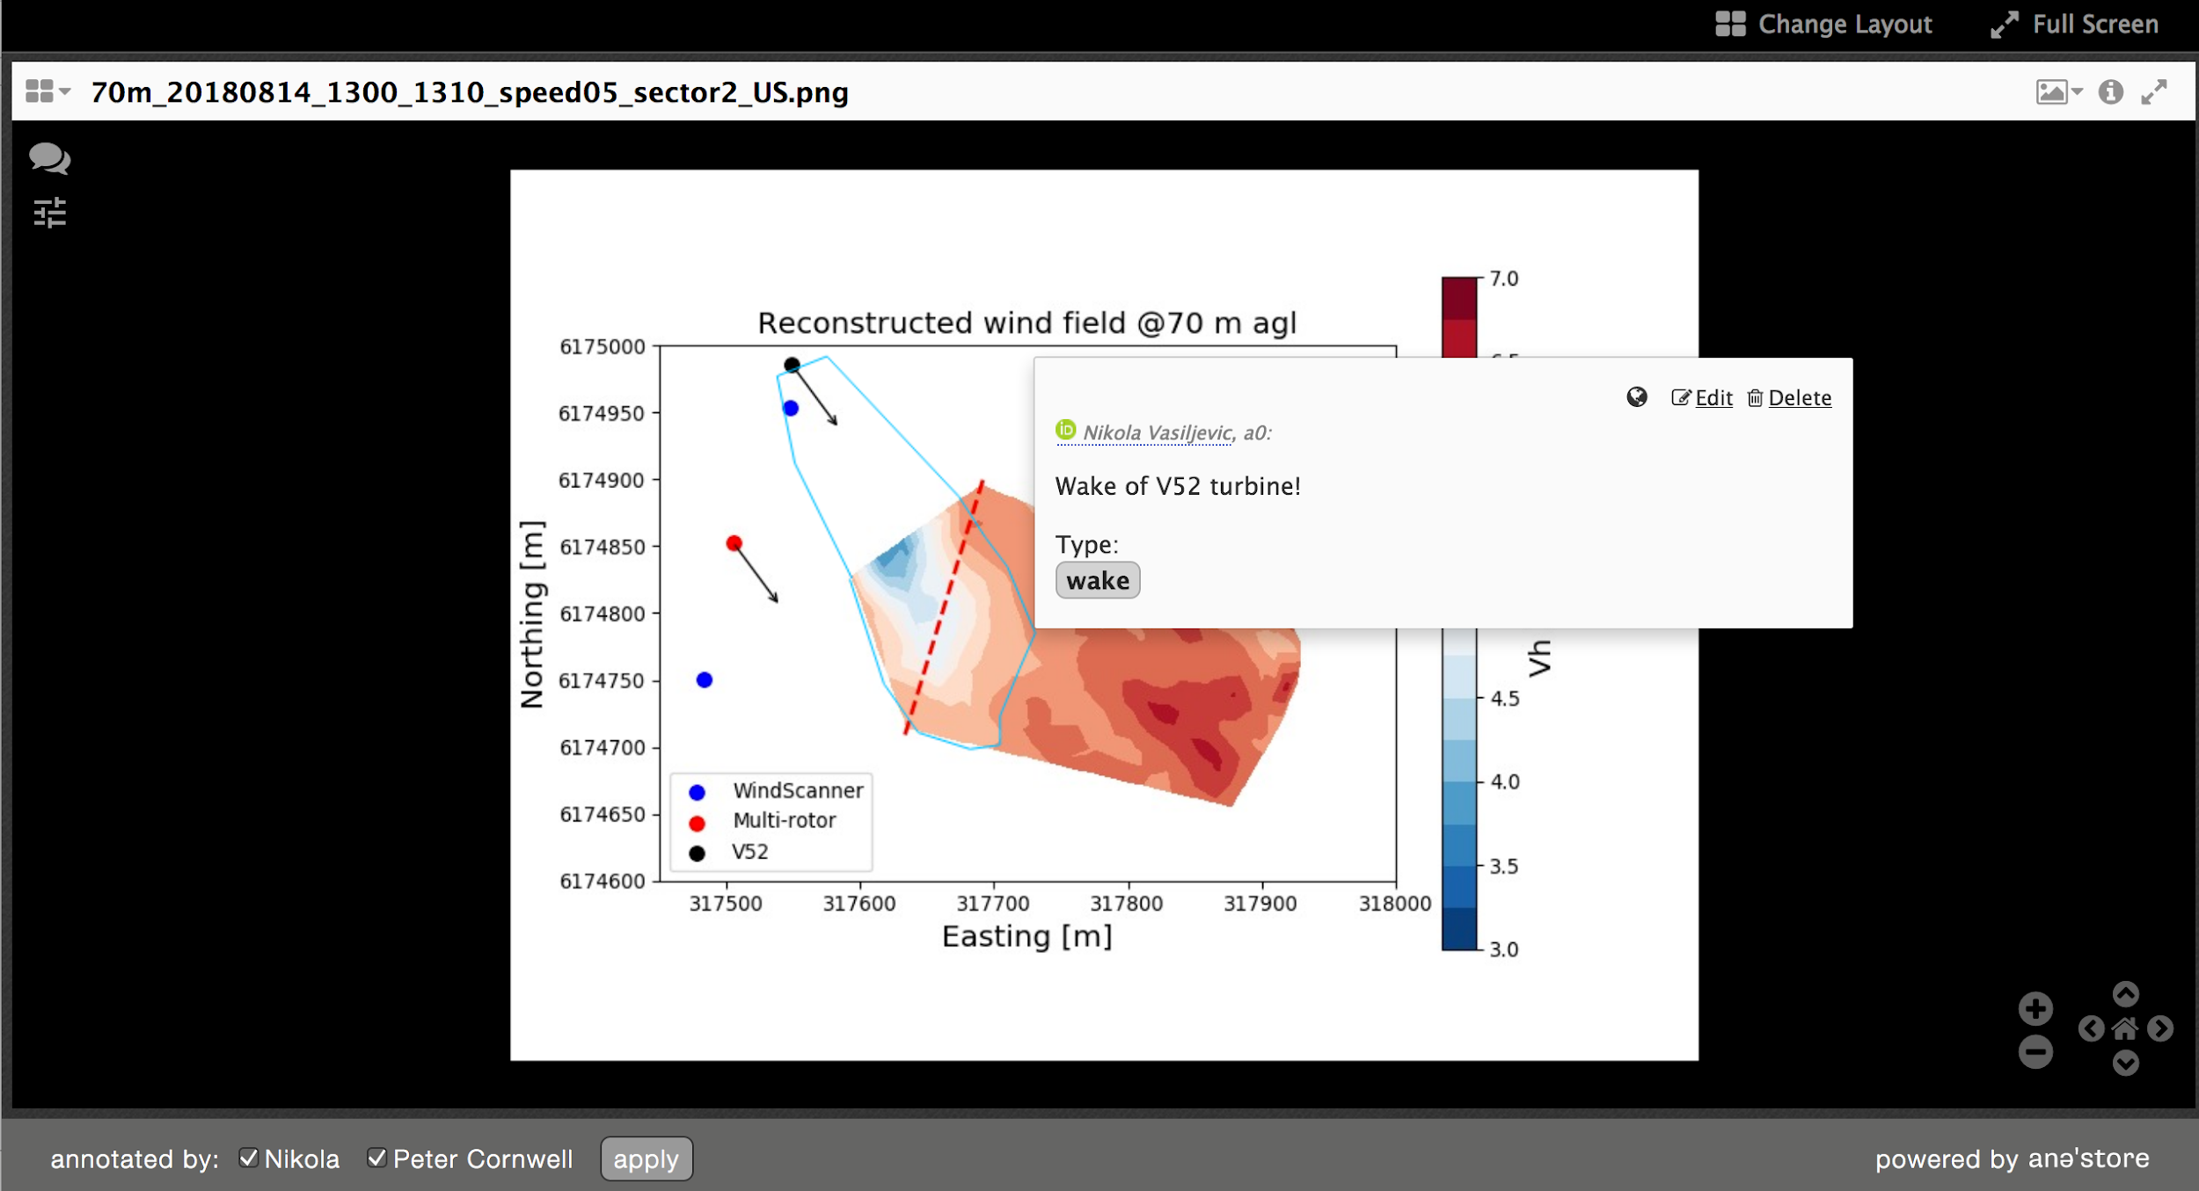
e.g. https://dtu-wind-energy.freizo.org/m/book.cgi?catno=12736
Meeting notes: http://bit.ly/2oRhvcu
24/10/2019

Slide 33
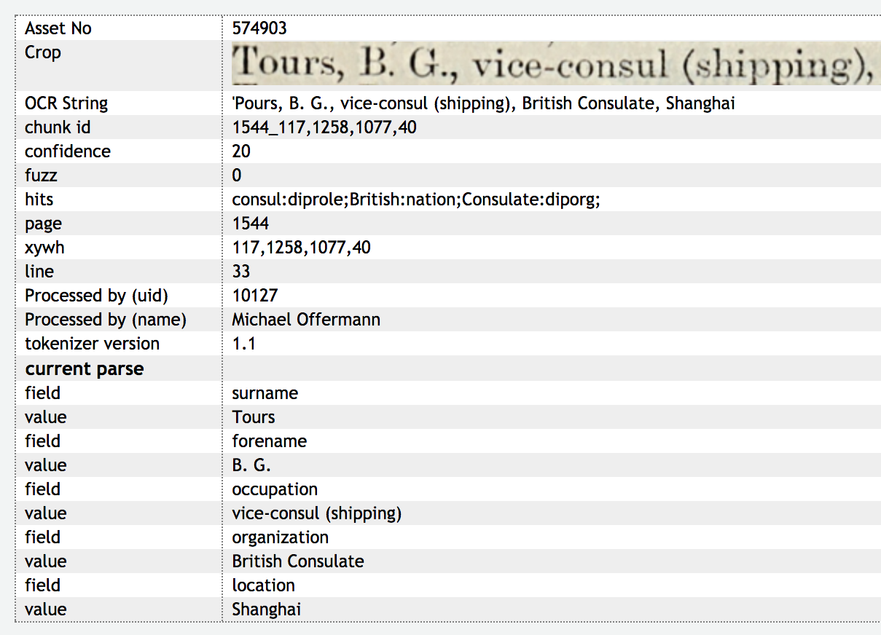
800k annotations generated by analysis of OCR XML on single publication, by EIB-Basel humanities project
Meeting notes: http://bit.ly/2oRhvcu
24/10/2019

Slide 34
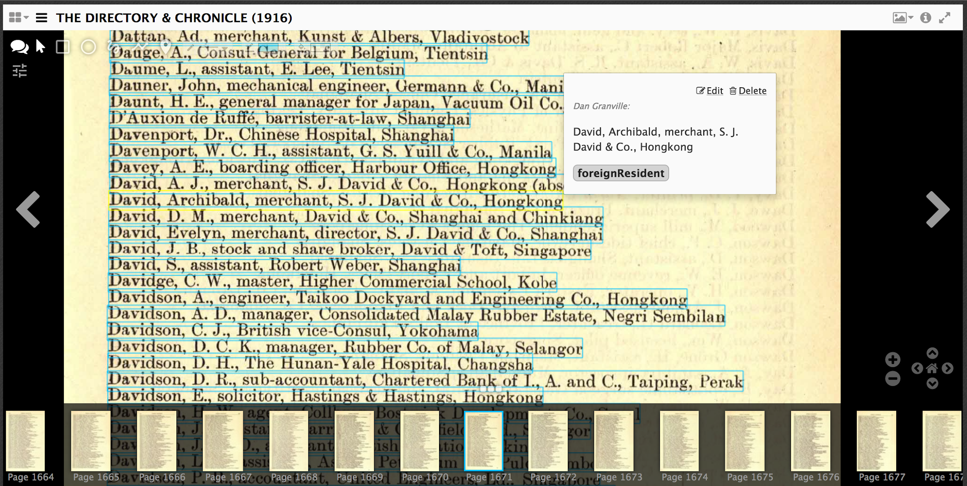
Meeting notes: http://bit.ly/2oRhvcu
24/10/2019

Slide 35
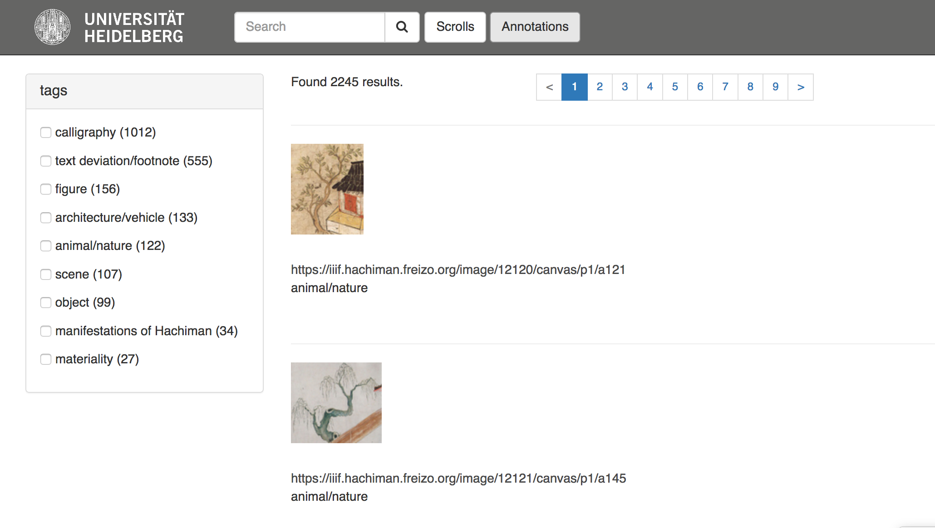
annotations as primary research assets using Invenio repository
Meeting notes: http://bit.ly/2oRhvcu
24/10/2019

Slide 36
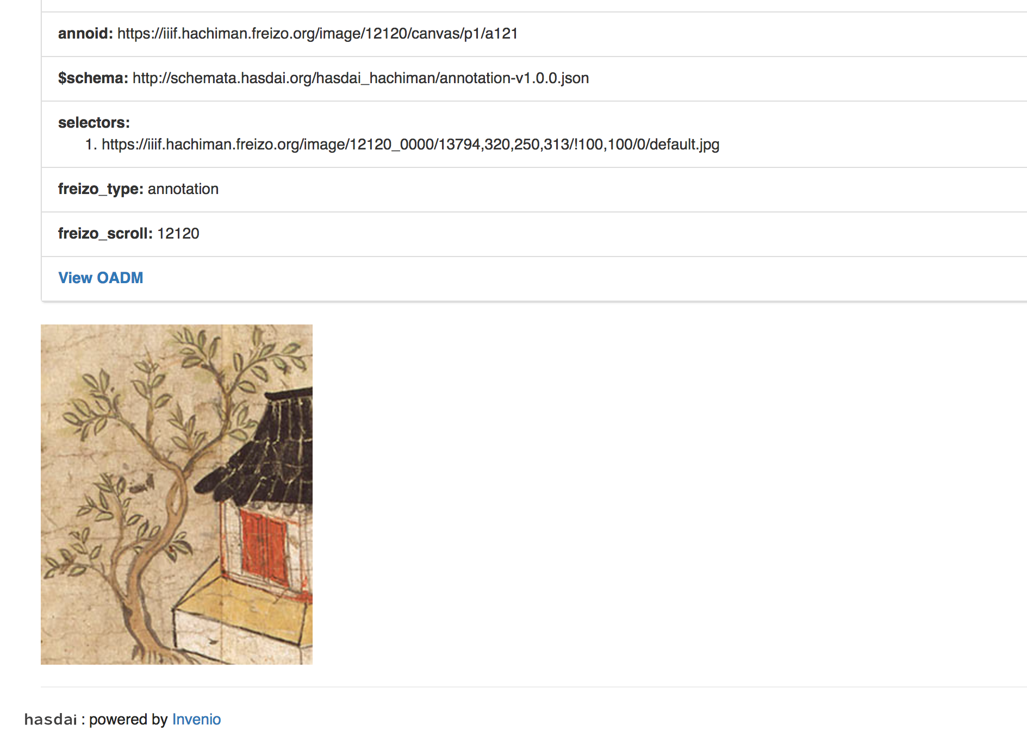
Meeting notes: http://bit.ly/2oRhvcu
24/10/2019

Slide 37
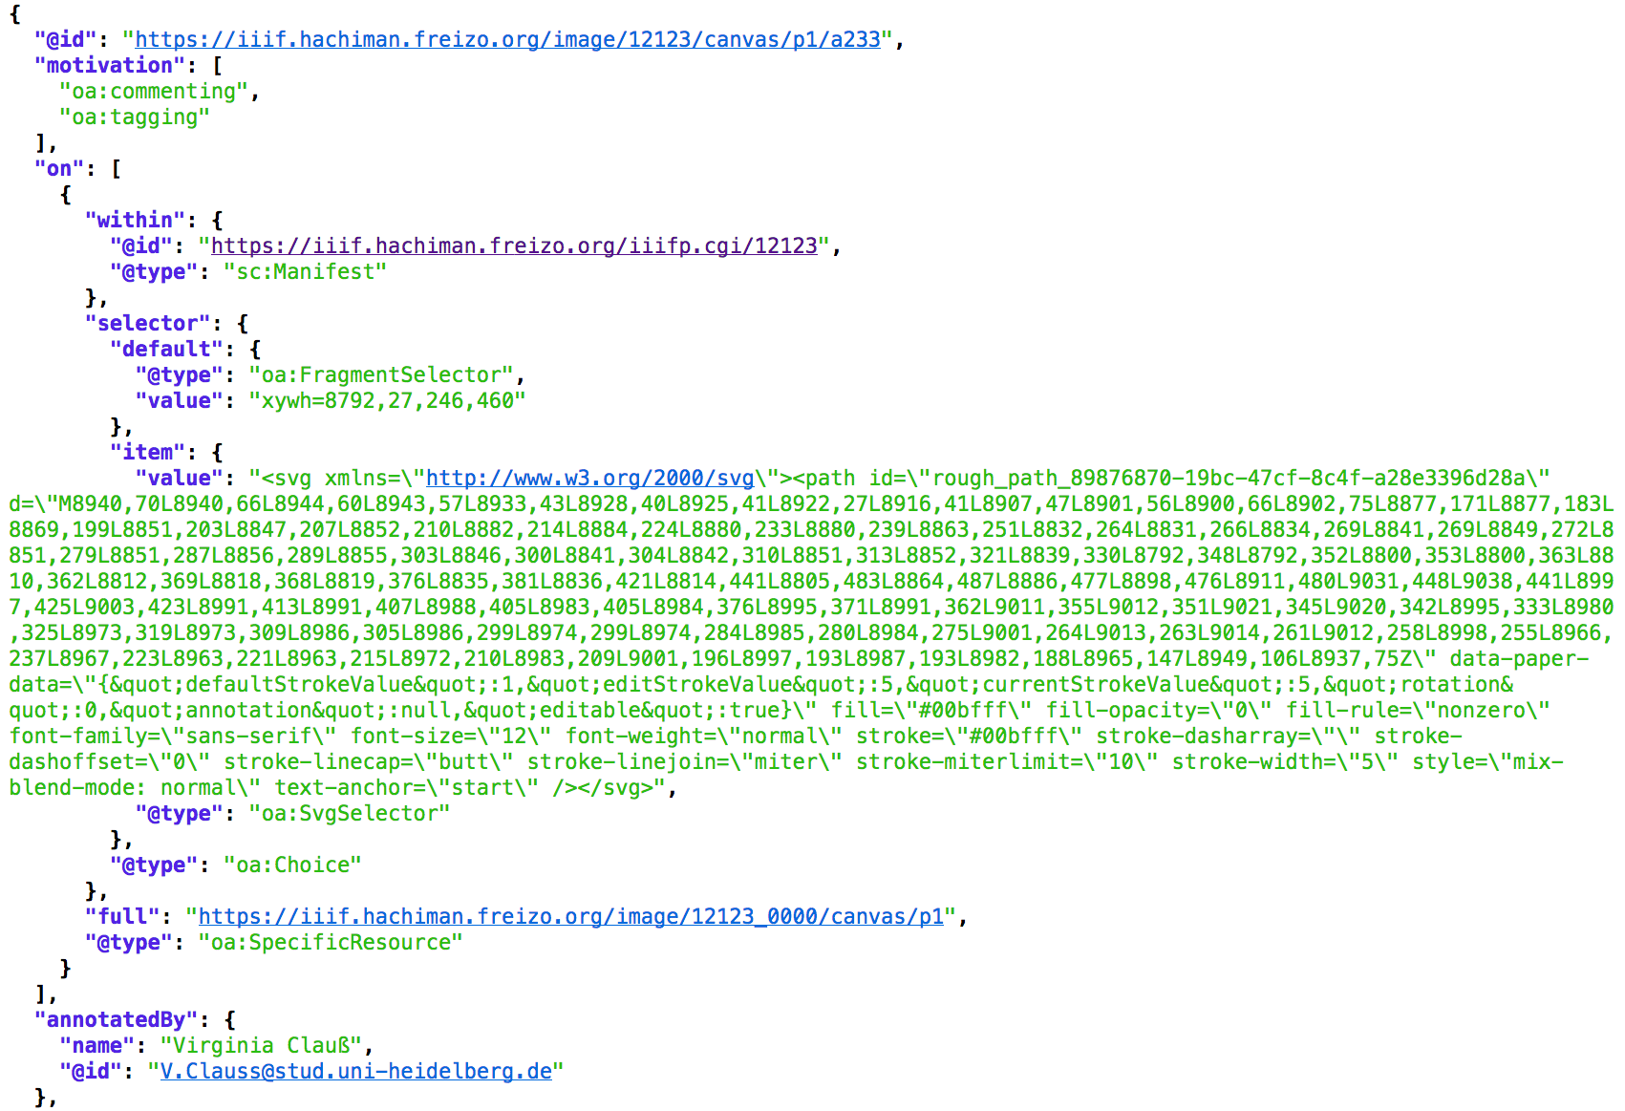
historic annotation redelivered as (O)WADM
Meeting notes: http://bit.ly/2oRhvcu
24/10/2019

Slide 38
EngMeta
Dorothea Iglezakis, Sibylle Hermann
University of Stuttgart, Competence Center for Research Data Management
RDM-IG

Slide 39

EngMeta - Metadata for Engineers
04/17 - 06/19
Project partners (University of Stuttgart): Institutes for Thermodynamics and Thermal Process Engineering (ITT) and Aerodynamics and Gas Dynamics (IAG), High Performance Computing Centre (HLRS), Technical Services for Information and Communication (TIK) and University Library (UB)
DiplIng
Networking with national services
metadata schema for research data
requirement analysis
concept for research data management in engineering sciences
evaluation
Competence Center for Research Data Management
Integration into the university Infrastructure
Meeting notes: http://bit.ly/2oRhvcu
24/10/2019

Slide 40
Results of requirement analysis
What information is important when trying to find, understand and replicate engineering data?
Iglezakis, D., & Schembera, B. (2018). Anforderungen der Ingenieurwissenschaften an das Forschungsdatenmanagement der Universität Stuttgart - Ergebnisse der Bedarfsanalyse des Projektes DIPL-ING. O-Bib. Das Offene Bibliotheksjournal / Herausgeber VDB, 5(3), 46-60. https://doi.org/10.5282/o-bib/2018H3S46-60
Meeting notes: http://bit.ly/2oRhvcu
24/10/2019

Slide 41
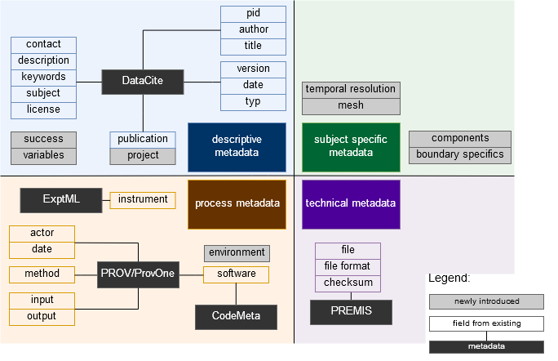
EngMeta
Schembera, B. & Iglezakis, D. (2019). The Genesis of EngMeta - A Metadata Model for Research Data in Computational Engineering. In E. Garoufallou, F. Sartori, R. Siatri & M. Zervas (eds.), Metadata and Semantic Research (p./pp. 127-132), Cham: Springer International Publishing. https://doi.org/10.1007/978-3-030-14401-2_12
Meeting notes: http://bit.ly/2oRhvcu
24/10/2019

Slide 42
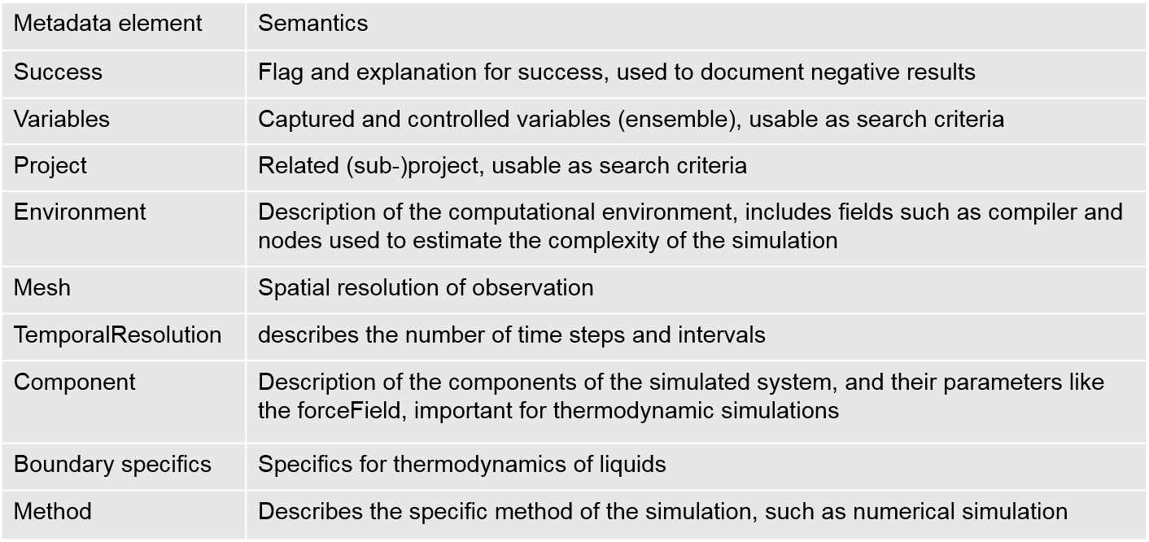
Introduced metadata elements
Meeting notes: http://bit.ly/2oRhvcu
24/10/2019

Slide 43
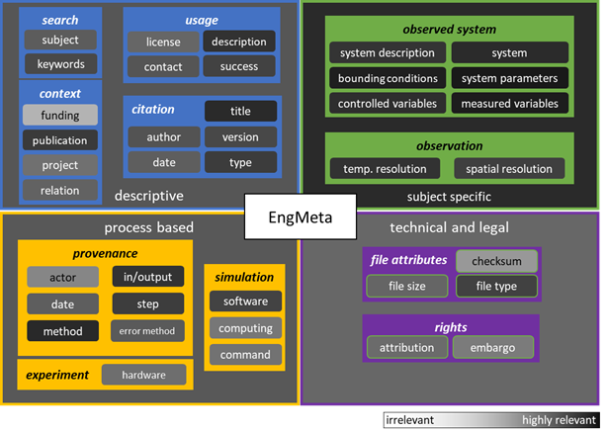
EngMeta - Evaluation
Meeting notes: http://bit.ly/2oRhvcu
24/10/2019

Slide 44
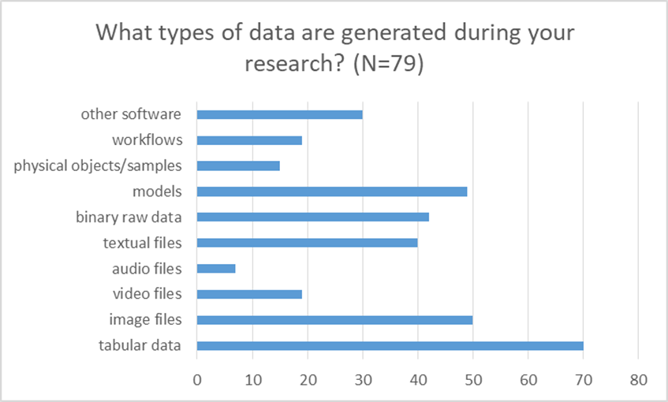
Evaluation
Meeting notes: http://bit.ly/2oRhvcu
24/10/2019

Slide 45
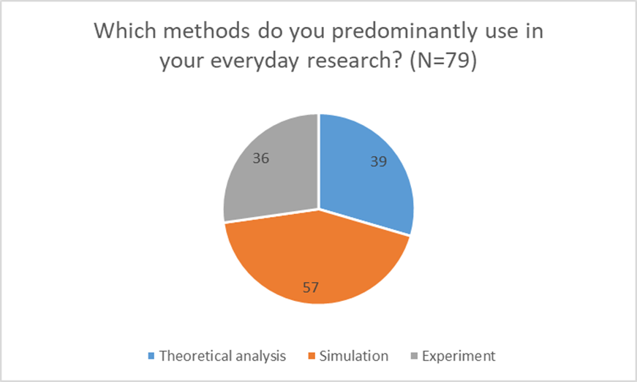
Evaluation
Meeting notes: http://bit.ly/2oRhvcu
24/10/2019

Slide 46
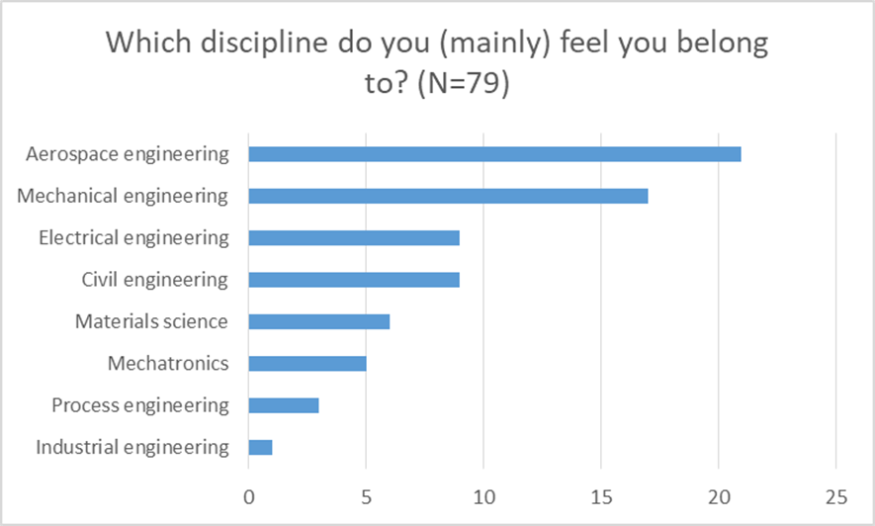
Evaluation
Meeting notes: http://bit.ly/2oRhvcu
24/10/2019

Slide 47
Further information
https://www.izus.uni-stuttgart.de/fokus/engmeta
Hermann, S., Iglezakis, D. & Seeland, A., 2019. Requirements for Finding Research Data and Software. PAMM. Available at: http://dx.doi.org/10.1002/pamm.201900480.
24/10/2019

Slide 48
Group discussion (20 min.)
Choose a topic you are interested in and join the group discussion
Presenters of this morning will moderate discussion
Document the discussion and ideas collected in the google docs:
1. Open Science http://bit.ly/2W0TITj
2. DMP http://bit.ly/2Ncs6a7
3. Annotation http://bit.ly/2pDMGbf
4. Metadata http://bit.ly/2P8Ef2e
Choose one member to pitch the ideas at the end of the session (2 min in each group)
Meeting notes: http://bit.ly/2oRhvcu
24/10/2019

Slide 49
Inspiration - Think about:
The presentations of this morning as a starting point and determine how we move forward - how we convert this preliminary work on a useful output for researchers in engineering?
How to move forward the collaboration with other groups in RDA
How to move forward collaboration with groups outside RDA e.g. research communities
Collect concrete next steps to make your ideas reality
Meeting notes: http://bit.ly/2oRhvcu
24/10/2019

Slide 50
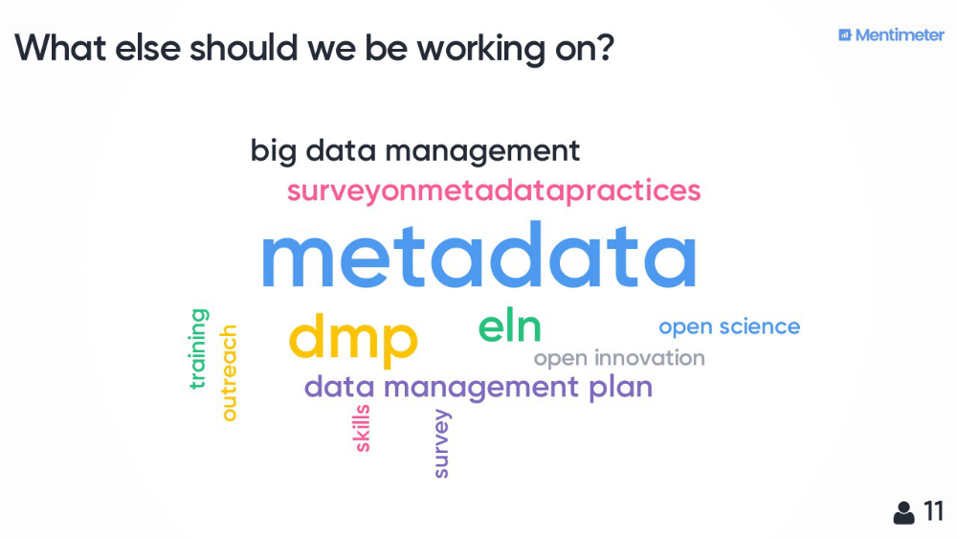
Results of the mentimeter – future work
24/10/2019

Slide 51
Thank you!
24/10/2019

