Slide 1

Introduction to Data Sharing
Hugh Shanahan
Department of Computer Science
Royal Holloway, University of London
Hugh.Shanahan@rhul.ac.uk
@hughshanahan

Slide 2
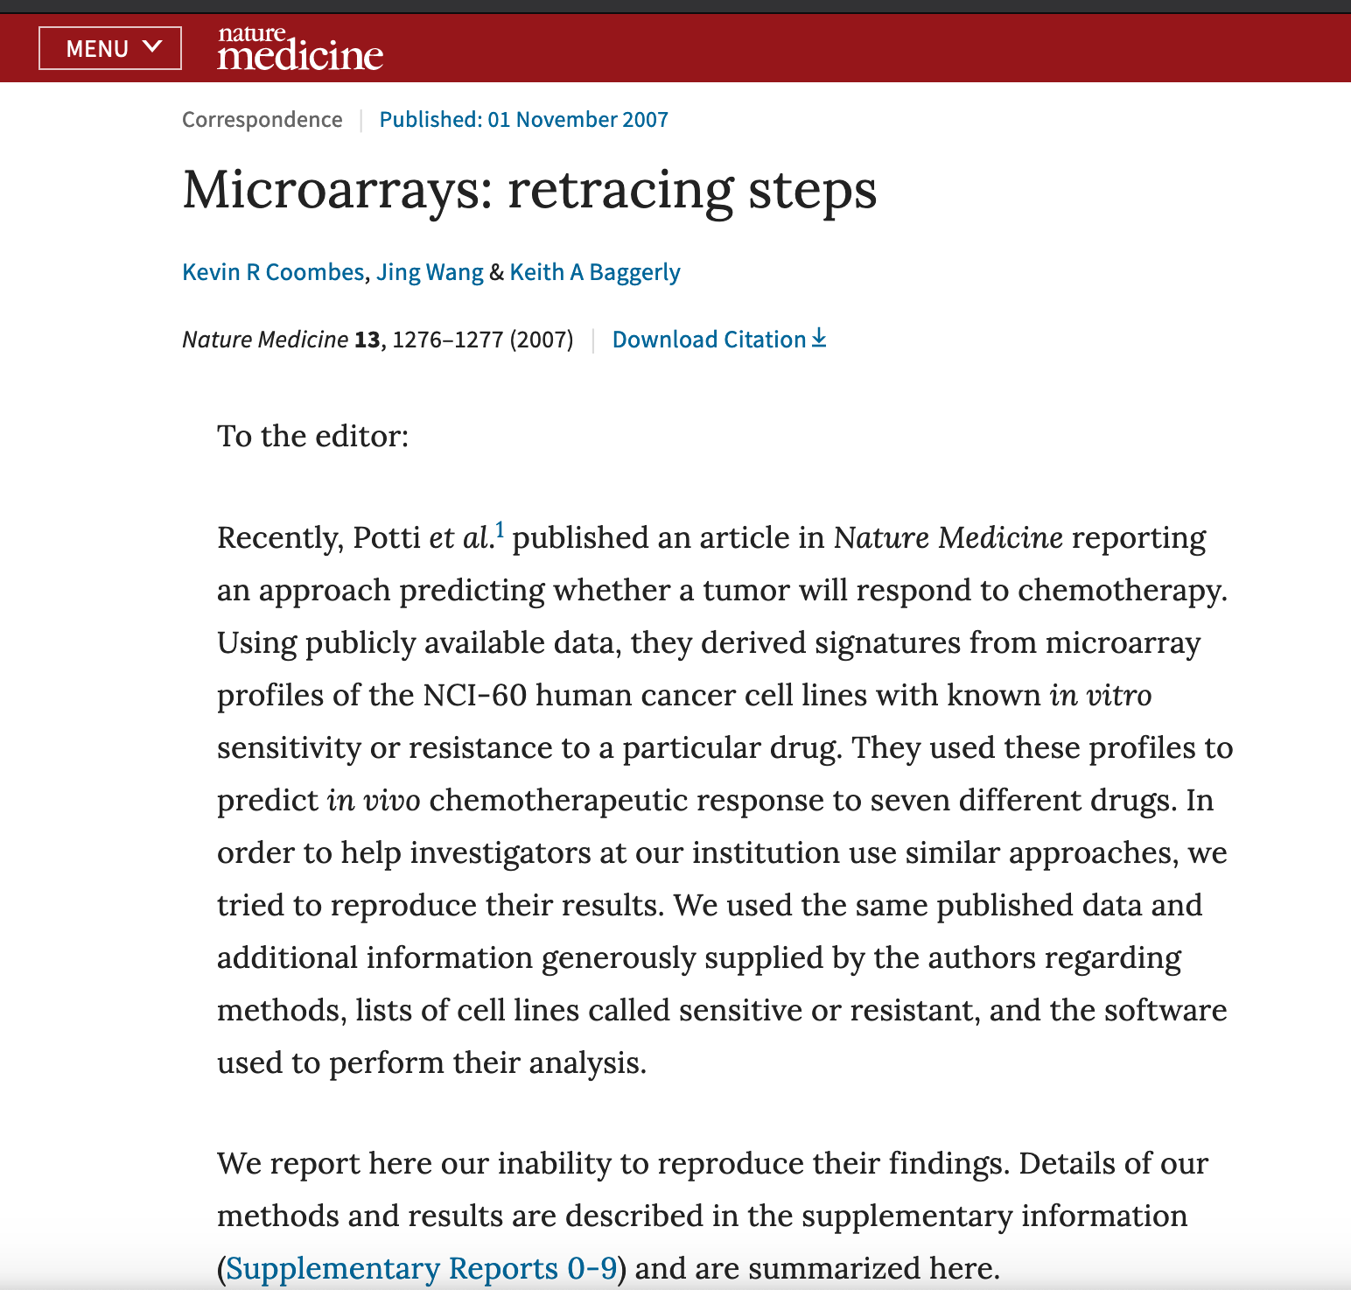
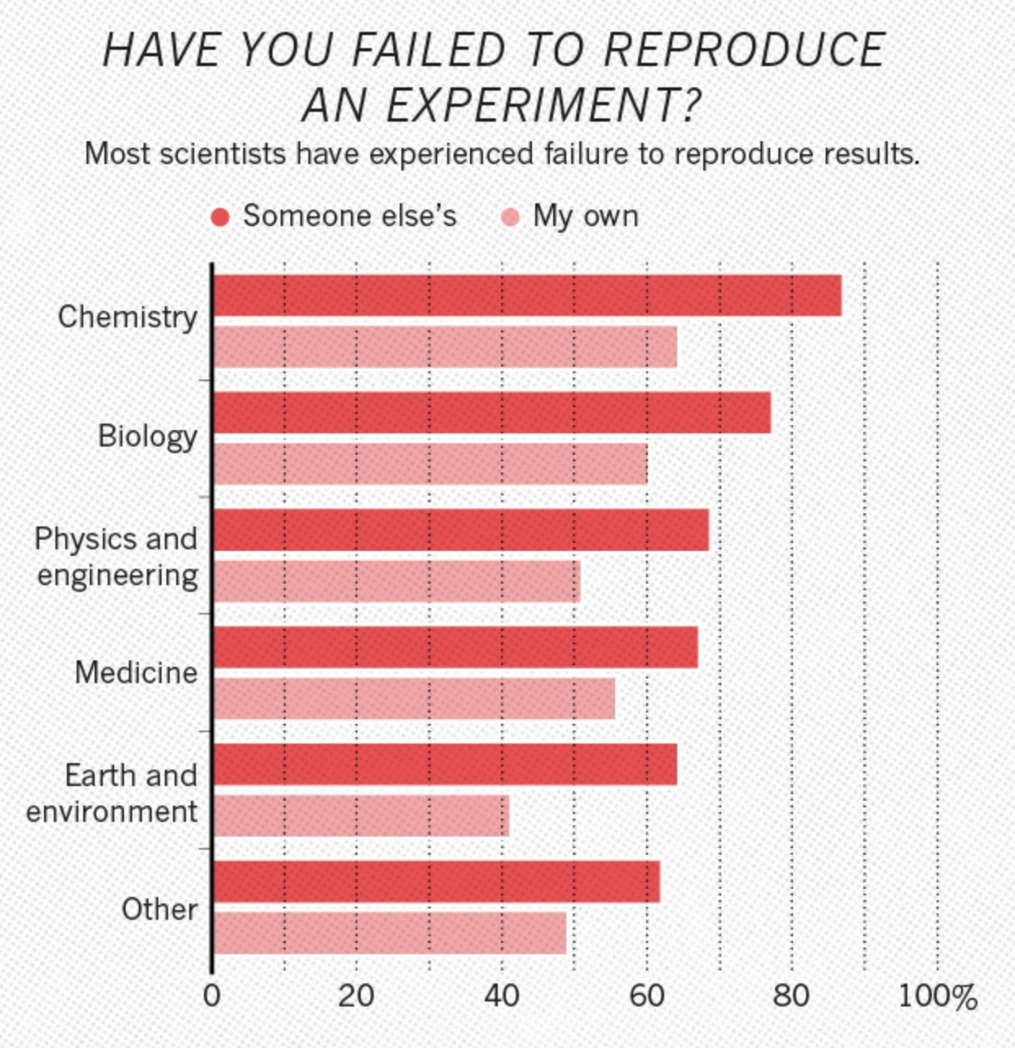
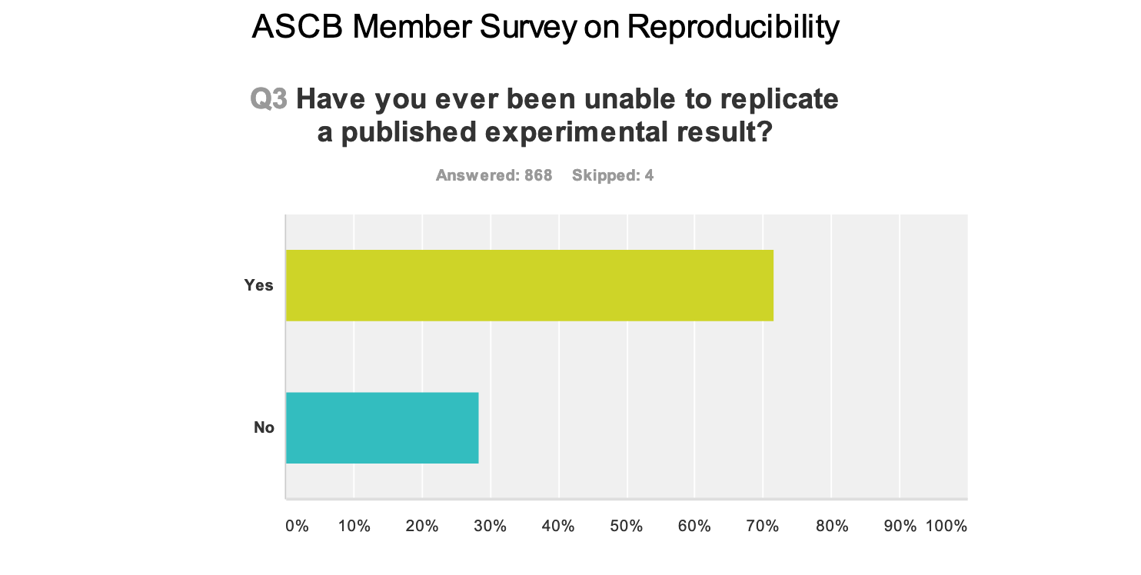
Reproducibility crisis
Systemic evidence that large fraction of experiments
are not reproducible.
Examples from Cancer Genomics, Clinical Medicine, Economics
Survey data of Cell Biologists and 1500 Scientists

Slide 3
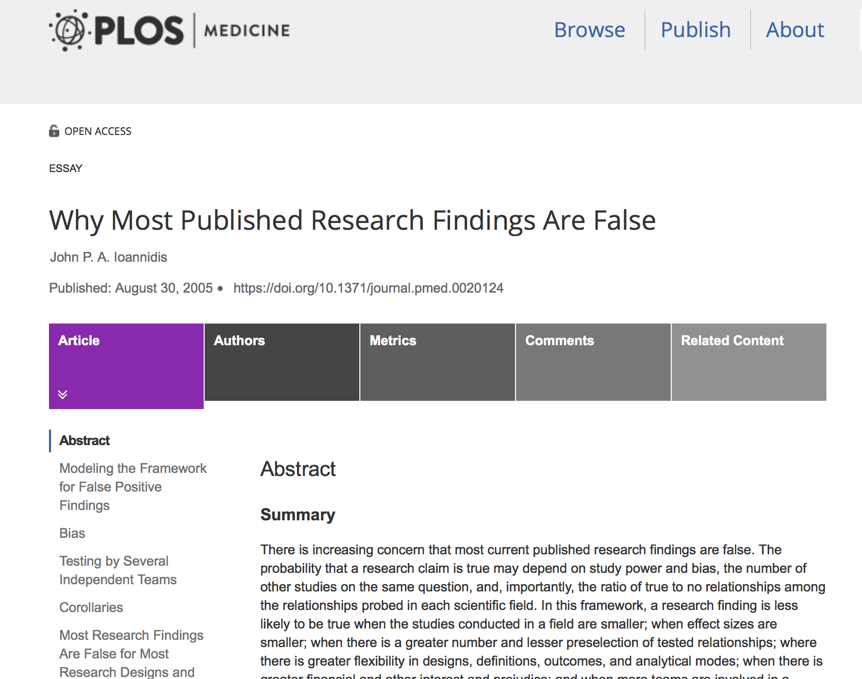
Breakdown of traditional Statistics
Many hypotheses – number of false positives diverge with usual controls.
Pointed out systematic behaviours
The smaller the studies conducted in a scientific field, the less likely
the research findings are to be true.
The greater the number and the lesser the selection of tested
relationships in a scientific field, the less likely the research findings
are to be true.
The hotter a scientific field (with more scientific teams involved),
the less likely the research findings are to be true
(if they don’t work together).

Slide 4
Radical (?) conclusions
Reproducibility crisis (some would disagree with that second word).
Present model of publication is abetting this.
Need to think of alternatives.
Openness - sharing
Data (negative results as well as positives)
Code
Alter hegemony of The Paper
THIS IS ABOUT PEOPLE NOT ABOUT PROCESS

Slide 5

The Evolution of Open Research
For funders and in policy, the balance has increasingly shifted towards arguments for sharing and collaboration:
  Registration of clinical trials (and other research) on website
  Encouragement of publication of negative results
  Publication of protocols
  Open access publications
  Sharing of data and other outputs
  Open research publishing model and post-publication review e.g. Wellcome Open

Slide 6
Sharing data
Addressing issues noted from Ioannidis
One fifth of clinical trials registered on clinicaltrials.gov are published
Alltrials.net – registration of planned clinical trials, providing summary of trial protocol.
Sharing of data post-publication – Data Management Plan (DMP)
Sharing of data pre-publication – evidence of improved clinical outcomes (Gross et al. JAMA, 2000)

Slide 7
Sharing software
Much more haphazard
Same issues as with data
Post-publication?
Pre-prublication?
Often associated with URL with very short life-span
Reproducibility is as much a problem there as with wet lab
Excitement about tools such as git or svn (and sites such as github, gitlab etc.)
Creation of DOI’s using zenodo, figshare,…

Slide 8
Meta-analyses
Standard meta-analyses – Cochrane
Automated parsing of papers? Jury still out…
Bioinformatics
Transcriptomics analysis – many experiments pulled together.
Infer genes involved in diseases not spotted previously (Caldas and Vinga, PLOS ONE, 2014)

Slide 9









FAIR principles
Huge amount of interest at the present moment.

Slide 10
Important point
There are principles ….
But not standards!
Implementation is dependent on each research community.

Slide 11
Two visions of FAIR
“strong FAIR”
  Focus on machine to machine interoperability
  Building ontologies, rigorous metadata schemes…
  Very demanding but also very hard work.

Slide 12
Other vision
“FAIR enough”
  FAIR as an encapsulation of Research Data Management principles
  Message – keep doing what you’re doing and keep on getting better at it.

Slide 13
Reality
Which visions are correct?
How are researchers react to all of this?

Slide 14
From a researcher’s perspective
Think of efficiency gains.
  Data not sitting on dodgy hard drives
  Data quickly accessible.
  Data you can analyse with more than ()^&()^!!!! Excel
Think of effectiveness gains.
  Don’t lose your data.
  Don’t have to start all over again with every new postdoc/PhD student.
  Citations for their data.
Think of compliance and responsible research.

Slide 15









Acknowledgments

Slide 16
References
Coombes, Kevin R. and Wang, Jing and Baggerly, Keith A., Microarrays: Retracing Steps, Nature Medicine, 10.1038/nm1107-1276b
ASCB Task Force Report on Reproducibility in Science, https://www.ascb.org/science-policy-public-outreach/advocacy-policy/ascb-task-force-reproducibility-in-science/
Baker, Monya, 1,500 Scientists Lift the Lid on Reproducibility, Nature News, 10.1038/533452a
Ioannidis, John P. A. and Chen, JJ and Kodell, RL and Haug, C and Hoey, J, PLoS Medicine, 10.1371/journal.pmed.0020124

