Slide 1
Reimagining how we evaluate the production of knowledge: The Curtin Open Knowledge Initiative
重构我们如何评估知识生产：科廷开放知识倡议
Dr. Richard Hosking
The Centre for Culture and Technology in collaboration with
The Curtin Institute for Computation

Slide 2
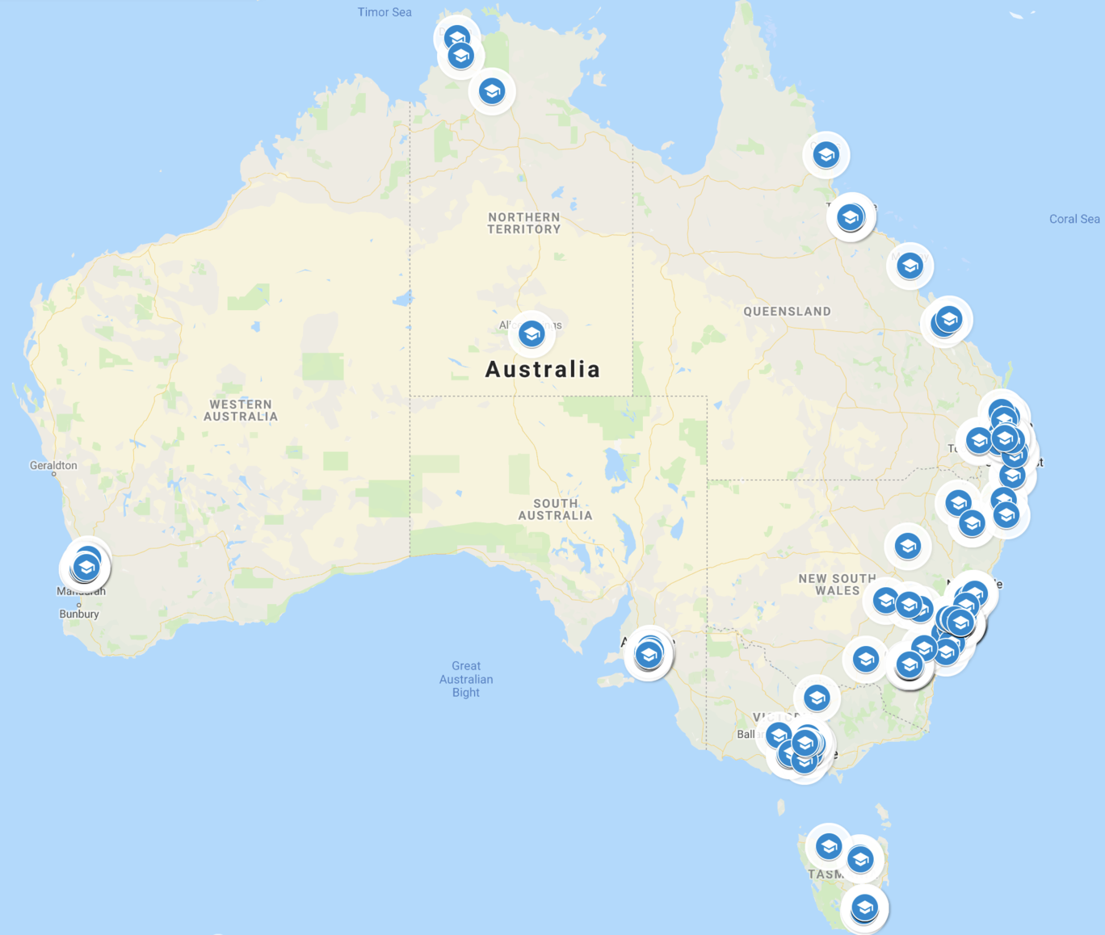



Slide 3




Key questions
主要问题
Why do universities exist?
How do they serve the community?
Which universities are performing and how can others achieve similar outcomes?
What happens to the brilliant research insights that researchers make?

Slide 4
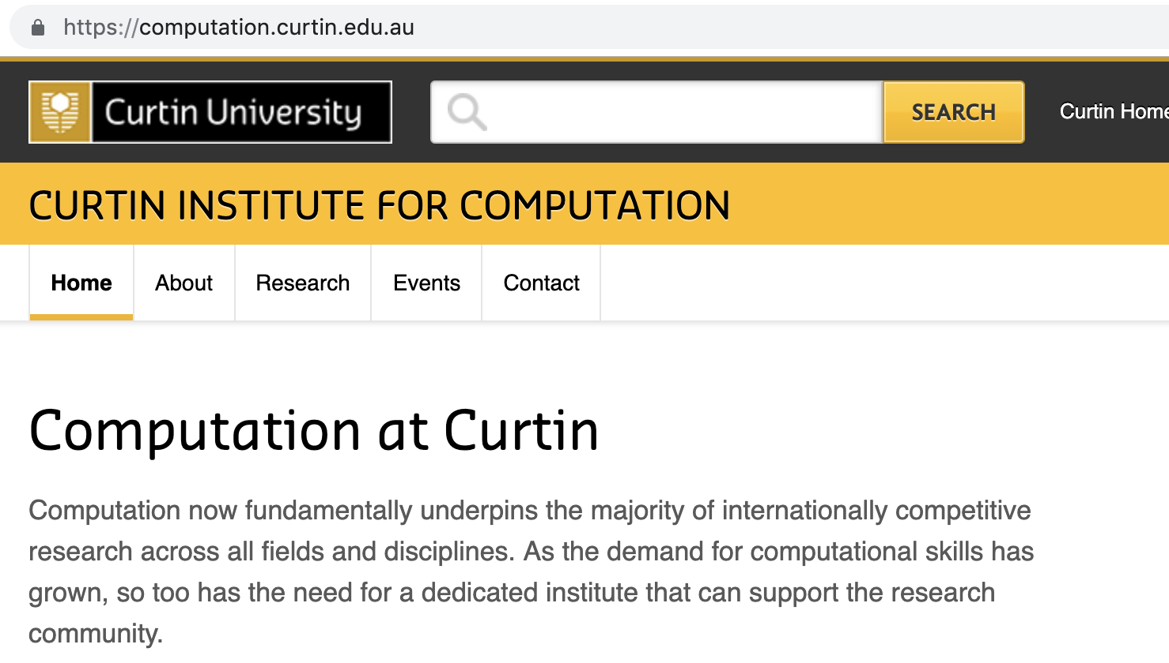
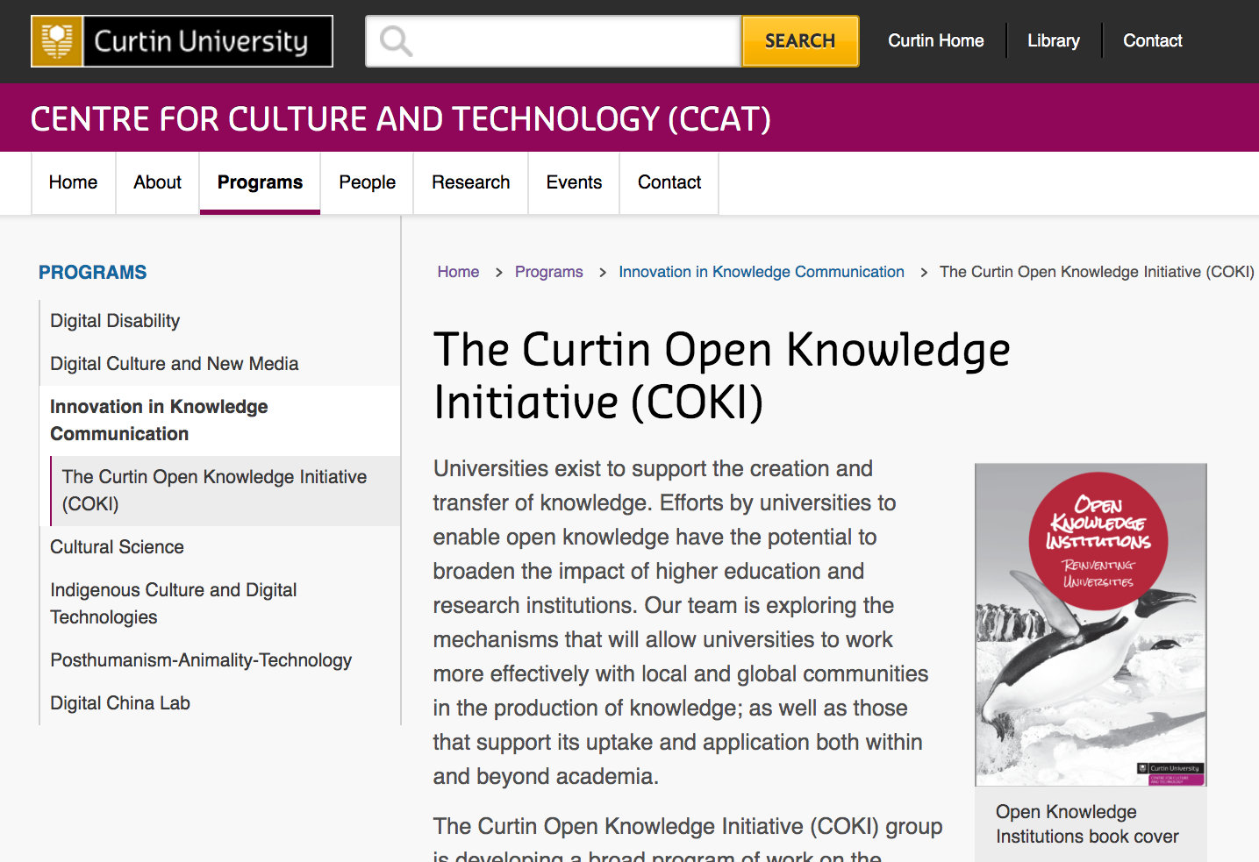
Introductions – Myself 关于我

Slide 5
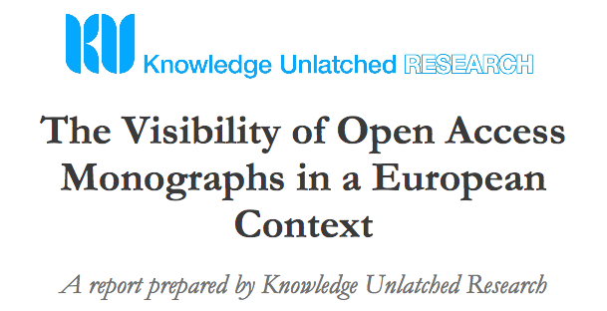

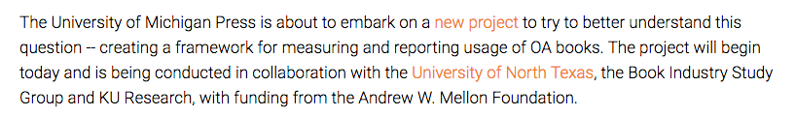

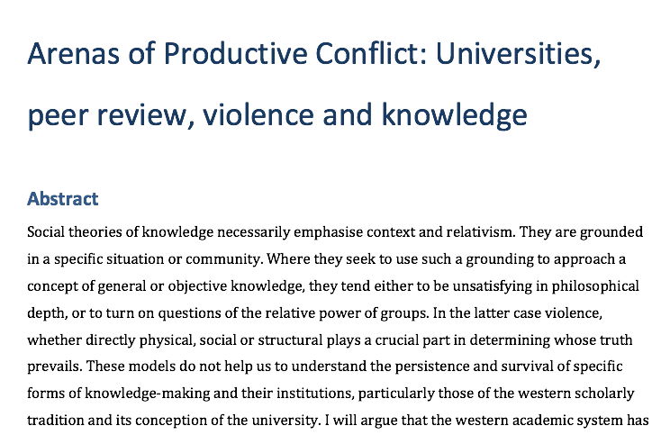
Introductions – The COKI Project
关于COKI项目
https://wip.mitpress.mit.edu/pub/oki

Slide 6
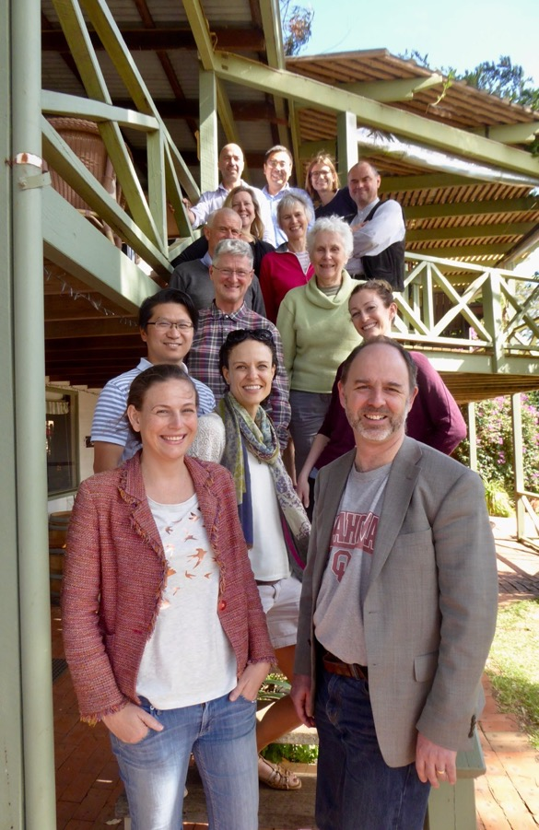
Introductions – The COKI Team 关于COKI团队
Cameron Neylon, Professor of Research Communications
Lucy Montgomery, Associate Professor, Internet Studies
John Hartley, Professor of Cultural Science
Richard Hosking, Data Science Infrastructure Lead
Chun-Kai (Karl) Huang, Data Scientist
Katie Wilson, Research Fellow
Alkim Ozaygen, Data Scientist
Chloe Brookes-Kenworthy, Data Wrangler
Emma de Francisco, Project Coordinator

Slide 7
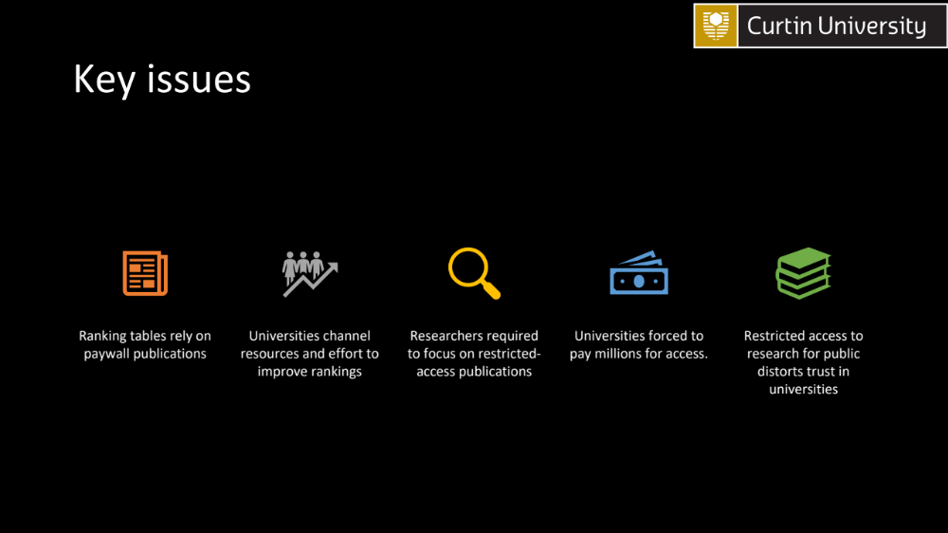





Key issues
主要议题
Ranking tables rely on paywall publications
Universities channel resources and effort to improve rankings
Researchers required to focus on restricted-access publications
Universities forced to pay millions for access.
Restricted access to research for public distorts trust in universities

Slide 8
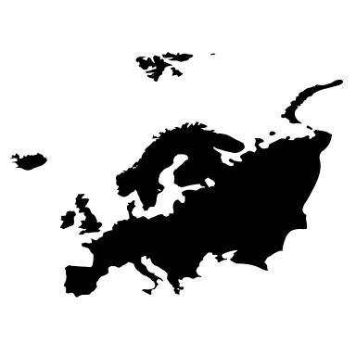




The Pushback
Europe pursues Plan S
Resistance to paying $millions – University of California system, Swedish universities
Questions over open access compliance
Growing concerns over equity and access
Grassroots movements for open access – particularly in medicine

Slide 9
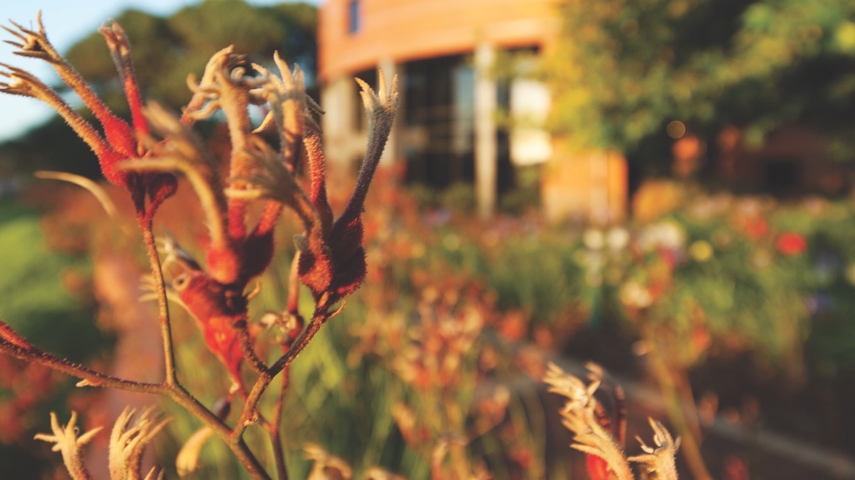
Open Access
开放存取

Slide 10
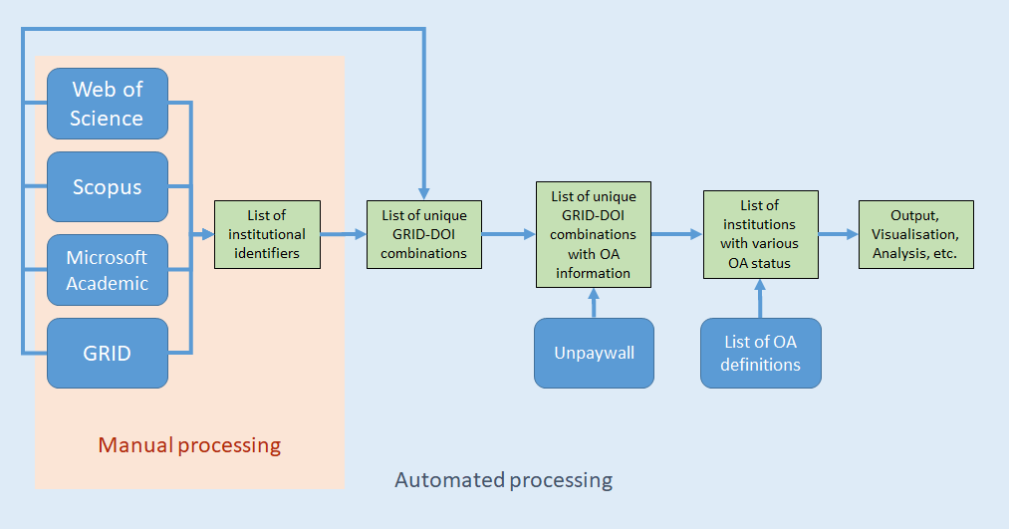
Open Access Data Analysis Pipeline
开放存取数据分析流程图

Slide 11
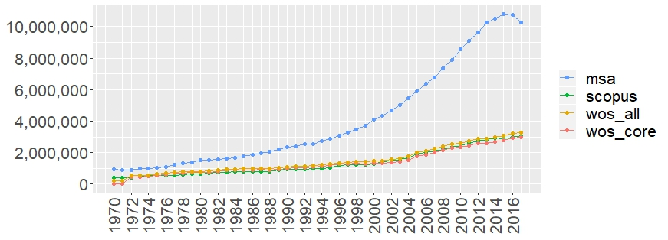
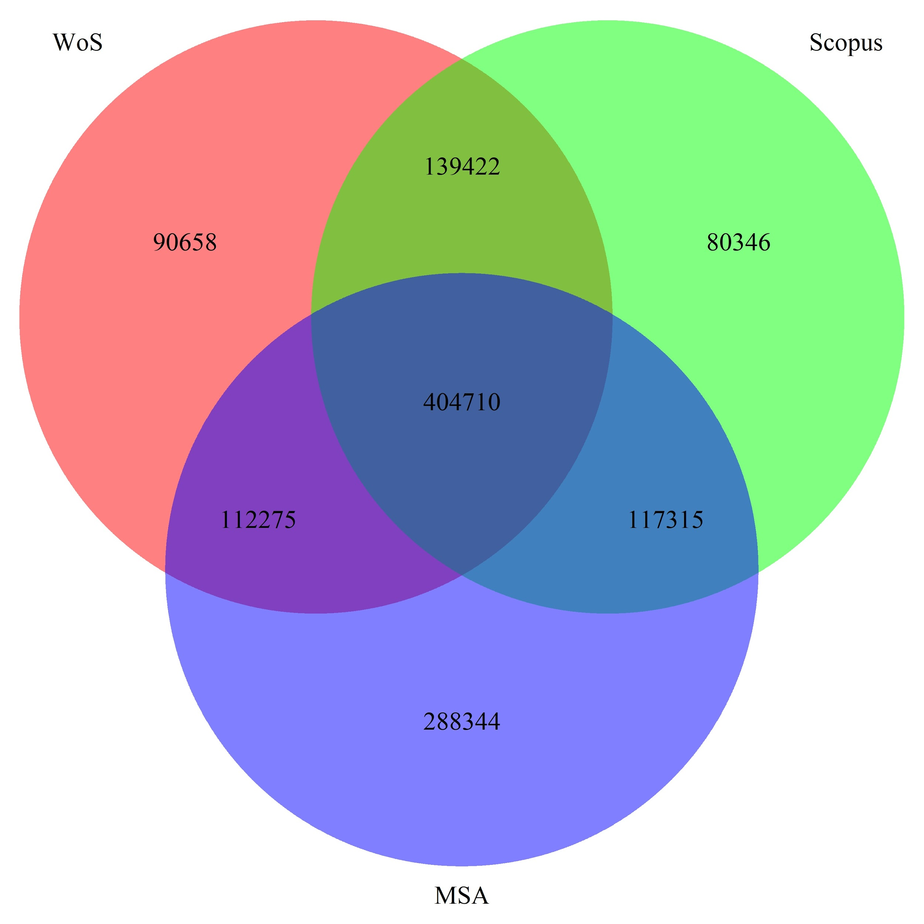
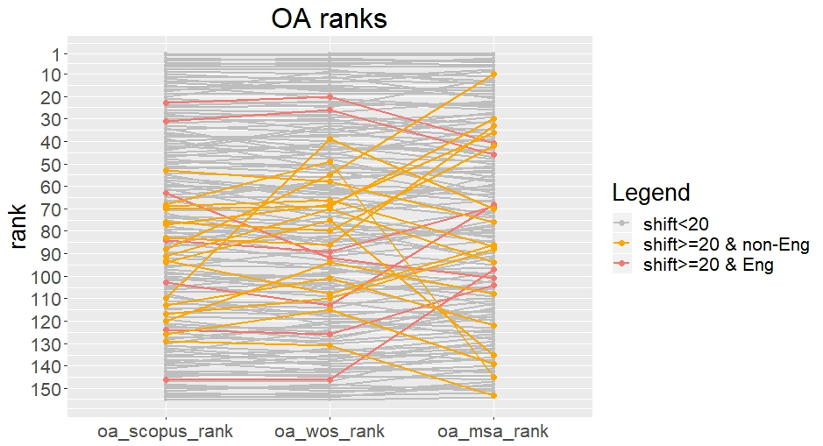
Issues with selecting a single source
选定单个来源遇到的问题
Object count in all sources
15 universities
For 155 universities
Comparison of bibliographic data sources: Implications for the robustness of university rankings
Chun-Kai (Karl) Huang, Cameron Neylon, Chloe Brookes-Kenworthy, Richard Hosking, Lucy Montgomery, Katie Wilson, Alkim Ozaygen bioRxiv 750075; doi: https://doi.org/10.1101/750075

Slide 12
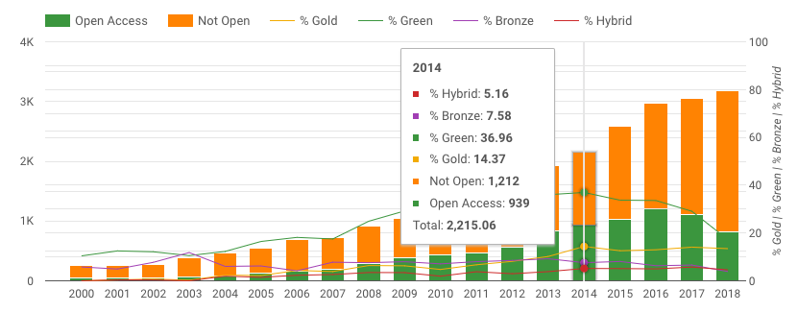
OA for Curtin University
科廷大学的开放存取

Slide 13
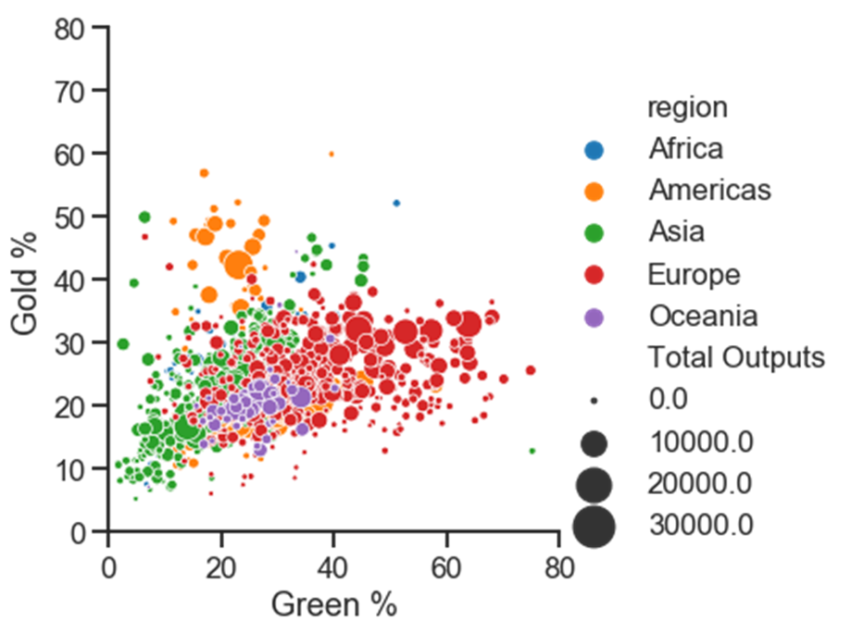
Open Access seen Globally
全球的开放存取

Slide 14
Impacts of Policy?
政策影响

Slide 15
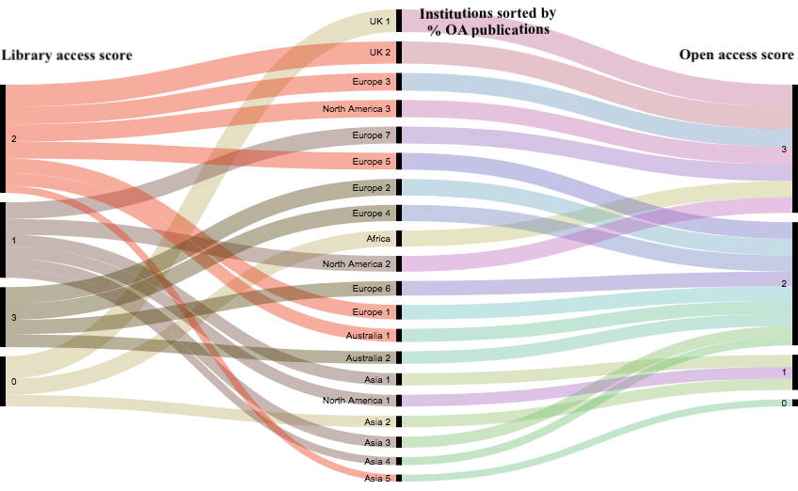
20 Institutions: 20家机构：
Library access scores, percentage OA publications, OA scores
图书馆访问分数，开放存取出版物百分比，开放存取分数
One point for each:
Public access to library
No physical restrictions
No fees for public access
One point for each:
OA policy
Institutional repository
OA publishing funds
% OA output for 2017 (COKI data)
WIlson, K., Neylon, C., Montgomery, L. & Huang, C-H. (2019). Library access policies: an indication of openness? Information Research, 24(1), paper 809.
Retrieved from http://InformationR.net/ir/24-1/paper809.html (Archived by WebCite® at http://www.webcitation.org/76tOSpfrn)

Slide 16
Global Connections
(And our blind spots)
国际联系（以及盲点）

Slide 17
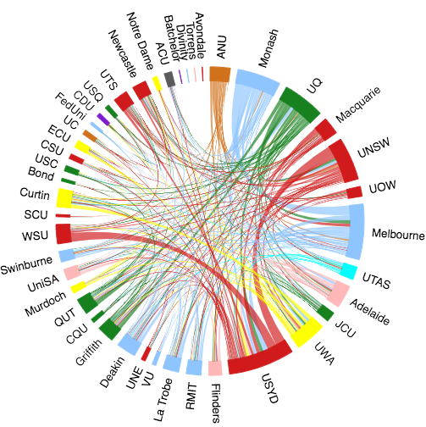
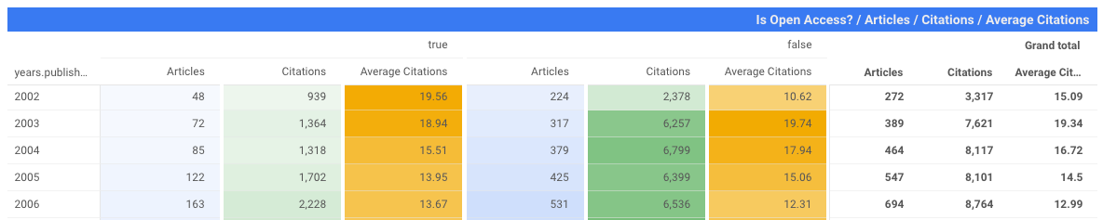
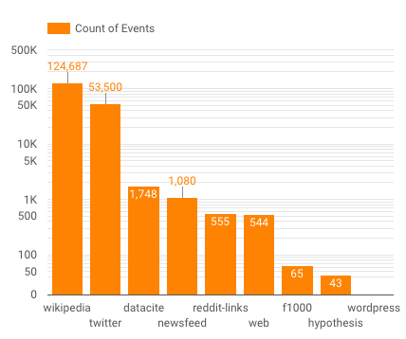
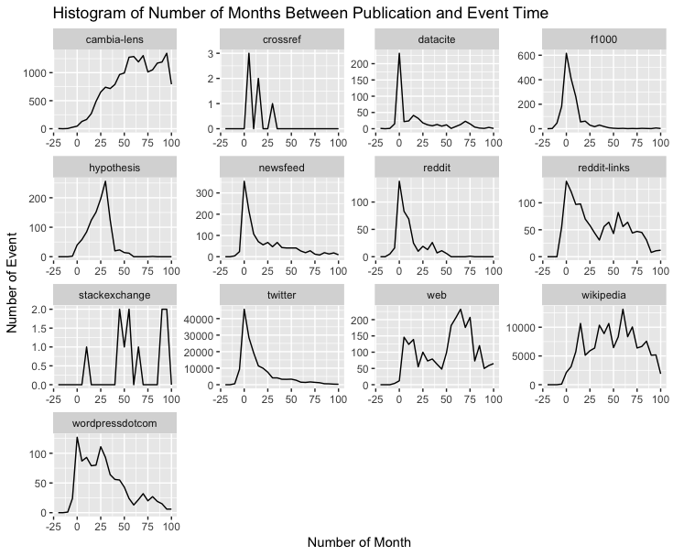
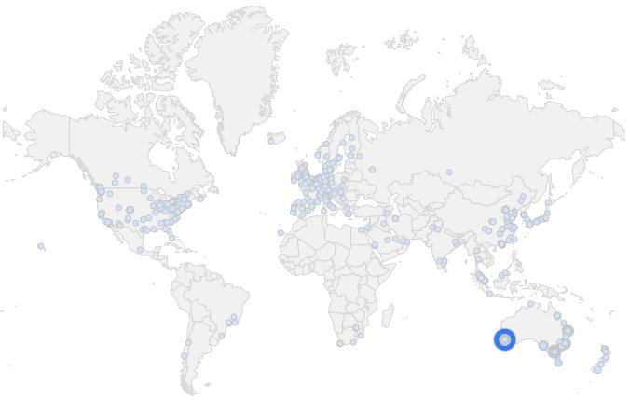
Connections and Collaborations
关联与合作

Slide 18
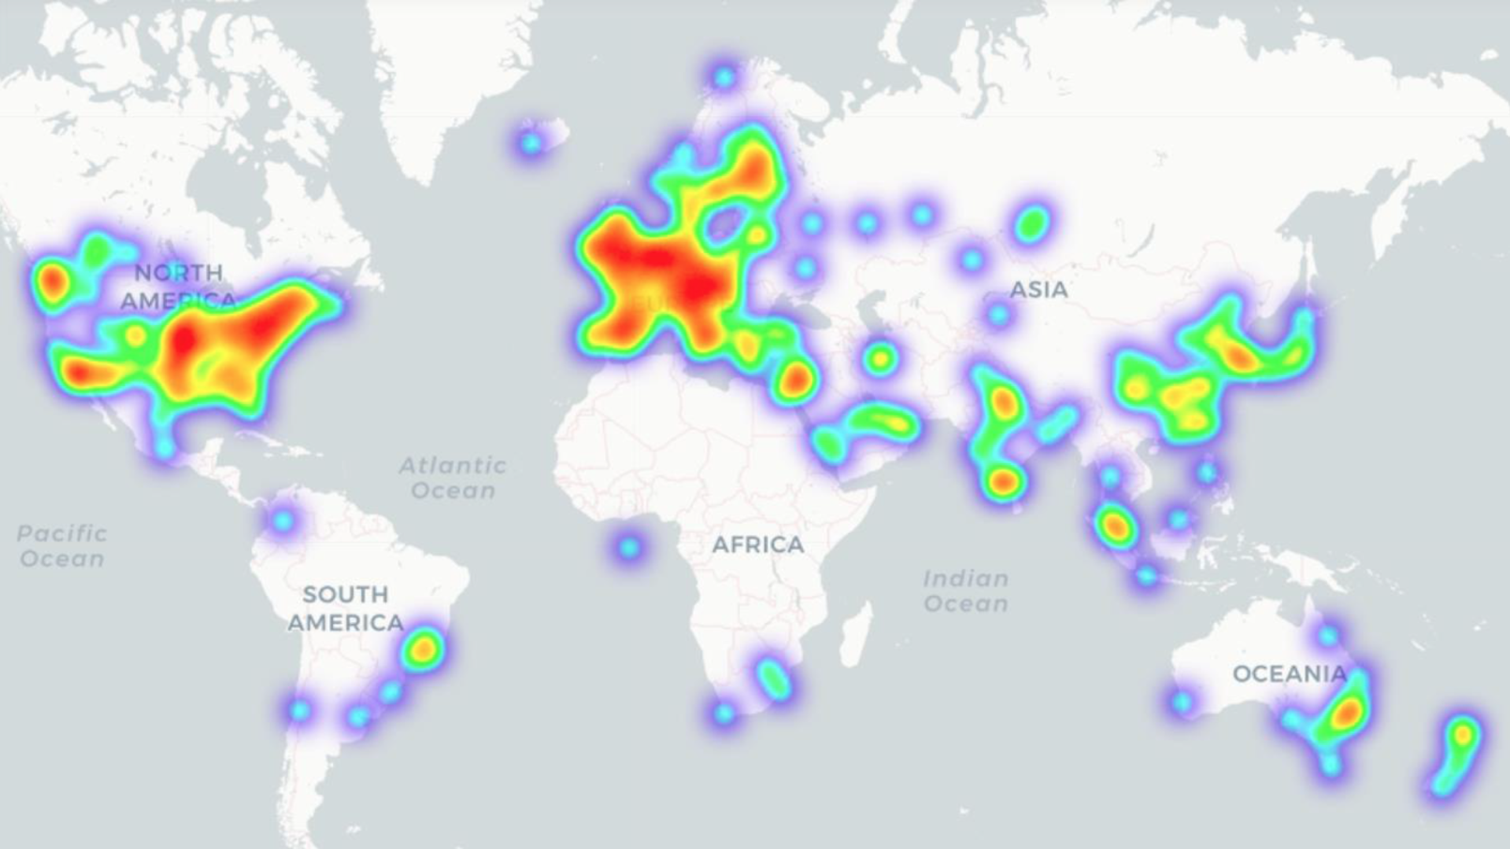
Major Geographical issues主要的地域问题
Taken from Friso Selten’s presentation at COKI workshop in Mauritius August 2019
A Longitudinal Analysis of University Rankings https://arxiv.org/abs/1908.1063

Slide 19
Who gets to make
Knowledge?
谁来制造知识？

Slide 20
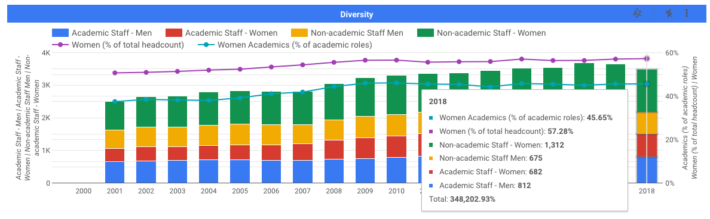
Staffing Diversity – Gender
员工多样性——性别

Slide 21
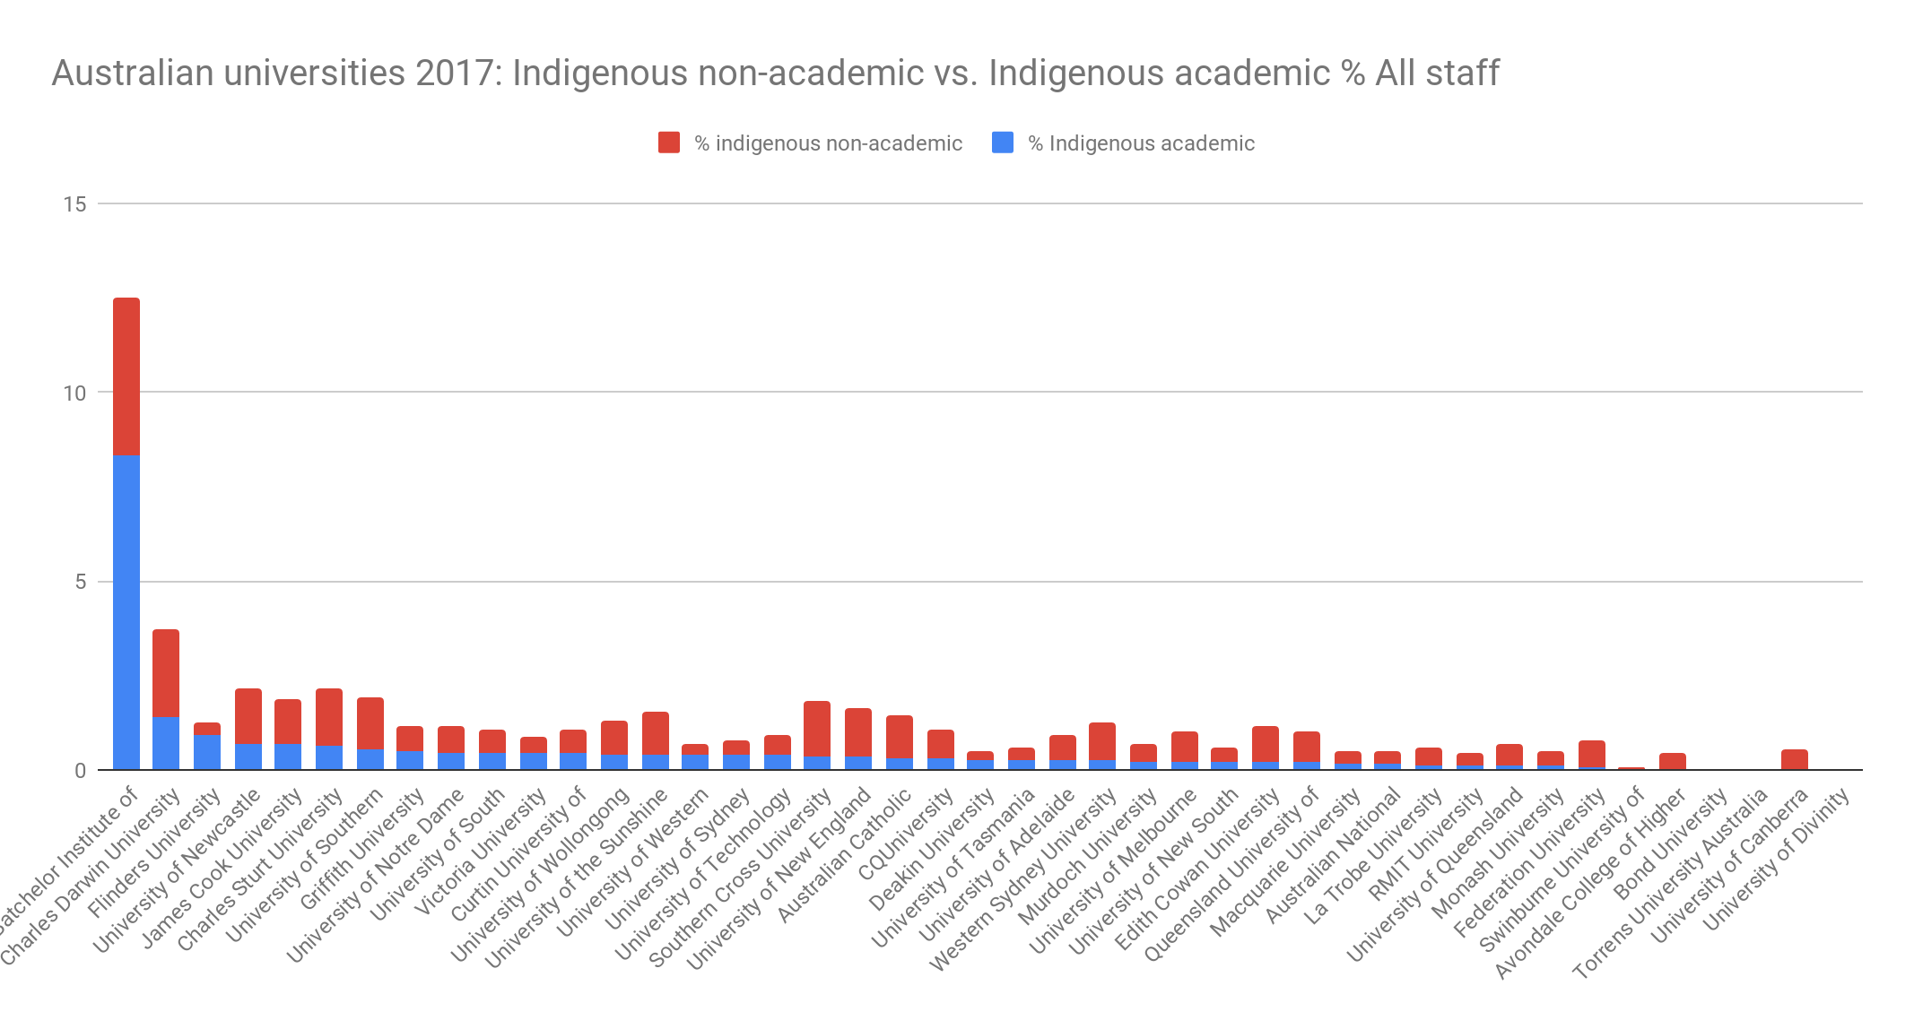
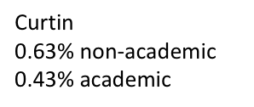
Staffing Diversity – Indigenous staff
员工多样性——本国员工
Batchelor Institute of Indigenous Tertiary Education
4.17% non-academic
8.33% academic
Charles Darwin University
2.35 % non-academic
1.35% academic
University of Sydney
0.4% non-academic
0.38% academic

Slide 22
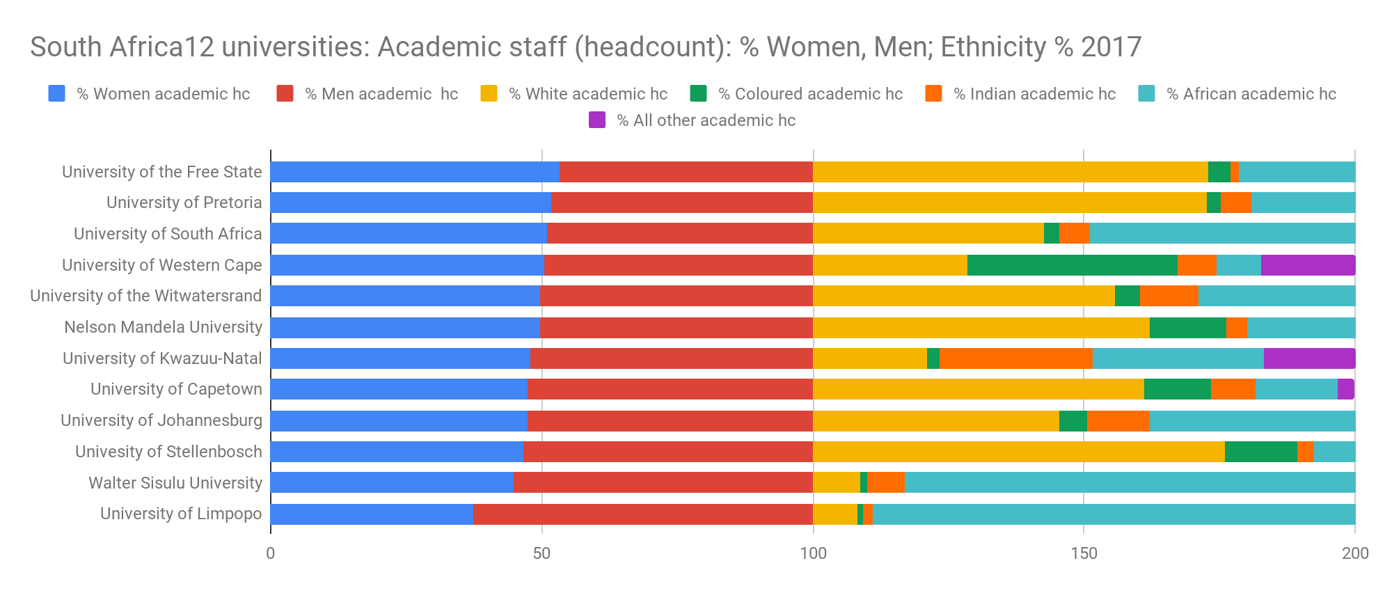
Staffing Diversity – Ethnicity and Gender
员工多样性——种族和性别

Slide 23
The Future of Evaluating Openness
评估开放性的未来

Slide 24
A new paradigm
新的范式
Evaluate
Open Knowledge performance
Analyse
Analyse diversity of gender, race, nationality
Identify
Identify independent metrics of what we do for communities
Ignite
Ignite new conversations about relevance of universities for 21st Century

Slide 25
“COKI” Mauritius Workshop – August 2019
“COKI”毛里求斯工作室——2019年8月
“The OKI/Coalition is a global coalition for collaborative, equitable learning and knowledge creation and sharing, to broaden the impact of HE and research institutions.
The coalition aims to make the world a better, more equitable place by strengthening and facilitating the commitment of institutions to openness in all its aspects. This demands knowledge-sharing and a proactive approach to inclusive participation in research and education”
From left to right Susan Veldsman (Academy of Science of South Africa), Rodrigo Costas (CWTS-Leiden University), Anthony Kiuna (University of Global Health Equity , Rwanda), Patience Atim (Makerere University), Eva Méndez (Universidad Carlos III de Madrid & YERUN & Chair, EU Open Science Policy Platform), Cameron Neylon (Curtin University), Friso Selten (University of Amsterdam), Lina Pelliccione (PVC Curtin Mauritius), Paul Groth (University of Amsterdam), Lucy Montgomery (Curtin University), Richard Hosking (Curtin University), Iryna Kuchma (EIFL), Catriona Macallam (Hindawi Ltd), Stephen Curry (Imperial College & Chair of DORA), Katie Wilson (Curtin University), Muriel E Swijghuisen Reigersberg (The Open University), Richard Bruce Lamptey (Kwame Nkrumah University of Science and Technology), Nicky Agate (Columbia University & HuMetricsHSS), Felix Rop (University of Nairobi), Alkim Ozaygen (Curtin University), Chun-Kai (Karl) Huang (Curtin University). Photo by Sanish Moher. Location: Curtin Mauritius Campus, Moka, Mauritius.

