Slide 1
RDA Europe: the experience of the Italian node
Gina Pavone
CNR/ISTI Open AIRE Noad and RDA node responsible

Slide 2
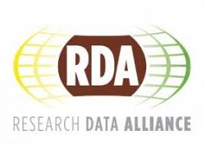


Open Science
Webinar Series
Notes:
One of the objectives established for the RDA national node is to foster collaboration and networking with other local initiatives involved in OS and fostering collaboration and sharing of knowledge

Slide 3
- Collaboration: OpenAIRE NOADs, Italian RDA Node, IOSSG (Italian Open Science Support Group)
- Purpose: networking and coordination with other initiatives, avoid duplication of efforts and dispersion of participants
- The three organisers were introduced at the beginning of each webinar and their services underlined
- In each webinar was presented: RDA and the Italian node, RDA results and WG and IG related to the treated issue
- Structured in a simple and interactive way: 30 min. of presentation and 30 min. of discussion
- Speakers selected within RDA community
Open Science
Webinar Series 2018 and 2019
Notes:
The three organizers ere presented at the beginning of each webinar, and their services well underlined. Besides RDA and the Italian node were presented, as well as the activities od Interest Groups and Working groups related to the treated issue.

Slide 4
> Why webinars?
- reach a larger audience
- no travel or venue costs for participants
- focus on specific aspects
> Main aims:
- introduce the participants to Open Science related topics and RDA specific themes
- provide clear information and practical tools to the users
- engage the community in a simple way
- foster participation and interaction with the users

Slide 5
> Three Series completed
2 in Autumn 2018 total 4 Chapters, 1 hour each:
1.1 Open Science Introduction and OA to Pubblications
2.1 RDM and OA to Data
2.2 FAIR Data and Action Plan
2.3 DMP and Practical Tools
1 in Spring 2019 total 3 Chapters, 1 hour each:
3.1 Legal aspects of research data
3.2 Data stewardship e Research Data Management
3.3 Data Management Plan
Notes:
The webinars were focused on the issue of the national node, that is research data management. at the beginning of the first serie a special chapter was dedicated to a general introduction carried out by OpenaAIRE to the issues of OS, but still introductory to the other chapters

Slide 6
> Results
- Total about 500 participants
- Very interactive
- Materials: Presentations, Q&A Document, Recordings
- Certificates of attendance released
Notes:
The certificate of attendance was much requested. Quite all the participants asked to have their certificate of attendance. Different materials were produces and given to the attendee, that is the presentation

Slide 7
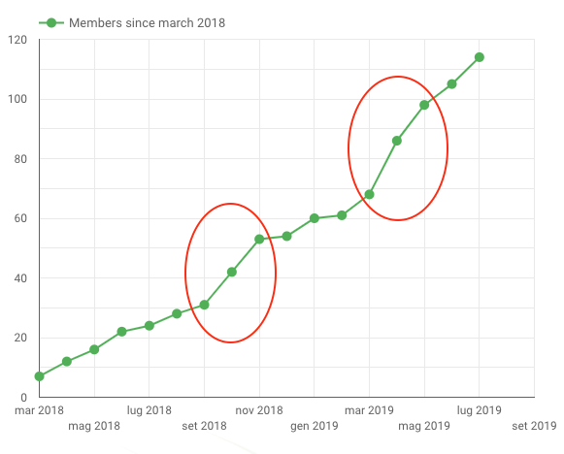
> Italian RDA node members growth
Notes:
The number of node members recorded an evident increase in correspondence of the webinar series, in autum 2018 and in spring 2019.

Slide 8

> Workshop at MIUR
May 23th
National node workshop held at MIUR premices (Italian Ministry of Education, University and Research)
In collaboration with ICDI (Italian Computing and Data Infrastructure), a forum of the main Italian Research Infrastructures and e-infrastructures.
Main aim: introducing RDA and the Italian node
Themes touched upon: legal aspects of research data sharing, data stewardship and data management plan
Experts from RDA community
Notes:
This workshop was part of a wider collaboration with MIUR, that include also the support for drafting a national roadmap for Open Science and the reform of the national law on Open Access.

Slide 9
> Italian Open Science portal
The idea: provide a single national point of access for Open Science issues
First in Italian
Info on RDA and initiatives related to OS
4 user types:
Researcher
Institution
Funder
Repository manager
Notes:
Specific information for every kind of user, and every kind of user will have its section, with specific contents. There will be also external resources, a catalogue with eterogeneous contents

Slide 10
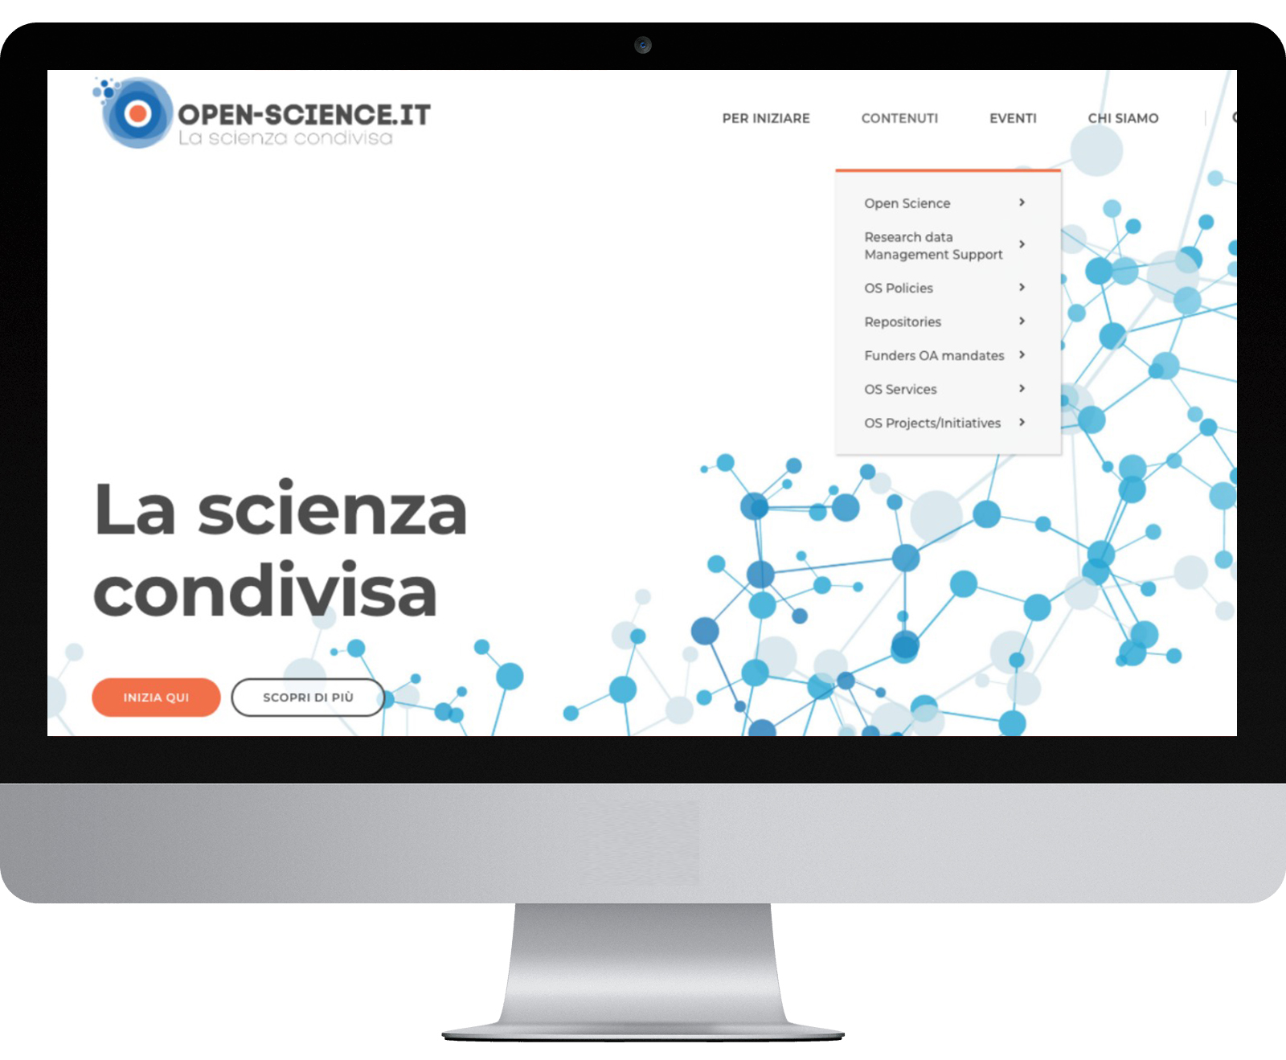

Slide 11
> Thank you
Gina Pavone
gina.pavone@isti.cnr.it

