Slide 1


Making data management practices compliant with Essential Variables frameworks: A practical approach in the marine biological domain
Zilioli M., CNR-IREA, Italy
Oggioni A., CNR-IREA, Italy
Tagliolato P., CNR-IREA, Italy
Fugazza C., CNR-IREA, Italy
Bergami C., CNR-ISMAR, Italy
Pugnetti A., CNR-ISMAR, Italy
Carrara P., CNR-IREA, Itally

Slide 2
Index
Introduction | Historical context and theoretical framework
Methodology | Goals, rationale and phases of the practical approach
Results
Conclusions

Slide 3
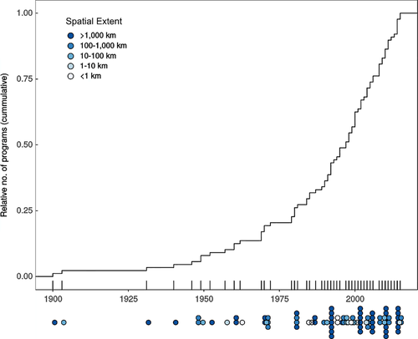
Marine biological observing programs
Miloslavich et al. Global Change Biology, Volume: 24, Issue: 6, Pages: 2416-2433, First published: 05 April 2018, DOI: (10.1111/gcb.14108)
Introduction
Notes:
These efforts started on 2013 grounded to the historical background of biological observing programs.
This is the timeline showing the cumulative number of programs since the early 1900s.
Two remarks:
First: the darker the dot, the larger the spatial scale at which each operates
Increasing number of darker dots started from ‘70
Second: Many of the observation programs started in search for answers to scientific questions wihile in the last decades they were solving societal problems including in the economic and policy sectors

Slide 4
Needs
Coordination
  from local to global level
Maturity
  to fill the gap with the technological development of physical and chemical observing components
  to identify what to measure to give information about the status of the marine ecosystem with respect to societal benefits
  Essential Variables frameworks
Introduction
Notes:
Coordinate the cumulative number of observing systems acting at wider spatial scales

Slide 5



Building a global system for measuring marine biological diversity
EBVs
Muller-Karger described conceptual relationships among the variables of the two frameworks
Benson proposed five key tenets to implement the information flow in a global system which integrates the two frameworks
GEO BON developed the framework of Essential Biodiversity Variables
Marine BON (MBON) was established as thematic group to frame the EBVs concept in marine realm
2013
2014
2015
2016
2017
2018
2019
MBON, GOOS and OBIS set a community of practice where resources and needs for marine biological and biodiversity observations are identified
GOOS entrusted the neo Biology and Ecosystem Panel with the identification of bio-eco Essential Ocean Variables
Miloslavich identified a set of EOVs to focus observing systems and fundings on technologically feasable measurements of biological components
bio-eco EOVs
Introduction

Slide 6
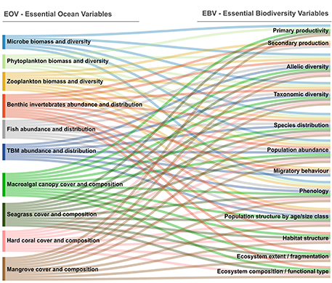
Conceptual relationships between bio-eco EOVs and EBVs
Muller-Karger et al. Frontiers in Marine Science, Volume: 5, Page: 211, First published: 27 June 2018, DOI: (10.3389/fmars.2018.00211)
Introduction
Notes:
ebvs require to describe the taxonomical,spatial,temporal diversity at different organization levels (i.e. the genetic, species and ecosystem)
eovs require complementary data about the ecosystem. Eovs sort organisms around trophic levels thus beingmore informative about the top-down pressures in trophic groups.
The relationships suggest an alternative use of a common set of records collected by any observing system.
Even if this encourage the reuse of data, methodologies and instruments are not yet standardized thus limiting the sharing of data. Much fforts is such sense.

Slide 7
Developing the operational framework
Issues:
  reusability of data records across the two frameworks
  strengthening existing networks and programs through coordination with global initiatives (GOOS-MBON-OBIS Agreement priority)
Rationales:
  EVs are mostly theoretical approaches whose adoption is still uncoupled and often limited in locally-based scientific practice
  The independent development of the two frameworks reached distinct best practices as well as they were approached according to the habits of the communities involved
Introduction
Notes:
To adress these issues, we choose an operational framework grounded on two rationales

Slide 8
A Practical approach
Improving the reusability of measurements through data management
Notes:
Data life ccyle

Slide 9
Method - Phase 1
Literature review
of data management recommendations
of the two frameworks
…
Synoptic comparison Matrix
Methodology
Notes:
In phase 1
Differences
Commonalities
And more mature achievements

Slide 10
Method - Phase 2
Case Study selection
Synoptic comparison Matrix
Literature review
of data management recommendations
of the two frameworks
…
Compliance
Matrix
Methodology
Notes:
P2 is
Aimed at adopting the matrix in a real case study to compare data m practices of Observing system to data management reccomandations

Slide 11
Phase 1
Synoptic comparison of the management recommendations for EVs primary data

Slide 12
Literature review
1
Standardized data collection
2
Addressing global reporting needs
3
4
5
Making data FAIR
Analytical algorithms, tools, and workflows are accessible
Adhering to the Action Ecology principles
Benson’s five key-tenets (2018)
Results

Slide 13
Literature review
1
Standardized data collection
2
Addressing global reporting needs
3
4
5
Making data FAIR
Analytical algorithms, tools, and workflow are accessible
Adhering to the Action Ecology principles
Benson’s five key-tenets (2018)
Results

Slide 14
Phase 1 - Results
5 key-tenets (Benson et al. 2018) | EBVs | Bio-eco EOVs
 | Missing. Open issue: completeness of methodologies documentation | Missing. Open issues: hidden information about methodologies to collect sensitive data
 | CBD, Ramsar CMS, Habitat Directive, Birds Directive, MSFD, WFD (Geijzendorffer et al. 2016) | Different conventions and agreements (Miloslavich et al. 2018)
 | Data standard (e.g. Darwin Core); metadata standard (e.g. EML, ISO19115, ISO 19157); information system (e.g. Global Biodiversity Information Facility); Bari Manifesto (Hardisty et al. 2019) | Data standard (e.g. Darwin Core) metadata standard (e.g. EML); information system (e.g. Ocean Biogeographic Information System); Framework for Ocean Observing (FOO, 2011)
 | Data management and processing workflow (e.g. EBVs data product) (Kissling et al. 2018) | Ocean Data Product (Buck et al. 2019)
Standardized data collection
1
Addressing global reporting needs
2
Making data FAIR
3
Analytical algorithms, tools, and workflow are accessible
4
^{[1]} Convention on Migratory Species of Wild Animals;
^{[2]} Marine Strategy Framework Directive;
^{[3]} Water Framework Directive;
Results

Slide 15
Differences to take into account
EBV reports to seven policy reporting instruments for biodiversity management, not addressed by bio-eco EOV
EBV is more mature for integration and processing of multi-sourced data at global scale
Bio-eco EOV pays significative attention to developing human capacity (e.g. training scientists in underdeveloped/remote countries, promote CS initiatives) to address uneven density of the observations and the costs of monitoring oceans
Results

Slide 16
PHASE 2
Case study selection and evaluation of its compliance with the matrix

Slide 17

Case study requirements
Observing system
Adoption of one of the two frameworks
Biological measurement programs
Open-science initiative
Northern Adriatic Sea (NAS)
ecological observatory
Results
Notes:
assess the compliance of any observing system

Slide 18
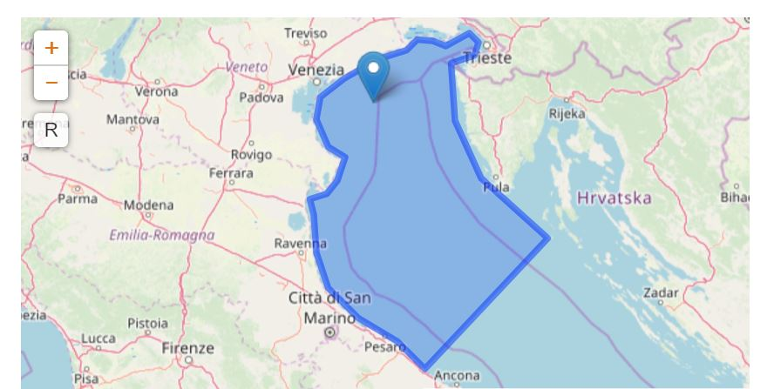
Northern Adriatic Sea (NAS) ecological observatory
Gulf of Venice
Po Delta and Romagna Coast
Senigallia-Susak transect
Gulf of Trieste
Monitoring and experimental area
Long-Term Ecological Research Network sites
Results

Slide 19
Compliance evaluation: operational steps
Identify information sources on the practices of the observing system
Interview the site managers
Fill the matrix with the detected practices
3
2
1
Results

Slide 20

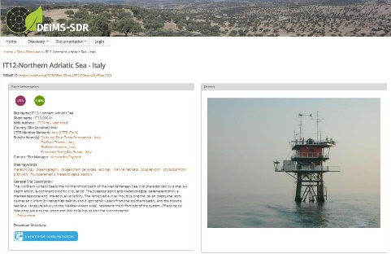
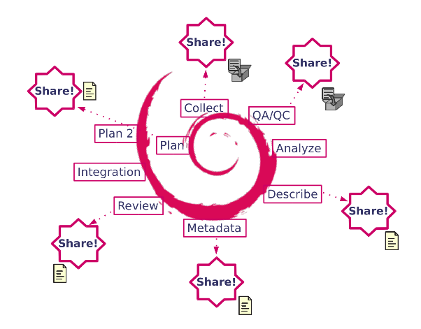
Ongoing activities
DEIMS-SDR Metadata registry
Identify information sources documenting the practices of the observing system
Interviews of site managers
Fill the matrix with the detected practices
3
OUTPUT
Identify the gap among recommendations and practices of the NAS
management plan to fill the gap
strengthening the NAS observing system in contributing to global scale assessment of marine biodiversity
2
1
EcoNAOS project
Results

Slide 21
Conclusions
To overcome the reusability issue between the EBV and bio-eco EOV frameworks, we propose a practical approach that generates a comparison matrix to evaluate the practices of an observing system
We have selected NAS as case study: by applying the approach we are going to improve its data management and reach accordance with global initiatives
Conclusions
Notes:
Reduce the gap between the research activities of NAS and global initiative

Slide 22
QUESTIONS AND SUGGESTIONS

Slide 23
References
Lindstrom, E., Gunn, J., Fischer, A., McCurdy, A., and Glover, L. K. 2012. A Framework for Ocean Observing. By the Task Team for an Integrated Framework
Miloslavich, P, et al. Challenges for global ocean observation: the need for increased human capacity, 2018, Journal of Operational Oceanography
European Marine Board, Strengthening Europe’s Capability in Biological Ocean Observations, 2018, Future Science Brief 3
Benson, A, et al. Integrated Observations and Informatics Improve Understanding of Changing Marine Ecosystems, 2018, Frontiers in Marine Science, 5:428.
Muller-Karger, FE, et al. Advancing Marine Biological Observations and Data Requirements of the Complementary Essential Ocean Variables (EOVs) and Essential Biodiversity Variables (EBVs) Frameworks, 2018, Frontiers in Marine Science 5: 211.
Canonico, G, et al. Global Observational Needs and Resources for Marine Biodiversity, 2019, Frontiers in Marine Science, 6:367.
Minelli et al. The project EcoNAOS: vision and practice towards an open approach in the Northen Adriatic Sea ecological observatory, 2018, Research Ideas and Outcomes 4: e24224.
Acri Francesco, Bastianini Mauro, Bernardi Aubry Fabrizio, Camatti Elisa, Bergami Caterina, Boldrin Alfredo, De Lazzari Amelia, Finotto Stefano, Minelli Annalisa, Oggioni Alessandro, Pansera Marco, Sarretta Alessandro, Socal Giorgio, Pugnetti Alessandra. 2019. LTER Northern Adriatic Sea (Italy) marine data from 1965 to 2015. 10.5281/zenodo.3266245.
Zilioli, M, et al. Feeding Essential Biodiversity Variables (EBVs): actual and potential contributions from LTER-Italy, 2019, Nature Conservation 34: 477–503.

