Slide 1
Ergonomics in Schools
Student-Furniture Mismatch
Nastja Podrekar
nastja.podrekar@innorenew.eu
Kaja Kastelic
kaja.kastelic@s2p.si
dr. Nejc Šarabon
nejc.sarabon@fvz.upr.si
Portorož, 20.09.2019

Slide 2

Content
Introduction: school furniture as a risk factor for musculoskeletal symptoms among students
Methods: study design and mismatch calculation
Results: student-furniture mismatch in Slovenian high school
Discussion: comparison with the existing studies
What’s next
Nastja Podrekar– Student-furniture mismatch

Slide 3
Introduction Methods Results Discussion
Musculoskeletal disorders & risk factors
Internal factors
Age (Kristjansdottir & Rhee, 2002)
Gender (Auvinen idr., 2007)
Genetics (MacDonald, Stuart, in Rodenberg, 2017)
…
External factors
Lifestyle (Hafeez idr., 2013)
School bag (Akbar idr., 2019)
School furniture (Murphy, Buckle, in Stubbs, 2007)
…
Rapid growth of adolescents
Large differences in anthropometry
Standard school furniture
Student-furniture mismatch
Increased risk of musculoskeletal symptoms
Nastja Podrekar– Student-furniture mismatch

Slide 4
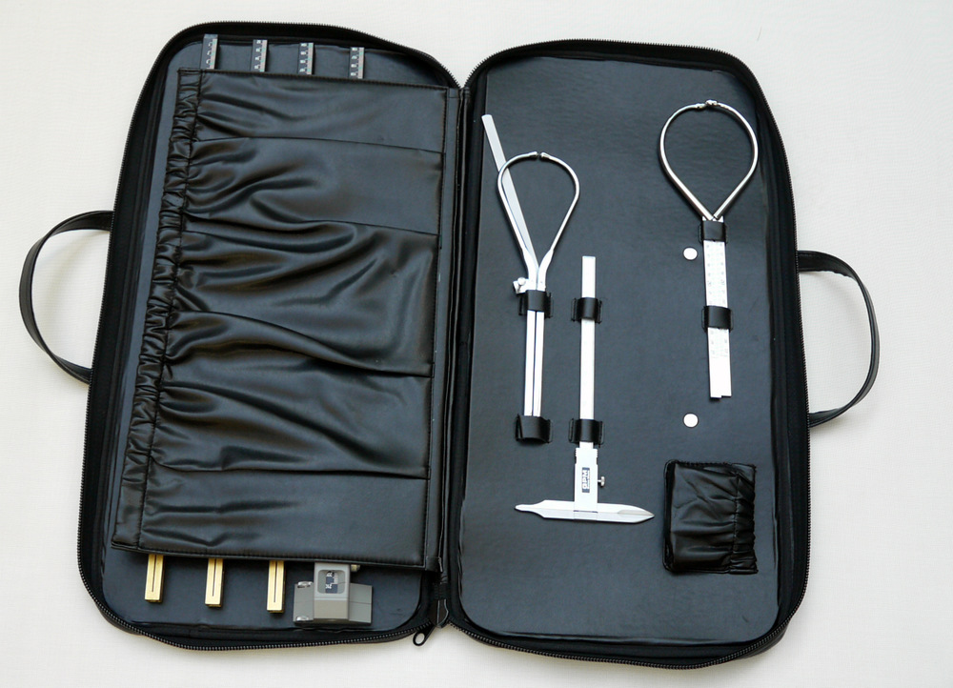
Introduction Methods Results Discussion
Aim: to evaluate student-furniture mismatch in Slovenian high school
Cross-sectional study design
Collaboration with Škofja Loka carpentry high school
Mismatch equations used were proposed by Castelluci et al. 2014
upper edge of backrest
shoulder height sitting
subscapular height
thigh thickness
elbow height sitting
seat width
seat depth
underneath desk height
desk heigth
seat to desk clearance
popliteal height
hip width
seat height
buttock-popliteal length
Nastja Podrekar– Student-furniture mismatch

Slide 5
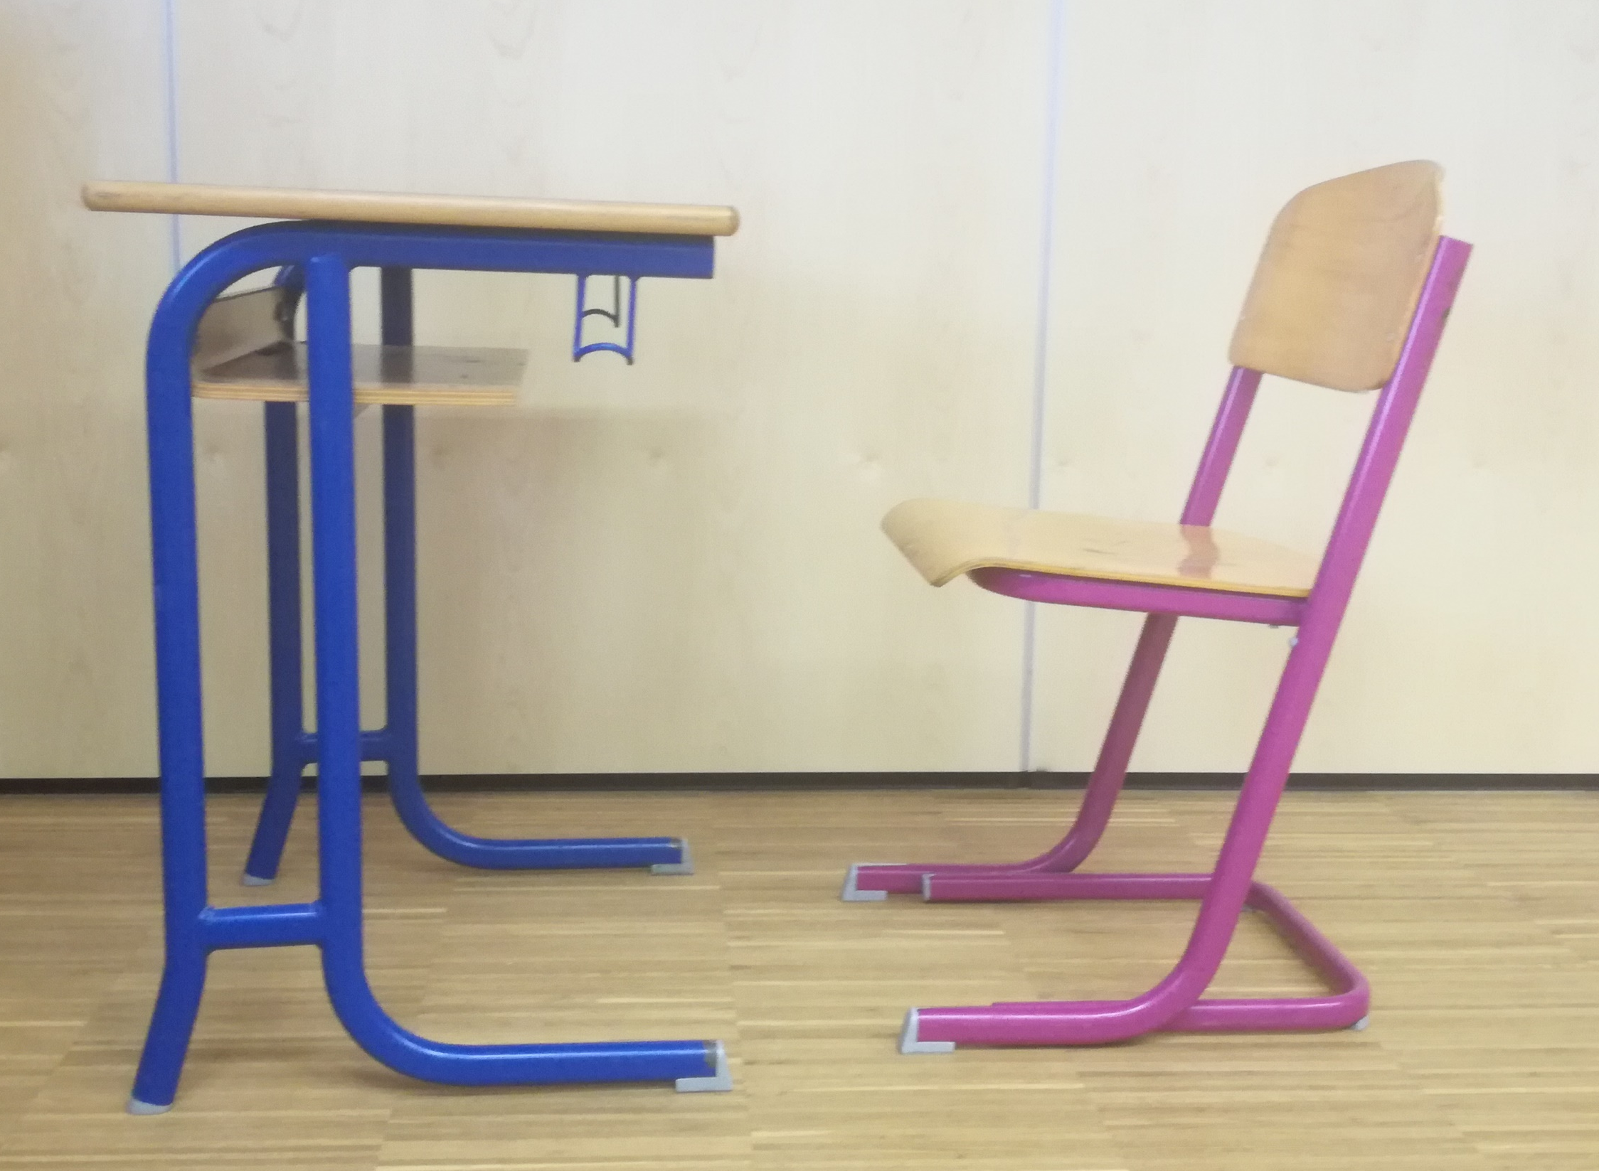
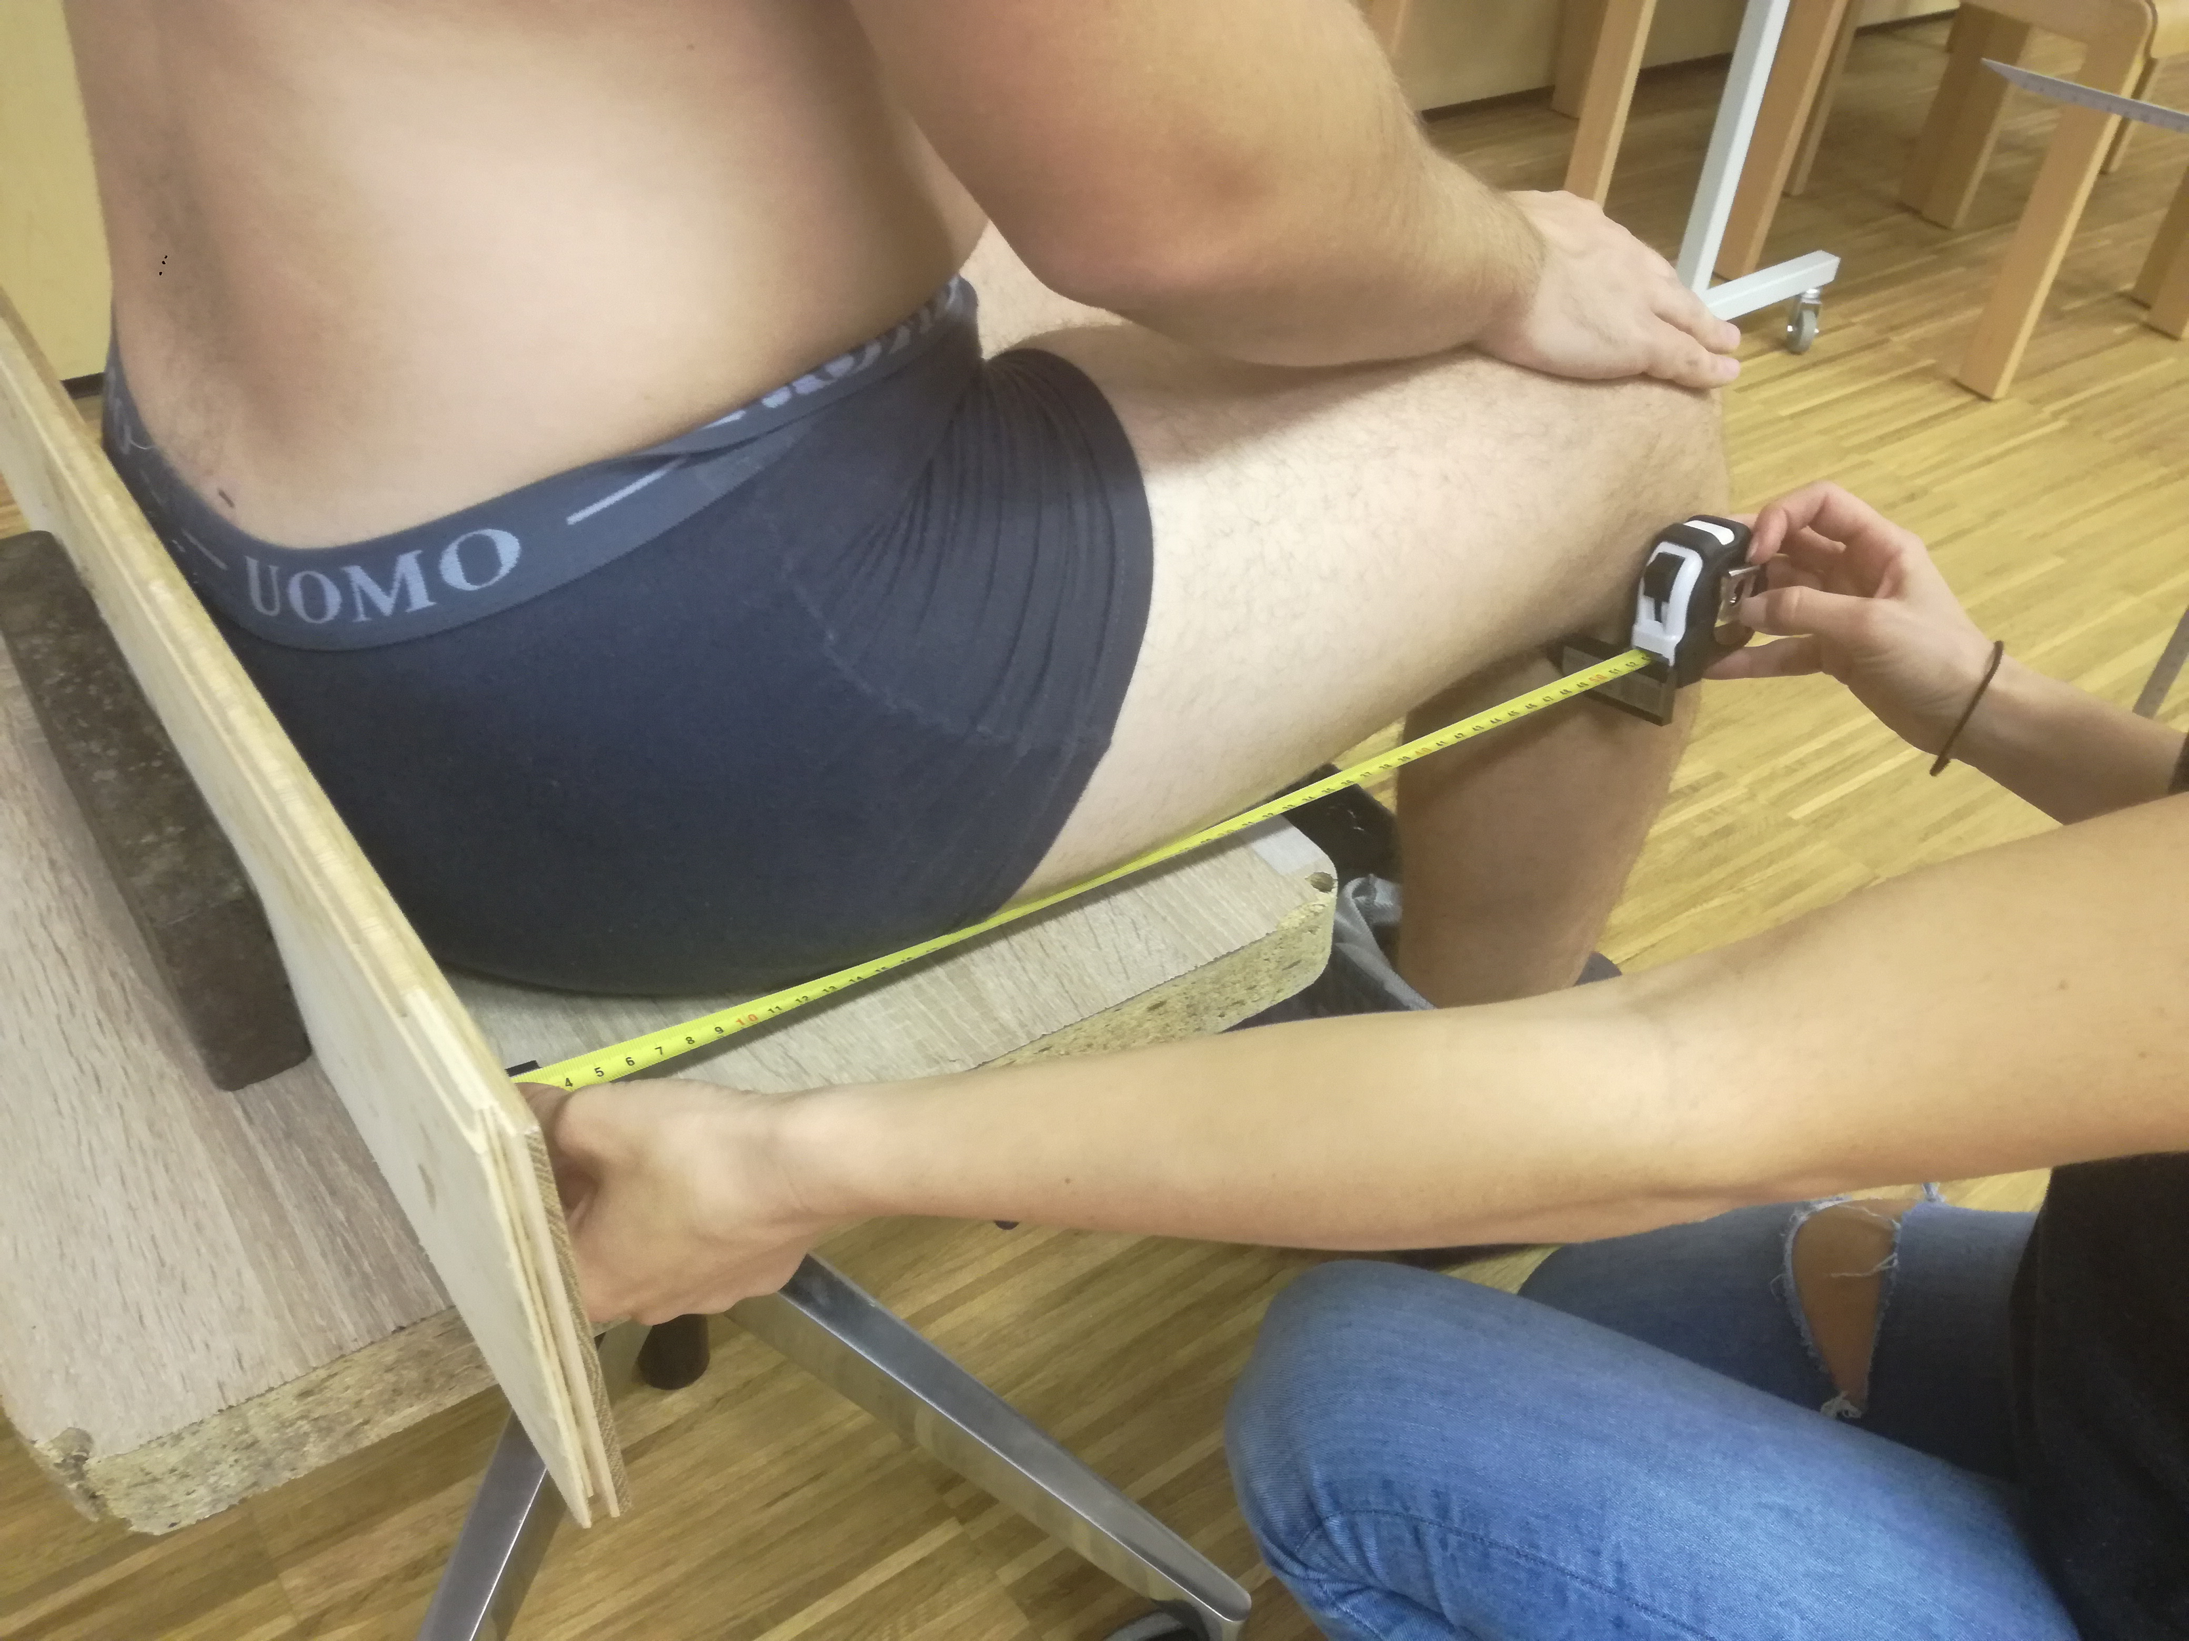
Introduction Methods Results Discussion
A total of 139 students from carpentry high school, aged 16.6 ± 1.4
Furniture | Mismatch (n, %)
Upper edge of backrest | 4 (2.88 %)
Seat height | 35 (25.18 %)
Seat depth | 54 (38.85 %)
Seat Width | 57 (41.01 %)
Desk height | 41 (29.50 %)
Seat to desk clearance | 136 (97.84 %)
Nastja Podrekar– Student-furniture mismatch

Slide 6
Introduction Methods Results Discussion
Furniture deviation (cm)
Desk too low | 1.21 cm
Desk too high | 1.36 cm
Too little legroom under the table | 3.51 cm
Seat too low | 0.04 cm
Seat to high | 1.59 cm
Seat too narrow | 3.18 cm
Seat too deep | 1.31 cm
Seat not deep enough | 0.77 cm
Upper edge of backrest too low | 1.16 cm
Nastja Podrekar– Student-furniture mismatch

Slide 7
Introduction Methods Results Discussion
The high mismatch between the furniture and students’ anthropometry indicates that there is a need to ergonomically redesign school furniture in Slovenian high schools
The data obtained could be considered when designing new school furniture in Slovenia.
Results are comparable with existing studies (Agha et al., 2010; Batistao et al., 2012; Bahrampour et al., 2013; Assiri et al., 2019)
However, school furniture is only one among many factors in the multifactorial field of the health of school children.
Nastja Podrekar– Student-furniture mismatch

Slide 8
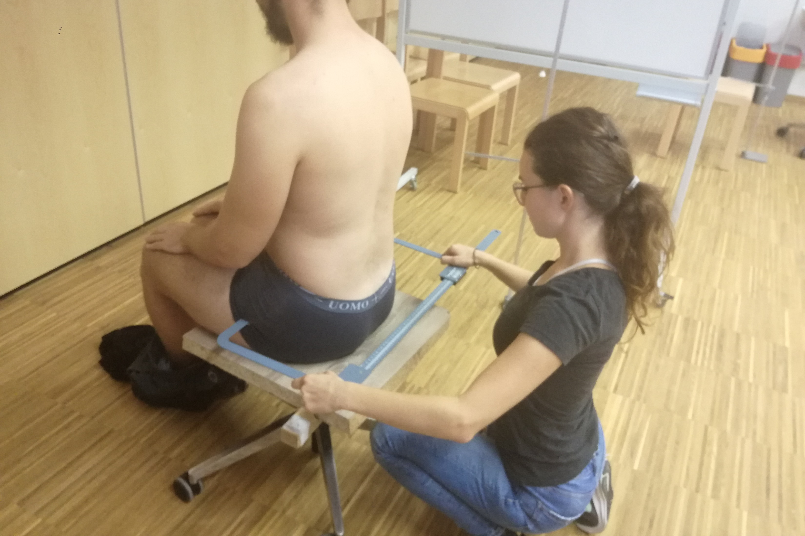
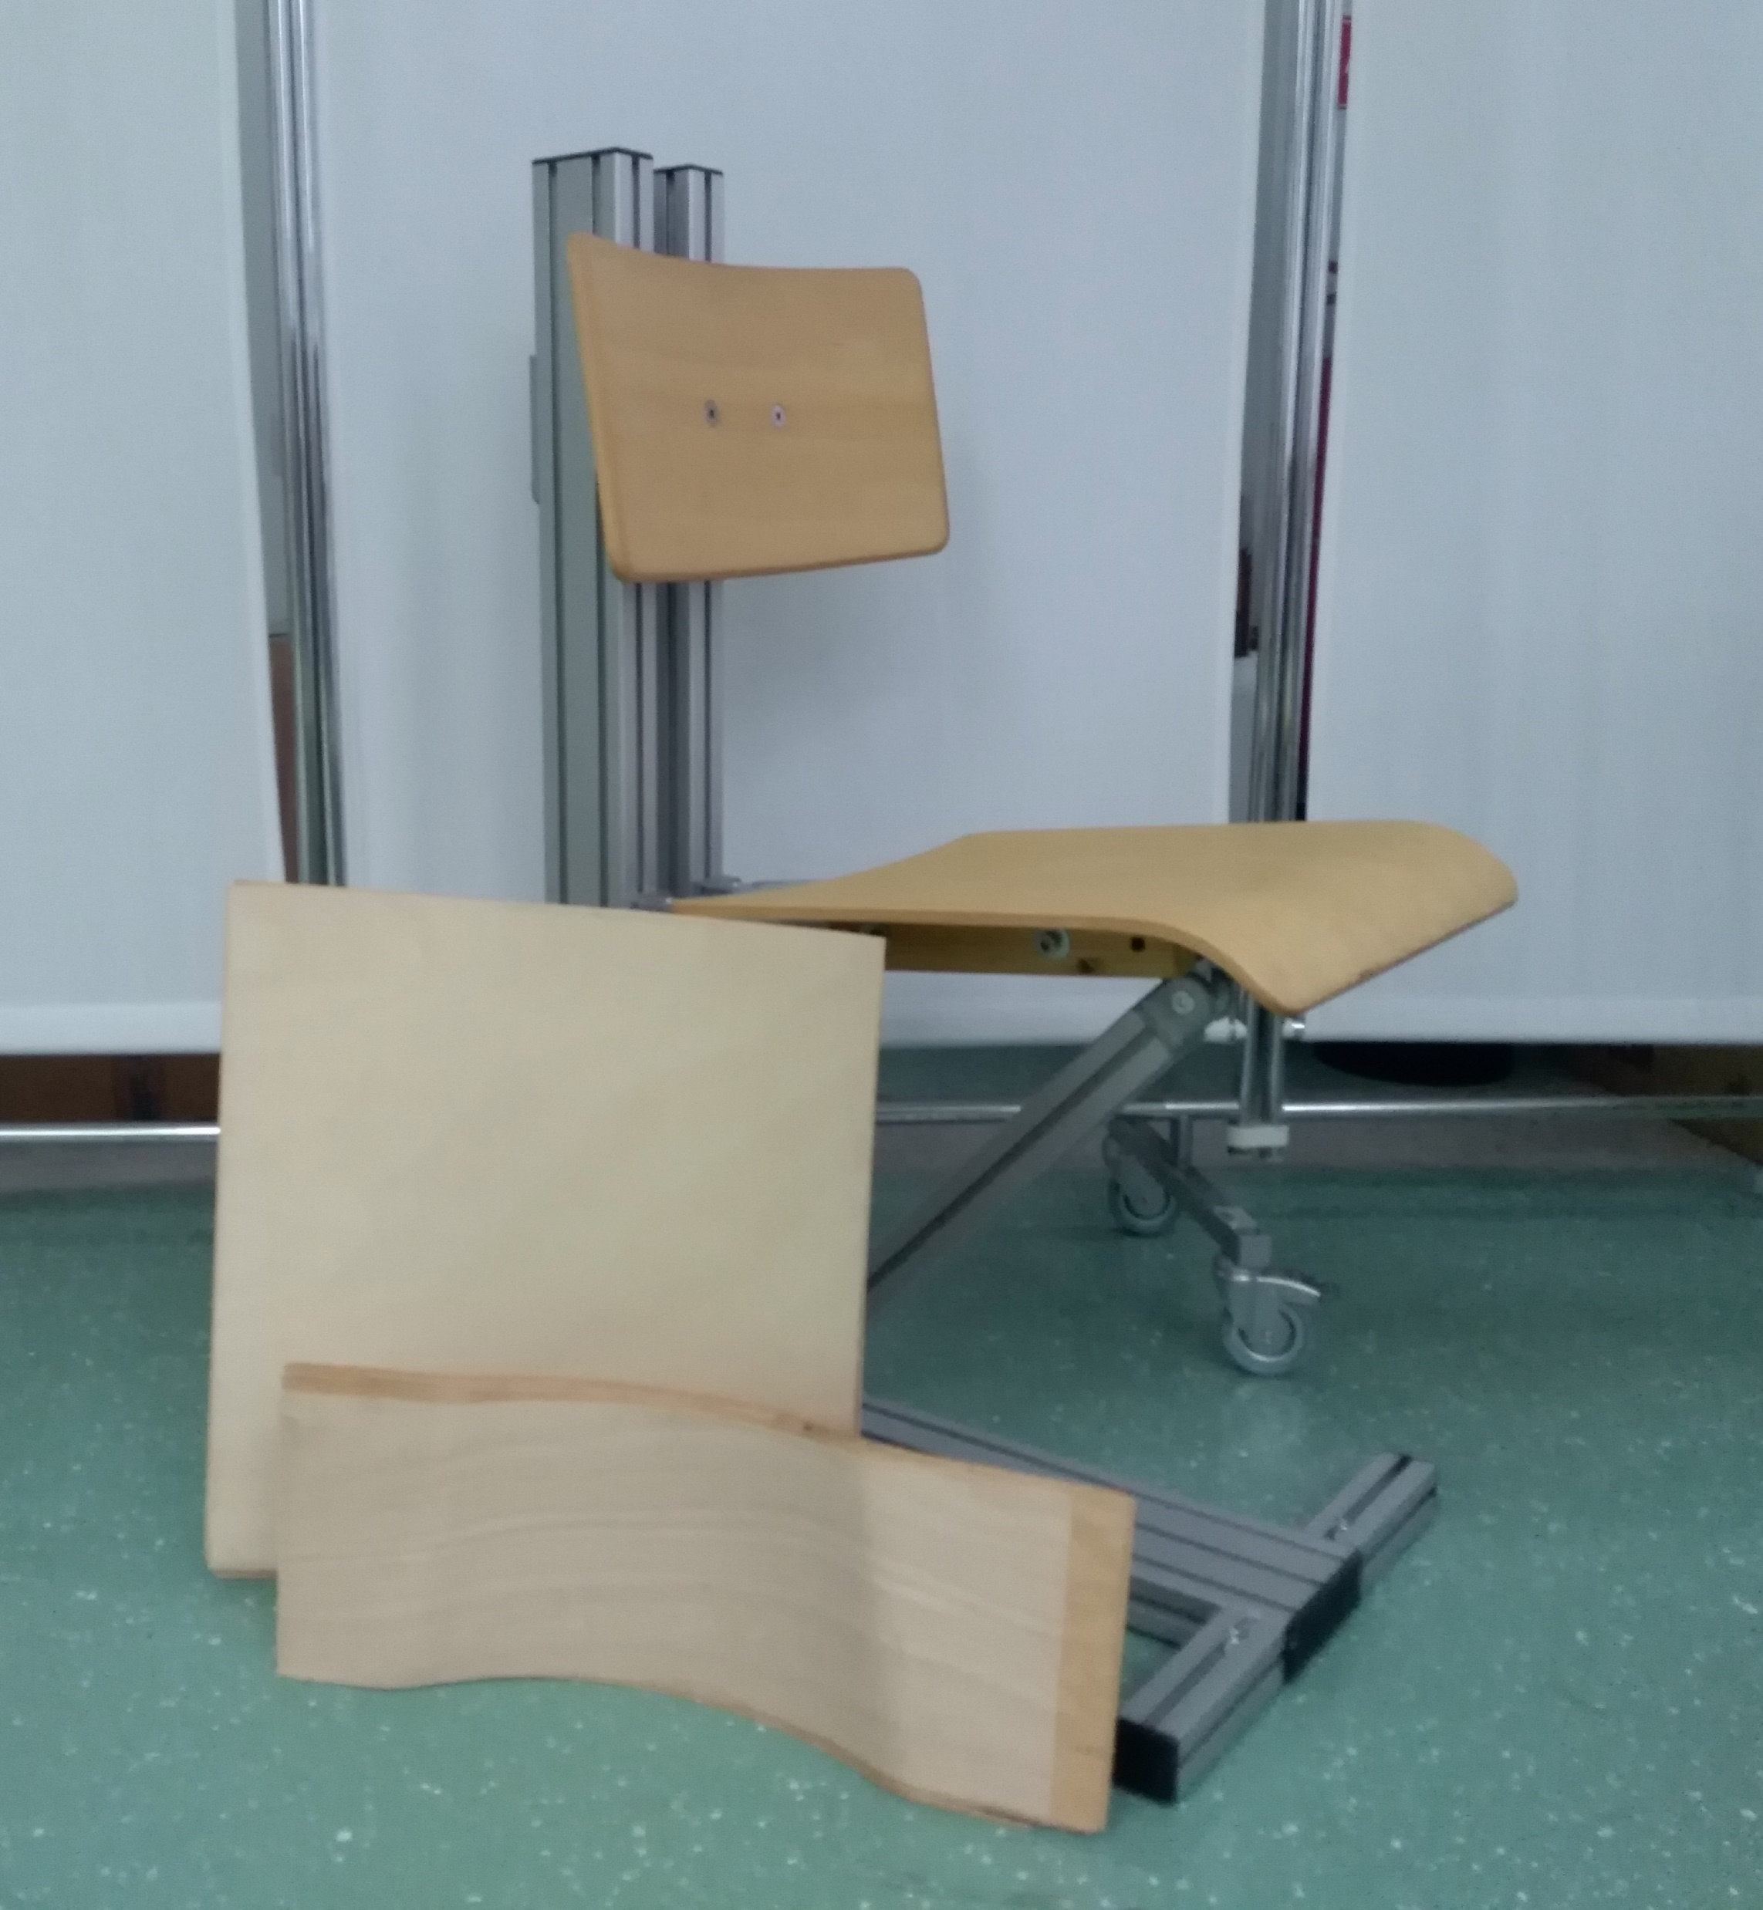
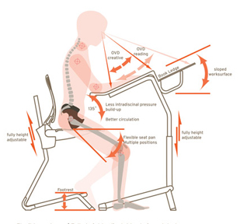
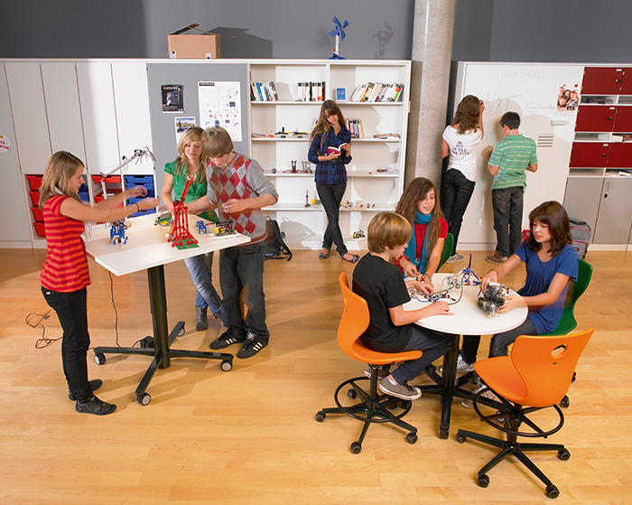
What’s next
CROSS-SECTION
  Student-furniture mismatch:
    Primary school
    High school
    University
LABORATORY TESTING
  Determining the ergonomic parameters of school chair and desk
    Seat pan and backrest inclination
    Desk inclination
    Standing desk
INTERVENTION
  Introducing ergonomic/adjustable school furniture into school environment
    Effect on musculoskeletal disorders
    Effects on well-being
    Effects on sitting time
    …
correlation with musculoskeletal symptoms …
Nastja Podrekar– Student-furniture mismatch

Slide 9
Thank you for your attention
Nastja Podrekar
nastja.podrekar@innorenew.eu
Portorož, 20.09.2019
  The authors gratefully acknowledge the European Commission for funding the InnoRenew CoE project (Grant Agreement #739574) under the Horizon2020 Widespread-Teaming program and the Republic of Slovenia (Investment funding of the Republic of Slovenia and the European Union of the European regional Development Fund).

Slide 10
References
Agha, S. R. (2010). School furniture match to students’ anthropometry in the Gaza Strip. Ergonomics, 53(3), 344–54. https://doi.org/10.1080/00140130903398366
Akbar, F., AlBesharah, M., Al-Baghli, J., Bulbul, F., Mohammad, D., Qadoura, B. in Al-Taiar, A. (2019). Prevalence of low Back pain among adolescents in relation to the weight of school bags. BMC Musculoskeletal Disorders, 20(1), 37. https://doi.org/10.1186/s12891-019-2398-2
Assiri, A., Mahfouz, A., Awadalla, N., Abouelyazid, A., Shalaby, M., Abogamal, A., … Riaz, F. (2019). Classroom Furniture Mismatch and Back Pain Among Adolescent School-Children in Abha City, Southwestern Saudi Arabia. International Journal of Environmental Research and Public Health, 16(8), 1395. https://doi.org/10.3390/ijerph16081395
Auvinen, J., Tammelin, T., Taimela, S., Zitting, P. in Karppinen, J. (2007). Associations of physical activity and inactivity with low back pain in adolescents. Scandinavian Journal of Medicine & Science in Sports, 18(2), 188–194. https://doi.org/10.1111/j.1600-0838.2007.00672.x
Baharampour, S., Nazari, J., Dianat, I. in Asgharijafarabadi, M. (2013). Student’s Body Dimensions in Relation to Classroom Furniture. Health promotion perspectives, 3(2), 165–74. https://doi.org/10.5681/hpp.2013.020
Batistão, M. V., Sentanin, A. C., Moriguchi, C. S., Hansson, G.-Å., Coury, H. J. C. G. in de Oliveira Sato, T. (2012). Furniture dimensions and postural overload for schoolchildren’s head, upper back and upper limbs. Work (Reading, Mass.), 41 Suppl 1, 4817–24. https://doi.org/10.3233/WOR-2012-0770-4817
Castellucci, H. I., Arezes, P. M. in Molenbroek, J. F. M. (2014). Applying different equations to evaluate the level of mismatch between students and school furniture. Applied Ergonomics, 45(4), 1123–1132. https://doi.org/10.1016/j.apergo.2014.01.012
Hafeez, K., Ahmed Memon, A., Jawaid, M., Usman, S., Usman, S. in Haroon, S. (2013). Back Pain - Are Health Care Undergraduates At Risk? Iranian journal of public health, 42(8), 819–25. Pridobljeno s http://www.ncbi.nlm.nih.gov/pubmed/26056635
Kristjansdottir, G. in Rhee, H. (2002). Risk factors of back pain frequency in schoolchildren: a search for explanations to a public health problem. Acta paediatrica (Oslo, Norway : 1992), 91(7), 849–54. Pridobljeno s http://www.ncbi.nlm.nih.gov/pubmed/12200915
MacDonald, J., Stuart, E. in Rodenberg, R. (2017). Musculoskeletal Low Back Pain in School-aged Children. JAMA Pediatrics, 171(3), 280. https://doi.org/10.1001/jamapediatrics.2016.3334
Murphy, S., Buckle, P. in Stubbs, D. (2007). A cross-sectional study of self-reported back and neck pain among English schoolchildren and associated physical and psychological risk factors. Applied Ergonomics, 38(6), 797–804. https://doi.org/10.1016/j.apergo.2006.09.003
Nastja Podrekar– Student-furniture mismatch

