Slide 1
FAIR4S
FAIR skills and role templates for data stewardship
Angus Whyte
Open Science Fair
Porto, September 18 2019

Slide 2
Outline
FAIR4S will help us describe practices and skills in FAIRsFAIR competence centre
About FAIRsFAIR – objectives and activities
Developed in EOSCpilot, FAIR4S offers any research producing organisation a set of competences and profiles of FAIR data stewardship skills and roles
Introduce those roles and competences
Questions the profiles help organisations to answer
Give you an example - Data Steward

Slide 3
FAIRsFAIR - Fostering Fair Data Practices in Europe
Key facts
Starting date: March 1, 2019
Duration: 36 months
22 partners from 8 Member States (MS)
6 core partners: DANS (project coordinator), CSC, DCC, TrustIT, STFC, EUA

Slide 4

FAIRsFAIR objectives
Supply practical solutions for the use of the FAIR data principles throughout the research data life cycle -fostering FAIR data culture and the uptake of good practices in making data FAIR
Provide a platform for using and implementing the FAIR principles in the day to day work of European research data providers and repositories.
Deliver FAIR-related aspects of the Rules of Participation (RoP) and regulatory
compliance for participation in
the European Open Science Cloud.

Slide 7
What practices need support?

Slide 8
What practices need support?
What skills need enhanced?

Slide 9

Back to one year ago
EOSCpilot developed FAIR4S competence framework
Stewardship Skills for Science, Scholarship
“Skills to make data FAIR, keep it FAIR”
Synthesising frameworks for data science, open science, data management, data literacy

Slide 10
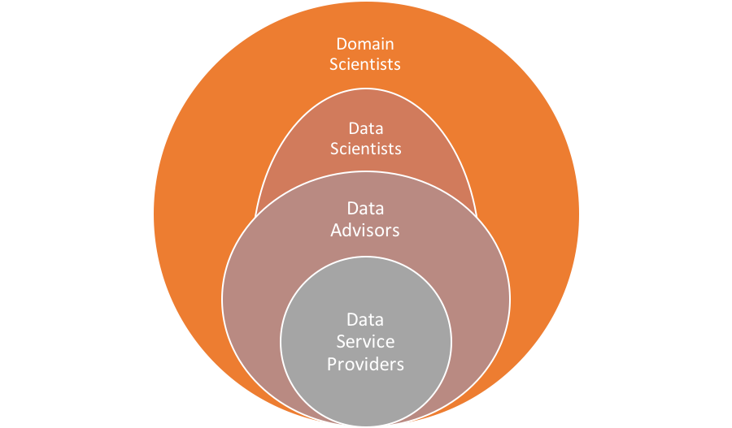
Roles
Stewardship as shared responsibility
PIs - domain researchers and data scientists
Connecting Data Stewards to other advisory and service roles

Slide 11
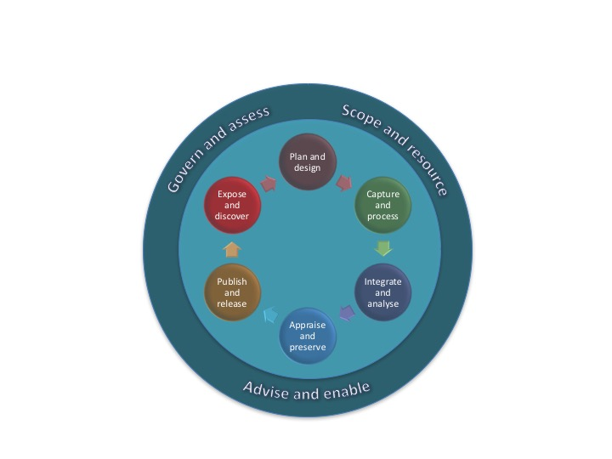
Competences
Stewardship skills to support data
Across project lifecycle
And to deliver organisational capabilities for sustaining FAIR
59 competences in 9 groups

Slide 12
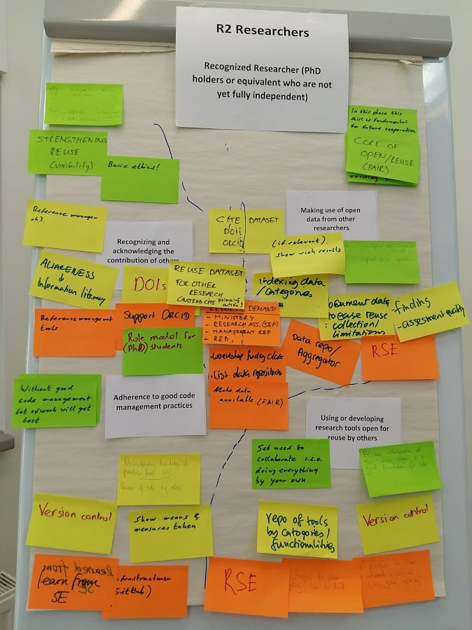
Role profiles: templates for organisations to define answers to questions, to help their groups define and link relevant support roles
Which skills are key and why?
For each skill, what level of expertise?
Which other roles should offer expert support?
Where can you learn about this skill?
See ‘Time for open science skills to count”
https://openworking.wordpress.com/2018/12/03/its-time-for-open-science-skills-to-count-in-academic-careers-part-1-talks/

Slide 13
FAIR4S relates 10 ‘key skills’ to roles, including researchers
Group | Competence topics – each comprising skill, knowledge, attitude | First stage researcher | Recognized researcher
Plan and Design | Plan for the stewardship and sharing of FAIR outputs | ✮
Capture and Process | Reuse data from existing sources |  | ✮
Integrate and Analyse | Use or develop open research tools or services |  | ✮
Appraise and Preserve | Prepare and document data/code to make research outputs FAIR |  | ✮
Publish and Release | Publish FAIR outputs on recommended repositories
Expose and Discover | Recognise, cite and acknowledge contributions | ✮ | ✮
Govern and Assess | Apply policies to comply legal requirements, ethical, FAIR principles | ✮
Govern and Assess | Develop open research strategy and vision
Scope and Resource | Secure funding for open science and support services | ✮
Advise and Enable | Lead good practice by example

Slide 14
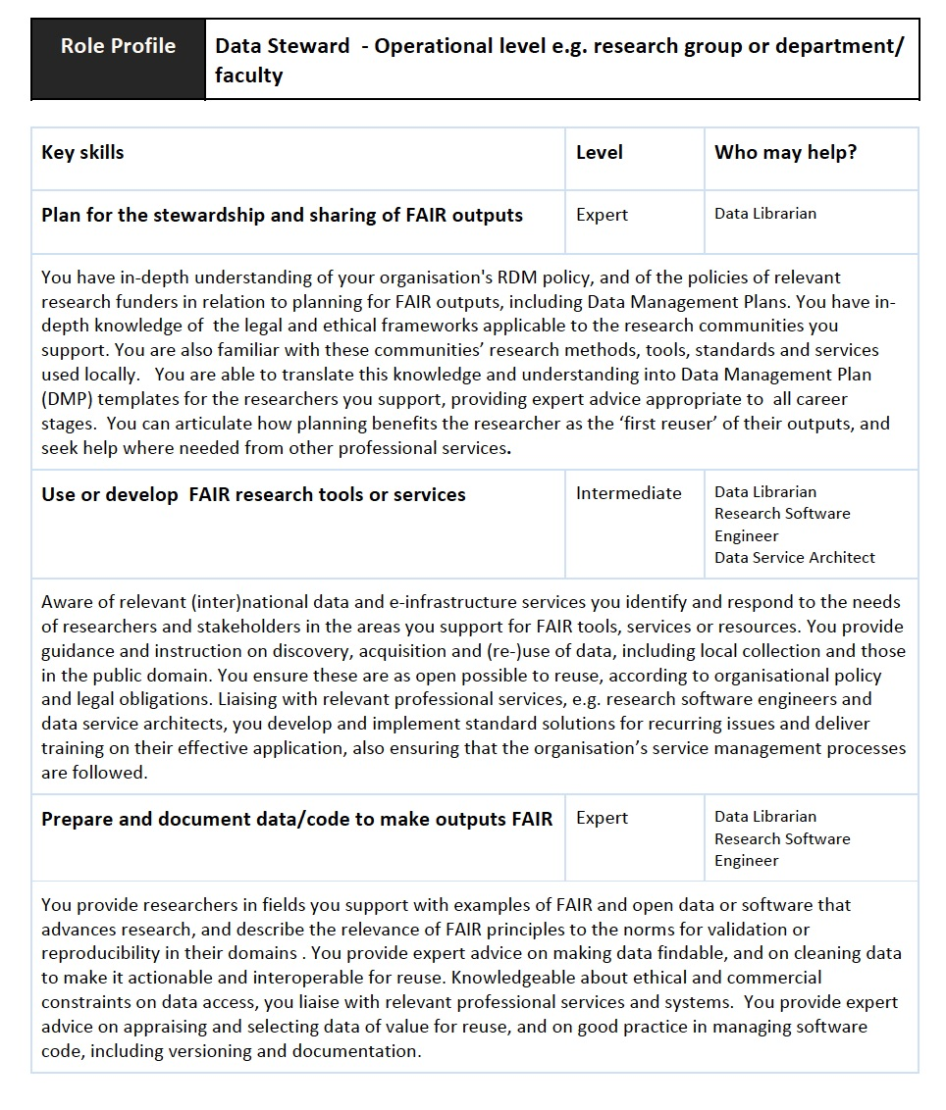
Role profiles: e.g. Data Steward
Proposed boilerplate text for organisations to adapt.
Links to online learning resources
See ‘EOSCpilot D7.5 Strategy for sustainable development of skills and capabilities’
https://eoscpilot.eu/content/d75-strategy-sustainable-development-skills-and-capabilities

Slide 15
Back to the future
Input to FAIRsFAIR competence framework for both professional development and university curricula
Competence centre will tag learning resources on FAIR skills - applying terms4FAIRskills
Landscape surveys on community needs – until Sept 27

Slide 16


FAIR data policy and practice survey http://bit.ly/FAIRdos a.whyte@ed.ac.uk
FAIRsFAIR_EU
In/fairsfair
info@fairsfair.eu

