Slide 1


The Importance of Expression Production and Presentation on Authenticity Discrimination
Mircea ZLOTEANU
Mircea Zloteanu¹, Eva Krumhuber², Daniel C. Richardson²
¹Teesside University, ²University College London

Slide 2
Genuine and “Posed” Expressions
Non-verbal behaviour
  How are non-genuine emotional displays perceived?
  How convincing are posed emotional expression?
  What factors influence these judgments?
People are very good at classifying emotional facial expressions (Ekman, 2003).
But, deception research has shown that people are bad at detecting liars or truth-tellers based on their emotions (DePaulo, et al., 2003)
Additionally, little is know about how well people determine if an emotion is “posed” or real (e.g. Krumhuber, Likowski, & Weyers, 2014)
Can people identify real from fake emotions?

Slide 3
“Posed” Expression/s?
Non-verbal behaviour
  Many studies claim that there are differences in emotional perception between “genuine” and “posed” expressions.
  However, many rely on specific claims about facial expressions and underlying affect (i.e. the emotion)
  Few are designed to make directional claims.
  Namely, having only 2 categories in the stimuli is not informative – nor does it reflect reality
    How we operationalize expressions matter! (as we will see shortly)

Slide 4
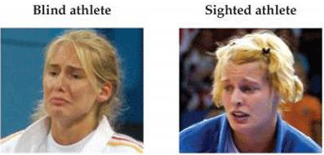
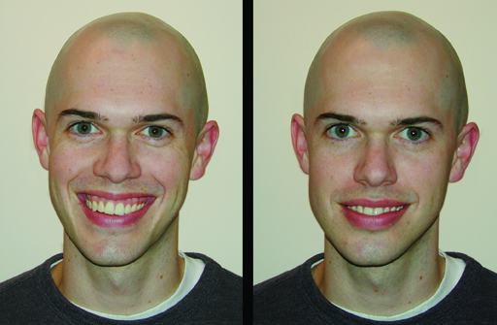
Behavioural Differences?
Reliable Behaviour?
Non-verbal behaviour
Comparison of Blind and Sighted athletes who just lost a match for a medal
Non-Duchenne Smile
Duchenne Smile
HOWEVER:
Studies finding no such reliable muscles (e.g., Krumhuber & Manstead, 2009)
Research finding that authenticity discrimination is poor (e.g., Hess & Kleck, 1994)
Notes:
Overreliance on pre-selected stimuli based on such criteria

Slide 5
Term confusion ???
Non-verbal behaviour
  Posed
  Deliberate
  Fakes
  Deceptive
  Voluntary
  Non-genuine
Notes:
Naming is less important
What matters is how we treat the procedures used to elicit the expressions

Slide 6
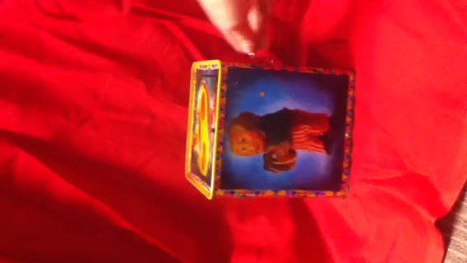



Deceptive Emotions
STUDY 1: Deceptive Emotions
Can individuals detect genuine from deceptive emotional cues (i.e. authenticity discrimination)?
Can senders produce genuine-looking expressions which can ‘fool’ decoders?
Notes:
Not all signals are honest.
Decoders are not just bad at integrating diagnostic cues, they can be mislead
Emotions are a strong cue that people rely on when making such judgements
But if these cues are insincere it can lead to incorrect judgements – deception.

Slide 7
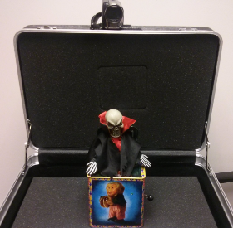
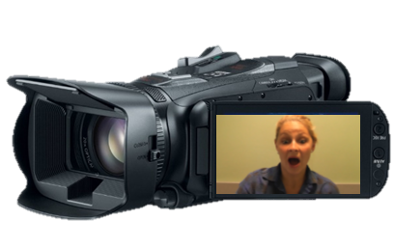

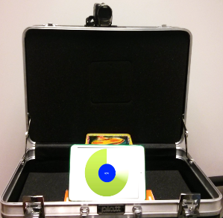


Method
STUDY 1: Deceptive Emotions
Stimuli Creation - 13 videos were created for each condition
Genuine
Genuine
Rehearsed
Rehearsed
(recall experience)
Improvised
Improvised
(act surprised)

Slide 8
Method
STUDY 1: Deceptive Emotions
Participants: 43 participants (23m), M_{age} = 29.5 (SD = 7.5)
Design: Within-subjects
  IV: Genuine, Rehearsed and Improvised
  DV: Accuracy, Genuineness, Expression Intensity, and Confidence
Procedure: Decoders watched all the videos and rated the expressions

Slide 9
Findings
STUDY 1: Deceptive Emotions
Rehearsed expressions were harder to classify as fake
Rehearsed was rated as more genuine.
Both fake conditions were rated as less genuine than Control
Accuracy
Genuineness
Fake | Real
* p<.05
Notes:
Accuracy – the correct discrimination of expressions as having been elicited in response to the jack or without the jack.
Liars can reproduce an emotion convincingly; but not improvise

Slide 10
Findings
STUDY 1: Deceptive Emotions
Rehearsed and Improvised were rated equally expressive
Both were rated less expressive than the Genuine surprise
Lower confidence for Rehearsed and Improvised expressions
No difference in confidence between the two fake conditions
Intensity
Confidence

Slide 11
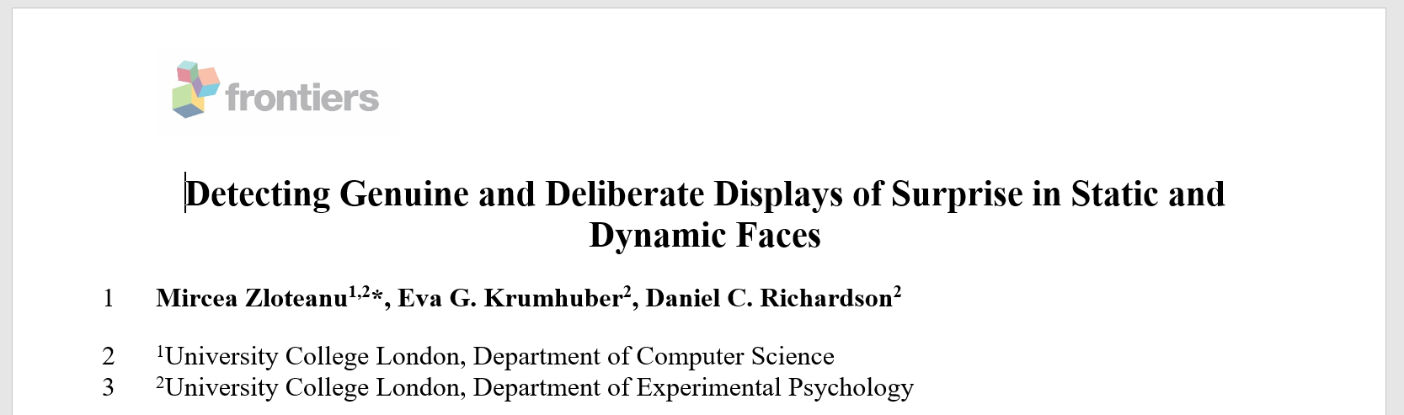
Dynamic vs Static Expressions
STUDY 2: Dynamic vs Static Expressions
VS
https://doi.org/10.3389/fpsyg.2018.01184

Slide 12
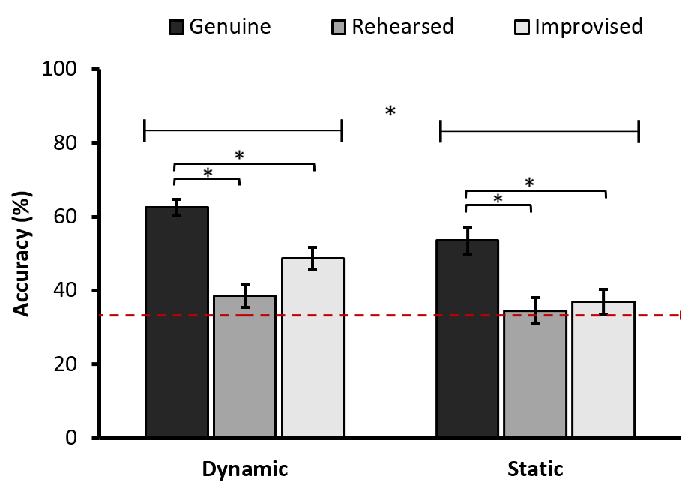
Accuracy
STUDY 2: Dynamic vs Static Expressions
Presentation Format
Dynamic_{ACC} > Static_{ACC} (M_{diff} ≈ 10%)
Expression Condition:
Genuine > Rehearsed = Improvised
Notes:
Dynamic better than static
Same patter for detection between genuine and deceptive expressions

Slide 13
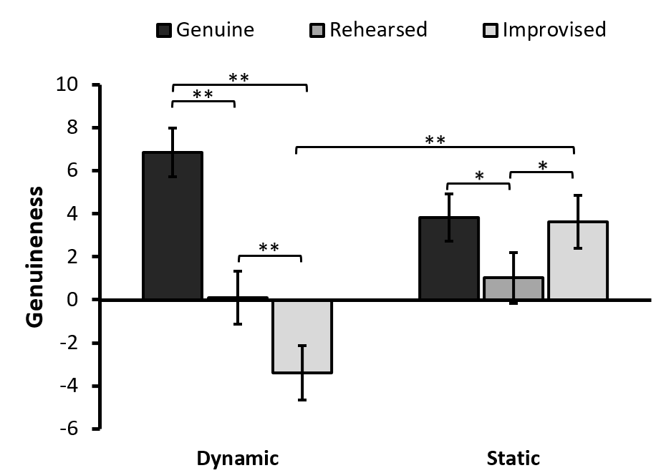
Genuineness
STUDY 2: Dynamic vs Static Expressions
Dynamic Condition:
Genuine > Rehearsed | Improvised
Improvised < Rehearsed
Static Condition:
Genuine > Rehearsed
Improvised > Rehearsed
Genuine = Improvised
Dynamic v Static:
Improvised Static < Improvised Dynamic
Genuine Static = Genuine Dynamic
Rehearsed Static = Rehearsed Dynamic
Notes:
Genuine – prototypical, expected, matching-stereotypes

Slide 14
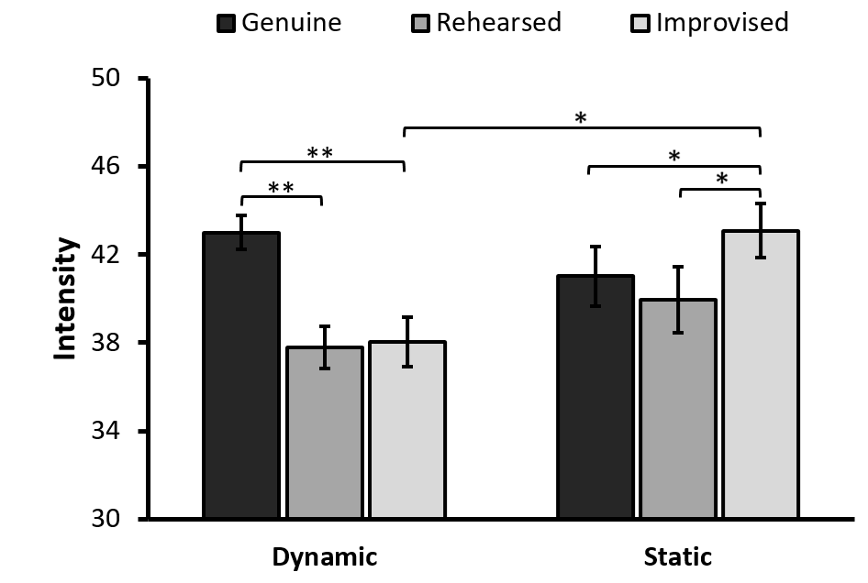
Intensity
STUDY 2: Dynamic vs Static Expressions
Dynamic condition
Genuine > Rehearsed | Improvised
Rehearsed = Improvised
Static Condition
Genuine < Improvised
Genuine = Rehearsed
Improvised > Rehearsed
Dynamic v Static
Improvised_{STATIC} > Improvised_{DYNAMIC}
Notes:
Posed should be more intense – communication advantage
Posed should be less intense – lacking underlying affect needed to activate relevant facial muscles

Slide 15
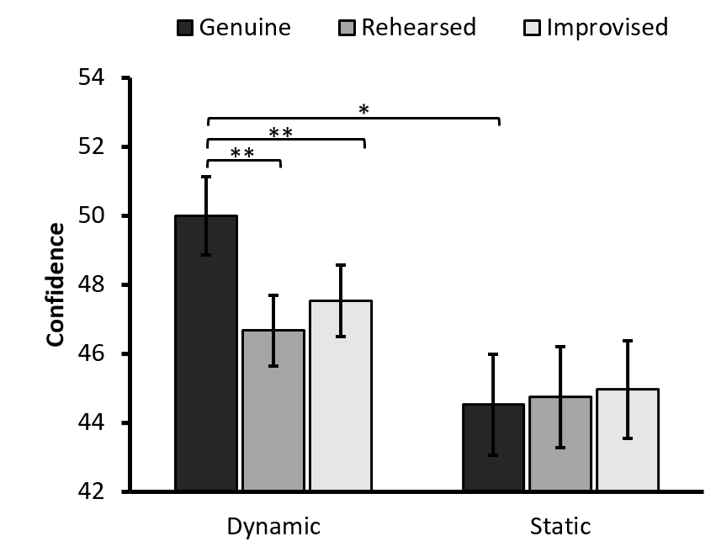
Confidence
STUDY 2: Dynamic vs Static Expressions
Dynamic Condition
Genuine > Rehearsed | Improvised
Rehearsed = Improvised
Static Condition
Genuine = Rehearsed = Improvised
Dynamic v Static
Genuine_{DYNAMIC} = Genuine_{STATIC}

Slide 16
Dynamic vs Static Expressions
STUDY 2: Dynamic vs Static Expressions
Presentation Format matters - Dynamic leads to superior (more nuanced, and clearer) judgment differences
Production method matters - using the umbrella term of “posed” expressions in research will lead to unclear, conflicting, and misleading effects
Accuracy – People show some ability to detect genuine emotional expression, but this is not great. The type of deceptive expression can affect authenticity discrimination.
Rehearsed expressions were the most convincing “genuine-looking” expressions, i.e. it is easy to fake emotional expressions.

Slide 17
Dynamic Emotions: Short vs Long
STUDY 2b: Short vs Long Dynamic Expressions
Story so far:
Presentation Format matters - Dynamic leads to superior (more nuanced, and clearer) judgment differences
Full-length (S1-2) vs Thin-slice
80 videos.
IV: Presentation Format (Full vs Short)
IV: Expression conditions (Genuine, External, Improvised, Rehearsed)
So, 20 edited videos from the Rehearsed condition (10 full and 10 short), etc. The duration of the full videos was 8-12sec; The short videos were between 1-3sec.
DV: genuineness, accuracy, intensity, confidence
N = 44 (28 males, M_{age}= 30.89, SD = 8.86)

Slide 18
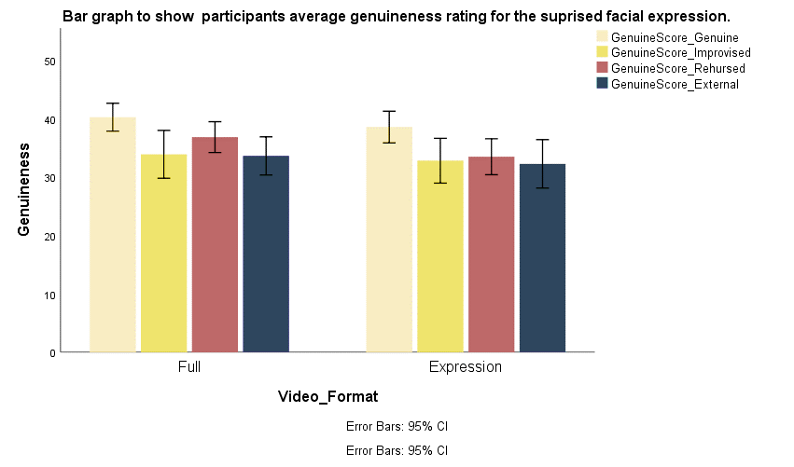
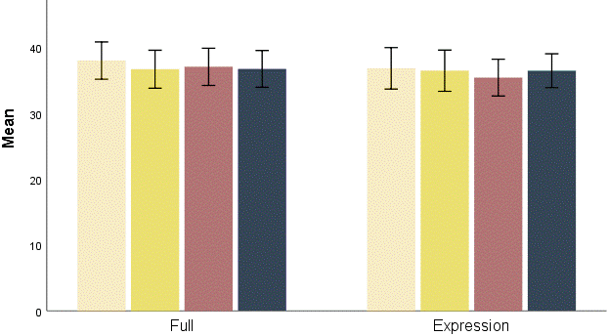
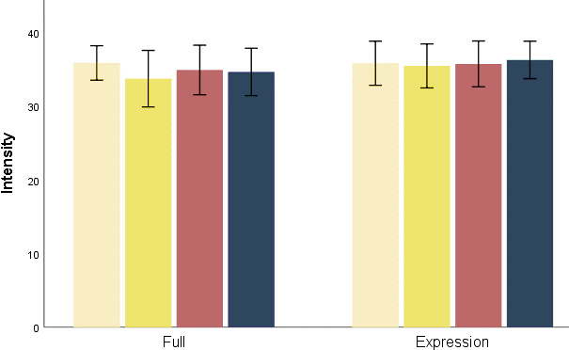
Dynamic Emotions: Short vs Long
STUDY 2b: Short vs Long Dynamic Expressions
Full vs Short
2 (Video Format: full vs. thin slice ) x 4 (Expression: genuine , improvised , rehearsed, and external)
No significant differences on any measures for Video Format!
Intensity; Genuineness; Accuracy; Confidence
Genuine | Improvised | Rehearsed | External

Slide 19


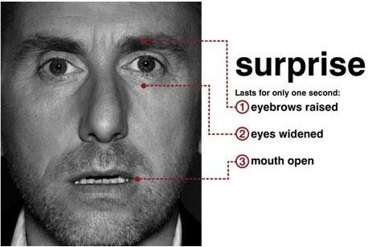

Internal vs External
STUDY 3: Acting Surprised: Mimic vs Stanislavsky
Which aspect of the previous experience with the emotion was relevant to successfully recreating the emotional expression on command?
Hypothesis: Experiencing the internal sensation of surprise versus its external appearance will affect how the faked expression is perceived
Internal
  External

Slide 20




Method
STUDY 3: Acting Surprised: Mimic vs Stanislavsky
Stimuli Creation - 13 videos were created for each condition
Genuine
Genuine
Internal
(suppressed reaction)
(recall experience)
External
(recall experience)

Slide 21
Method
STUDY 3: Acting Surprised: Mimic vs Stanislavsky
  Stanislavski’s system
Participants: 50 participants (36f), M_{age} = 25 (SD = 7.2)
Design: Within-subjects
  IV: Genuine, Internal and External
  DV: Accuracy, Genuineness, Intensity, and Confidence
Procedure: decoders watched all the videos and rated the expressions
Mimic method

Slide 22
Findings
STUDY 3: Acting Surprised: Mimic vs Stanislavsky
External surprise > Internal surprise
Both fake conditions were rated as less genuine that Genuine surprise
External surprise was also harder to accurately identify as faked or real
Accuracy
Genuineness
Fake | Real
* p<.05

Slide 23
Findings
STUDY 3: Acting Surprised: Mimic vs Stanislavsky
External surprise was rated as more expressive that Internal surprise
External surprise was rated as expressive as Genuine surprise
Observers were less confident they were correct in their decisions for both Internal and External conditions
Intensity
Confidence
Notes:
Intensity – a feature of the elicitation condition, not of authenticity!

Slide 24
Conclusions so far
STUDY 3: Acting Surprised: Mimic vs Stanislavsky
Study 1: Having recent experience with actual surprise allows individuals to convincingly fake the emotional expression
Study 2: Knowing what a genuine emotional expression looks like (External) is better for producing a genuine-looking deceptive expression (i.e. Mimic method is superior to Stanislavsky)
Overall, there seem to be observable differences between real and fake emotional displays, but these can be diminished using simple techniques

Slide 25
Ongoing & Future Projects:
Dynamic Expressions Database – Behavioral Research Methods
(Zloteanu, Ong, Krumhuber & Richardson, in progress)
Chapter: Deceptive Emotional Control – Handbook of Facial Expressions of Emotion Vol.3
(Zloteanu, Krumhuber & Richardson, in prep.)
Automatic Authenticity Classification – ongoing
(Zloteanu, Cohn & Krumhuber)

Slide 26
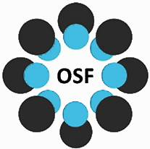
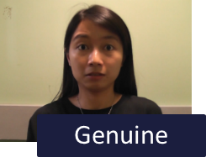
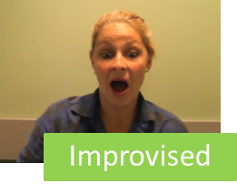
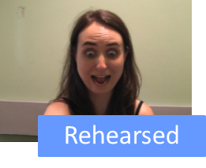
Surprise.D: Dynamic Surprise Expressions Database
Producing a dynamic emotion database with the mentioned production method techniques,
Allow clearer investigations of emotion perception, recognition, and affective judgements.

Slide 27
Dynamic Surprise Database
Videos/Senders
N = 128 (32 Genuine; 32 Rehearsed; 32 Improvised; 32 External)
Decoders
N = 108
Sender behavioural readings:
Gender, Age, Mood, Acting Experience, Acting ability (self-rated), Felt emotion (10 point ratings for 6 basic emotions), Confidence in performance
Decoder ratings:
Genuineness, Intensity, Accuracy, Confidence, Trustworthiness, Attractiveness

Slide 28
Dynamic Surprise Database
Accuracy
Genuineness
Intensity
Confidence

Slide 29
Take home message(s):
Perceptual differences between genuine and deceptive expressions are driven by both the method used to produce and present stimuli [helps explain past inconsistencies in research]
When investigating Emotion Recognition we need for a clear separation between
Classification Accuracy and Authenticity Discrimination !!!
Together, the findings illustrate the complexity of human emotion production and perception, the need for ecologically valid stimuli (dynamic is better)
Concluding remarks
Notes:
Deceptive= deliberate

Slide 30









Thank you!
Questions?
Dr Eva Krumhuber
Prof. Daniel Richardson
Samantha Chye
Jing Ong Han
Korede Fakayode
Contact
: m.zloteanu@tees.ac.uk
T: : @mzloteanu
: mz555.github.io

