Slide 1
Appendix
Animation of MEG-PBI Vibrations
Resonance Raman study of the J-type aggregation process of a water soluble perylene bisimide
E. Alloa,¹ V. Grande,² Rishat Dimurat,³ David Beljonne,³ F. Würthner,² S. C. Hayes^{1,}*
¹University of Cyprus, Department of Chemistry, Nicosia, 2109, Cyprus
²Universität Würzburg, Institut für Organische Chemie, Würzburg, 97074, Germany
³Laboratory for Chemistry of Novel Materials, University of Mons, 20 Place du Parc, B-7000 Mons, Belgium.

Slide 2
Calculated Raman Spectrum
* In order to view the animation of each vibration in the next slides, please use presentation mode.

Slide 3
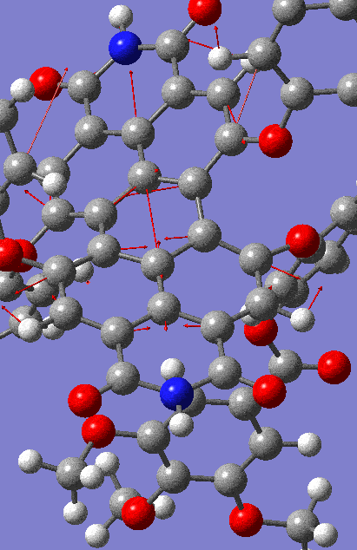
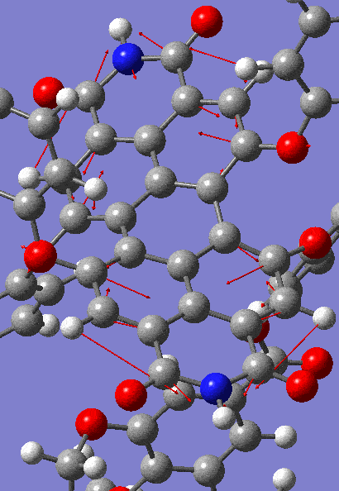


1341 cm⁻¹
1381 cm⁻¹
ν_{C=C} $∥$to N-N axis
ip δ_{C-H} / ν_{C=C} $⊥$ to N-N axis

Slide 4
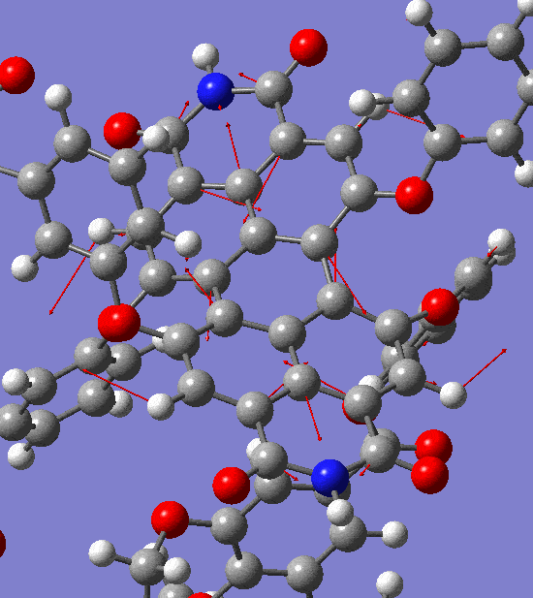
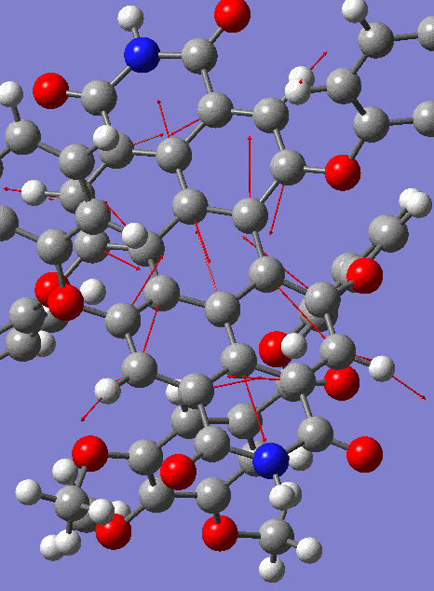

1424 cm⁻¹
1528 cm⁻¹
s ν_{C=C} (central ring)
ν_{C=C} $∥$N-N axis

Slide 5
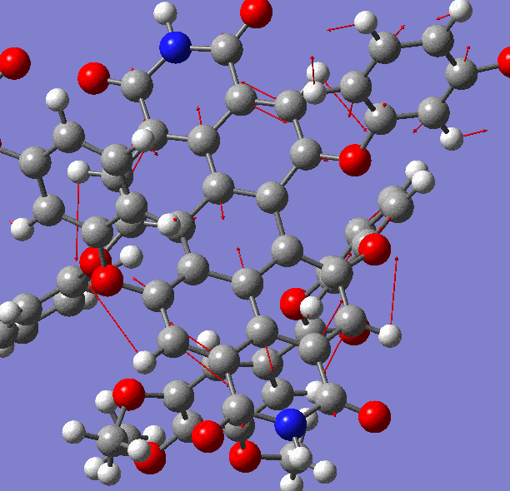
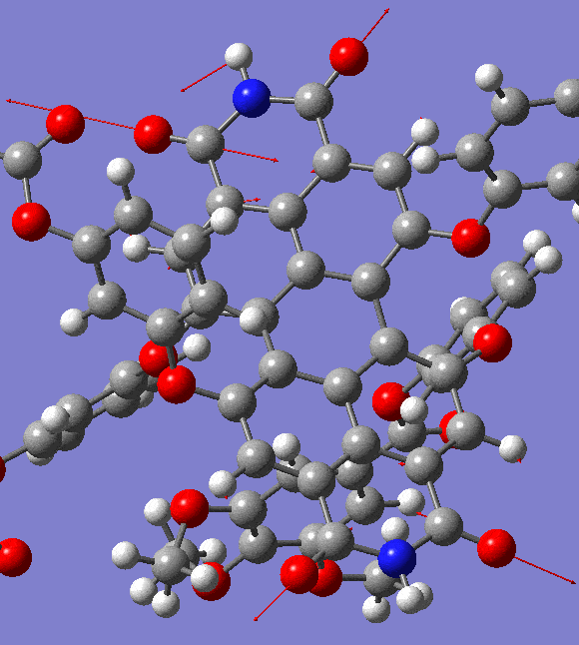

1592 cm⁻¹
1737 cm⁻¹
ip δ_{C-H} / ν_{C=C} $⊥$ to N-N axis
ν_{C=O}

