Slide 1

Research Data Management – Basics
Notes:
...and other universities & institutions.

Slide 2
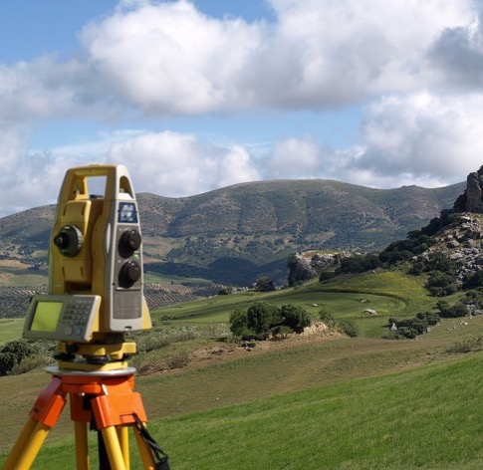


Examples
Notes:
Exemplary
Measurements
Code
Broadly speaking: every relevant information of the scientific process.

Slide 3

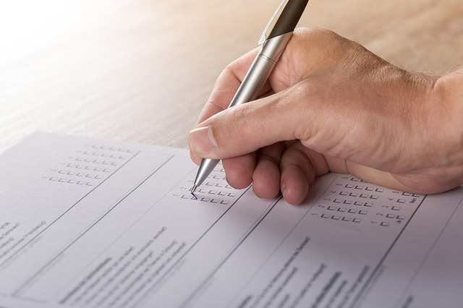
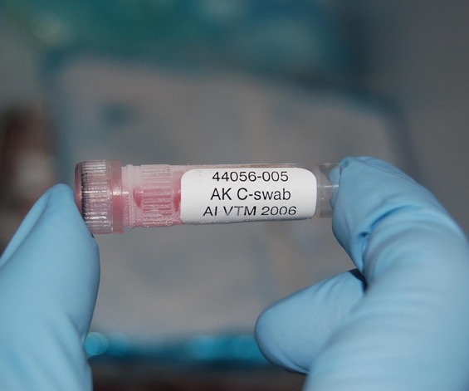
Examples
Notes:
Exemplary
Language
Surveys
Data
Broadly speaking: every relevant information of the scientific process.

Slide 4

WHAT?
Primary data such as…
  Experiment data
  Measurements
  Surveys, polls
But also…
  Visualizations
  Models
  Tools
Notes:
Exemplary
Broadly speaking: every relevant information of the scientific process.

Slide 5

Definition
Data that arises during scientific activity (e.g. measurements, surveys, sourcing), which enable scientific work (e.g. digitized material) or which document the result of scientific work, are called research data.- Forschungsdaten.info, translated
Notes:
Inkludierende Definition: Was ist notwendig/hilfreich um die Forschung nachzuvollziehen
Was kann von anderen nachgenutzt warden?

Slide 6

WHAT?
Creation
Reusing
Processing
Research data
Allowing access
Analysis
Archiving
Notes:
Research data lifecycle
Archiving doesn't mean hiding away
!
Begins anew with the re-use of existing research

Slide 7

WHAT?
Universities and scientists are responsible for the development and cultivation of science.
Research at universities follows scientific standards and requirements to produce comprehensible and verifiable results.
Research data management is an essential part of good scientific practice.
Notes:
Uni + Scientists
Comprehensive + verifiable
- striving for knowledge & the betterment of the world

Slide 8

WHY?
Avoid duplicate work
Reusability
Good science
Notes:
Data collection is hard work. So it should not unnecessarily be repeated
Extended research on the same RQ can take place
Data can answer multiple research questions, even from different fields
- Easy & organized access to research data improves science both in speed and quality

Slide 9

WHY?
Theft
Abuse
Future proof
Long term
Notes:
- Researchers are (often) not IT professionals & don't need to be
- The people at the data centers are
- Ensure university staff (& others) can access research data
- Become independent of people, software & hardware

Slide 10

WHY?
Third party funds
Help
Improved visability
Notes:
Money $
Practical help

Slide 11

Notes:
"To be Findable:
- F1. (meta)data are assigned a globally unique and eternally persistent identifier.
- F2. data are described with rich metadata.
- F3. (meta)data are registered or indexed in a searchable resource.
- F4. metadata specify the data identifier.
To be Accessible:
- A1 (meta)data are retrievable by their identifier using a standardized communications protocol.
- A1.1 the protocol is open, free, and universally implementable.
- A1.2 the protocol allows for an authentication and authorization procedure, where necessary.
- A2 metadata are accessible, even when the data are no longer available.
- To be Interoperable:
- I1. (meta)data use a formal, accessible, shared, and broadly applicable language for knowledge representation.
- I2. (meta)data use vocabularies that follow FAIR principles.
- I3. (meta)data include qualified references to other (meta)data.
To be Re-usable:
- R1. meta(data) have a plurality of accurate and relevant attributes.
- R1.1. (meta)data are released with a clear and accessible data usage license.
- R1.2. (meta)data are associated with their provenance.
- R1.3. (meta)data meet domain-relevant community standards."^{[1]}

Slide 12
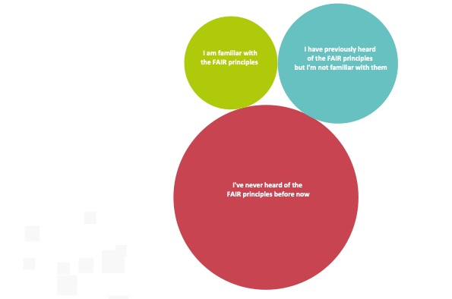

Slide 13
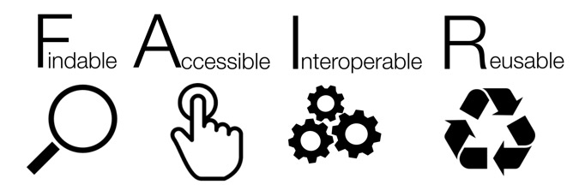
Findable:
F1. (Meta)data are assigned a globally unique and persistent identifier
F2. Data are described with rich metadata (defined by R1 below)
F3. Metadata clearly and explicitly include the identifier of the data they describe
F4. (Meta)data are registered or indexed in a searchable resource
Notes:
"To be Findable:
- F1. (meta)data are assigned a globally unique and eternally persistent identifier.
- F2. data are described with rich metadata.
- F3. (meta)data are registered or indexed in a searchable resource.
- F4. metadata specify the data identifier.
To be Accessible:
- A1 (meta)data are retrievable by their identifier using a standardized communications protocol.
- A1.1 the protocol is open, free, and universally implementable.
- A1.2 the protocol allows for an authentication and authorization procedure, where necessary.
- A2 metadata are accessible, even when the data are no longer available.
- To be Interoperable:
- I1. (meta)data use a formal, accessible, shared, and broadly applicable language for knowledge representation.
- I2. (meta)data use vocabularies that follow FAIR principles.
- I3. (meta)data include qualified references to other (meta)data.
To be Re-usable:
- R1. meta(data) have a plurality of accurate and relevant attributes.
- R1.1. (meta)data are released with a clear and accessible data usage license.
- R1.2. (meta)data are associated with their provenance.
- R1.3. (meta)data meet domain-relevant community standards."^{[1]}

Slide 14
Accessible:
A1. (Meta)data are retrievable by their identifier using a standardised communications protocol
A2. Metadata are accessible, even when the data are no longer available.
Notes:
"To be Findable:
- F1. (meta)data are assigned a globally unique and eternally persistent identifier.
- F2. data are described with rich metadata.
- F3. (meta)data are registered or indexed in a searchable resource.
- F4. metadata specify the data identifier.
To be Accessible:
- A1 (meta)data are retrievable by their identifier using a standardized communications protocol.
- A1.1 the protocol is open, free, and universally implementable.
- A1.2 the protocol allows for an authentication and authorization procedure, where necessary.
- A2 metadata are accessible, even when the data are no longer available.
- To be Interoperable:
- I1. (meta)data use a formal, accessible, shared, and broadly applicable language for knowledge representation.
- I2. (meta)data use vocabularies that follow FAIR principles.
- I3. (meta)data include qualified references to other (meta)data.
To be Re-usable:
- R1. meta(data) have a plurality of accurate and relevant attributes.
- R1.1. (meta)data are released with a clear and accessible data usage license.
- R1.2. (meta)data are associated with their provenance.
- R1.3. (meta)data meet domain-relevant community standards."^{[1]}

Slide 15
Interoperable:
I1. (Meta)data use a formal, accessible, shared, and broadly applicable language for knowledge representation.
I2. (Meta)data use vocabularies that follow FAIR principles
I3. (Meta)data include qualified references to other (meta)data
Notes:
"To be Findable:
- F1. (meta)data are assigned a globally unique and eternally persistent identifier.
- F2. data are described with rich metadata.
- F3. (meta)data are registered or indexed in a searchable resource.
- F4. metadata specify the data identifier.
To be Accessible:
- A1 (meta)data are retrievable by their identifier using a standardized communications protocol.
- A1.1 the protocol is open, free, and universally implementable.
- A1.2 the protocol allows for an authentication and authorization procedure, where necessary.
- A2 metadata are accessible, even when the data are no longer available.
- To be Interoperable:
- I1. (meta)data use a formal, accessible, shared, and broadly applicable language for knowledge representation.
- I2. (meta)data use vocabularies that follow FAIR principles.
- I3. (meta)data include qualified references to other (meta)data.
To be Re-usable:
- R1. meta(data) have a plurality of accurate and relevant attributes.
- R1.1. (meta)data are released with a clear and accessible data usage license.
- R1.2. (meta)data are associated with their provenance.
- R1.3. (meta)data meet domain-relevant community standards."^{[1]}

Slide 16
Re-usable:
R1. Meta(data) are richly described with a plurality of accurate and relevant attributes
  R1.1. (Meta)data are released with a clear and accessible data usage license
  R1.2. (Meta)data are associated with detailed provenance
  R1.3. (Meta)data meet domain-relevant community standards
Notes:
"To be Findable:
- F1. (meta)data are assigned a globally unique and eternally persistent identifier.
- F2. data are described with rich metadata.
- F3. (meta)data are registered or indexed in a searchable resource.
- F4. metadata specify the data identifier.
To be Accessible:
- A1 (meta)data are retrievable by their identifier using a standardized communications protocol.
- A1.1 the protocol is open, free, and universally implementable.
- A1.2 the protocol allows for an authentication and authorization procedure, where necessary.
- A2 metadata are accessible, even when the data are no longer available.
- To be Interoperable:
- I1. (meta)data use a formal, accessible, shared, and broadly applicable language for knowledge representation.
- I2. (meta)data use vocabularies that follow FAIR principles.
- I3. (meta)data include qualified references to other (meta)data.
To be Re-usable:
- R1. meta(data) have a plurality of accurate and relevant attributes.
- R1.1. (meta)data are released with a clear and accessible data usage license.
- R1.2. (meta)data are associated with their provenance.
- R1.3. (meta)data meet domain-relevant community standards."^{[1]}

Slide 17
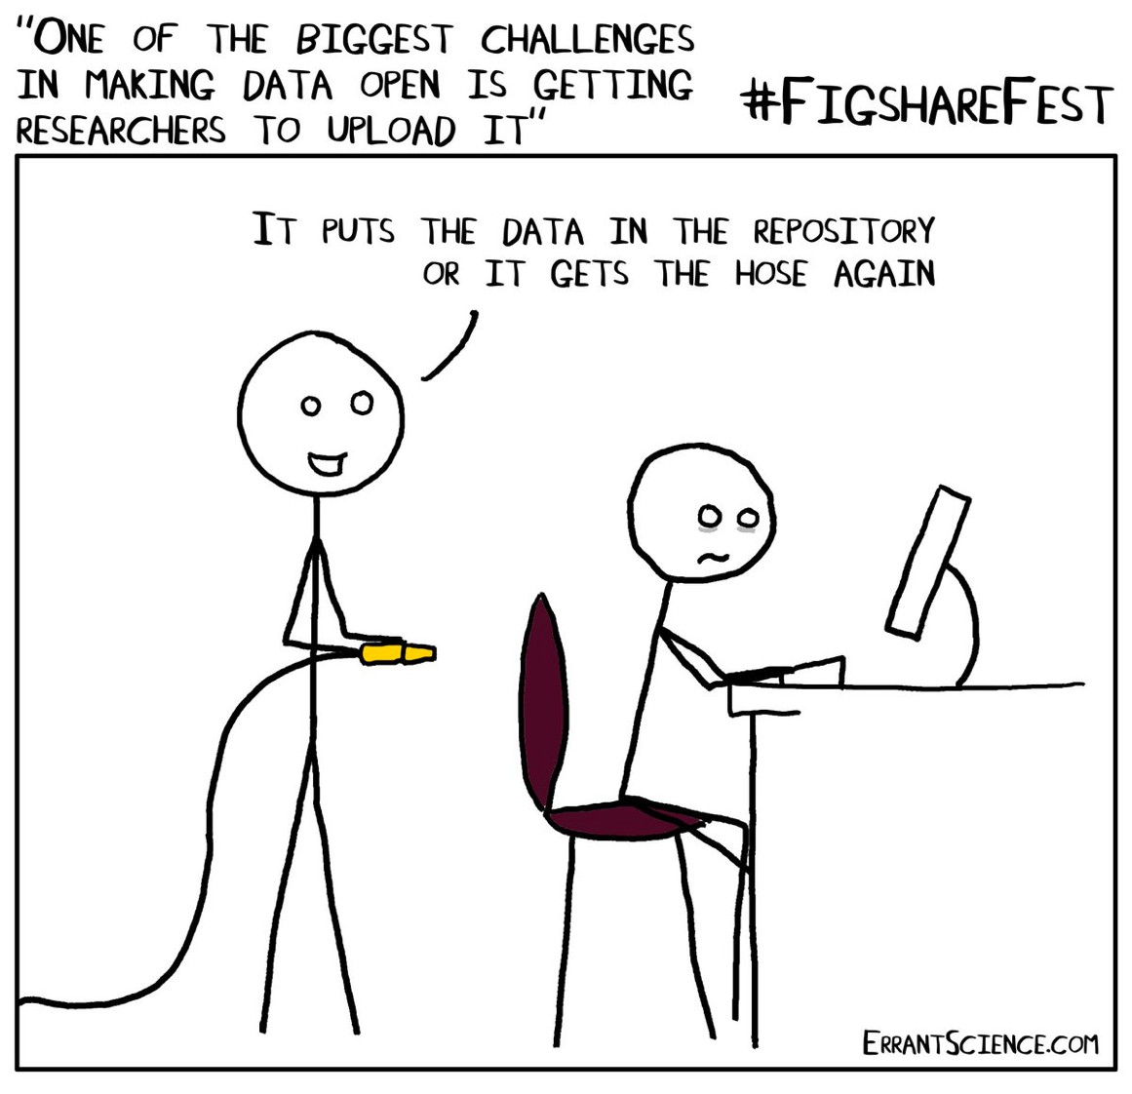
Notes:
We don’t want to do this
This is why I am doing this presentation

Slide 18

HOW?
Contact research data management team.
We create a data management plan.
We find a good place for your data.
We make sure the data has the appropriate meta data.
Store the data during & after your research
Notes:
use a data management plan
all relevant information in one place
third-party storage or internal (university)
also required by third parties (DFG)

Slide 19

Additional Information
Projekt: fodako.nrw
Allgemein: forschungsdaten.info

Slide 20
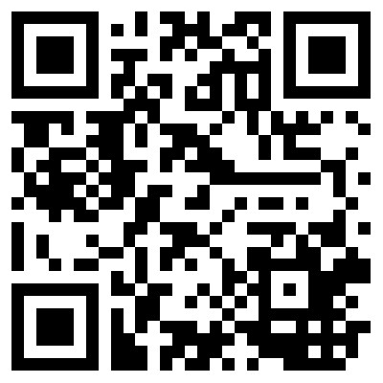
References
Slide 11
  SangyaPundir. (2016). English: FAIR guiding principles for data resources. Retrieved from https://commons.wikimedia.org/wiki/File:FAIR_data_principles.jpg
Slide 13-16:
  Wilkinson, M. D., Dumontier, M., Aalbersberg, Ij. J., Appleton, G., Axton, M., Baak, A., … Mons, B. (2016). The FAIR Guiding Principles for scientific data management and stewardship. Scientific Data, 3, 160018. https://doi.org/10.1038/sdata.2016.18
Slide 12
  Science, D., Hahnel, M., Fane, B., Treadway, J., Baynes, G., Wilkinson, R., … Osipov, I.. (2018, October 22). The State of Open Data Report 2018 (Version 2). figshare. https://doi.org/10.6084/m9.figshare.7195058.v2

