Slide 1

EPOS ICS - TCS
System basics
Daniele Bailo – INGV,
Rossana Paciello - INGV

Slide 2
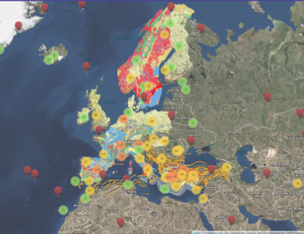










EPOS ARCHITECTURE
GUI
ICS-D
ICS-C
INTEROPERABILITY
INTEROPERABILITY
TCS
TCS
TCS
TCS

Slide 3
EPOS ARCHITECTURE
10 communities
190 data sources
15 metadata standards
No pre-defined common format
Harmonization
GUI
ICS-C
INTEROPERABILITY
INTEROPERABILITY
TCS
TCS
TCS
TCS
3

Slide 4
ARCHITECTURE
GUI
ICS-C
Main Functionalities:
  Discovery and contextualisation
  Filter dataset / services / software
  Integrated data visualisation on map
  Spatio/temporal search (In progress)
  Workspace and Workflows
  Integration of ICS-D services (In progress)
INTEROPERABILITY
TCS
TCS
TCS
TCS
4

Slide 5

ARCHITECTURE
WEB APIs
Software Components
GUI
CERIF Metadata Catalogue
EPOS WEB APIs
ICS-C
“entry point” of EPOS ICS-C
Enable GUI to interoperate with the ICS-C system
can be used by “curl script lovers”
curl -X GET --header 'Accept: application/json’ 'http://epos.cineca.it/webapi/v1.1/resources/ddss’
Web APIs DOC: http://epos.cineca.it/webapi/v1.1/swagger-ui.html
Response payload: geoJSON → covJSON
INTEROPERABILITY
TCS
TCS
TCS
TCS
5

Slide 6
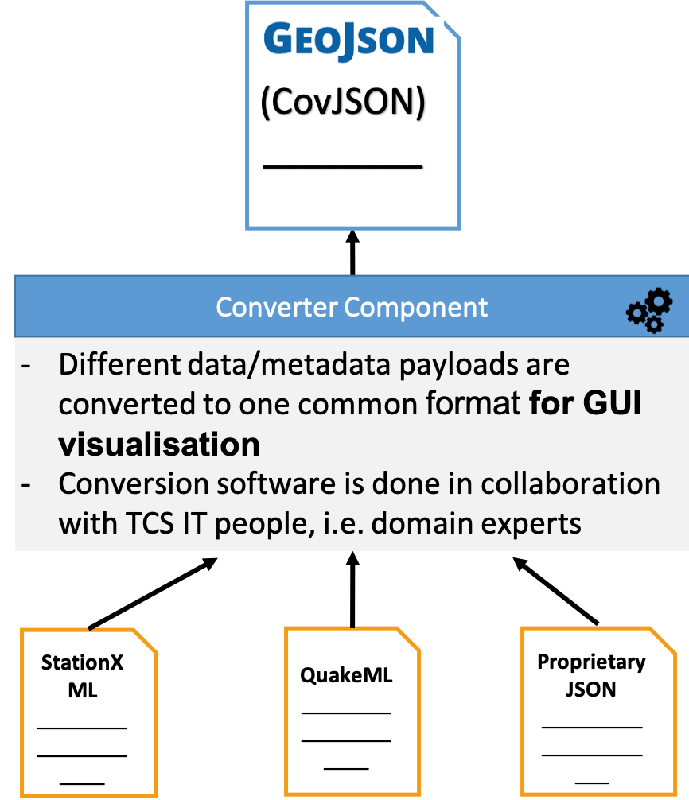
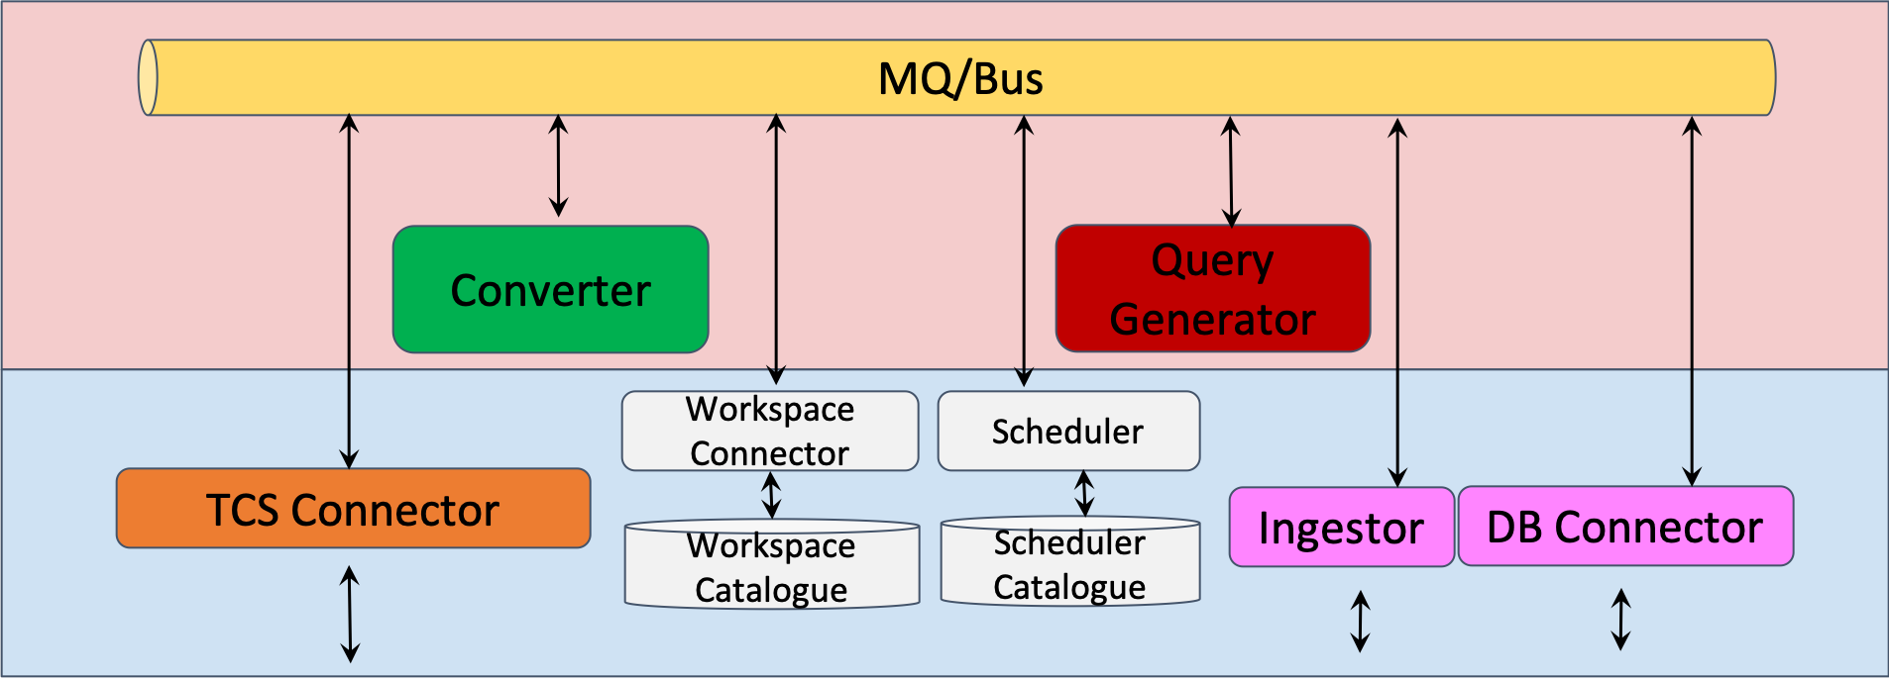
ARCHITECTURE
WEB APIs
Software Components
GUI
CERIF Metadata Catalogue
Microservice approach that ensures scalability, flexibility and system interoperability
INTEROPERABILITY
TCS
TCS
TCS
TCS
6

Slide 7
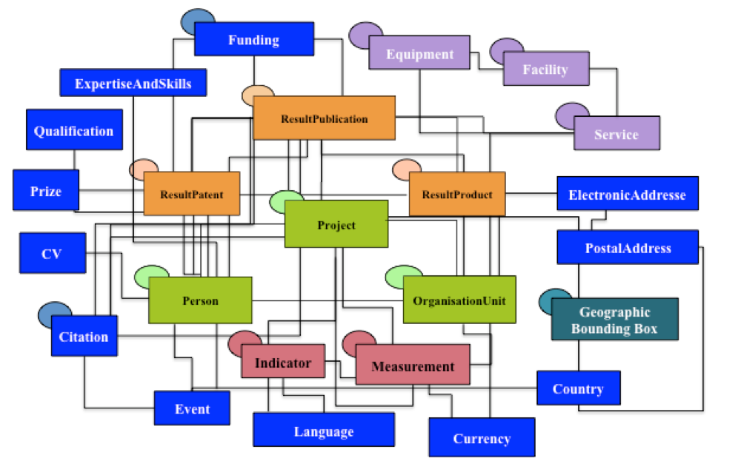
ARCHITECTURE
WEB APIs
Software Components
GUI
CERIF Metadata Catalogue
CERIF Metadata Catalogue
  based on the CERIF model;
  stores information about Data, Users, Resources, Processing models, Equipments etc.;
  Formal syntax
  Declared semantics
INTEROPERABILITY
TCS
TCS
TCS
TCS
7

Slide 8
ARCHITECTURE
GUI
EPOS-DCAT Application Profile:
  DCAT model extension with entities required in EPOS
  EPOS-DCAT-AP files into GitHub repository (https://github.com/epos-eu/EPOS-DCAT-AP)
ICS-C
INTEROPERABILITY
TCS
TCS
TCS
TCS
8

Slide 9
ARCHITECTURE
Data
Metadata
Metadata
Data
GUI
ICS-C
WS description
EPOS-DCAT-AP
WebServ
WebServ
WebServ
INTEROPERABILITY
TCS
TCS
TCS
TCS

Slide 10
ARCHITECTURE
INGESTION PHASE
Conversion from EPOS-DCAT-AP to CERIF model;
Ingestion metadata into CERIF DB;
GUI
ICS-C
INTEROPERABILITY
EPOS-DCAT-AP
Metadata Exchange
TCS
MAPPING PHASE
TCS
TCS
Description of TCS assets into EPOS- DCAT-AP RDF/Turtle;
TCS
10

Slide 11

ARCHITECTURE
GUI
EPOS AAAI Service
Proxy
Proxy
Single authentication point to access to both ICS and TCS
TCS delegate ICS system to act on behaf of an authorised user
Pre-production service connected to ICS GUI and WEBAPI by CYFRONET https://epos-aai.cyfronet.pl/
Based on http://www.unity-idm.eu
ICS-C
INTEROPERABILITY
Proxy
TCS
TCS
TCS
TCS
11

Slide 12
ARCHITECTURE
GUI
ICS-D APIs
ICS-D
ICS-C
INTEROPERABILITY
ICS-D
Computational and Storage Infrastructures (HPC, Cloud)
Visualisation
Elaborate data stored in ICS-C Workspace
API based communication
TCS
TCS
TCS
TCS
12

Slide 13
Thanks
Thanks
Thank you
Thank you
Thank you
Thank you
Presentation Credits:
Daniele Bailo, Rossana Paciello

