Slide 1


Missing Data for Data – Our Quest to Clean Up
Institutional Affiliations in Dryad
Wrangling RORs
Daniella Lowenberg, Daniella.Lowenberg@ucop.edu,
Dryad Product Manager,
California Digital Library, https://ror.org/03yrm5c26
Ted Habermann, tedhabermann@gmail.com,
Metadata Game Changers, duns: 081351642

Slide 2

The Problem
We do not have reliable institutional affiliation information for 27,000 data publications at Dryad

Slide 3

The Quest
Without this info, we cannot:
Report on deposits by institution
Evaluate usage and citations by institution
Send appropriate metadata or copies to institutions

Slide 4

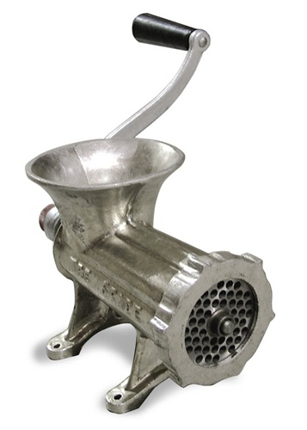


Strategy
DOI
Affiliation
Token
ROR
Notes:
The strategy we are using includes several steps:
Extract DOIs for papers from Dryad.
Search Crossref / PLOS or some other source for affiliation strings from those paper.
Process those strings to extract names of organizations
Search ROR for those organization names
Add discovered RORs to DataCite metadata
Today we focus on the processing

Slide 5
THE PERFECT AFFILIATION
Department of Geosciences; University of Arizona; Tucson AZ USA
Notes:
The perfect affiliations string is simple

Slide 6
THE PERFECT AFFILIATION
Department of Geosciences; University of Arizona; Tucson AZ USA
Consistent delimiters

Slide 7
THE PERFECT AFFILIATION
Department of Geosciences; University of Arizona; Tucson AZ USA
Consistent delimiters
Single affiliation

Slide 8
THE PERFECT AFFILIATION
Department of Geosciences; University of Arizona; Tucson AZ USA
Token
Consistent delimiters
Single affiliation
This makes extracting the organization name and finding identifers easy.
The real-world is not perfect.!
University of Arizona
ROR
https://ror.org/03m2x1q45

Slide 9

AFFILIATIONS
Notes:
A selection of affiliation strings

Slide 10
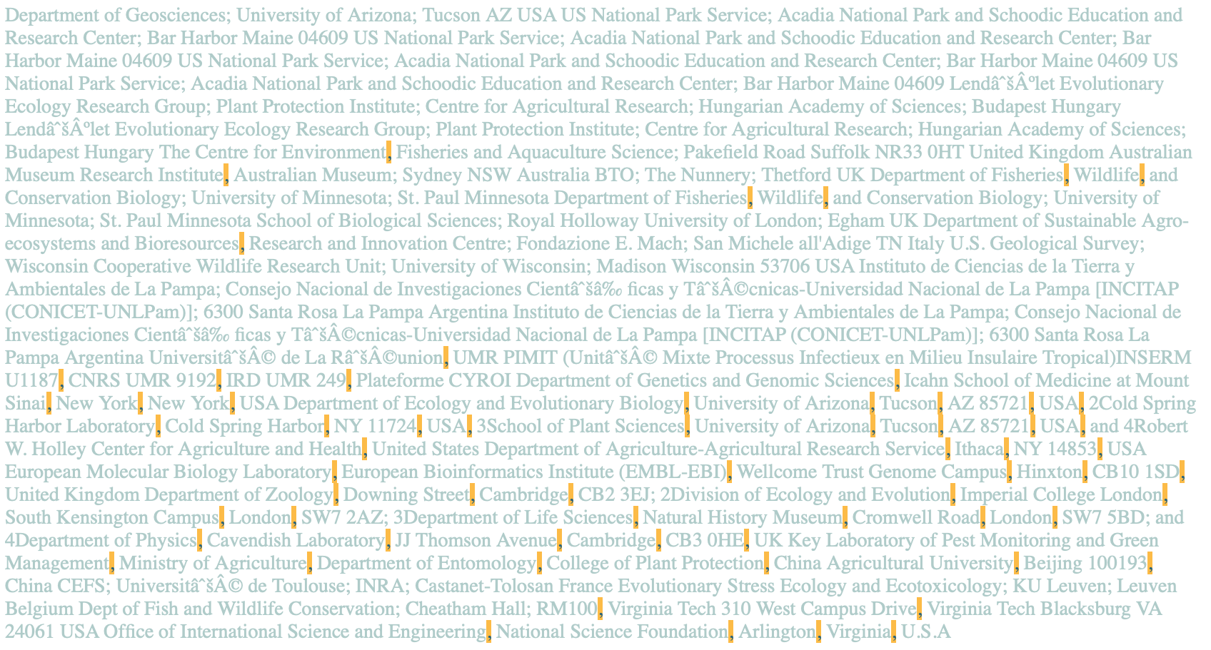
COMMAS
Notes:
Some are delimited by commas

Slide 11

SEMICOLONS
Notes:
Some are delimited by semi colons

Slide 12

DELIMITERS
Notes:
Some are not delimited at all – so extracting organization names can be difficult.

Slide 13
= STRINGS EXPECTED IN ORGANIZATION NAMES
TARGETS = STRINGS EXPECTED IN ORGANIZATION NAME
'Univ','Inst','Academy','Royal','Center','Department’,
'Centre','INRA','College','Nacional','Museum’,
'Investigaciones','Fish','Dept','Trust','School','CNRS’,
'Consultoria','National','Labora','Surv','Service’,
'Leuven','Found','Estacin','CSIRO','Fond','Research’,
'Ministry'
Notes:
Words or word fragments that occur in organization names are targets that we search for to help identify organization names.

Slide 14
= STRINGS EXPECTED IN ORGANIZATION NAMES
TARGETS = STRINGS EXPECTED IN ORGANIZATION NAME
'Univ','Inst','Academy','Royal','Center','Department’,
'Centre','INRA','College','Nacional','Museum’,
'Investigaciones','Fish','Dept','Trust','School','CNRS’,
'Consultoria','National','Labora','Surv','Service’,
'Leuven','Found','Estacin','CSIRO','Fond','Research’,
'Ministry'
Step 1 – find all tokens in affiliations that contain these strings
Notes:
Words or word fragments that occur in organization names are targets that we search for to help identify organization names.

Slide 16
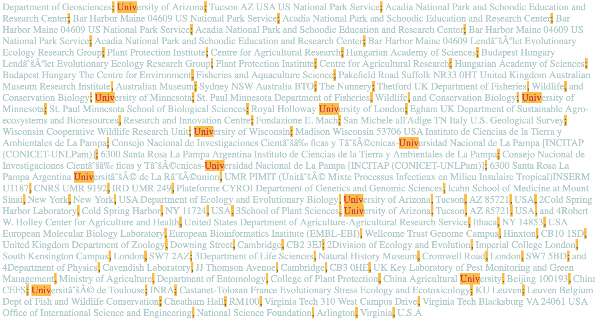
Univ
Notes:
These are affiliationTokens that include “Univ”.

Slide 17

National
Notes:
These are affiliationTokens that include “National”.

Slide 18
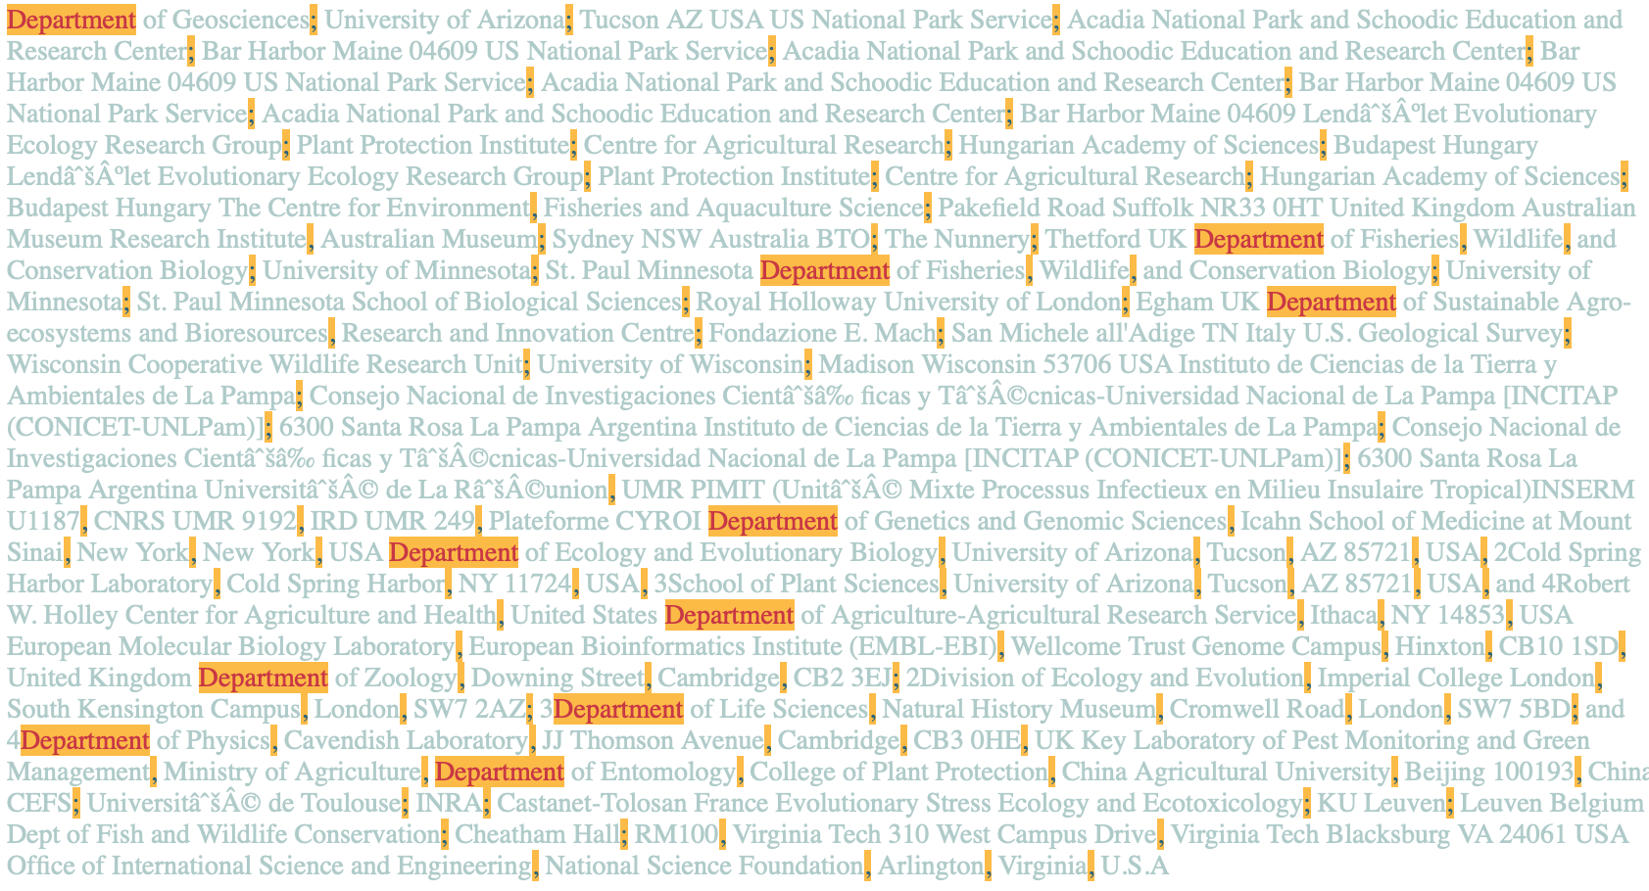
Department
Notes:
These are affiliationTokens that include “Department”.

Slide 19
PERFECT
LANGUAGE
CHARACTERS
DELIMITERS
Notes:
The tokens that include targets present many challenges.

Slide 20
CHALLENGE
- Abbreviations
Univ\. de --> Université de
Univ\. dos --> Universidade dos
Univ\. do --> Universidade do
Univ\. Federal --> Universidade Federal
Univ\. di --> Università di
Univ\. Nacional --> Universidad Nacional
Univ\. Rey --> Universidad Rey
Univ\. Darmstadt --> Universität Darmstadt
Univ\. Jena --> Universität Jena
Univ\. Pablo --> Universidad Pablo
Univ\. Javeriana --> Universidad Javeriana
Univ\. of --> University of
Univ\. for --> University for
Univ\. in --> University in
Univ\. St\. --> University St.
Univ\.$ --> University
Univ$ --> University
Univ\. Marburg --> University Marburg
Univ\. Esta --> Universidad Esta
Univ\. College --> University College
Univ\. Museum --> University Museum
Univ\. California --> University California
Univ\. and --> University and
Univ\. Centre --> University Centre
Univ\. Paris --> Université Paris
Univ\. Pompeu --> Universitat Pompeu
Univ\. Oldenburg --> Universität Oldenburg
Univ\. Agricultural --> University Agricultural
State Univ\. --> State University
Univ\. Amsterdam --> University Amsterdam
Univ. d --> Université d
Univ\.- --> University-
Univ\. --> University
Univ --> University
Notes:
The target “Univ” works in many languages

Slide 22

Notes:
These are tokens identified with all targets.

Slide 23

CHALLENGE
- Affiliations with multiple targets
Department of Zoology, Downing Street, Cambridge, CB2 3EJ; 2Division of Ecology and Evolution, Imperial College London, South Kensington Campus, London, SW7 2AZ; 3Department of Life Sciences, Natural History Museum, Cromwell Road, London, SW7 5BD; and 4Department of Physics, Cavendish Laboratory, JJ Thomson Avenue, Cambridge, CB3 0HE, UK
Notes:
Some of the tokens have multiple legitimate organization names

Slide 24


Slide 25
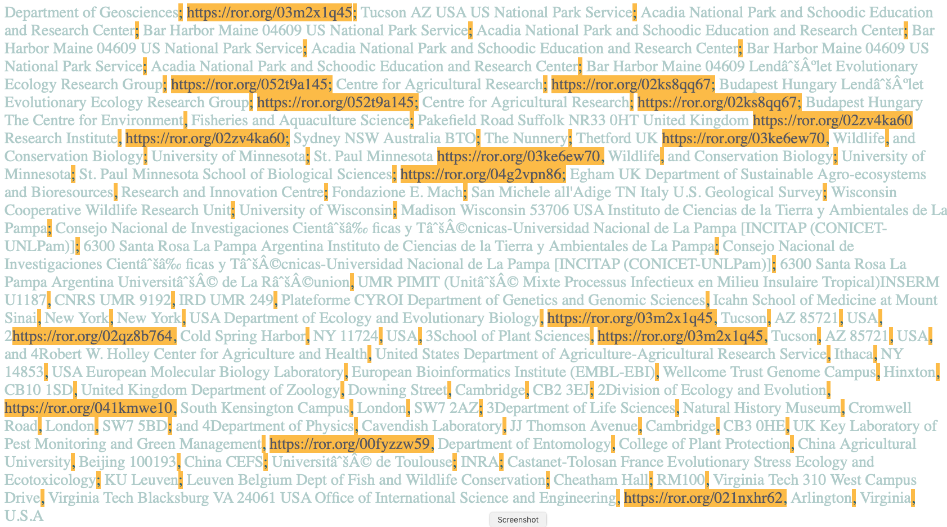
EXACT
Notes:
Some of these affiliations match ROR organization names exactly

Slide 26
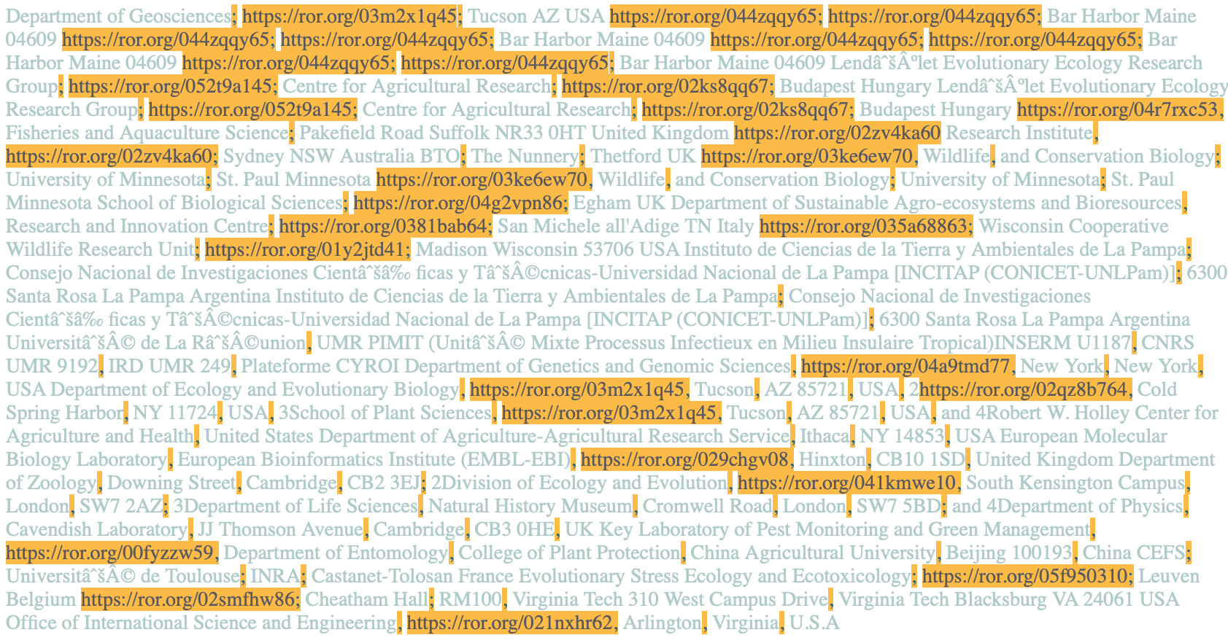
EXACT OR VALID
Notes:
Some need to be checked by hand to determine if they are valid

Slide 27
RESULTS
DOIs: 8826
Affiliations: 14,199
Affiliation Tokens: 11,829
RORs: 2513
DOIs with RORs: 71%
Authors with RORs: 65%
DOIs: 2496
Affiliations: 8686
Affiliation Tokens: 7841
RORs: 1592
DOIs with RORs: 91%
Authors with RORs: 75%
Notes:
Our goal is to find RORs for 90% of the papers and 75% of the authors. Success varies with the source of the affiliation strings.

Slide 28
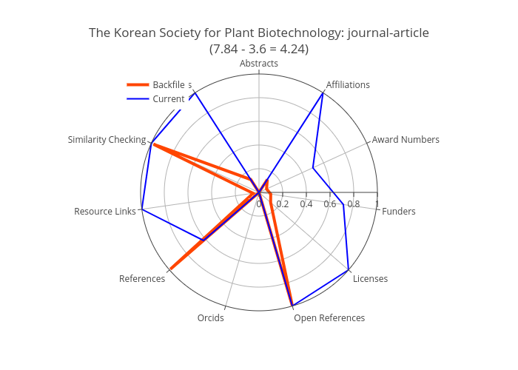
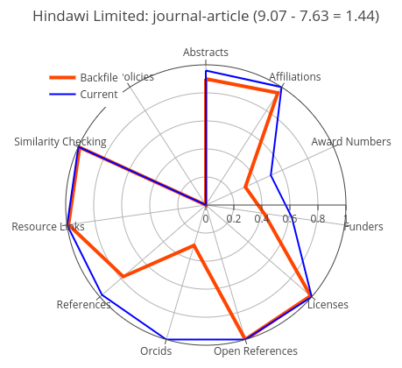
FUTURE DIRECTIONS - ROR Adoption
Open Refine – useful, user interface challenges for large datasets, learn API?
RORs added to Wikidata – use Wikidata reconciler
Testing and implementation with more partners
Big Increase
Long History
Notes:
We are using Crossref Participation Reports to look for partners to continue this work. Our first targets are Crossref members that have recently increased completeness of affiliations in their collections (example on the left) or those that have long histories of complete affiliation information.

Slide 29
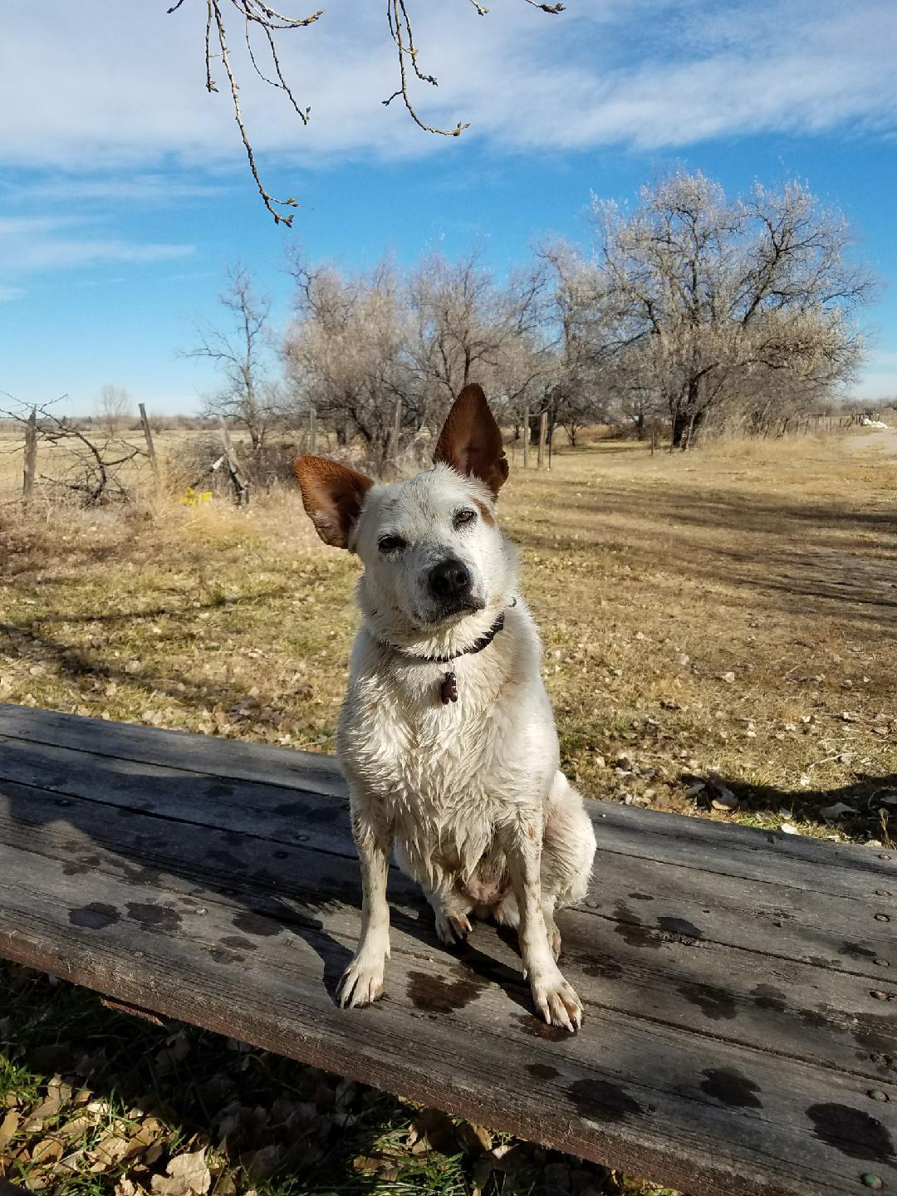
QUESTIONS?
tedhabermann@gmail.com
Daniella.Lowenberg@ucop.edu
Notes:
Please contact us if you have questions.

