Slide 1




topi.link - A graph-based topology for vague geographical relations
Florian Thiery ¹⁺² | Mainz, Germany
¹ mainzed
² Linked Geodesy
ISGM 2019 - Warsaw, Poland - 23rd-29th June 2019

Slide 2







Cheers!
Florian Thiery Research Software Engineer @ RGZM
MSc, Geoinformatics and Surveying, Mainz, Germany
thiery@rgzm.de 0000-0002-3246-3531
@fthierygeo http://cv.fthiery.de

Slide 3


Slide 4
modelling
topological relations
with a degree of connection
to make automatically
rule-based conclusions

Slide 5


Slide 6

What?
JavaScript library for modelling and reasoning of vague graph data
Who?
Mainz Centre for Digitality in the Humanities and Cultural Studies (mainzed)
Martin Unold, Florian Thiery
Where?
http://academic-meta-tool.xyz https://github.com/mainzed/academicmetatool-js

Slide 7
modelling a trip
from the North of Sweden
around Scandinavia
using topological relations
and a modelled degree of northness to enable reasoning

Slide 8

specify
nodes
»CONCEPTS«
POI
pixabay Pixabay License

Slide 9
specify
edges
»ROLES«
northOf
POI
POI
southOf
POI
POI
pixabay Pixabay License

Slide 10
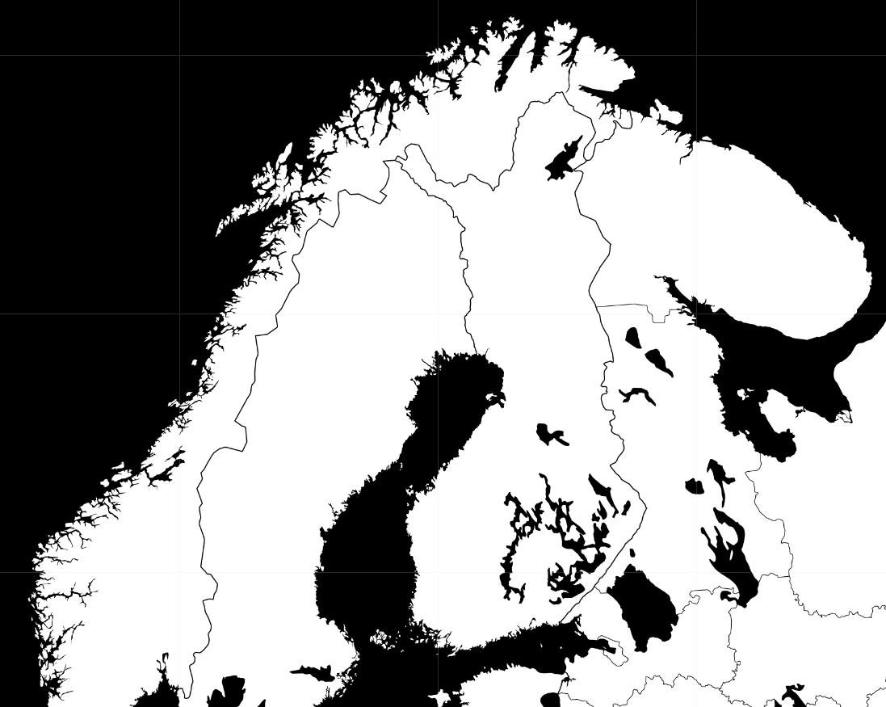
specify
degree of northness
⇒ normalisation
7.3455° == 1
Umeå
63.8270°N
North Cape
71.1725°N
pixabay Pixabay License | Leaflet - Map tiles by Stamen Design, CC BY 3.0 — Map data © OpenStreetMap contributors

Slide 11
specify
Role-Chain axioms
antecedent1
northOf
antecedent2
northOf
consequent
northOf
logic
Lukasiewicz, Product, Goedel
pixabay Pixabay License

Slide 12
specify
Inverse axioms
antecedent
northOf
inverse
southOf
pixabay Pixabay License

Slide 13
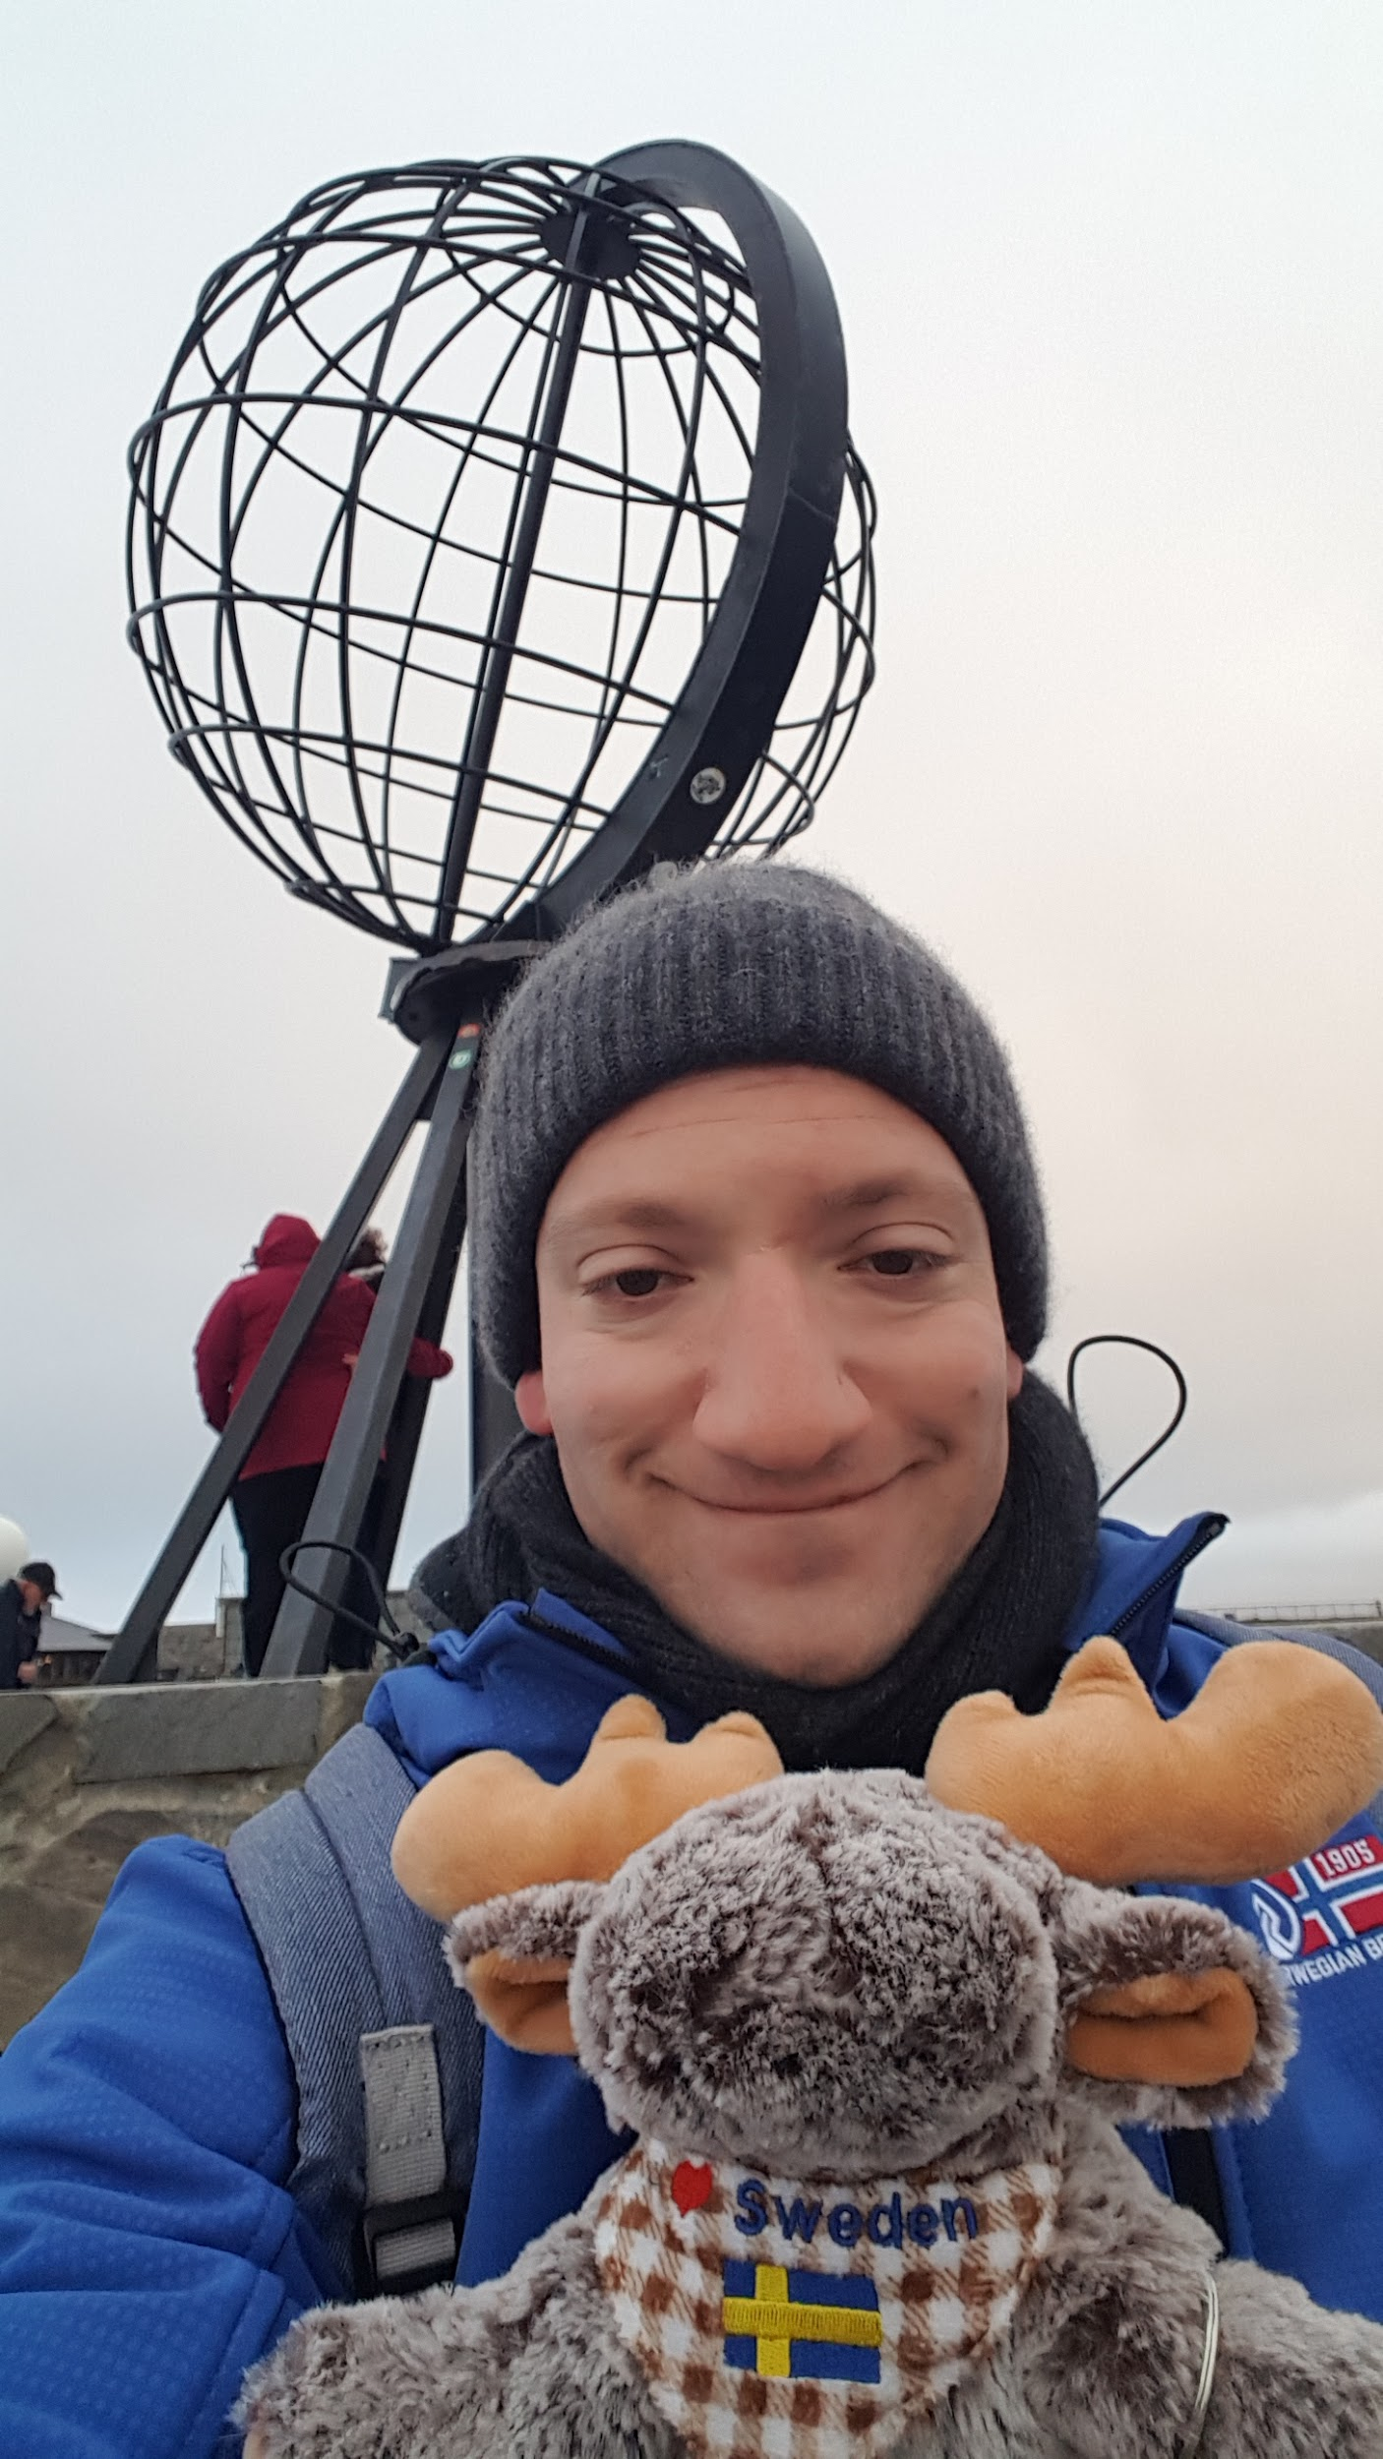
Let us model the
Scandinavian trip
of Flo and Emil!
Florian Thiery (CC BY 4.0)

Slide 14
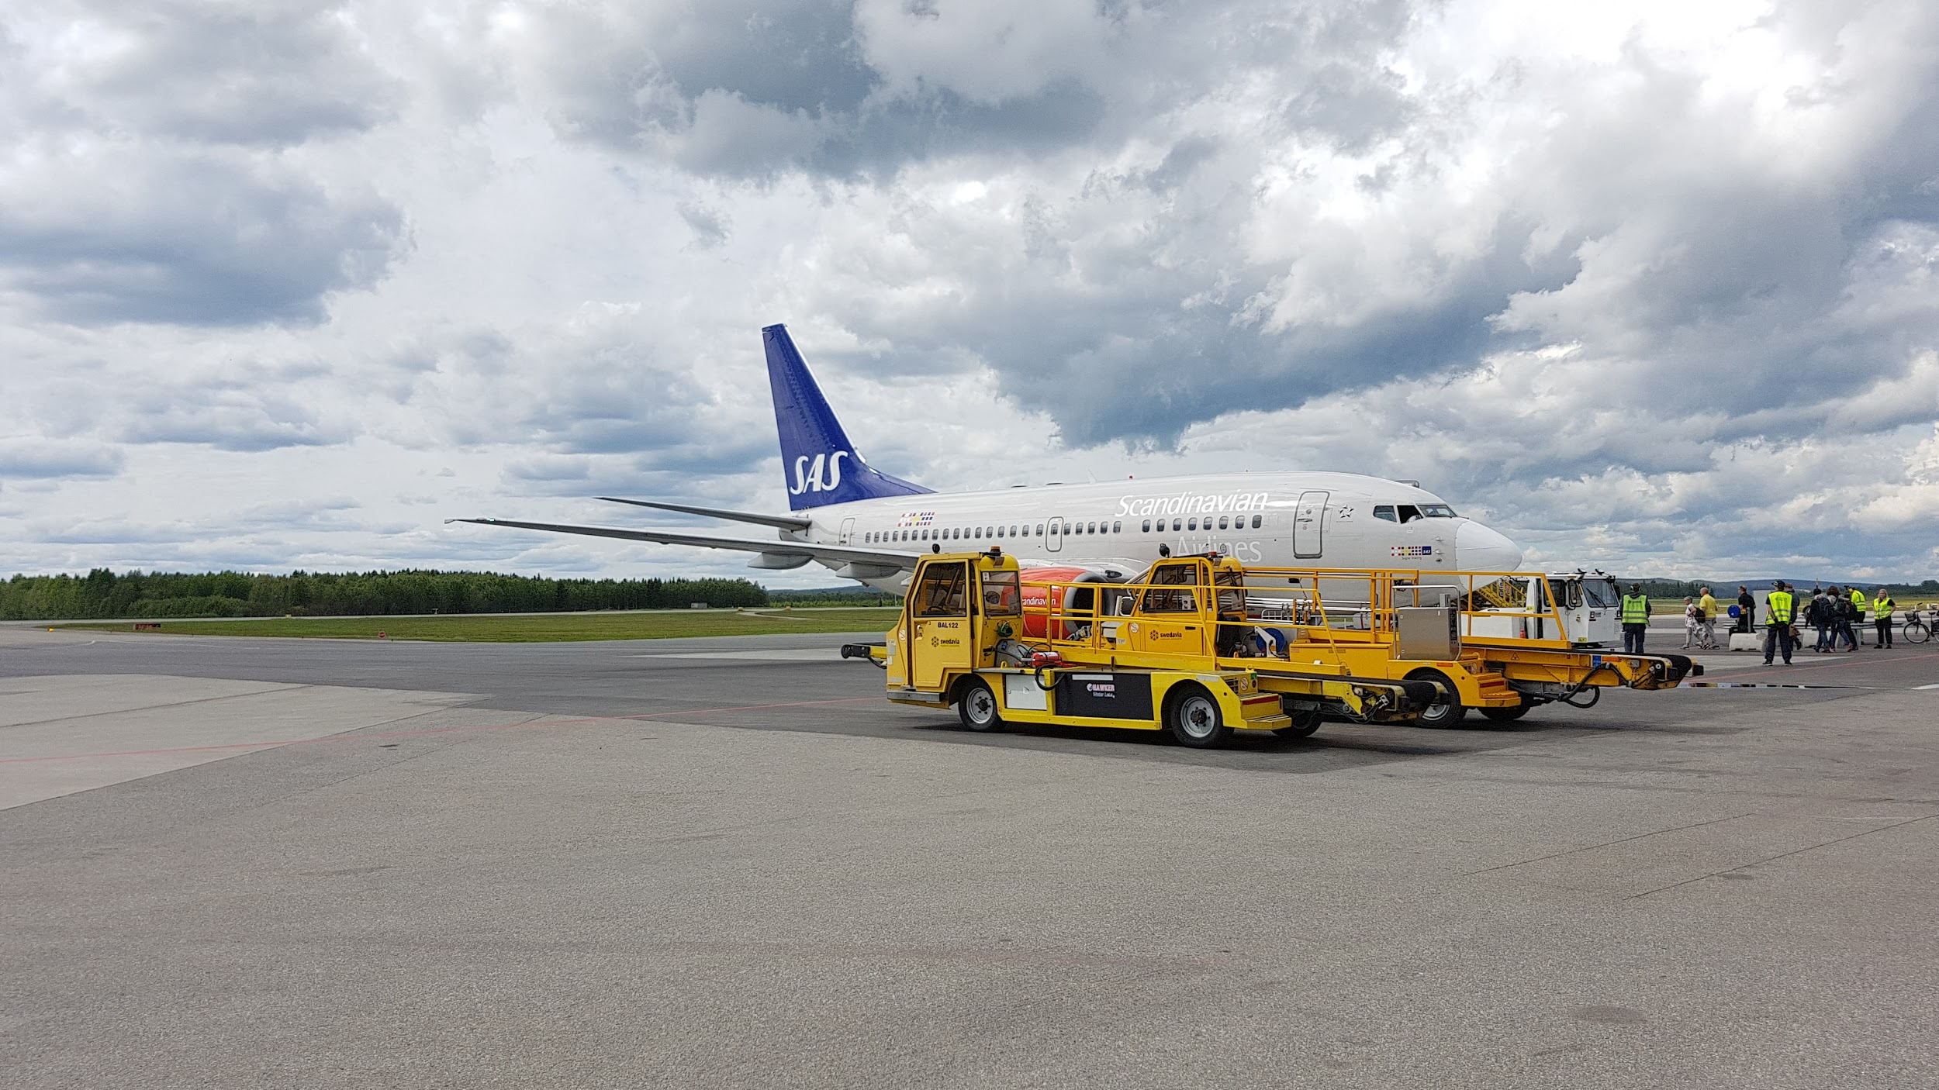

Umeå
63.8270°N
Florian Thiery (CC BY 4.0)

Slide 15
0.7674°N
0.10
Umeå
Lycksele
pixabay Pixabay License

Slide 16
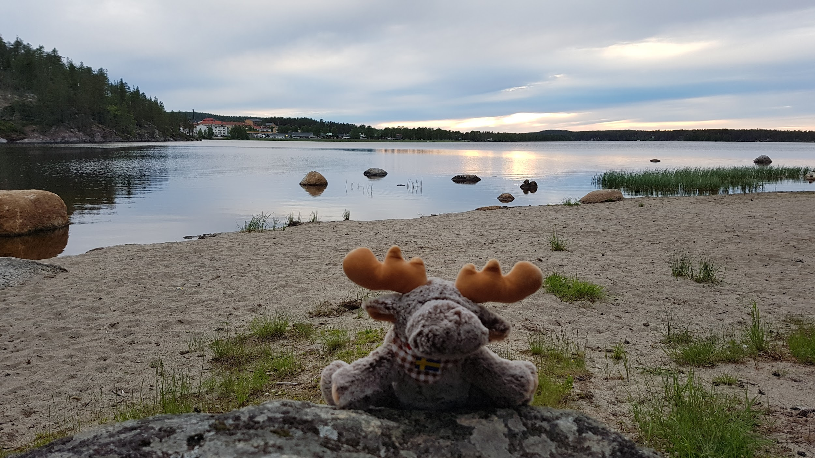

Lycksele
64.5944°N
Florian Thiery (CC BY 4.0)

Slide 17
1.7456°N
0.24
Lycksele
Arctic Circle
pixabay Pixabay License

Slide 18
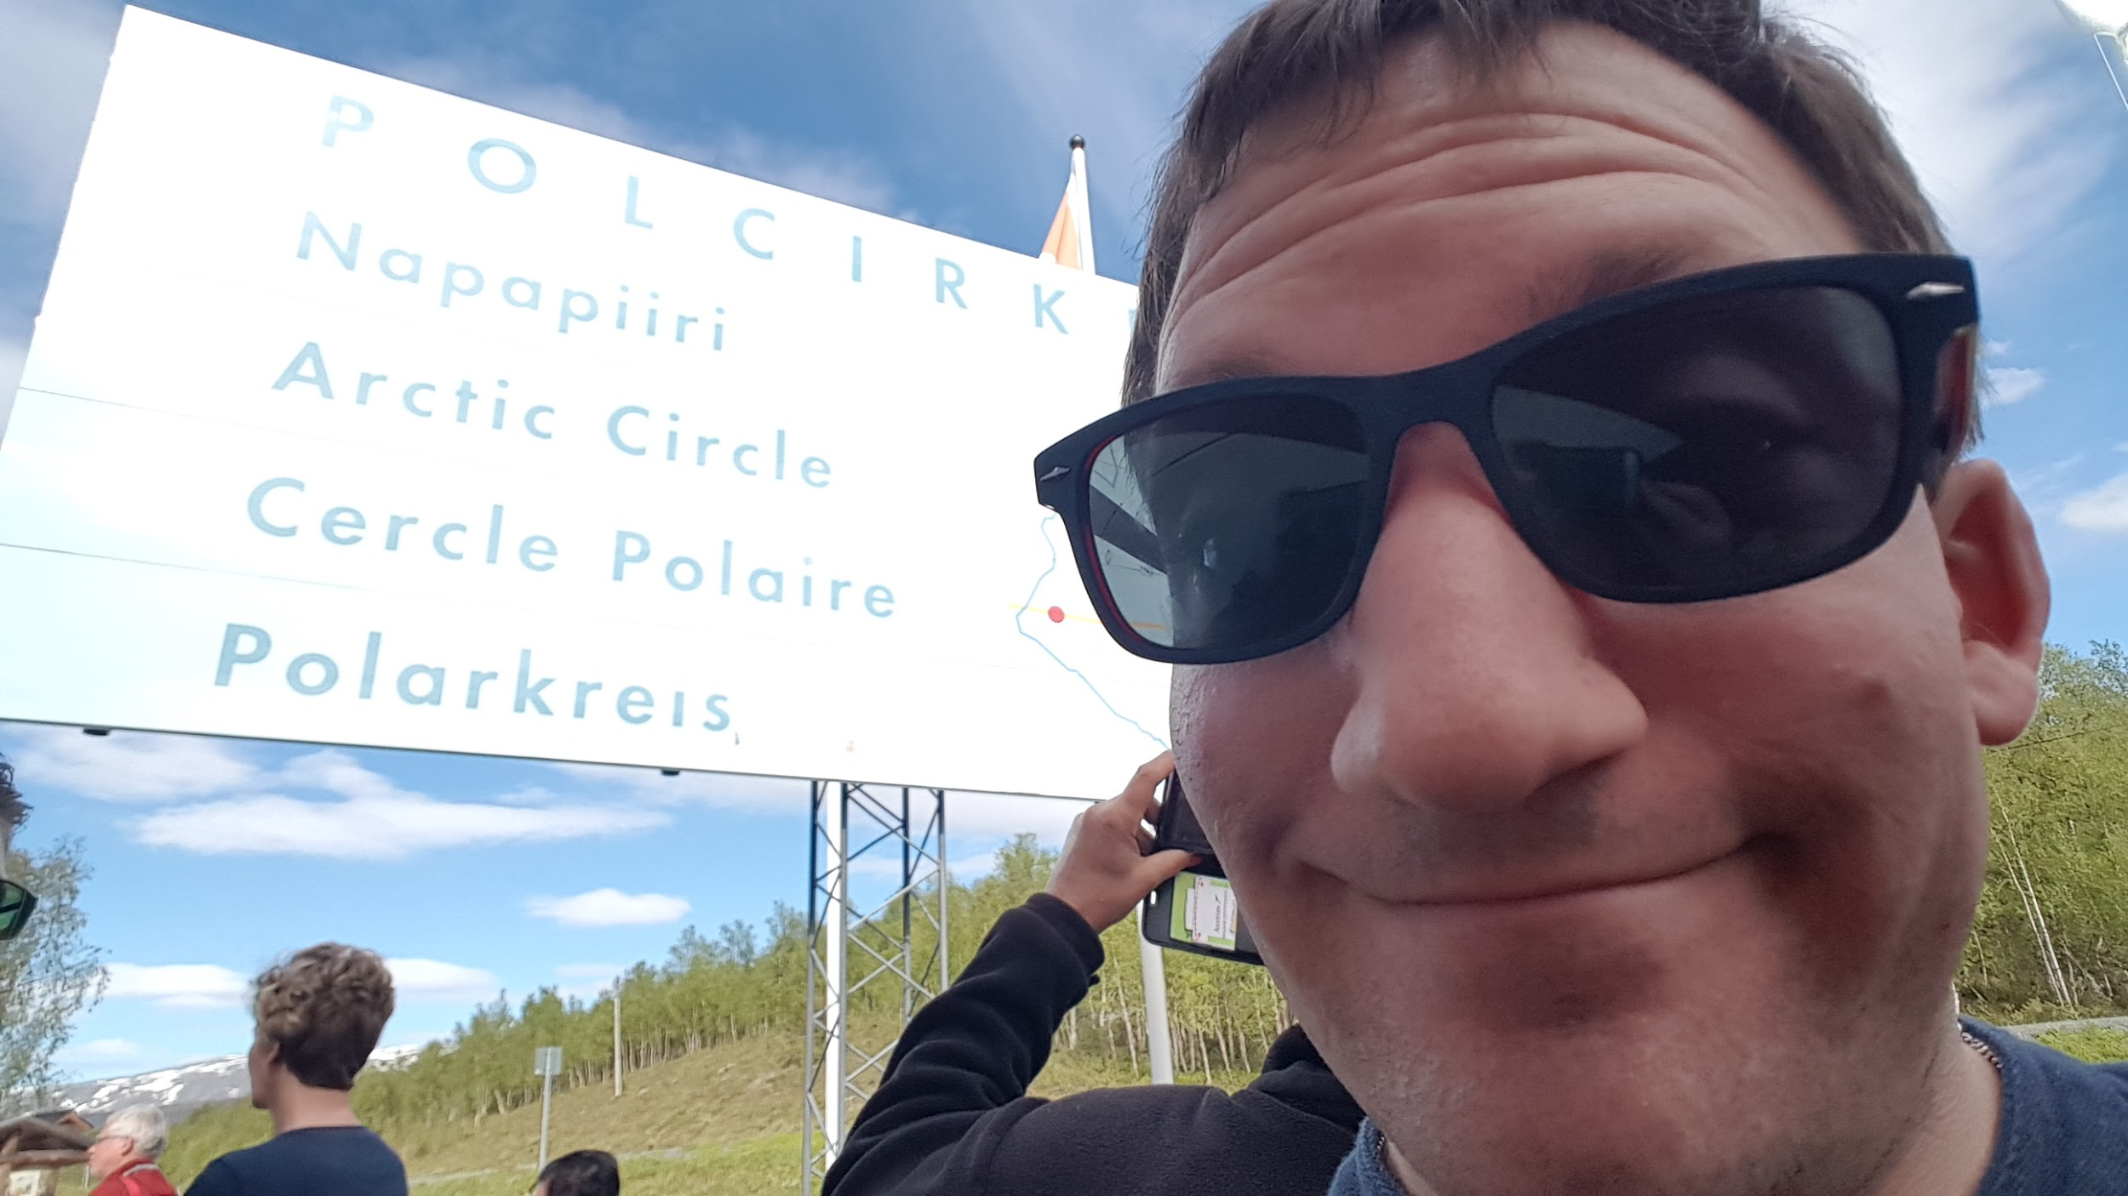
Arctic Circle
66.34°N
Florian Thiery (CC BY 4.0)

Slide 19
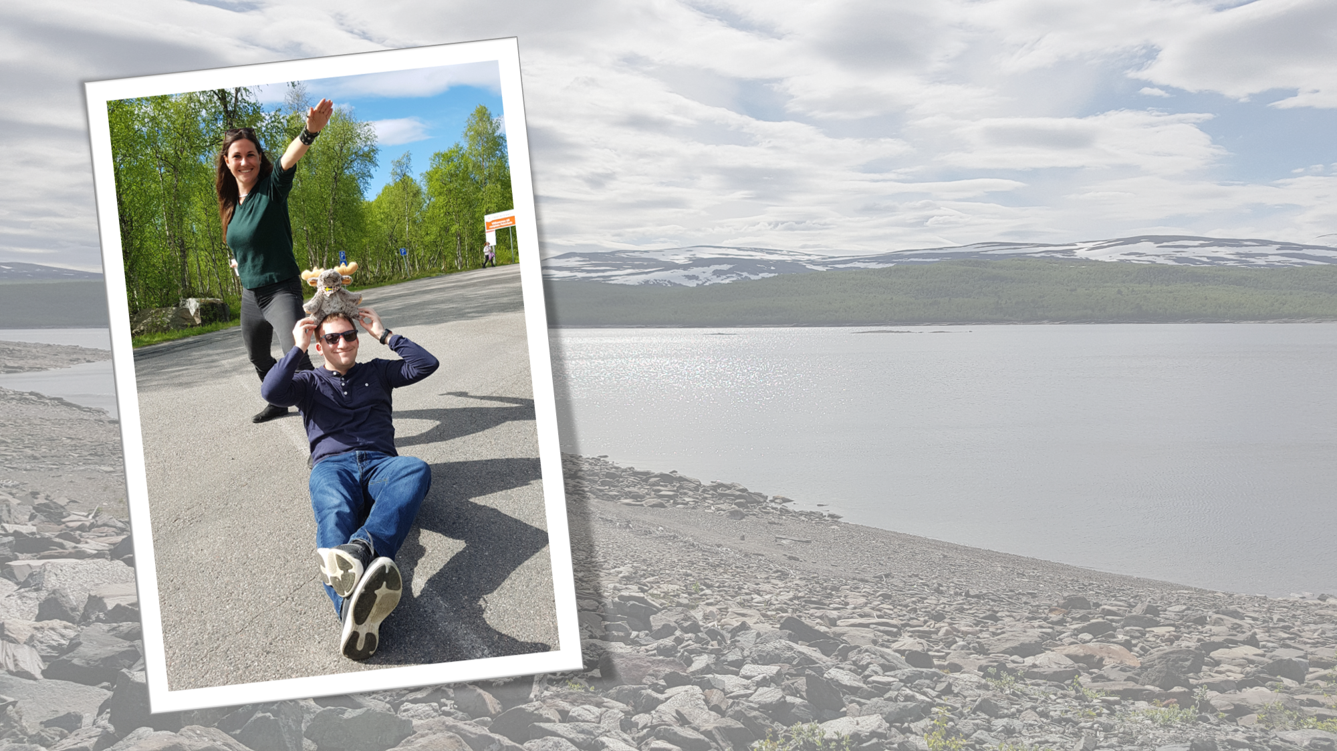
Arctic Circle
66.34°N
Florian Thiery (CC BY 4.0)

Slide 20
0.7572°N
0.10
Arctic Circle
Rognan
pixabay Pixabay License

Slide 21
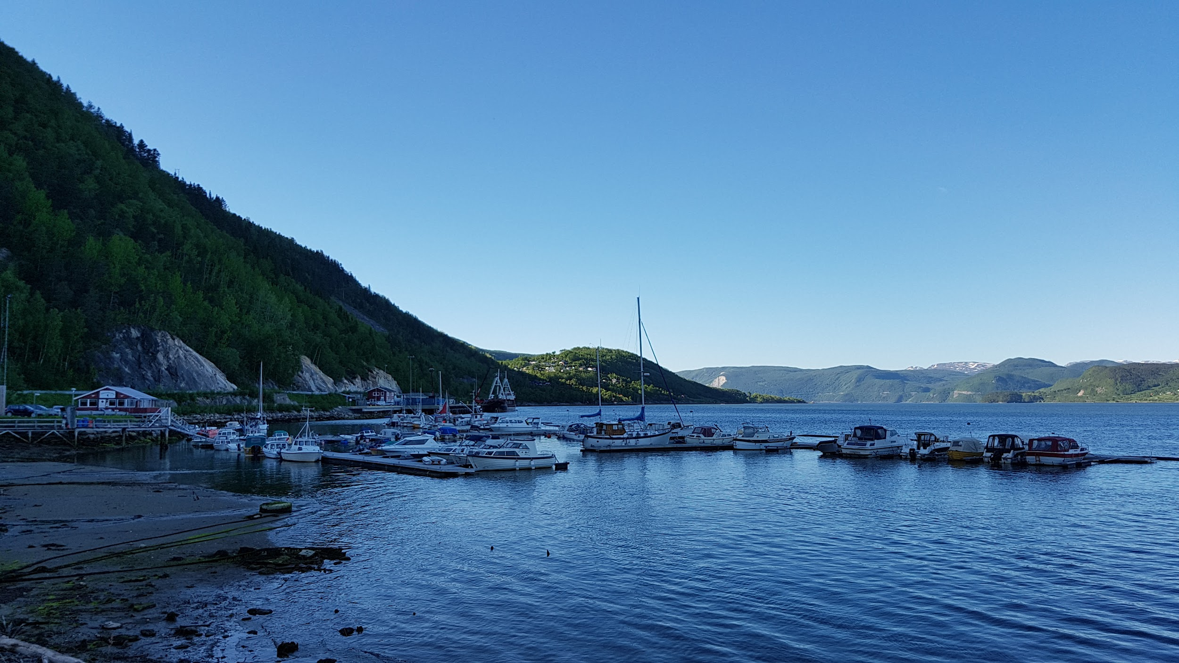
Rognan
67.0972°N
Florian Thiery (CC BY 4.0)

Slide 22
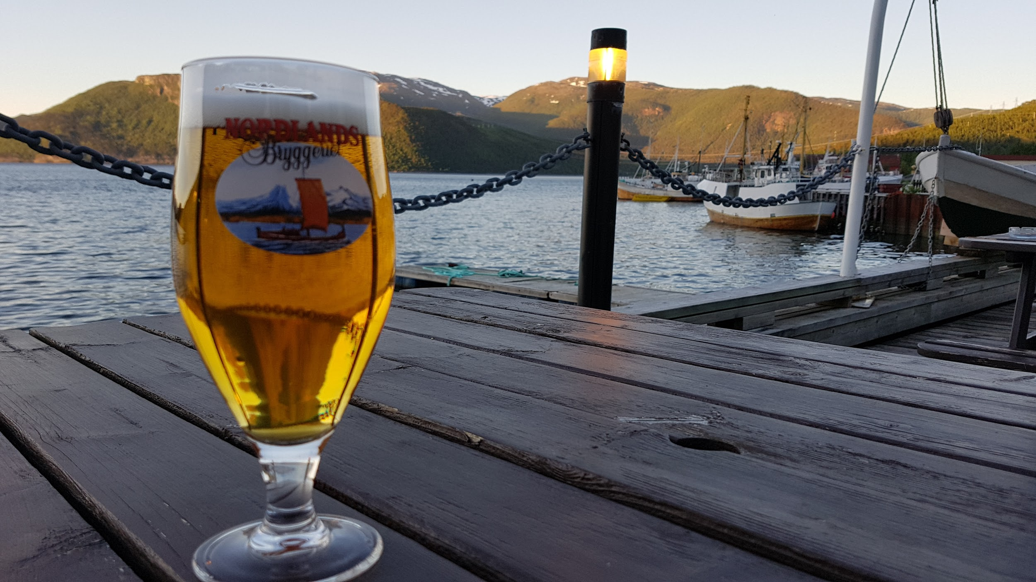
Rognan
67.0972°N
Florian Thiery (CC BY 4.0)

Slide 23
1.2359°N
0.17
Rognan
Lofoten
pixabay Pixabay License

Slide 24
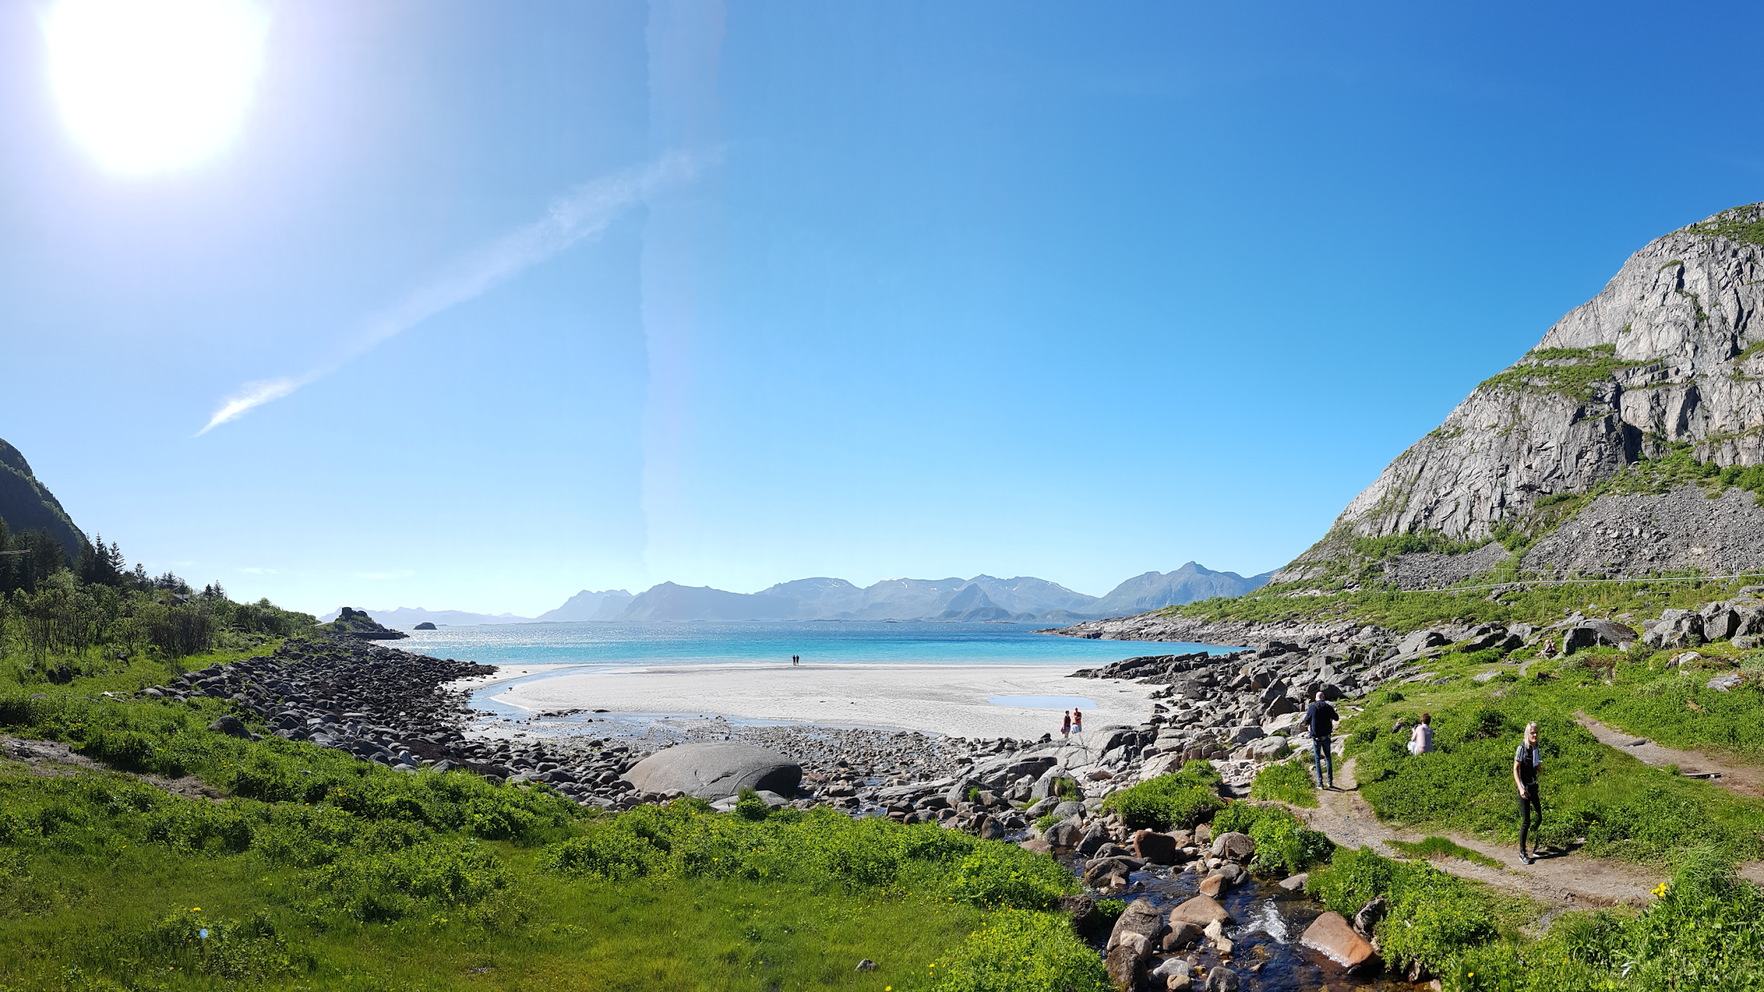
Lofoten
68,3331°N
Florian Thiery (CC BY 4.0)

Slide 25
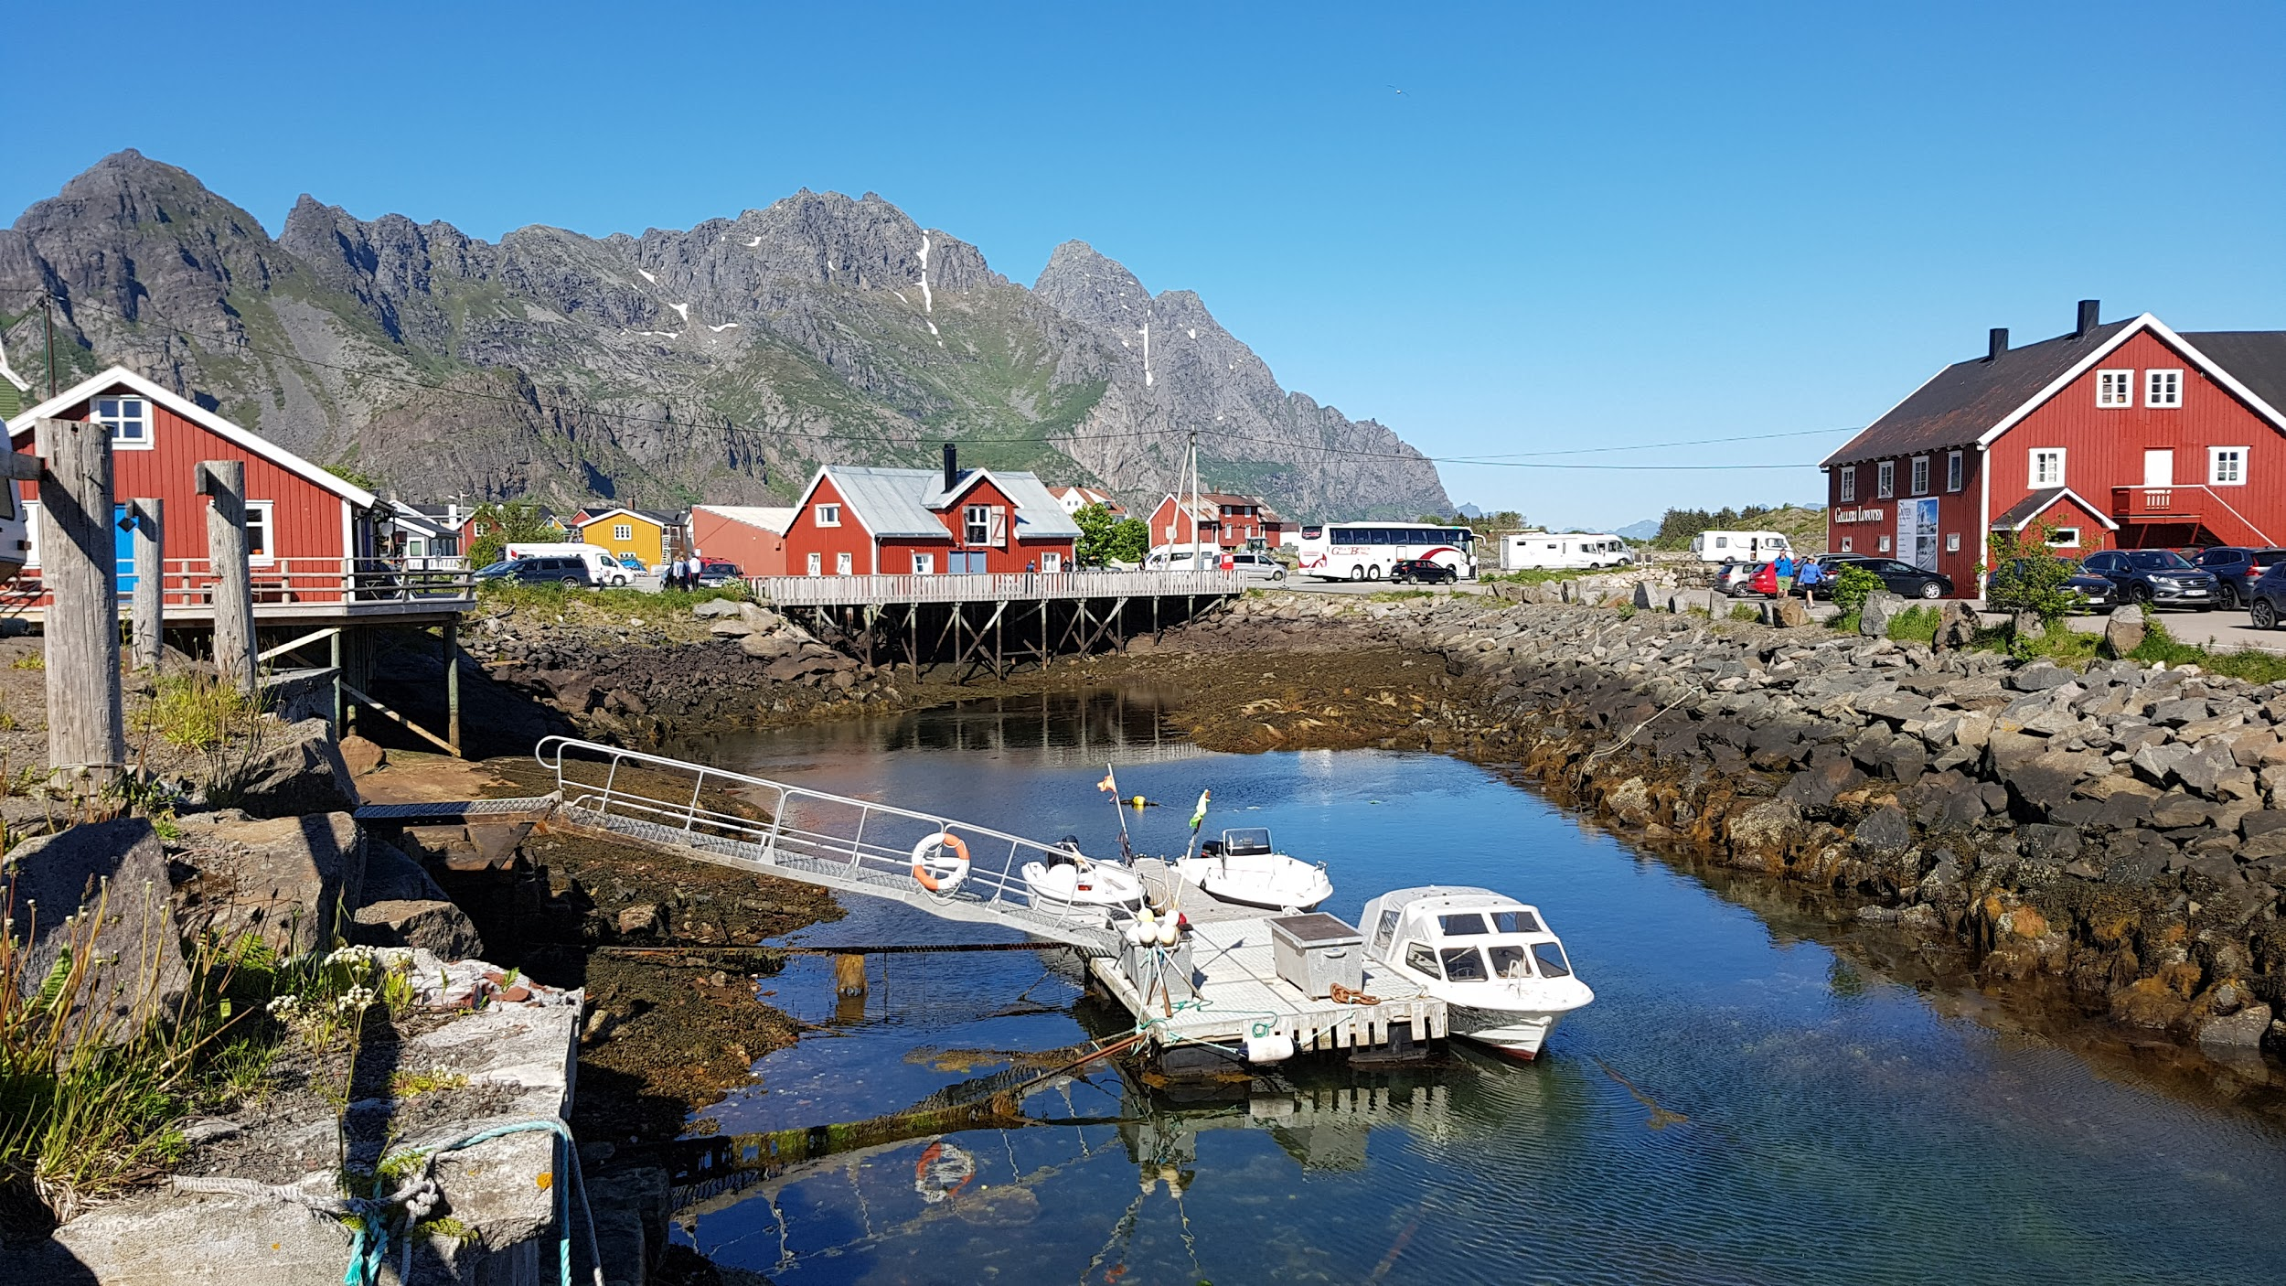
Lofoten
68,3331°N
Florian Thiery (CC BY 4.0)

Slide 26
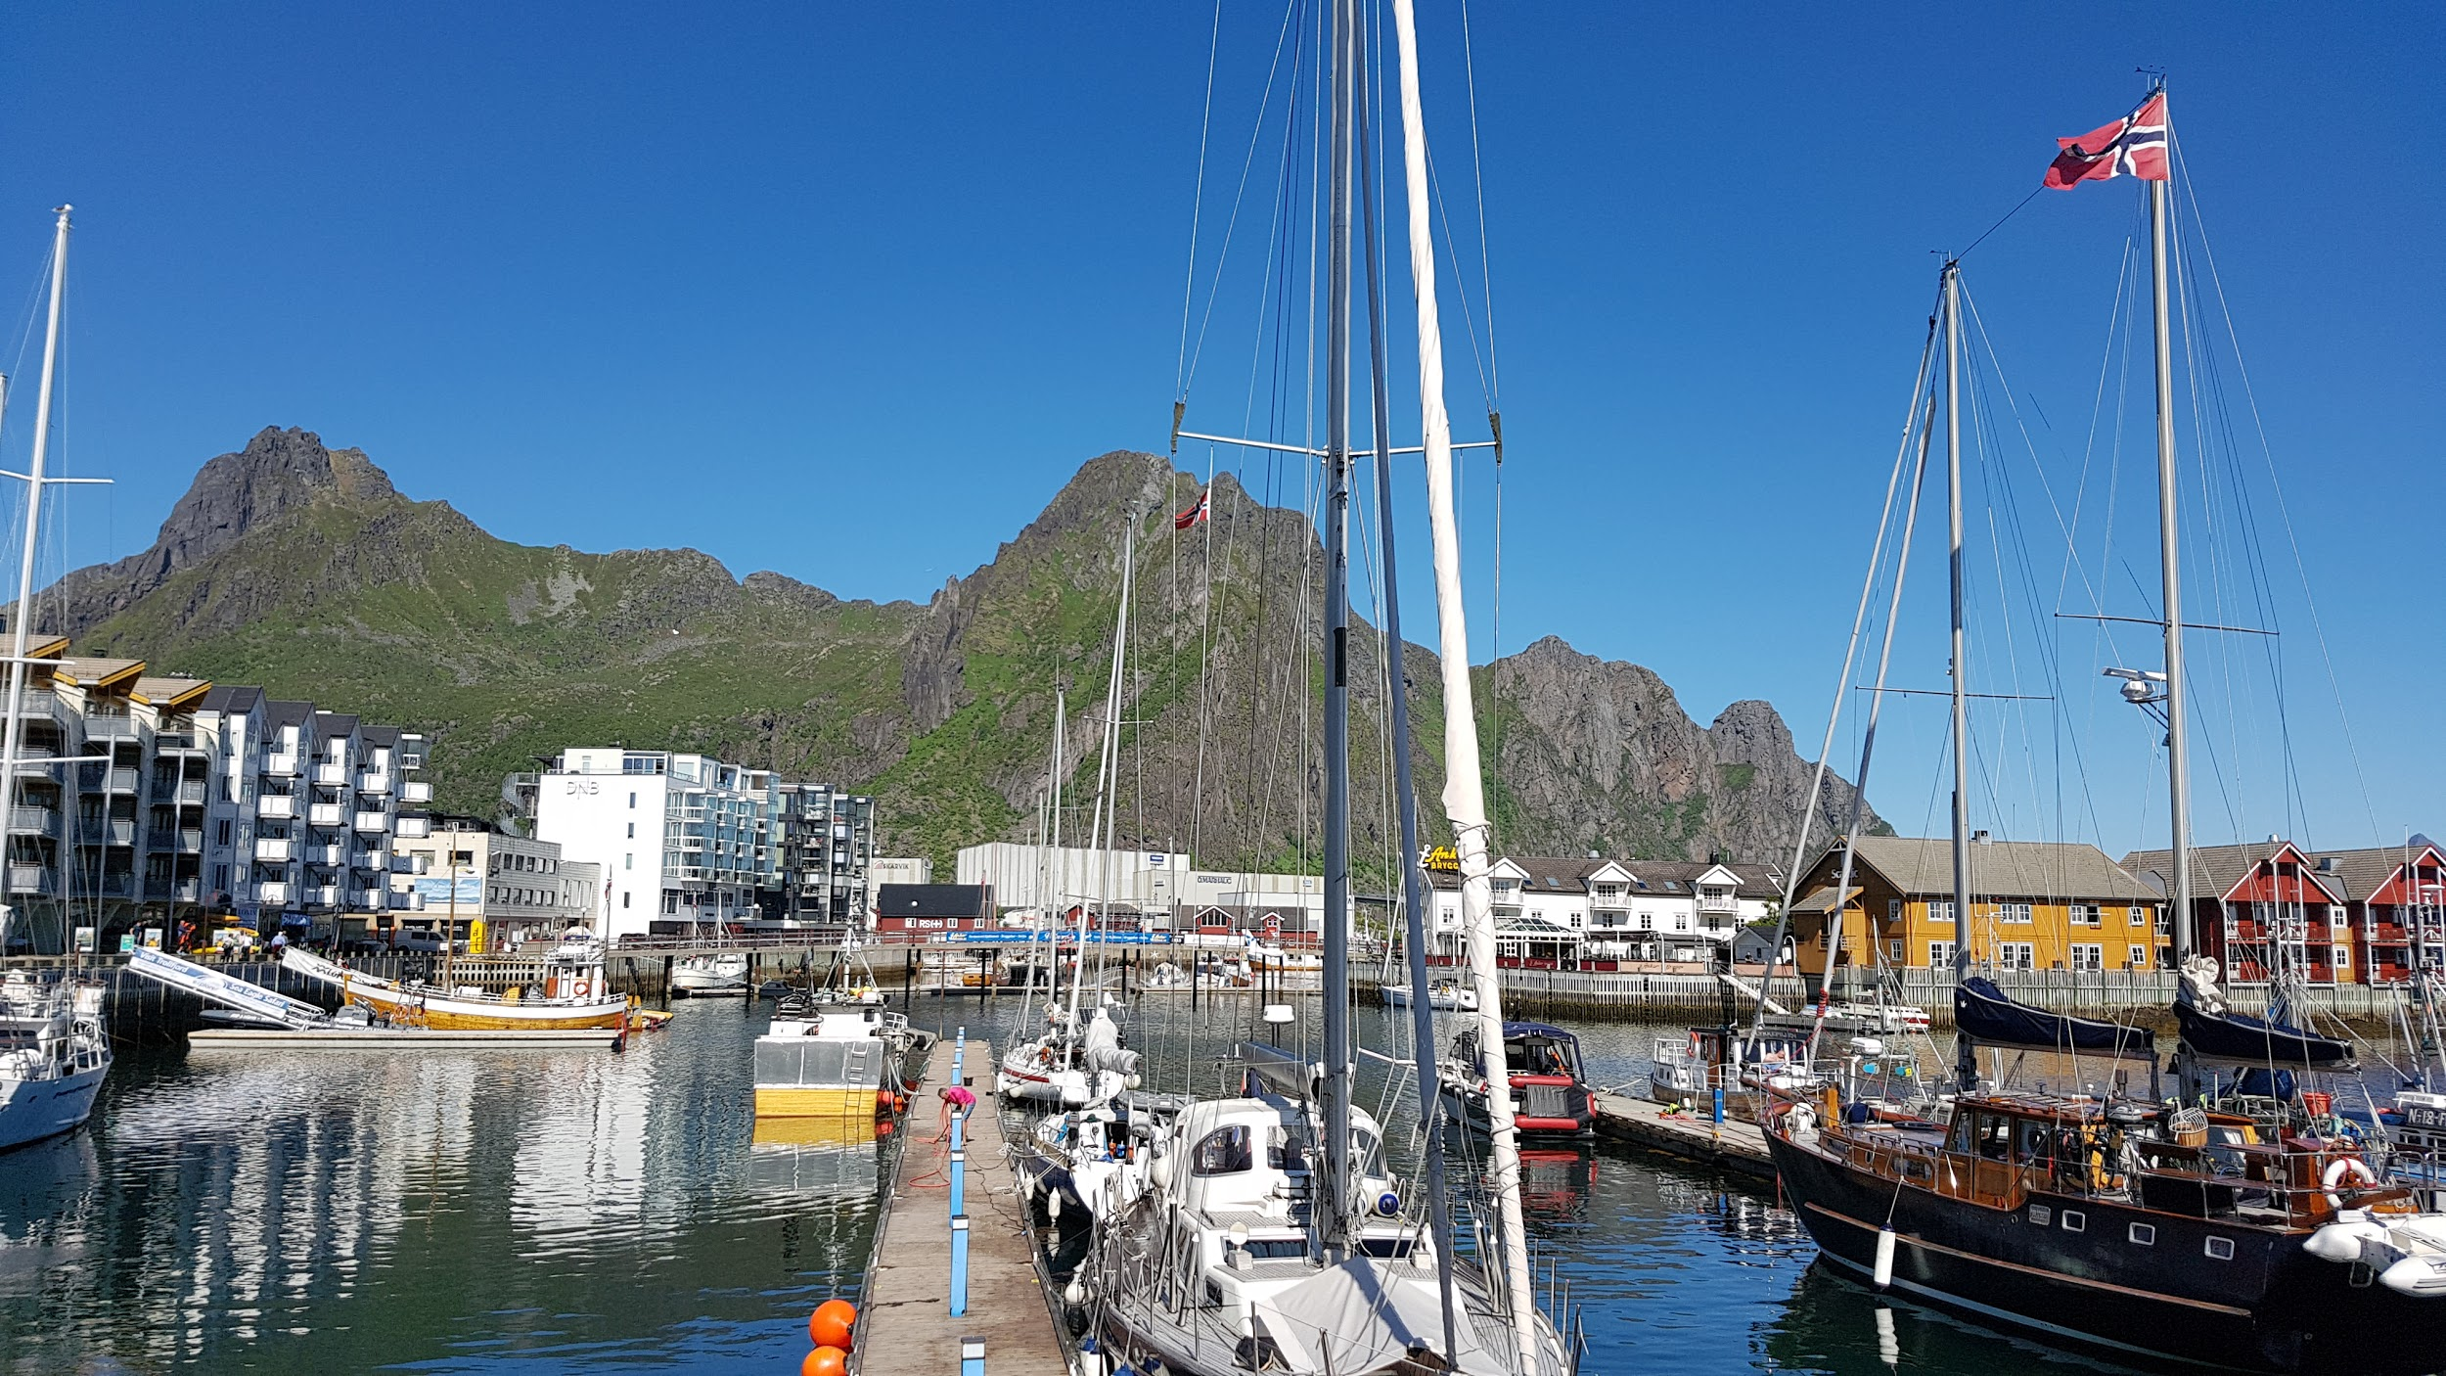
Lofoten
68,3331°N
Florian Thiery (CC BY 4.0)

Slide 27
1.3187°N
0.18
Lofoten
Tromsø
pixabay Pixabay License

Slide 28
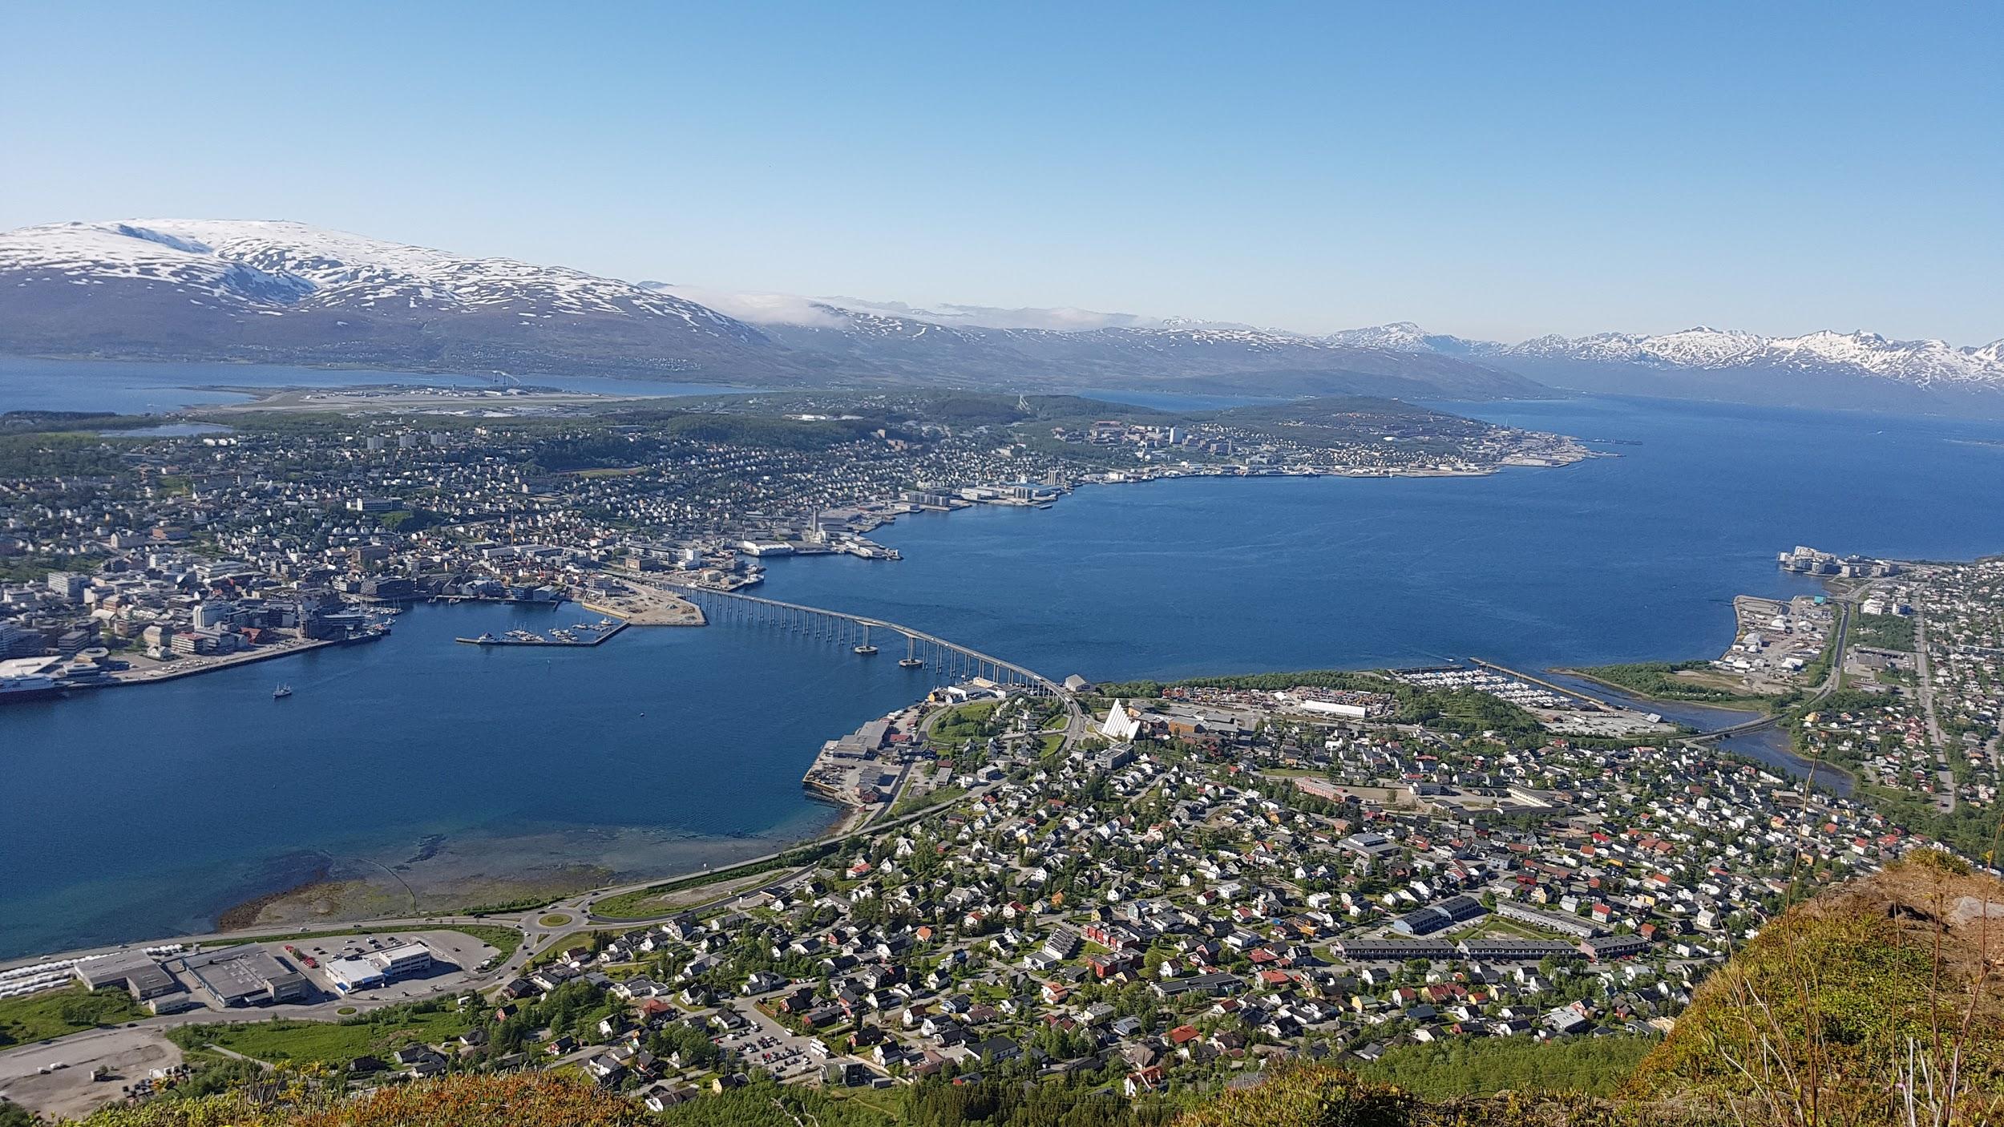
Tromsø
69,6518°N
Florian Thiery (CC BY 4.0)

Slide 29
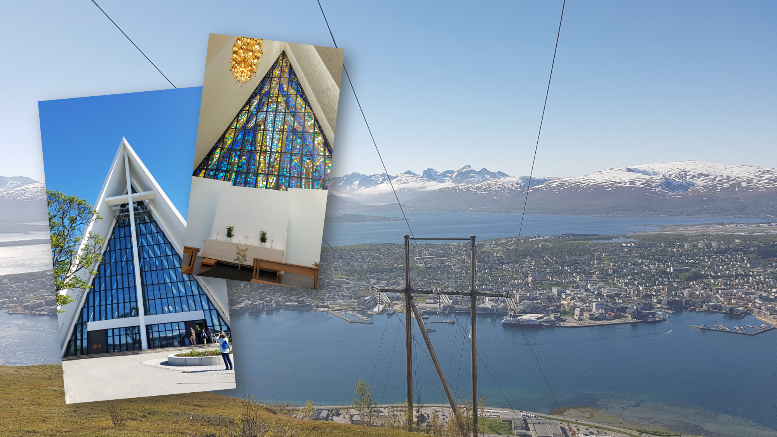
Tromsø
69,6518°N
Florian Thiery (CC BY 4.0)

Slide 30
1.5207°N
0.21
Tromsø
North Cape
pixabay Pixabay License

Slide 31
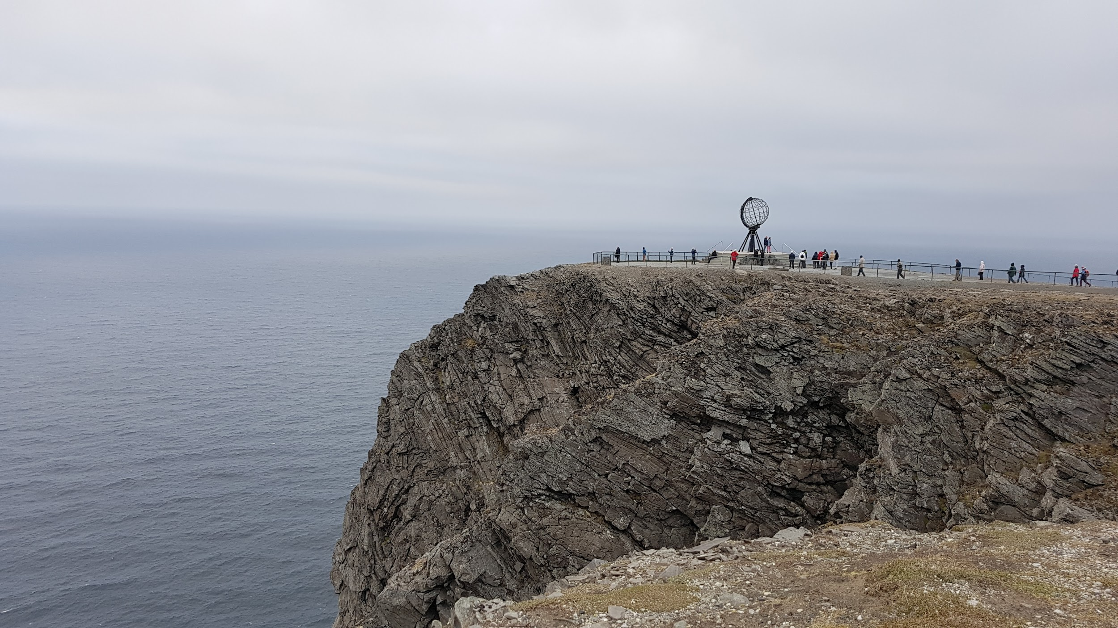
North Cape
71,1725°N
Florian Thiery (CC BY 4.0)

Slide 32
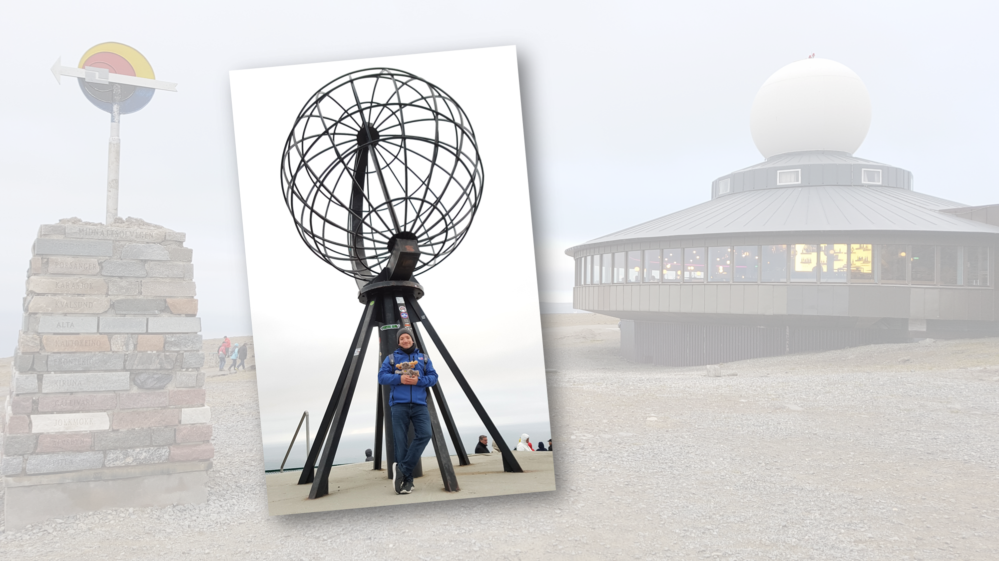
North Cape
71,1725°N
Florian Thiery (CC BY 4.0)

Slide 33
-2.2669°N
-0.31
North Cape
Inari
pixabay Pixabay License

Slide 34
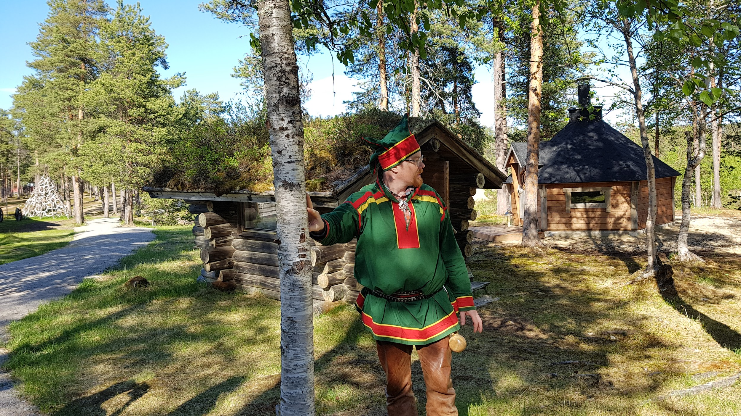

Inari
68,9056°N
Florian Thiery (CC BY 4.0)

Slide 35

Inari
68,9056°N
Florian Thiery (CC BY 4.0)

Slide 36
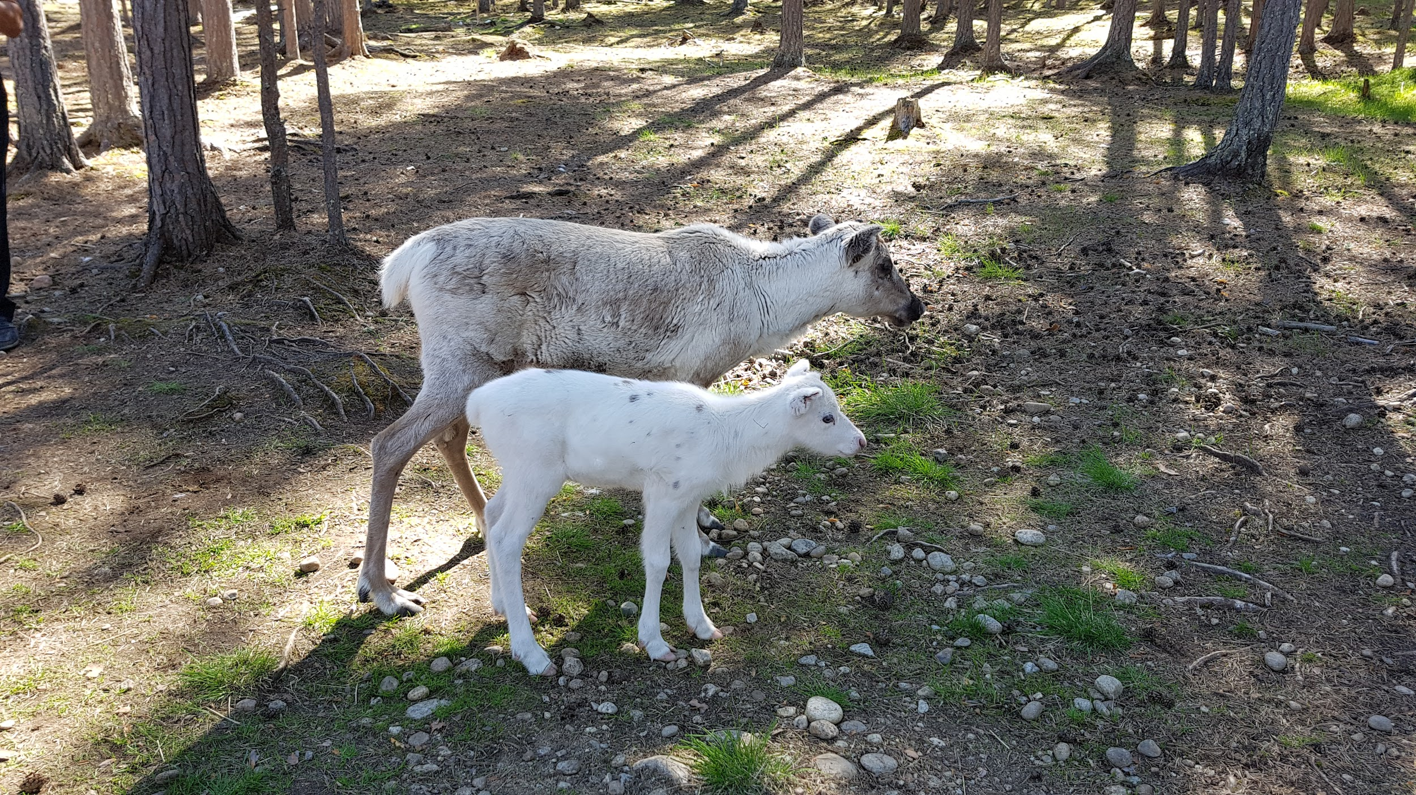
Inari
68,9056°N
Florian Thiery (CC BY 4.0)

Slide 37
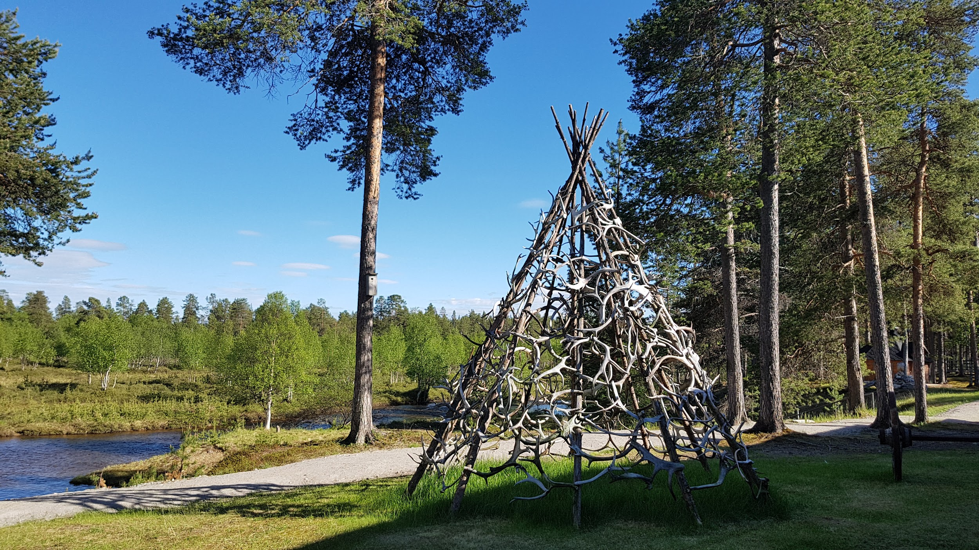
Inari
68,9056°N
Florian Thiery (CC BY 4.0)

Slide 38
-2.3625°N
-0.32
Inari
Santa Claus
pixabay Pixabay License

Slide 39
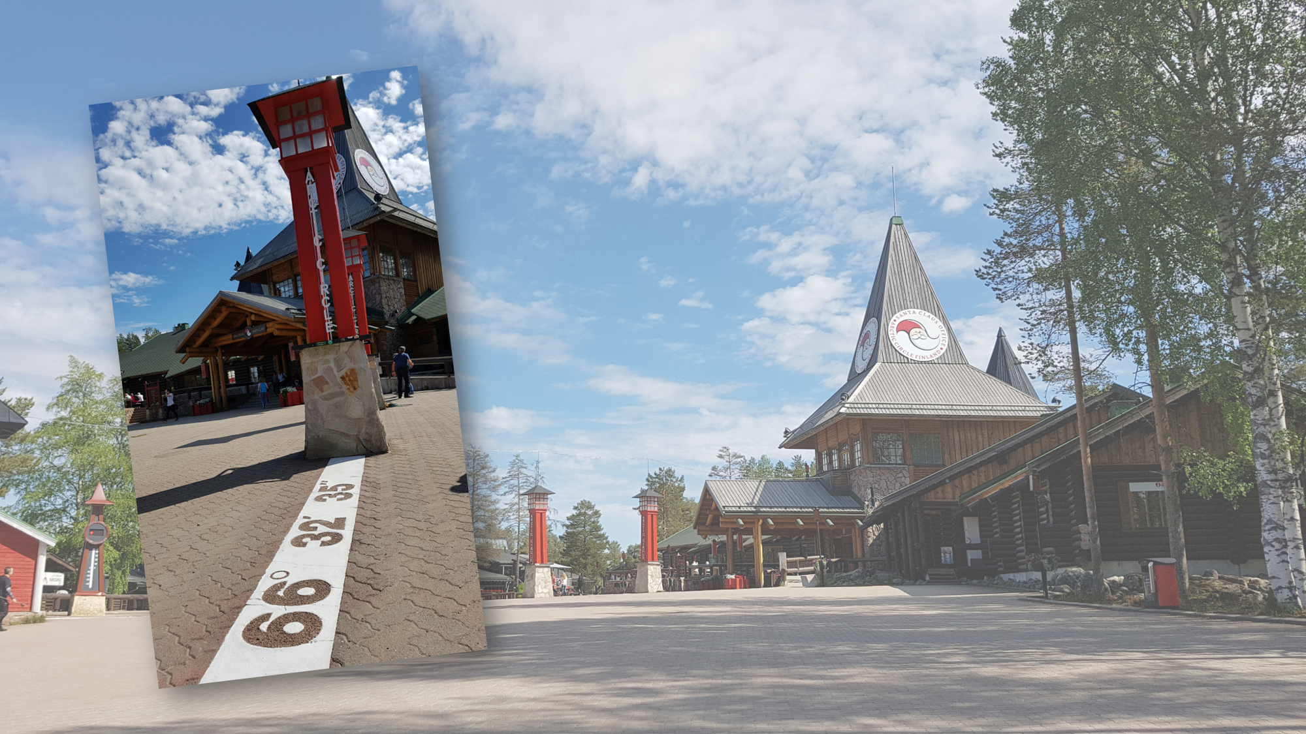
Santa Claus
66,5431°N
24C°
Florian Thiery (CC BY 4.0)

Slide 40
-2.7161°N
-0.37
Santa Claus
Umeå
pixabay Pixabay License

Slide 41
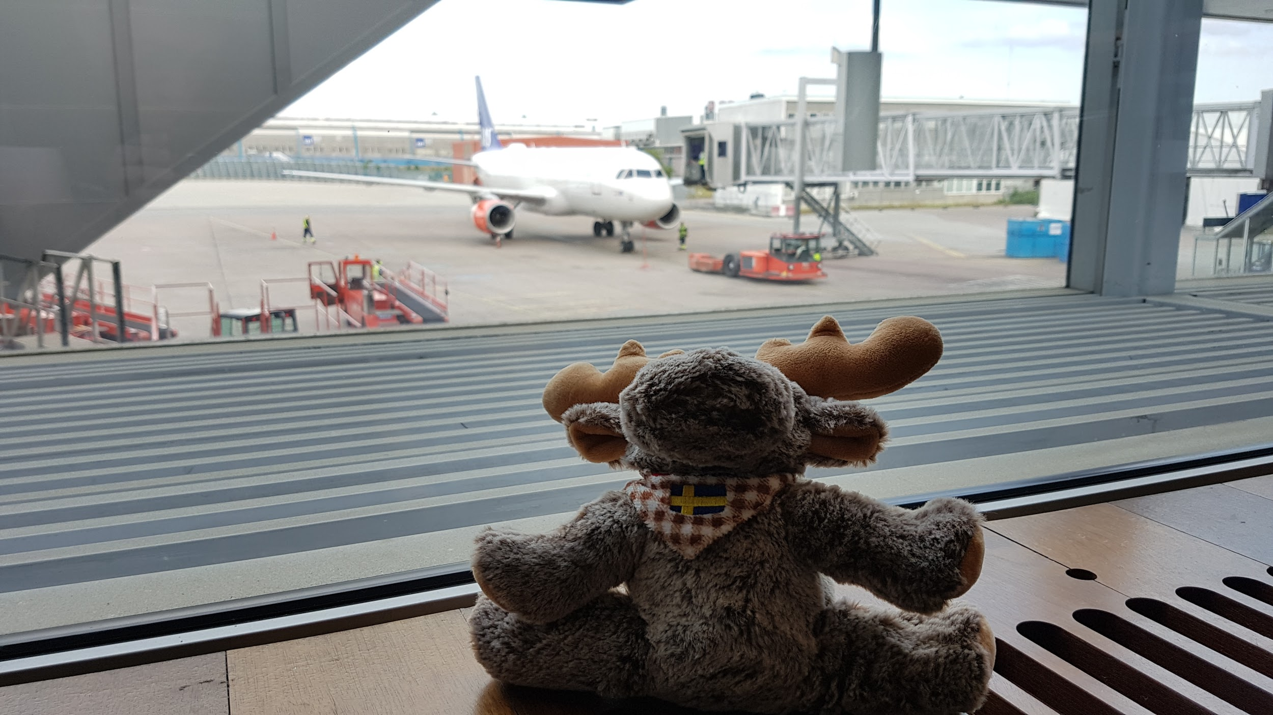
Umeå
63.8270°N
Florian Thiery (CC BY 4.0)

Slide 42
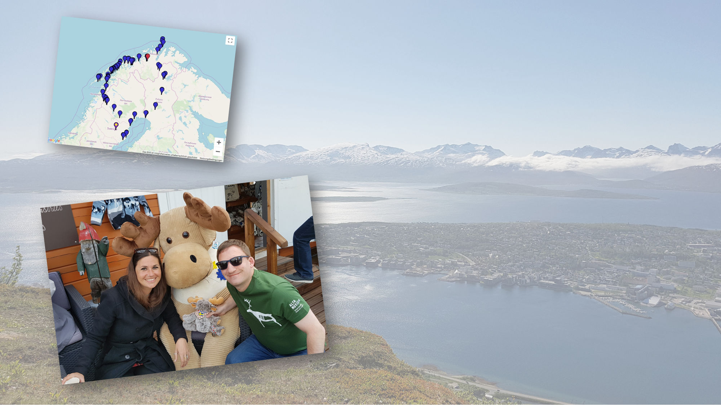
Thx Anne for the great experience!
Florian Thiery (CC BY 4.0)

Slide 43
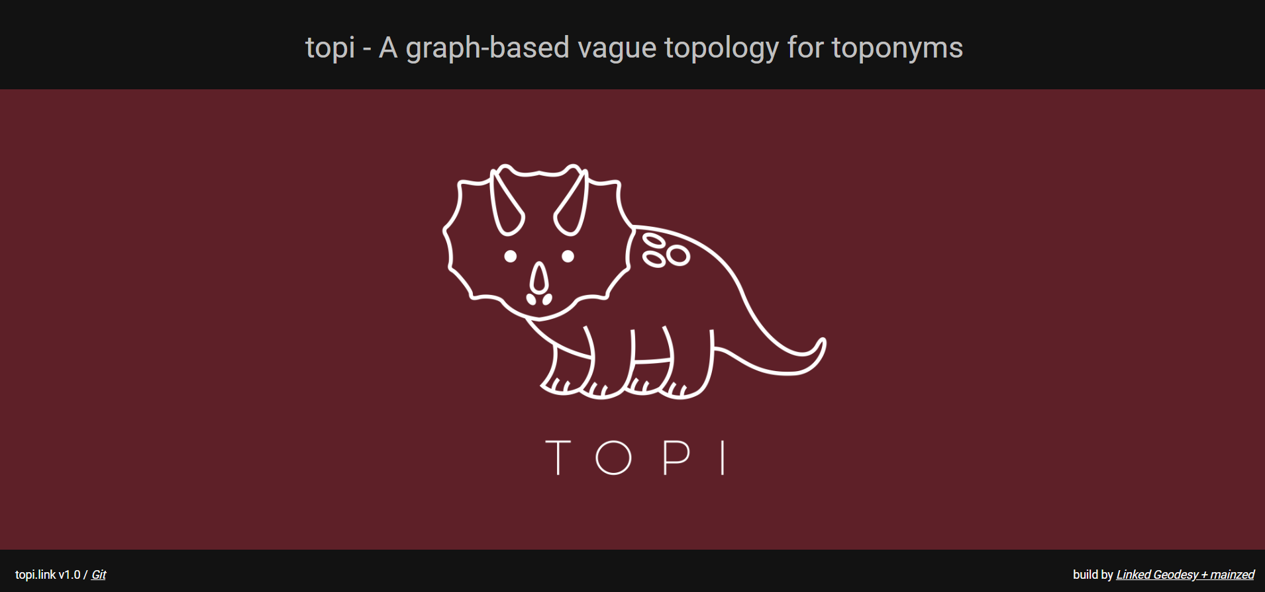
model the trip via topi.link …

Slide 44
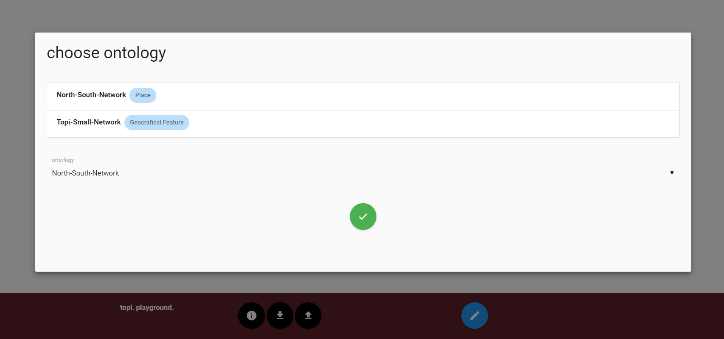
… using the North-South Network …

Slide 45
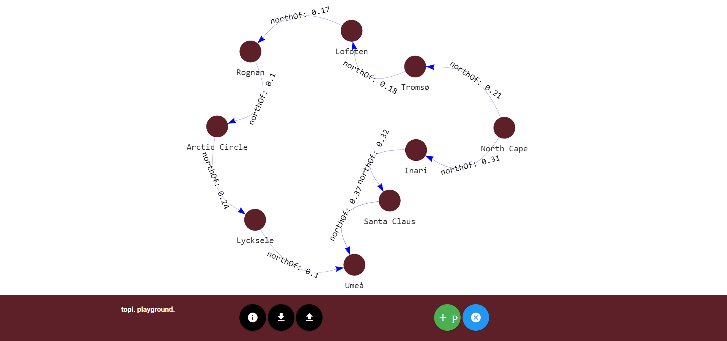
… create the trip network …

Slide 46
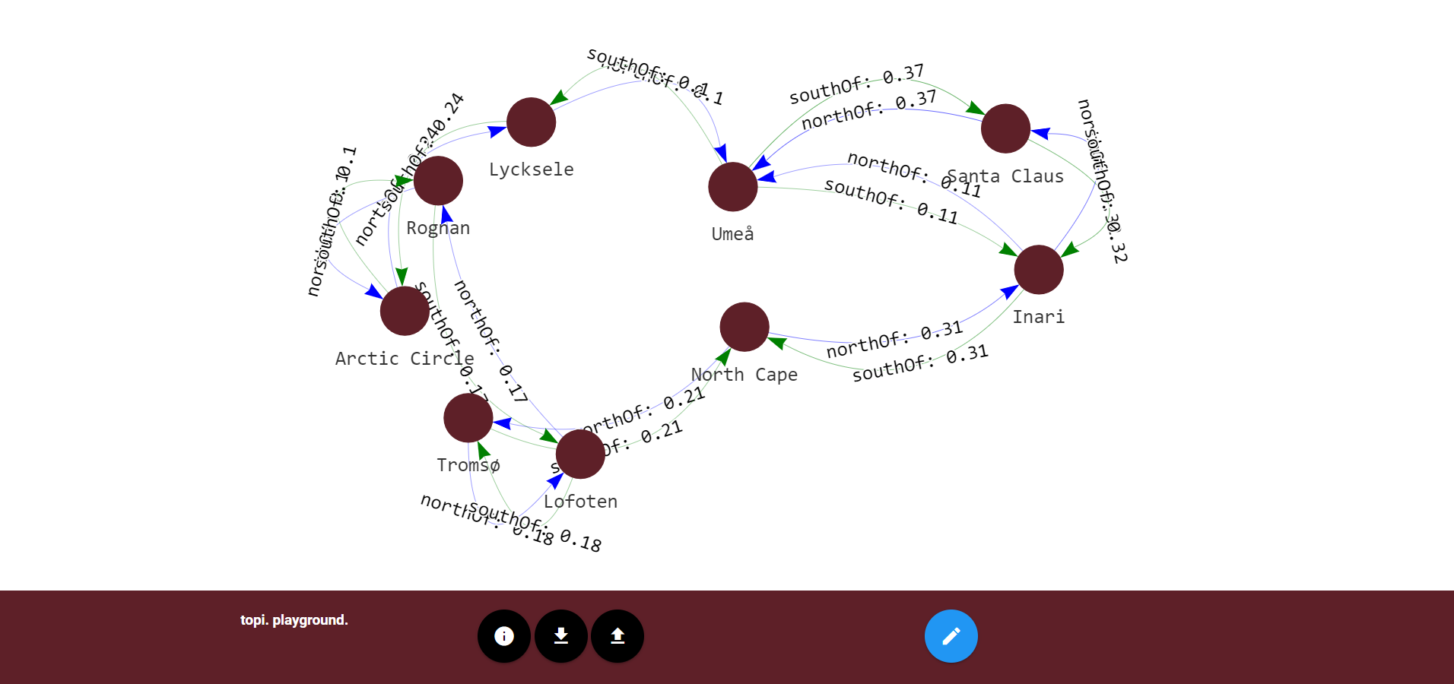
… and let us do magic :-)

Slide 47
http://topi.link

Slide 48


Thx!
Any questions?
you can find me on twitter @fthierygeo
contact via mail rse@fthiery.de
ORCID 0000-0002-3246-3531

Slide 49
Literature & Talks
Unold, M., Thiery, F., Mees, A. (2019). Academic Meta Tool – Ein Web-Tool zur Modellierung von Vagheit. In Andreas Kuczera, Thorsten Wübbena and Thomas Kollatz, Eds., Die Modellierung des Zweifels – Schlüsselideen und -konzepte zur graphbasierten Modellierung von Unsicherheiten, (Zeitschrift für digitale Geisteswissenschaften / Sonderbände, 4).
http://dx.doi.org/10.17175/sb004_004 (German only)
Thiery, F., Mees, A. (2019). Dating Mechanism: Eine Linked Data Strategie zur interoperablen und nachvollziehbaren Modellierung relativer Chronologien am Beispiel südgallischer Terra Sigillata in Limes-Abschnitten, Graphentechnologien 2019, Mainz, Germany, 18th January 2019.
https://doi.org/10.5281/zenodo.2540373 (German only)
Thiery, F., Mees, A. (2018). Taming the chronology of South Gaulish Samian found at Hadrian's Wall and the German Limes using Linked Open Data, UK Chapter of Computer Applications and Quantitative Methods in Archaeology (CAA-UK 2018), Edinburgh, Scotland, 26th October 2018.
https://doi.org/10.5281/zenodo.1469298 (English)

Slide 50
Literature & Talks
Seidensticker, D., Thiery, F., Mees, A., Schmid, C. (2018). RDF based modeling of relative and absolute chronological data: Examples from the central african rainforest and roman periodisation, 24th Annual Meeting of the European Association of Archaeologists (EAA2018), Barcelona, Spain, 08th September 2018. https://doi.org/10.5281/zenodo.1410516 (English)
Thiery, F., Mees, A. (2018). Taming Time – Modelling uncertainty as reproducible Linked Open Data, 24th Annual Meeting of the European Association of Archaeologists (EAA2018), Barcelona, Spain, 08th September 2018. https://doi.org/10.5281/zenodo.1402509 (English)
Thiery, F., Mees, A. (2018). Taming Ambiguity - Dealing with doubts in archaeological datasets using LOD, Computer Applications and Quantitative Methods in Archaeology (CAA), Tübingen, Germany, 22nd March 2018. https://doi.org/10.5281/zenodo.1200111 (English)
Florian Thiery. (2019). topi.link: The Northern and Southern Ontology, In F. Thiery Ed. Linked Geodesy Working Papers. 10.5281/zenodo.2643727. Mainz, Germany. DOI: 10.5281/zenodo.2635490 (English)

Slide 51
Literature & Talks
Thiery, F., Mees, A. (2018). Putting Samian pots together – modelling ceramic service family roots – connecting figure types. Wie Graphen bei der Modellierung des Zweifels helfen können, Graphentechnologien 2018, Mainz, Germany, 19th January 2018.
https://doi.org/10.5281/zenodo.1155748 (German only)
Unold, M., Thiery, F. (2018). Academic Meta Tool – Ein Web-Tool zur Modellierung des Zweifels, Graphentechnologien 2018, Mainz, Germany, 19th January 2018.
https://doi.org/10.5281/zenodo.1155727 (German only)
Unold, M. et al. (2017). Basic types of non-boolean description logics.
http://unold.net/research/p_dls_20170320.pdf (English)
Unold, M., Cruz, C. (2017). How to enrich description logics with fuzziness. 2017 Computing Conference, London, 2017, pp. 51-57. https://doi.org/10.1109/SAI.2017.8252080 (English)

Slide 52
Credits
presentation template by SlidesCarnival
photos not referenced by Pixabay or Florian Thiery
Thanks to Anne Götz (Zonista) for the great trip

Slide 53
License
Except where otherwise noted, content on this presentation "topi.link - A graph-based topology for vague geographical relations" is licensed under a Creative Commons Attribution 4.0 International license.

