Slide 1

Following laboratory protocols: Filling in the gaps using protocols.io
Esther Plomp, Data Conversations, 17 June 2019
Vrije Universiteit Amsterdam Library @UBVU
https://doi.org/10.5281/zenodo.3246801
Notes:
https://www.slidescarnival.com/kate-free-presentation-template/3530

Slide 2
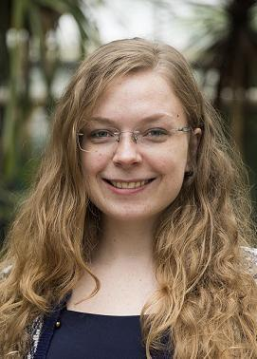

Hello!
Esther Plomp
@PhDToothFAIRy / e.plomp@vu.nl

Slide 3
My Research
Human Teeth
Modern wisdom teeth
Isotopes
Chemical composition which can tell you something about the diet or geographical location of an individual
Neodymium
“New” isotope to study human provenance

Slide 4
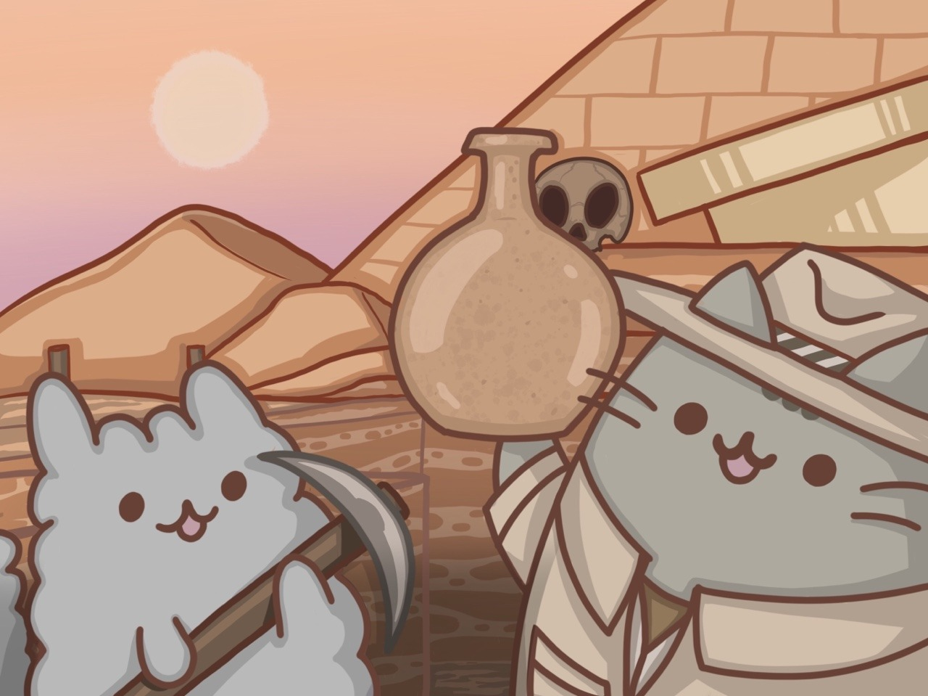
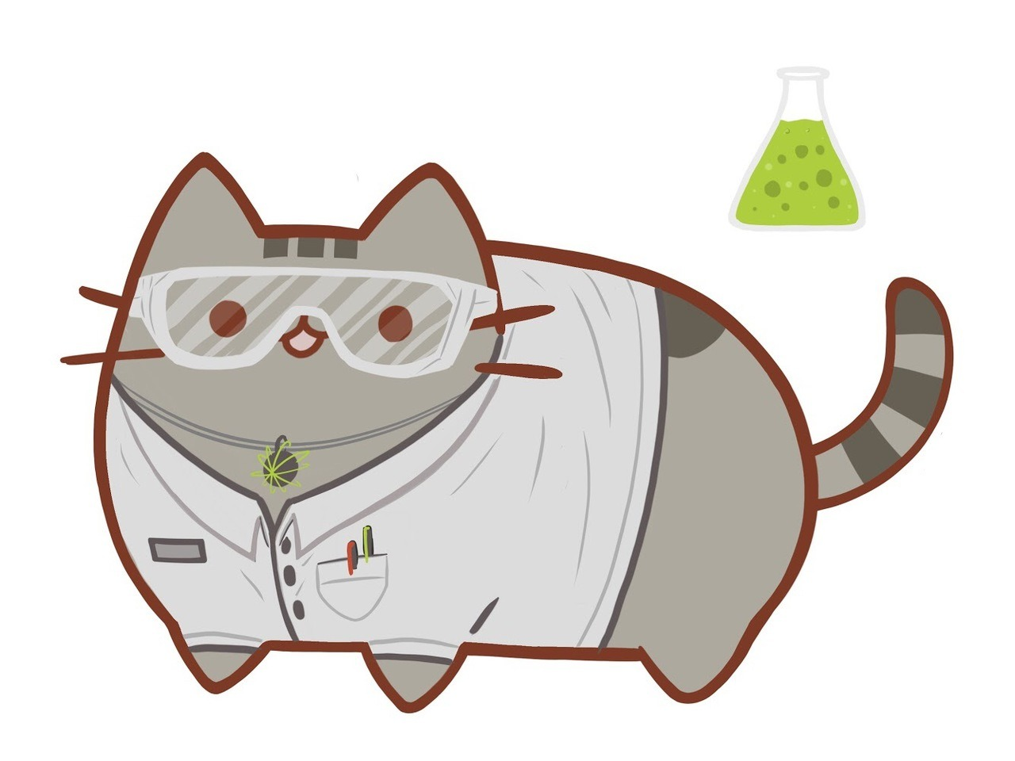
Wet Lab Science
Illustrations by Kelly Stanford
Protocols

Slide 5
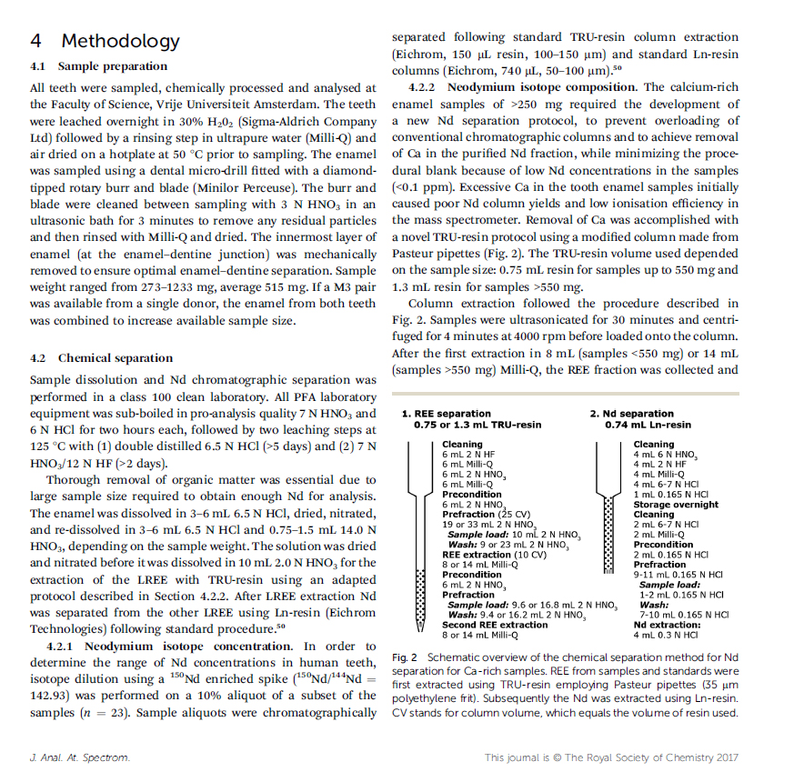
Method Paper 2017
Postprint on EarthArXiv10.31223/osf.io/ky9e3
DOI: 10.1039/c7ja00312a
Elaborate description

Slide 6
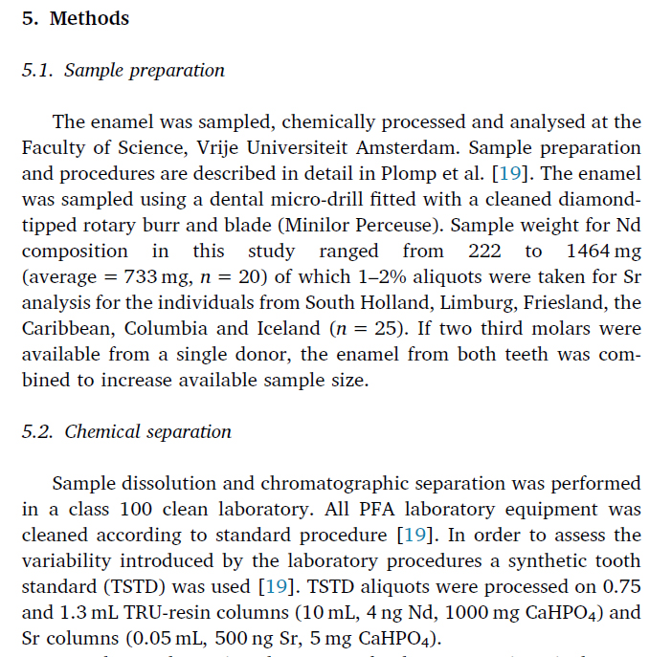
http://doi.org/c696
One sentence description
Evaluation Paper 2019

Slide 7
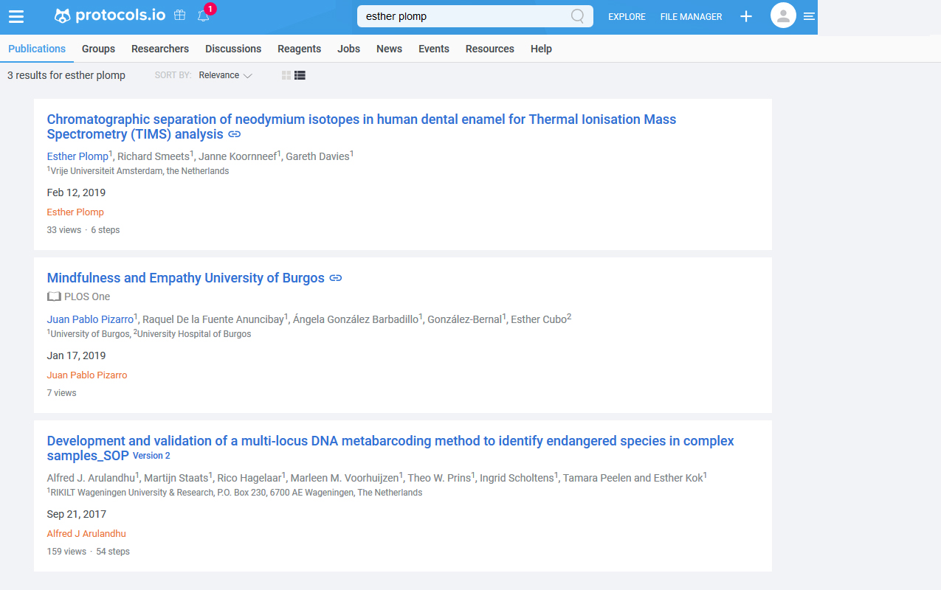
Protocols.io
Place your screenshot here
Online platform for protocol management
Publishing + DOI

Slide 8
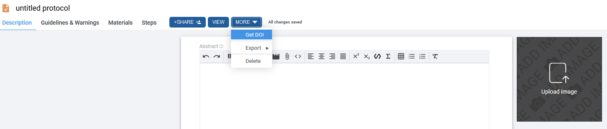
PROCESS
Edit protocol
Reserve DOI
Publish!
Restricted Access (sharing possible)
Snapshot of the protocol
Publically available

Slide 9
“Neodymium extraction followed the procedure described in Plomp et al. [19] (available on protocols.io: dx.doi.org/10.17504/protocols.io.xzmfp46)”

Slide 10
Why?
Visibility
Reproducible
Standardisation
Transparant
Credit
Research
Efficiency
Preservation

Slide 11
“What is your protocol for processing this standard? ”

Slide 12

Thanks!
Any questions?
@PhDToothFAIRy / e.plomp@vu.nl / e.plomp@tudelft.nl
Credits
Presentation template by SlidesCarnival

