Slide 1


Mechanisms for Decadal Climate Predictability
in the Atlantic-Arctic Sector
Rong Zhang
GFDL/NOAA, Princeton, NJ, USA
Workshop on Climate Prediction in the Atlantic-Arctic Sector
5-7 June 2019, Bergen, Norway

Slide 2
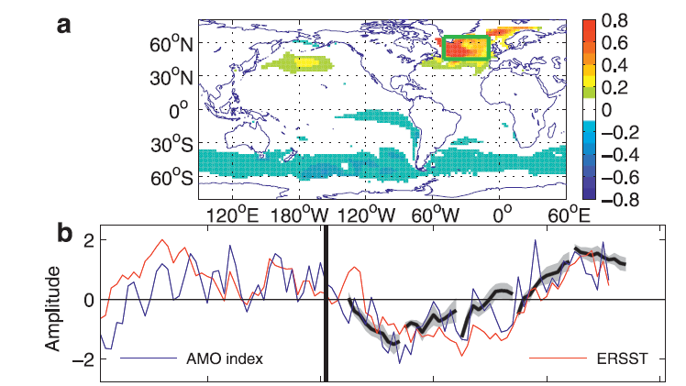
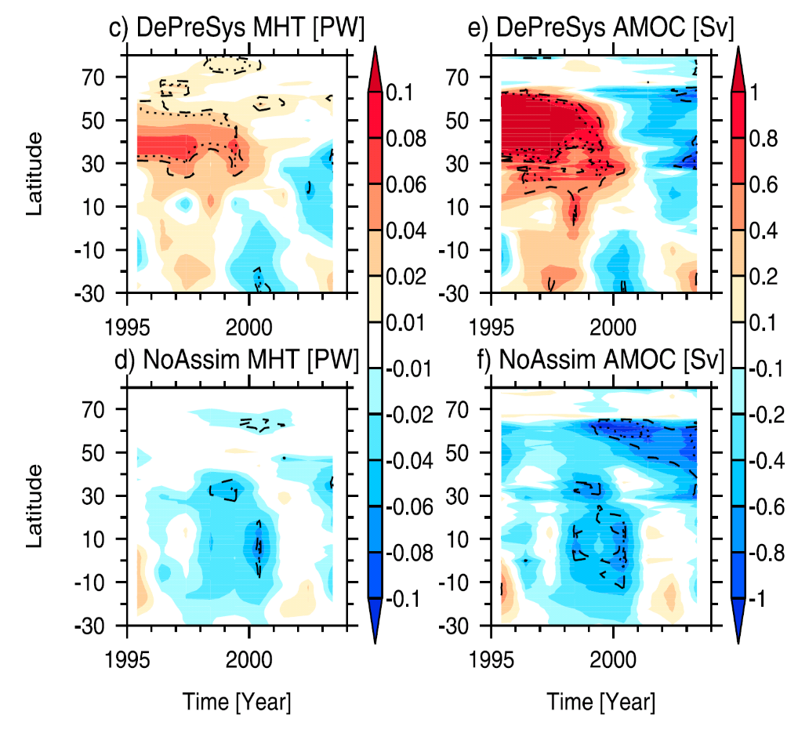
Decadal Prediction of the Observed Atlantic Multidecadal Variability (AMV)
Yang et al, 2013, J. Climate
Robson et al. 2012, GRL
Recent decadal prediction studies (e.g., Matei et al. 2012; Yeager et al. 2012; Robson et al. 2012; Yang et al., 2013; Msadek et al. 2014) successfully predicted the decadal warming shift in the mid 90’s in the NA SPG with initialized ocean state
Initializing a positive AMOC anomaly at northern high latitudes is the key for the successful predictions
Hindcasts with changes in external forcings and no initialization in the ocean state are not able to predict the decadal warming shift

Slide 3
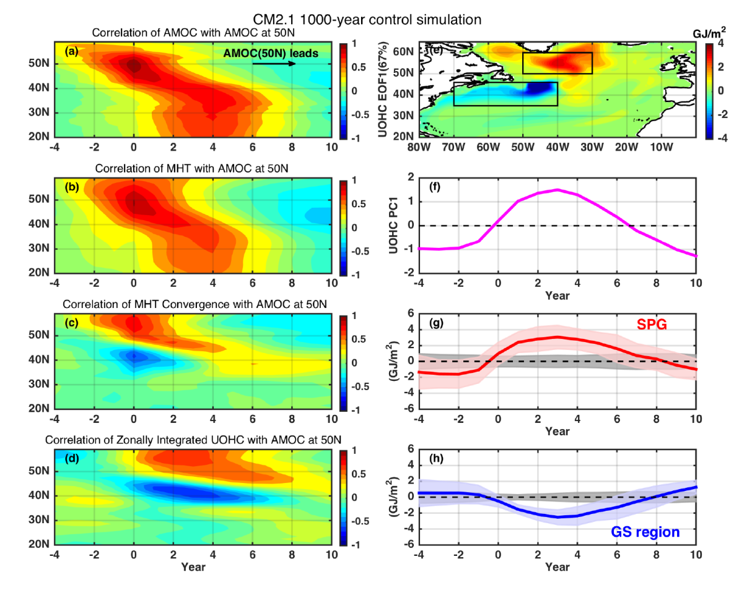
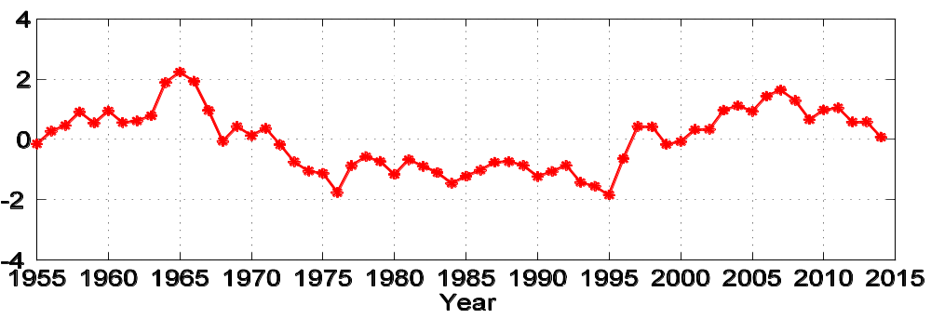
Extra-tropical AMOC Fingerprint – Leading Mode of Upper Ocean Heat Content
Southward propagation of AMOC anomaly
Zhang, 2008, GRL
Zhang and Zhang, 2015, GRL
Southward propagation of MHT anomaly
The slow propagation of AMOC anomaly is crucial for enhanced decadal predictability of SPG and GS temperature, consistent with enhanced decadal prediction skills obtained by initializing AMOC anomalies at northern high latitudes in recent studies
MHT convergence
in SPG and divergence in GS
Warming in SPG
and cooling in GS
Observed AMOC Fingerprint
Strengthen
Decline

Slide 4
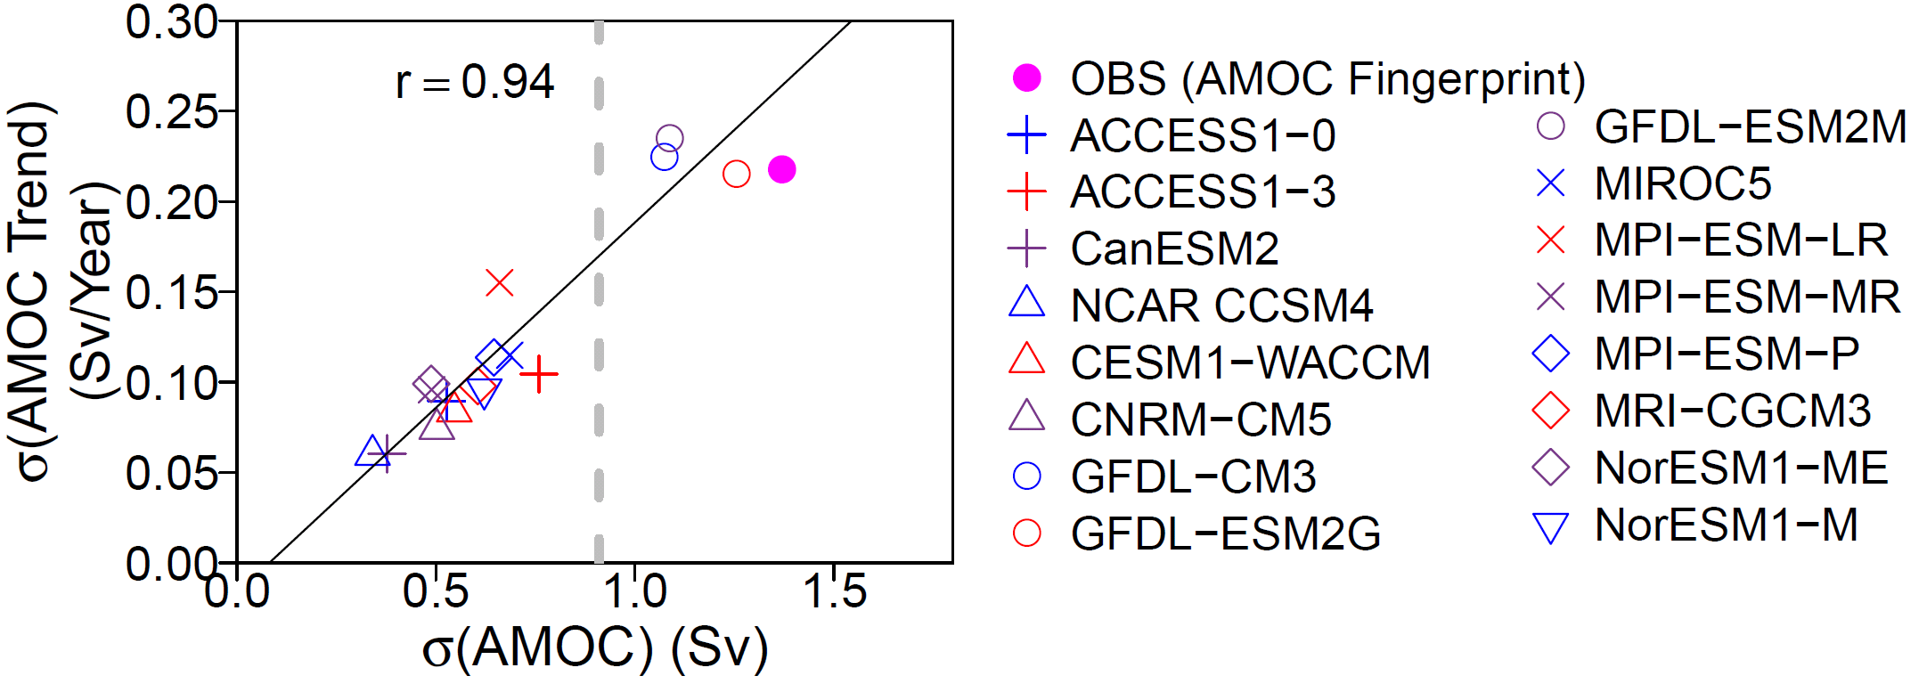
Underestimated Low-Frequency AMOC Variability in Most CMIP5 Models
Scatterplot of the standard deviations of 12-year AMOC trends versus the amplitudes of low-frequency AMOC variability (i.e., standard deviations of the 10-year low-pass filtered AMOC anomalies) in CMIP5 control simulations
Yan, Zhang, and Knutson, 2018, GRL

Slide 5
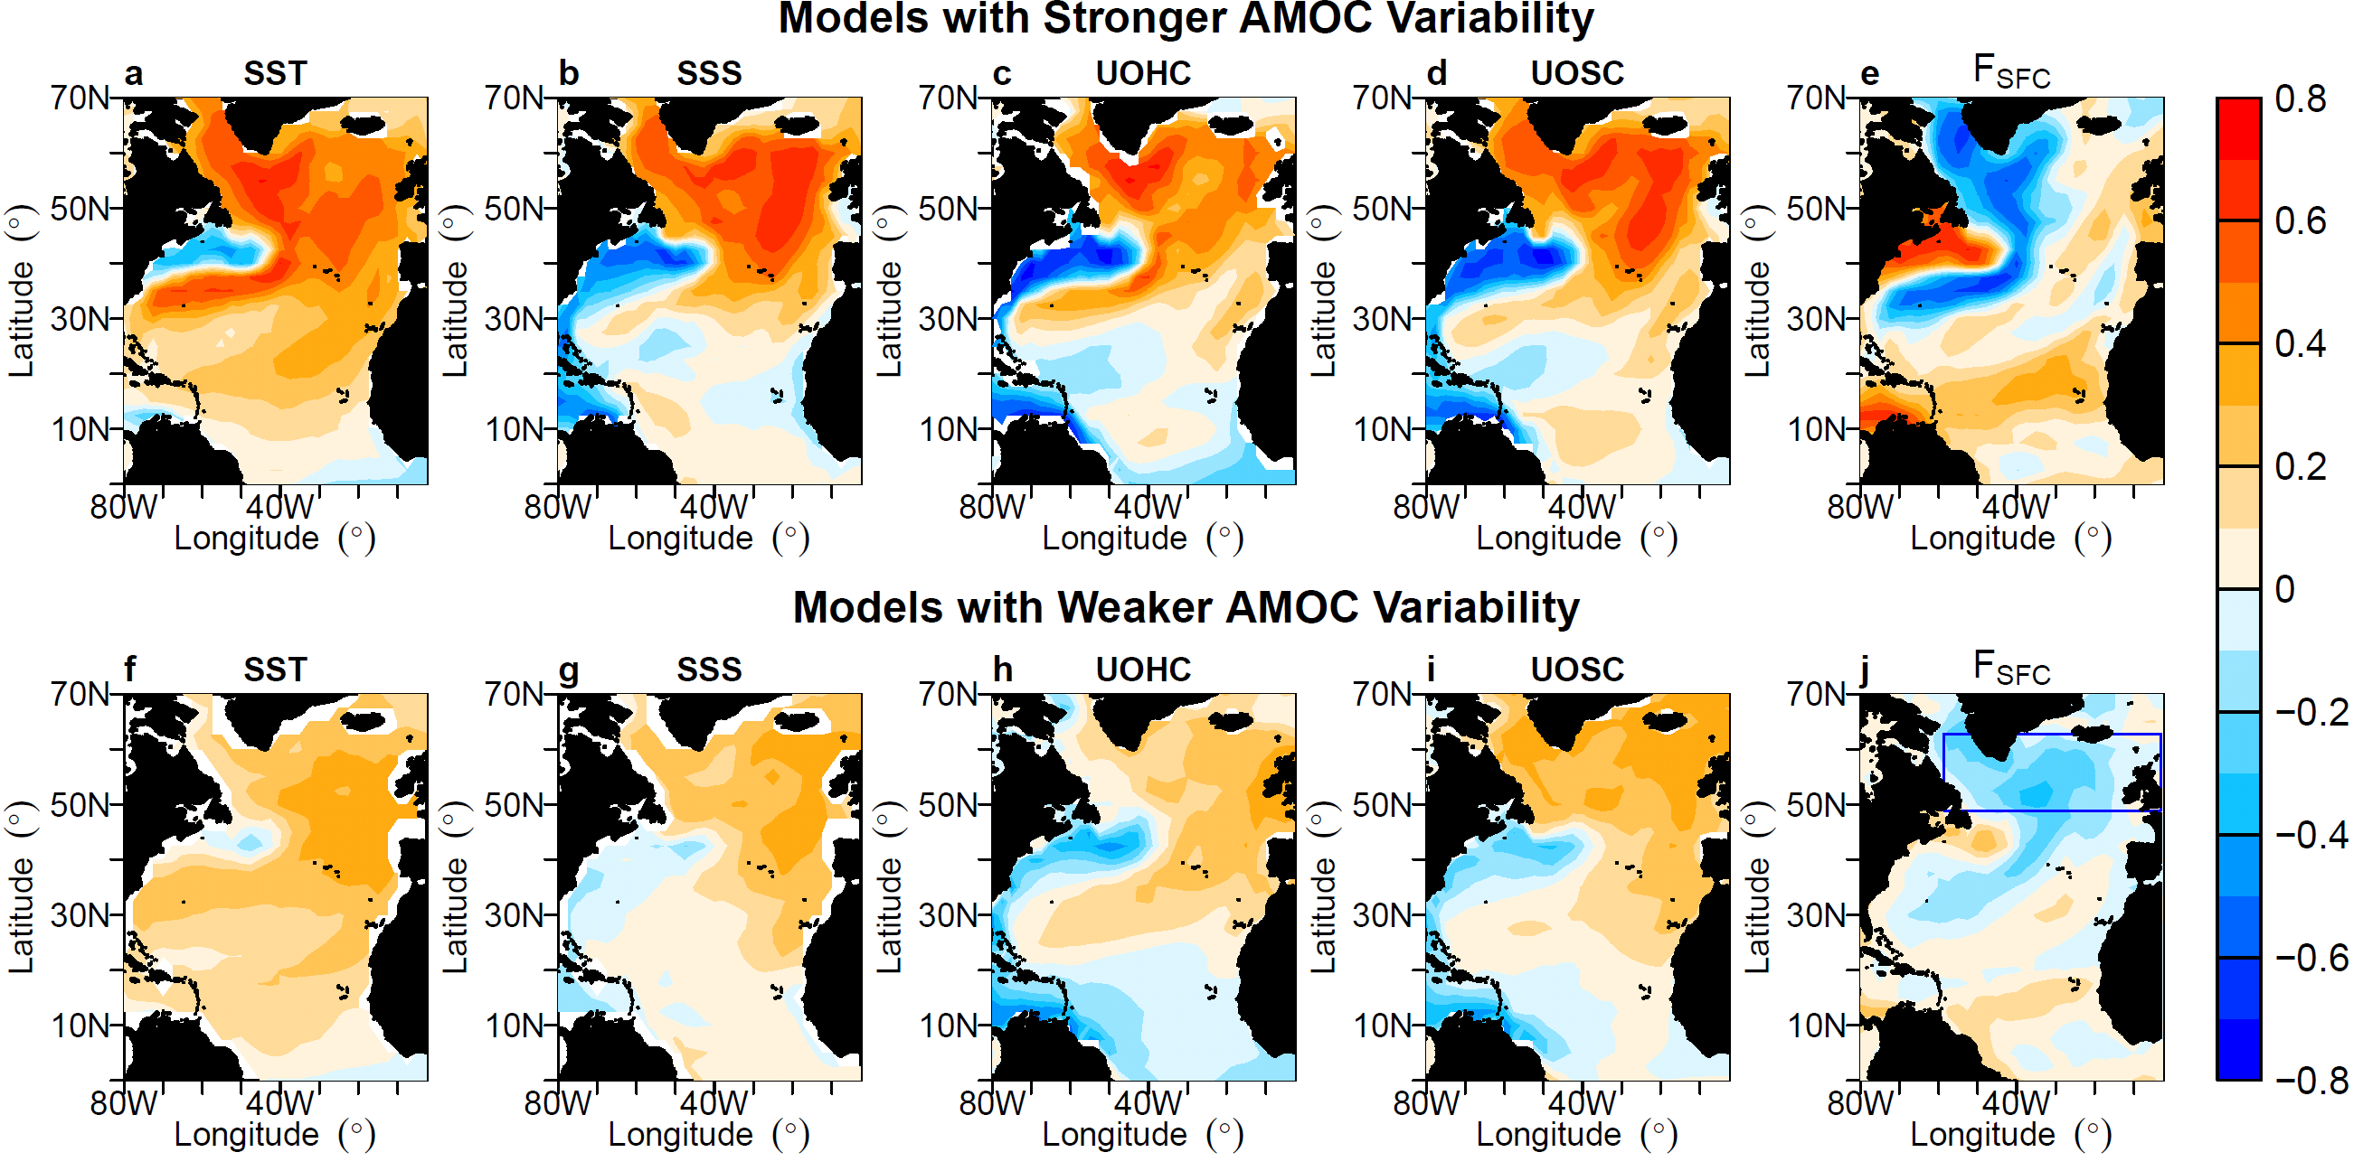
Correlations with AMOC
Yan, Zhang, and Knutson, 2018, GRL

Slide 6
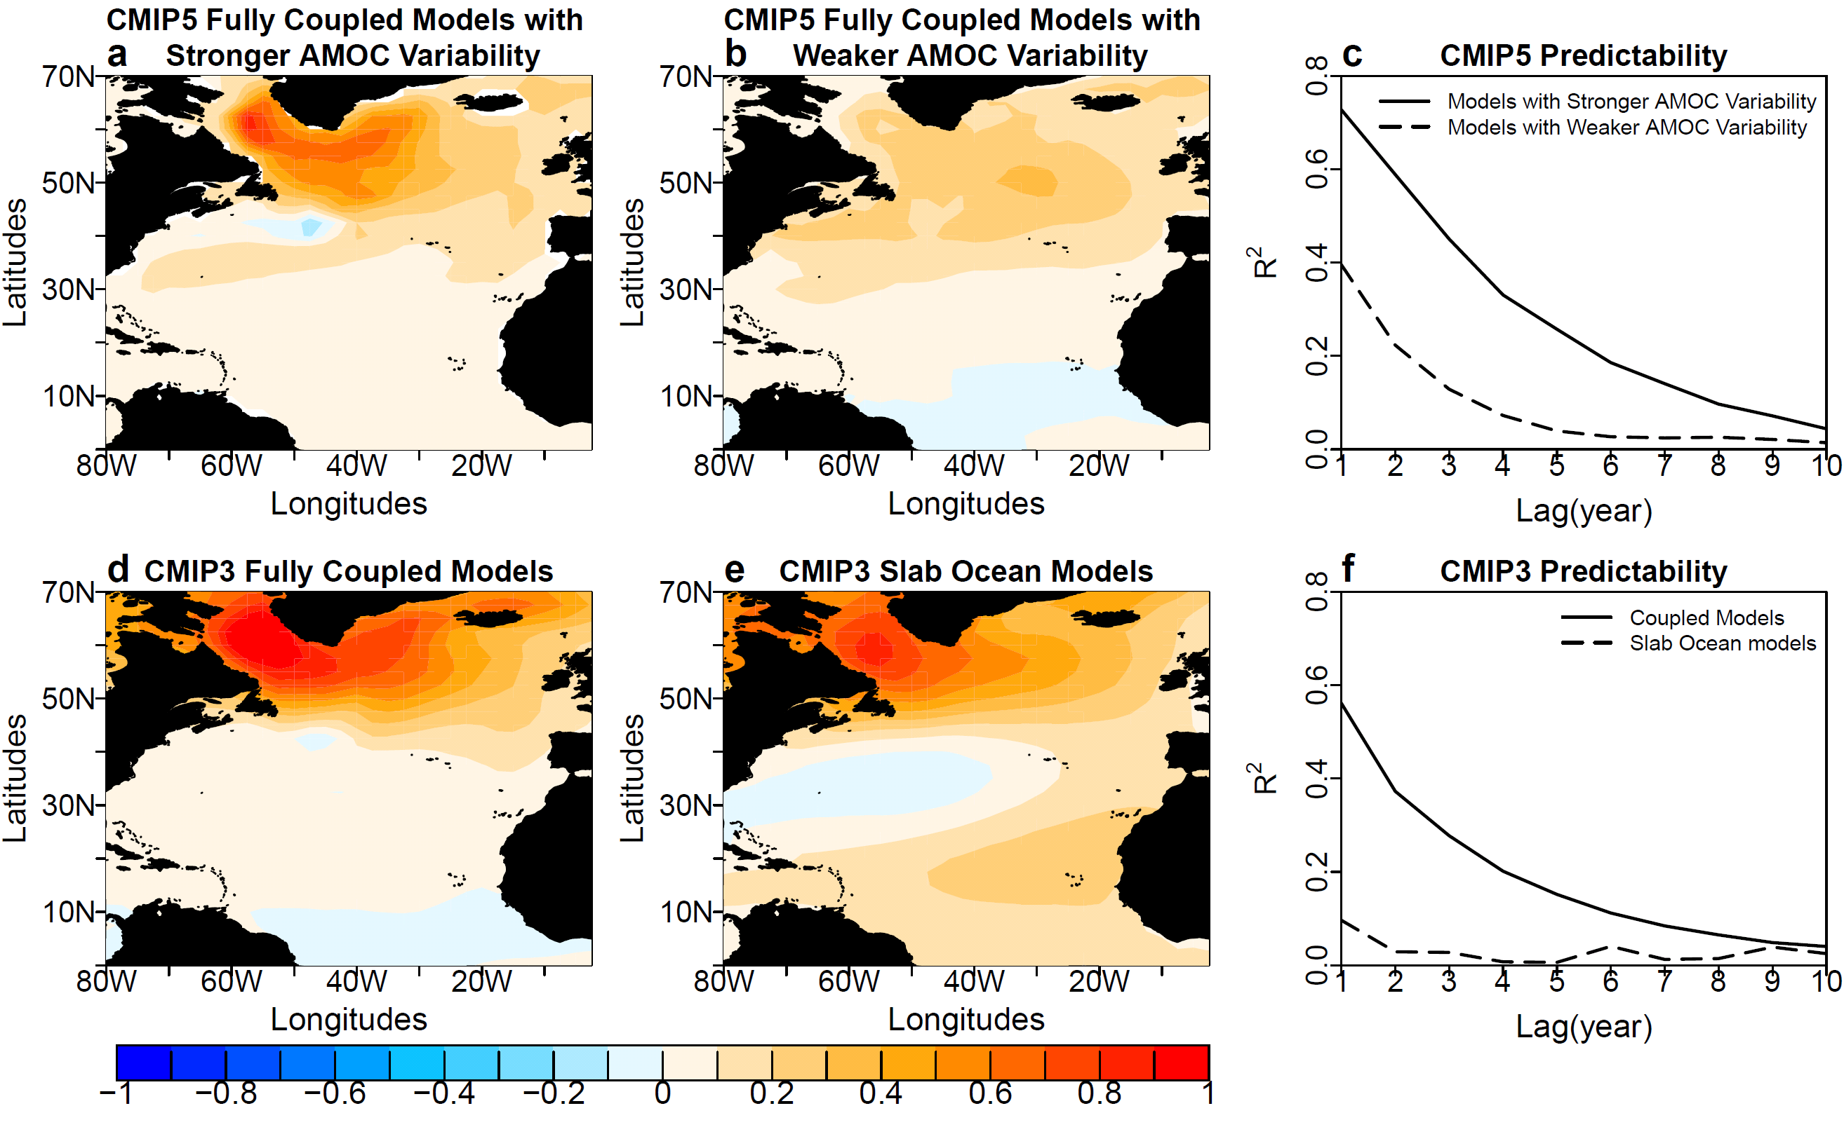
The Role of AMOC in Atlantic Decadal Predictability
The most predictable patterns of SST and associated predictability in the North Atlantic,
derived by maximizing the Average Predictability Time (APT) (Srivastava and Delsole, 2016)
Yan, Zhang, and Knutson, 2018, GRL

Slide 7
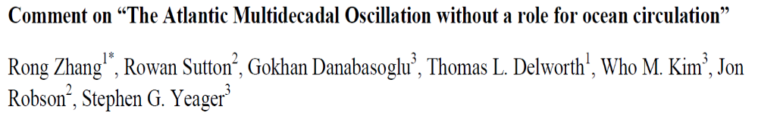
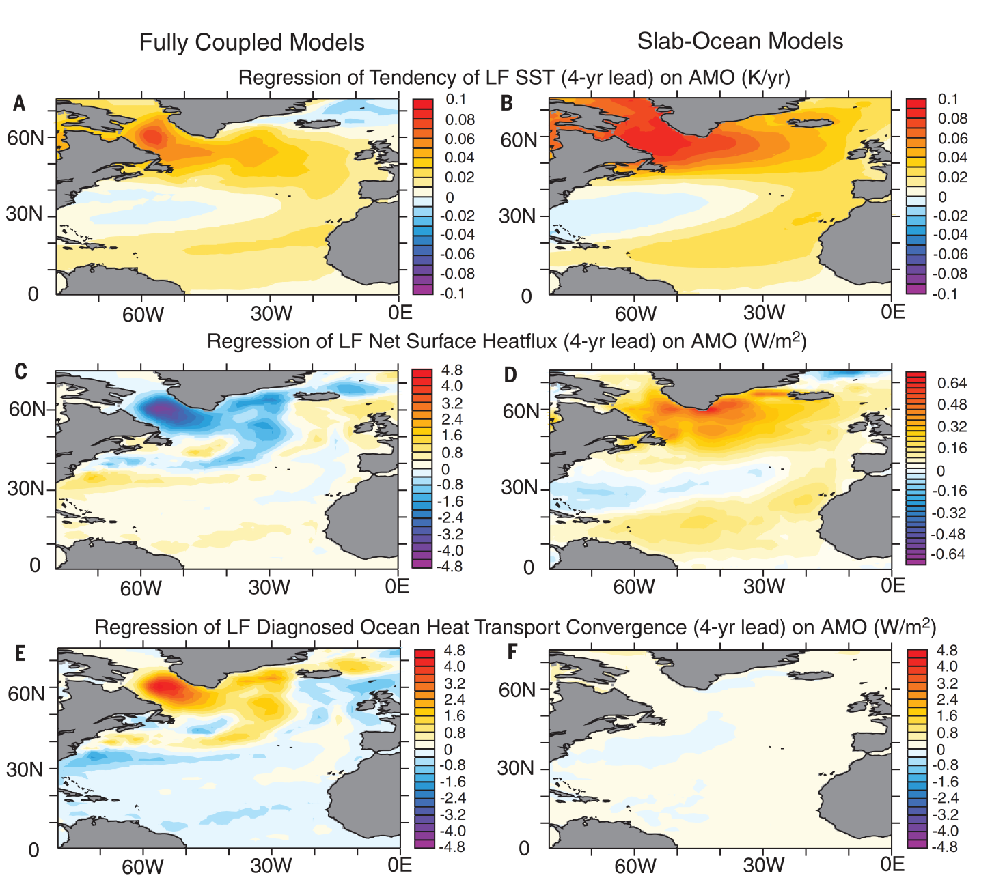
Recent Debate on Mechanisms of AMV
Recent study (Clement et al. 2015, Science) concludes that AMV in fully coupled models is generated by the red noise process as found in slab ocean models without ocean dynamics
However, the fundamental equation and mechanisms for AMV are quite different between fully coupled models and slab-ocean models
The negative regression between net downward surface heat flux and SST in subpolar NA in fully coupled models indicates the important role of ocean dynamics in AMV
Zhang et al. 2016, Science

Slide 8
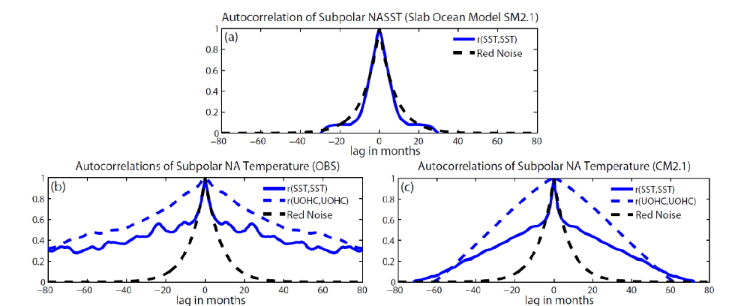
Recent Debate on Mechanisms of AMV
The observed and GFDL CM2.1 simulated autocorrelations of Subpolar NASST anomalies
with two different persistent time scales (decadal and intermonth) are very different from the
slab ocean model results or the red noise process
The observed and GFDL CM2.1 simulated decadal persistence of Subpolar NASST anomalies associated with AMV will lead to much higher decadal predictability than that obtained from the slab ocean models or the fitted red noise model
Zhang, 2017, GRL

Slide 9
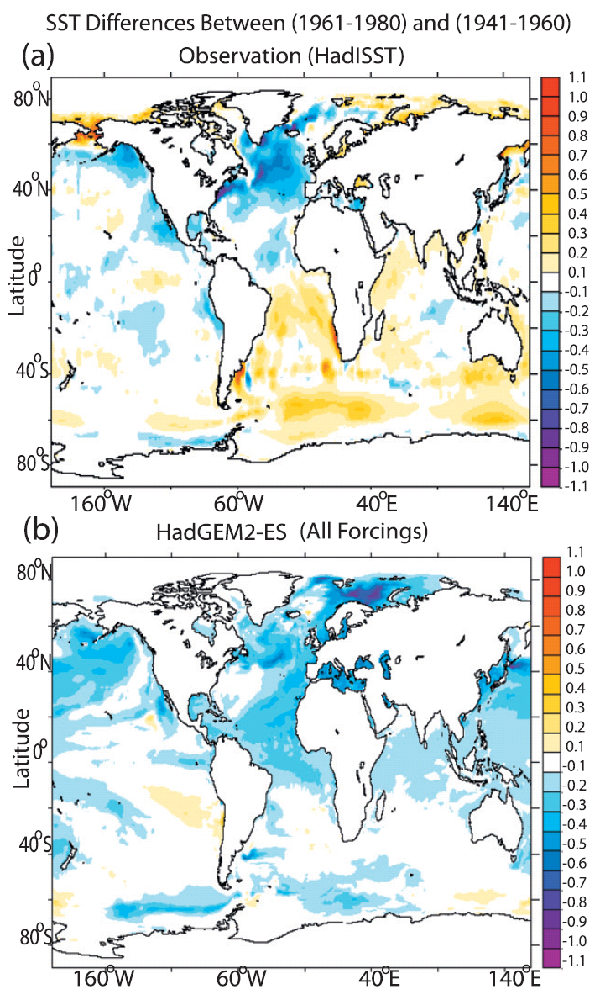
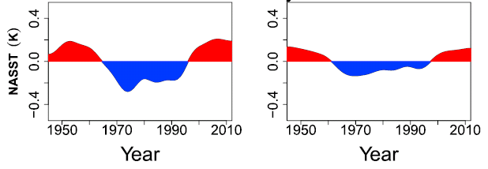
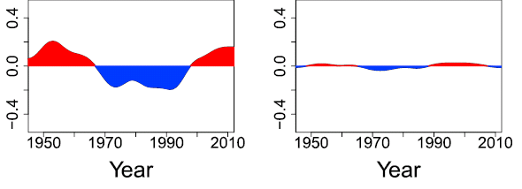
Recent Debate on Mechanisms of AMV
Some studies suggest that AMV is dominated by anthropogenic aerosols (e.g., Booth et al., 2012), based on the resemblance of the linearly detrended AMV index between observations and the externally forced response in some historical climate simulations
Linear Trend Removed
OBS
CMIP5 MMM
Signal Regressed on Global Mean SST Removed
OBS
CMIP5 MMM
Zhang et al., 2013, JAS
Yan, Zhang, & Knutson, 2019, GRL
The simulated externally forced multidecadal SST signal is not unique to the Atlantic, but also appears in many other ocean basins and represents a global scale response to external forcings
The resemblance between linearly detrended observed and CMIP5 forced basin‐wide SST‐based AMV indices is an artifact of linear detrending. When the signal associated with global mean SST is removed, such resemblance disappears

Slide 10
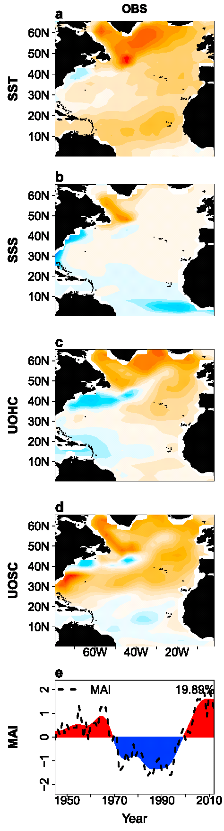
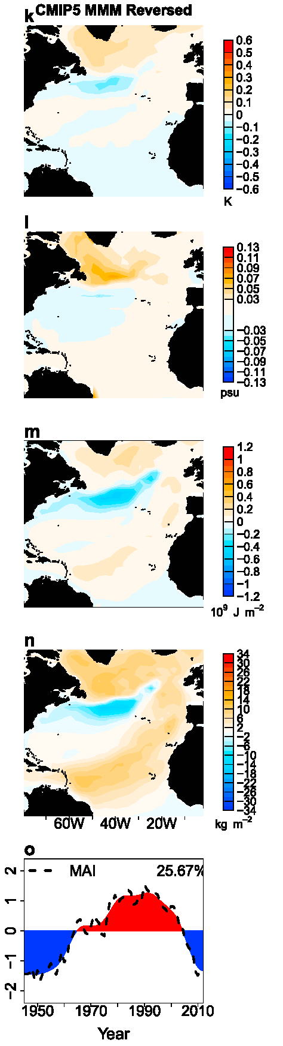
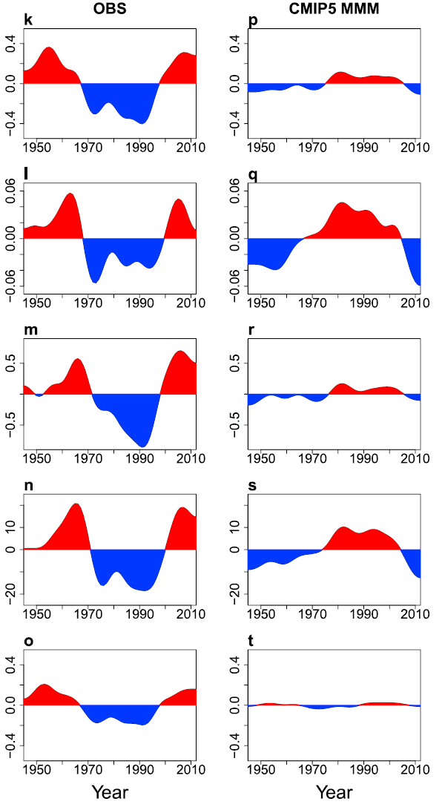
The Multivariate EOF analysis has been applied to obtain a Multivariate AMV Index (MAI), defined as the normalized leading principal component of combined detrended anomalies of SST, SSS, UOHC, and UOSC over the North Atlantic to reflect the multivariate nature of AMV
Yan, Zhang, & Knutson, 2019, GRL

Slide 11
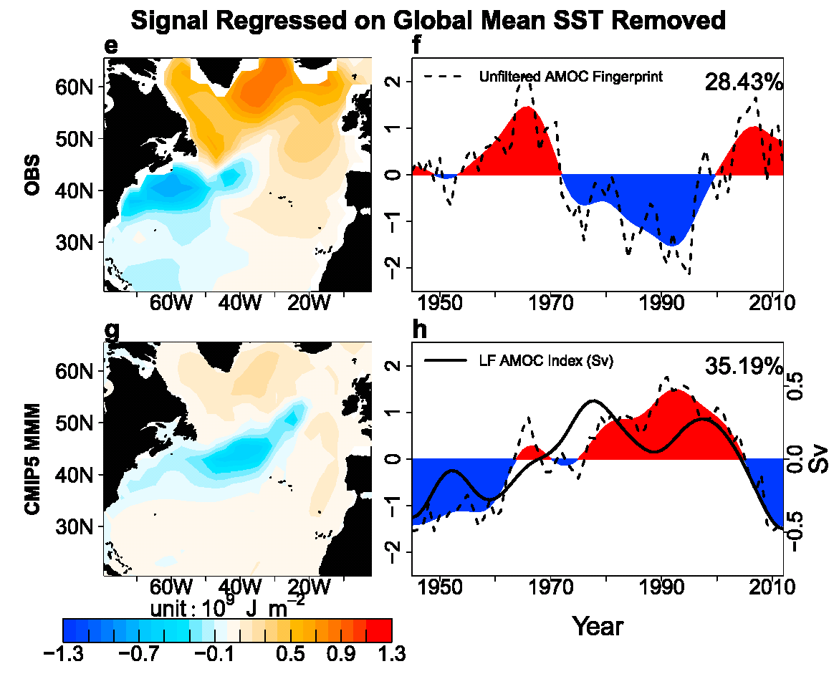
Linkage to Multidecadal AMOC Variability
Signal Regressed on Global Mean SST Removed
Yan, Zhang, & Knutson, 2019, GRL
When the signal associated with global mean SST is removed, the Multivariate EOF extracted forced AMV signal is in phase with forced AMOC variations in CMIP5 models, although very different from observations

Slide 12
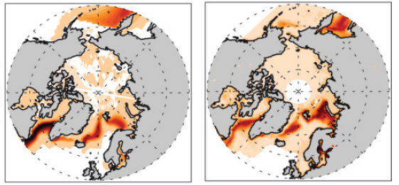


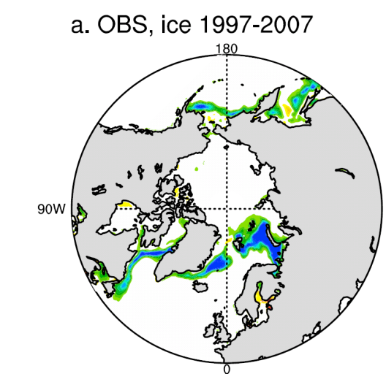
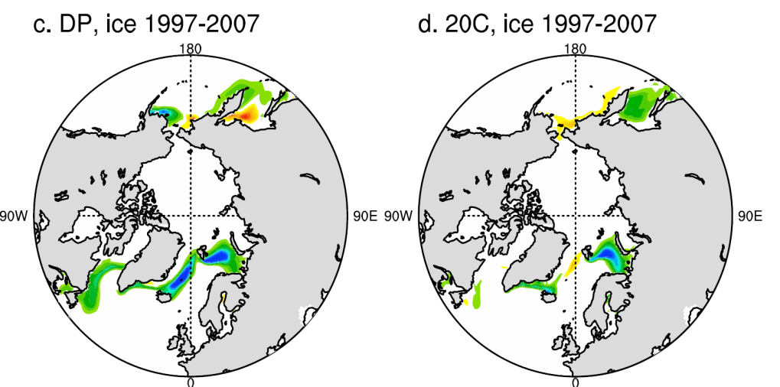
AMV and Winter Arctic Sea Ice Variability
Modeled Regression on AMV
Observed Trend (1979-2008)
Winter Arctic sea ice in the Atlantic side declines with an intensified AMOC/positive AMV
Similar spatial patterns suggest a possible role of the AMOC/AMV in the observed winter sea ice decline
CM2.1
Mahajan et al. 2011, JOC
The observed decadal decline of winter Arctic sea ice can be predicted by initializing ocean states
Yeager et al. 2015, GRL
Notes:
12

Slide 13
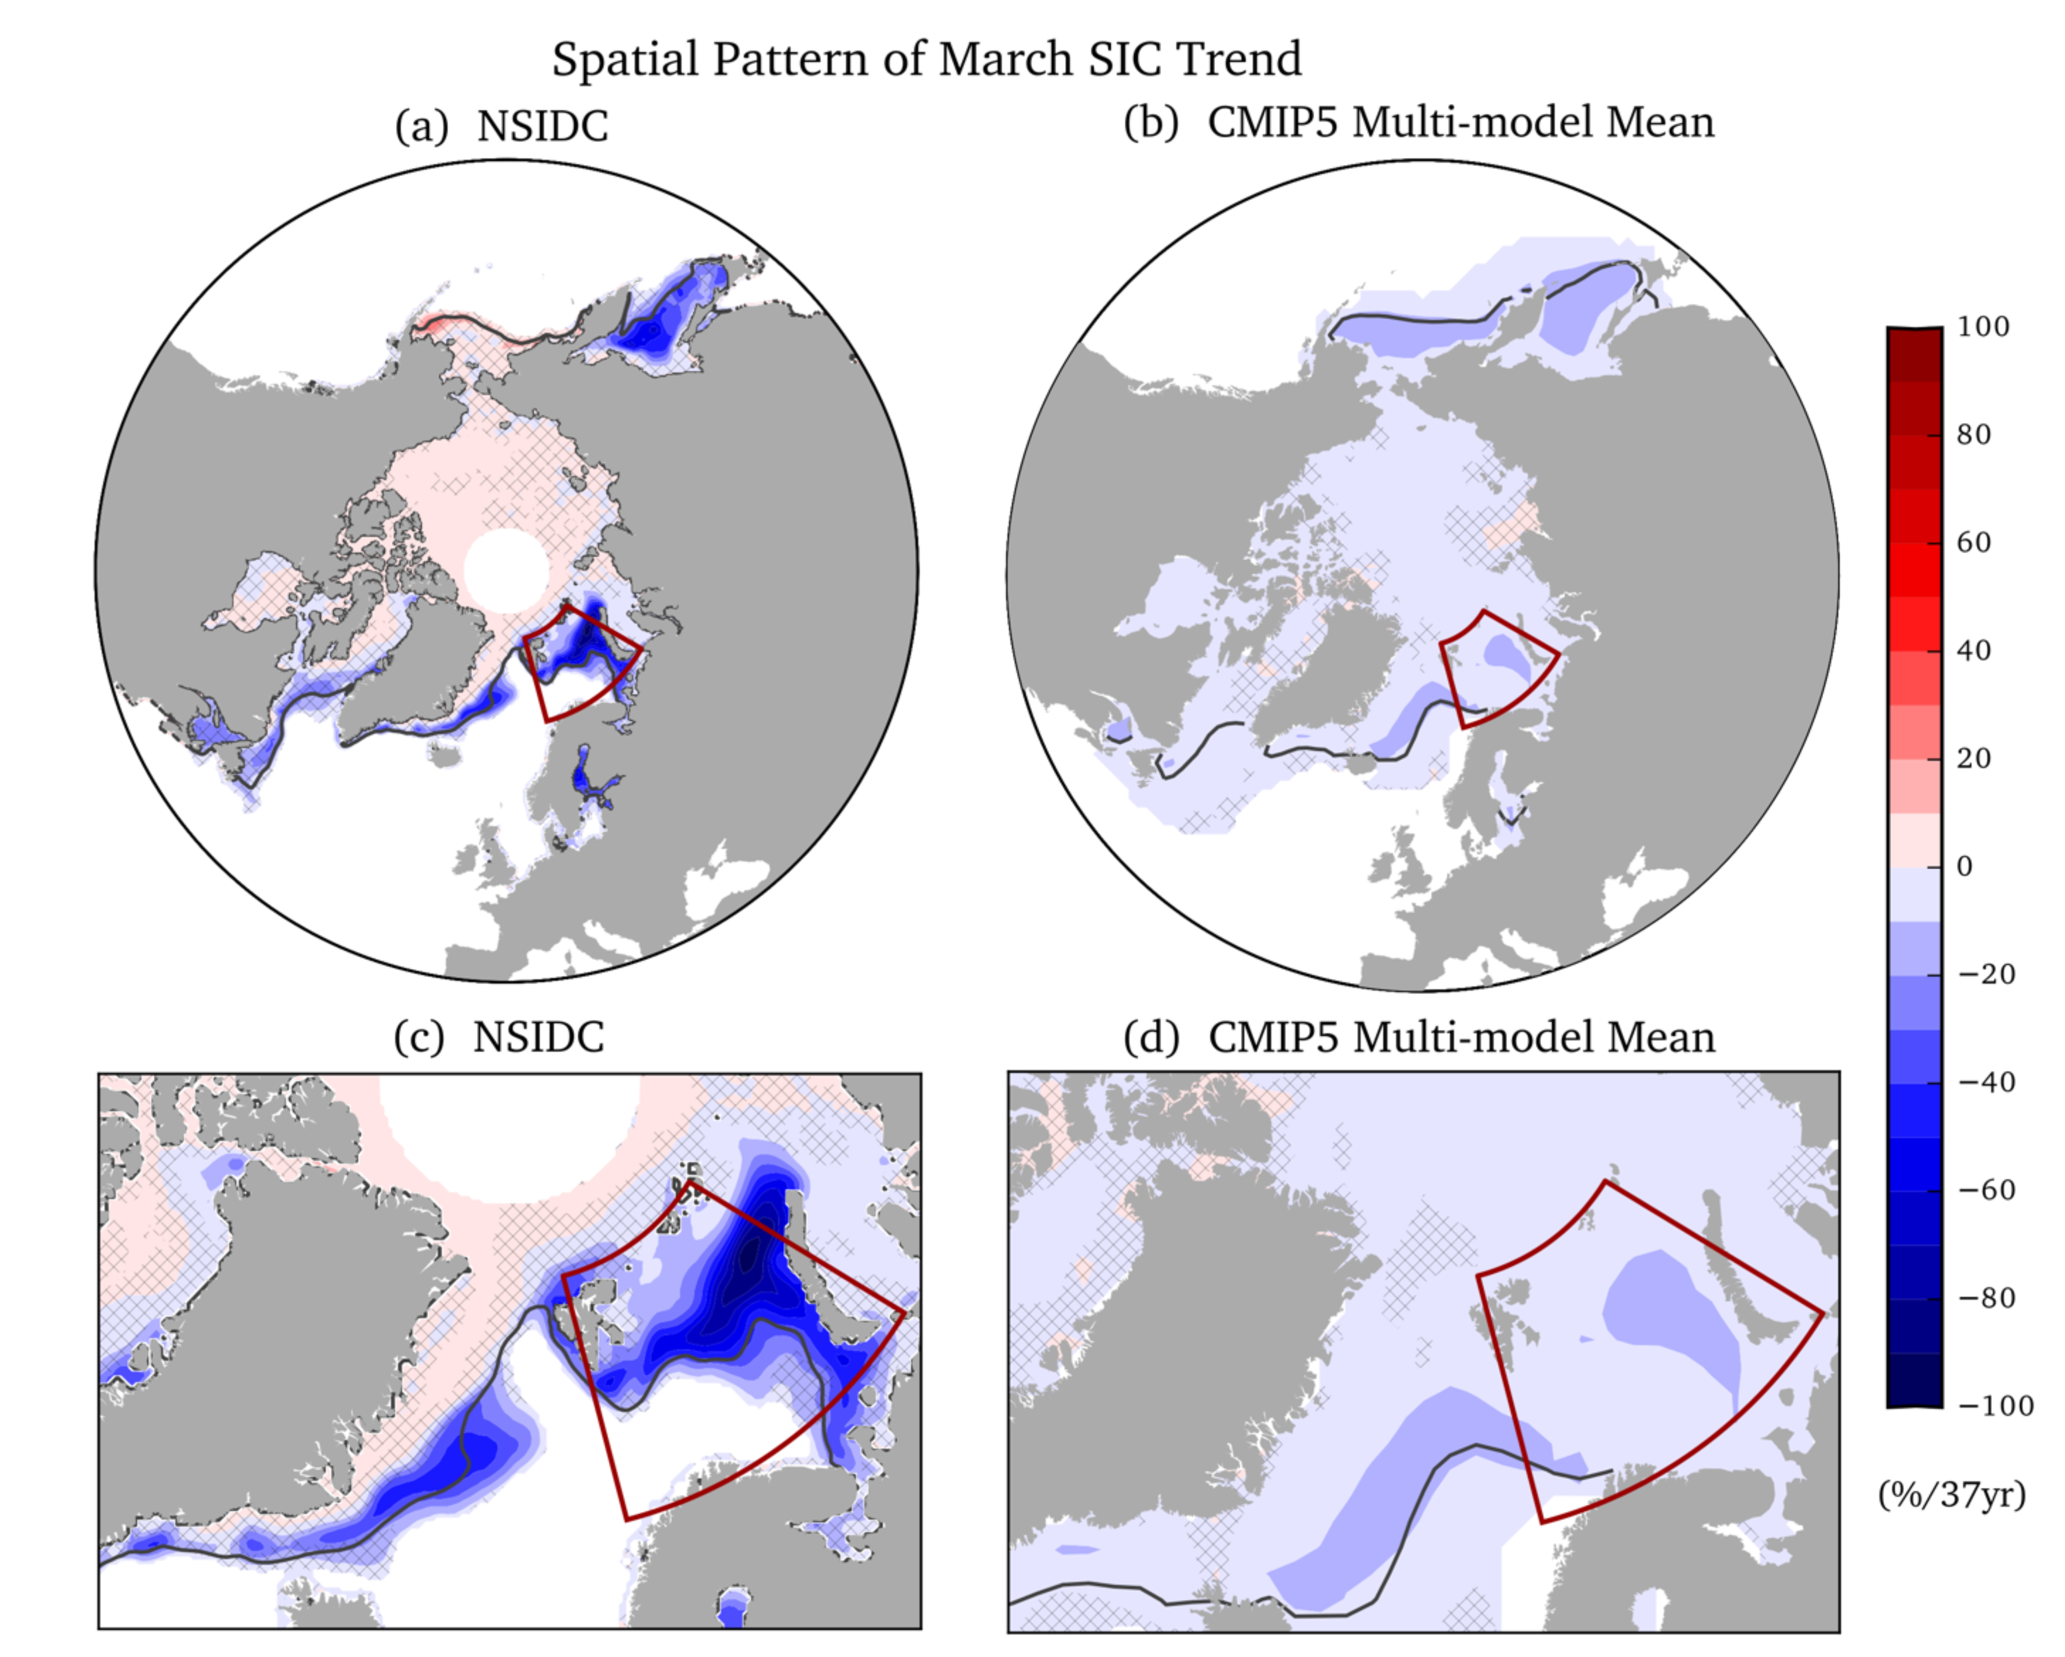
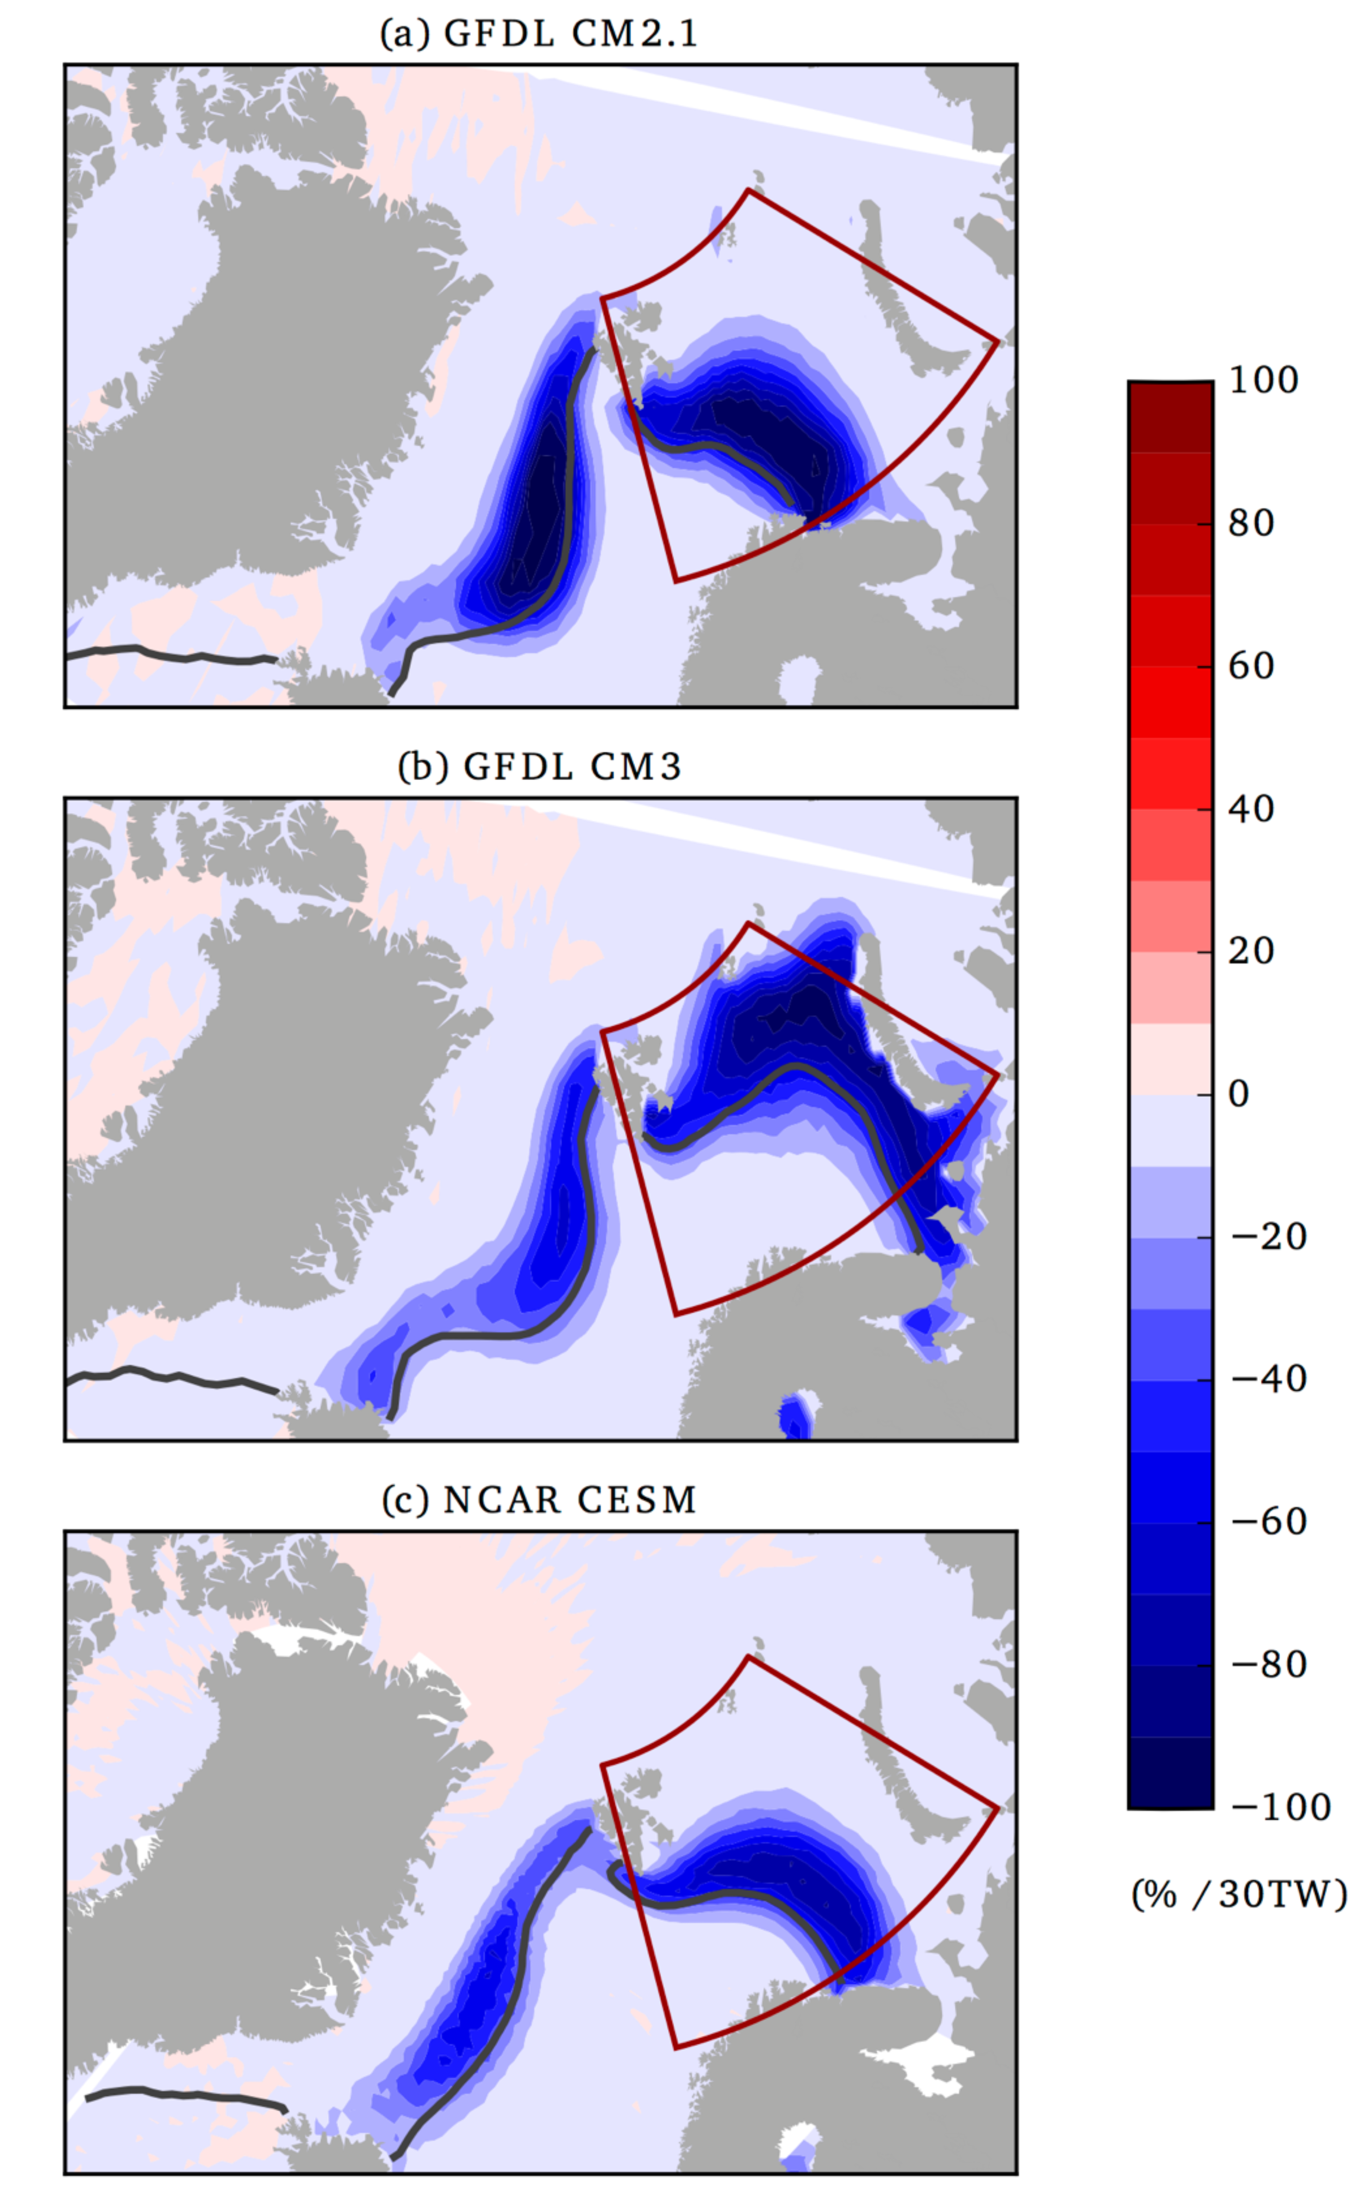
Discrepancy between Observed and CMIP5 Simulated Winter Sea Ice Decline
Li, Zhang, and Knutson, 2017, Nature Communications
CMIP5 externally forced March SIC trend in individual regions (e.g. Barents Sea) differs substantially from that observed
Enhanced Atlantic heat transport across the BSO may have played a leading role in the observed winter Barents Sea SIE decline

Slide 14
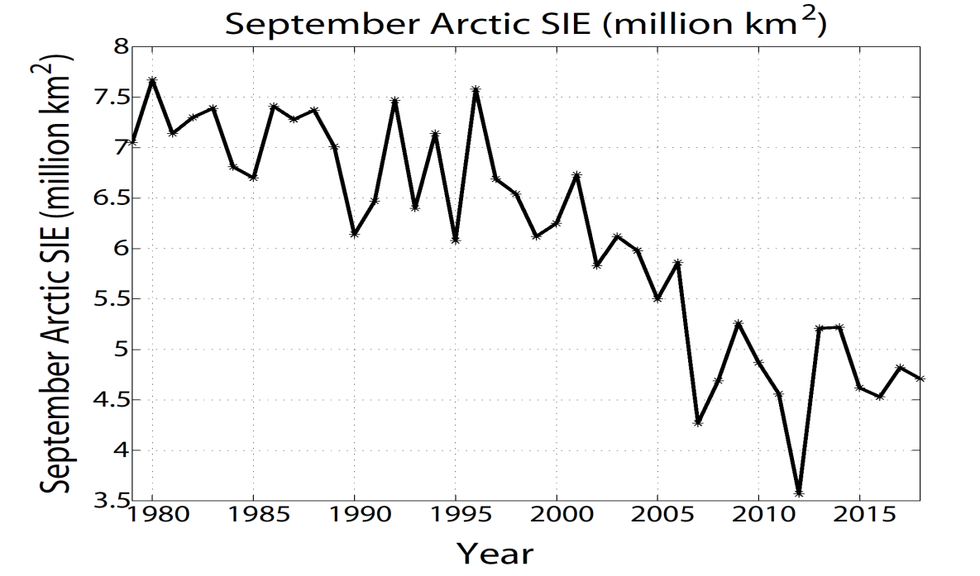
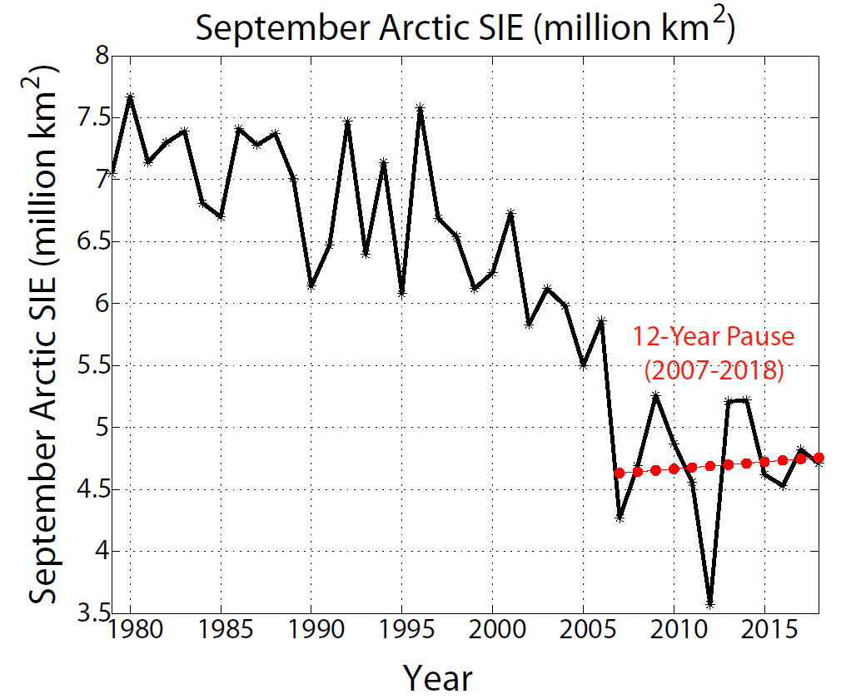
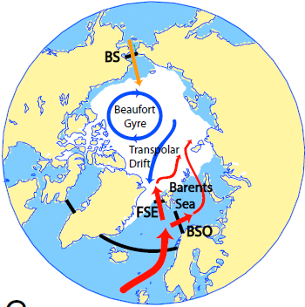

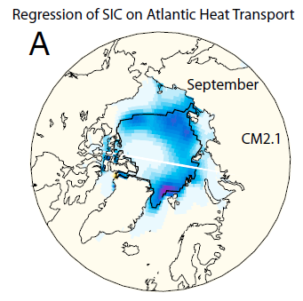
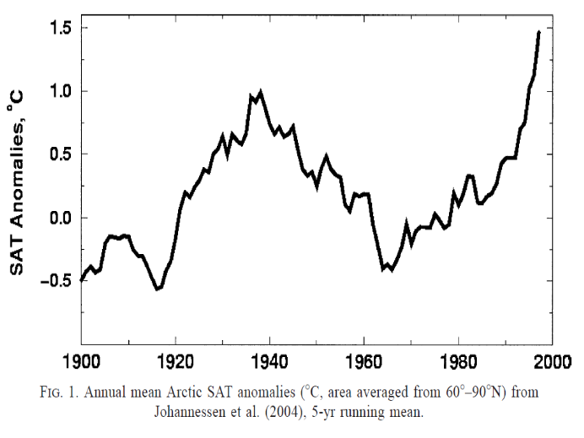
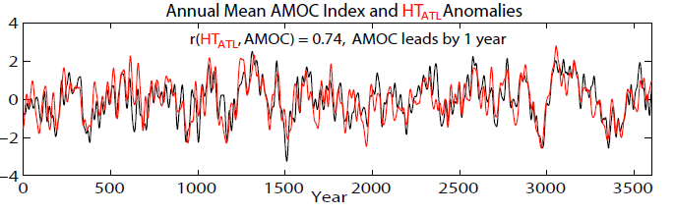
Low Frequency Variability of Summer Arctic Sea Ice
Observed Summer Arctic Sea Ice Decline
Impact of AMOC on Summer Arctic Sea Ice Variability
(NSIDC)
Zhang, 2015, PNAS
CM2.1
Bengtsson et al. 2004
Observed Multidecadal Variations in Arctic Surface Air Temperature
The AMOC variability and associated Atlantic heat transport into the Arctic also play a significant role in the low frequency variability of summer Arctic sea ice extent

Slide 15
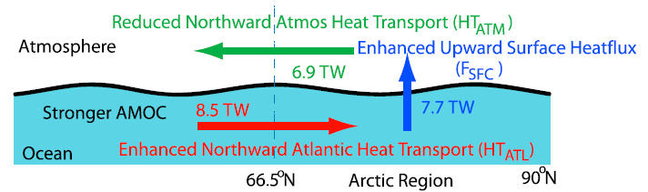
Response of Atmosphere Heat Transport
Zhang, 2015, PNAS
The Bjerknes compensation (Bjerknes, 1964) has been found at decadal time scale (Shaffrey & Sutton, 2006; Jungclaus & Koenigk, 2010; Farneti and Vallis, 2013)
At multidecadal/centennial time scale, the coherences among HT_{ATL}, Arctic SHF, and inverted HT_{ATM} are much higher than those at decadal time scale
Changes in HT_{ATM} are forced by anti-correlated changes in HT_{ATL} thus provide a negative feedback to September Arctic SIE variations

Slide 16
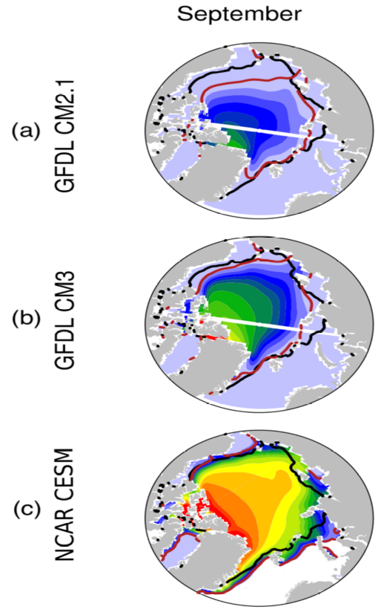
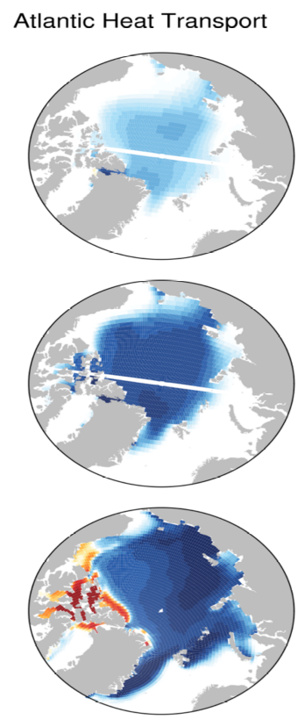
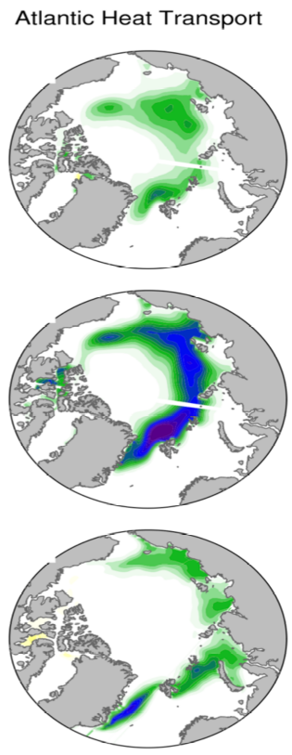
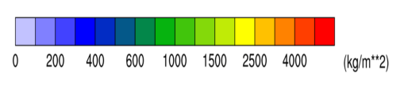
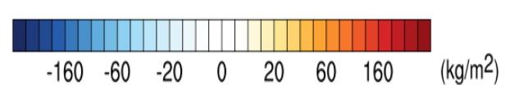
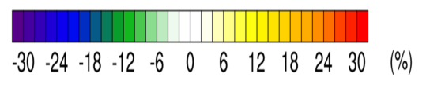
Low Frequency Variability of Summer Arctic Sea Ice
Climatological summer sea ice mass
Regression of summer sea ice mass
Regression of summer sea ice concentration
The response of sea ice mass to enhanced Atlantic heat transport increases with mean state sea ice thickness, while the response in sea ice concentration is largest in the model with intermediate mean state sea ice thickness
Li, Zhang, and Knutson, 2018, J. Climate

Slide 17
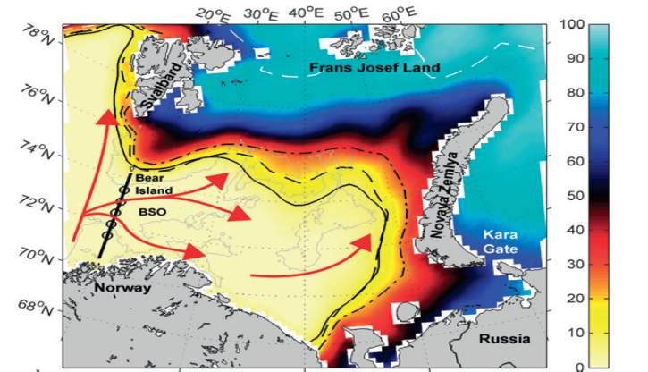
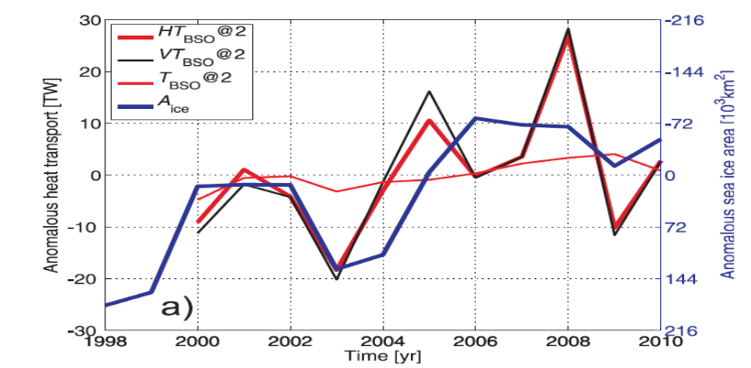
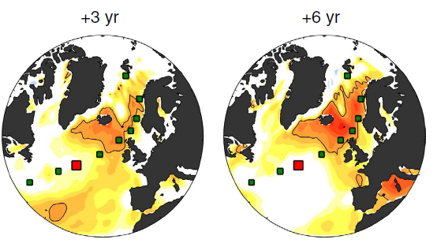



Observed Ocean Heat Transport across Barents Sea Opening (HT_{BSO})
$\dot{A}$rthun et al. 2012, J. Climate
The observed increase in HT_{BSO} is also found as a prime driver for the observed sea ice decline in Barents Sea
Observed multiyear propagation of SST anomalies from the subpolar North Atlantic into and through the Nordic Seas provides decadal prediction skill for Arctic sea ice extent
$\dot{A}$rthun et al. 2017, Nature Communications

Slide 18
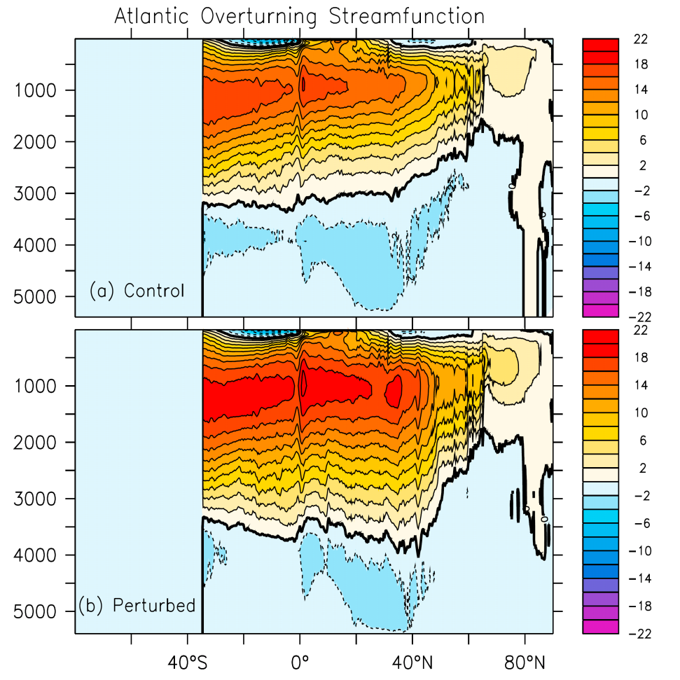
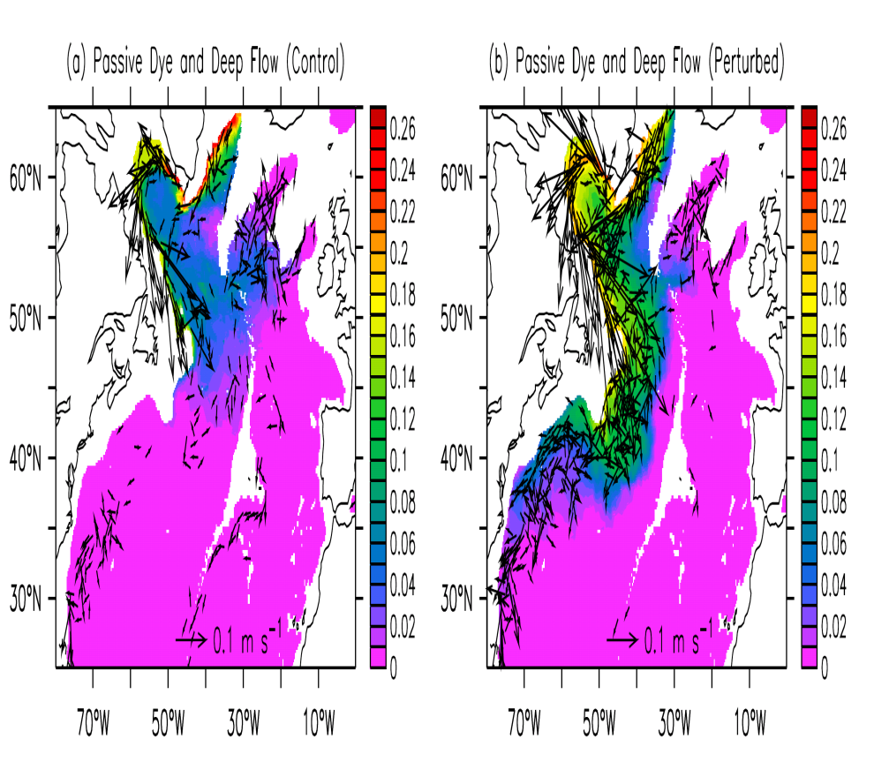
Modeling Biases in the North Atlantic
Zhang et al. 2011, JGR-Oceans
GFDL Eddy-Permitting Coupled Model CM2.5
A stronger and more realistic Nordic Sea overflow can lead to deeper AMOC and enhanced meridional ocean heat transport (MHT) (Zhang et al. 2011)

Slide 19
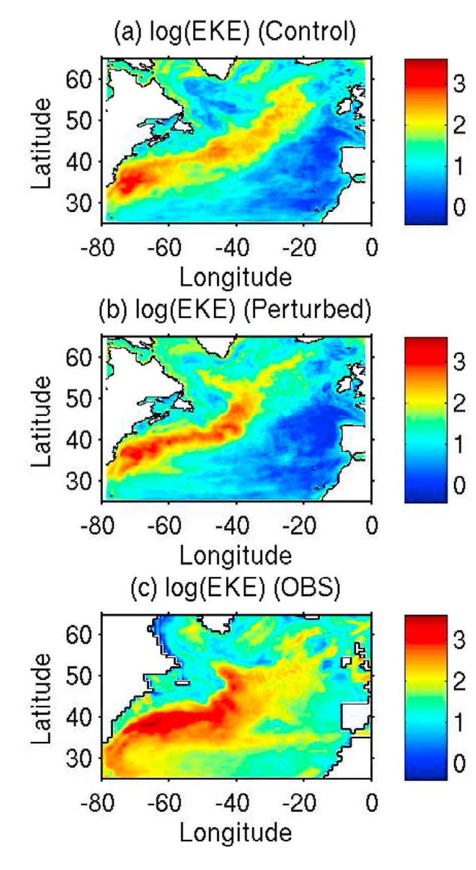
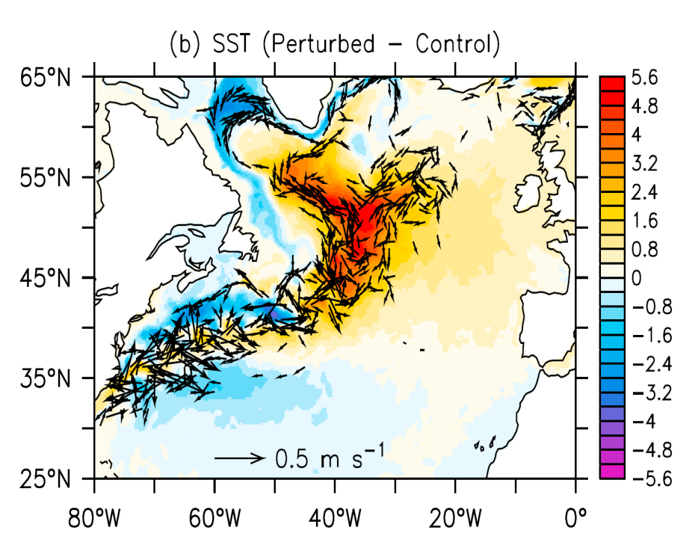
Modeling Biases in the North Atlantic
Zhang et al. 2011, JGR-Oceans
A stronger and more realistic Nordic Sea overflow can lead to stronger/deeper AMOC and more realistic North Atlantic Current (NAC) pathways, thus reduced SST cold bias in mid-latitude North Atlantic

Slide 20
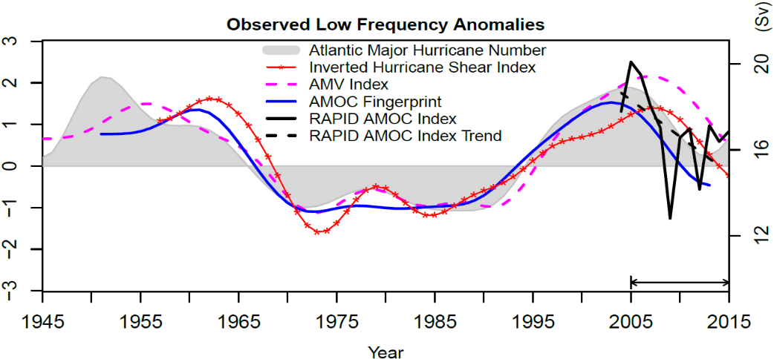
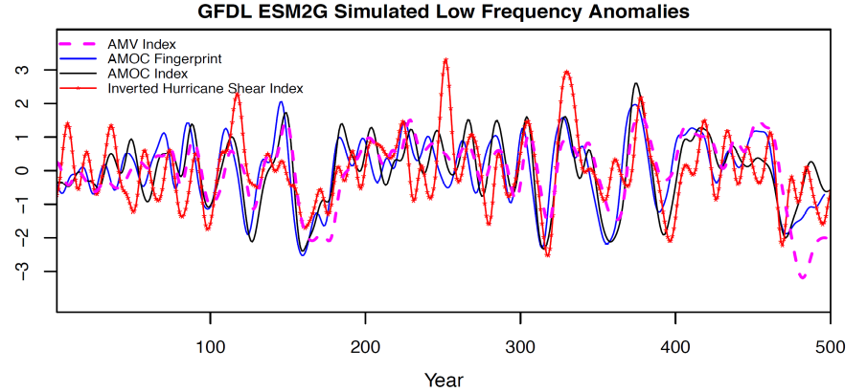
Impact of AMOC on AMV and Atlantic Major Hurricane Frequency
Observations show coherent multidecadal variations among the Atlantic major hurricane frequency, AMOC fingerprint, AMV Index, and Inverted Hurricane Shear Index. The observed decline of the Atlantic major hurricane frequency during 2005–2015 is associated with the directly observed AMOC weakening
Coherent variations among AMOC Index/fingerprint, AMV Index, and Inverted Hurricane Shear Index in GFDL-ESM2G control simulation suggest an important role of AMOC in the AMV and the multidecadal variability in the Atlantic major hurricane frequency
Yan, Zhang, and Knutson, 2017, Nature Communications

Slide 21
Multi‐year Predictability of Tropical Atlantic Atmosphere
driven by the Subpolar North Atlantic Ocean
The North Atlantic Subpolar Gyre (SPG) is identified as a key driver of skills in predicting the tropical Atlantic atmosphere, including tropical precipitation, wind shear, vertical velocity, and storm numbers
Anomaly correlations for Years 2-6 ensemble means of the perfect and the initialized forecast experiments using HadCM3
Dunstone et al. 2011, GRL

Slide 22
Summary
The slow southward propagation of the AMOC anomaly provides the physical mechanism for enhanced decadal prediction skills in NA SPG obtained in decadal prediction experiments
Most CMIP models underestimate amplitudes of low-frequency AMOC variability.
Models with relatively stronger low-frequency AMOC variability have relatively
stronger linkage between the AMOC and AMV, and much higher Atlantic decadal
predictability
The observed decadal persistence of Subpolar NASST anomalies will lead to much higher decadal prediction skill than that obtained from the slab ocean models or the red noise process
Coherent multidecadal variability that is unique to the Atlantic is found in observations. The Multivariate AMV Index (MAI) and associated spatial patterns are obtained to reflect the multivariate nature of AMV

Slide 23
When the signal associated with global mean SST is removed, the forced AMV and forced AMOC variability in CMIP5 models disagree strongly with observations, suggesting that the observed multidecadal AMOC variability and associated AMV are not dominated by external forcings
The AMOC variability and associated Atlantic heat transport have a predictive impact on Arctic sea ice
AMOC plays an important role in the multidecadal variability of Atlantic major
hurricane frequency. The subpolar North Atlantic is a key region for predicting
tropical Atlantic atmospheric response
It’s crucial to improve climate models’ mean state in the Atlantic to achieve more realistic linkage between the AMOC and AMV and associated climate impacts, and much higher Atlantic decadal prediction skills

Slide 24
