Slide 1


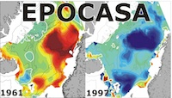



Development of ensemble-based data assimilation techniques for climate prediction
Yiguo Wang^{1,2}, François Counillon^{1,2,3}, Madlen Kimmritz^{1,2}
1 Nansen Environmental and Remote Sensing Center, Norway
2 Bjerknes Centre for Climate Research, Norway
3 Geophysical Institute, University of Bergen, Norway
Bjerknes Climate Prediction Unit

Slide 2
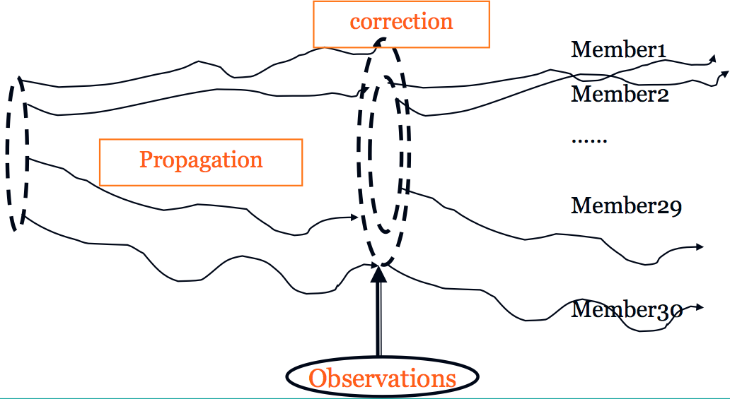
Norwegian Climate Prediction Model (NorCPM)
Norwegian Earth System model (NorESM)
Data assimilation (EnKF)
chemistry/aerosols
CAM
30 members
CICE
CISM
CLM
MICOM
RTM
HAMOCC
Observations
Objectives:
Climate reconstructions (long-term reanalyses)
Skilful and reliable climate predictions
-CMIP6 decadal climate prediction project (DCPP), the WMO Lead Centre for Annual-to-Decadal Climate Prediction
-Climate services (provide seasonal forecasts to Norwegian stakeholders though seasonal forecast engine project)
(Bentsen et al., 2013; Counillon et al, 2014)
Notes:
TS
2

Slide 3
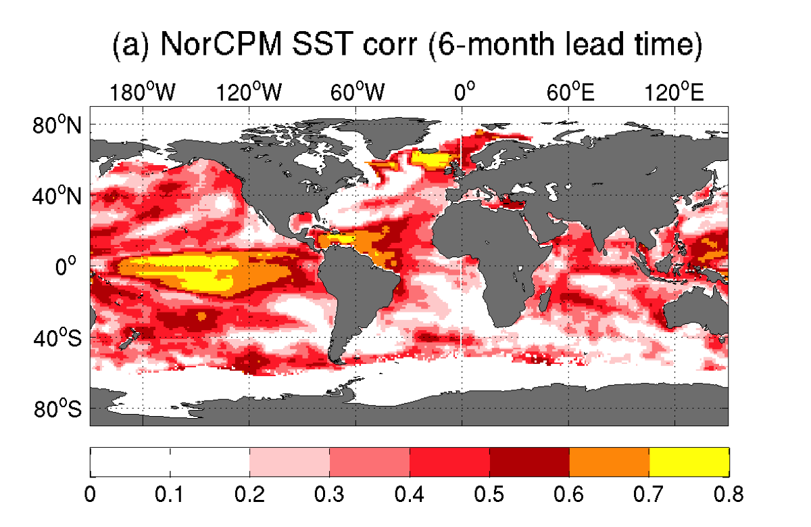
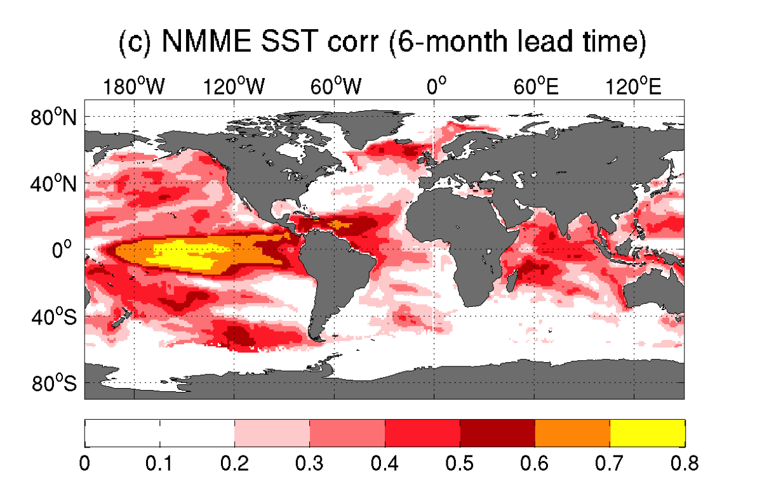
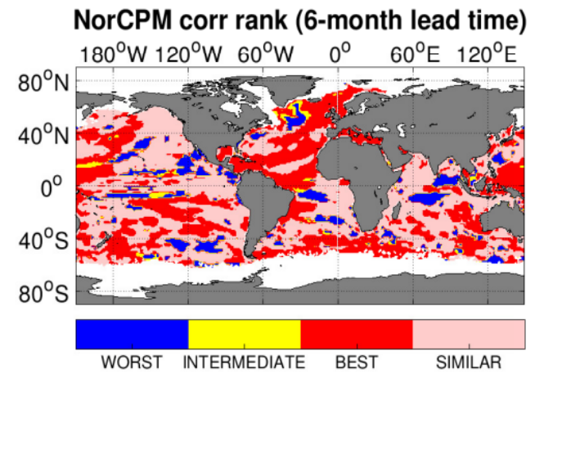
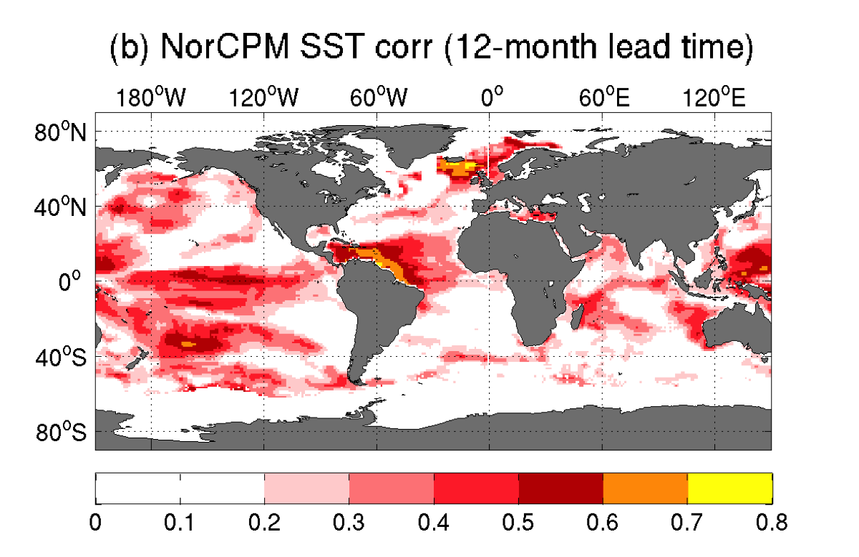
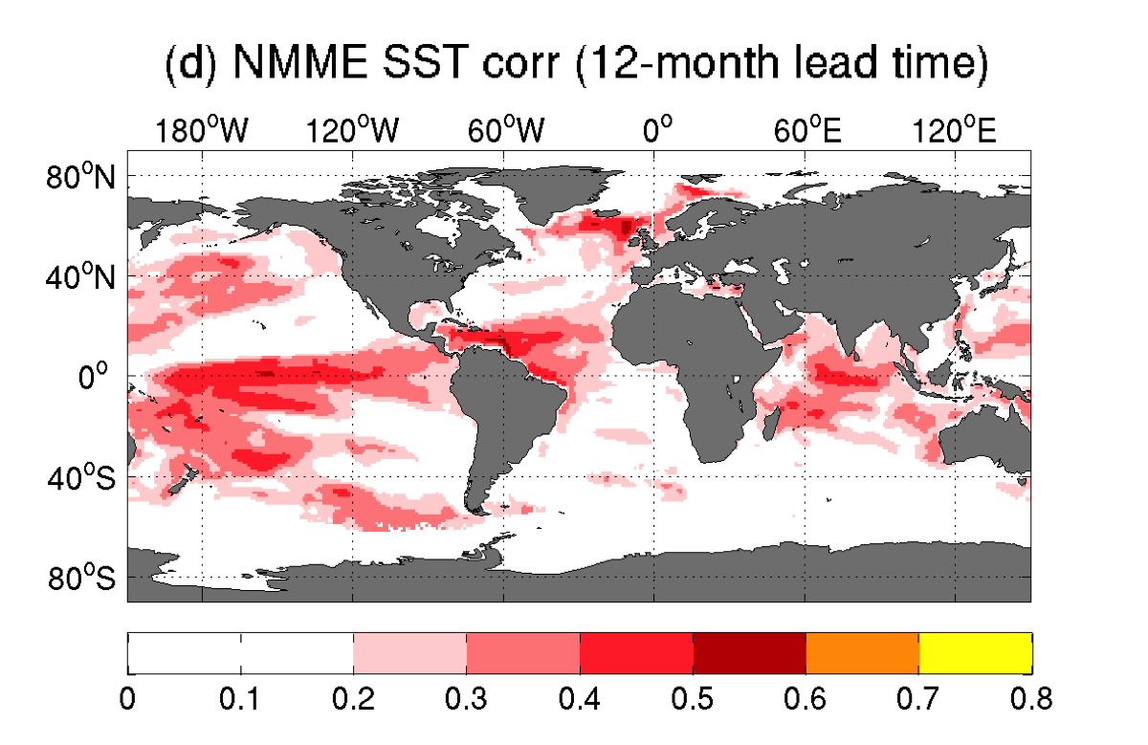
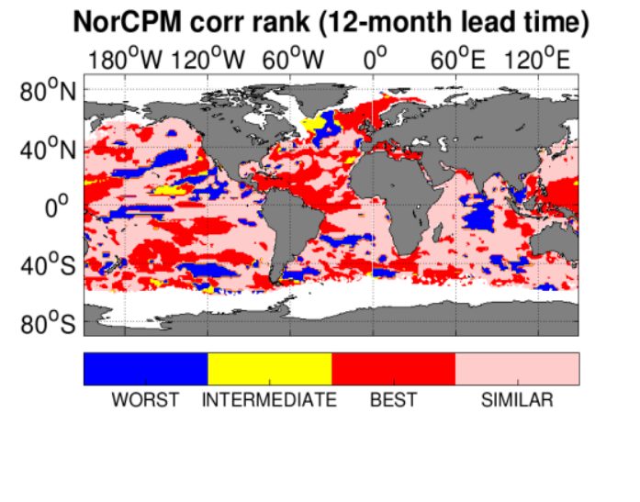
Seasonal prediction of SST tested by retrospective forecast from 1985-2010
NorCPM is competitive with NNME just using SST observations
(Wang et al, under review)

Slide 4
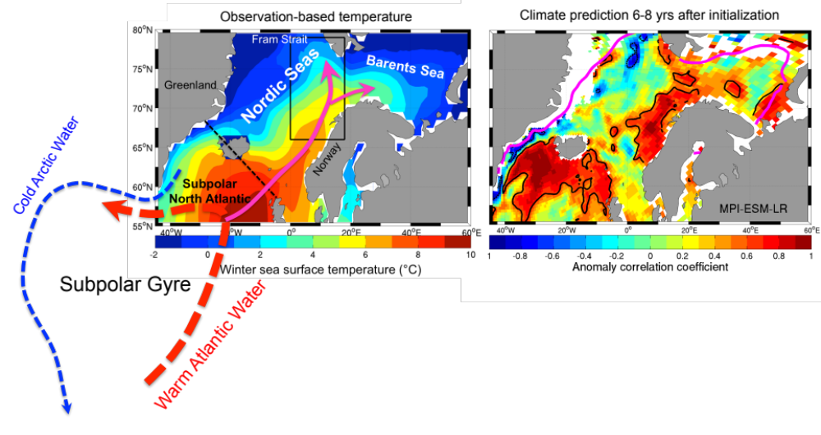
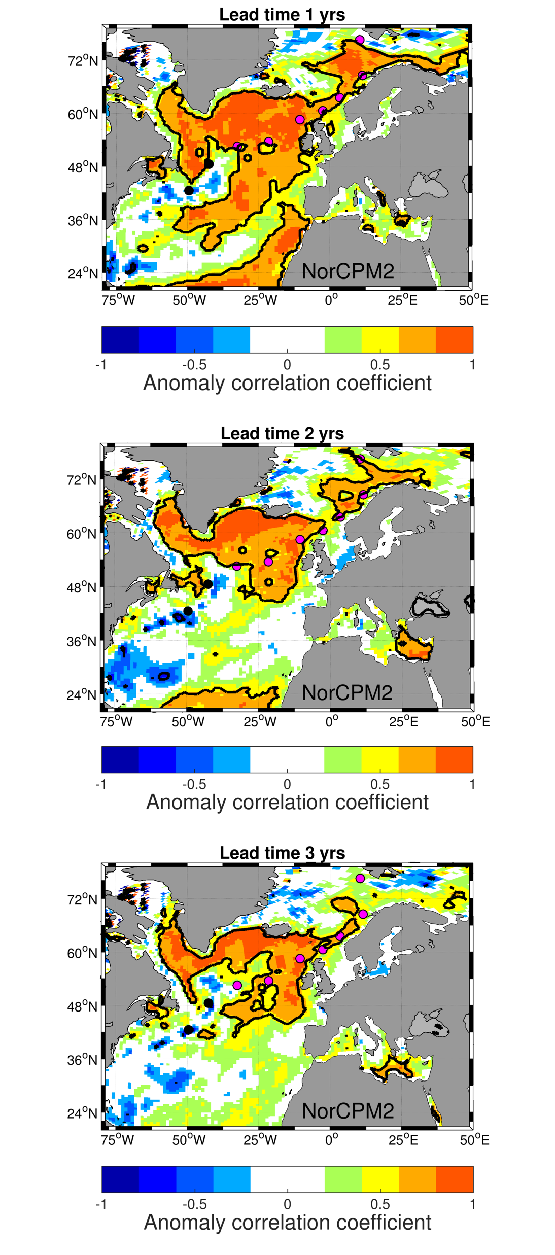
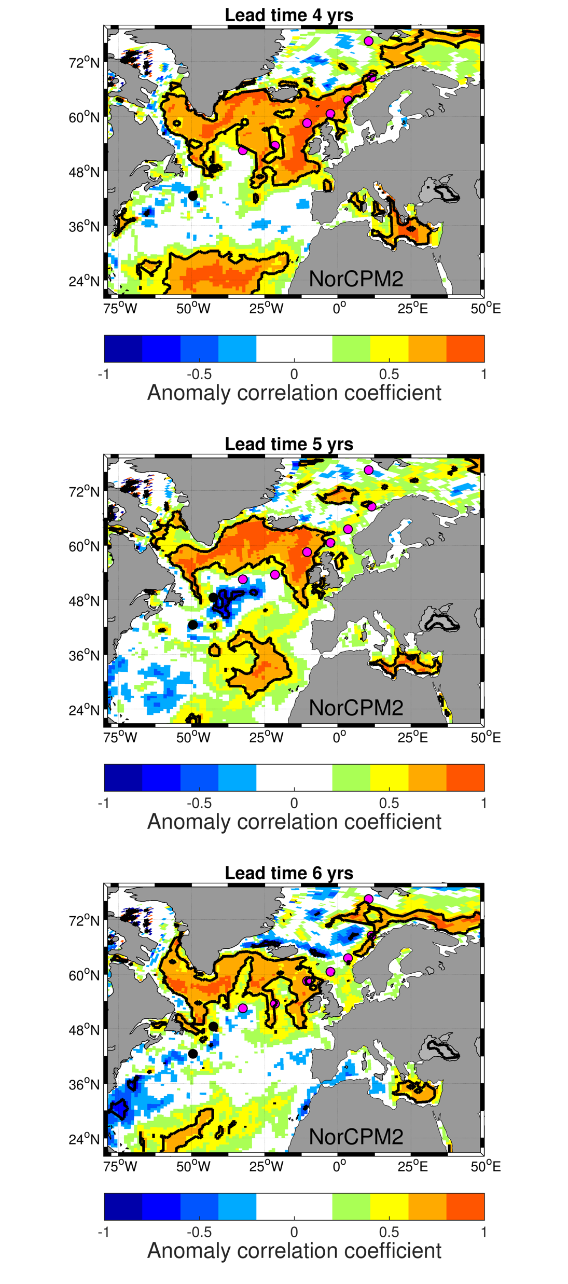
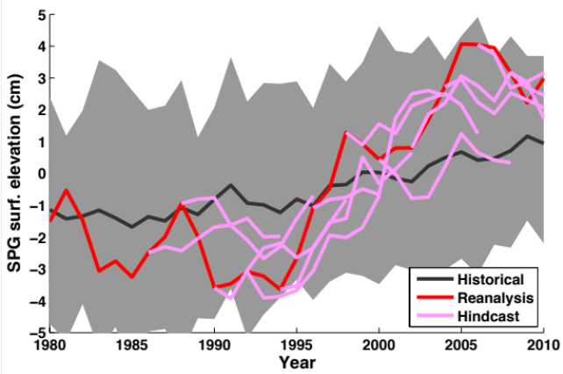
Seasonal-to-decadal prediction skill with SST+TS
Courtesy H. Langehaug

Slide 5
Key assets in NorCPM
1. We use dynamical
covariance
OBS
2. Covariance are constructed in isopycnic coordinate
Surface
OBS :SSTA
T1, S1, DP1
3. Preservation of climate quantities (e.g. ocean heat and salt content, Wang et al., 2016).
4. Joint update of the ocean and multi category sea ice state (strongly coupled DA of ocean and sea ice, Kimmritz et al., 2018)
5. Anomaly assimilation (Weber et al., 2015)
T2, S2, DP2
Propagate update via covariance
Ocean bottom
(Counillon et al., 2016)

Slide 6
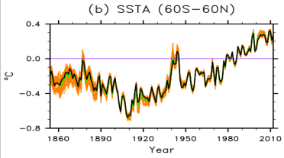

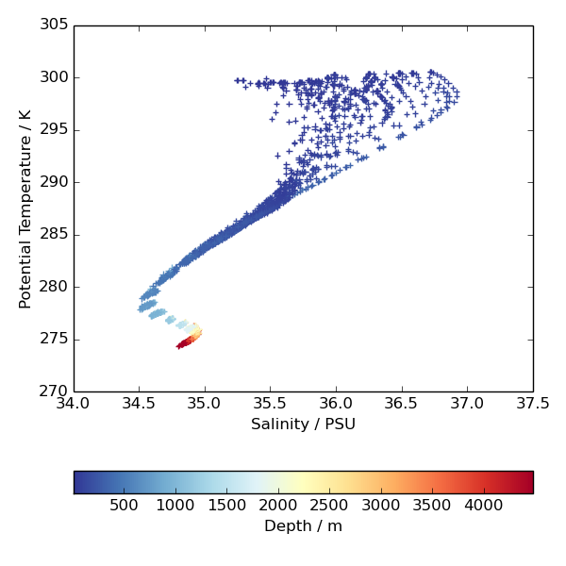
Norwegian Climate Prediction Model (NorCPM)
Norwegian Earth System model (NorESM)
Data assimilation (EnKF)
chemistry/aerosols
CAM
30 members
CICE
CISM
CLM
MICOM
RTM
HAMOCC
Observations
NorCPM V0: SST (WCDA, ocean only)
NorCPM V1: SST+TS (SCDA, ocean+sea ice)
NorCPM V2: SST+TS+ICEC (SCDA ocean+sea ice)
NorCPM V3: with atmosphere (in development)
SST & ice-conc
T-S
profiles
SSH
https://wiki.uib.no/norcpm/index.php/Norwegian_Climate_Prediction_Model
(Bentsen et al., 2013; Counillon et al, 2014)
Notes:
TS
6

Slide 7
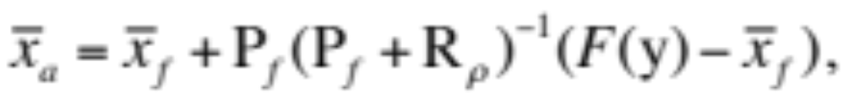
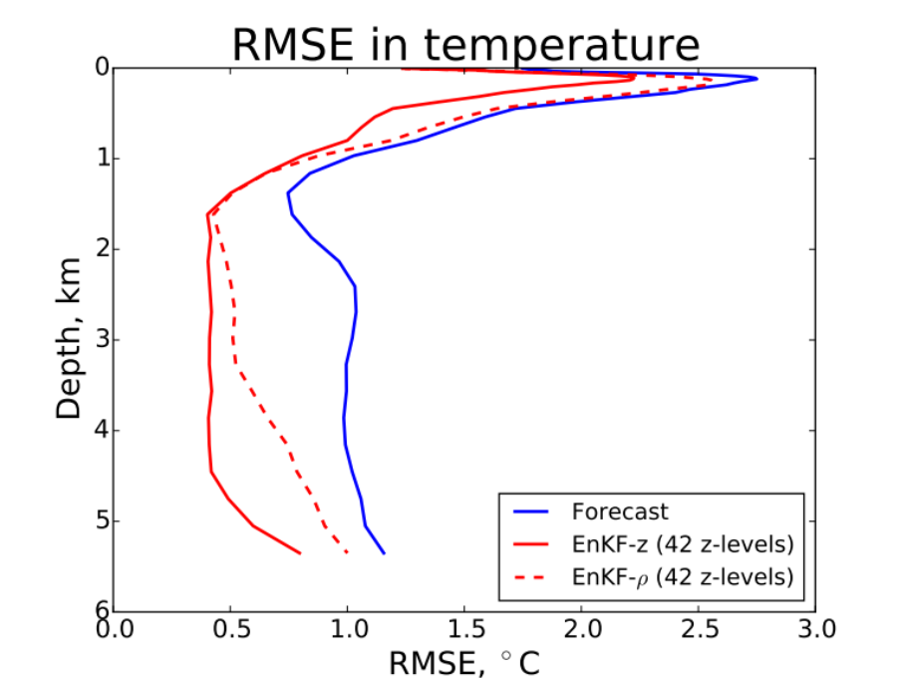
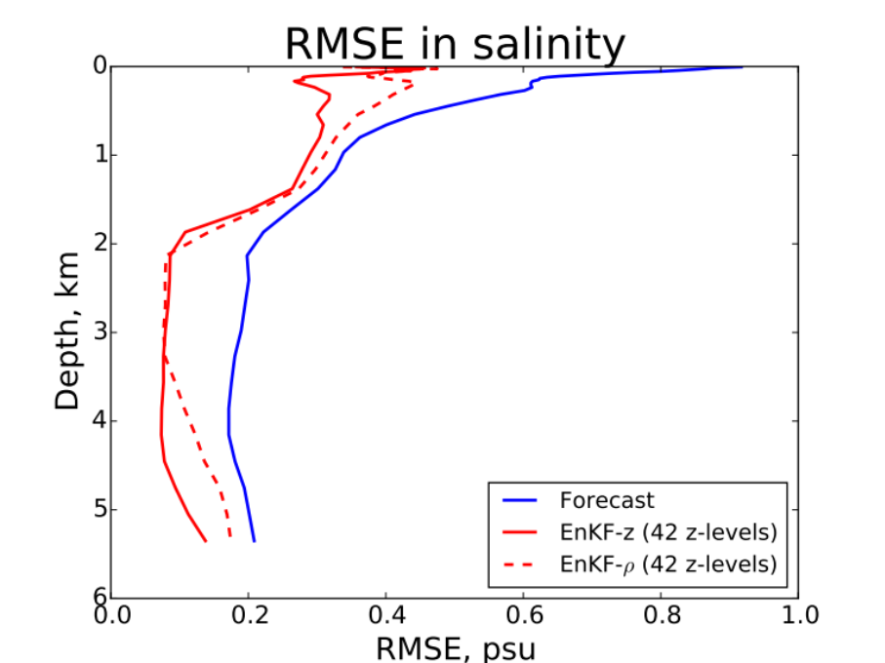
EnKF-z vs. EnKF-ρ for EN4 profile data
1) EnKF-z:
where H is an operator from model space to observation space.
2) EnKF-ρ (Xie and Zhu, (2010), Thacker and Esenkov, 2002):
where F is a non-linear operator from observation space to model space.
(Wang et al. 2017)

Slide 8
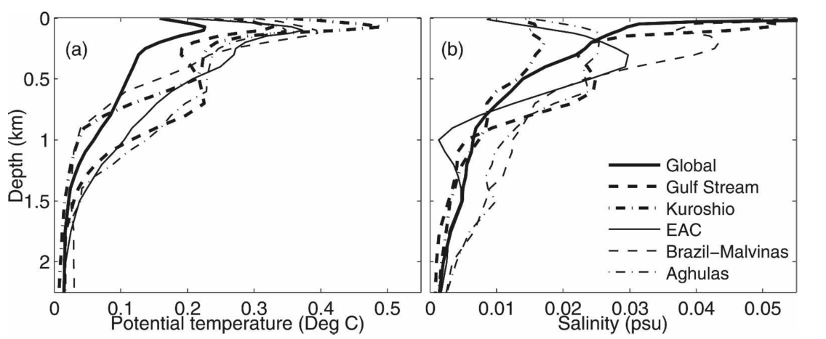
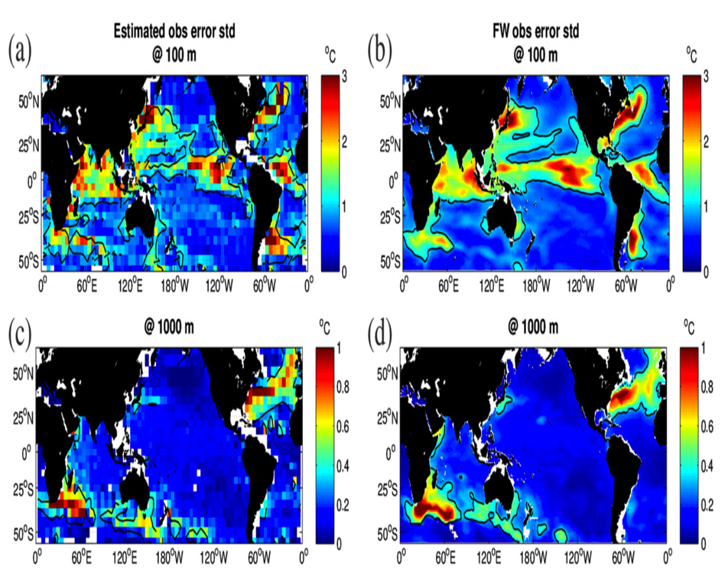
Observation error
(Oke and Sakov, 2008)
(Karspeck, 2016)
The error estimation of Karspeck (2016):
Notes:
We estimate the observation error variance of T-S profilles using the ensemble-based
technique of Karspeck (2016).

Slide 9
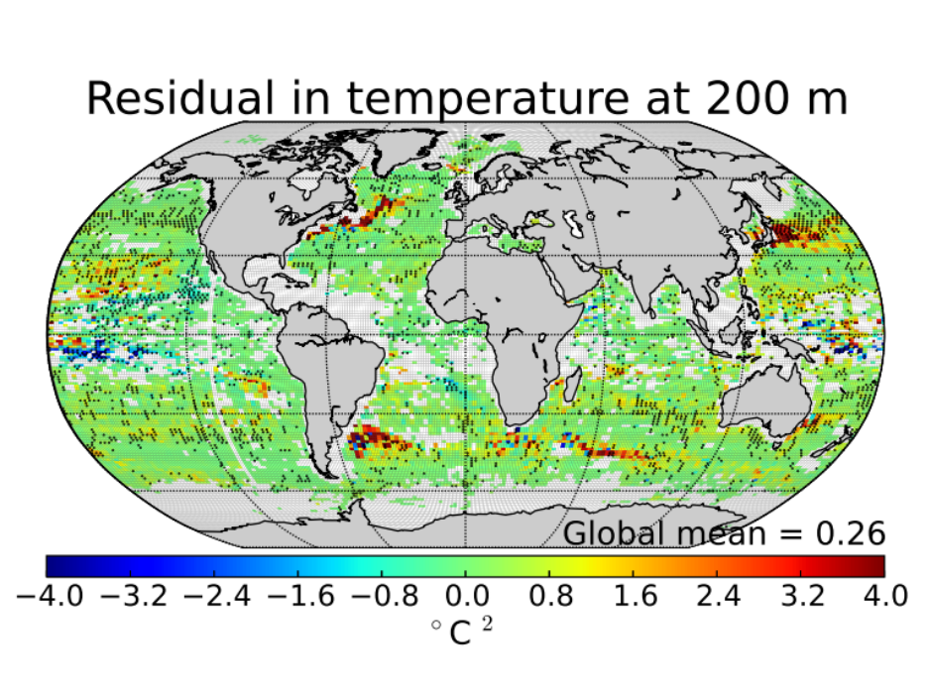
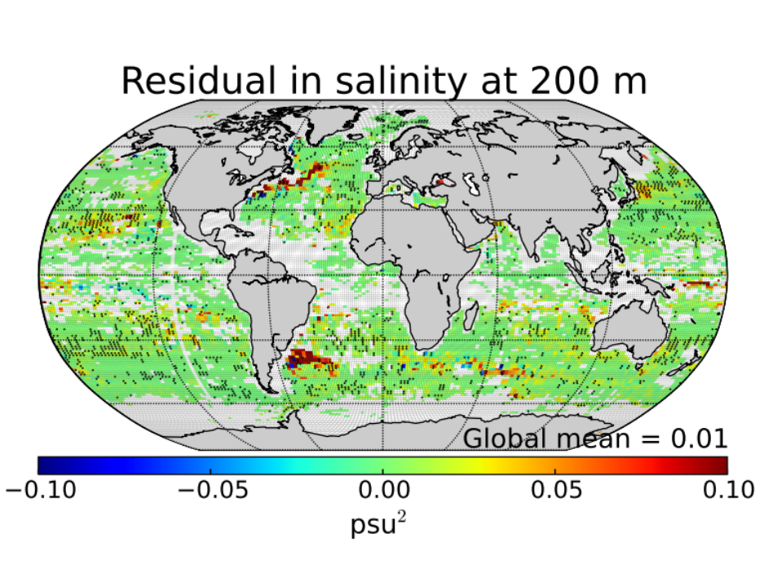
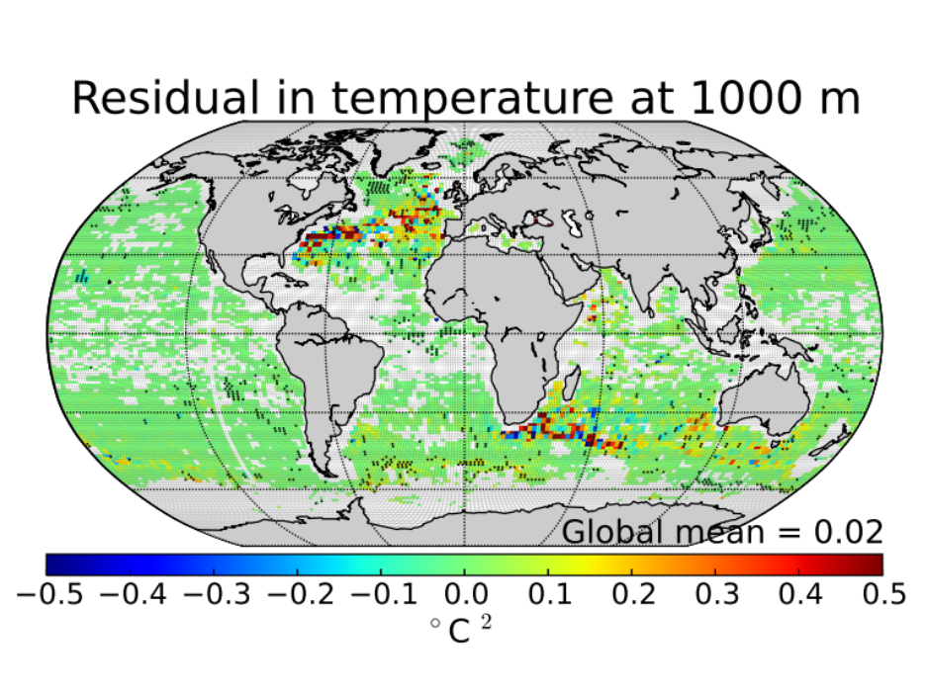
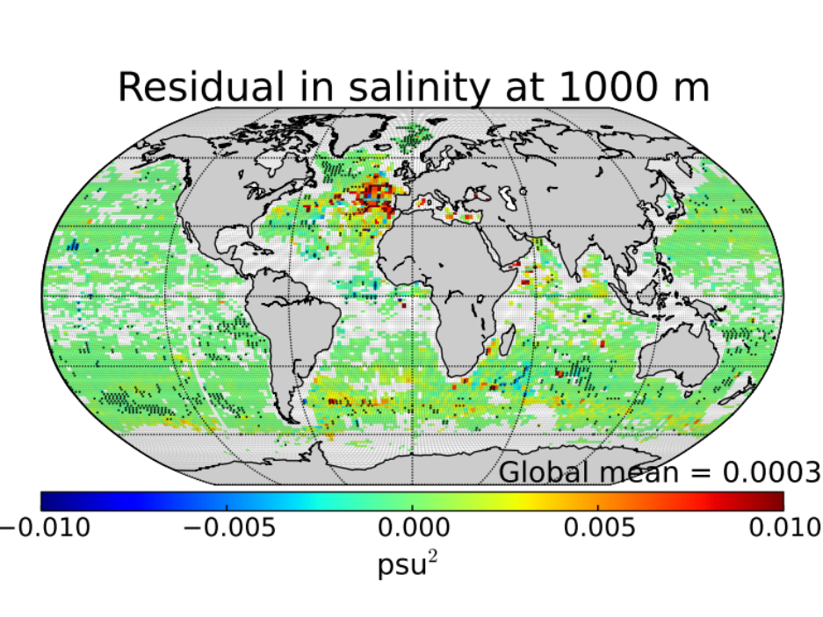
Reliability budget (Rodwell et al. 2016)

Slide 10
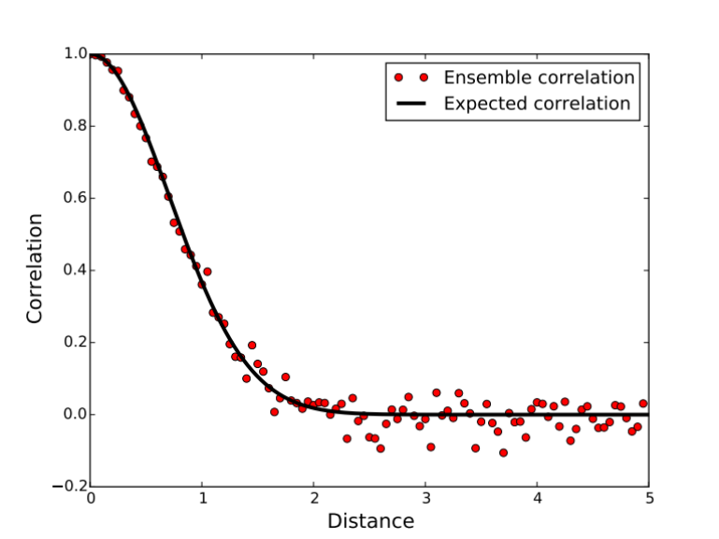
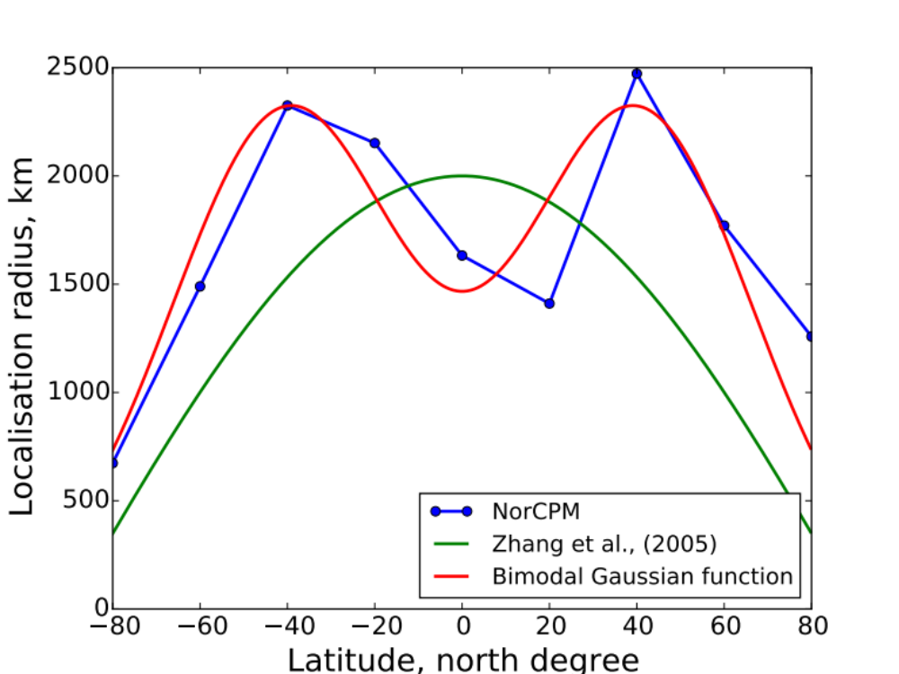
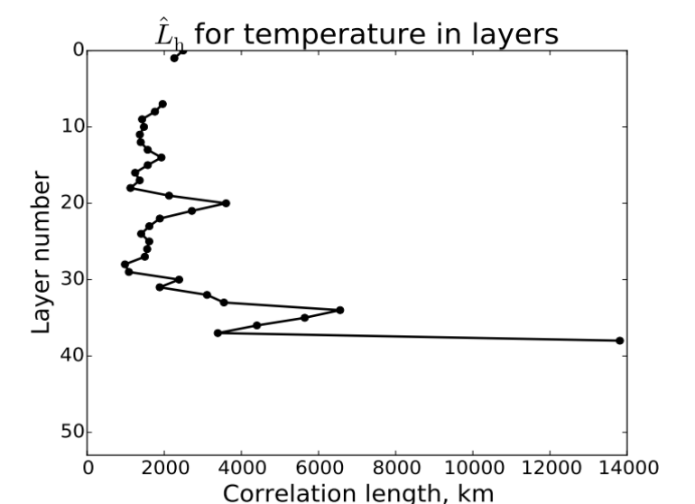
Empirical localisation in NorCPM
r_{loc}
Auto-correlation is anisotropic at Equator due to the influence of Coriolis force.
(Wang et al., 2017)
Notes:
Vertical localisation is not considered here.

Slide 11
Experimental design
Pre-industrial run, save monthly restart files
Year
002
003
001
….
300
Big ensemble with 300 members for each calendrer month (i.e., 3600 static members in total).
We would like to test two approaches:
    Bootstrapping (Barth et al., personnel communication)
    Linear filtering of sample covariances (Menetrier et al., 2015)

Slide 12
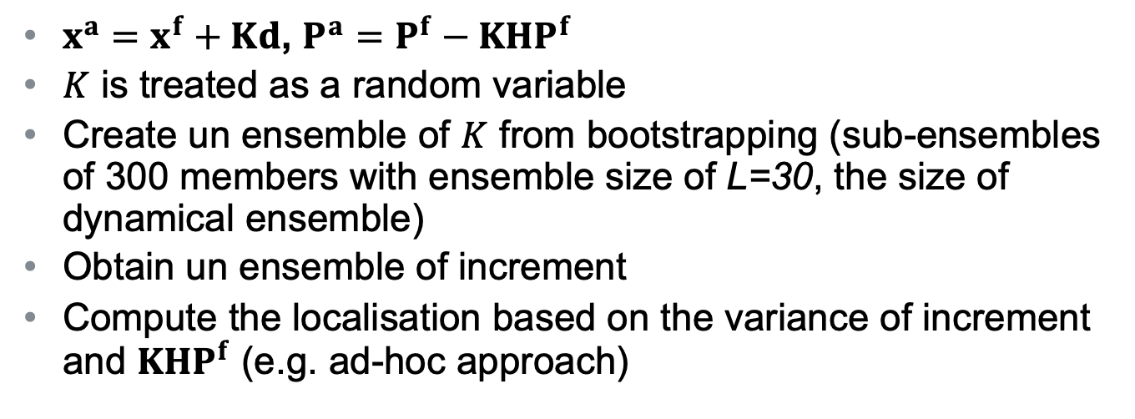
Bootstrapping
$x^{a}=x^{f}+Kd$, $P^{a}=$ $P^{f}−KHP^{f}$
$K$ is treated as a random variable
Create un ensemble of $K$ from bootstrapping (sub-ensembles of 300 members with ensemble size of L=30, the size of dynamical ensemble)
Obtain un ensemble of increment
Compute the localisation based on the variance of increment and $KHP^{f}$ (e.g. ad-hoc approach)
    (Barth et al., personnel communication)

Slide 13
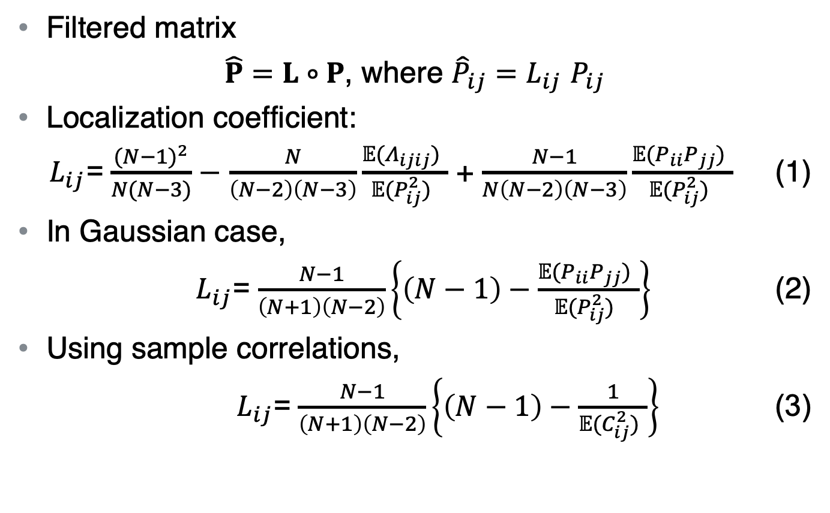
Linear Filtering of Sample Covariances
﻿Filtered matrix
$\hat{P}=L∘P$, where ${\hat{P}}_{ij}=L_{ij}$ $P_{ij}$
﻿Localization coefficient:
$L_{ij}$= $\frac{{(N−1)}^{2}}{N(N−3)}−$ $\frac{N}{\left(N−2\right)\left(N−3\right)}\frac{𝔼(Λ_{ijij}) }{𝔼(P_{ij}^{2}) }$ + $\frac{N−1}{N\left(N−2\right)\left(N−3\right)}\frac{𝔼(P_{ii}P_{jj}) }{𝔼(P_{ij}^{2}) }$ (1)
In Gaussian case,
$L_{ij}$= $\frac{N−1}{\left(N+1\right)\left(N−2\right)}\left\{\left(N−1\right)−\frac{𝔼(P_{ii}P_{jj}) }{𝔼(P_{ij}^{2}) }\right\}$ (2)
﻿Using sample correlations,
$L_{ij}$= $\frac{N−1}{\left(N+1\right)\left(N−2\right)}\left\{\left(N−1\right)−\frac{1}{𝔼(C_{ij}^{2}) }\right\}$ (3)
    Menetrier et al.: Linear Filtering of Sample Covariances for Ensemble-Based Data Assimilation. Part I: Optimality Criteria and Application to Variance Filtering and Covariance Localization, MWR, 2015.

Slide 14
Summay
NorCPM is one of the state-of-art coupled climate prediction system, combing NorESM and the EnKF.
Formulate background error covariance in isopycnic coordinate (model space) and innovation in z-level (observation space)
Estimate observation error for profile data
Empirical localisation in NorCPM
  Bimodal Gaussian varying with latitude (isotropic and Gaspari-Cohn)
  Bootstrapping and linear filtering (anisotropic and non-Gaspari-Cohn)

