Slide 1


Growing the Chemical Probes’ Community
Milka Kostic, Ph.D.
Chemical Biology Program
Dana-Farber Cancer Institute
Twitter: @MilkaKostic (OK to take photos/tweet)

Slide 2

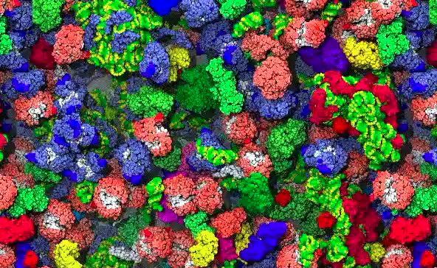
Questions that biomedical research is trying to answer are
numerous and hard
Citation: McGuffee SR, Elcock AH (2010) Diffusion, Crowding & Protein Stability in a Dynamic Molecular Model of the Bacterial Cytoplasm. PLoS Comput Biol 6(3): e1000694.

Slide 3
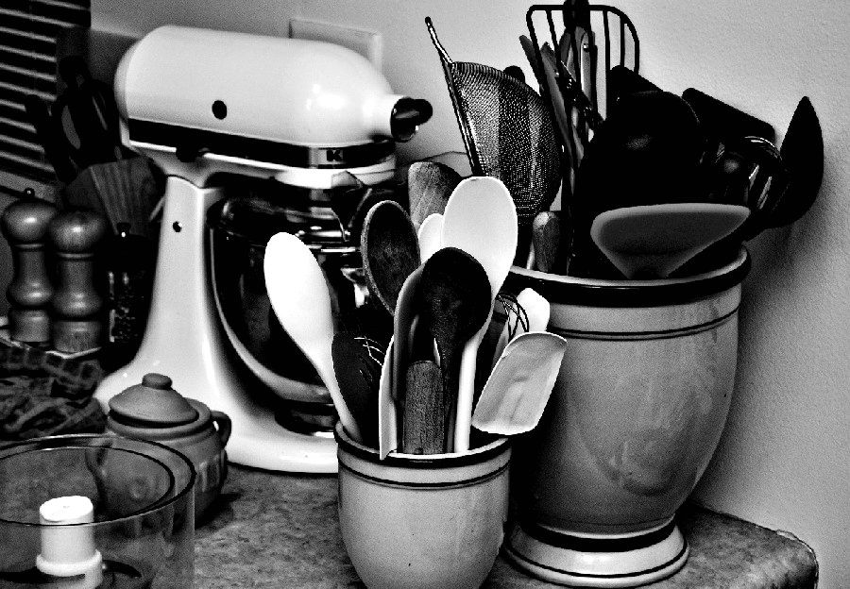
Biomedical research, like my cooking, needs the right research tools for the job!
https://www.flickr.com/photos/artbystevejohnson/4622241124

Slide 4
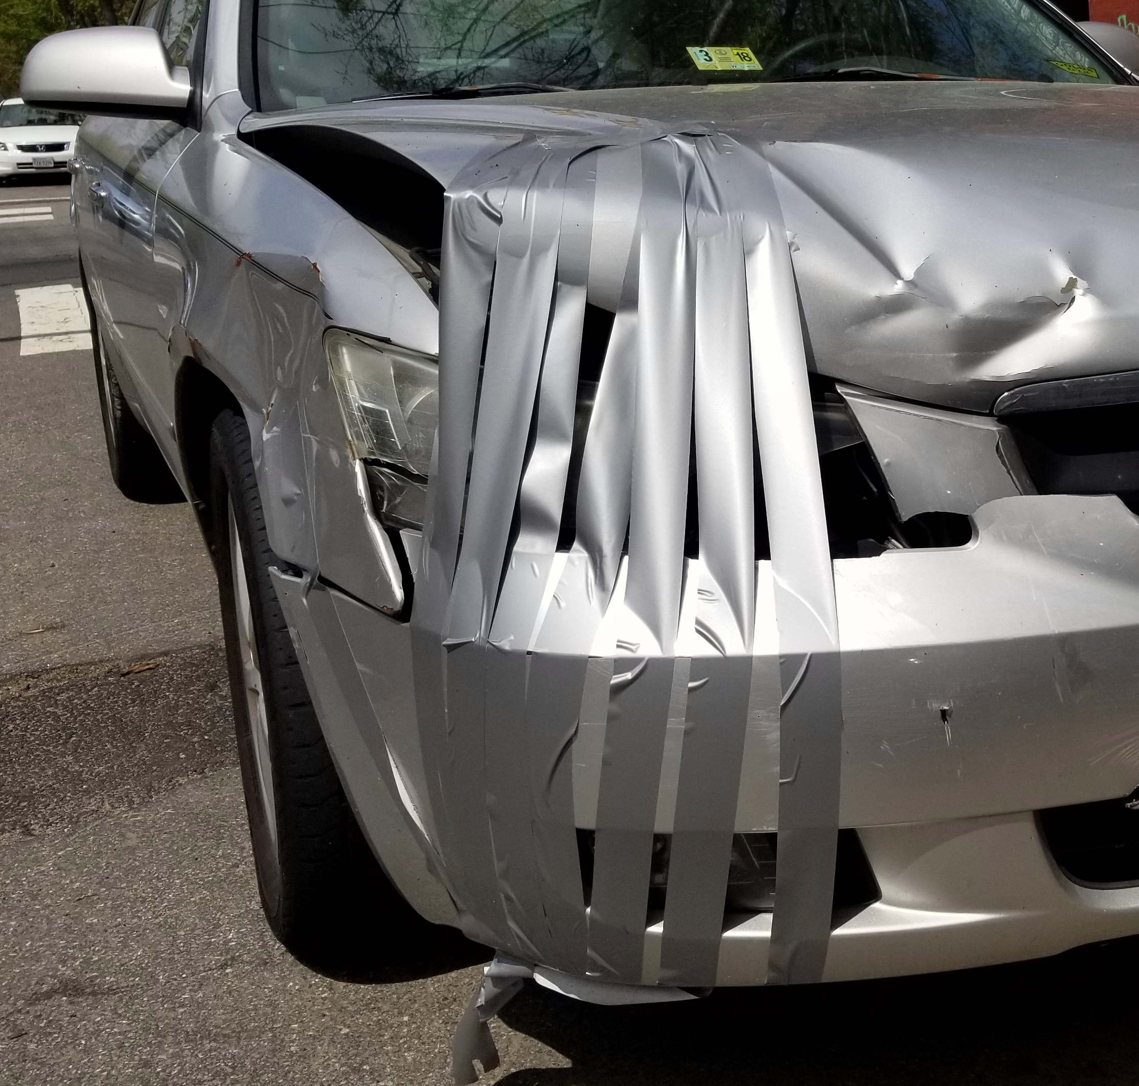
To be useful, any research tool has to be:
rigorously validated
objectively evaluated
precisely documented
accurately employed
https://www.flickr.com/photos/gammaman/40497010885

Slide 5
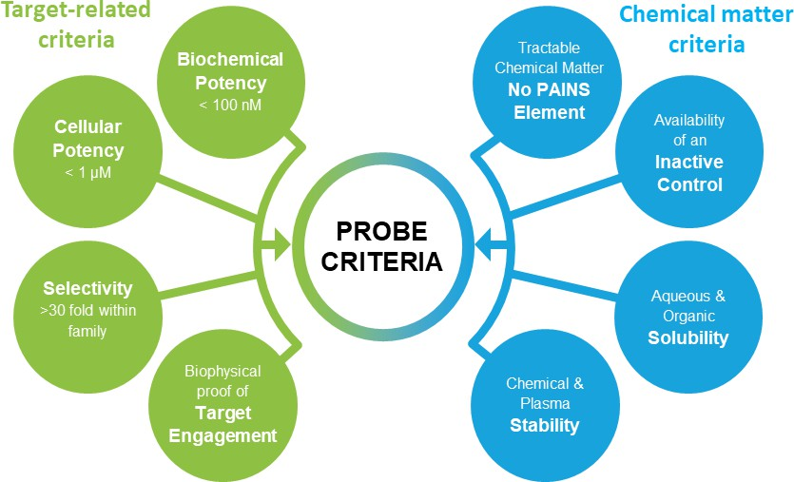
Chemical probes are research tools that check off the following criteria:
“Science Forum: Donated chemical probes for open science”- Müller et al. (2018) eLife 7:e34311

Slide 6
“A chemical probe is simply a reagent—a selective small-molecule modulator of a protein's function that allows the user to ask mechanistic and phenotypic questions about its molecular target in biochemical, cell-based or animal studies. “
Arrowsmith et al. (2015) Nat. Chem Biol.

Slide 7
One thing chemical probes don’t need to be is…?
≠
chemical probes
drugs

Slide 8

AND: chemical probes is NOT where
Ooops!-we-thought-there-were-good leads
go to retire!

Slide 9
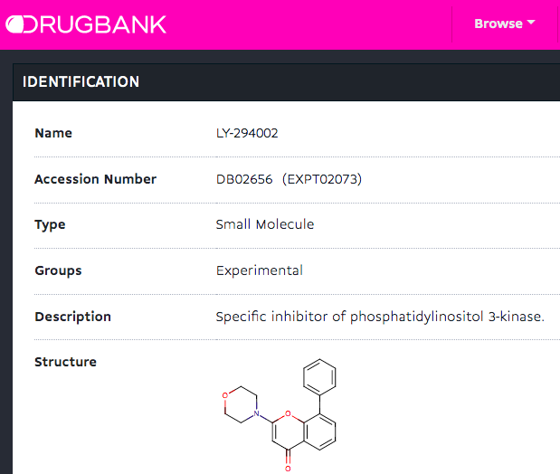
Problematic probes will not just go away
developed to target PI3K in 1990’s
affects a range of targets, including BET bromodomain proteins
still being used in 2019 as PI3K research tool

Slide 10
Estimated cost of using bad chemical probes is…
$1.8B
http://www.chemicalprobes.org/news/estimating-cost-poor-quality-reagent-selection

Slide 11

Photo source: https://www.flickr.com/photos/aukirk/32520898816

Slide 12

Diversify chemical probes’ community to include a much larger number of people and types of entities

Slide 13
Diverse and inclusive chemical probes’ community
Chemical probe developers
Chemical probe users
Chemical probe vendors
Publishers, editor & journals
Funders

Slide 14
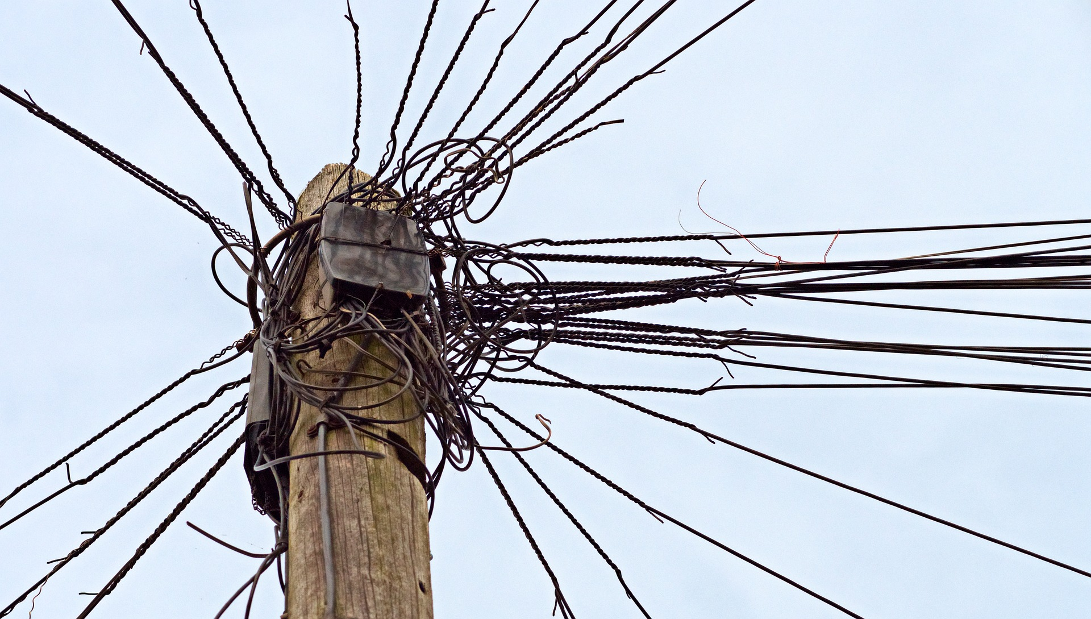
Too many cultures, too many pre-existing silos

Slide 15
Our glue is our common goals and values
Ability to study, understand and drug disease
Changing in the lives of fellow humans (and ourselves)
Ability to make research breakthroughs
Reputation and credibility of biomedical science
Shared Goals and Values

Slide 16
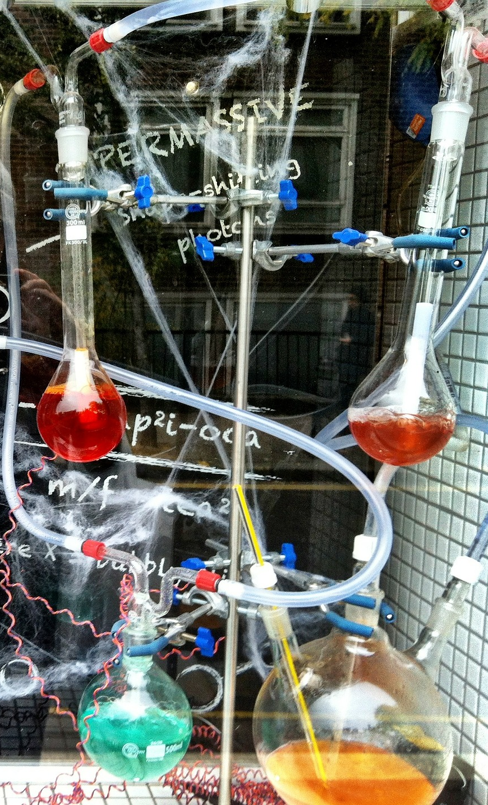
Chemical probe developers should:
Push the chemical probes efforts
Adopt robust sharing and reporting principles
Provide training resources and guidelines
Share the ownership of the problem and the solutions
Advocate for funding
Engage, engage, engage
(and learn to speak the language of biologists)

Slide 17

How can biomedical (life science) research journals make a difference:
Adopt community endorsed chemical probe standards
Provide space to discuss issues and broadcast best practices
Introduce mandates for probe validation, deposition and resource sharing

Slide 18
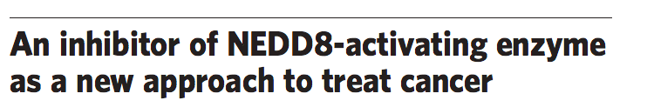

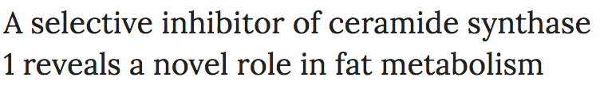

Most people get their chemical probe info via…

Slide 19
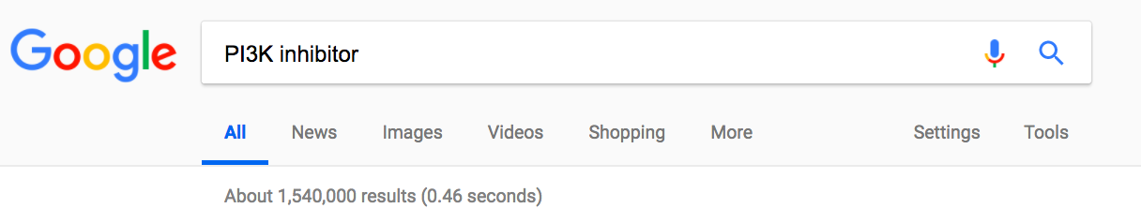
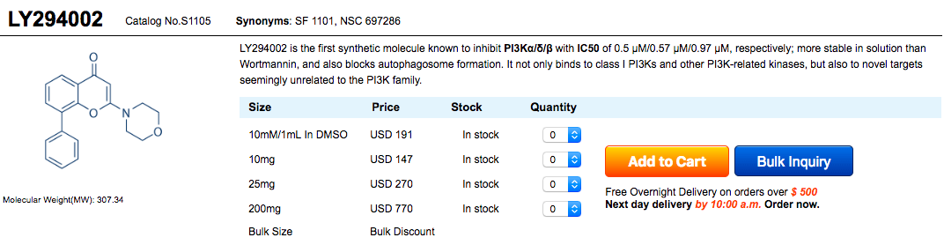
Most people find their chemical probe via…

Slide 20
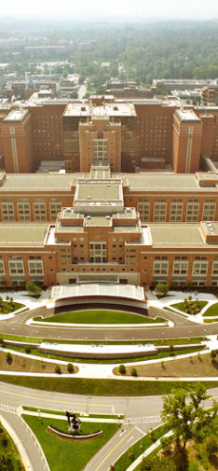
Common-sense things funders could be doing
Provide long-term funds and infrastructure to enable high-quality chemical probe development
Require detailed plan for chemical probe validation and/or assessment in grant applications, as well as clear user statements on their probe choosing criteria
Require public sharing of all the probe validation data and use guidelines, potentially via a global chemical probe depository

Slide 21

Finally, what about chemical probe users?
It will be an uphill battle, but with help from funders, journals, vendors and KOL from across life sciences we can get there!
Why?
Because we share common goals and values!

Slide 22
Growing chemical probes’ community
Engagement
Respect
Accountability
Communication

Slide 23
Many questions of biology and physiology are still wide open and we need all hands on deck, and all tools on deck to help answer them

Slide 24
THANK YOU

