Slide 1
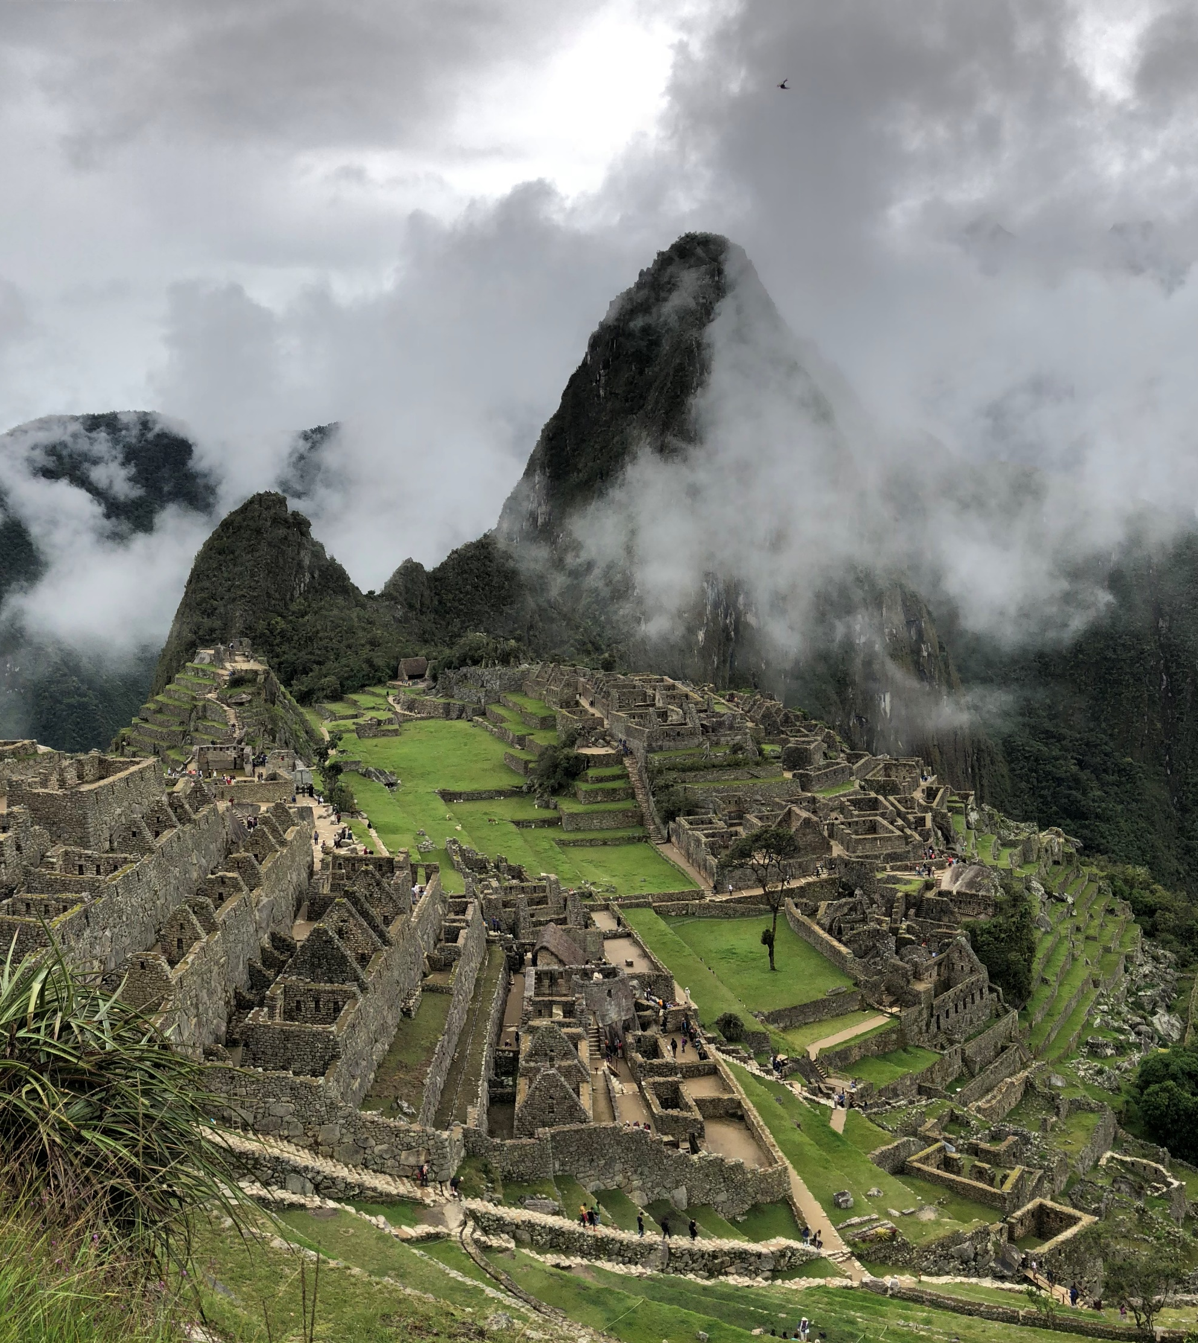

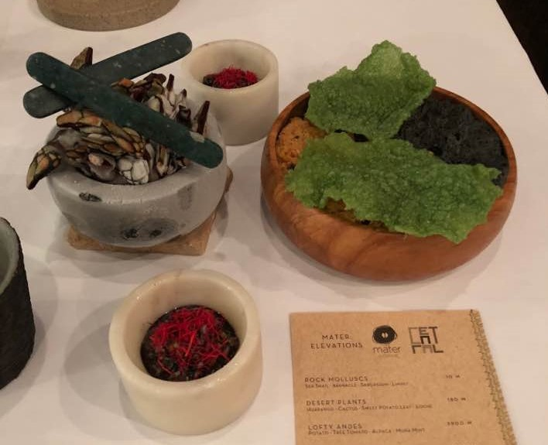
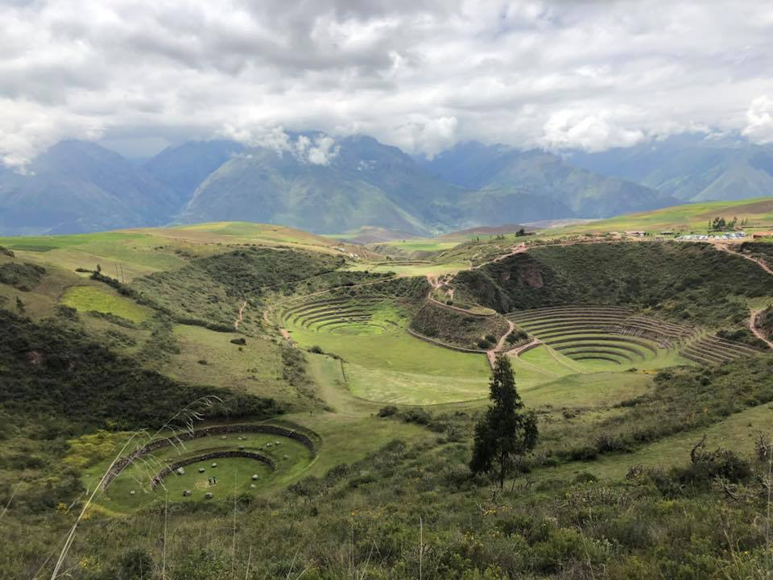
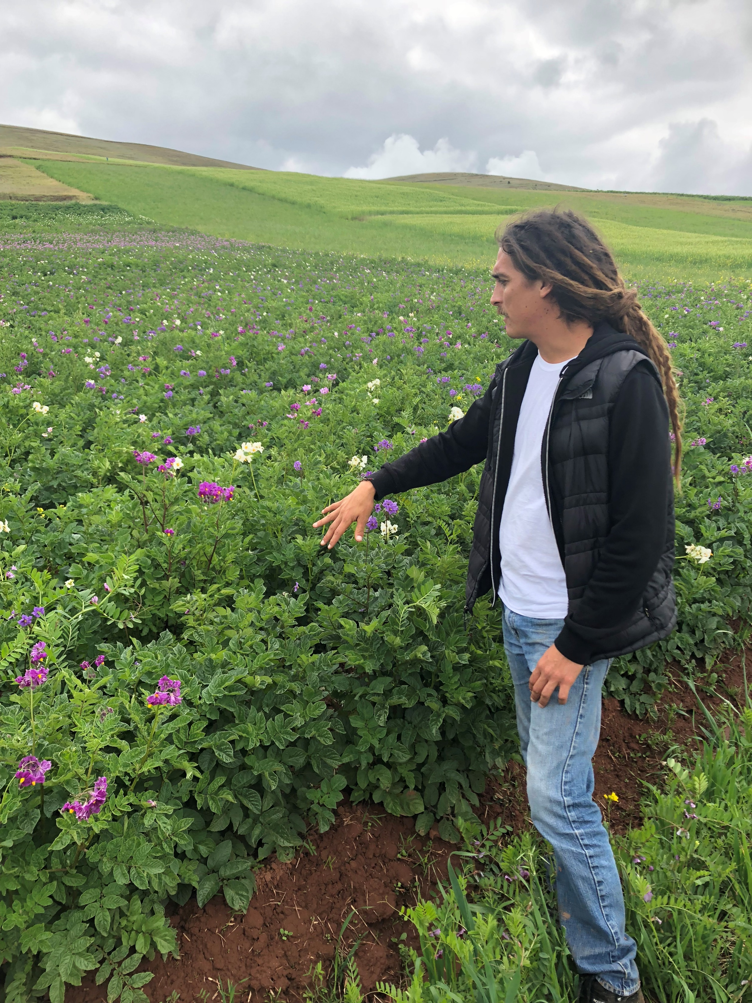


mobilize communities and utilize engineering to preserve biodiversity and protect and empower local cultures
Non-Cognitive Predictors of Student Success:
A Predictive Validity Comparison Between Domestic and International Students
Non-Cognitive Predictors of Student Success:
A Predictive Validity Comparison Between Domestic and International Students
Applied Research Innovation through Social Networks:
The Story of a Mechanical Engineer, a Sociologist, and a Restaurant
Devin R. Berg, Nels Paulson
MOTIVATIONS
The problems facing our world are evolving and challenging
Globalization often perpetuates those problems and requires new skills for tomorrow’s leaders
Cross-disciplinary collaboration can improve outcomes, draw from the available diversity of experiences
Scholars must also find and/or develop non-academic partners with similar goals in sustainability and justice
GOALS
Develop, maintain, and grow relationships to tackle challenging and evolving problems
Work to address issues of equity, justice, and sustainability in agriculture
Develop solutions for the preservation of biodiversity in agricultural products and the strengthening of local cultures
Create educational opportunities for students that will shape them into leaders in addressing future problems for our globalized world
Partner with the research organization, Mater Iniciativa, and Central Restaurante to invest in the strength of rural communities in Peru
Expand the work done in Peru and extend it to Wisconsin
afuera hay más
Notes:
Notes:
In Powerpoint, click View > Guides
Keep text within gutter guides.
Author list: Don’t split names onto two lines (e.g., “Jimmy [break] Smith”). If that happens, use a new line, unless you need the space. Bold the first names of anybody who’s presenting in person.
Intro/methods/result: Do not drop below font size 28, but if you have extra space, jack up the font size until the space is full.
Do not use color in the sidebars except in graphs/figures. It’ll pull attention from the center and slow interpretation for passersby.

