Slide 1
The role of Atlantic heat transport in future Arctic winter sea ice loss
Marius Årthun, Lars H. Smedsrud & Tor eldevik
Geophysical Institute, University of Bergen, norway
bjerknes centre for climate research

Slide 2
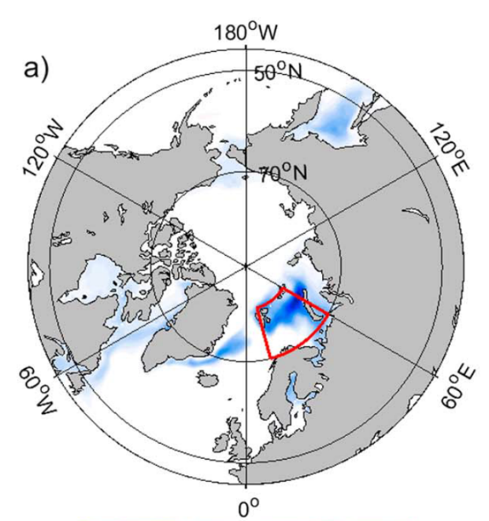
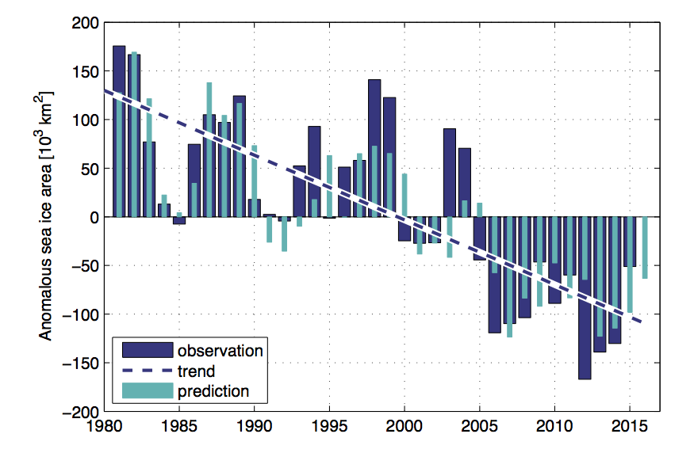
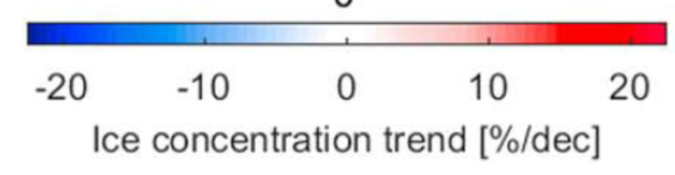
Role of Atlantic heat transport in Arctic winter sea ice loss
In winter, recent Arctic sea ice loss has been most pronounced in the Barents Sea.
Sea ice loss has largely been a result of increased Atlantic heat transport → “Atlantification” of the Arctic.
1-year prediction of sea ice cover in the Barents Sea
NAC/NwAC
r² = 71%
Onarheim and Årthun, 2017. Geophys. Res. Lett.
Onarheim et al. 2015. Geophys. Res. Lett.

Slide 3

Research questions
ICE FREE BARENTS SEA?
GULF STREAM?
COD STOCK?
ATLANTIFICATION?
To what extent are future Arctic sea ice variability and retreat influenced by internal variability of the Atlantic inflow?
What are the drivers of future changes in poleward ocean heat transport?
GALε
Marius Årthun
Årthun et al
*adapted from George Friedman (2009)

Slide 4
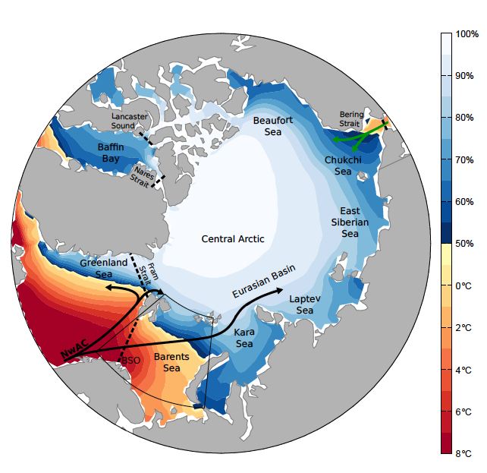
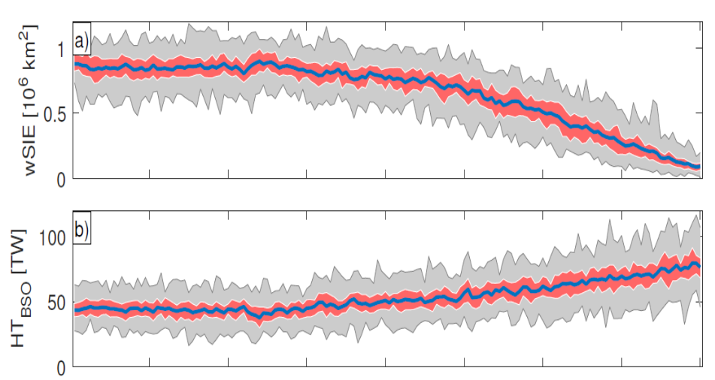
CESM large ensemble
40 ensemble members for the time period 1920-2100
RCP8.5
Externally forced response: Ensemble mean
Internally driven variability: Ensemble spread
Atlantic heat transport through the Barents Sea Opening

Slide 5
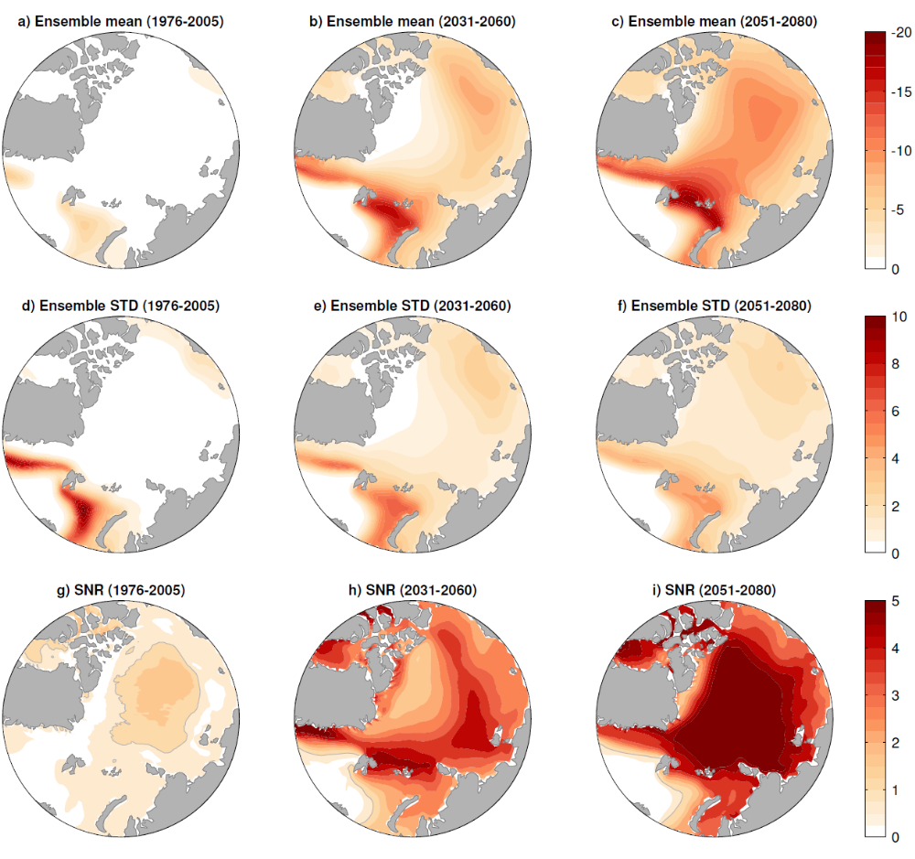
Externally forced trends
%/decade
%/decade
Internally forced trends
SNR: Signal-to-noise ratio
SNR<1: Internal variability most important

Slide 6
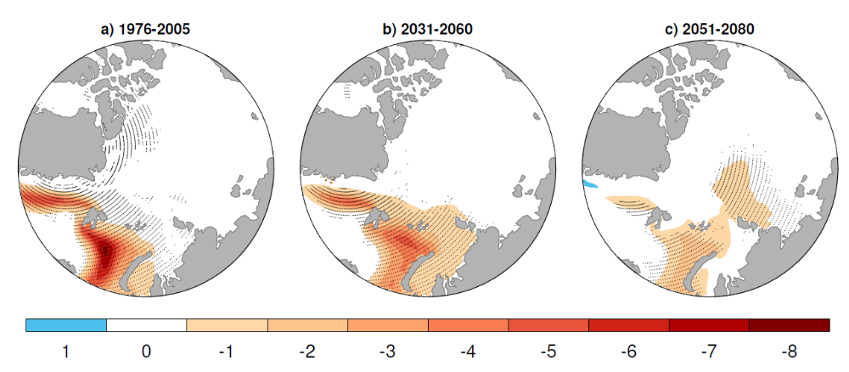
Internally forced trends
Internally forced trends
by ocean heat transport
%/std(ensemble spread)

Slide 7
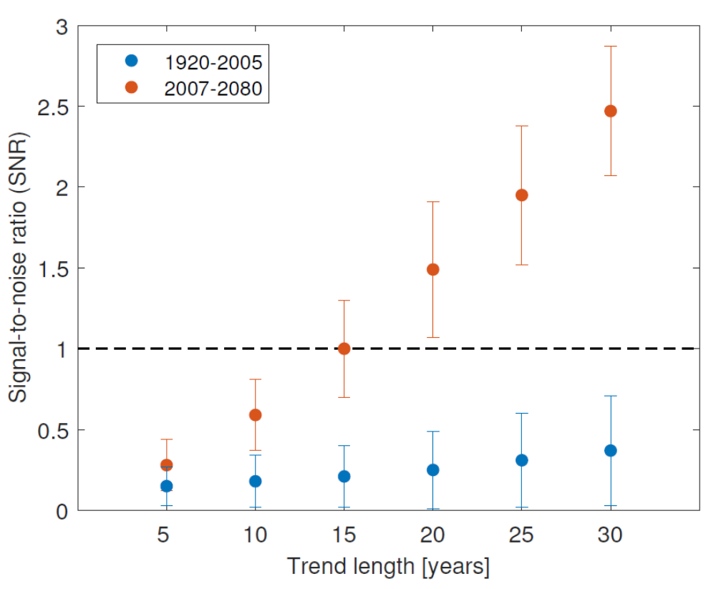
The importance of internal variability for Arctic winter sea ice loss
The relative importance of internal and external variability is highly dependent on the trend length considered.

Slide 8
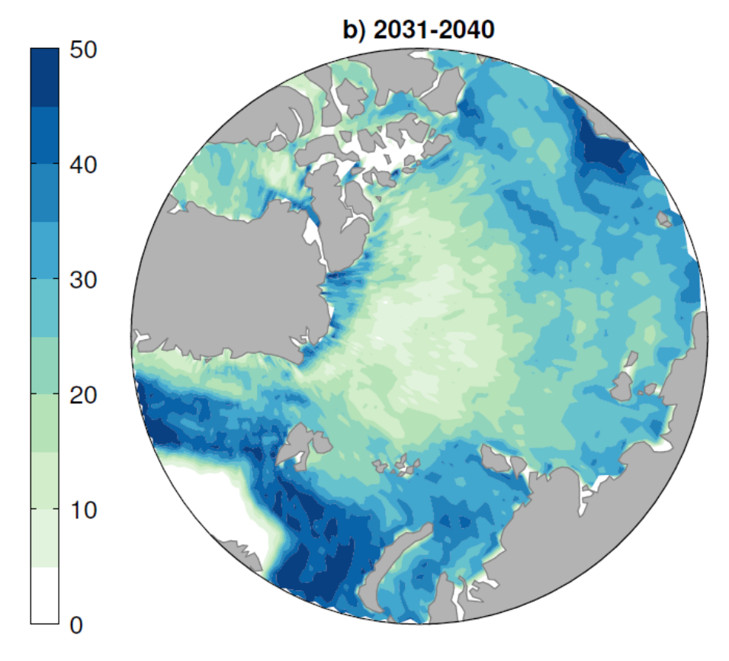
The importance of internal variability for Arctic winter sea ice loss
The relative importance of internal and external variability is highly dependent on the trend length considered.
Decadal periods of positive sea ice trends can occur in the future when ocean heat transport variability counteracts anthropogenic forcing.
Probability (%) of a positive 10-year trend in sea ice concentration

Slide 9
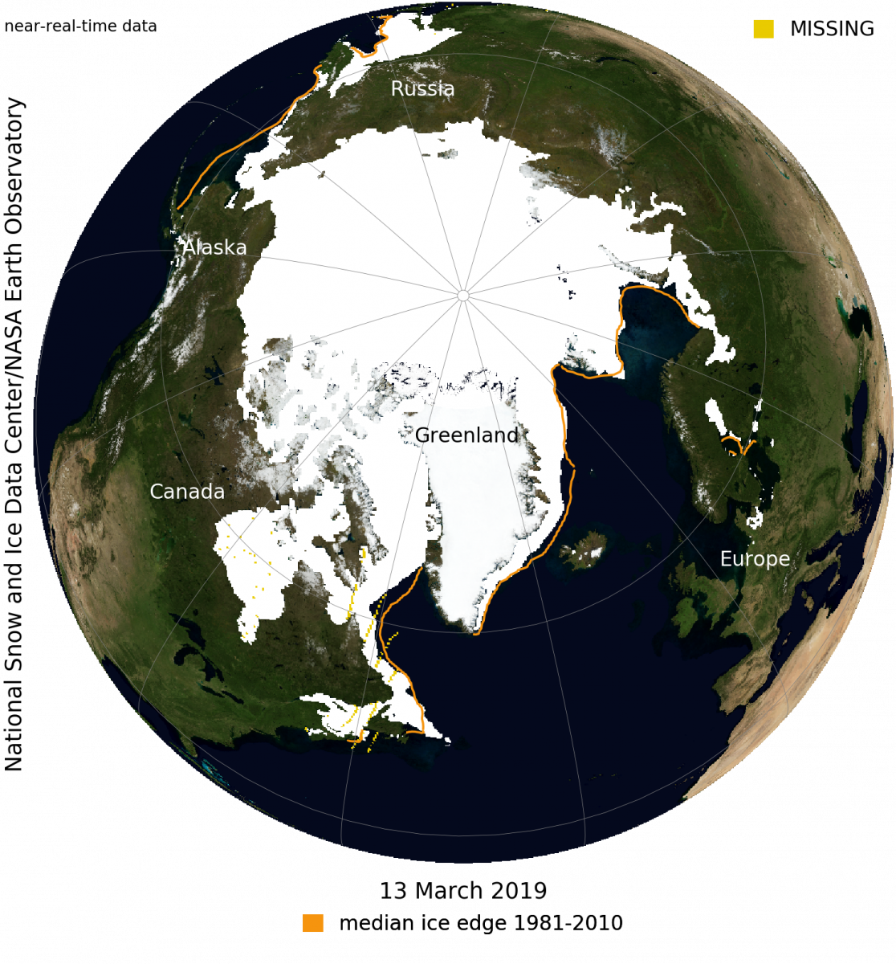
The importance of internal variability for Arctic winter sea ice loss
The relative importance of internal and external variability is highly dependent on the trend length considered.
Decadal periods of positive sea ice trends can occur in the future when ocean heat transport variability counteracts anthropogenic forcing.

Slide 10
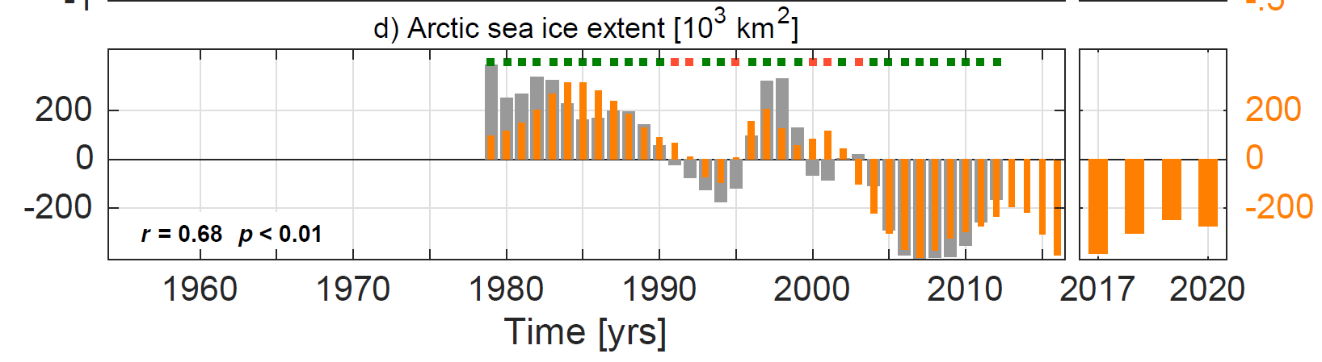
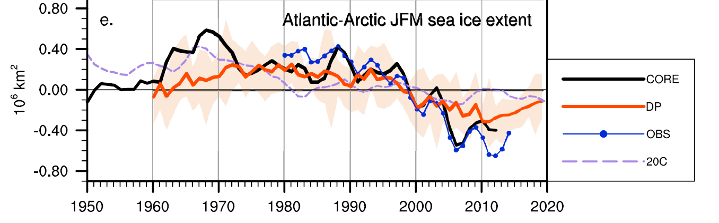
The importance of internal variability for Arctic winter sea ice loss
Interannual to decadal sea ice trends are predictable.
Statistical prediction
Årthun et al. 2017. Nat. Commun.
Dynamical prediction
Yeager et al. 2015. Geophys. Res. Lett.

Slide 11
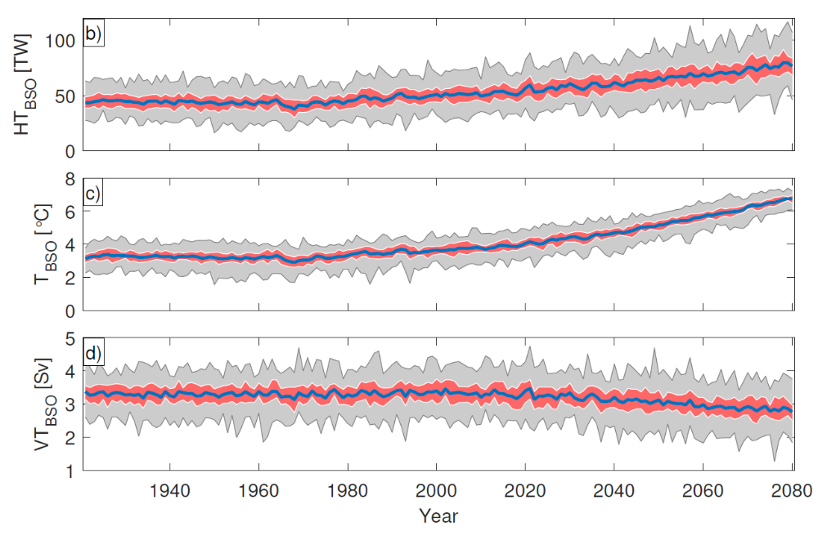
Drivers of future ocean heat transport variations
Future OHT increase in CESM-LE is a result of higher ocean temperature, counteracted by a decrease in the strength (volume) of the Atlantic inflow.
OHT co-varies with volume transport and temperature on interannual time scales.
What are the drivers of future decline in BSO inflow?

Slide 12
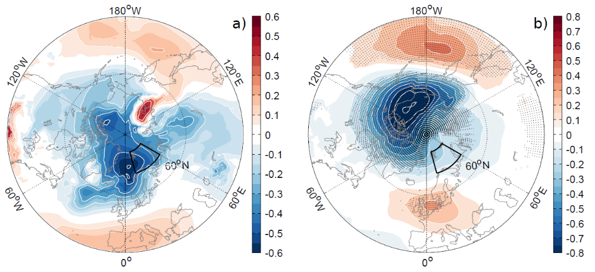
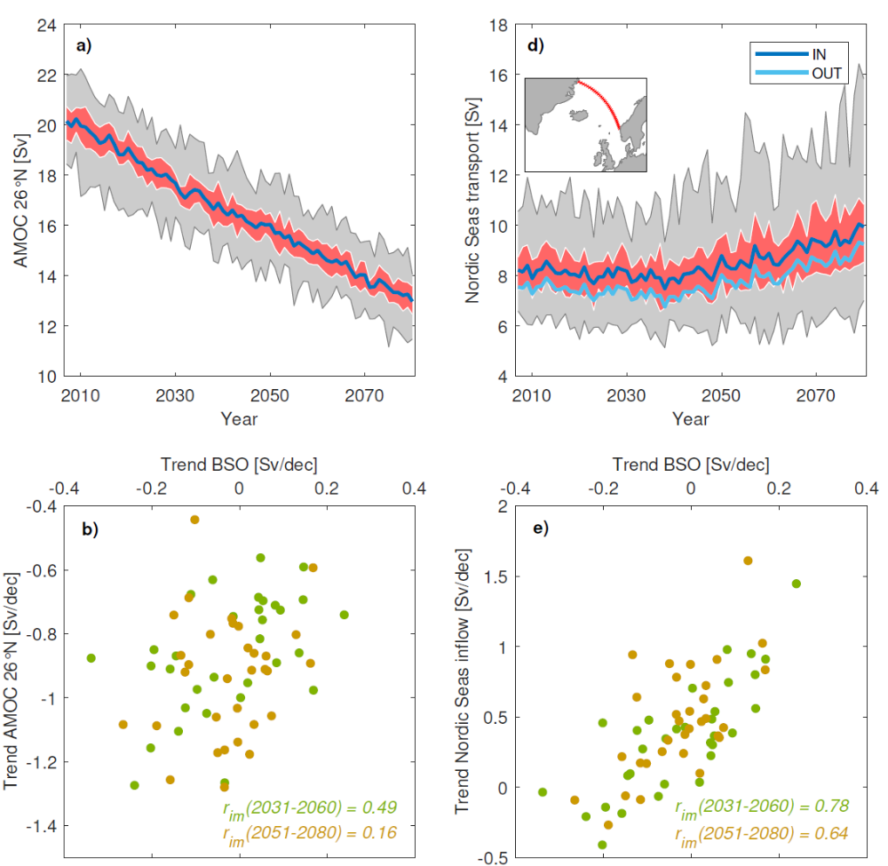
Drivers of future ocean EXTERNAL heat transport variations
hPa/decade
The AMOC substantially weakens toward 2080.
The circulation within the Nordic Seas increases as a result of a trend toward lower SLP.
SLP gradient decreases across BSO → weaker inflow.

Slide 13
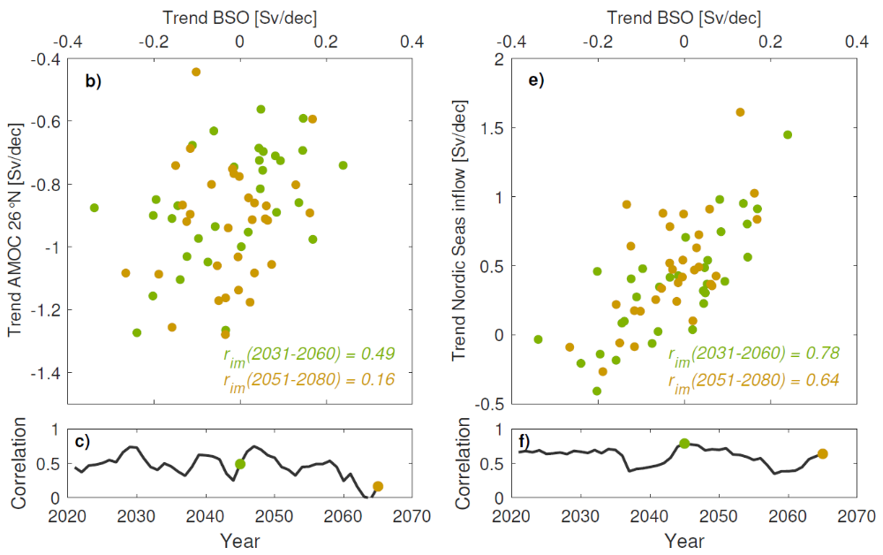
Drivers of future ocean INTERNAL heat transport variations
hPa/std(ensemble spread)
Internal OHT variability is associated with both upstream ocean circulation changes, including AMOC, and large-scale atmospheric circulation anomalies reminiscent of the Arctic Oscillation.

Slide 14
CONCLUSIONS
Ocean heat transport into the Barents Sea has been, and will continue to be, a major source of internal Arctic winter sea ice variability and predictability.
Future long-term increase in Atlantic heat transport is carried by warmer water as the current itself is found to weaken.
Internal heat transport variations associated with upstream ocean circulation and large-scale atmospheric circulation anomalies.

Slide 15


Årthun et al. 2019: The role of Atlantic heat transport in future Arctic winter sea ice loss. Journal of Climate.
Årthun et al. 2017: Skillfull prediction of northern climate provided by the ocean. Nature Communications.
Onarheim & Årthun 2017: Toward an ice-free Barents Sea. Geophysical Research Letters.
THANK YOU!

