Slide 1
Put a pin in it
Software and specimen citation in the natural sciences
Josh Humphries
Sarah Vincent
Informatics Tech Lead
j.humphries@nhm.ac.uk
Informatics Data Analyst
s.vincent@nhm.ac.uk

Slide 2

NHM Science
Data and software citations
  Collection of ~80 million objects
  Research from 300+ scientists
  Large number of citation use cases
Biodiversity & Informatics
  Data architecture and software development
  Technical projects: DCP, Data Portal, Scratchpads, PREDICTS etc
Notes:
One of the most (if not the most) important natural history collections in the world.
Collection is large and covers the entire world and a large time period.
Collection is ever increasing in size as we continue to add specimens to the collection.
Research in varying areas:
earth and life sciences
different scales (molecular vs. dinosaurs)
different scales again (specific period and taxonomic genus vs. more far reaching studies such as the recent report by IPBES into biodiversity and extinction which our scientists contributed to
Informatics contribute to large EU projects, many with goals that specifically tackle PID problems in our domain.
We also do data architecture and software development as a part of the science department at the Museum.
We have 4 developers and 2 data architects in the team working across various projects.

Slide 3
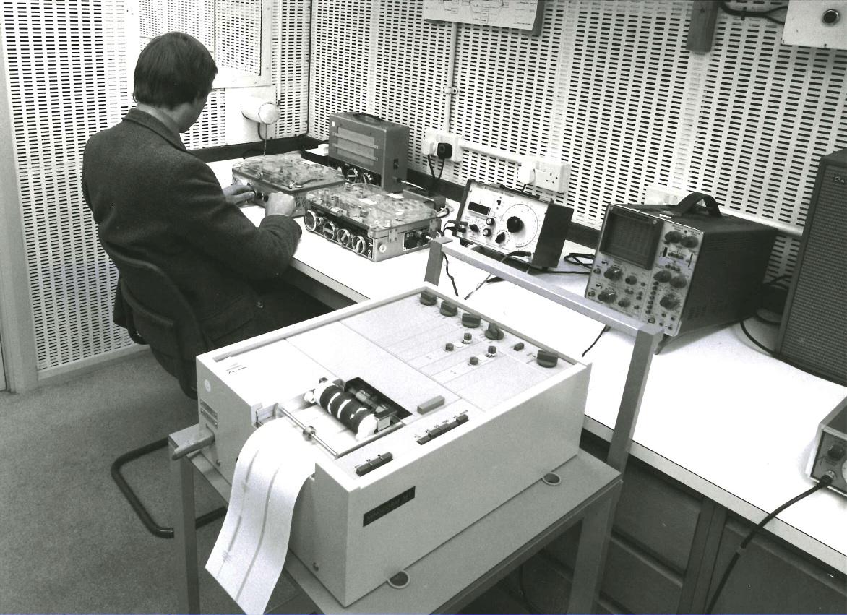

Software citation
Key software projects:
PREDICTS - https://www.predicts.org.uk/
Scratchpads - http://scratchpads.eu/
Data Portal - https://data.nhm.ac.uk/
Inselect - https://naturalhistorymuseum.github.io/inselect/
Notes:
In informatics we manage, develop, maintain, advise and architect.
PREDICTS: (Projecting Responses of Ecological Diversity In Changing Terrestrial Systems) - looking at large quantities of data from different localities to identify common trends in how biodiversity responds to human activities
Scratchpads: VRE for biodiversity research, allowing users to share data and knowledge with their peers across a range of topics

Slide 4
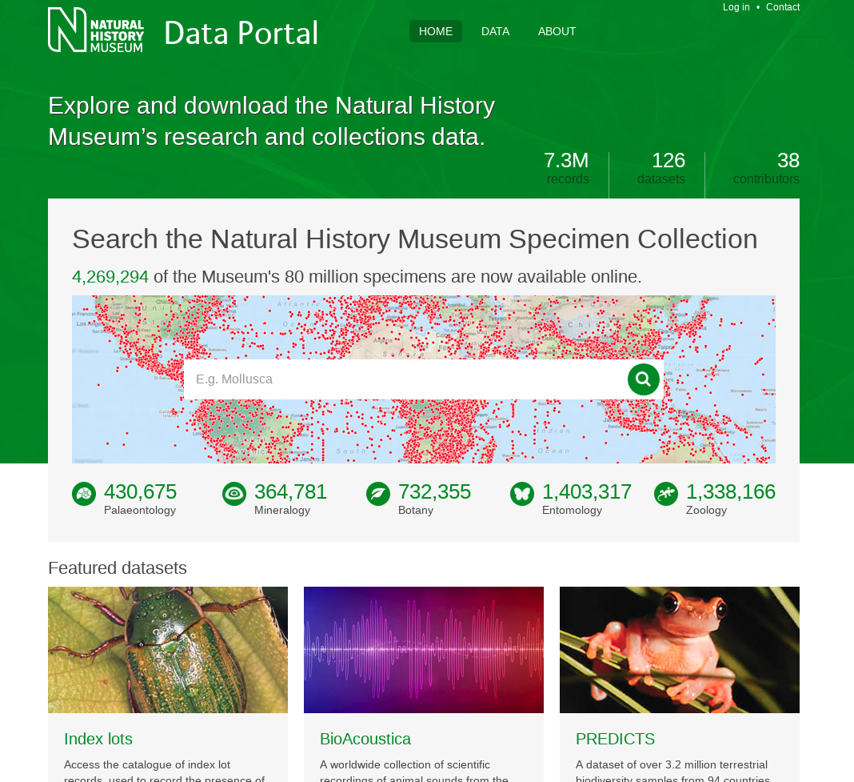
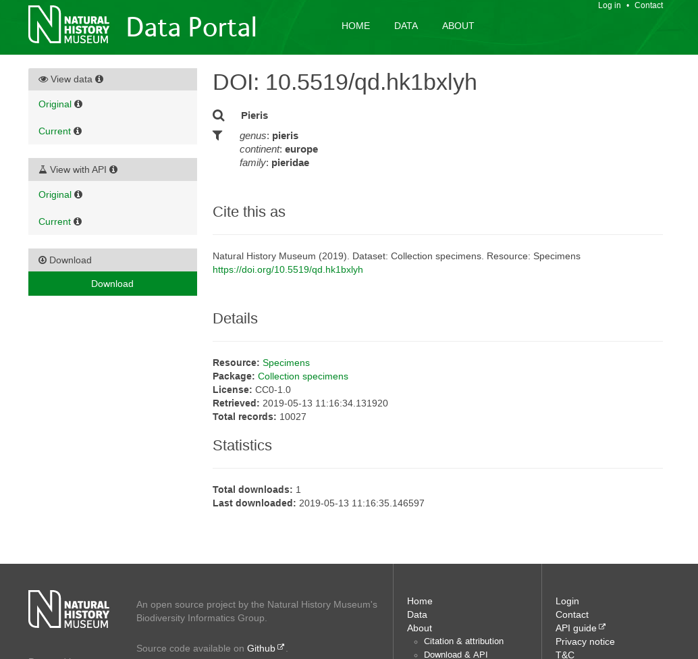
NHM Data Portal
Online repository for digitised specimen + research data
4.2 million specimens (so far…)
https://www.data.nhm.ac.uk
Notes:
DP: online portal for access to the museum’s digitised specimens. Supports LOD standards and can produce DOIs on datasets and query subsets.

Slide 5
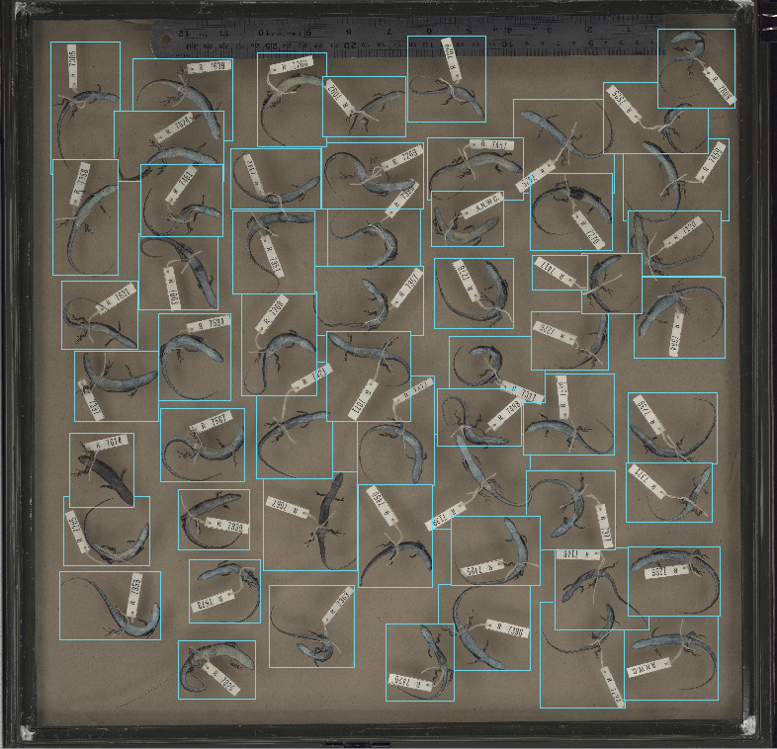
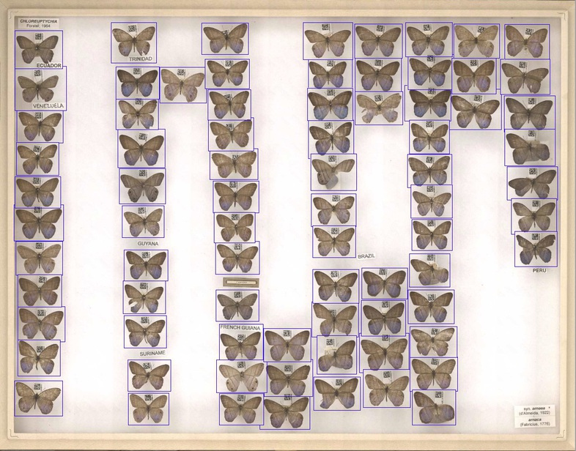
Inselect
Lizard soup
Moth drawer
Automated image segmentation software
Developed for mass digitisation workflows
Notes:
Lizards and moths
Inselect: project to automatically slice up large images of drawers into individual specimens.

Slide 6


Current software citation practices
Papers used as proxies for software
Examples:
Smith V.S., Rycroft S., Scott B., Baker E., Livermore L., Heaton A., Bouton K., Koureas D.N., Roberts D. (2012). Scratchpads 2.0: a virtual research environment infrastructure for biodiversity data. Accessed at http://scratchpads.eu on 2012-11-19
Hudson LN, Blagoderov V, Heaton A, Holtzhausen P, Livermore L, Price BW, van der Walt S and Smith VS. 2015. Inselect: automating the digitization of natural history collections. PLOS ONE. 10 (11), e0143402. 10.1371/journal.pone.0143402.
Notes:
Scratchpads, Predicts, Inselect and the Portal all have papers which they recommend you use to cite them with.
They are different kinds of projects with different reasons to cite and likelihood of citing.
Inselect papers provide details about the methods
Portal and scratchpads describe code and infrastructure used in the projects
Predicts is more traditional in that it has many papers, mostly about the results with citations of the data, not necessarily about the software methods
Papers are useful, but not ideal. Better than nothing!
So we should consider the use cases for these citations
We get a lot of data citations, should these also cite the software (I’d argue not!)
You’d probably cite if you were building a new VRE and were either building off of scratchpads or discussing it as an alternative/during research (for example).
This seems like a better use case for a software citation because it can be discussed as part of the method. Inselect provides a good use case for this.

Slide 7

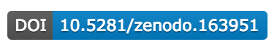
The Future?
Zenodo integration with GitHub to create DOIs for archives
Commit level
Release level
Persistent zip
Figshare integration to create citations for GitHub repos
Release level only
Both provide automatic updates when new releases are created.
Notes:
More awareness of the problem (thanks to events like this!).
We’ve concentrated on data citation in our specific domain but there are lessons that we’ve already gone through (sarah is going to talk about these in a moment) that are applicable to software and citations in general.
Asking what the intent of the citation is is critical to producing the correct guidance and DOI (for example).
Zenodo - they store an archive of github repos and give a doi to that, good for persistence
Figshare - similar to zenodo
Only useful for open source projects though which is fine for our use cases at the NHM as our code is open but the conversation is very different for proprietary software.

Slide 8
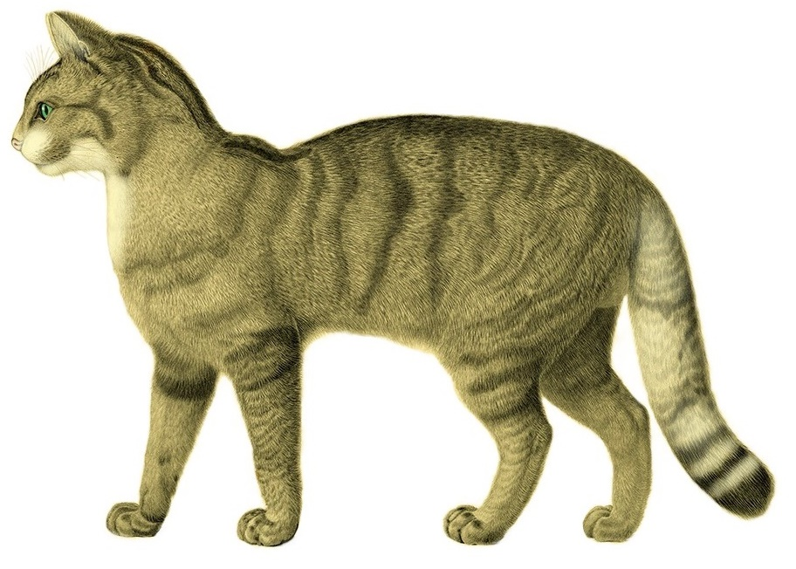
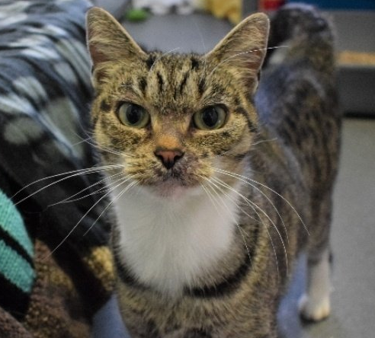
Citation of other ‘unusual’ objects
Species: A class of individuals or objects grouped by virtue of their common attributes and assigned a common name
Specimen: An individual, item, or part representative of a class or whole.
e.g., Felis catus
e.g., Safari (F. catus)
Order: Carnivora
Family: Felidae
Genus: Felis
Species: Felis catus
Colour: Tortoiseshell
Location: South London
Diet: Canned food, unwary birds
Temperament: Furious
Notes:
Software citation is still a (relatively) young problem for the NHM
As a sector, the Natural Sciences already has a problem with changeable, non-traditional research objects: species! Pesky evolution.
Disclaimer: I’m not a taxonomist, nor am I a cat owner (sadly).

Slide 9
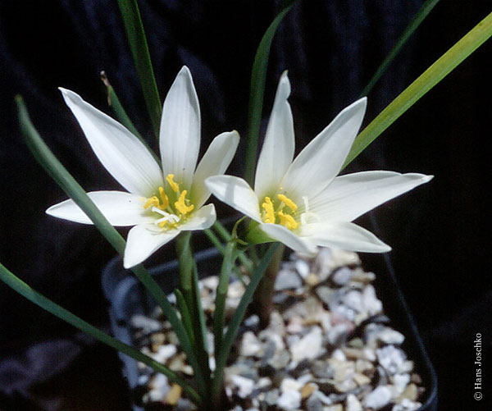
Species citation
Binomial nomenclature (‘two-term naming system’) used to identify species in literature:
Felis catus
Genus
Species
As we learn more about species, the taxonomic tree can change: species are merged, split, moved, etc.
Resolution services exist, but still - at this scale, things get complicated quickly
Amaryllis entreriana
Amaryllis hassleriana
Amaryllis mesochloa
Haylockia mesochloa
Mesochloa canaliculata
Zephyranthes acuminata
Zephyranthes bakeriana
Zephyranthes entreriana
Zephyranthes flavescens
Zephyranthes hassleriana
Zephyranthes kurtzii
Zephyranthes mesochloa flavescens
Zephyranthes mesochloa grandiflora
Zephyranthes mesochloa latifolia
Zephyranthes mesochloa rosea
Zephyranthes oxitepala
Zephyranthes stenopetala
Zephyranthes timida
or
Zephyranthes mesochloa
‘Rain lily’
Notes:
Species citation is important for e.g., ecosystem modelling: a species is a unique bundle of traits that dictate its response to stimuli such as changes in habitat. If we understand these interactions, we can make better predictions and hopefully not kill the planet and ourselves.
Buuuut taxonomy is difficult! It’s sort of an attempt to fit continuous variables into a categorical structure. So there’s lots of movement in the tree of life and names don’t always mean the same thing from year to year.
Example: Plants Under Pressure: text mining historic publications for species traits. But, all the names listed below are actually a single species (for now). It makes like more difficult, text mining more complicated and reproducibility dependent on the snapshot of taxonomy at this point… If it’s hard for us now, reproducing the work in the future will be even harder.

Slide 10
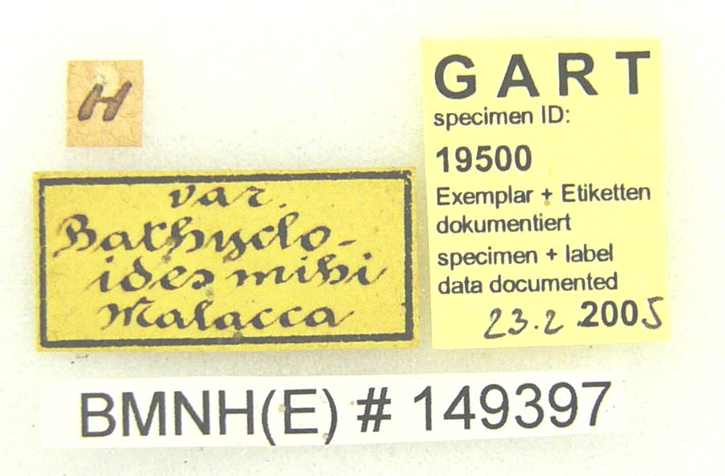
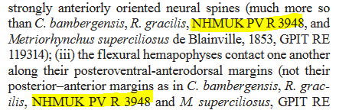
Specimen citation
NHM hosts ~10k research visitors a year and frequently loans specimens to other institutions
Subsequent papers often reference particular specimens
Location and form of citations in papers vary widely
Specimen numbering syntaxes vary widely!
Notes:
Published research often refers to a specific specimen: either to justify changes in the taxonomic record, to give provenance for downstream analyses e.g., carbon dating, sequencing, etc…
In the NHM alone we have more than 50 identification schemes, often linked to legacy departments/sub-departments
NHM is currently working on tracking specimen citation in published literature, but hard to do without standards (inc where specimens should be cited). To date, we’re picking up ~50 citations of collection a month, using the most common identifier patterns, but no way of telling how many we’re missing. The citations can be in text, captions, footnotes etc. Sometimes they reference specimen identifiers, other times the name of the curator or wider taxonomic group they studied during the visit.
Has a negative effect on: justifying spend on collection care, keeping specimen records up to date using research findings.

Slide 11
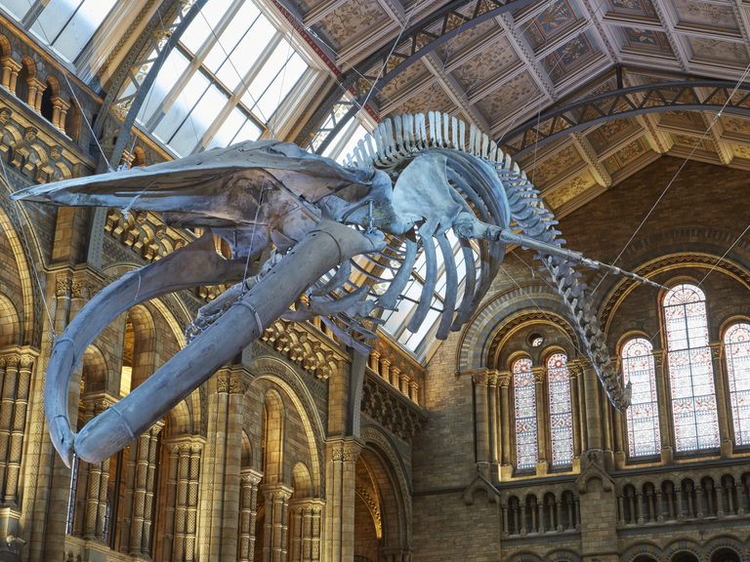
Summary
Citation of dynamic resources is still a work in progress at the NHM (and in the wider community)
Citation practices that we think will make life difficult for future researchers (because we’re dealing with them now):
  Encoding relationships within identifiers
  Inconsistent syntax
  Disagreement on how and where to cite

Slide 12
Any questions?
Notes:
Any questions

