Slide 1
Requirements Management
Phase A:
Architecture Vision
Phase B: Business Architecture
Phase C:
Information System Architecture
Phase D:
Technology Architectures
Phase E:
Opportunities Solutions
Phase F:
Migration Planning
Phase G:
Implementation Governance
Phase H:
Architecture Change Management

Slide 2
individuals and interactions
over
processes and tools
working software
over
comprehensive documentation
customer collaboration
over
contract negotiation
responding to change
over
following a plan

Slide 3
Agile Software Development
is better at only modelling to a level of detail that is needed
is happy for that knowledge to live within developer’s heads (and indirectly in the code)
supports and encourages emergent and evolving architecture
most models that persist are often code-based
requires that value delivered is directly visible to the user
Traditional Software Engineering
generally tries to build complete models (iteratively)
likes to make as much knowledge about the problem and solution explicit within the models)
encourage upfront architecture (with justification and evaluation of options)
encourages many models for specification
is generally happy with value that is not immediately visible to the user

Slide 4
Agile Software Development
Traditional Software Engineering
requires that value delivered is directly visible to the user
is generally happy with value that is not immediately visible to the user
is better at only modelling to a level of detail that is needed
generally tries to build complete models (iteratively)
is happy for that knowledge to live within developer’s heads (and indirectly in the code)
likes to make as much knowledge about the problem and solution explicit (within the models)
supports and encourages emergent and evolving architecture
encourage upfront architecture (with justification and evaluation of options)
most models that persist are often code-based
encourages many models for specification

Slide 5
Prioritisation
  Prioritisation is the ability to take the pressures of all project elements and determine which path to follow based on what's most important to achieve.
Pragmatism
  Physical problems cannot be solved abstractly. Sometimes things are meant for one use only. That's not a bad thing if it gets the job done and functions properly.
Dynamism
  Dynamism means the ability to switch strategies when the current one isn't working.

Slide 6
Explicit Architecture
essential design decisions and architectural guidance
Emergent Architecture
evolving detailed design
Transition Layer
direction of change
(technology choices, interaction patterns, …)
D4.2
D4.1
D4.2
D4.3
D4.4

Slide 7
Explicit Architecture
essential design decisions and architectural guidance
Emergent Architecture
evolving detailed design
Lean Design
Up Front
Just in Time
Just Enough

Slide 8
analyse
  Product Vision
  User Stories
Stakeholder Workshops
Market / Exploitation Requirements
design
  initial Test Cases
  initial Mock-ups / Prototypes
identify & specify Building Blocks
identify Software Components and assess adaptability and extensibility
stabilise essential upfront design
Explicit Architecture
evolve along direction of change
Transition Layer
document detailed design
Emergent Architecture
create
  CSIS / ICT Climate Services
  Expert Climate Services
adapt, customise and extend Software Components
integrate and assemble Building Blocks

Slide 9
analyse
  Product Vision
  User Stories
Stakeholder Workshops
Market / Exploitation Requirements
design
  initial Test Cases
  initial Mock-ups / Prototypes
identify & specify Building Blocks
identify Software Components and assess adaptability and extensibility
stabilise essential upfront design
D4.2
Explicit Architecture
evolve along direction of change
D4.1
D4.2
Transition Layer
document detailed design
D4.3
D4.4
Emergent Architecture
create
  CSIS / ICT Climate Services
  Expert Climate Services
adapt, customise and extend Software Components
integrate and assemble Building Blocks

Slide 10
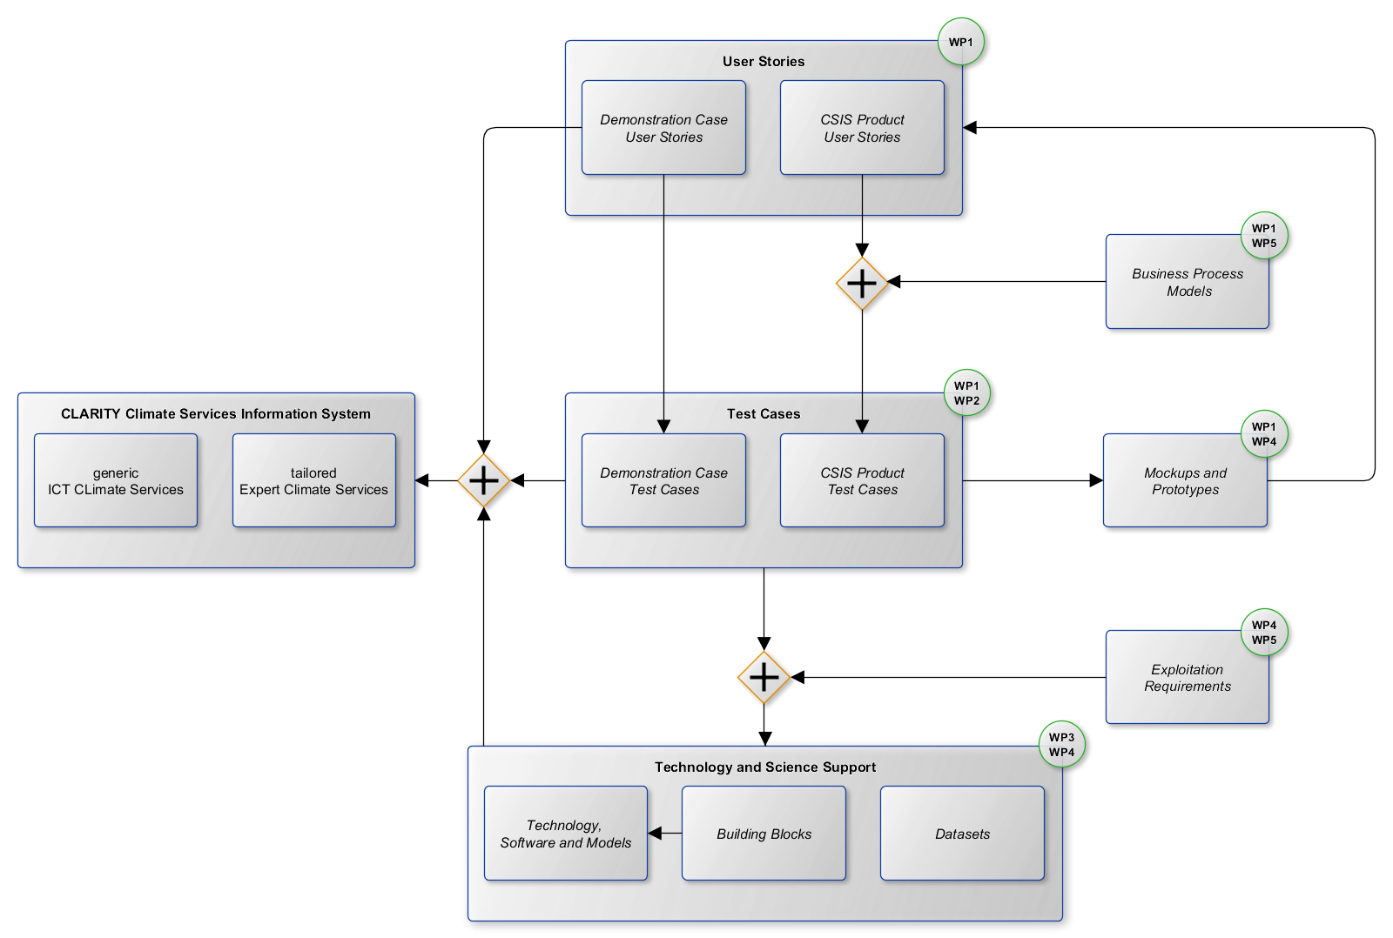
Emergent Architecture

Slide 11

CRISMA
Framework Architecture
Functional
Architecture
Implementation Architecture
Application Architecture
Application Architecture
Application Architecture

Slide 12
M
C
R
I
Mission: What are the primary goals of
the CSIS?
Concepts: What are the key concepts and business opportunities to realise the goals?
Realisation: What are the system components, how are they logically organised and how do they interact to realise the concepts?
Implementation: How are system components implemented?

Slide 13
M
C
R
I
Explicit Architecture

Slide 14
Explicit Architecture
M
Explicit Architecture
C
Explicit Architecture
Transition Layer
R
Transition Layer
Emergent Architecture
I

Slide 15
Explicit Architecture
M
Explicit Architecture
C
Explicit Architecture
Transition Layer
R
Transition Layer
Emergent Architecture
I

Slide 16
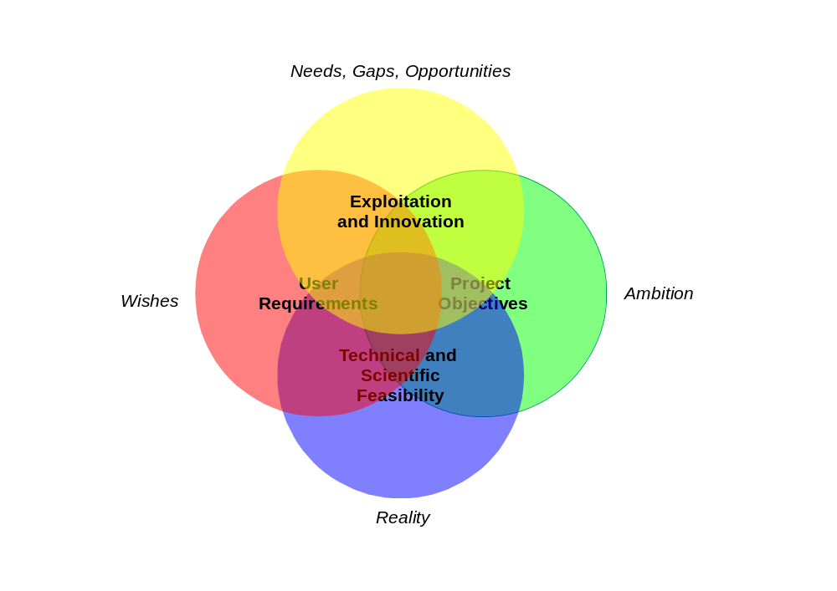

Slide 17
WP5
T4.1
WP1
WP2
DoA
Functional Requirements
-> Building Blocks
Technology Support
-> Software Components
WP3
WP4

Slide 18
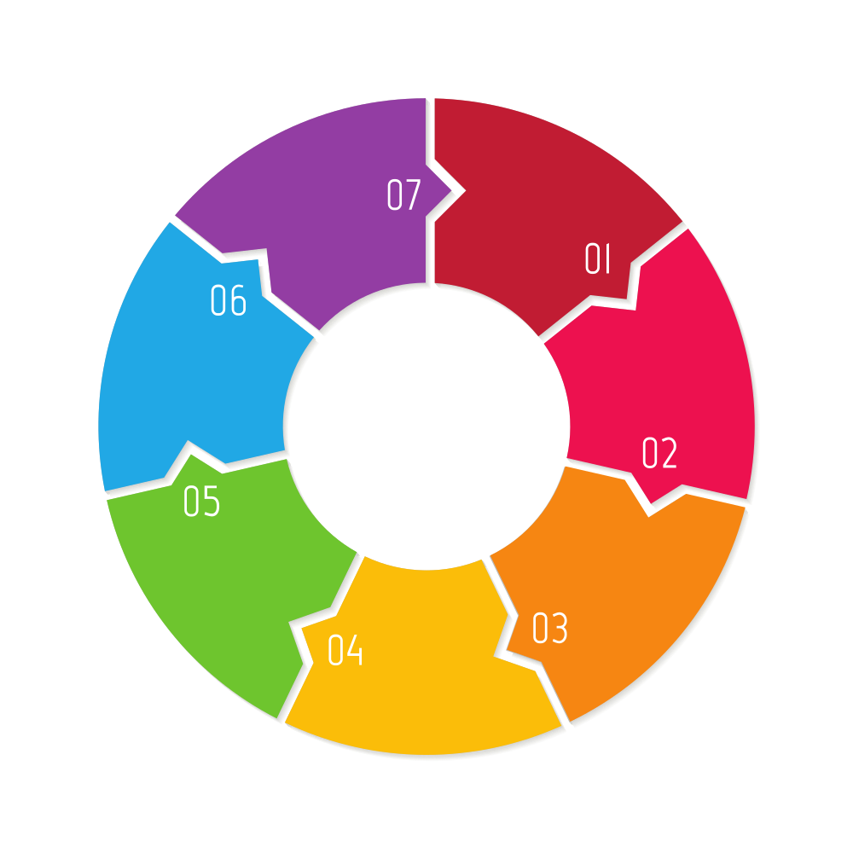
IAAP
HC
AAO
EE
IAO
VA
RA
IA

Slide 19
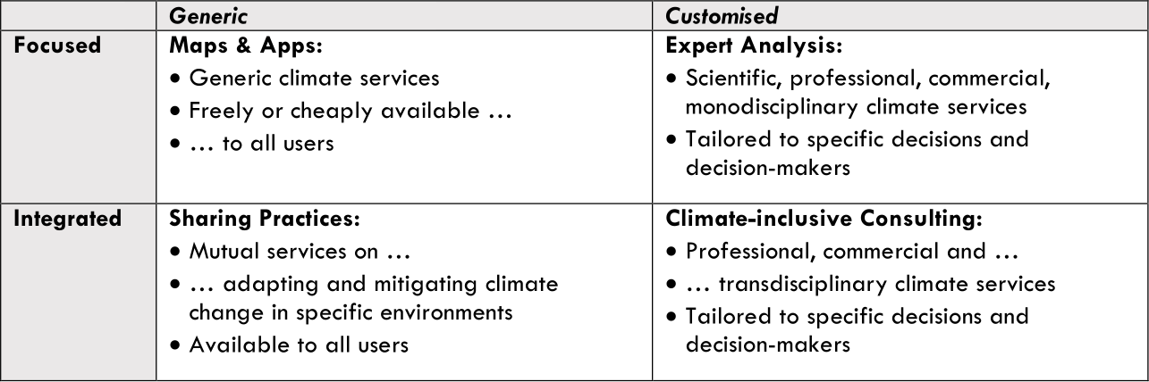
ICT CS
Expert CS

Slide 20

ICT CS
Expert
CS

Slide 21
(partially) free
free or low-cost to use software tools and open-data software services
multi-hazard, full European coverage, no site-specific modelling, at the cost of “simple” but credible results
data-driven
no on-demand downscaling, impact model execution or high-performance computing involved
easy to use
no or just little knowledge of climate change science needed, no specific technical skills needed
credible
following an accepted and scientifically sound climate risk assessment approach
generic

Slide 22
ICT Climate Services
Expert Climate Services
(partially) free
free or low-cost to use software tools and open-data software services
multi-hazard, full European coverage, no site-specific modelling, at the cost of “simple” but credible results
data-driven
no on-demand downscaling, impact model execution or high-performance computing involved
easy to use
no or just little knowledge of climate change science or specific technical skills needed
credible
following an accepted and scientifically sound climate risk assessment approach
generic
commercial
project-specific scenarios, custom data and model integration, custom micro-climate modelling, detailed adaptation studies
scenario-driven
(off-line) scenario analysis and site-specific numerical modelling (calibration and execution)
collaborative
joint venture activity of operational, technical and industry specialists
credible
following an accepted and scientifically sound climate risk assessment approach
individual
paid professional consulting and advisory services

Slide 23
ICT Climate Services
Expert Climate Services
(partially) free
commercial
  free or low-cost to use software tools and open-data software services
  paid professional consulting and advisory services
credible
credible
  following an accepted and scientifically sound climate risk assessment approach
  following an accepted and scientifically sound climate risk assessment approach
generic
individual
  multi-hazard, full European coverage, no site-specific modelling, at the cost of “simple” but credible results
  project-specific scenarios, custom data and model integration, custom micro-climate modelling, detailed adaptation studies
data-driven
scenario-driven
  ready-to-use pre-calculated hazard, vulnerability and exposure data available
  (off-line) scenario analysis and site-specific numerical modelling (calibration and execution)
easy to use
collaborative
  just little knowledge of climate change science or specific technical skills needed
  joint venture activity of operational, technical and industry specialists

Slide 24
CLARITY Climate Services Information System
bridges the gap from supply driven (Upstream) Climate Services to demand driven (Downstream) Climate Services
acts as co-creation environment that allows Climate Service Customers and Climate Service Suppliers to create fit-for-purpose and tailored Expert Climate Services under the umbrella of a scientifically sound CLARITY methodology
supports and enforces the standardised workflow of the EU-GL for each of the distinct modules and provides respective user interfaces that guide the user through the process
offers a simple but credible preliminary (“pre-feasibility”) assessment and creates in parallel an initial specification for a tailored assessment (“blueprint” for Expert Climate Service)
tries to stimulate the creation and uptake of tailored Expert Climate Services instead of providing a technical infrastructure for hosting or integrating any kind of (ICT) Climate Services

Slide 25
CLARITY Climate Services Information System
bridges the gap from supply driven to demand driven CS
co-creation environment for CS Customers and Suppliers
offers a simple but credible “pre-feasibility” assessment
creates in parallel a “blueprint” for an Expert Climate Service
stimulates creation and uptake of tailored Expert CS
allows to create fit-for-purpose and tailored Expert CS under the umbrella of the scientifically sound CLARITY methodology
supports and enforces the standardised EU-GL workflow

Slide 26
(partially) free
  free or low-cost to use software tools and open-data software services
credible
  following an accepted and scientifically sound climate risk assessment approach
generic
  multi-hazard, full European coverage, no site-specific modelling, at the cost of “simple” but credible results
data-driven
  no on-demand downscaling, impact model execution or high-performance computing involved
easy to use
  no or just little knowledge of climate change science needed, no specific technical skills needed

Slide 27
commercial
project-specific scenarios, custom data and model integration, custom micro-climate modelling, detailed climate risk & adaptation studie
scenario-driven
(off-line) scenario analysis and site-specific numerical modelling (calibration and execution)
collaborative
joint venture activity of operational, technical and industry specialists
credible
following an accepted and scientifically sound climate risk assessment approach
individual
paid professional consulting and advisory services

Slide 28
commercial
  paid professional consulting and advisory services
credible
  following an accepted and scientifically sound climate risk assessment approach
individual
  project-specific scenarios, custom data and model integration, custom micro-climate modelling, detailed climate risk & adaptation studie
scenario-driven
  (off-line) scenario analysis and site-specific numerical modelling (calibration and execution)
collaborative
  joint venture activity of operational, technical and industry specialists

Slide 29
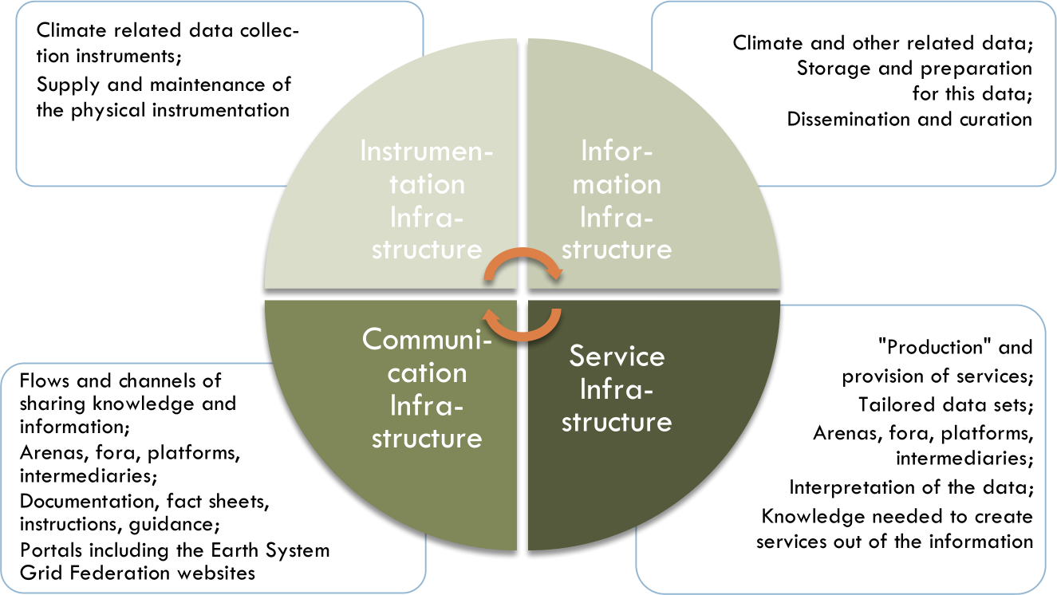

Slide 30
Supplier Catalogue
supplier profiles signal professionalism, reputation and trustworthiness
links to clients and case studies (demonstrators)
portfolio in (Expert) Climate Services Catalogue
(Expert) Climate Services Catalogue
clear and detailed description (in relation to CLARITY Methodology) of the (tailored) Expert Climate Services
Customer Inquiries
user can create private inquiries
service specification can be generated by CSIS as simple requirements specification for an Expert Climate Service
Expert CS Offer
supplier can make an offer, provide a contract specification, etc.
supplier can request access to the user’s workspace in expert workflow tool, e.g. down- or upload data
may contain not only advisory, consulting, modelling, development, etc. services but also local data and tools
Data Offer
suppliers of Upstream Climate Services (climate data services) can advertise climate and hazard data
suppliers of high-quality and high-resolution exposure and vulnerability data can advertise their data

Slide 31
Data Access
Business Logic
Presentation
Raster and Vector data storage
Spatial Data Infrastructure
Application Programming Interfaces
User Interface Integration
User Interface Development
External Repositories
GIS and Catalogues
Infrastructure
Technical Infrastructure
Interoperability Standards

Slide 32
Infrastructure
  Technical Infrastructure
  Interoperability Standards
Data Access
  Raster and Vector data storage
  External Repositories
Business Logic
  Spatial Data Infrastructure
  Application Programming Interfaces
Presentation
  User Interface Integration
  User Interface Development
  GIS and Catalogues

Slide 33
analyse
User Stories
Business Processes
design
Test Cases
Mock-ups / Prototypes
create
CSIS / ICT Climate Services
Expert Climate Services
End-User Workshops
Market Analysis
identify & specify Building Blocks
identify Software Components and assess adaptability and extensibility
adapt, customise and extend Software Components
integrate and assemble Building Blocks

Slide 34
stabilise essential upfront design
Explicit Architecture
evolve along direction of change
Transition Layer
document detailed design
Emergent Architecture

Slide 35
analyse
  Product Vision
  User Stories
Stakeholder Workshops
Market / Exploitation Requirements
design
  initial Test Cases
  initial Mock-ups / Prototypes
identify & specify Building Blocks
identify Software Components and assess adaptability and extensibility
Explicit Architecture
Emergent Architecture
Transition Layer
stabilise essential upfront design
evolve along direction of change
document detailed design
create
  CSIS / ICT Climate Services
  Expert Climate Services
adapt, customise and extend Software Components
integrate and assemble Building Blocks

Slide 36
Application
Extended Use Case
Framework
EXT
BB
BB
EXT
BB
BB
BB
BB
BB
EXT

Slide 37
EXT
Platform
Common Use Case
BB
BB
BB
BB
BB
BB
EXT
BB
EXT
Extended Use Case

