Slide 1

Totem - prototype // communication + information in remote areas

Slide 2


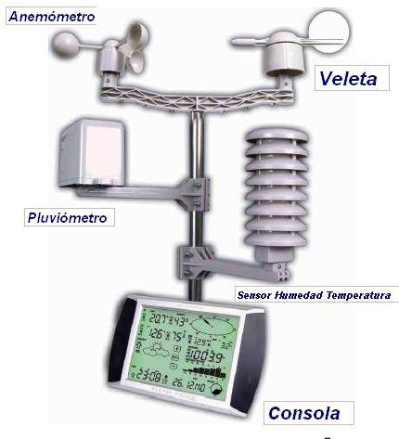
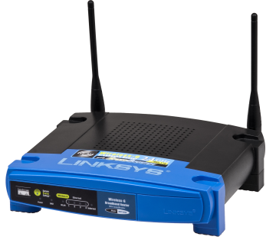
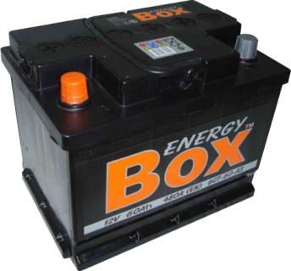
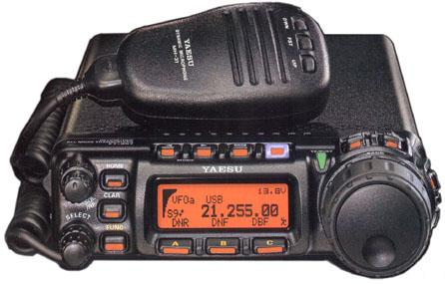
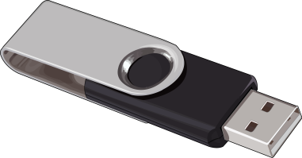
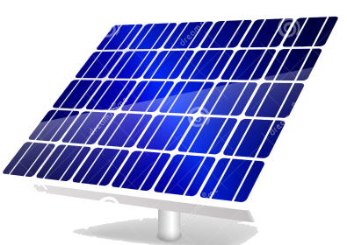
Soporte físico
It is proposed the construction of a totem (pedestal + Access Point) with the following attributes:
Pedestal or stand
Solar panel + battery
External memory (changeable)
Antenna (long range wireless router or antenna)
Automatic Weather Station
Radio HF
It considers the integration in a single product (prototype to be developed), that feeds of solar energy that gives autonomy, allows to deliver in an open signal of wifi (web - intranet) in a range of up to 100 mts. The prototype allows changing the content to be delivered, changing a removable device.

Slide 3

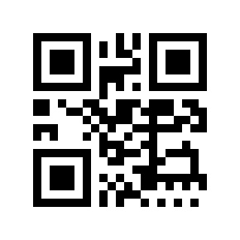

Support
Support
Web
Intranet
App
Audioguide
Forum
Languages +2
Weather
Remote communication
Story
tourism
Graphic design
Utem TV
Computing
What's New?
General Information
Geography
Flora
Fauna
History
Maps
Videos
Comments

Slide 4
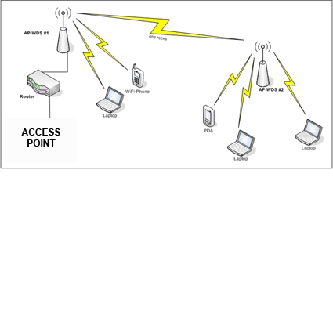

Access point / cell
Also called AP only, Access Point translated means access point. It is a device used in Wireless Local Area Network (WLAN), a local wireless network is one that has an interconnection of relatively close computers, without the need for cables, these networks operate on the basis of waves of Radius. The Access Point is then responsible for being a gateway to the wireless network in a specific location and for a certain radio coverage, for any device that requests access, as long as it is configured and has the necessary permissions.

Slide 5
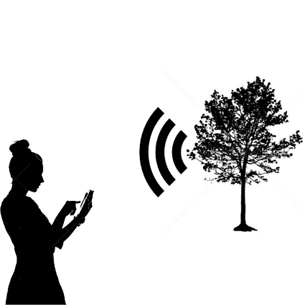
Use in Remote Zones

Slide 6
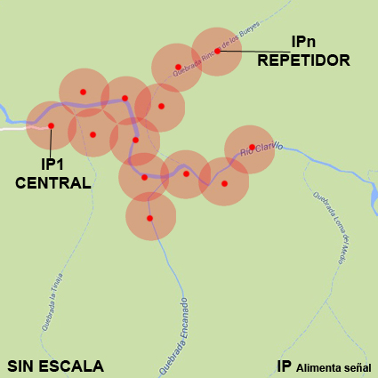
AP network in an area, forming cells.
The project would allow the creation of a set of APs as independent and autonomous cells, which allow the mass information to be delivered to the users who request it, so as to have information for QR codes and audioguides that circulate within the range of the devices.
A space is created for the use of technology in order to improve the user experience in urban areas and in remote areas.

Slide 7




Use
Environmental education
- Delivery of massive information to users about characteristics of the unit.
Delivery of No Trace Manuals
Others
Expeditions - Tourism
Technical use of environmental interpretation for expeditions on routes, mapping.
Possibility to install Weather Stations
Tourism information
Accessibility
Delivery of multimedia information to people with disabilities.
Audioguide Development
Others
ALLOWS INSTALLATION IN ANY TYPE OF LAND AND AUTOMATICALLY OPERATES

Slide 8


Concept

Slide 9



SCHEME
HF - COMUNICATION
Totem for information consultation in "intranet", it is necessary to define the radius of antenna illumination and the support (tubular profile of galvanized steel?)
PC to HF Radio connector for data transmission with totem pole
Totem for delivery of information and communication via HF with third (guardaparque?) Requires HF transceiver and dipole antenna. Communication distance and programming must be studied for HF to WiFi frequencies and vice versa.

