Slide 1

Connecting Researchers to Data Repositories in the Earth, Space, and Environmental Sciences
15th Italian Research Conference on Digital Libraries
Area della Ricerca del CNR di Pisa, Istituto di Scienza e Tecnologie dell’Informazione
February 1, 2019
Michael Witt, Associate Professor, Purdue Libraries and School of Information Studies, USA

Slide 2



Michael Witt, Purdue University
Shelley Stall, American Geophysical Union
Ruth Duerr, Ronin Institute
Raymond Plante, NIST
Martin Fenner, DataCite
Robin Dasler, DataCite
Trisha Cruse, DataCite
Sophie Hou, UCAR/NCAR
Robert Ulrich, Karlsruhe Institute of Technology
Danie Kinkade, Woods Hole Oceanographic Institution
Corresponding author:
Michael Witt, mwitt@purdue.edu
http://www.lib.purdue.edu/research/witt

Slide 3
Outline
Enabling FAIR Data Project
Repository Finder use case
Social part
Technical part
Skip ahead: https://repositoryfinder.datacite.org

Slide 4
AGU: Enabling FAIR Data Project
Project website: https://copdess.org/enabling-fair-data-project
~1-year project launched November 2017
Six working groups (TAGs) formed & pursued mutual interests around:
Data repository guidance
Publishers in the domain
Resources and training
Data and Digital Object Identifier Workflows and Handoffs
Culture Change Through Credit
Key Elements of Active Data Management Plans
Stall, S., et al. (2018), Advancing FAIR data in Earth, space, and environmental science, Eos, 99, https://doi.org/10.1029/2018EO109301. Published on 05 November 2018.

Slide 5
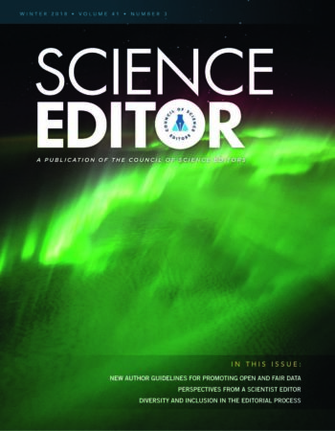
Outputs from the larger project included...
Commitment Statement in the Earth, Space, and Environment Sciences
Publisher Guidelines for Authors
Data Management Training Clearinghouse
Workflow Recommendations Between Publishers and Data Repositories
CoreTrustSeal Certification Cohort
Stall, S. et al. (2018), Data Sharing and Citations: New Author Guidelines Promoting Open and FAIR Data in the Earth, Space, and Environmental Sciences. Science Editor 41(3). https://bit.ly/2F0FTiX.

Slide 6
AGU: Enabling FAIR Data Project
Project website: https://copdess.org/enabling-fair-data-project
Six working groups (TAGs) formed & pursued mutual interests around:
Data repository guidance
Publishers in the domain
Resources and training
Data and Digital Object Identifier Workflows and Handoffs
Culture Change Through Credit
Key Elements of Active Data Management Plans
Stall, S., et al. (2018), Advancing FAIR data in Earth, space, and environmental science, Eos, 99, https://doi.org/10.1029/2018EO109301. Published on 05 November 2018.

Slide 7

Motivating Use Case:
A researcher producing data in the domain of Earth, space, or environmental sciences needs to identify appropriate repositories where he or she can deposit their data.

Slide 8
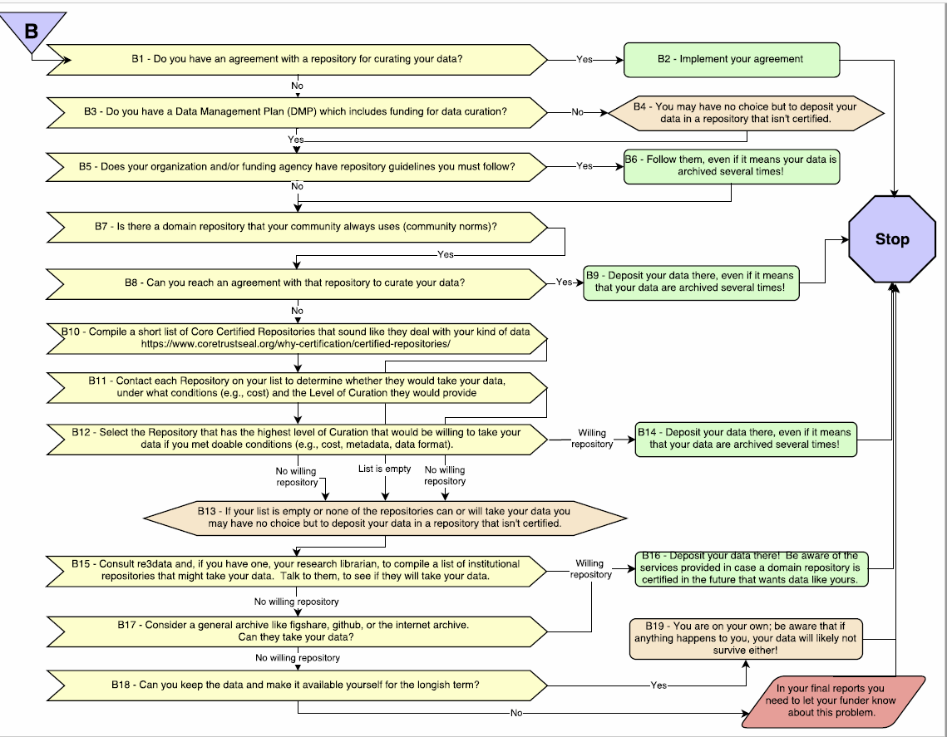
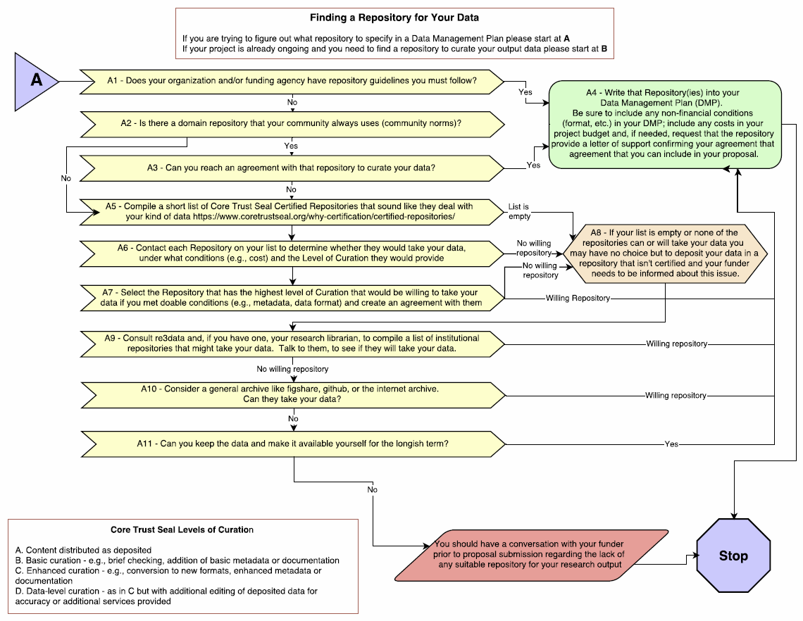
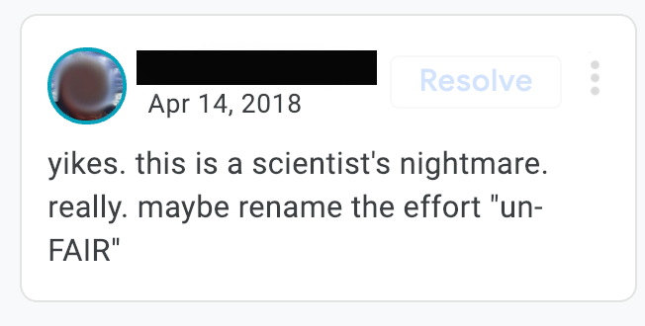

Slide 9
When selecting a repository to deposit their data, researchers in
the Earth, space and environmental sciences should:
Follow the mandate or recommendation of their funder / publisher / journal / institution / etc.
Use a domain repository that adheres to norms of their research community*
Use a certified repository*%
Use the repository with the highest level of curation*
Use an institutional repository*
Use a general repository
* that will take their data based on the repository’s terms of use or
direct interaction between the researcher and the repository staff
% leveraging this opportunity to encourage/facilitate repositories
who are are not certified to pursue certification, e.g., CoreTrustSeal

Slide 10
Interviews with 11 domain data facilities
Ag Data Commons (USDA)
Alabama Geological Survey
BCO-DMO
Dash (CDL)
Deep Carbon Observatory
Interdisciplinary Earth Data Alliance (IEDA)
Helmholtz Centre Potsdam GFZ
PANGAEA
Socioeconomic Data and Applications Center (NASA)
Research Data Archive (NCAR)
VTechData

Slide 11
Taking the temperature of data facilities
How do you as a repository manager conceive of FAIR as it relates to your data facility and the services and data you provide?
What have you currently implemented?
What do you have definite plans to implement?
What do you not have plans to implement?
1 hour each, informal - discussion to inform design of the tool, convenience sample, not a formal research methodology
Raymond Plante, & Michael Witt. (2018, September 21). Interview Questions to Assess Current Plans and Implementations of the FAIR Principles by Data Repositories in Earth, Space, and Environmental Sciences. http://doi.org/10.5281/zenodo.1432515.

Slide 12
Informal responses (n=11)
Not many facilities had a trustworthy repository certification; those that didn’t were interested in pursuing
All assigned DOIs to datasets
All presented human-readable metadata for browsing
All link (or attempt) to link datasets to related literature
All but one provided metadata for export or harvest (xml, json, rdf)
All provide geolocation metadata
Many provide temporal metadata
All provide landing pages for datasets
Two embed META tags; three embed JSON-LD
All were registered in re3data

Slide 13
Informal responses (con’t)
All provide additional consultation services around data beyond repository
A few provide explicit machine-readable citations (all did through DOIs although many didn’t realize it)
Some provide links from datasets to other, related datasets
All ascribe open licenses to data
Most capture some manner of provenance, but not always exposed to user
Most directly support peer-review
Just the process of conducting these interviews raised awareness and local discussions at facilities about the FAIR Principles

Slide 14
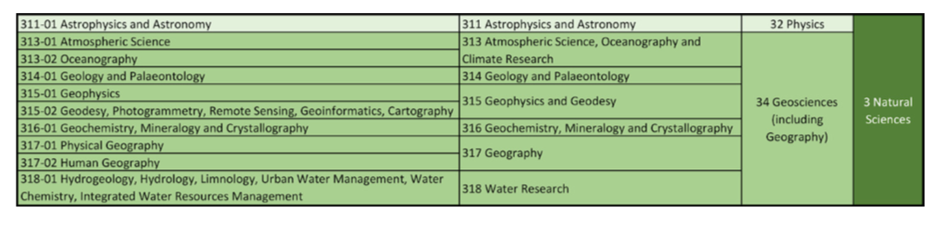
Community criteria for data facilities
Accept deposit of data
Provide open access to data
Issue PIDs to datasets
Be certified as trustworthy via CTS, DSA, WDS, ISO 16363
Reside in Earth, space, and environmental sciences domain
http://www.dfg.de/download/pdf/dfg_im_profil/gremien/fachkollegien/fk-wahl2015/2015_fachsystematik_2016_2019_en.pdf

Slide 15
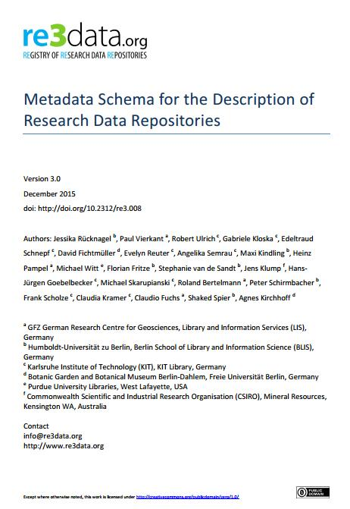
re3data.org
Data repositories catalogued
2,261
41
attributes
Based on analyses,
community input, and experience
3.0
Schema version
Rücknagel, J., et al. (2015): Metadata Schema for the Description of Research Data Repositories: version 3.0. http://doi.org/10.2312/re3.008.

Slide 16
re3data attribute mapping
type = disciplinary
subjectID = geosciences + astronomy
dataUploadType = open, restricted
dataAccessType = open
pidSystem = true

Slide 17
Repository Finder tool
Ruby on Rails application developed and hosted by DataCite provides user interface for repository suggestions
Using Elasticsearch API
Exposed by the re3data registry of research data repositories
Links to source code in conference paper.

Slide 18
Process
Calls every other Friday for 3 months
Wireframe in Balsamiq
Three dev sprints ⇒ functional prototype
Usability sessions with ESIP Usability Cluster (two sessions) and DeveloperTown (30-minute virtual tool task sessions with 24 subjects)
Metadata work session of re3data editorial team at KIT
Final dev sprint ⇒ initial release in October 2018

Slide 19
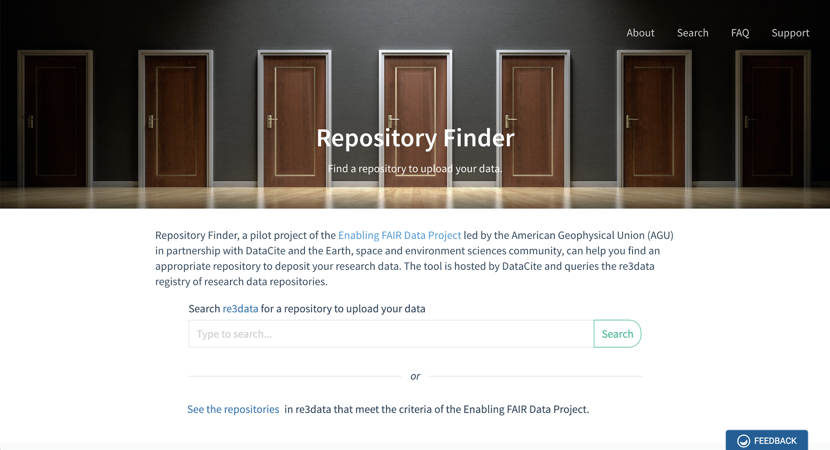

Slide 20
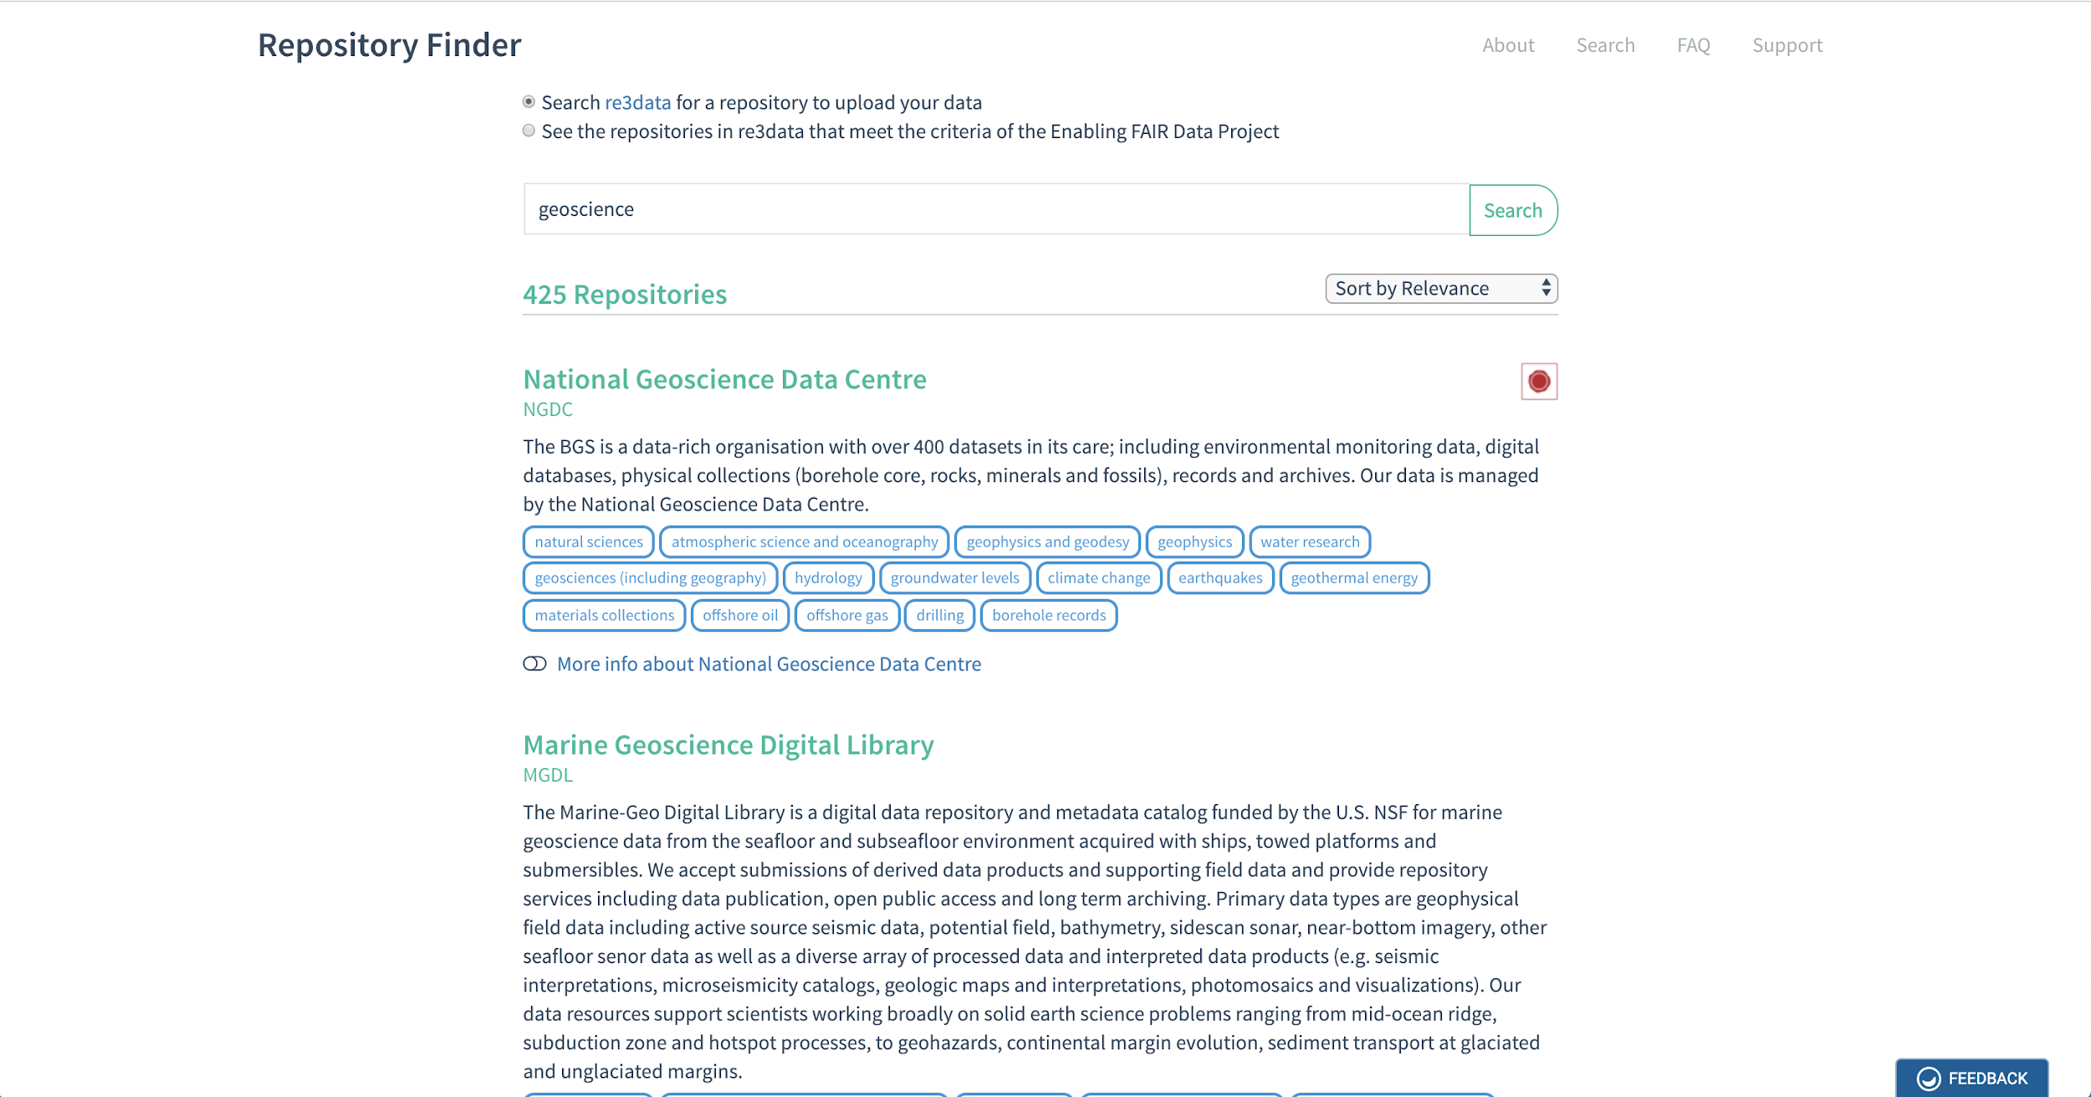

Slide 21
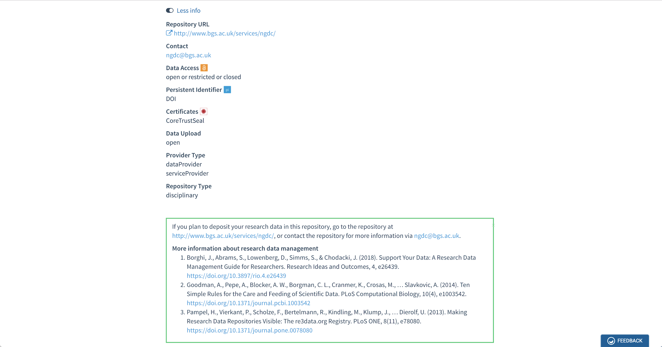

Slide 22
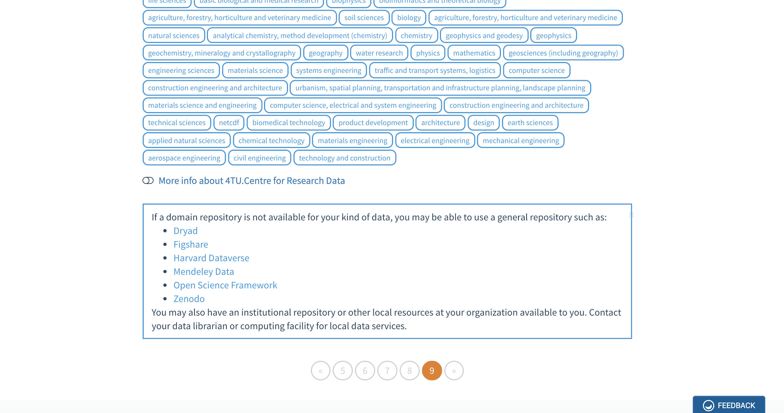

Slide 24
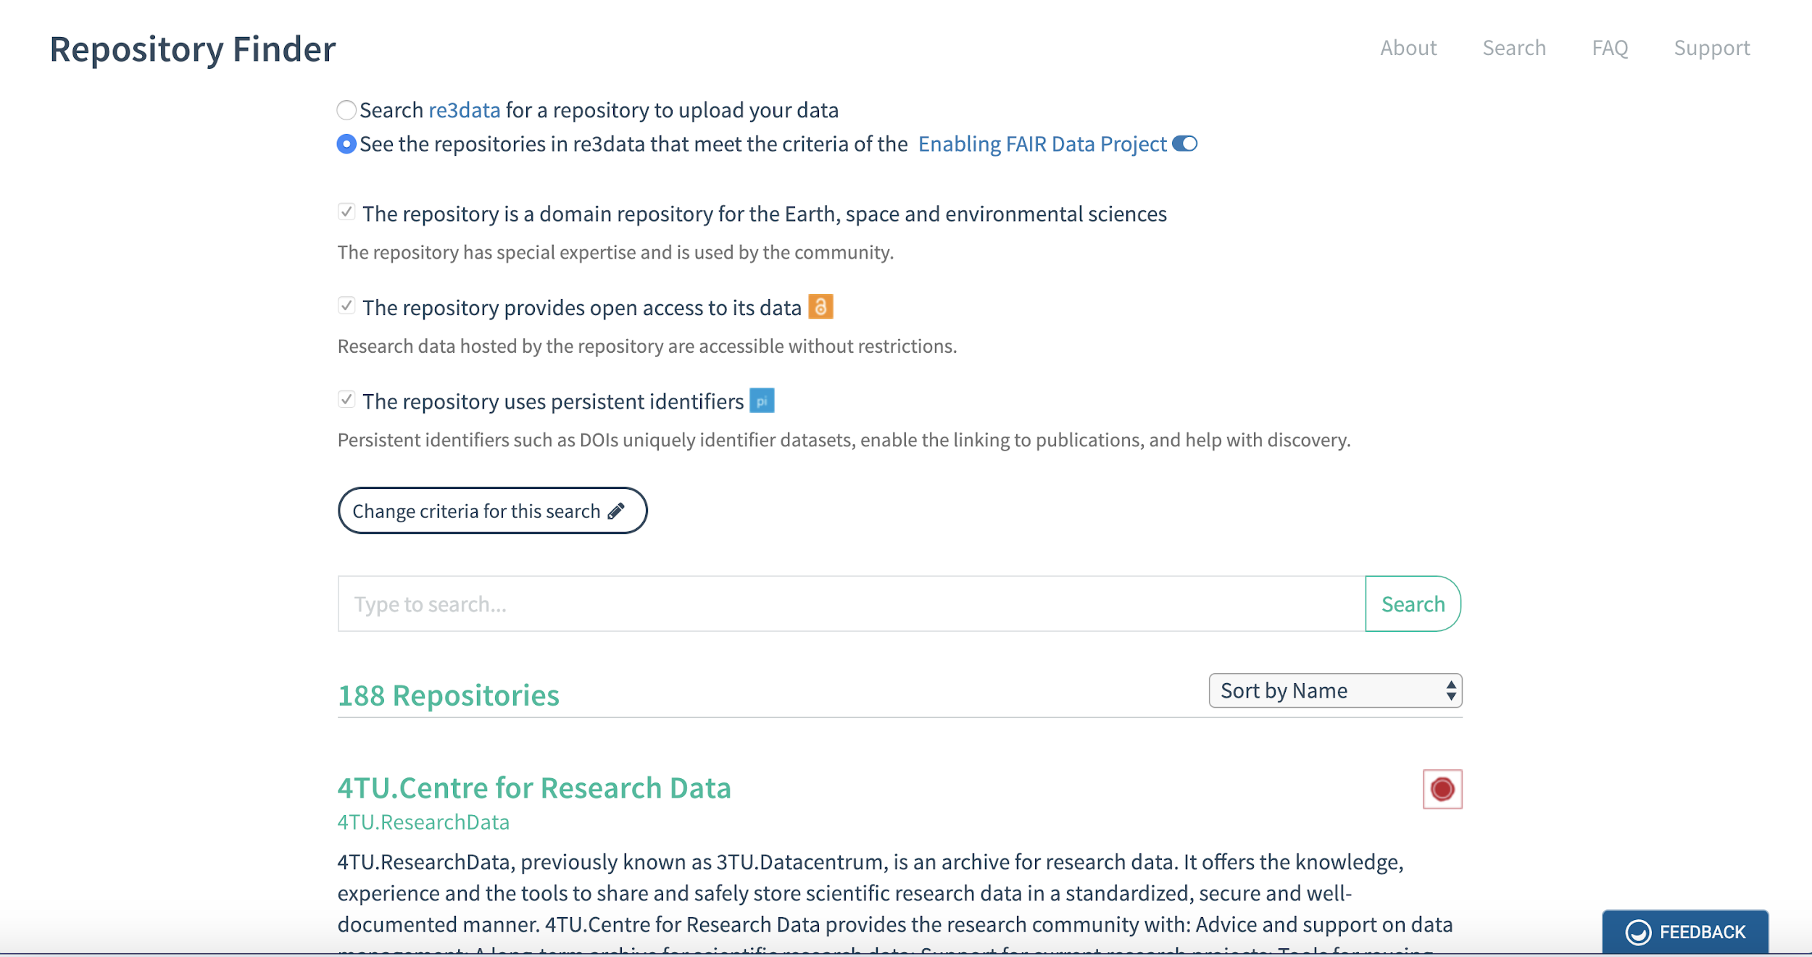

Slide 25
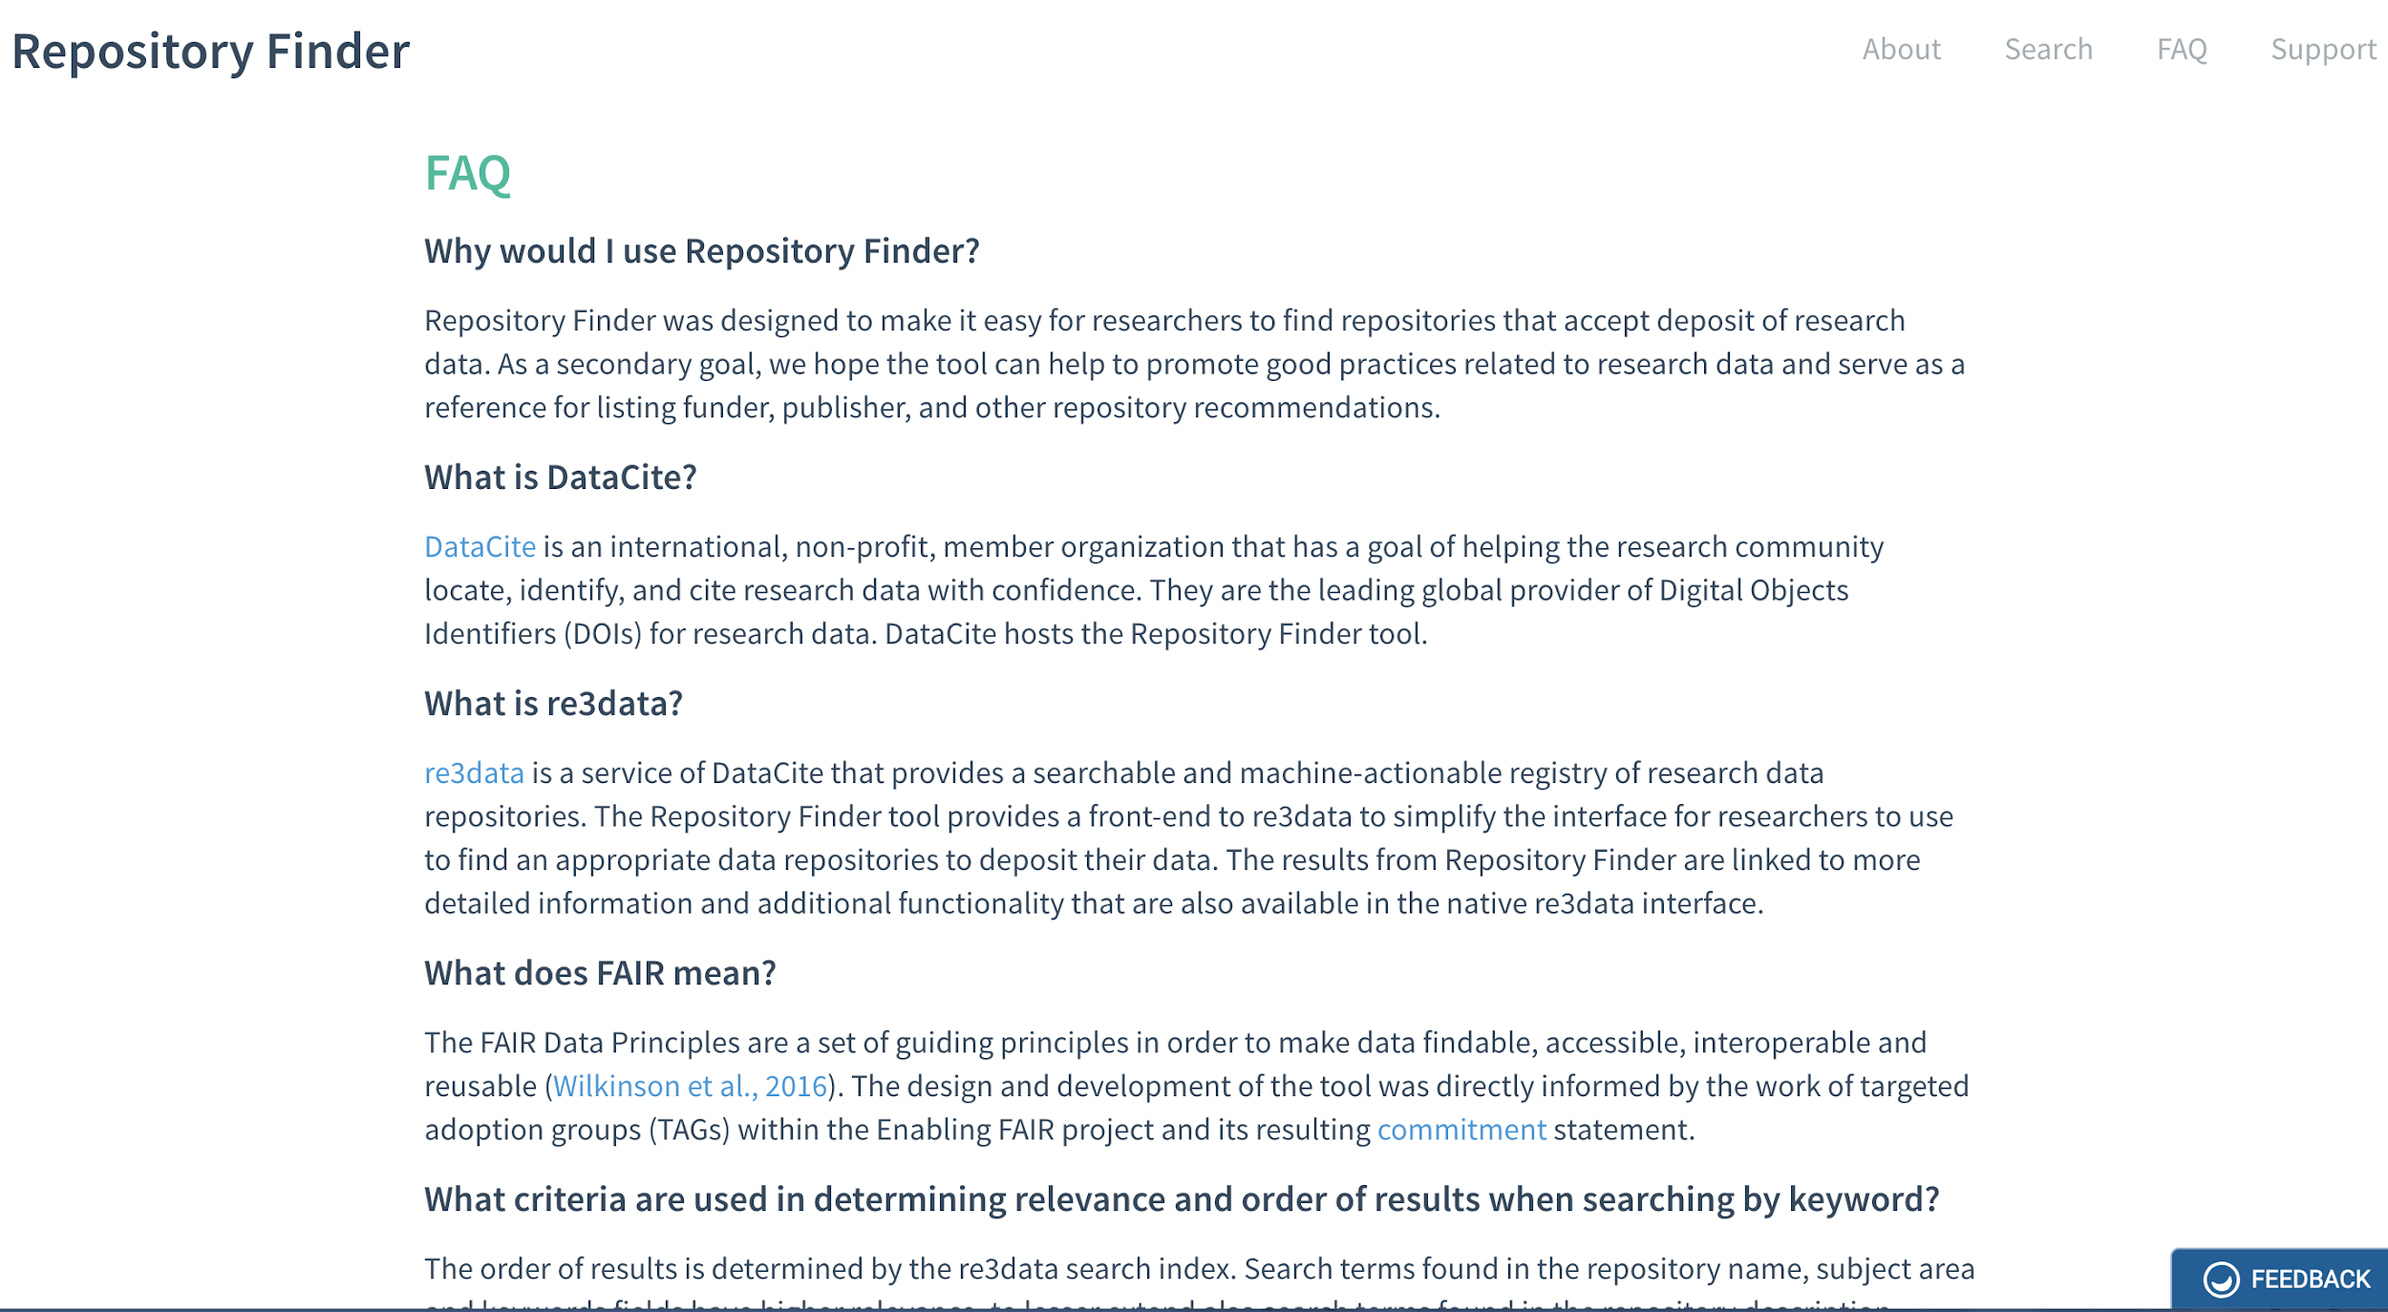
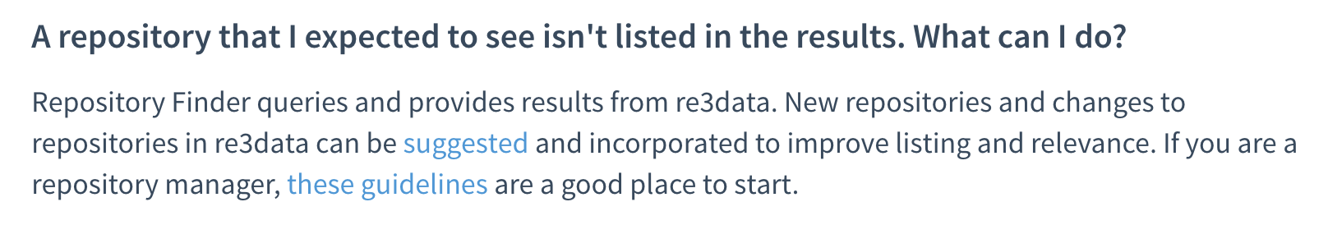

Slide 26
What we did:
Built an initial repository suggestion tool to connect researchers to data repositories
Began to rally the Earth, space, and environmental sciences research community around the FAIR Principles
Raised more awareness of FAIR among data facilities
What we didn’t do:
Build a fully comprehensive, international consensus
Address other compelling use cases (e.g., funders, publishers)
Define robust metrics for what is “FAIR” and what isn’t
What we’d like to do in the future:
Better metadata (there’s always better metadata)
Extend approach to other domains
Refine / improve / extend the tool

Slide 27
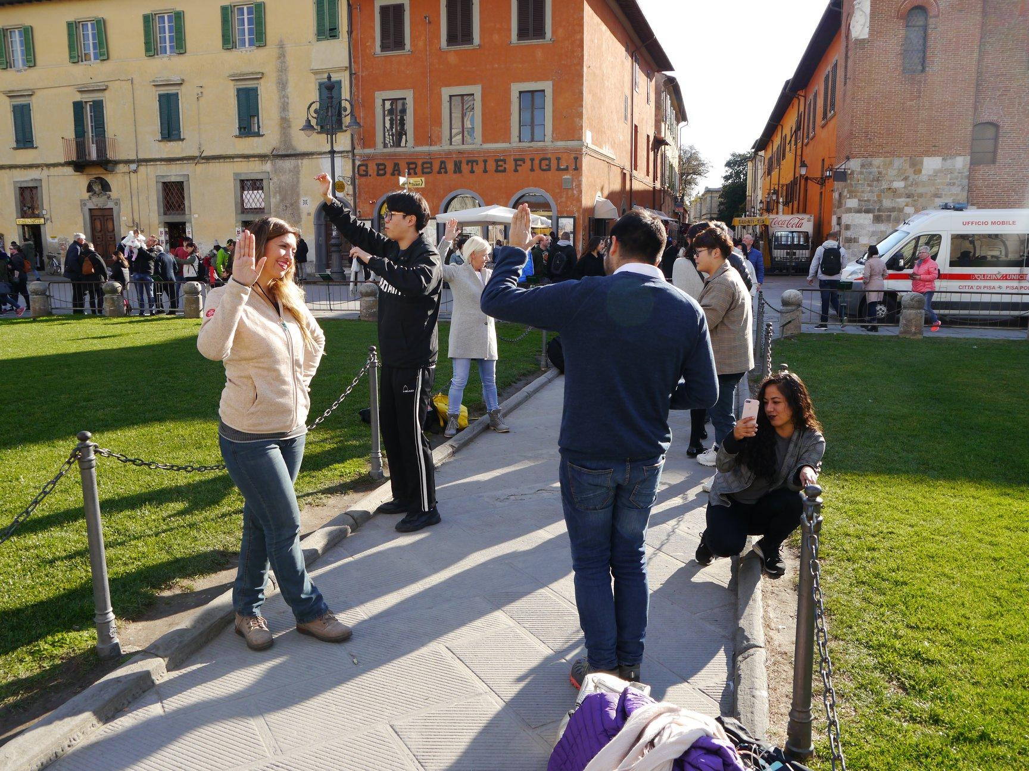
Molte grazie...

