Slide 1
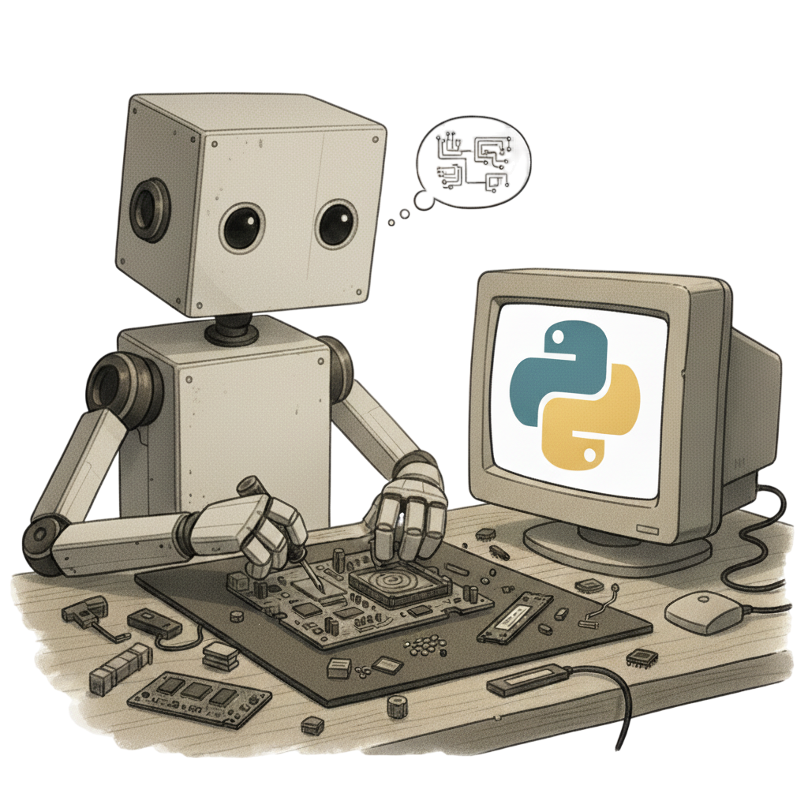
Basic computing concepts

Slide 2
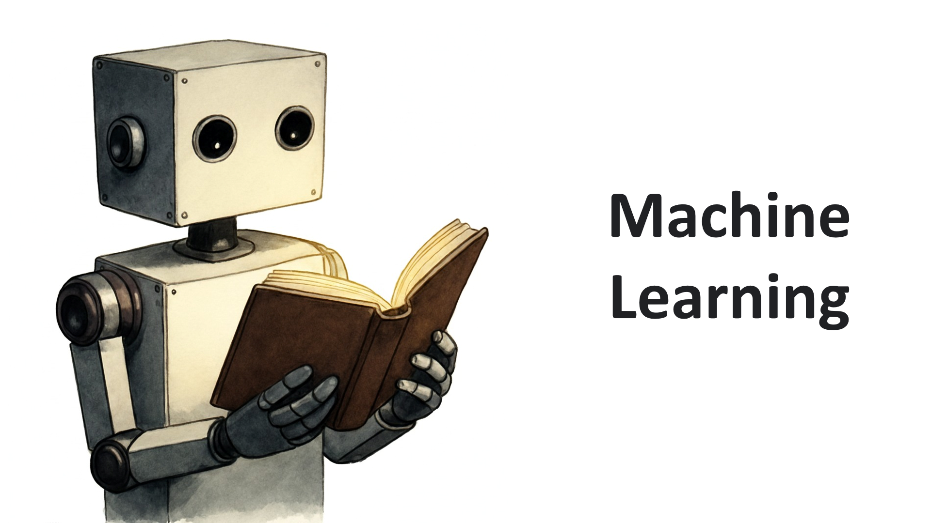
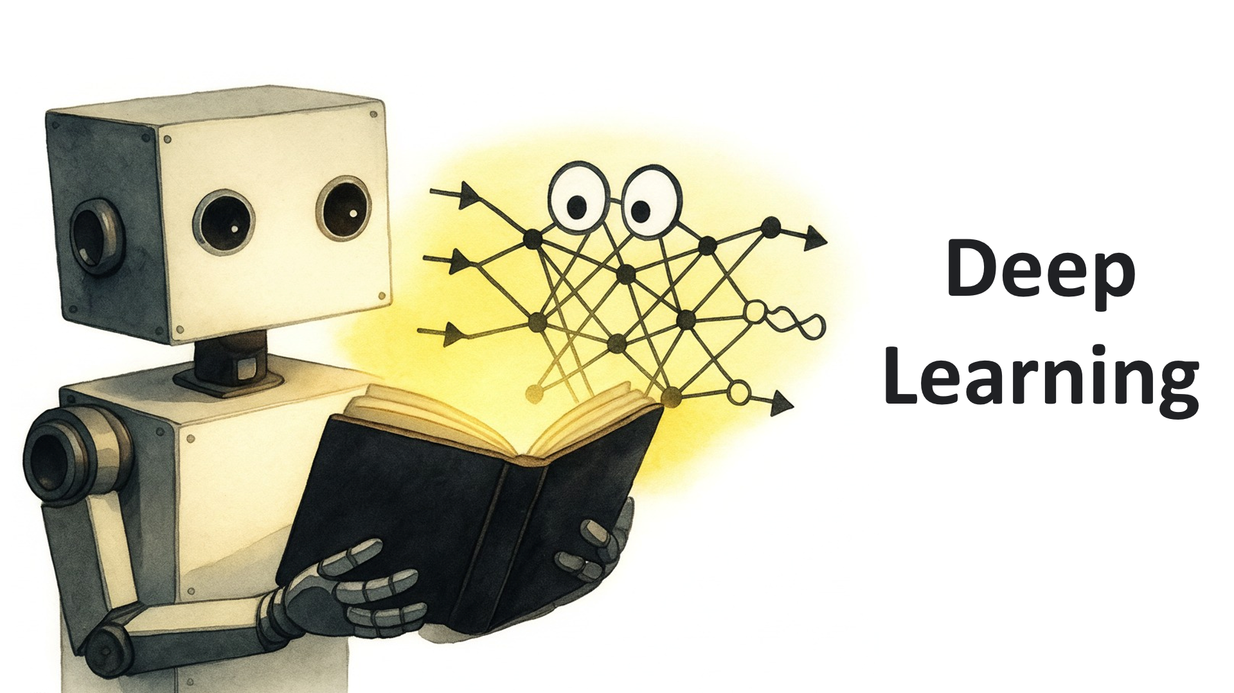
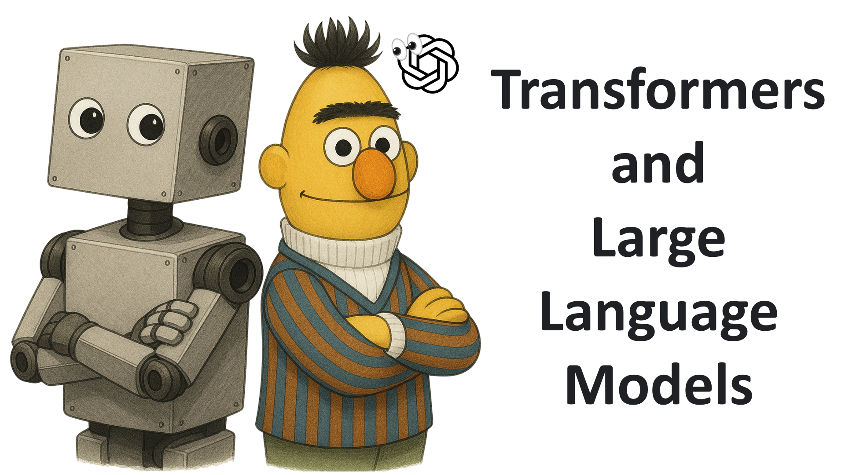
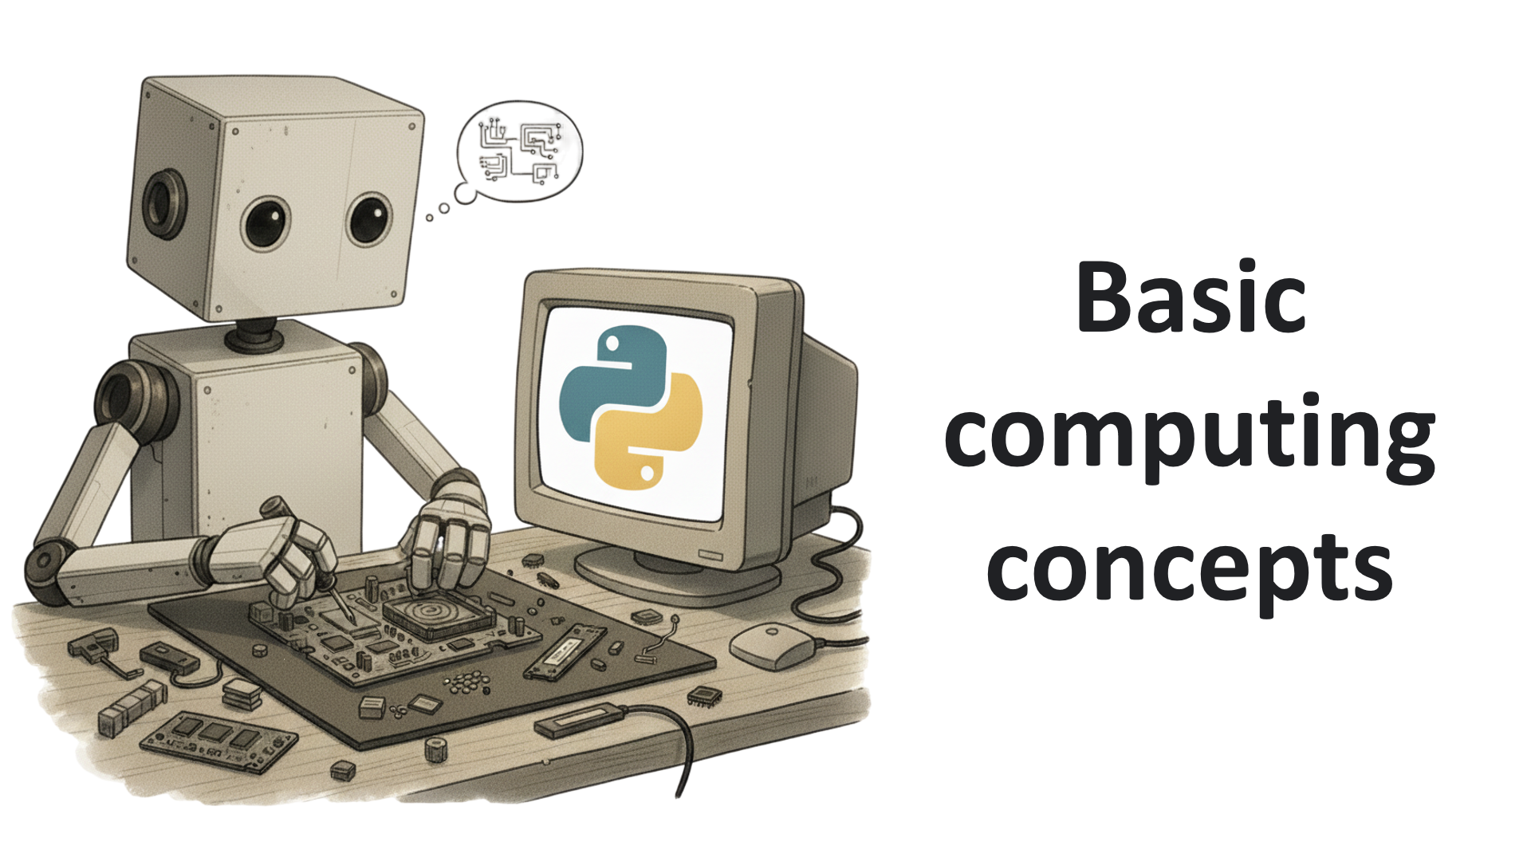
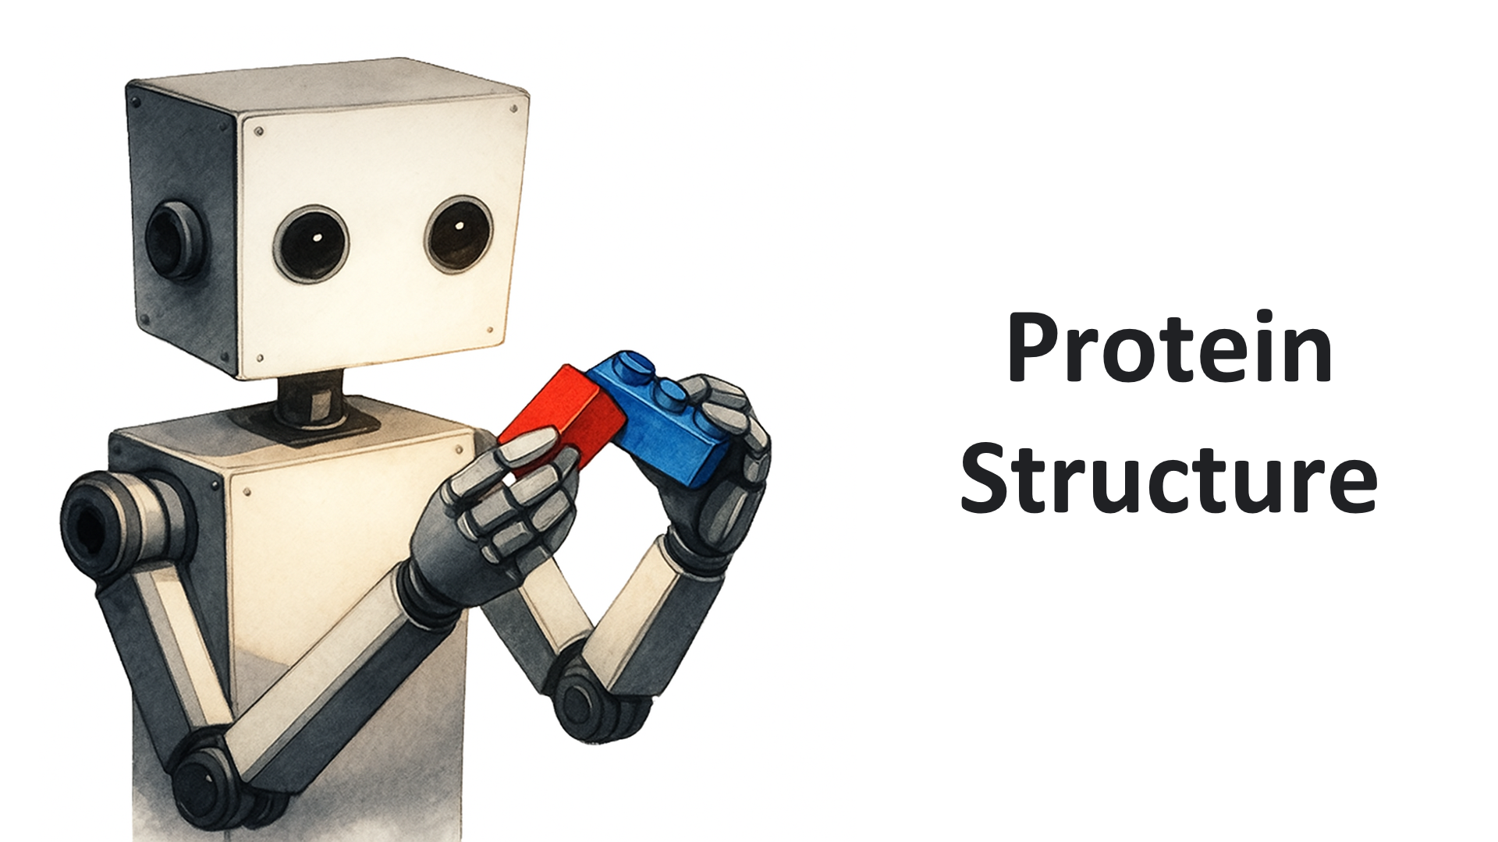
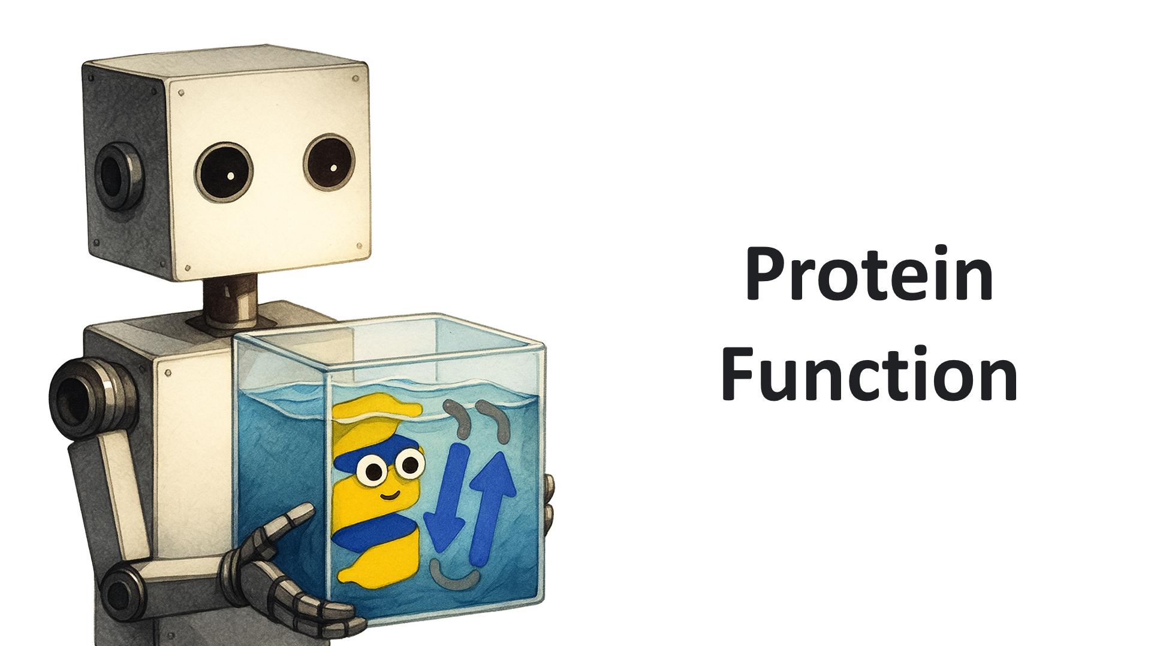
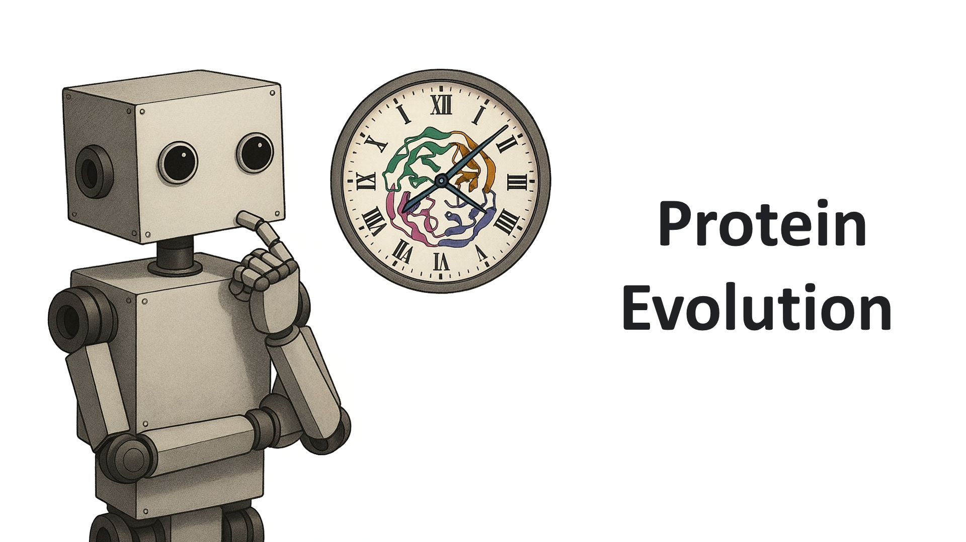


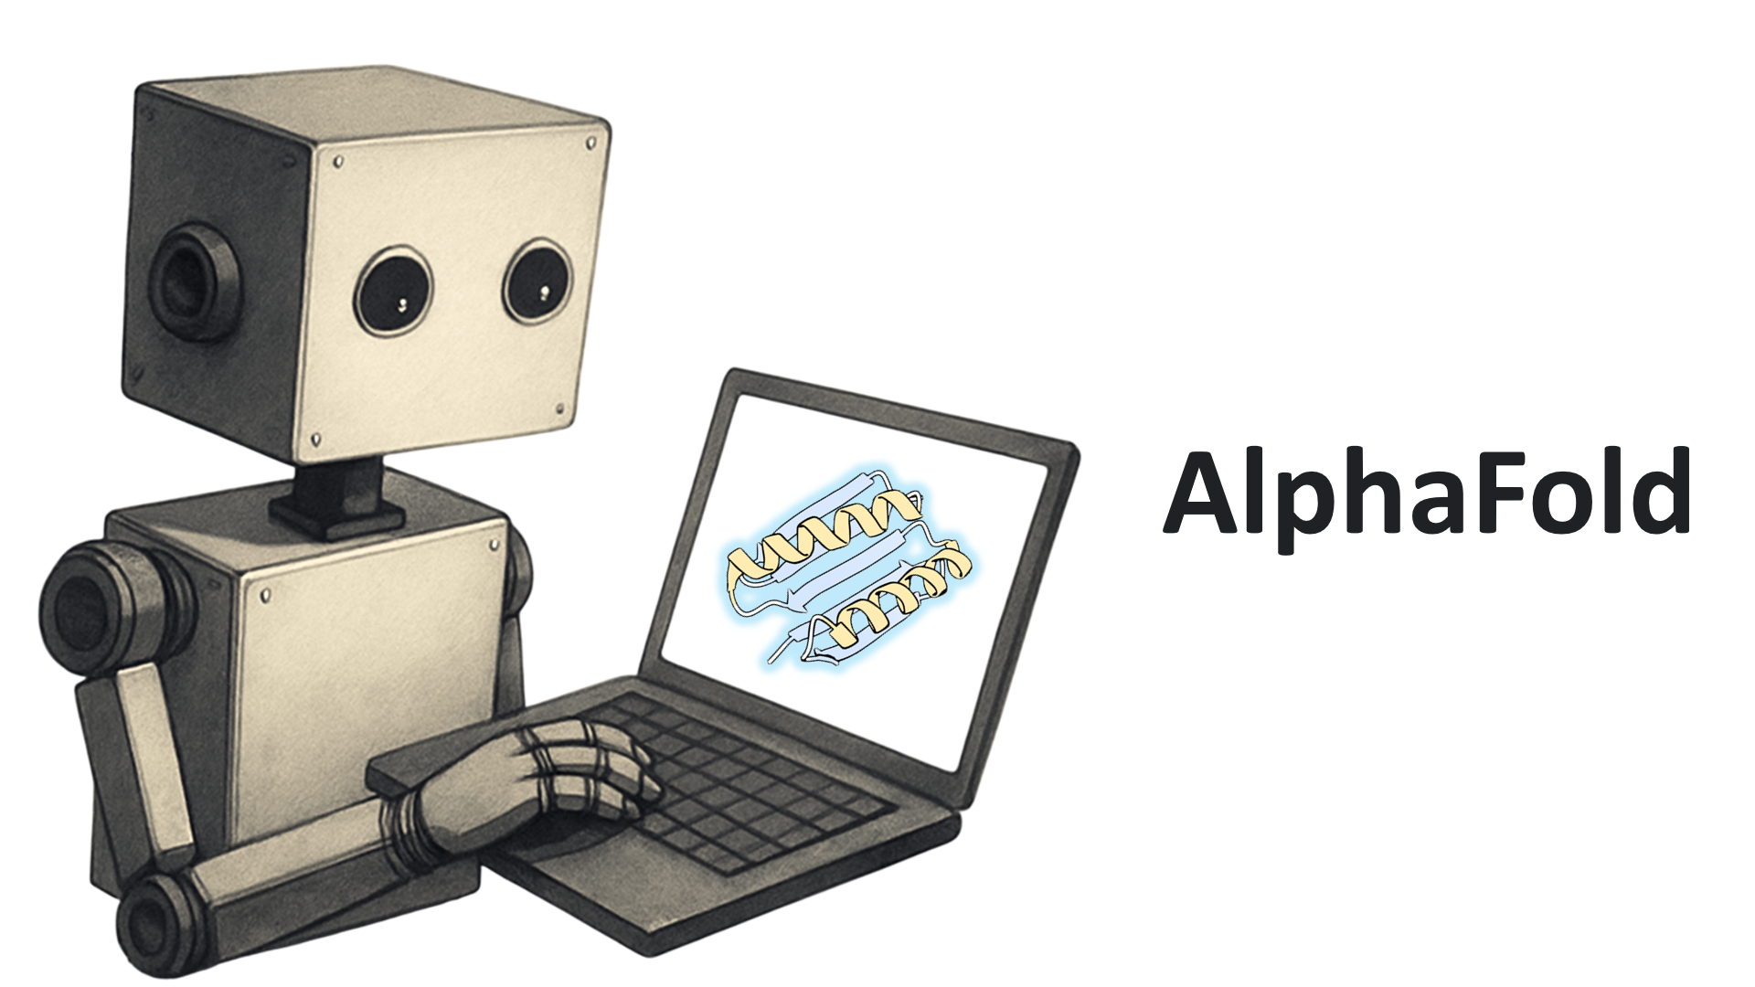
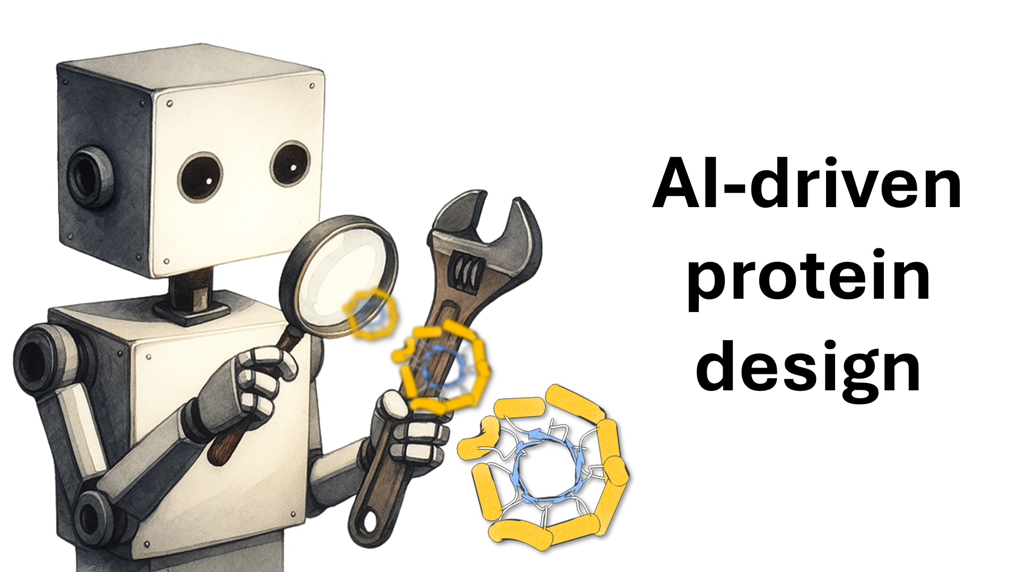
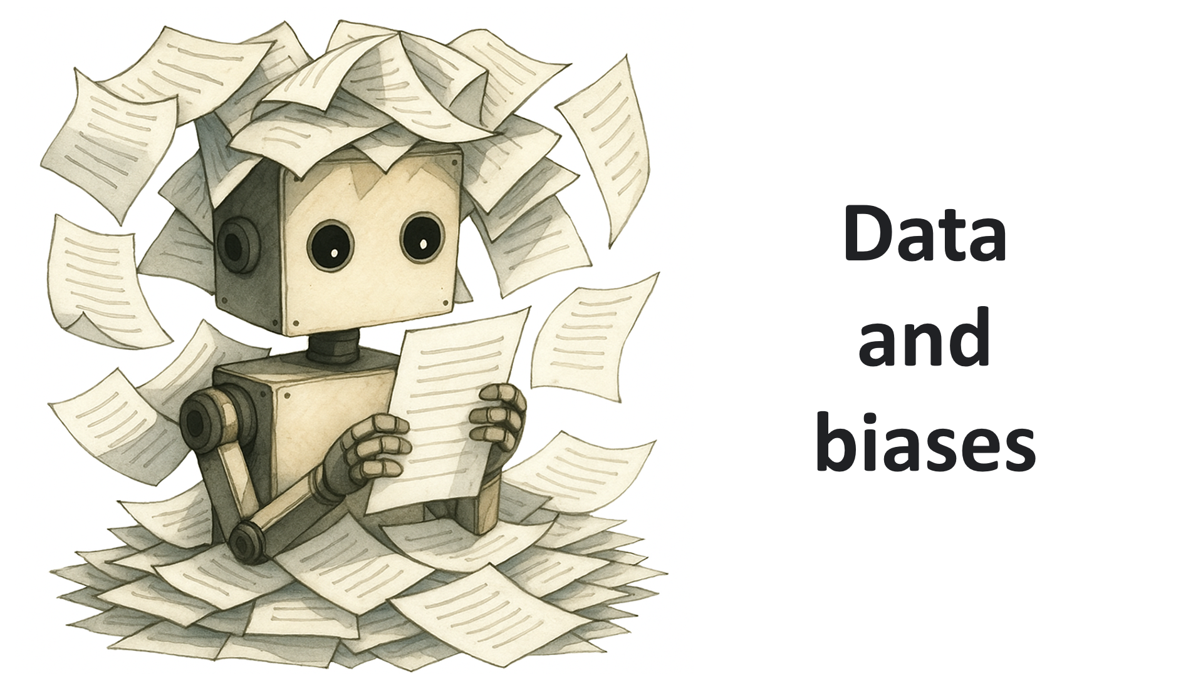
01
02
03
04
05
06
07
08
09
10
You can find the recorded lectures
(in Spanish) on my YouTube channel
https://www.youtube.com/@miangoar_bio
miangoaren.github.io/teaching/proteins

Slide 3
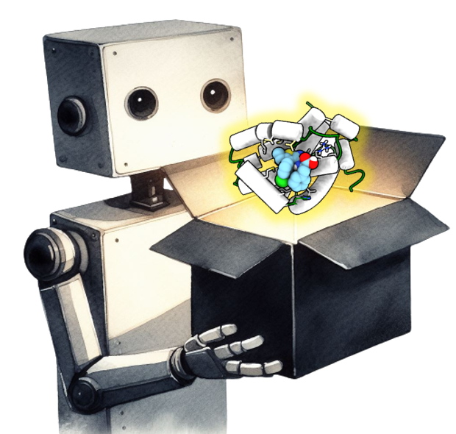

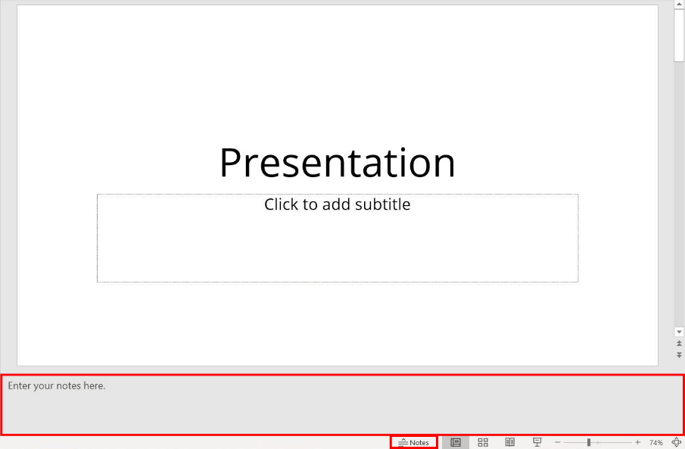







Check my webpage for more details about this
free course:
https://miangoaren.github.io/teaching/proteins
Disclaimer
Check the repository with tools, databases, learning resources and more:
https://github.com/miangoar/AI-driven-protein-design
The sources of the images and quotes,
as well as recommended literature,
are listed in the “Notes” section of the slides.
Thanks to all the authors!
You can download the slides from Zenodo/Drive. Let me know if you improved the course!
https://miangoaren.github.io/teaching/proteins
Find me on (X)Twitter, Bluesky, and Instagram as @miangoar. And on LinkedIn at the following link
www.linkedin.com/in/miguel-angel-gonzalez-arias-61b04b2ba
If you found this content useful, you can make a donation via
https://www.paypal.com/donate/?hosted_button_id=AG42EZTZW9AJN
miangoaren.github.io/teaching/proteins

Slide 4

Content
Where does your journey begin?
Hardware
  CPU
  GPU
Software
  Linux/Bash and GitHub
  Python
miangoaren.github.io/teaching/proteins

Slide 5
Where does your journey begin?

Slide 6
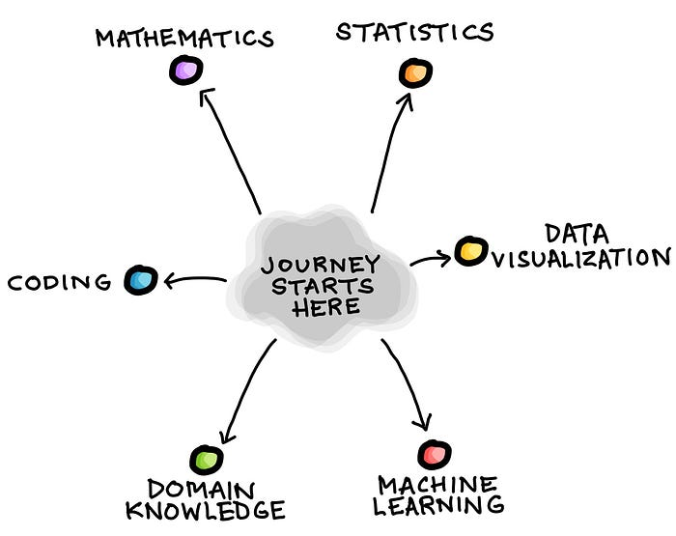

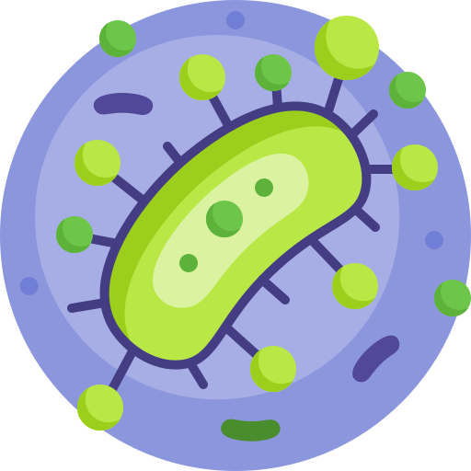
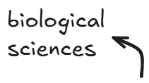
miangoaren.github.io/teaching/proteins
Notes:
https://dataprofessor.beehiiv.com/p/strategies-for-learning-data-science

Slide 7
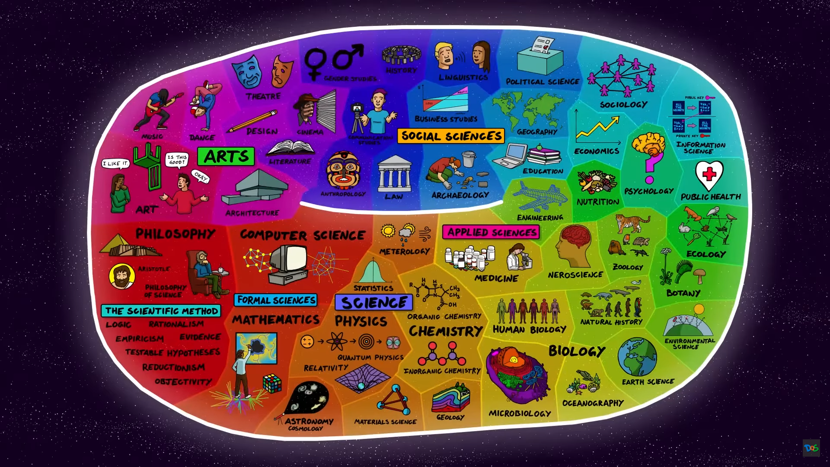
miangoaren.github.io/teaching/proteins
Notes:
https://youtu.be/ohyai6GIRZg

Slide 8
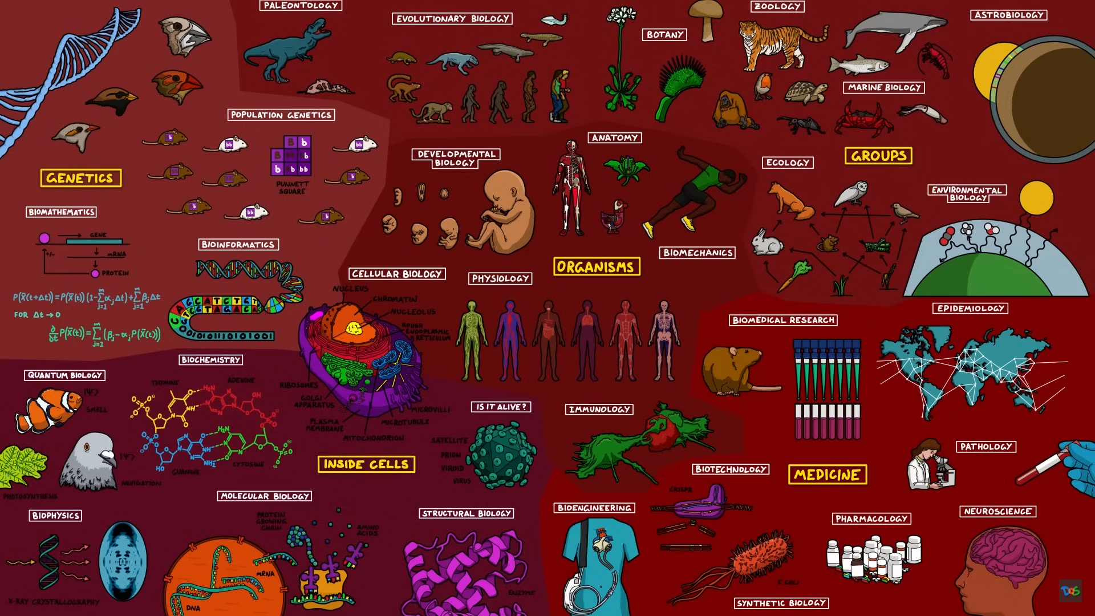
miangoaren.github.io/teaching/proteins
Notes:
https://youtu.be/wENhHnJI1ys

Slide 9
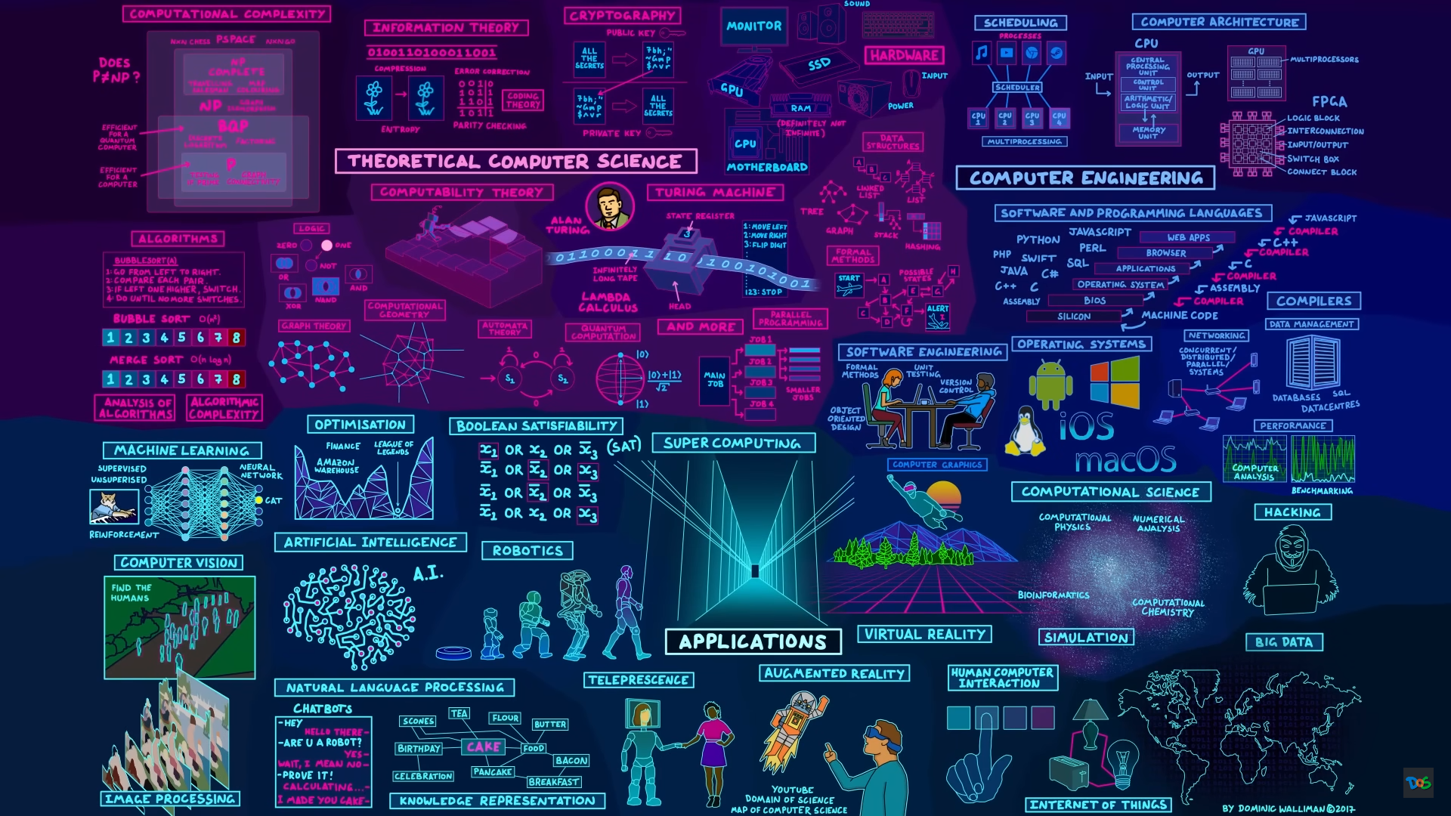
miangoaren.github.io/teaching/proteins
Notes:
https://youtu.be/SzJ46YA_RaA

Slide 10

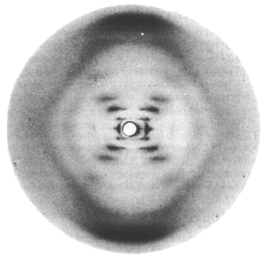
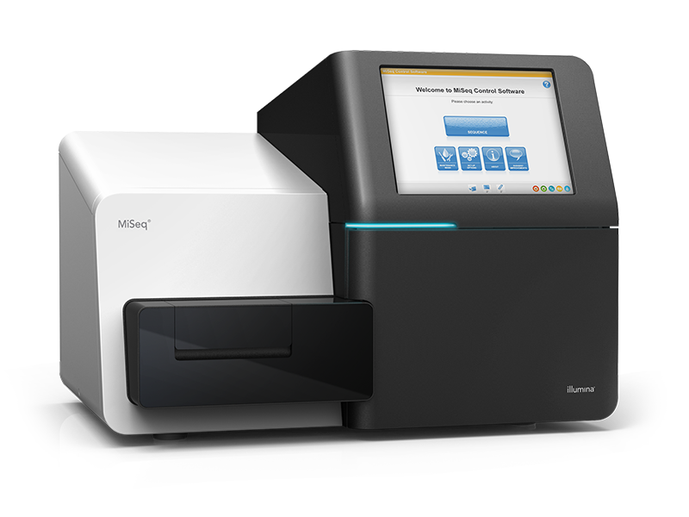
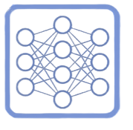
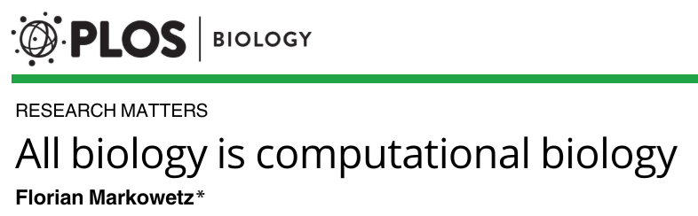
Analytical Evolution of Biology
Molecularization
Digitalization
Semantization
3D structure
Massive parallel sequencing
Machine learning
“it is the questions you address that matter, not the tools you use, computational biologists are just biologists using a different tool”
miangoaren.github.io/teaching/proteins
Notes:
The principle of uncertainty in biology: Will
machine learning/artificial intelligence lead to
the end of mechanistic studies

Slide 11
Hardware

Slide 12
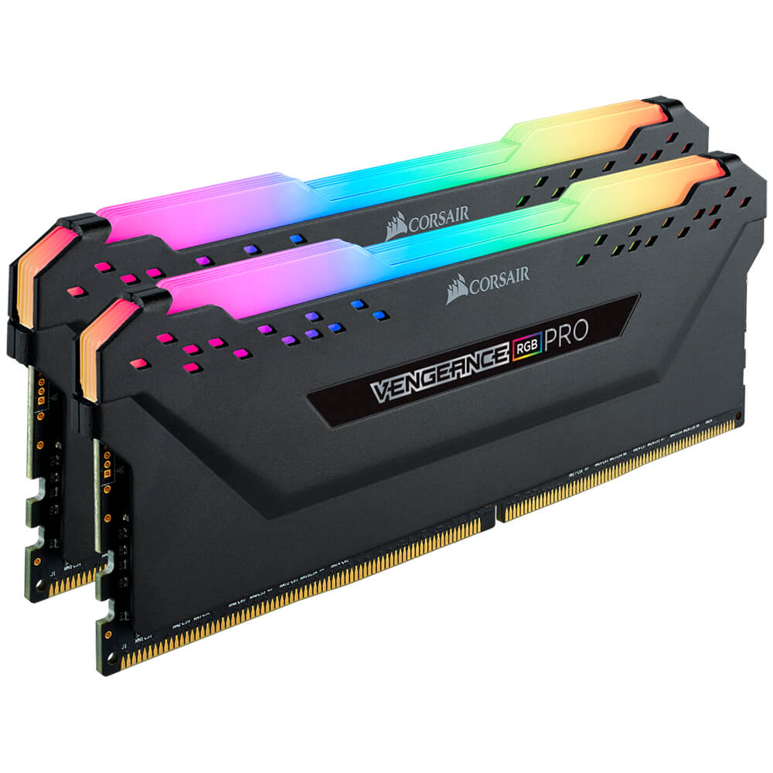
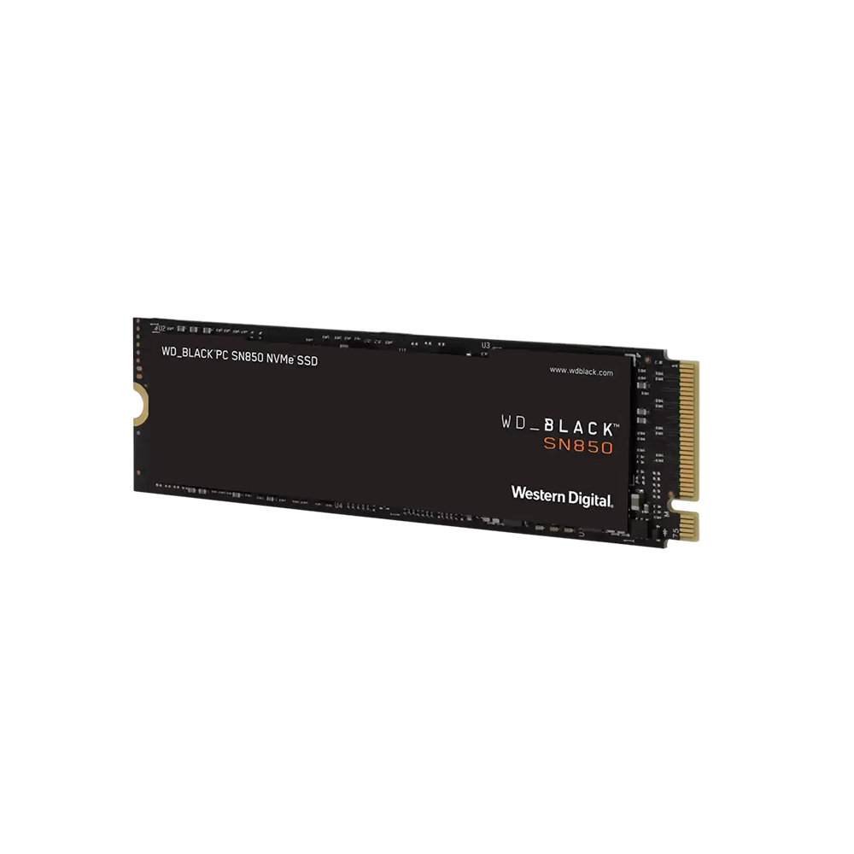
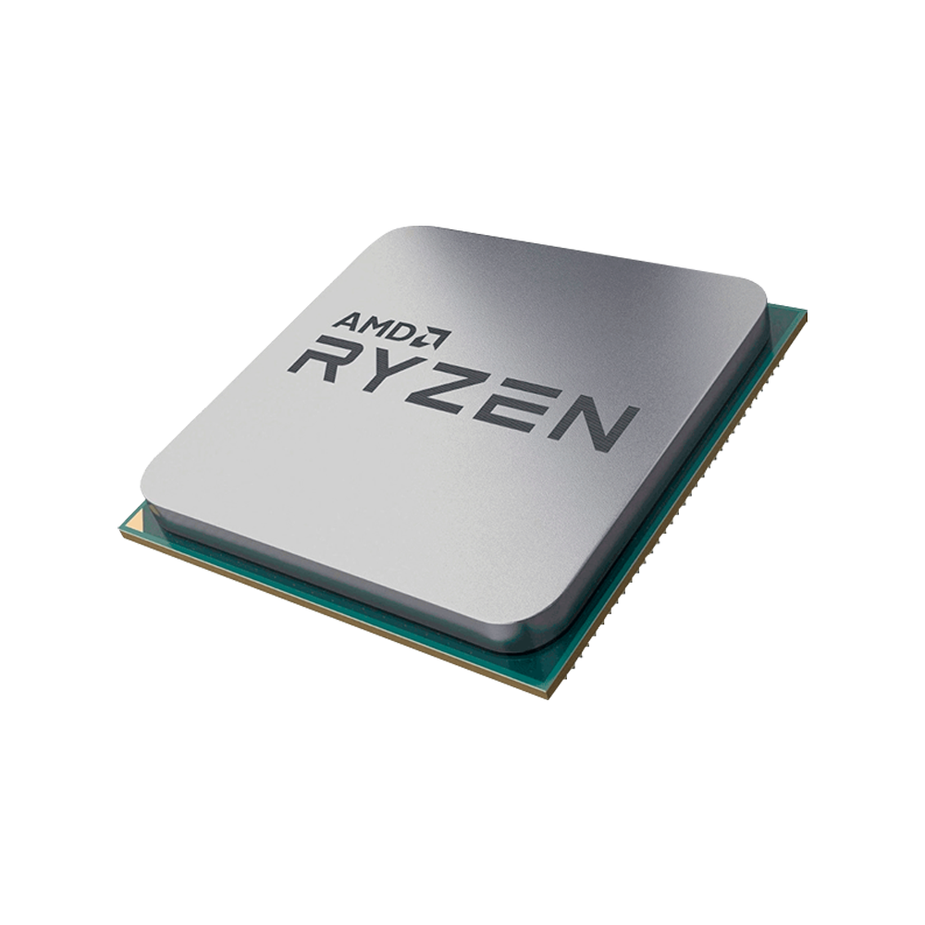
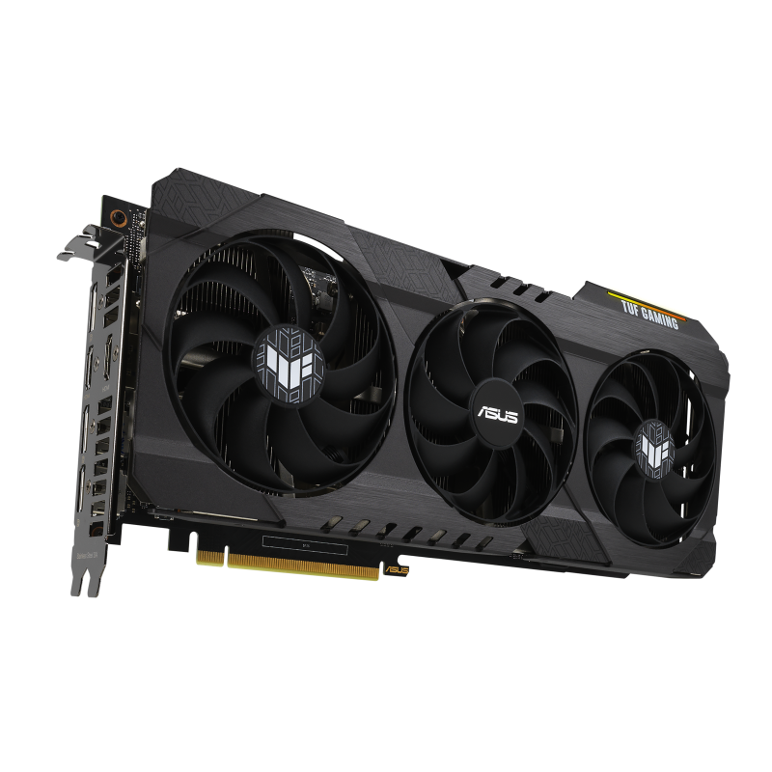
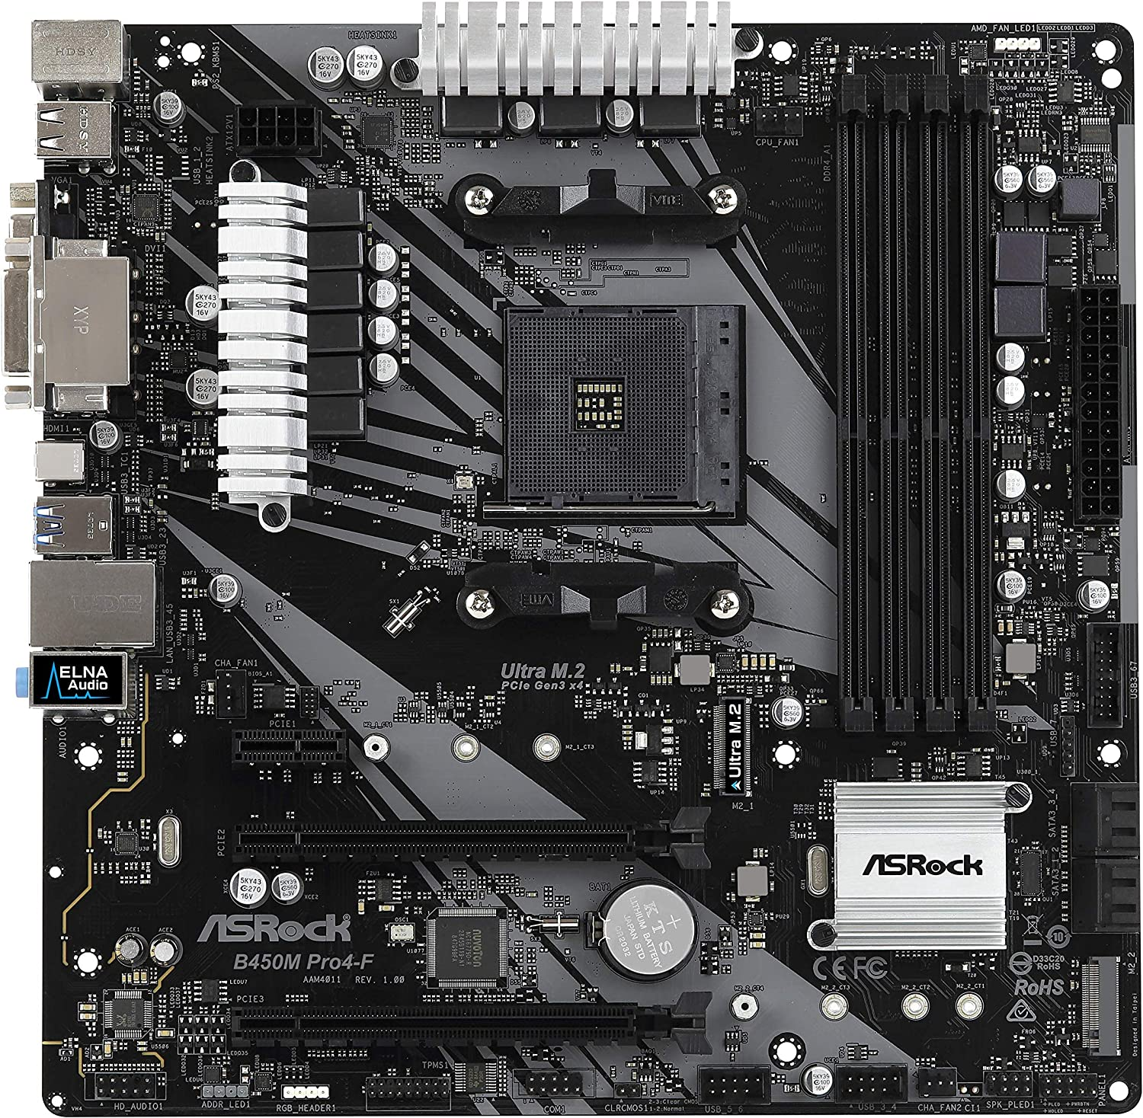

RAM memory
Central Processing Unit
(CPU)
Storage
(SSD/HHD)
To get started in bioinformatics,
you need to know your main tool
…
The computer
Motherboard
Graphics Processing Unit
(GPU)
miangoaren.github.io/teaching/proteins

Slide 13
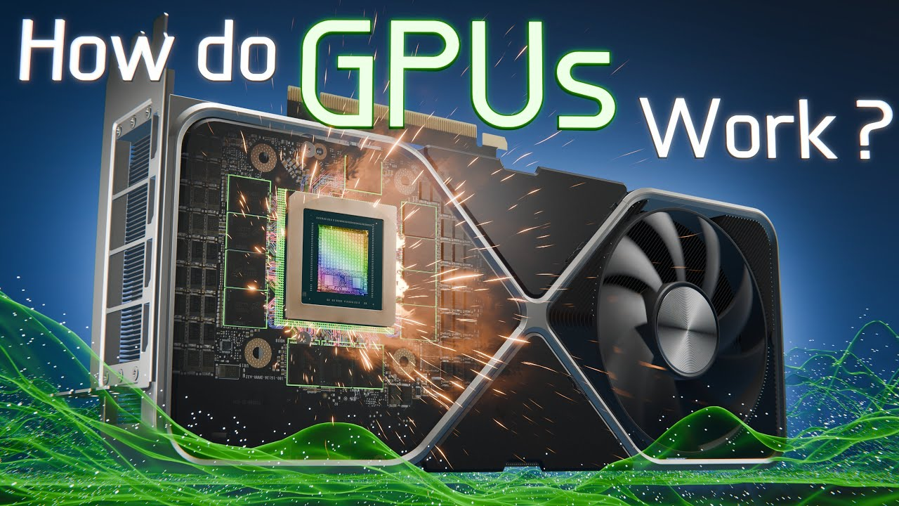
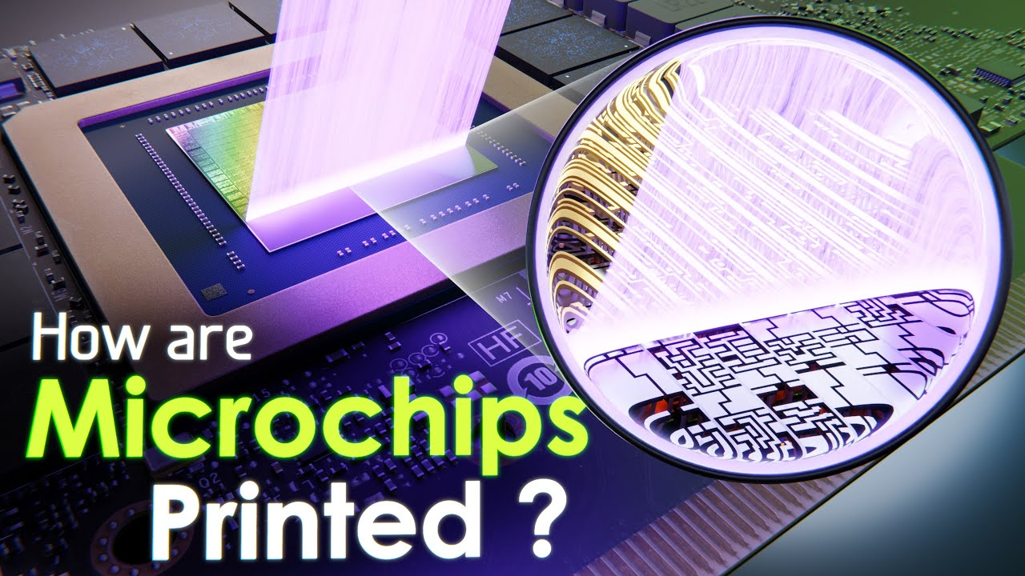

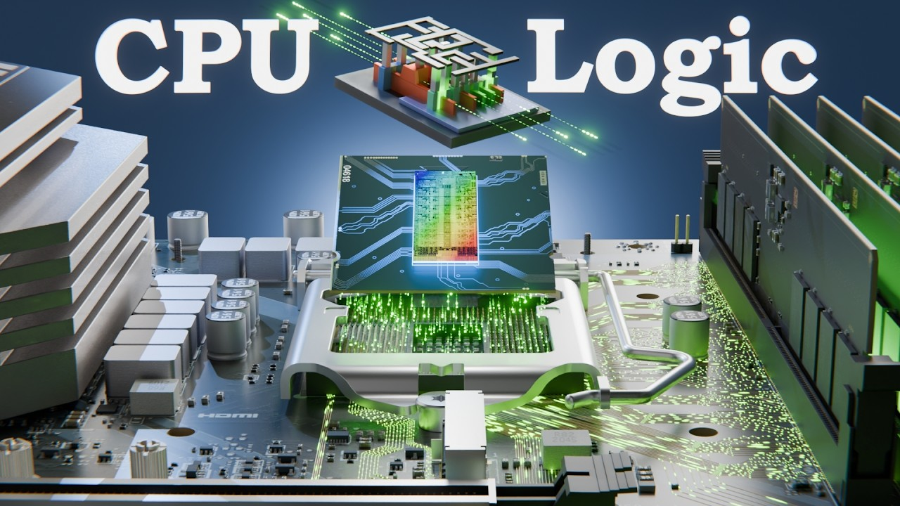
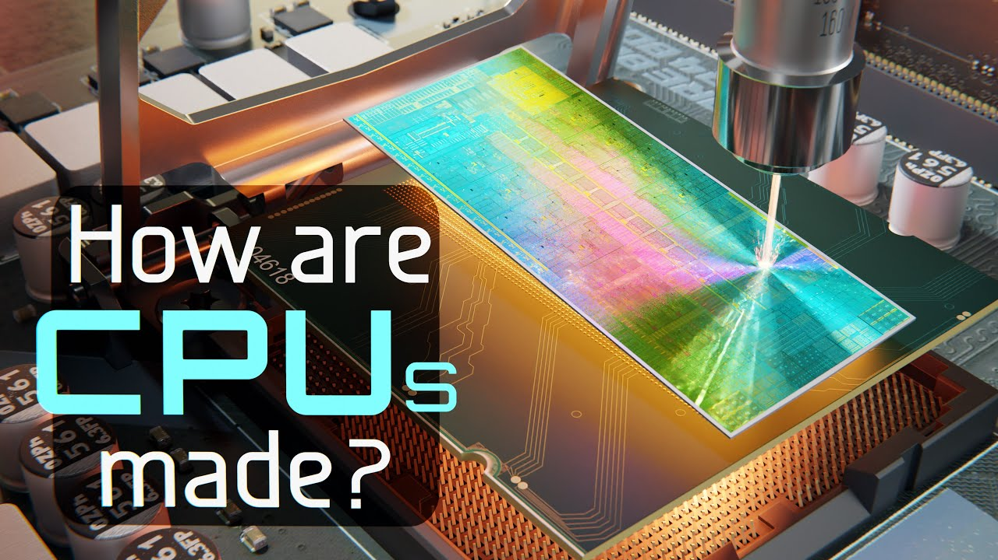

To learn more about hardware
www.youtube.com/@BranchEducation
miangoaren.github.io/teaching/proteins

Slide 14
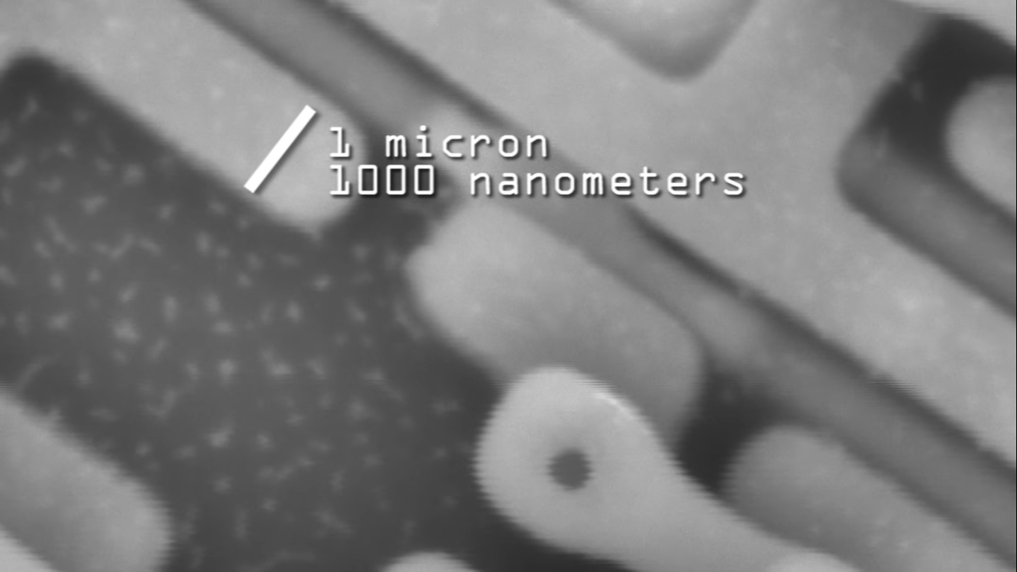
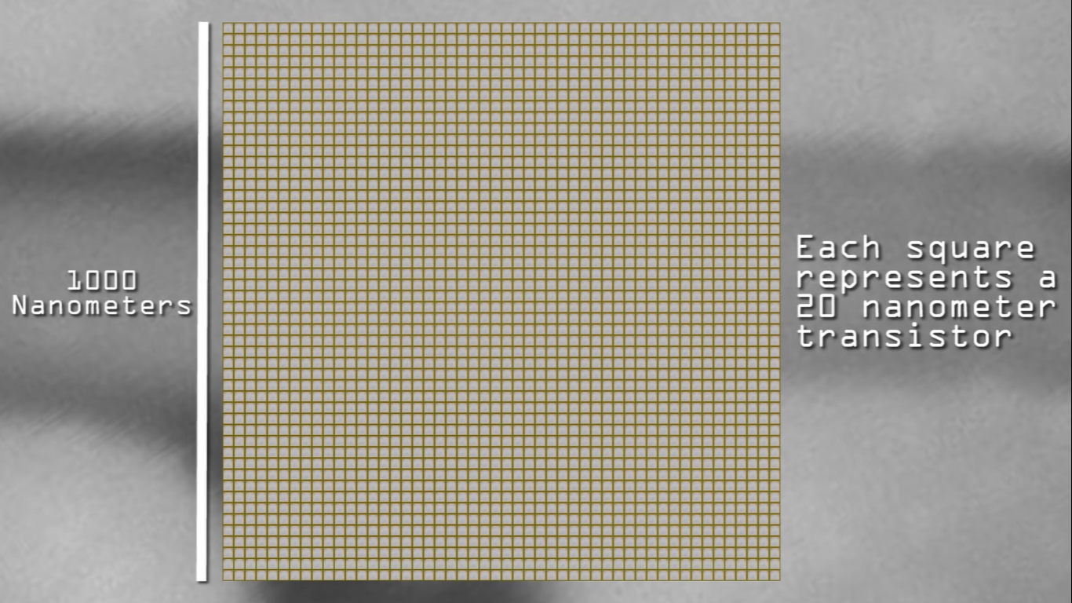
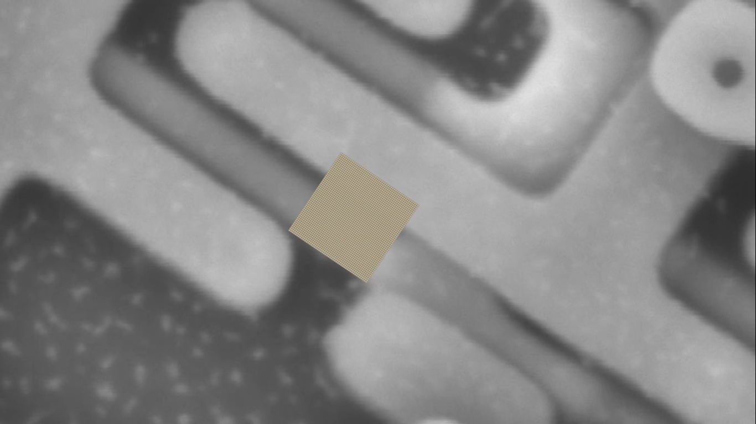
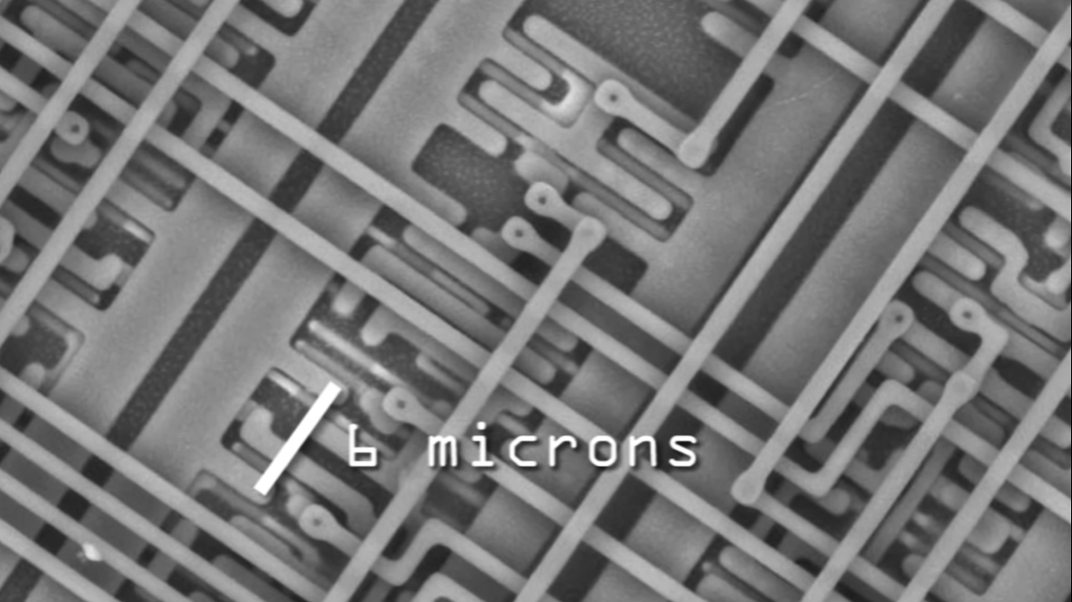
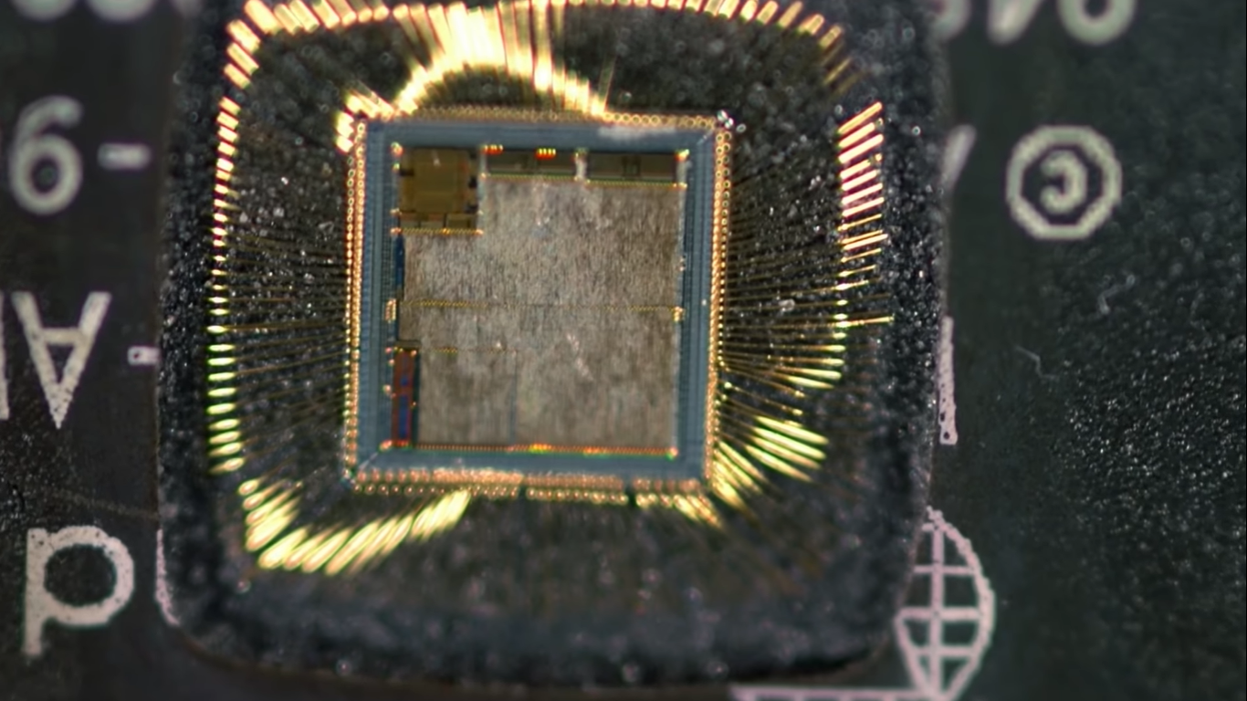
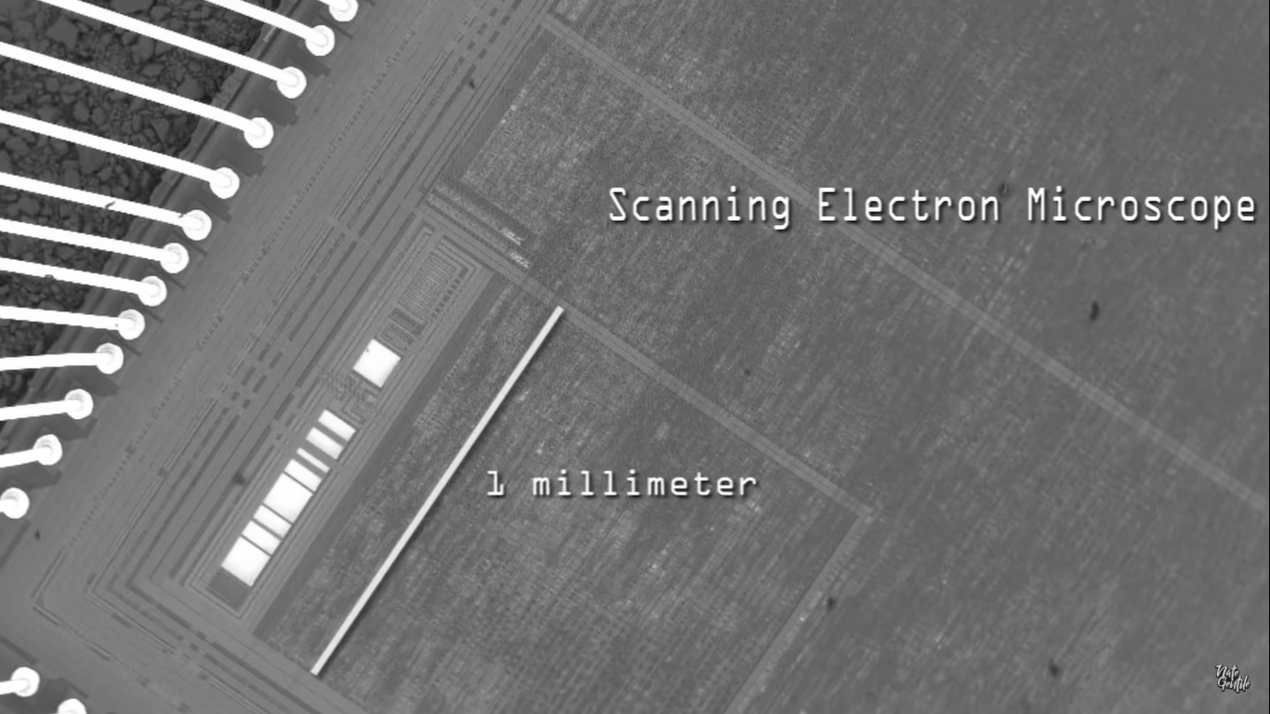
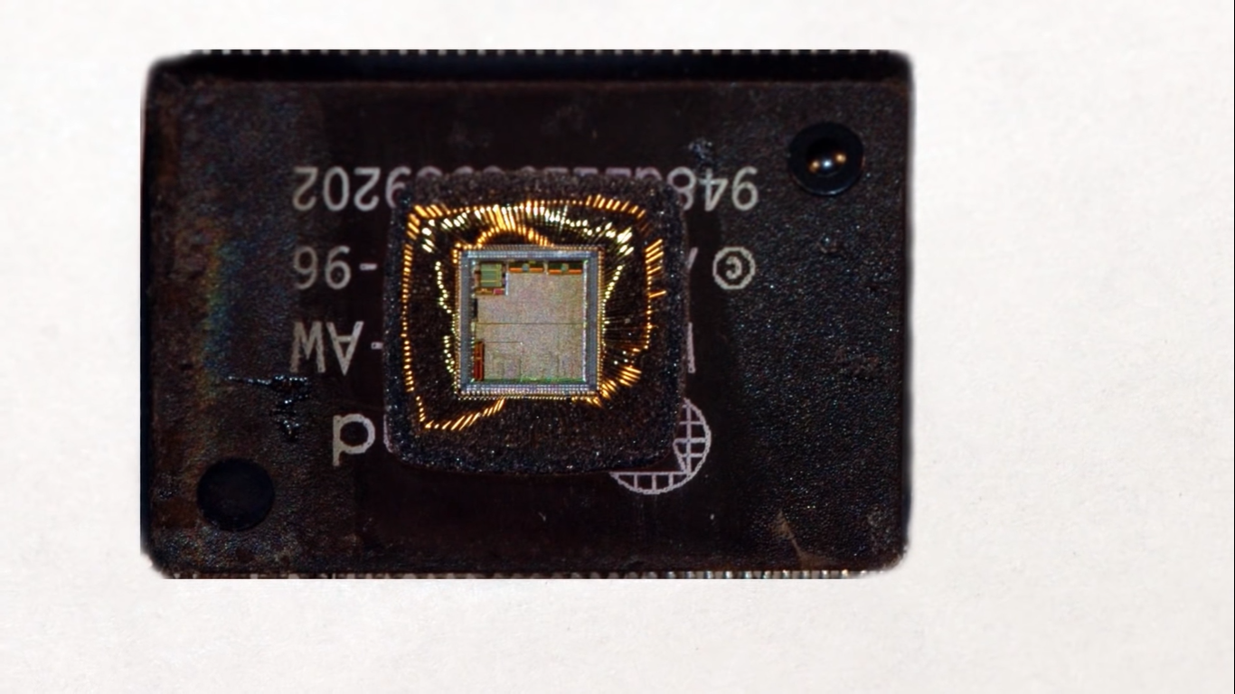
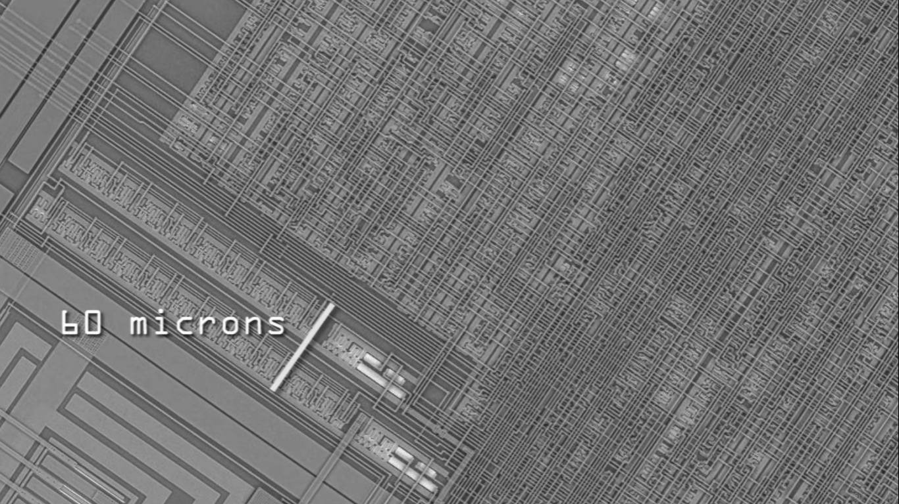
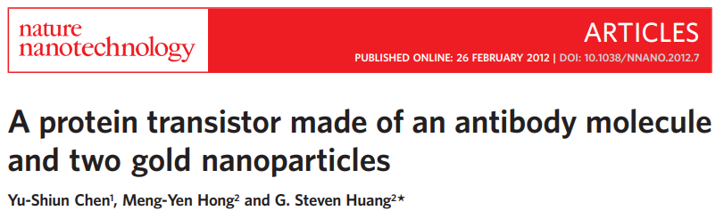
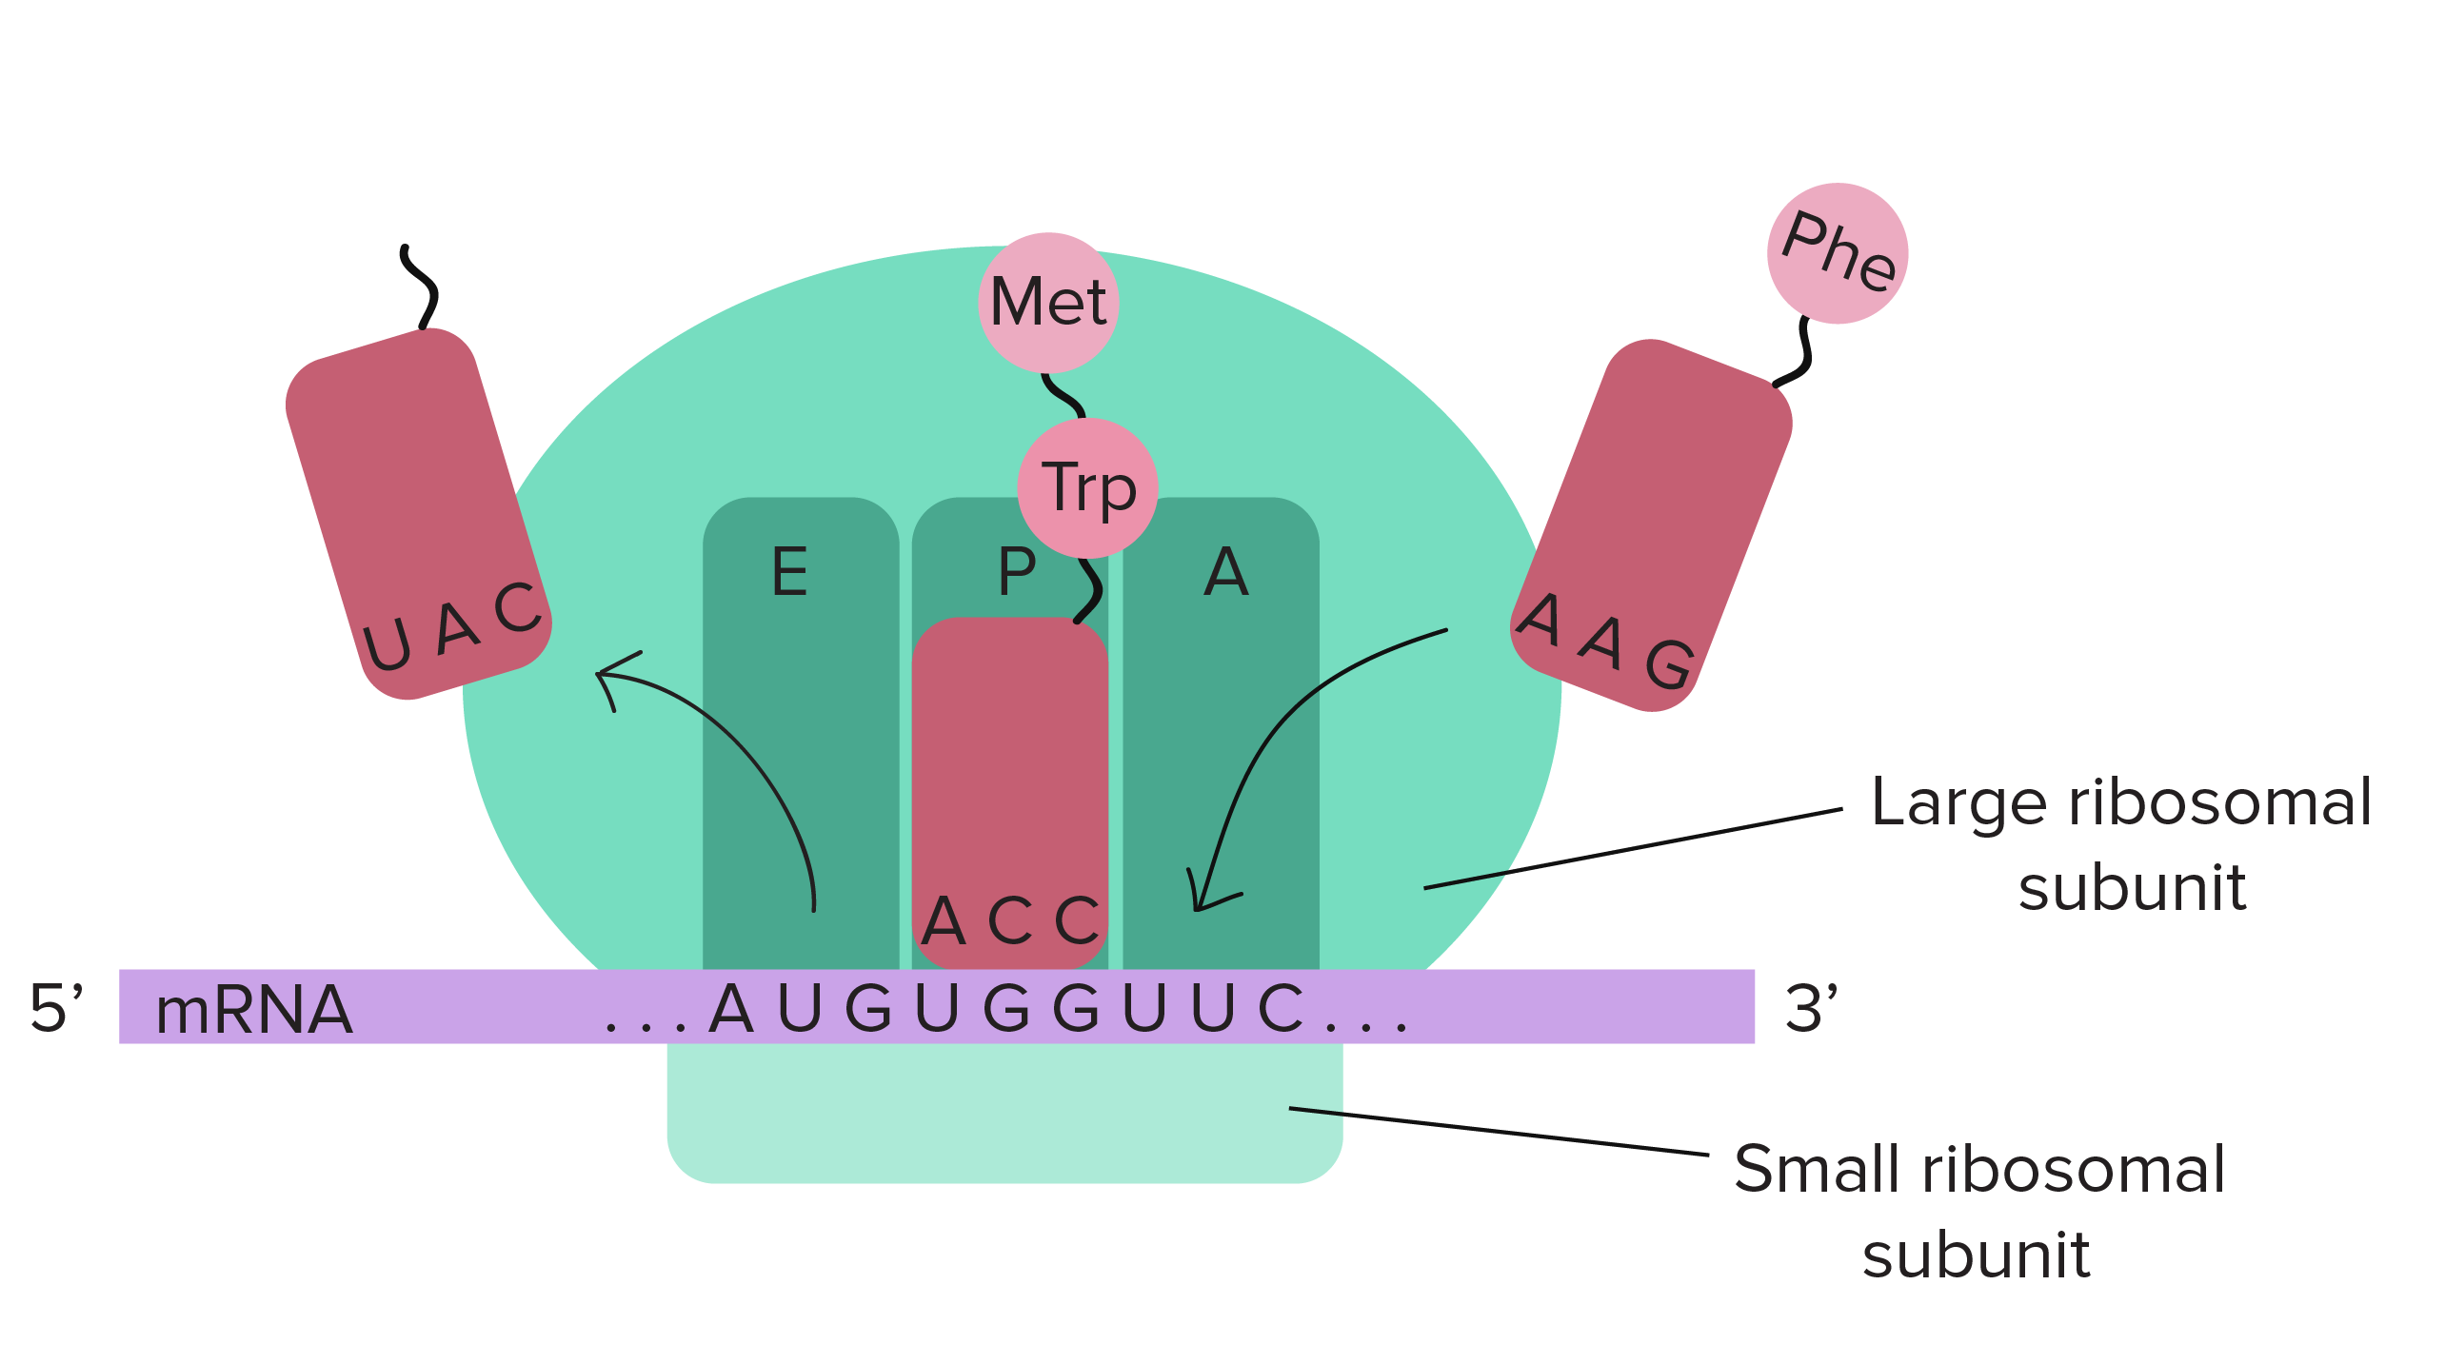
~1nm
~8nm
~30nm
miangoaren.github.io/teaching/proteins
Notes:
https://youtu.be/Fxv3JoS1uY8
tRNA = 7 nm | Hemoglobina = 6.5nm
Met = 700 picometros
Ribosomoa = 30 nm
https://youtu.be/d9SWNLZvA8g
https://youtu.be/SeNrVQBRHqE
https://www.youtube.com/watch?v=dX9CGRZwD-w&ab_channel=BranchEducation
https://www.youtube.com/watch?v=vuvckBQ1bME&ab_channel=RobertElderSoftware

Slide 15
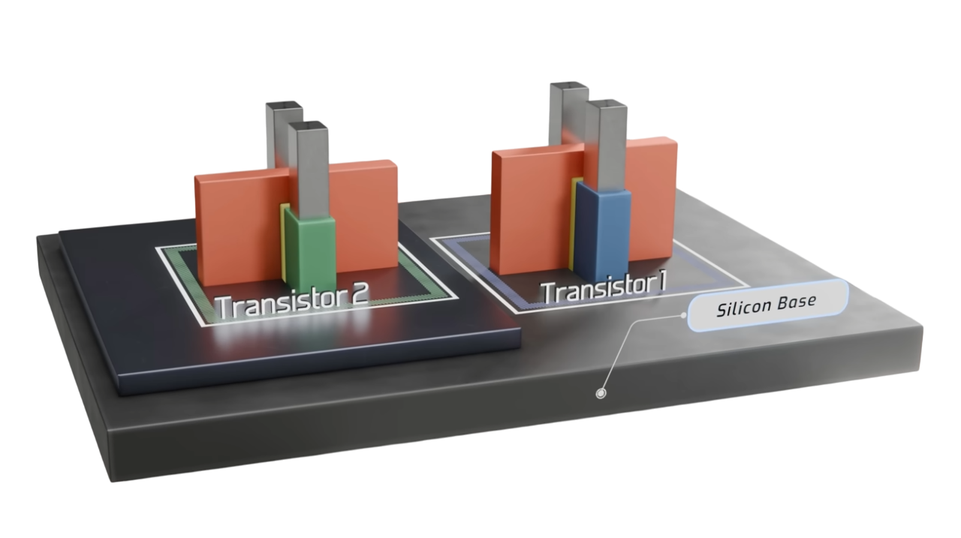
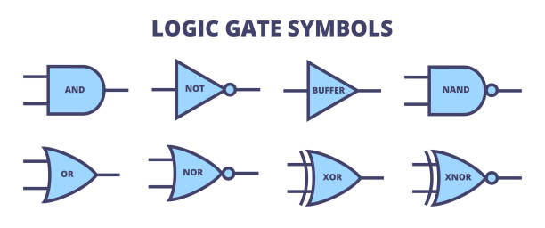
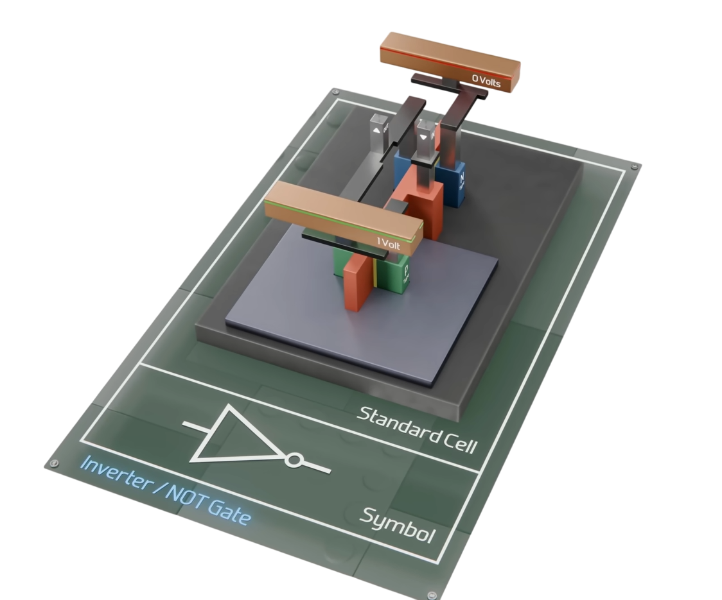
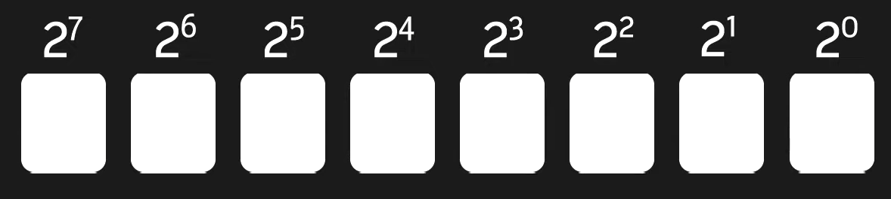
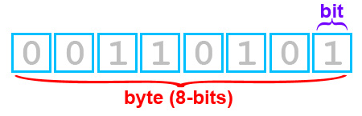
Voltage changes enable computational logic
Bit = 0 or 1
binary digits
Gate
Channel
binary code
2^8 = 256 → [0, 255]
0 0 1 1 0 1 0 1
128 64 32 + 16 + 8 4 + 2 1 = 53
miangoaren.github.io/teaching/proteins
Notes:
https://www.youtube.com/watch?v=_Pqfjer8-O4
https://www.youtube.com/watch?v=RVGIXfC4Xeg

Slide 16
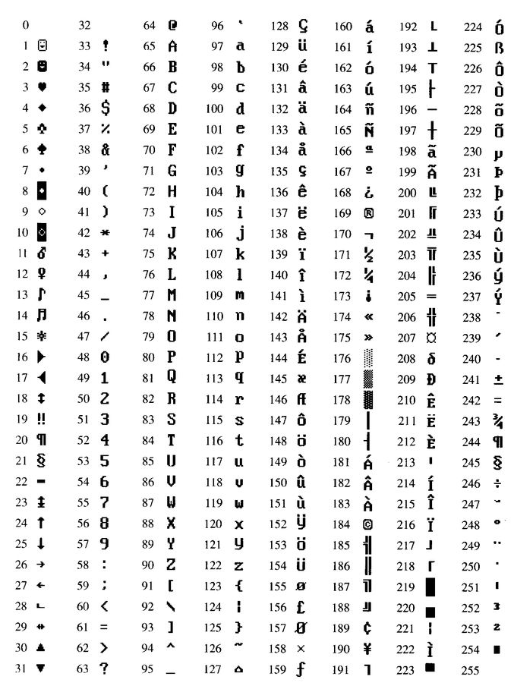
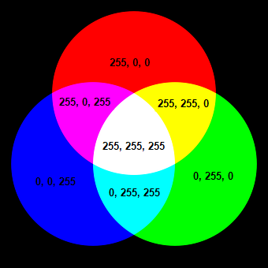




RGB code
ASCII Extended Code
Coding standards
UTF-8, UTF-16, UTF-32
IEEE 754 Floating-Point
High-Resolution Audio
37, 150, 190
miangoaren.github.io/teaching/proteins

Slide 17
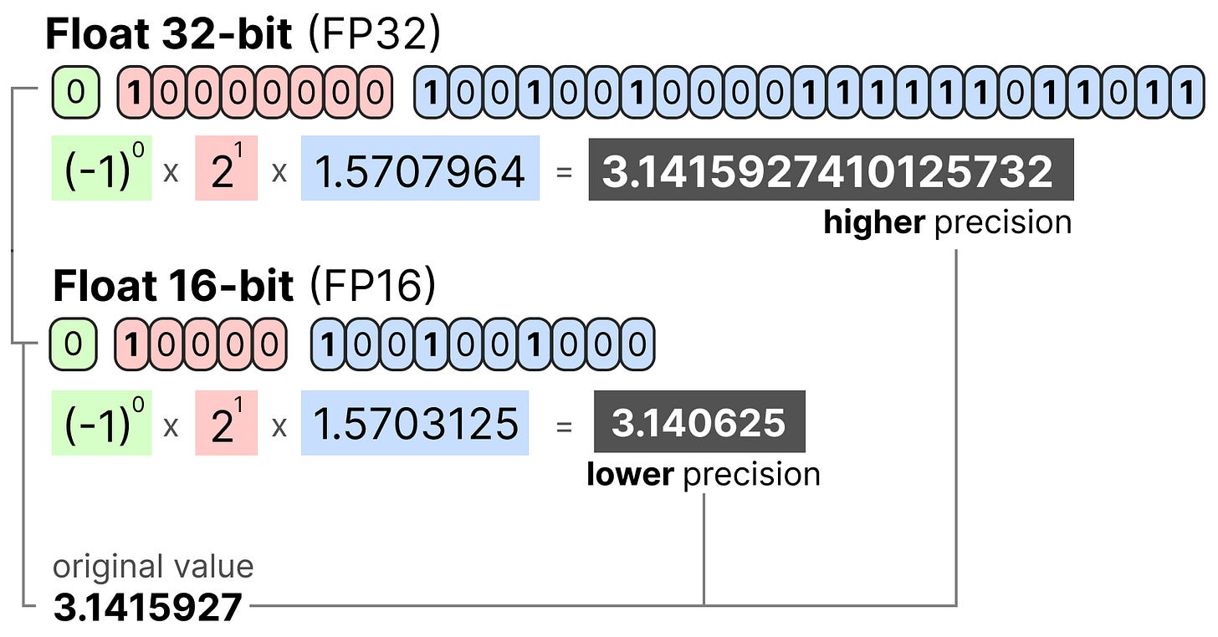



Numerical codification
scientific notation
2 = 2 x 10^0
15 = 1.5 x 10^1
128 = 1.28 x 10^2
0.0042 = 4.2 x 10^-3
60,000,000 = 6 x 10^7
0
0
0
0
0
0
1
1
integer-based codification
(int8, int16, int32, int64)
(-1)⁰
x
2¹+2⁰ = 2+1
=
3
precision formats used in AI:
FP32, FP16, BF16, FP8 (E4M3 / E5M2), FP4, INT8, INT4,
2-bit (ternary/binary quantization)
miangoaren.github.io/teaching/proteins
Notes:
https://newsletter.maartengrootendorst.com/p/a-visual-guide-to-quantization
https://www.youtube.com/watch?v=bbkcEiUjehk
https://lightning.ai/pages/community/tutorial/accelerating-large-language-models-with-mixed-precision-techniques/
https://huggingface.co/posts/Kseniase/707388483660581

Slide 18



The more bits we use to represent a value, the more precise it generally is
-1.8×10³⁰⁸
1.8×10³⁰⁸
FP64
Double precision
full-precision or simple precisión
(Most models are natively represented with float 32-bit )
Half precision
Integer-based representations
miangoaren.github.io/teaching/proteins
Notes:
https://newsletter.maartengrootendorst.com/p/a-visual-guide-to-quantization
https://lightning.ai/pages/community/tutorial/accelerating-large-language-models-with-mixed-precision-techniques/

Slide 19





miangoaren.github.io/teaching/proteins

Slide 20


[0, 1, 2, 3, 4, 5, 6, 7, 8, 9, 10, 11, 12, 13, 14, 15, 16, 17, 18, 19, 20, 21, 22, 23, 24, 25, 26, 27, 28, 29, 30, 31]
Architectures
64 bits
Memory limitations
2^32 = 4,294,967,296 ≈ 4.29 GB
2^64 = 1.8446744e+19 ≈ 16 EB
1GB = 10^9 bytes
1 EB = 10^18 bytes
32 bits
[0, 1, 2, 3, 4, 5, 6, 7, 8, 9, 10, 11, 12, 13, 14, 15, 16, 17, 18, 19, 20, 21, 22, 23, 24, 25, 26, 27, 28, 29, 30, 31, 32, 33, 34, 35, 36, 37, 38, 39, 40, 41, 42, 43, 44, 45, 46, 47, 48, 49, 50, 51, 52, 53, 54, 55, 56, 57, 58, 59, 60, 61, 62, 63]
miangoaren.github.io/teaching/proteins
Notes:
https://youtu.be/Mjho-cdDMDg
https://www.youtube.com/watch?v=1XotmNzVyjU&ab_channel=Migma

Slide 21




Hertz
(e.g. GHz)
ALU (Arithmetic Logic Unit)
AGU (Address Generation Unit)
FPU (Floating Point Unit)
Operations per second
Integers
(int)
Real numbers
(Floats)
Random Access Memory, RAM
Memory GB, Configuration, DDR4/DDR5, CL
miangoaren.github.io/teaching/proteins
Notes:
https://youtu.be/gzf0jdiBz80
https://www.youtube.com/watch?v=PGLUcbZDszA

Slide 22








Consumer range
(architecture: x86-64)
“Mobile” range
(architecture : ARM)
miangoaren.github.io/teaching/proteins

Slide 23
Nomenclature
Family
Generation
Variants
(U, K, X, HQ, M, G etc.)
Intel Core i5 9 700 k
AMD Ryzen 5 3 500 u
Stock Keeping Unit
(SKU)
Manufacturer
Series
miangoaren.github.io/teaching/proteins

Slide 24






- $
+$
miangoaren.github.io/teaching/proteins
Notes:
https://youtu.be/UjDniSrpcy4

Slide 25









- $
+$
miangoaren.github.io/teaching/proteins
Notes:
https://youtu.be/6PBIFIFAIis

Slide 26
RAM memory
Central Processing Unit
(CPU)
Storage
(SSD/HHD)
Computer
Motherboard
Graphics Processing Unit
(GPU)
miangoaren.github.io/teaching/proteins

Slide 27



What makes GPU computing special?
AMD Ryzen 5 3600
6 cores
RTX 4090 Ti
16,384 cores
miangoaren.github.io/teaching/proteins
Notes:
https://youtu.be/C_wSHKG8_fg

Slide 28



Data representation
x11
Rank-0
tensor
Rank-1
tensor
Rank-2
tensor
Rank-3
tensor
For 11 dimensions:
Rank-11 tensor
miangoaren.github.io/teaching/proteins
Notes:
https://github.com/analyticalrohit/pytorch_fundamentals

Slide 29








Tensors
“To deal with hyperplanes in a 14-dimensional space, visualize a 3-D space and say ´fourteen´ to yourself very loudly. Everyone does it”
- Geoffrey Hinton
miangoaren.github.io/teaching/proteins
Notes:
https://youtu.be/s4USUVBuFi0?si=QJPjP-Ro78PuN-Z8
https://dan.gop/articles/line-segment-density-maps/
https://x.com/spikedoanz/status/1877944710284668955
https://github.com/analyticalrohit/pytorch_fundamentals

Slide 30

What is a Tensor?
miangoaren.github.io/teaching/proteins
Notes:
https://x.com/vikhyatk/status/1969151806501487096
Tensor Decompositions and Applications

Slide 31






Multidimensionality
Tensor product ⊗
u
dim = n
v
dim = m
T
dim = n x m
Addition
Multiplication by
a scalar
⊗ creates a combined space that captures every possible interaction between
two source spaces
8 axioms
Vector space
https://www.youtube.com/playlist?list=PLZHQObOWTQDPD3MizzM2xVFitgF8hE_ab
miangoaren.github.io/teaching/proteins
Notes:
https://twitter-thread.com/t/1970205472947941389
https://youtu.be/kAjTrAUFIdQ
https://www.youtube.com/watch?v=m3hxPxPgSIY&ab_channel=DiBeos
https://www.youtube.com/watch?v=yCX8rW-8X2I&ab_channel=MatesMike
https://www.youtube.com/watch?v=zwAD6dRSVyI&ab_channel=3Blue1Brown
https://www.youtube.com/watch?v=bpuE_XmWQ8Y
https://youtu.be/TgKwz5Ikpc8?si=8w3OaM9A7C8QVYDh&t=742

Slide 32



miangoaren.github.io/teaching/proteins
Notes:
https://www.youtube.com/watch?v=oypdocrbTOE&ab_channel=DotCSV
https://www.youtube.com/watch?si=0NhRm3e7YGp-0D29&v=dULMDS_VJE8&feature=youtu.be

Slide 33






NCCL, cuFFT, cuSPARSE, etc.
deep neural network operations
linear algebra and matrix multiplications
XLA
Accelerated Linear Algebra
Tensor Processing Unit
(TPUs)
miangoaren.github.io/teaching/proteins
Notes:
https://www.aleksagordic.com/blog/matmul
https://henryhmko.github.io/posts/tpu/tpu.html

Slide 34










How to choose a GPU?
CUDA Cores
General purpose
Tensor Cores
Mixed-precision
vRAM
10,496 CUDA
cores
328 tensor
cores
24 GB
GDDR6X
Manufacturers/Assemblers
miangoaren.github.io/teaching/proteins
Notes:
https://softwareg.com.au/blogs/computer-hardware/nvidia-graphics-card-naming-convention
https://www.youtube.com/watch?v=-cRedoYETzQ
https://www.youtube.com/watch?v=vGZmK341Hrc&t=1s&ab_channel=O%21Technology

Slide 35



Which GPU(s) to Get for
Deep Learning
https://timdettmers.com/2023/01/30/which-gpu-for-deep-learning/
Consumer
GPUs
~$2000
High performance computing
40GB: $10,000 - $12,000
80GB: $15,000 - $17,000
A100
miangoaren.github.io/teaching/proteins
Notes:
https://timdettmers.com/2023/01/30/which-gpu-for-deep-learning/#

Slide 36





Differences between processing units
Highly parallelized
vector/matrix multiplication
Highly parallelized
Tensor multiplication
Parallelized scalar multiplication
miangoaren.github.io/teaching/proteins
Notes:
https://twitter.com/DamiBenveniste/status/1615752891725402113/photo/1
https://www.youtube.com/watch?v=D8HS-H-MIe0&list=PL5XwKDZZlwaY7t0M5OLprpkJUIrF8Lc9j&index=2&ab_channel=SimonOz

Slide 37

Accelerated
Processing
Unit
(APU)
e.g. Ryzen 7 5700G
miangoaren.github.io/teaching/proteins
Notes:
https://youtu.be/6PBIFIFAIis

Slide 38

Sohu by Etched: a specialized chip for Transformers
miangoaren.github.io/teaching/proteins
Notes:
https://www.youtube.com/watch?v=MZdH82aFPBc

Slide 39

miangoaren.github.io/teaching/proteins
Notes:
https://www.bsc.es/discover-bsc/visit-our-supercomputer
https://www.youtube.com/watch?v=nctTZplQY-o&ab_channel=NateGentile

Slide 40


miangoaren.github.io/teaching/proteins
Notes:
https://www.youtube.com/watch?v=Jf8EPSBZU7Y&t=32s

Slide 41


miangoaren.github.io/teaching/proteins
Notes:
https://openai.com/es-419/index/stargate-advances-with-partnership-with-oracle/

Slide 42
Software

Slide 43















Operating system architecture
Linux distributions
macOS
MMseqs
miangoaren.github.io/teaching/proteins
Notes:
https://shubhsharma19.hashnode.dev/beginners-guide-to-Linux
https://github.com/miangoar/Reconstruccion-de-genomas-a-partir-de-metagenomas-del-Golfo-de-Mexico
https://shubhsharma19.hashnode.dev/beginners-guide-to-linux

Slide 44



Windows Subsystem
for Linux
miangoaren.github.io/teaching/proteins
Notes:
https://developer.nvidia.com/blog/announcing-cuda-on-windows-subsystem-for-linux-2/

Slide 45


Most Used
Commands
bytebytego.kit.com
xmind.app/
m/WwtB/#
miangoaren.github.io/teaching/proteins
Notes:
https://www.learnshell.org/
https://x.com/alexxubyte/status/1707057397938979219
https://xmind.app/m/WwtB/#
https://realpython.com/terminal-commands/

Slide 46






#!/usr/bin/python
script.py
Console Text
Editor
(e.g. nano script.sh)
The operator (|)
Create a sorted list of the files in the directory:
ls | sort > list.txt
Find how many times a word appears in a file
cat file.txt | grep “hello" | wc -l
https://explainshell.com
https://vinuesa.github.io/intro2linux/index.html
miangoaren.github.io/teaching/proteins
Notes:
https://x.com/sysxplore/status/1861690003027349665
https://linuxconfig.org/bash-scripting-tutorial-for-beginners
https://astrobiomike.github.io/unix/scripting

Slide 47








miangoaren.github.io/teaching/proteins
Notes:
https://miangoar.github.io/bioinformatics/00005_git

Slide 48


What programming language should I learn?
“Python dominates AI projects.
It remains the clear leader inside AI-tagged repositories, where Jupyter Notebook usage nearly doubled in 2025 offering evidence of its role as the
go-to language for prototyping, training, and
orchestrating AI workloads”
miangoaren.github.io/teaching/proteins
Notes:
octoverse.github.com

Slide 49




Topics to learn in Python
Data
structures
Functions
Keyword
Object-oriented
programming
(OOP)
control flow
statements
miangoaren.github.io/teaching/proteins

Slide 50






miangoaren.github.io/teaching/proteins
Notes:
https://miangoar.github.io/bioinformatics/00008_py
https://x.com/atullchaurasia/status/1944778409361780814
https://miangoar.github.io/bioinformatics/00004_py

Slide 51













pip install scikit-learn
pip install scikit-learn==1.7.2
Dependencies
~680k libraries
~7.4M versions
conda create –n environment_1
conda create –n environment_2
conda create –n environment_3
miangoaren.github.io/teaching/proteins
Notes:
https://xkcd.com/1987/

Slide 52


miangoaren.github.io/teaching/proteins

Slide 53





Integrated Development Environment (IDE)
Integrated Development Environment
miangoaren.github.io/teaching/proteins

Slide 54







notebook combine code, output results, equations, text and images in a single document
Data
cleaning
Notebook_1.ipynb
Exploratoy data
analysis
Notebook_2.ipynb
Training a
model
Notebook_3.ipynb
Export your notebooks in different formats
miangoaren.github.io/teaching/proteins

Slide 55

Conclusions
  All backgrounds are good starting points for learning AI
  The PC coordinates many hardware and software components to work
  CPUs are general-purpose processors, and GPUs are highly parallel processors
  Learn to use Bash and Python as a minimal skills for AI
miangoaren.github.io/teaching/proteins

Slide 56
FIN

