Slide 1
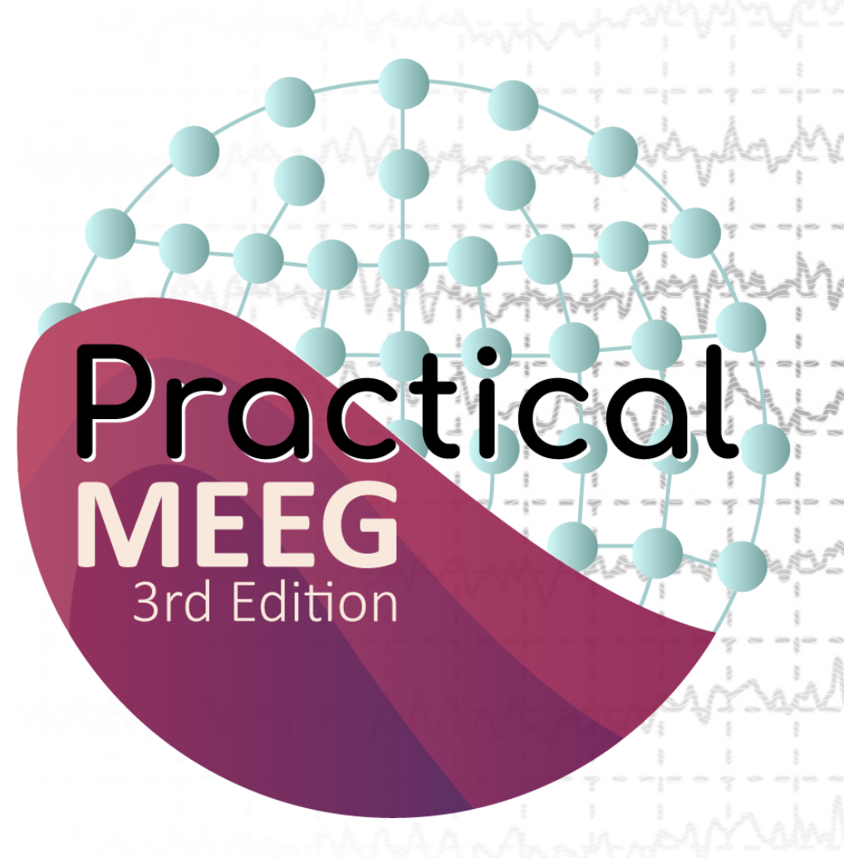
Source estimation with ICA
EEGLAB
Arnaud Delorme, PhD
Romain Grandchamp, PhD
Ramon Martinez-Cancino, PhD
Johanna Wagner, PhD
Notes:
Good afternoon everyone, and thanks joining this online symposium. Today I'm going to present a novel EEGLAB plugin we have developed at the SCCN for computing phase amplitude coupling also referred as PAC. Let's dive first into what is PAC

Slide 2
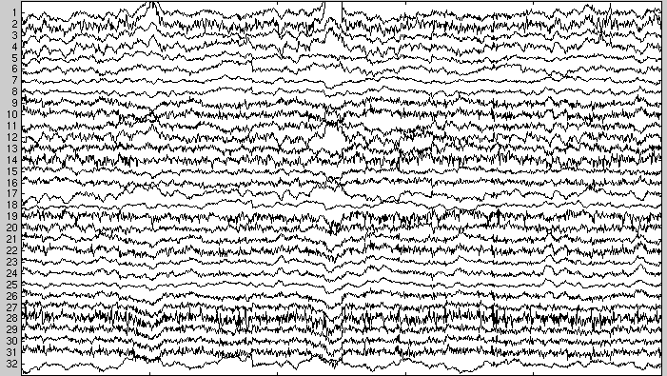
Source modeling
physiological source
electrical current
observed
potential or field
?
Forward Problem
Inverse Problem

Slide 3


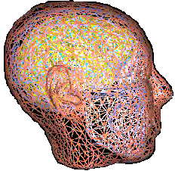
Forward Head Model Problem (well posed)
REQUIRES
Spherical
Model
→ Head Model
  Conductivity values
  Geometry
  → Sensor Locations
  → Possible source distribution
    Magnitudes
    Locations
    Directions
Numerical
Model
  → Solver
Notes:
3

Slide 4
Forward Head Model Problem (well posed)
REQUIRES
Spherical
Model
→ Head Model
  Conductivity values
  Geometry
  → Sensor Locations
  → Possible source distribution
    Magnitudes
    Locations
    Directions
Numerical
Model
  → Solver
Notes:
4

Slide 5
Since there is no unique solution the inverse problem is ill posed
Forward computation
?
Inverse computation

Slide 6
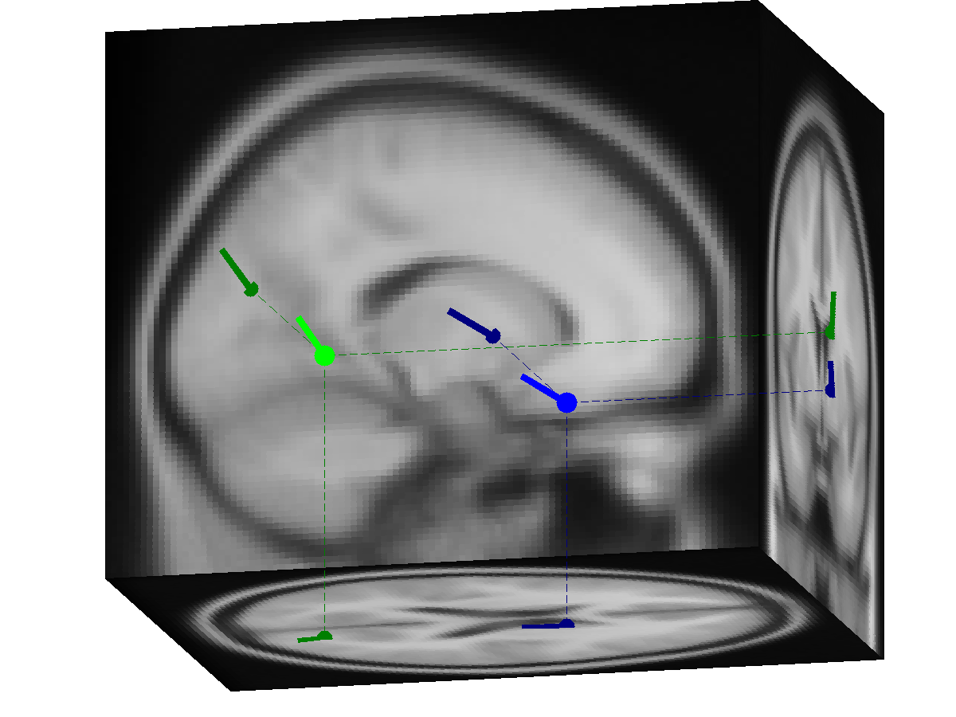
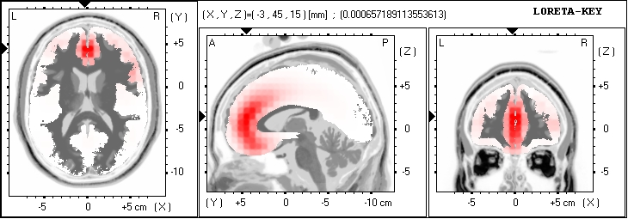
Inverse problem methods (ill posed)
Single and multiple dipole models
  Minimize error between model and measured potential/field
Distributed dipole models
  Perfect fit of model to the measured potential/field
  Minimize an additional constraint on sources
    LORETA (assume a smooth distribution)
    Minimum Norm (L2, minimum power at the cortex)
    Minimum Current (L1, minimum current in the cortex)

Slide 7
Solving the inverse problem
Spatial source filtering
  Scan whole brain with single dipole and compute the filter output at every location
    MUSIC algorithm
    Beamforming (e.g., LCMV, SAM, DICS)
  Perform ICA decomposition (higher-order statistics)
    ICA gives the projections of the sources to the scalp surface, i.e., ‘simple’ maps!
ICA solves ‘the first half’ of the inverse problem

Slide 8

Plan
Part 1: ICA
  What is ICA
  ICA and EEG
  ICA Vs PCA
Part 2: Source Localization of ICA components
  Approach
  Physiological interpretation
Part 3: Practicum

Slide 9
Source estimation with ICA
Part 1: Independent Component Analysis

Slide 10
What is ICA?
Independent Component Analysis is a signal processing method to separate independent sources linearly mixed in several sensors.
ICA for dummies
http://arnauddelorme.com/ica_for_dummies

Slide 11
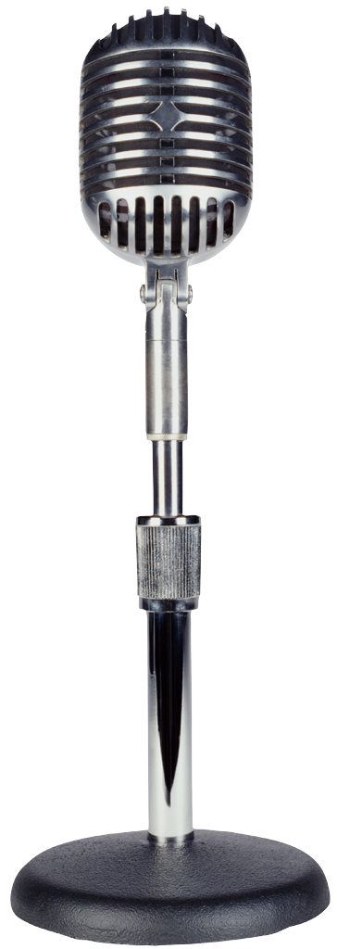








The Cocktail Party Problem
ICA

Slide 12
Electrodes
Cortex
Skin
Skull

Slide 13
Electrodes
Cortex
Local synchrony
Skin
Skull

Slide 14
Electrodes
Local synchrony
Cortex
Skin
Relative Independance
Local
synchrony
Skull

Slide 15



Independent Component Analysis
Mixture of Brain source activity
Cocktail Party

Slide 16
Independent Component Analysis
ICA is a method to recover a version of the original sources by multiplying the data by a unmixing matrix,
U = WX
  X is the data (channels x time)
  U are the ICA source activities (component x time)
  W is the ICA unmixing matrix (components x channels)

Slide 17
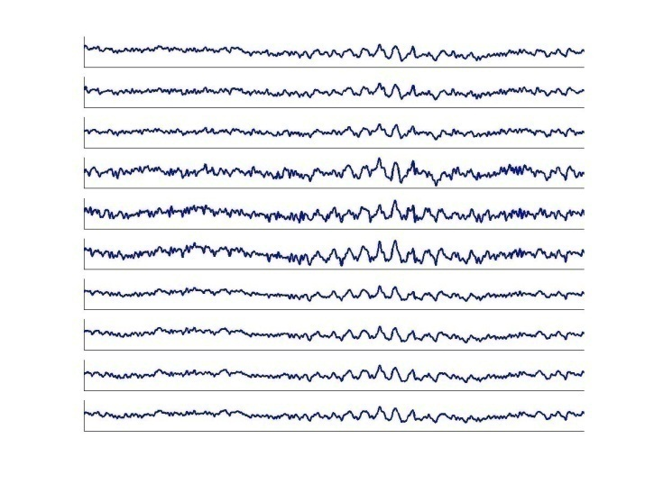
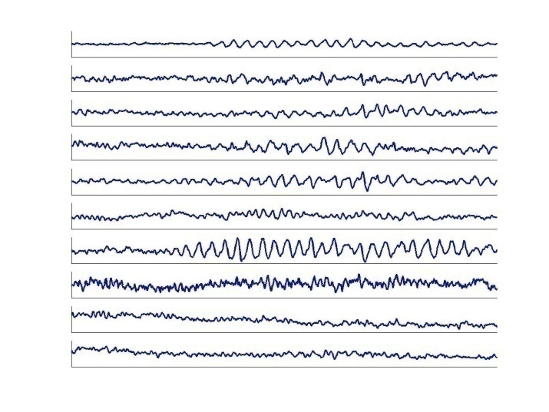
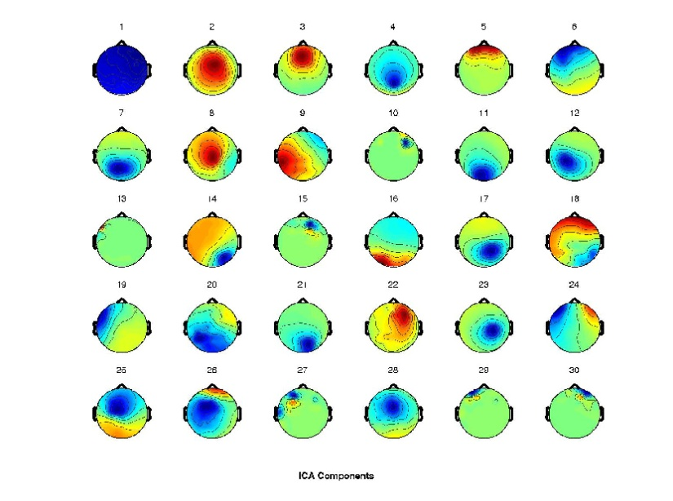
Independent Component Analysis
x = scalp EEG
W = unmixing matrix
u = sources
W*x = u
Components
Channels
ICA
Time
Time
W⁻¹ (scalp projections)
u = sources
x = W⁻¹*u
*

Slide 18
Review: ICA in Plain English
Source activation = unmixing * Channel data
Channel data = mixing (topo) * Source activation
EEG.icaact = (EEG.icaweights*EEG.icasphere) * EEG.data
EEG.data = EEG.icawinv * EEG.icaact

Slide 19
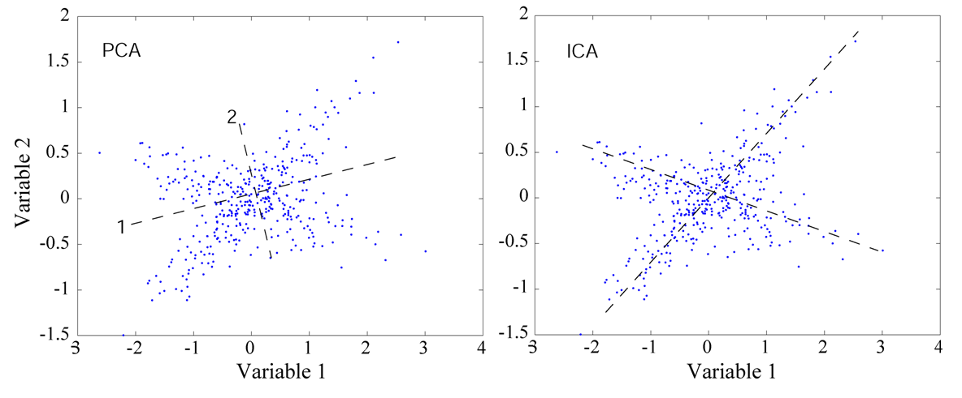
ICA and PCA
ICA is a method to recover a version of the original sources by multiplying the data by an unmixing matrix,
Principal component analysis Independent component analysis
While PCA simply decorrelates the outputs (using an orthogonal mixing matrix), ICA attempts to make the outputs statistically independent, while placing no constraints on the mixing matrix.

Slide 20
Historical Remarks
ICA algorithms
  Herault & Jutten (1986): Seminal paper, neural network
  Bell & Sejnowski (1995): Information Maximization
  Amari et al. (1996): Natural Gradient Learning
  Cardoso (1996): JADE
Applications of ICA to biomedical signals
  EEG/ERP analysis (Makeig, Bell, Jung & Sejnowski, 1996).
  fMRI analysis (McKeown et al. 1998)
Notes:
The “infomax” ICA algorithm we used (Bell and Sejnowski, 1995, 1996) is one of a family of algorithms that exploits temporal independence to perform blind separation. Recently, Lee et al. (1999a) have shown that all these algorithms have a common information theoretic basis, differing chiefly in the form of distribution assumed for the sources.

Slide 21
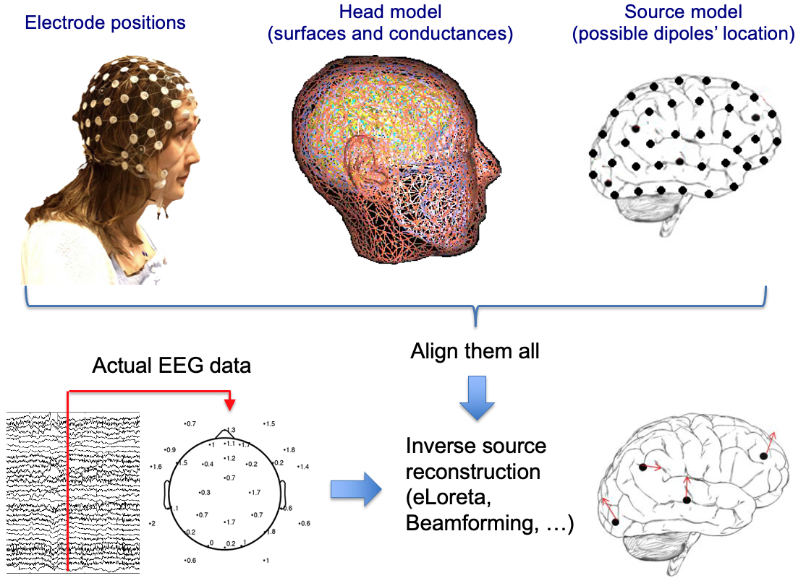

Slide 22
Source estimation with ICA
Part 2: Source Localization of ICA Components

Slide 23
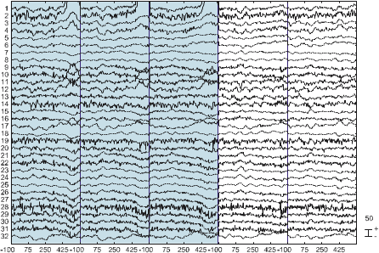
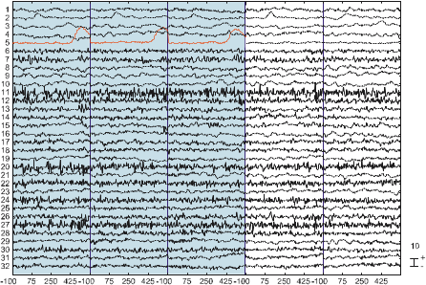
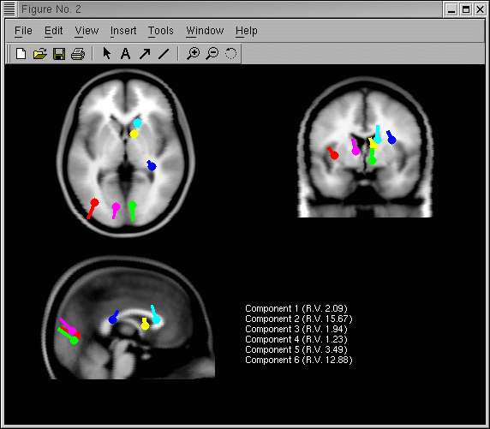
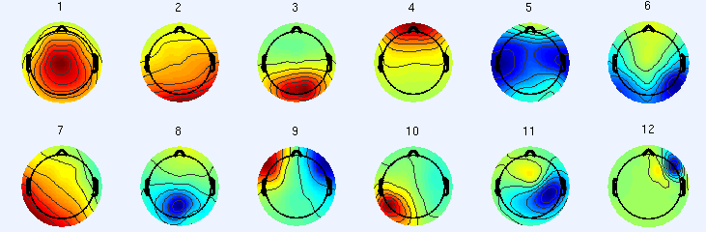
Localization
Two steps process
ICA takes care of unmixing of timeseries
Source analysis takes care of the location
Electrodes
ICA
Localization
Components
Time (ms)
ICA component
Scalp maps

Slide 24

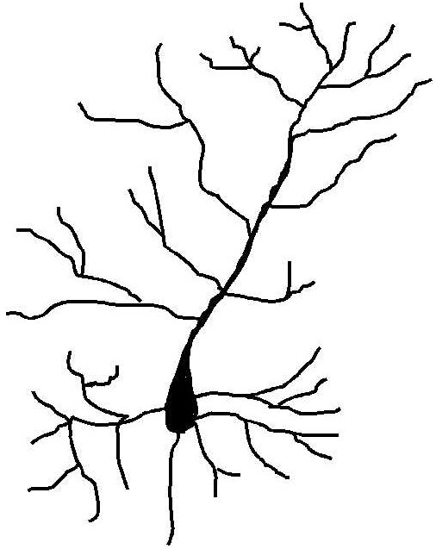
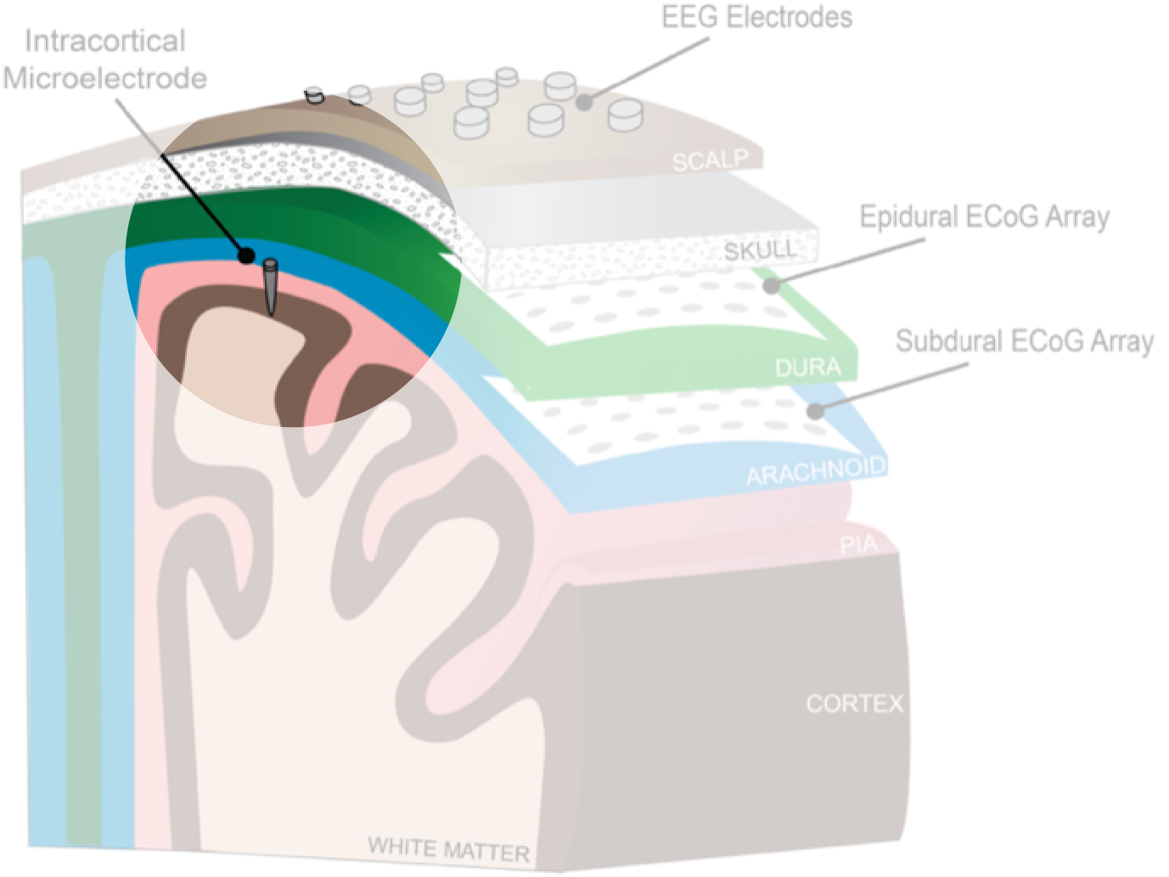
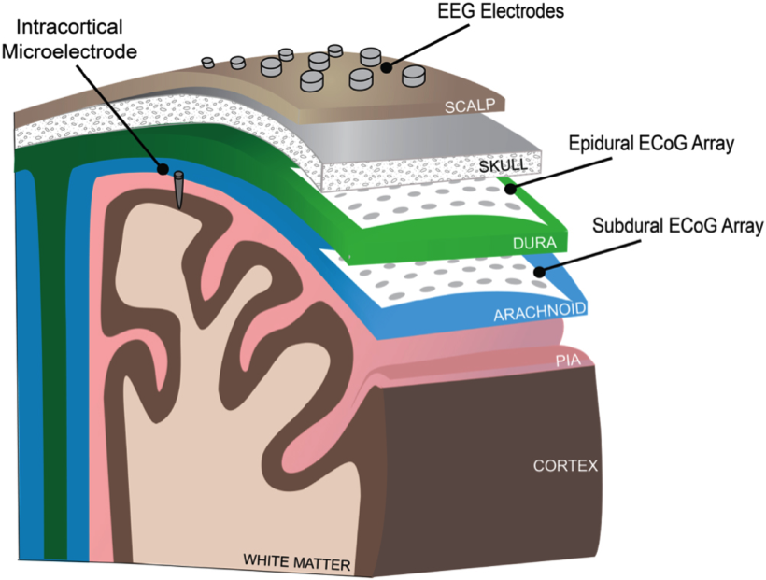
Patch of Cortex Acting as a Dipole
Assumption: components correspond to compact spatial patches (or bilateral patches)
Skull
Notes:
Let's take the example of a single canonical pyramidal neuron. Because of its dendritic architecture, it will likely create its own small electric field around itself by the separation of the cell body potential from that of the apical dendrites (dipole image animation). However, alone, this neuron would not create a field of sufficient magnitude to reach the scalp. But if this neuron oscillates in synchrony with its 100 or 1000 best friends (other neurons animation), then we might have a situation where the activity of this patch of cortex could be detected at the scalp. So, if we add to this cartoon the skull, we can imagine the projection onto it as a concentric ring of activity that is strong in the middle and falling off in magnitude as the distance from the center increases.
If we broaden the scope of this cartoon to include multiple patches of cortex throughout the brain…

Slide 25
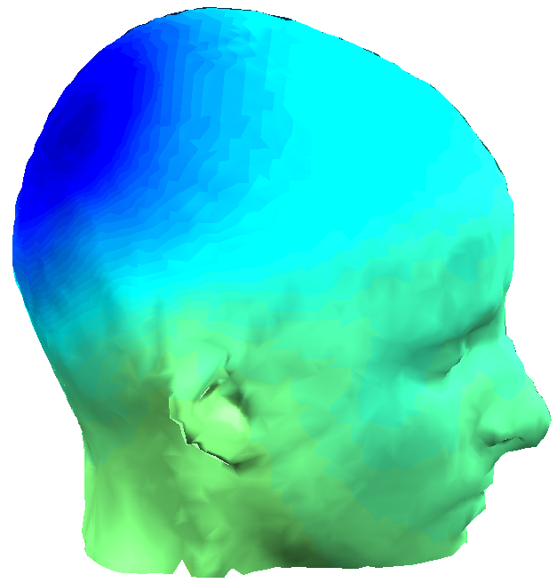
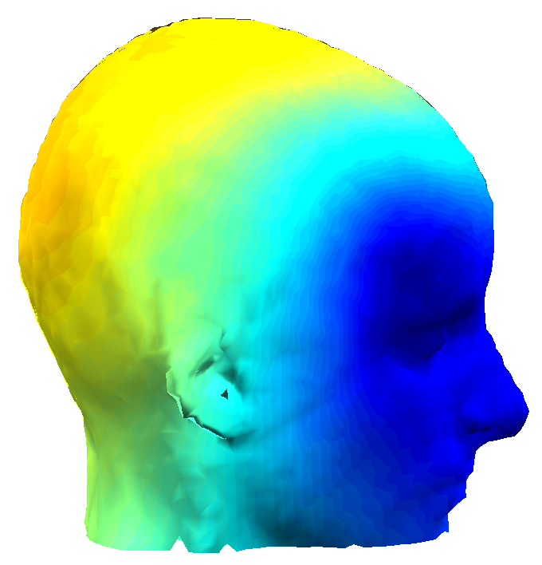
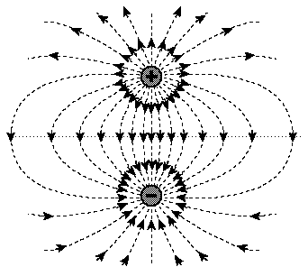
Dipolar Scalp projections
ICA creates a spatial
filter for each temporally
independent source
Notes:
…it might look something like this, which, one can imagine, could result from a dipolar EEG source somewhere in the brain oriented like this (animation). Similarly, a scalp projection like this (animation) would be compatible with a dipole oriented as such (animation). Of course these dipole images are grossly not to scale, but if we look at these equivalent dipole locations in an averaged MRI image (animation), we can see more precisely where a dipole might reside in the brain to create the observed scalp projections. so the local fields (animation), while very much less impressive when drawn slightly closer to scale, may, in fact, have a broad field that carries easily through the brain matter and finally through the skull and scalp to be recorded by EEG electrodes. This idea relates to ICA because what ICA actually does is to (animation) 'create a spatial filter for each temporally independent source'. For many of these components that ICA separates, the corresponding scalp projection, which looks like one of these model heads, can be modeled with a single or in some cases a symmetrically bilateral dipole inside the brain volume.
When we see ICA components with this kind of a pattern, we tend to regard it as a plausible single source of electromagnetic activity in the brain.
Now that we have a broad overview of the rationale behind using ICA…

Slide 26
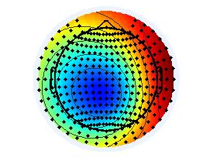
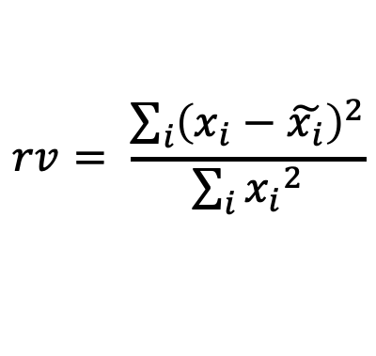


Computing Residual Variance
Actual IC map ($xi$)
Dipole projection ($\tilde{xi}$)
$$rv= \frac{\sum_{i}{{\left(x_{i}−\tilde{x_{i}}\right)}^{2}}}{\sum_{i}{{x_{i}}^{2}}}$$

Slide 27
Source estimation with ICA
Part 3: Practicum

Slide 28
Co-register electrodes with model

Slide 29
Getting ready
Load dataset 'wh_S01_run_01_preprocessing_data_session_1_out.set’

Slide 30
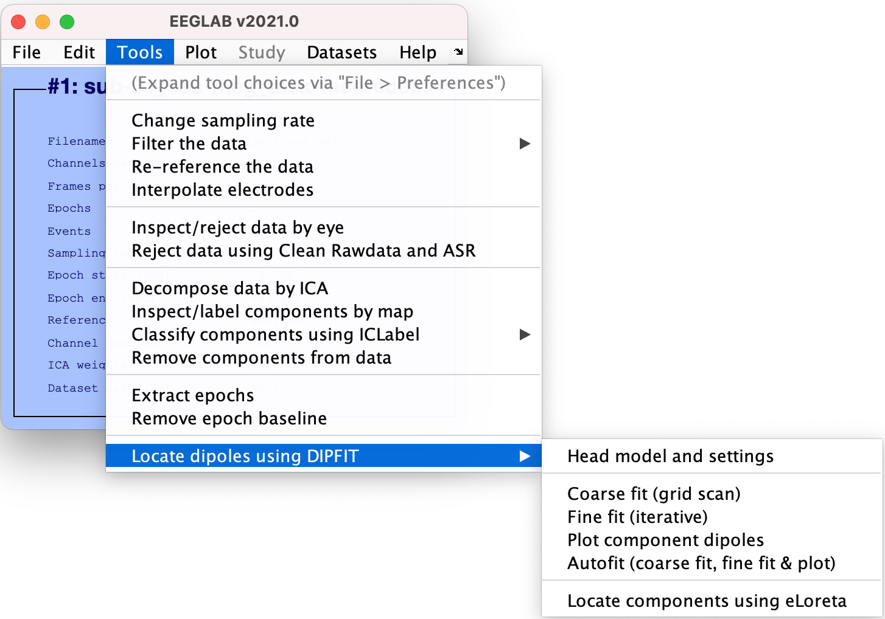
DIPFIT

Slide 31
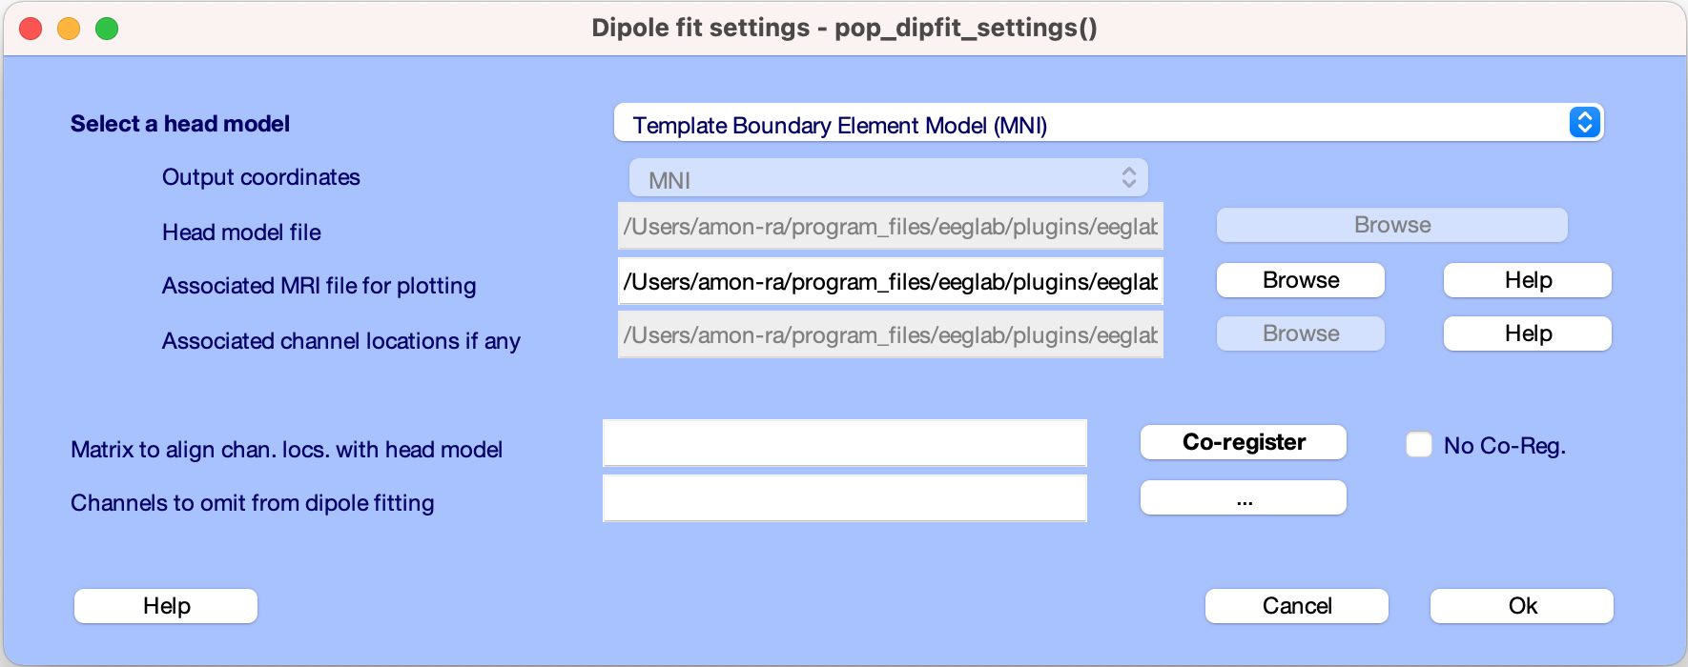
Head model and settings

Slide 32
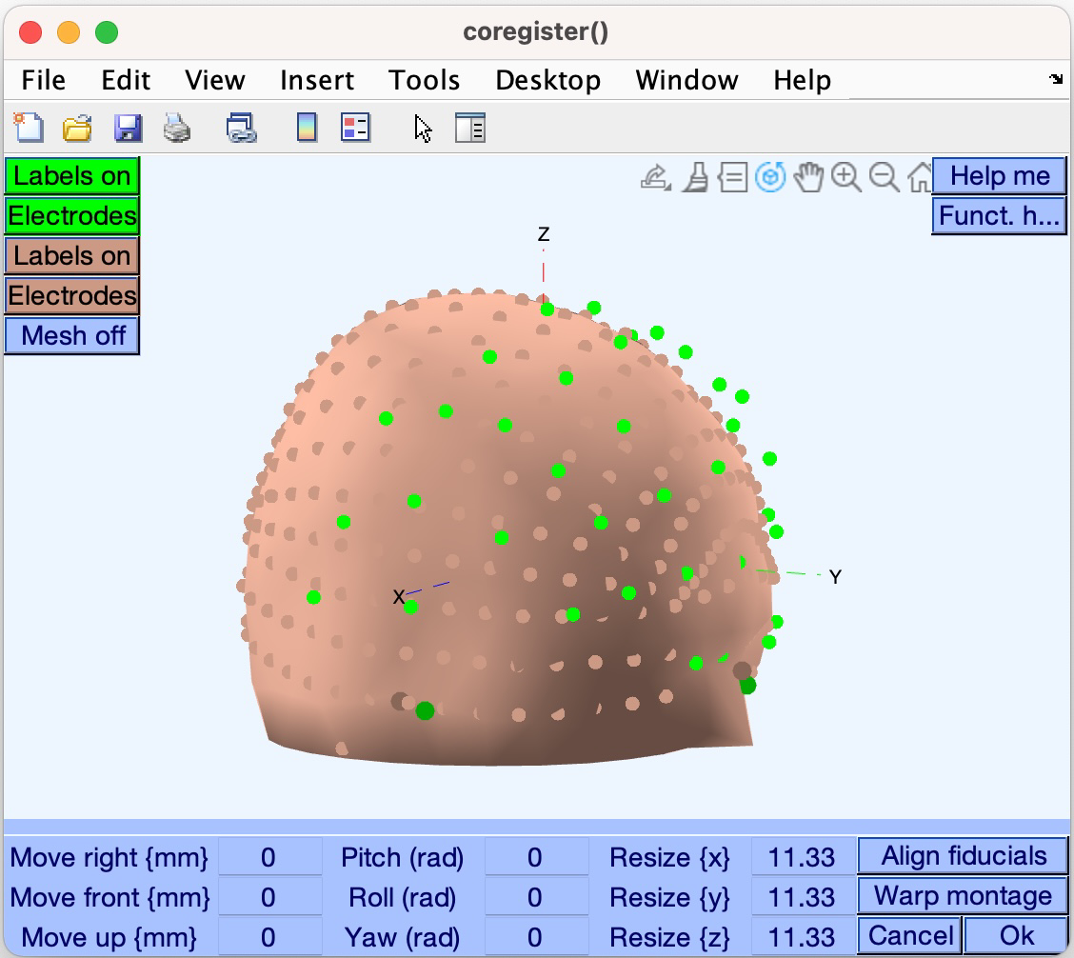
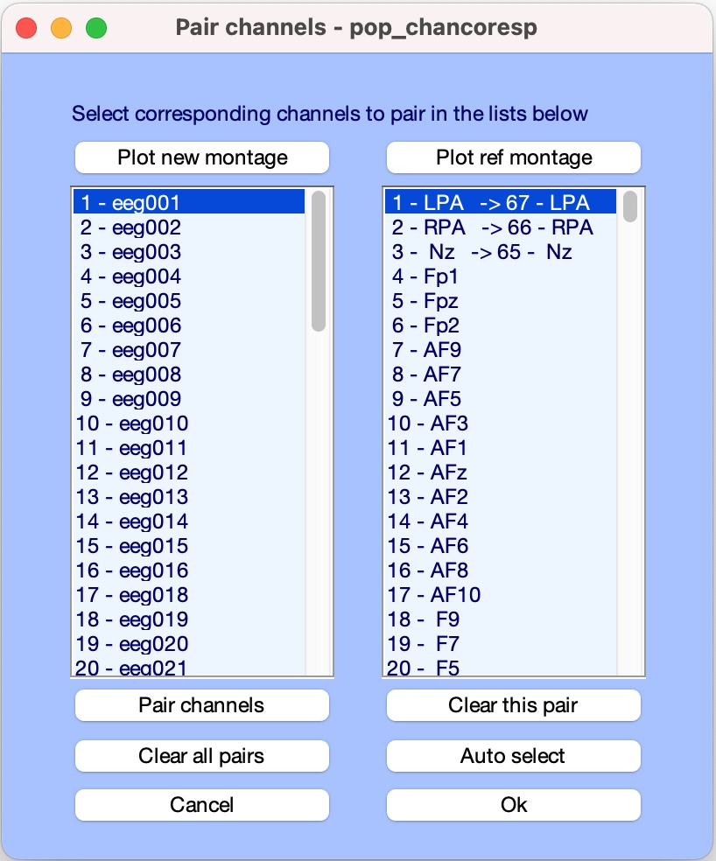
Warp to standard montage
Check matching of data electrodes to the head model electrodes
stats toolbox may be required for warping!

Slide 33
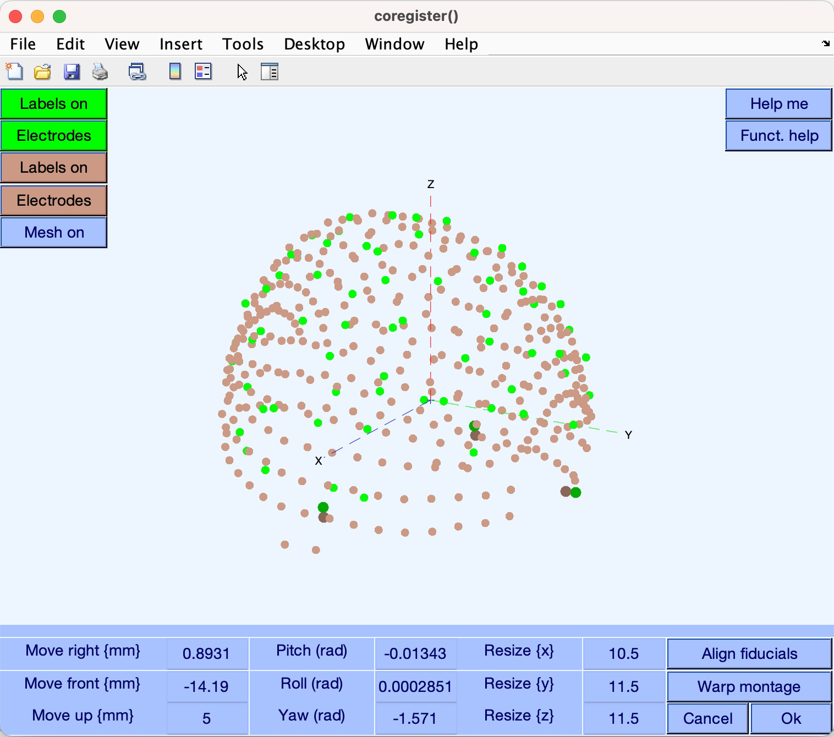
Check Coregistration with Model

Slide 34
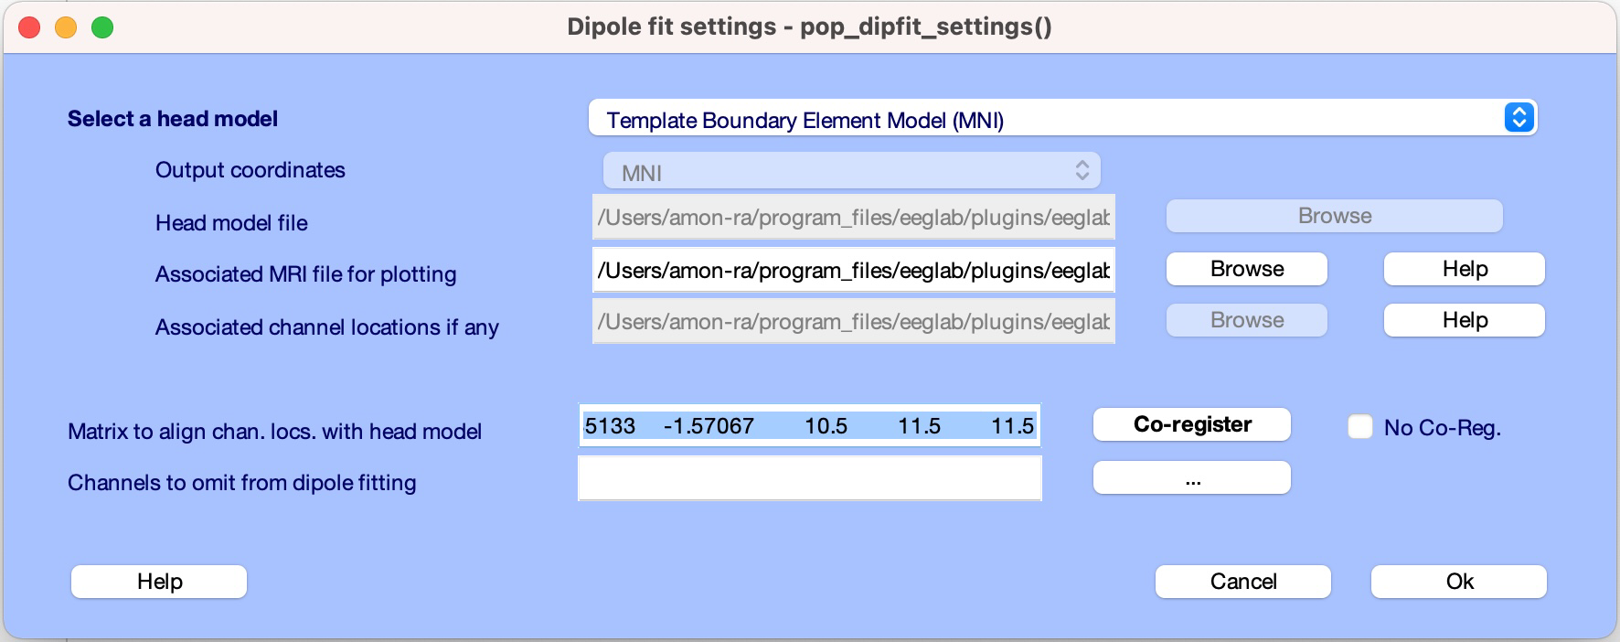
Confirm Transformation

Slide 35
EEG.dipfit structure
>> EEG.dipfit
ans =
struct with fields:
hdmfile: ‘… eeglab/plugins/eeglab2021.0/plugins/dipfit/standard_BEM/standard_vol.mat'
mrifile: ‘… eglab/plugins/eeglab2021.0/plugins/dipfit/standard_BEM/standard_mri.mat'
chanfile: ‘… eeglab/plugins/eeglab2021.0/plugins/dipfit/standard_BEM/elec/standard_1005.elc'
chansel: [1 : 11]
coordformat: 'MNI'
coord_transform: [0.8931 -14.1933 5 -0.0134 2.8513e-04 -1.5707 10.5000 11.5000 11.5000]
Notes:
0.893083 -14.1933 8.43918 -0.0134307 0.000285133 -1.57067 9.96352 11.569 13.7472

Slide 36
Autofit, plot dipoles, fine fit

Slide 37
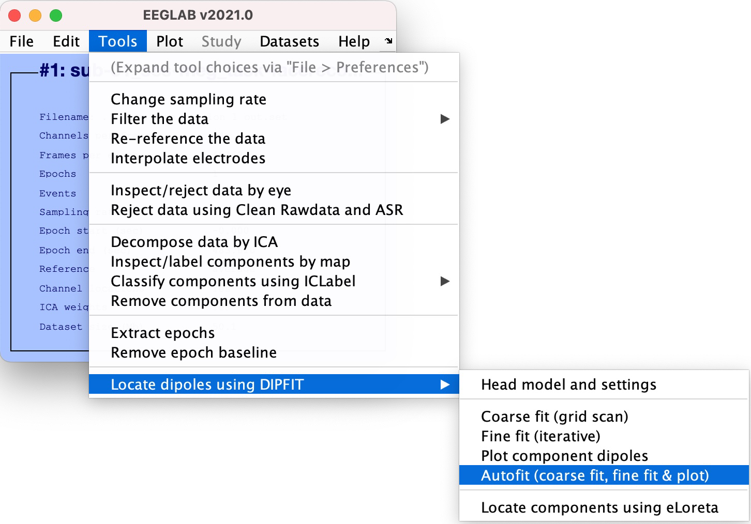
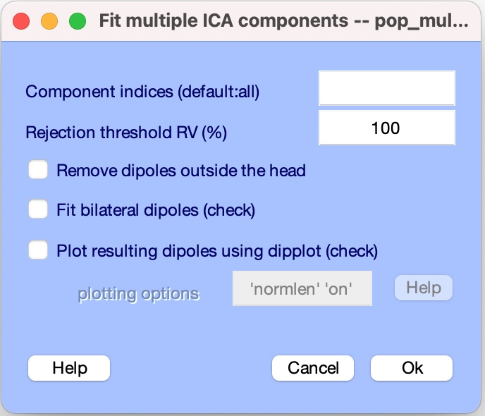
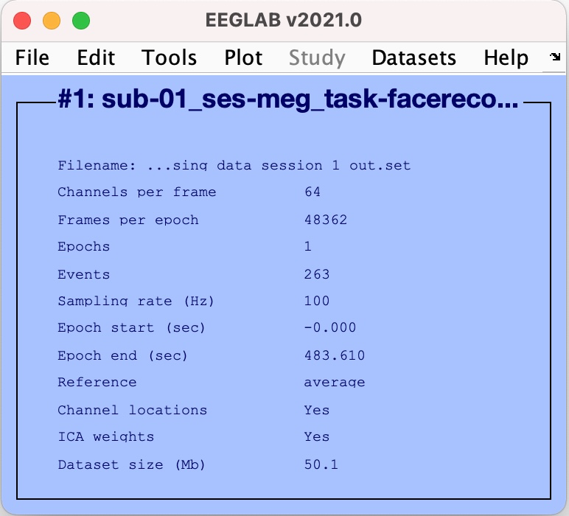
EEG.dipfit structure

Slide 38
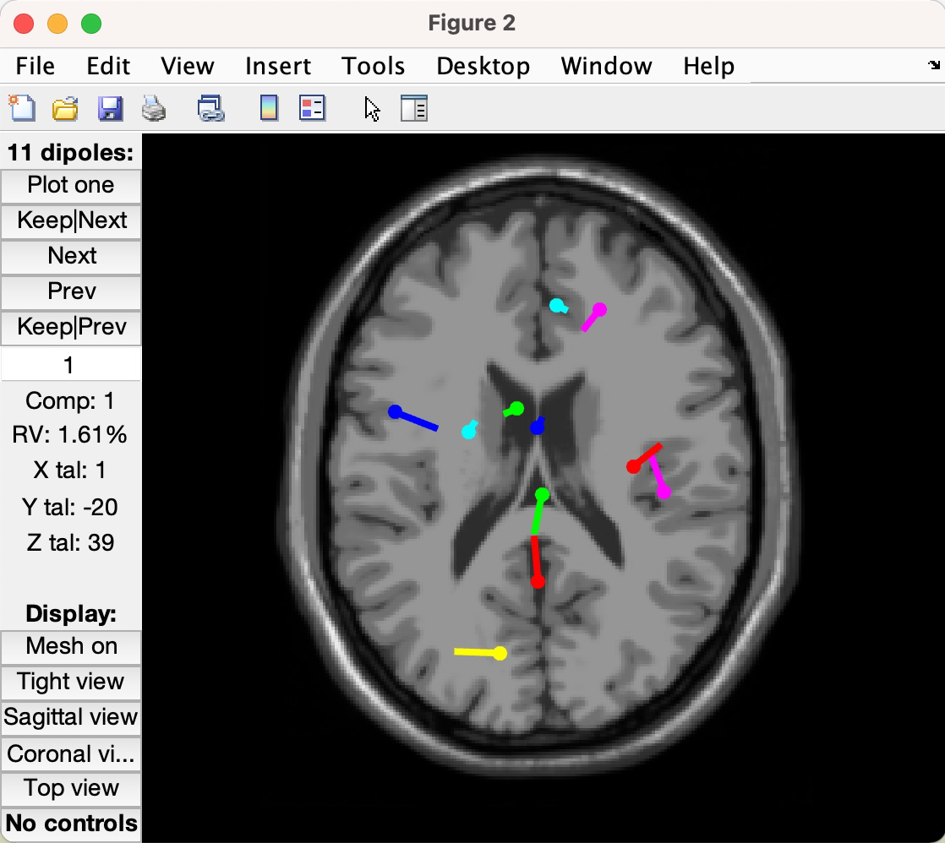
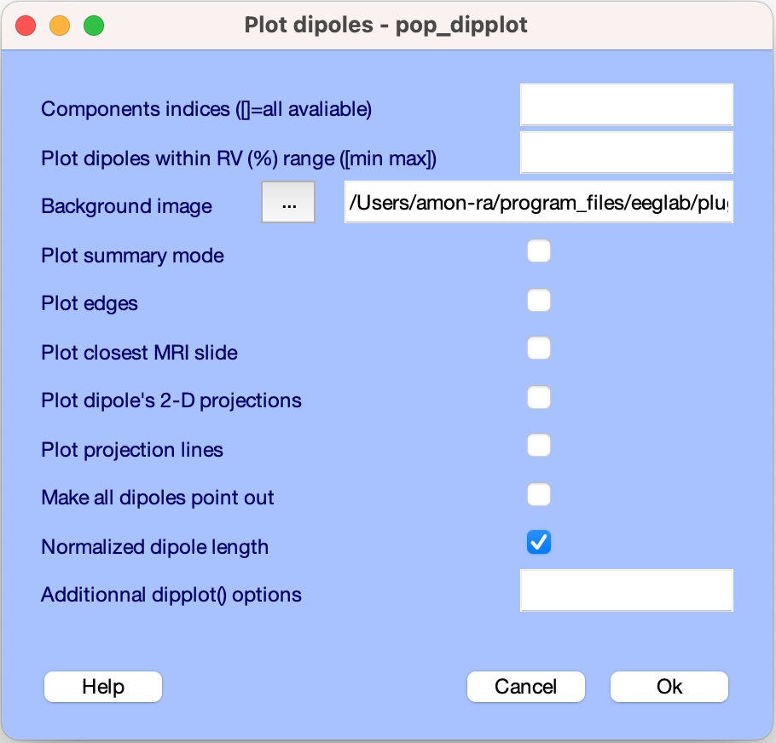
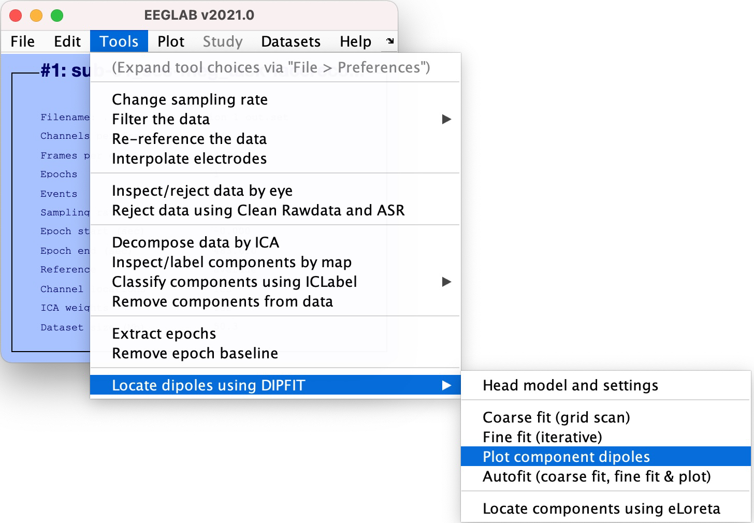
Plot Dipoles

Slide 39
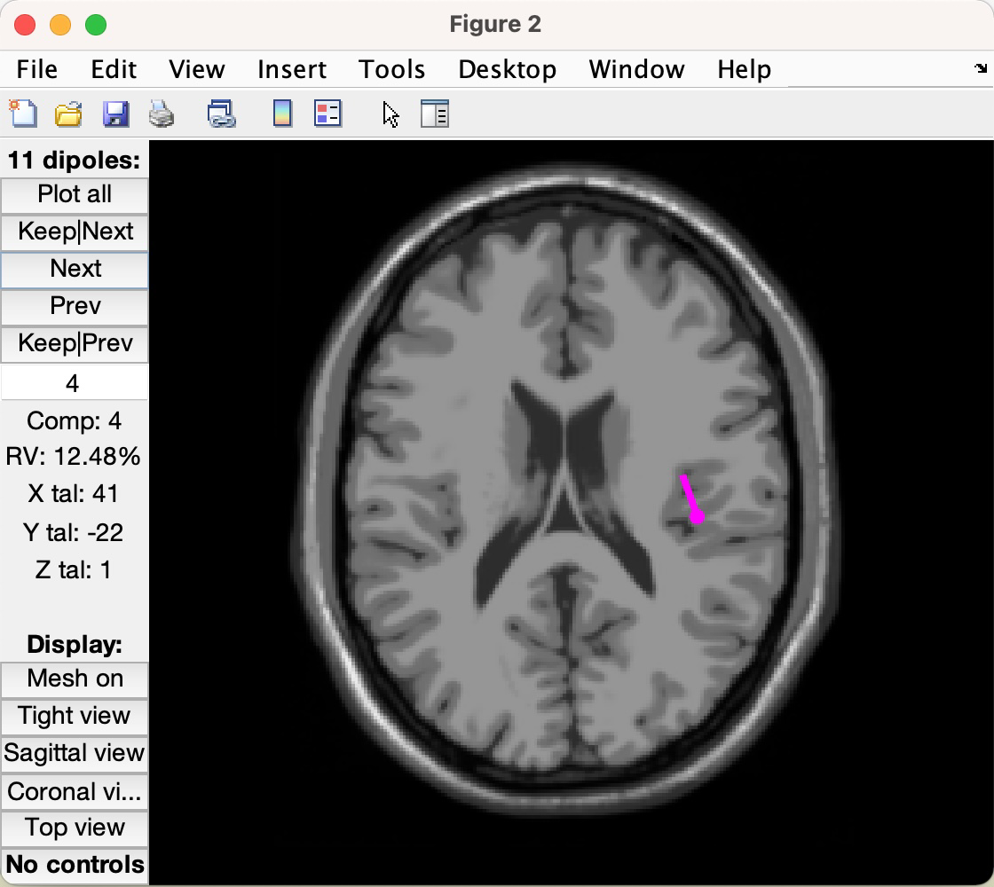
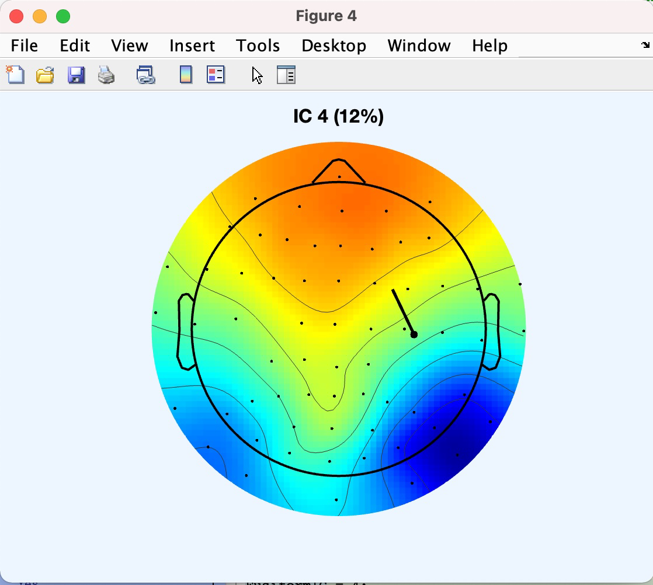
Plot Dipoles
IC Map associated to dipole 4

Slide 40
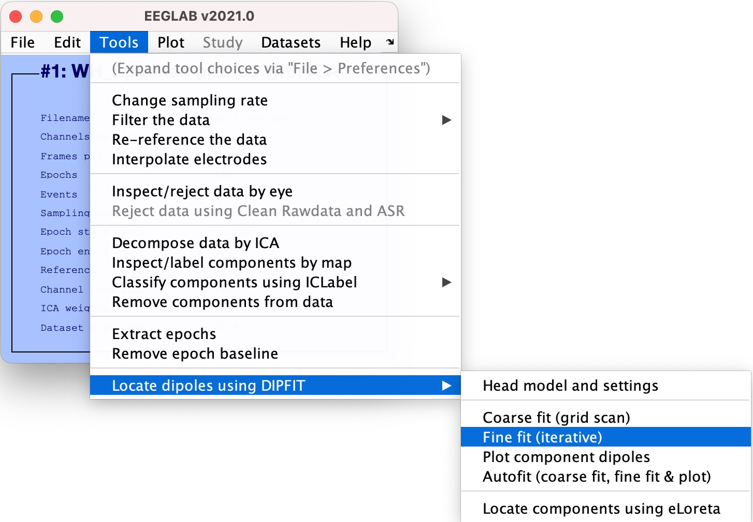
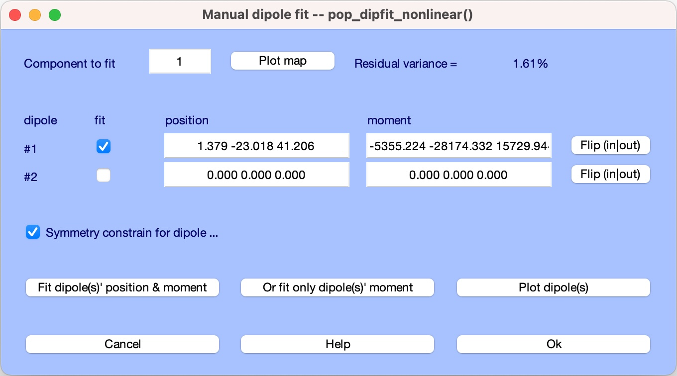
Fine fit options in DIPFIT: Fitting two dipoles

Slide 41
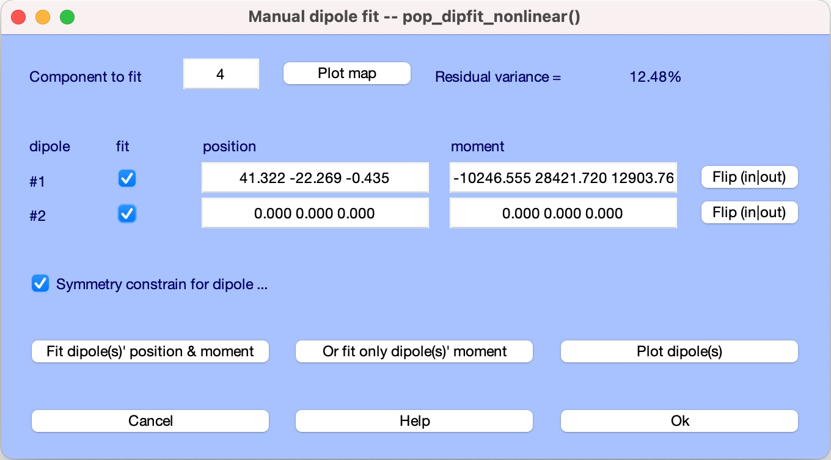
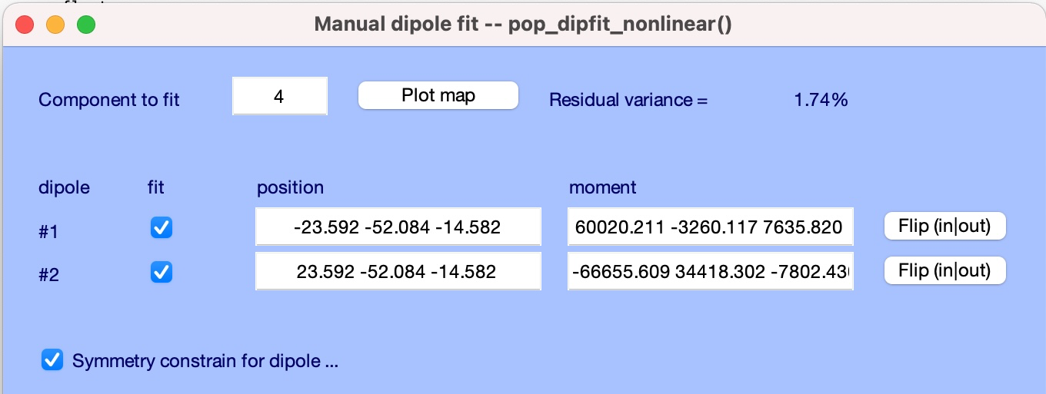
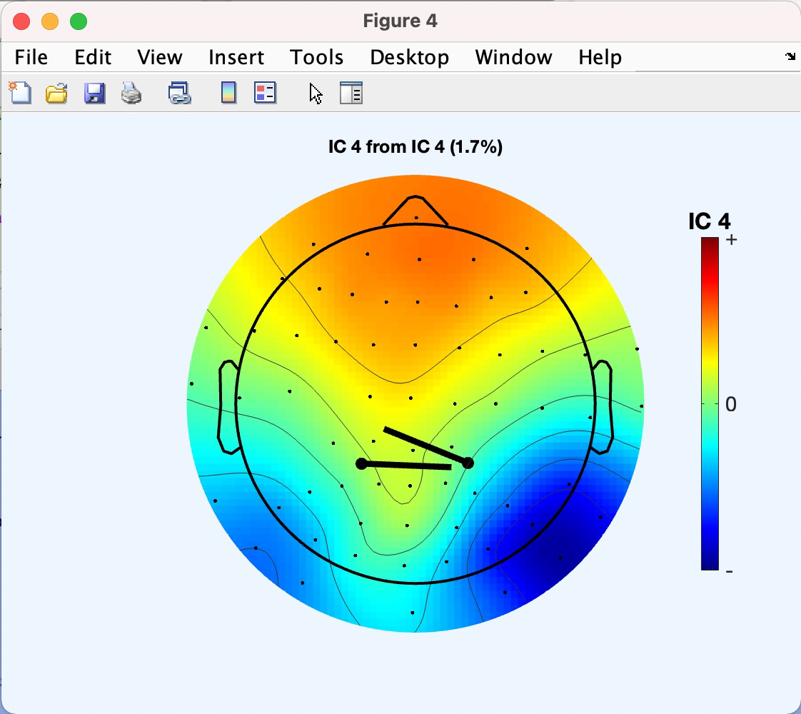
Fine fit options in DIPFIT: Fitting two dipoles

Slide 42
Hands-on
Load .set file using menu item File > Load existing dataset
‘ds000117_pruned/derivatives/meg_derivatives/sub-01/ses-meg/meg/wh_S01_run_01_preprocessing_data_session_1_out.set’
Select BEM model using menu item
Tools > Source localization using DIPFIT > Head model and settings
Fine fit dipole number 3 using menu item
Tools > Source localization using DIPFIT > Component dipole autofit

Slide 43
eLORETA

Slide 44
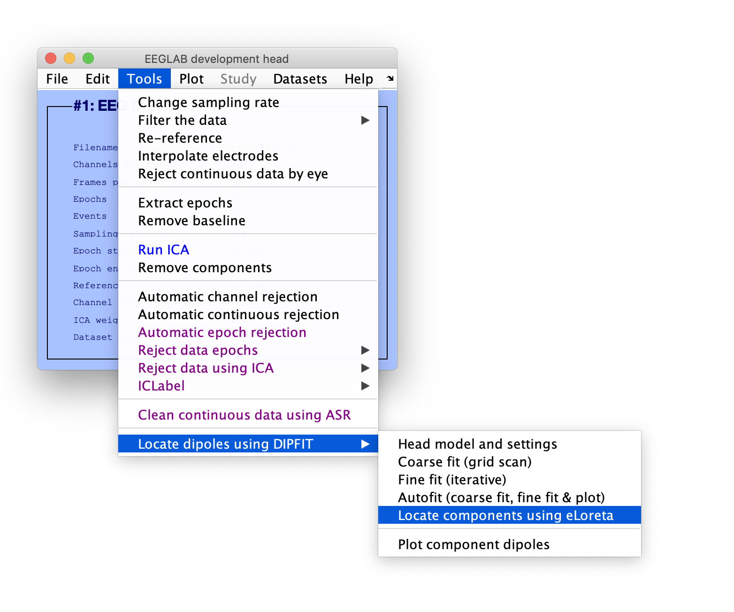

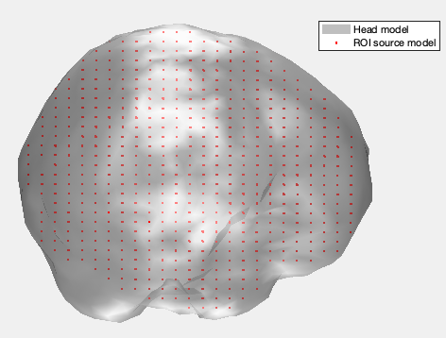
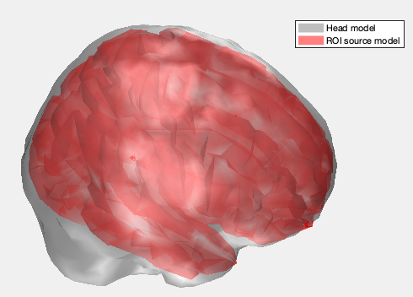
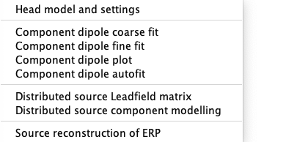
Distributed source localization in DIPFIT
Volume
Surface

Slide 45
Distributed source localization in DIPFIT
Volume
Surface
Electrode <-> Head model
Head model <-> Source model (blue)

Slide 46
Distributed source localization in DIPFIT
Volume
Surface
Electrode <-> Head model
Head model <-> Source model (red)

Slide 48
Distributed source localization
(eloreta or LCMV beamforming)
Volume
IC scalp topo
Surface

Slide 49
Hands-on
Compute Leadfield matrix using menu item
Source localization using DIPFIT > Compute Leadfield matrix
Compute eLoreta solution for component 3 using menu item
Source localization using DIPFIT > Distributed Source Component Modeling

Slide 50
Realistic fit

Slide 51
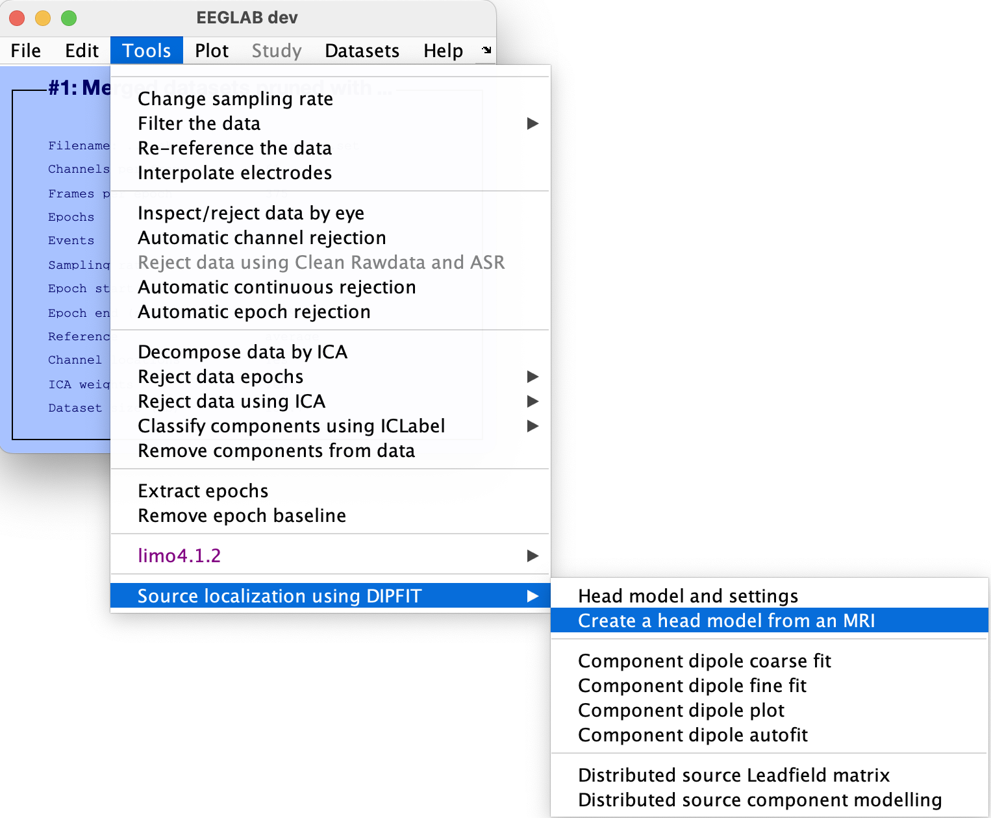
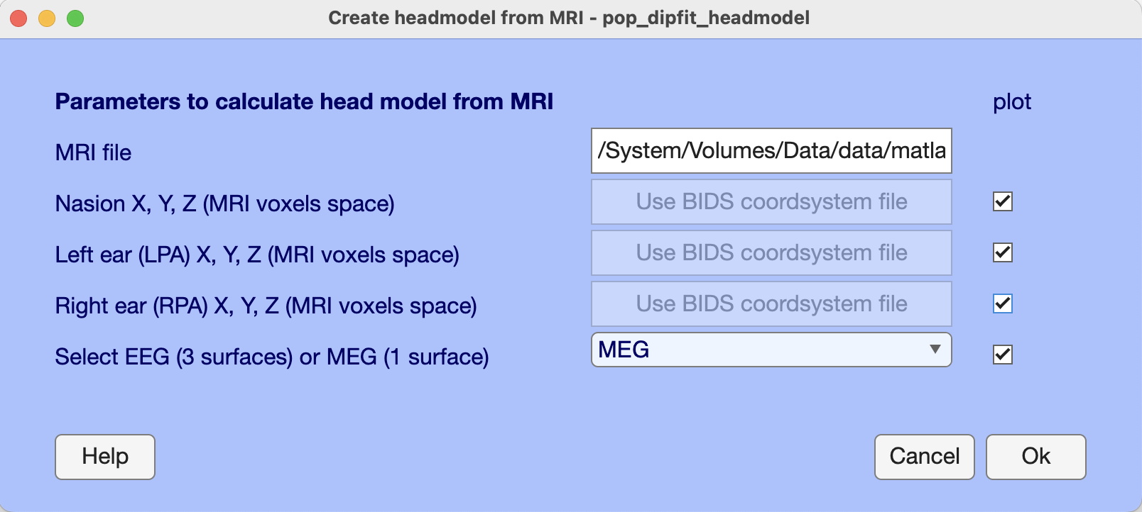
use file “ds000117_pruned/sub-01/mri/anat/sub-01_ses-mri_acq-mprage_T1w.nii.gz” (re-download from OpenNeuro if the file is empty)

Slide 52
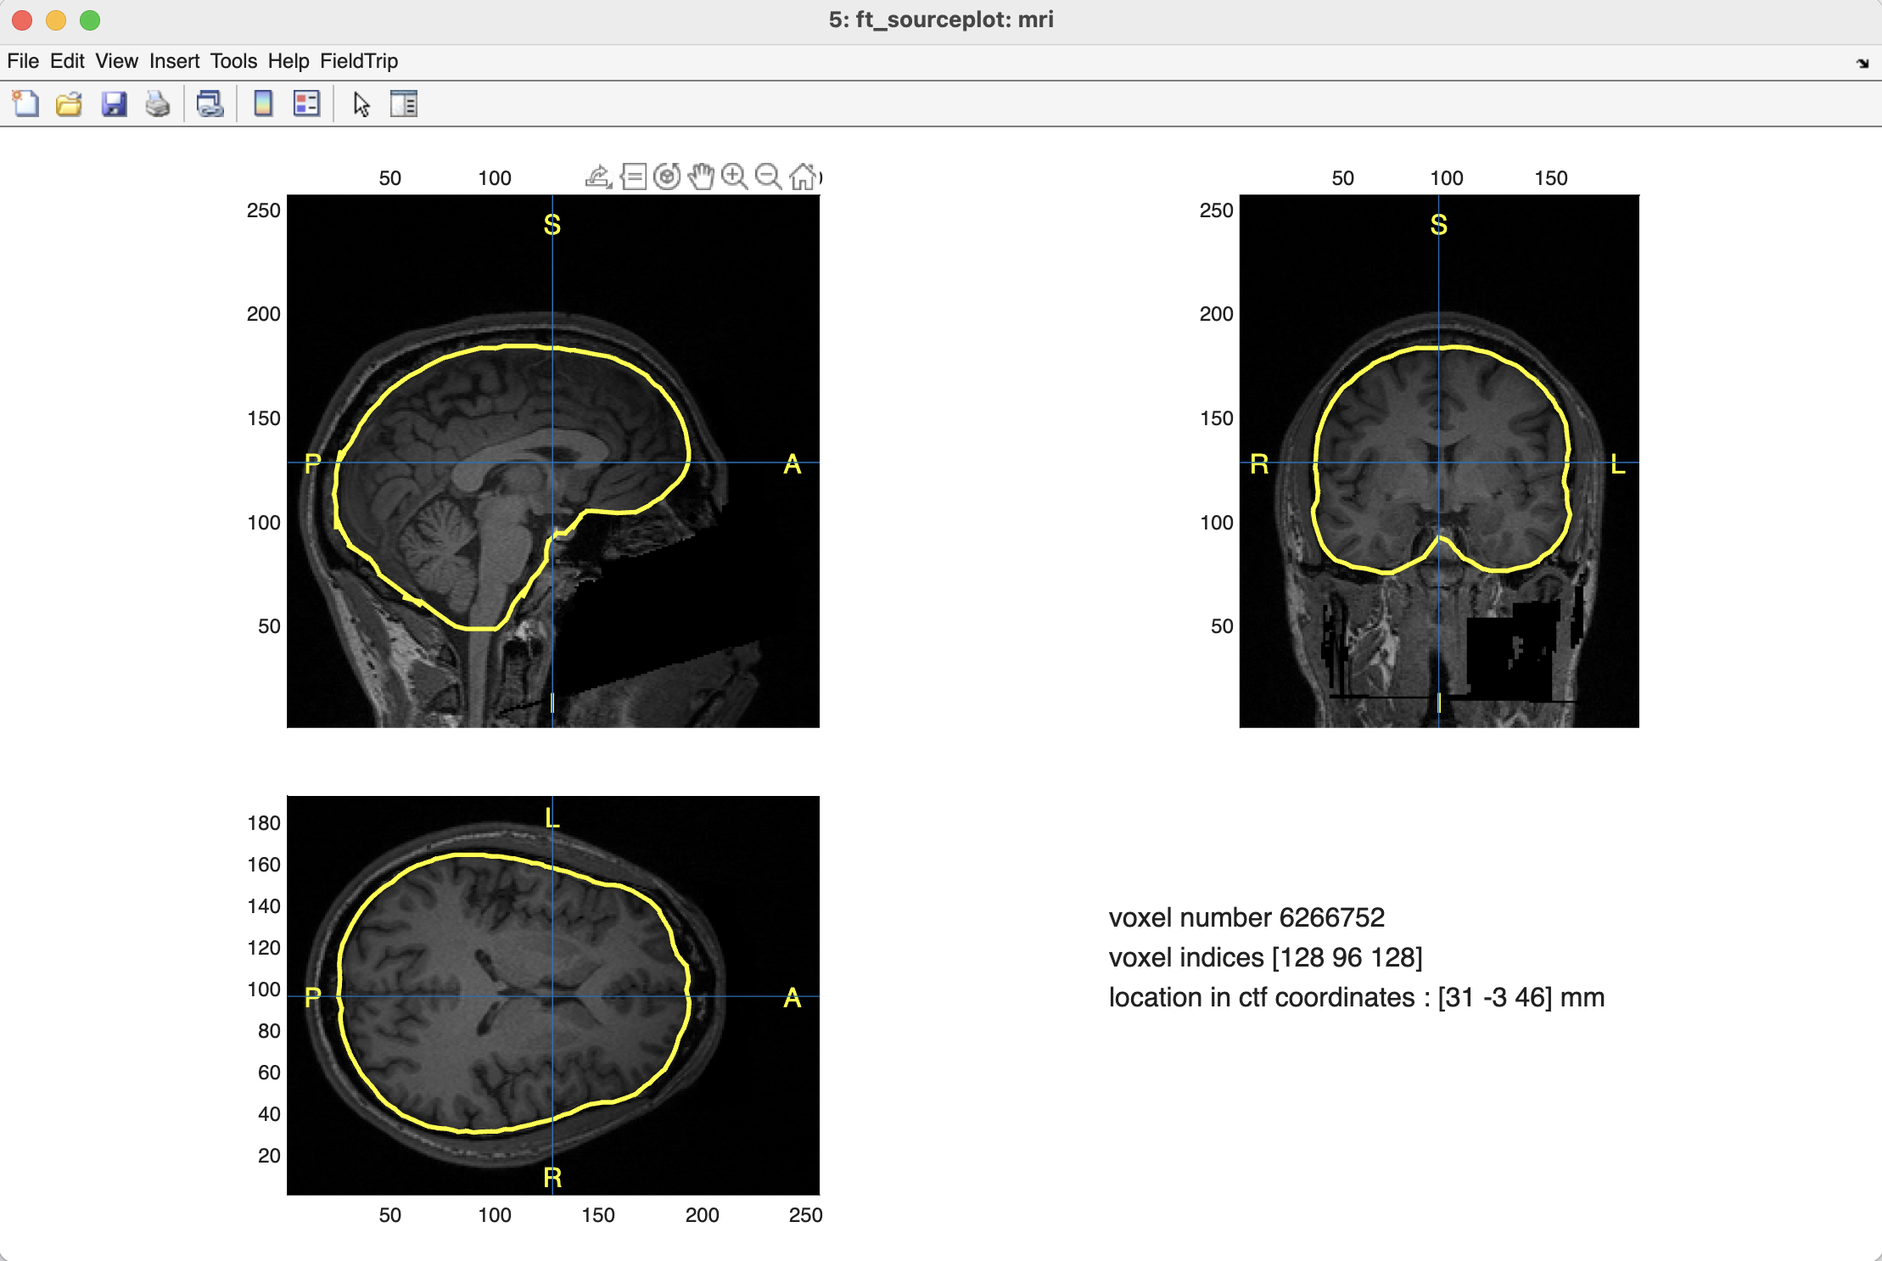

Slide 53
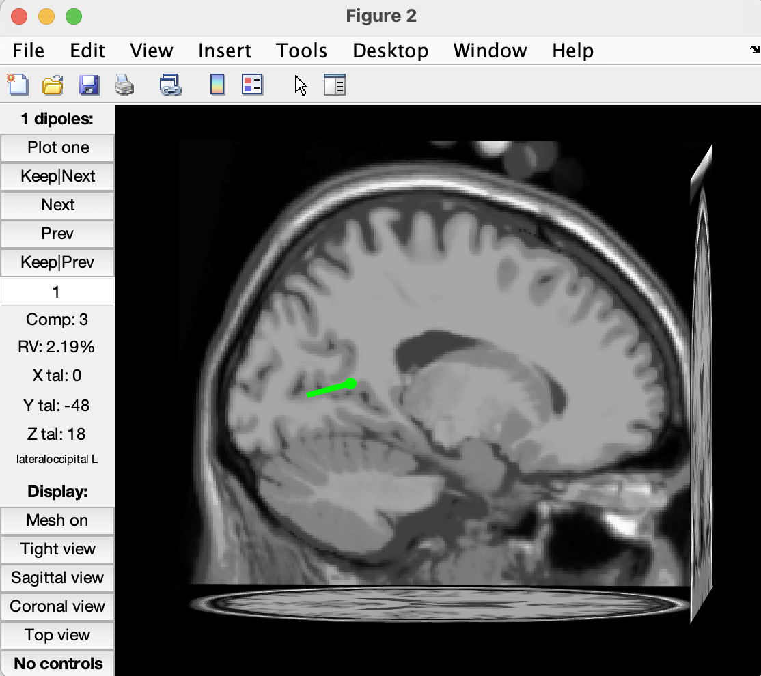

Template
Subject’s brain
The subject brain does not have the ideal orientation. His anatomical MRI of subject should be normalized to MNI first using SPM to fix this issue (and also allow potential group analysis).

