Slide 1
Enhancing Concrete Compressive Strength Prediction through Machine Learning Techniques
Hossein Babaei¹, Mohammad Zamani¹, Soheil Mohammadi¹
Hossein Babaei
High-Performance Computing Laboratory, School of Civil Engineering, University of Tehran, Iran
SE-01404-22-045
D2S3 - SE22

Slide 2
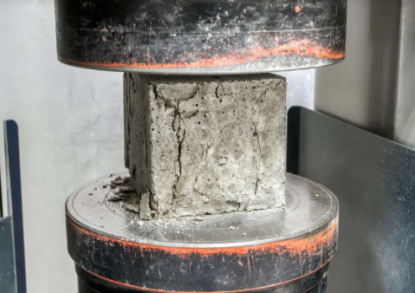
Introduction
The Problem: "Destructive" Testing of Concrete Mixtures
  Time consuming
  Costly
  Requires labor
The Solution: A Predictive "Non-Destructive" Approach
  Use Machine Learning (ML) to create predictive frameworks that forecast strength before mixing.

Slide 3
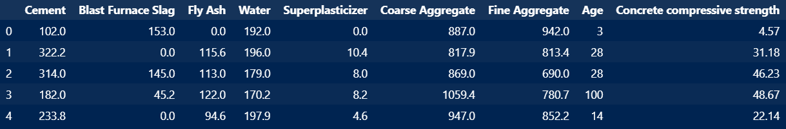
Dataset
Dataset:
  Using the standard benchmark dataset from Yeh [1].
  1,030 concrete mix instances.
  Inputs (8): Cement, Slag, Fly Ash, Water, Superplasticizer, Aggregates, and Age.
  Target (1): Concrete Compressive Strength (CS).
1. I.-C. Yeh, Modeling of strength of high-performance concrete using artificial neural networks. Cement and Concrete Research, 1998. 28(12): p. 1797-1808.

Slide 4
Literature Review
Previous Studies:
  Artificial Neural Networks (ANN)
  Random Forest (RF)
  AdaBoost
  Support Vector Regression (SVR)
  Gradient Boosting Regression Tree (GBRT)
  XGBoost
  CatBoost
  Deep Neural Networks (DNN)

Slide 5
Literature review
The Gap?
Data Splitting Concept
Training Set
  Used for learning the relationships within the data and estimating the model's true parameters.
Validation Set
  Used for testing and evaluating different model hyperparameters (e.g., model architecture, learning rate) to select the best-performing model and prevent overfitting.
Test Set
  Used only for the final assessment of the chosen model's performance on unseen data.
  It is not involved in any part of the training, tuning, or model selection procedures.

Slide 6

Train-Validation-Test Split
Weakness?
  The Impact of Imbalanced Data on Model Testing
    No Outlier Data in the Test Set
    All Outlier Data is in the Test Set
  Why is it more important in engineering datasets?
    The total number of data points is often low, as acquiring each one can be costly and time-consuming.
Notes:
1- procedure be che nahve
2- Overfit ruye validation set, mesal az shabake asabi architecture
3- Tafavote 2 ta scenario ke yek study 10 ta dade sakht ha dakhele test set beran, ya un yeki study 10 ta hich kodoum naran

Slide 7
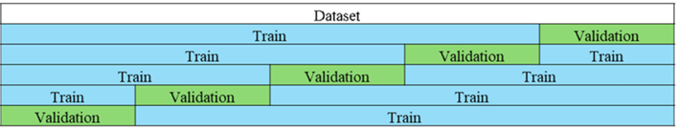
K-Fold Cross Validation
Problem?
  Absence of the test set
Notes:
1- procedure
2- inke dar nahayat ru hamin validation migan error cheghadr bude

Slide 8
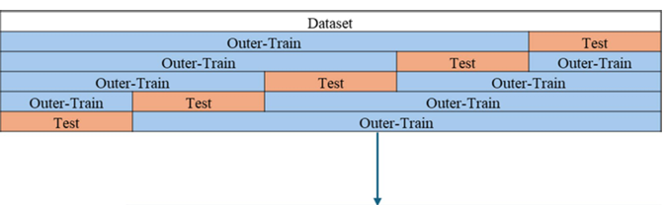
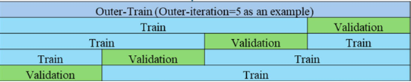
Nested Cross Validation
Solution
  Positive Aspects
    Each data point appears in the test set exactly once.
    Includes all train, validation, and test sets.
    Fair assessment of studies
  Negative Aspects
    Computational Cost
Why is it not well-known in Computer Science?

Slide 9
Models
Deep Neural Network (DNN)
eXtreme Gradient Boosting (Xgboost)
Random Forest (RF)
Light Gradient Boosting Machine (LGBM)

Slide 10
Results:
Comparative performance of machine learning models with varying numbers of hyperparameter sets (t).

Slide 11
Feature Importance
V1 (Cement), V2 (Blast Furnace Slag), V3 (Fly Ash), V4 (Water), V5 (Superplasticizer), V6 (Coarse Aggregate), V7 (Fine Aggregate), and V8 (Age).

Slide 12
Conclusion
Xgboost as best performing model
Increasing the number of hyperparameter sets does not result in meaningful performance enhancement
Age as the most important input feature

Slide 13
What else can you see in the paper?
More about the dataset
Hyperparameter tuning ranges for each model
More Results
More details about models and implementation

Slide 14
Thanks for you time and consideration
Q&A?

