Slide 1

Disaster Diplomacy:
Balancing research ethics, open science, and perceived security
http://www.disasterdiplomacy.org
Ilan Kelman
University College London
ilankelman.org Instagram Bluesky

Slide 2
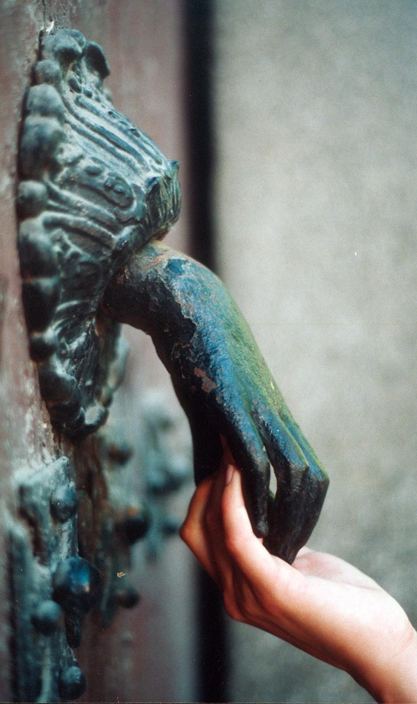
Disaster diplomacy
How and why disaster-related activities do and do not influence peace and conflict.

Slide 3
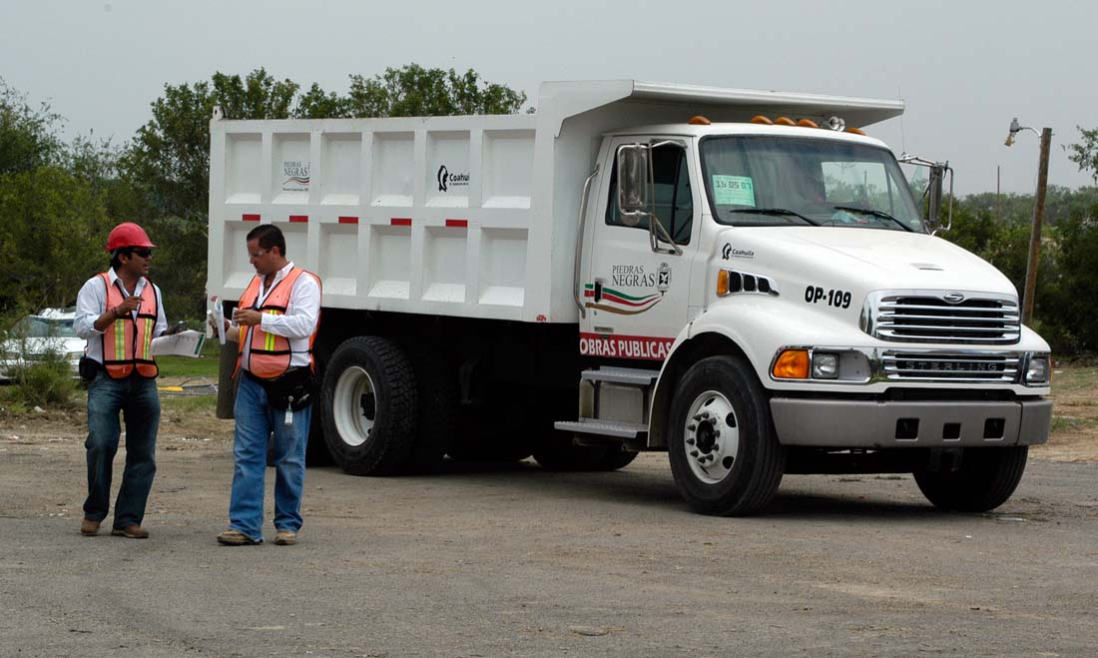
Disaster diplomacy
Can catalyze but not create diplomacy.
Over the short-term.

Slide 4
Disaster diplomacy examples
    Place:
    e.g. North Korea, Greece-Turkey.
    Hazard:
    e.g. tsunami, haze.
    Vulnerability:
    e.g. casualty id, discrimination.

Slide 5
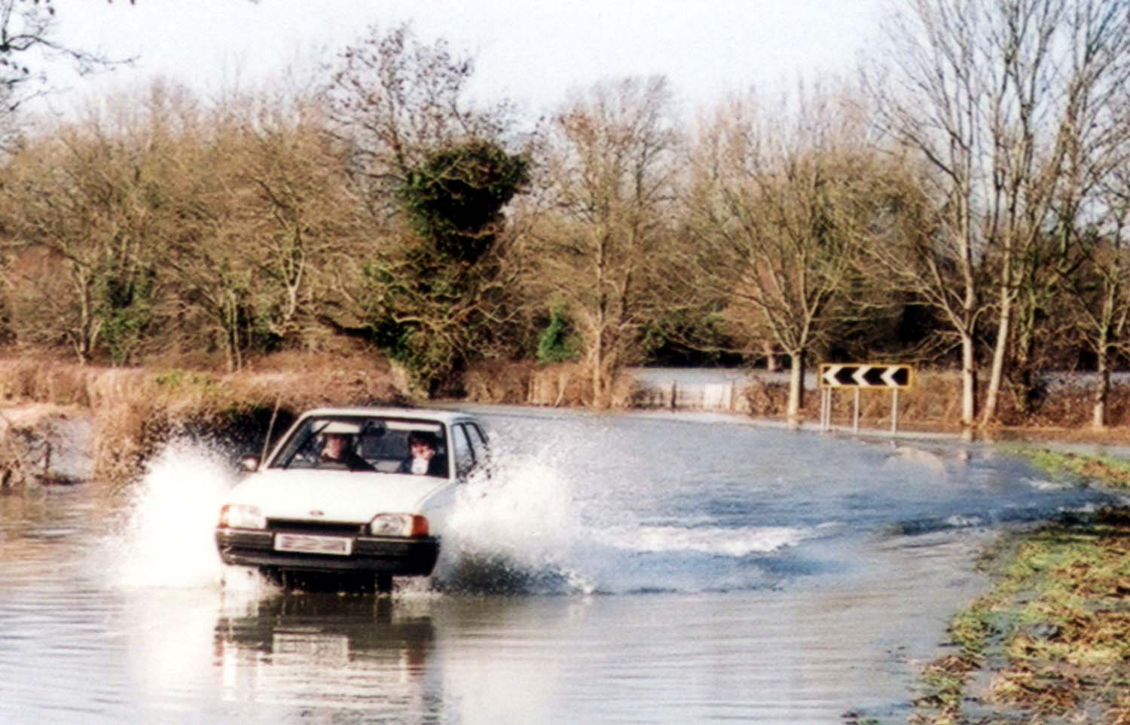
Research ethics

Slide 6
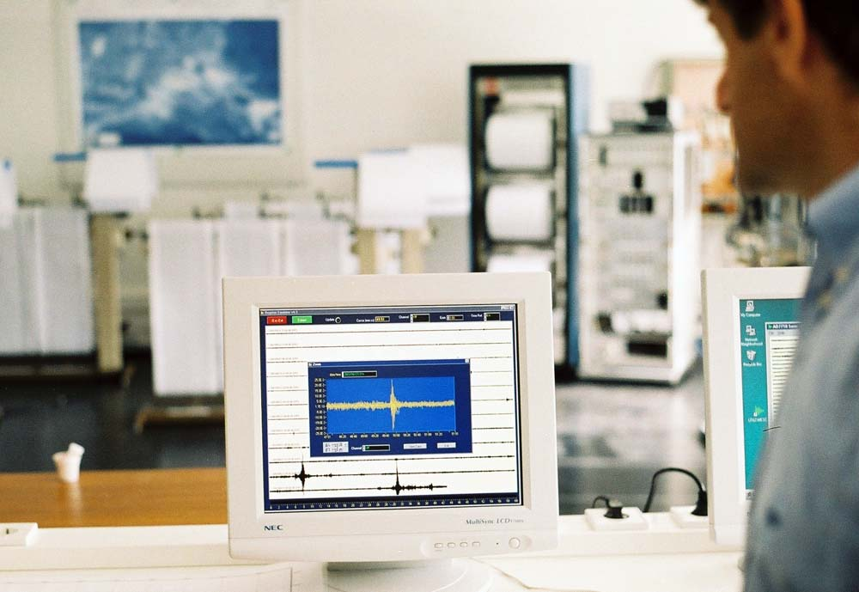
Open science

Slide 7
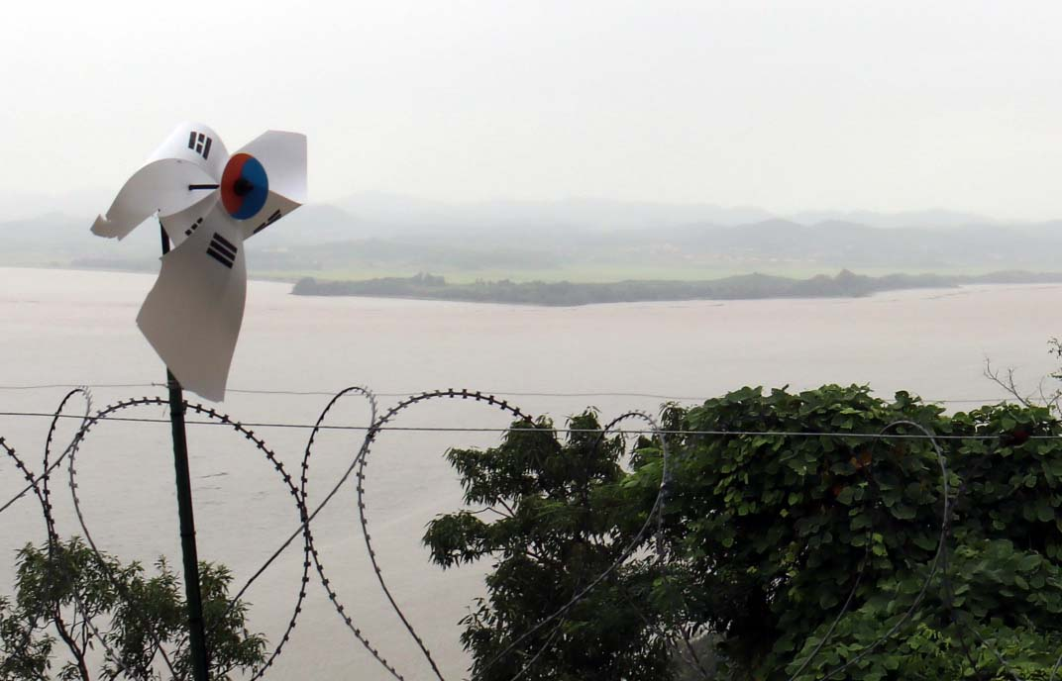
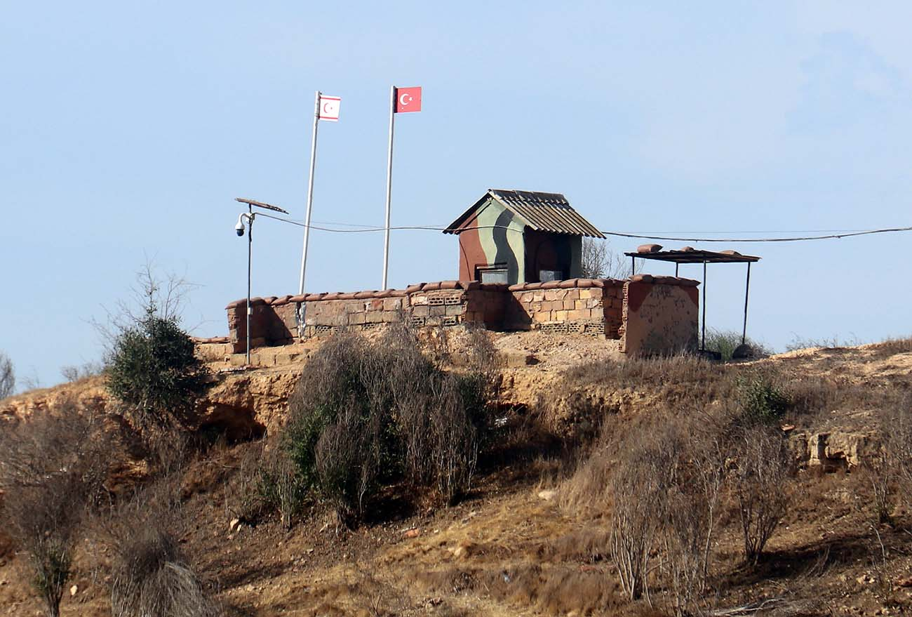
Perceived security

Slide 8
Disaster diplomacy and secrecy
  Example: Antarctic Treaty System and climate change impacts on it.
  Outcomes beyond the agreement for effective and aimed for diplomacy?
  Climate change impacts disasters environment diplomatic agreements?
Security
clearance
required

Slide 9
Ethical open science for disaster diplomacy
  Science results and science risks.
  Using and restricting open science.
  Security types – for whom or what?

Slide 10
Disaster Diplomacy:
Balancing research ethics, open science, and perceived security
http://www.disasterdiplomacy.org
Ilan Kelman
University College London
ilankelman.org Instagram Bluesky

