Slide 1


Open Science for All: Skills & Community
Accelerating the Pipeline:
Building Equitable Global Research
Pathways in Secondary Education
Janna Mino
Cleveland, Ohio, USA
Accelerating the Pipeline: Building Equitable Global Research Pathways in Secondary Education | Janna Mino, Hathaway Brown School | 2025

Slide 2

Our Context
When should we open science to the next generation?
  Hathaway Brown School
  The Science Research & Engineering Program (SREP)
  ABCs:
    All-inclusive
    (sense of) Belonging
    Confidence
  Shaping the next generation of scientists and engineers to embrace and practice open science
Accelerating the Pipeline: Building Equitable Global Research Pathways in Secondary Education | Janna Mino, Hathaway Brown School | 2025
Notes:
Hathaway Brown is an all girls school located in Cleveland, Ohio.
Our science research and engineering program began in 1998 with the goal of engaging more girls in STEM. My students work as scientists and engineers on independent multi-year research projects under the mentorship of STEM researchers in northeast Ohio, such as at Case Western Reserve University, NASA Glenn Research Center, and more.
Our goal is simple - we strive to be inclusive of all students interested in STEM, and as girls we especially want to make sure they feel a sense of belonging and grow their confidence.
These promising students are the next generation of scientists, engineers, and leaders in STEM - and I believe that now is exactly when they need to be exposed to open science so that they can bring these practices to their careers, so Open Science is at the foundation of our curriculum.

Slide 3
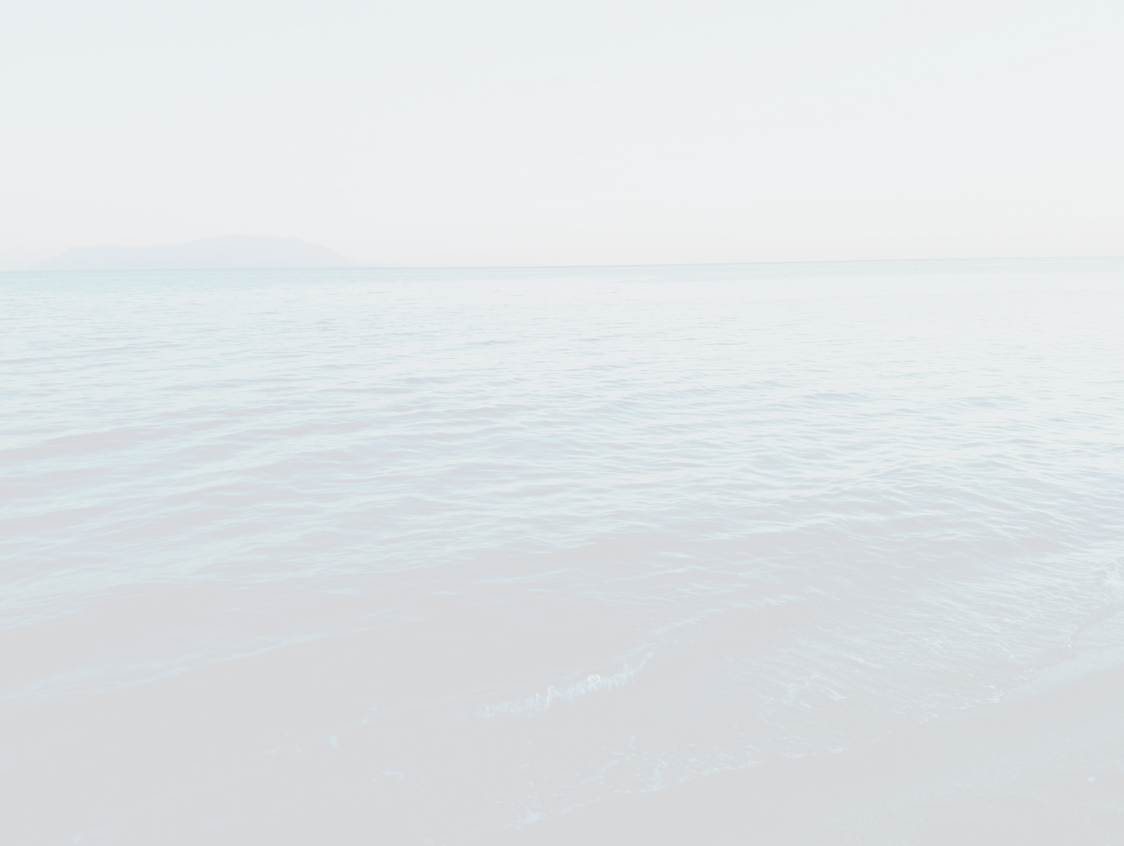
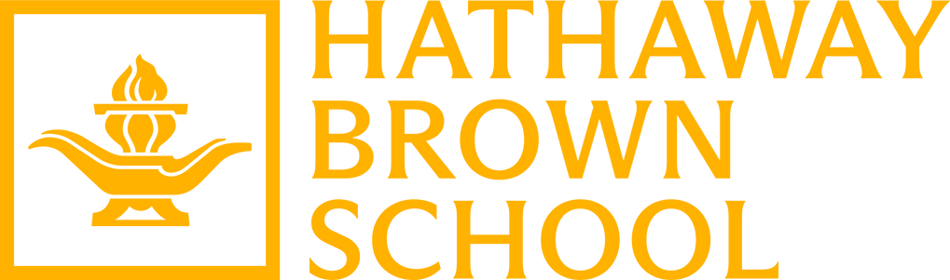
What is happening to research opportunities for my students?
Intentions & Ripples
  “...restoring a gold standard for science to ensure that federally funded research is transparent, rigorous, and impactful, and that Federal decisions are informed by the most credible, reliable, and impartial scientific evidence available” (Executive Order, May 23, 2025).
  “...the 2024 NIH Public Access Policy requires Author Accepted Manuscripts accepted for publication in a journal, on or after July 1, 2025, to be submitted to PubMed Central upon acceptance for publication, for public availability without embargo upon the Official Date of Publication” (NIH Public Access Policy).
Accelerating the Pipeline: Building Equitable Global Research Pathways in Secondary Education | Janna Mino, Hathaway Brown School | 2025
Notes:
This year there are 85 students in my program. 45 are returning students who are already placed - or matched - with their multi-year research host. The other 40 are new to the program.
This past year, we have encountered new challenges with placing our students in labs.
As I'm here at a research conference, I hope it is okay to assume that everyone has some degree of familiarity with the changes and uncertainty with federally-funded research in the United States, which is far beyond the scope of my presentation.
However, while the philosophy behind gold standard science and the push for immediately publicly-available research publications align with the core values of our program, their rapid enactment, coupled with grant pauses, freezes, indirect cost caps, and other changes have limited the placement options for my students. Many of our partners requested letters of support to fulfill their educational component of their federal grants, which are no longer a priority. Furthermore, our students tend to work most closely in the day-to-day with graduate students and post-doc researchers in the lab more than principal investigators, and the uncertainty of funding projects greatly impacts PIs' ability to assign the duty of mentoring a high school student to these researchers under their employ.

Slide 4
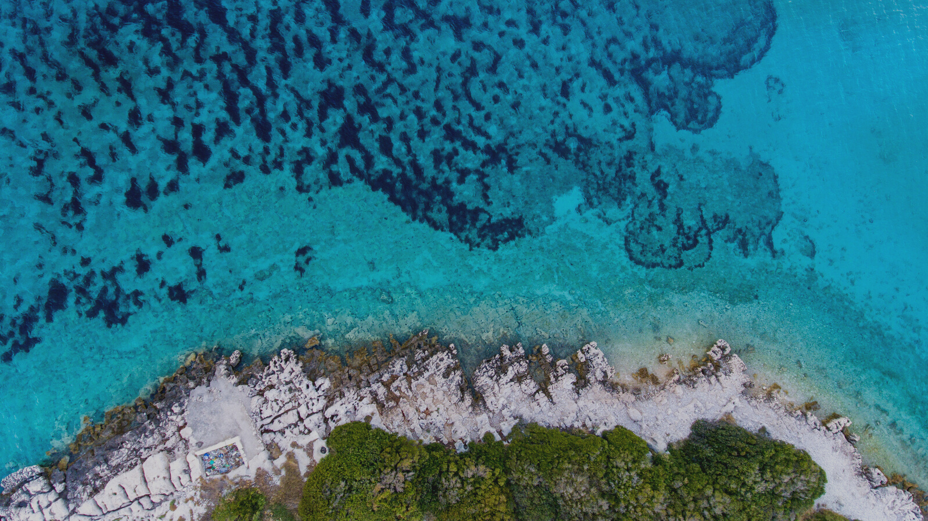
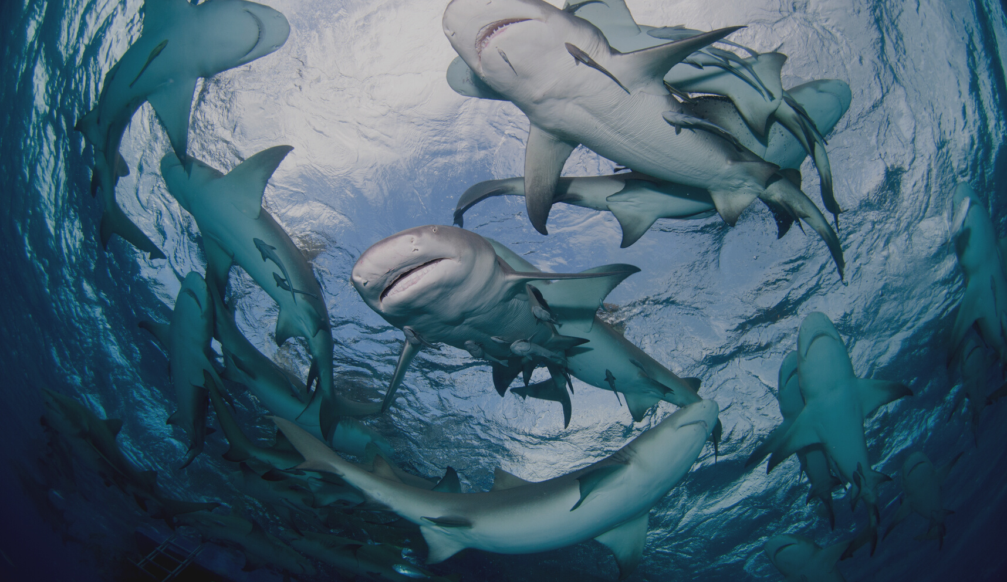
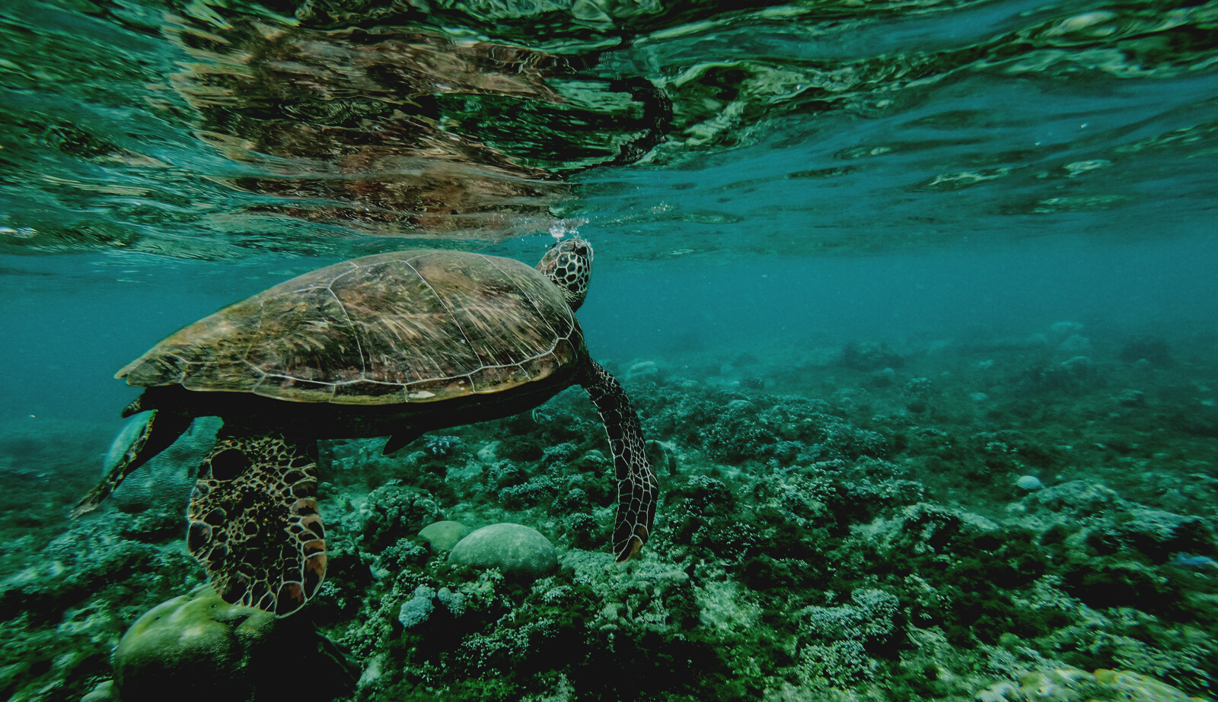
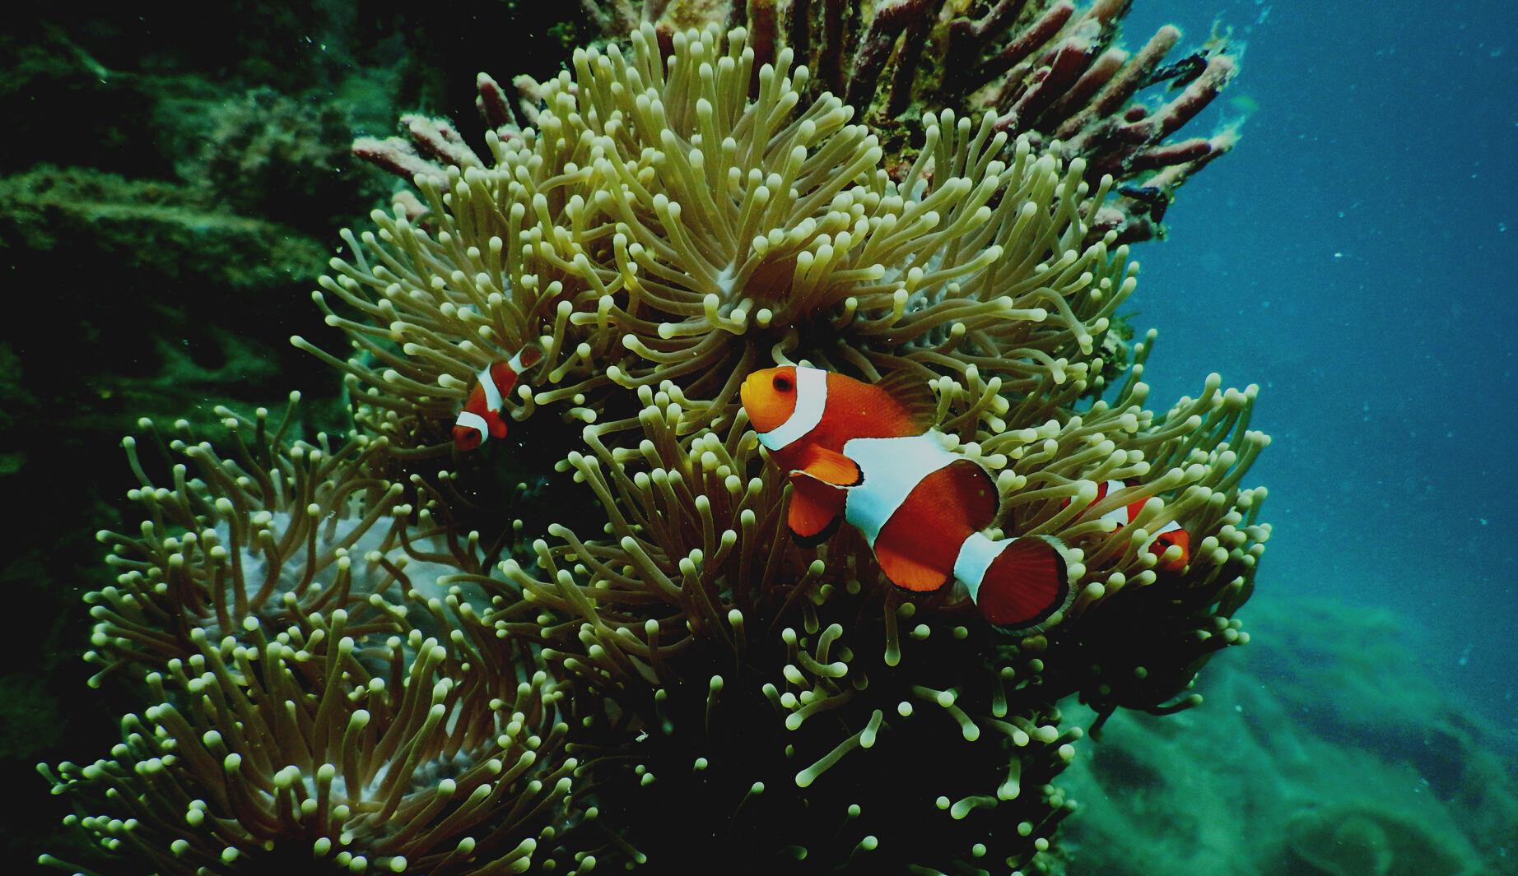
The Bigger Picture
  Non Scholae Sed Vitae Discimus
  “The goal of education is the advancement of knowledge and the dissemination of truth.”
- John F. Kennedy
Accelerating the Pipeline: Building Equitable Global Research Pathways in Secondary Education | Janna Mino, Hathaway Brown School | 2025
Notes:
So, over the past 9 months, we have reflected on what the reality of training the next generation of researchers will and can look like.
Our school's motto is "we learn not for school, but for life" which predates, but is reflected in a quote by another one of my country's presidents. JFK said "the goal of education is the advancement of knowledge and the dissemination of truth."
So, this moment felt like a crossroads between a complete roadblock and and a forest terrain without a trail to follow - we had two options, really for how we would respond: would we put up walls and do as much as we could internally while we wait for the dust to settle in this new landscape? Or would we do the opposite - do what feels scarier in the moment, but is in fact the opposite of a response to fear - to extend our connections, to persist in searching for real research opportunities that allow our students - the next generation - to learn by doing and to meet this moment in the real world, now.

Slide 5
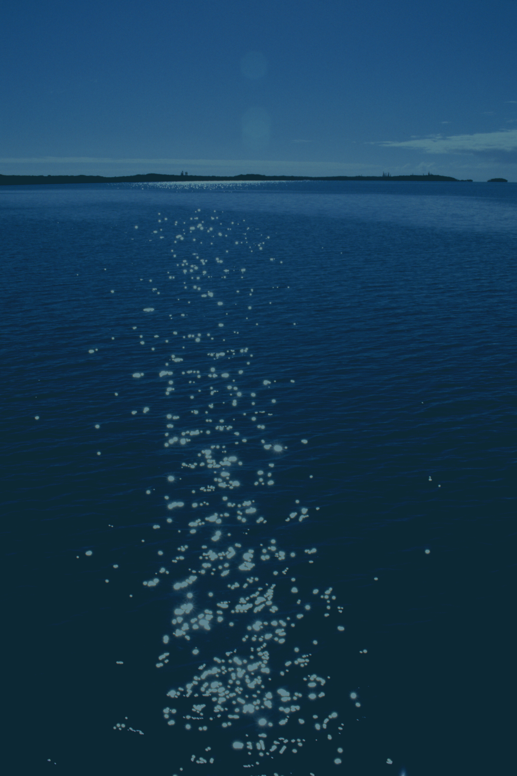
Pipeline ⟶ Estuary
Estuaries are transitional, dynamic zones where freshwater and saltwater mix; where change is constant, and life flourishes because of that flux.
High School Research
The Estuary
Diverse Representation
Biodiversity
Open Science
Constant Flow of Nutrients
International Partnerships
Mutualism
Secondary research education is often treated as upstream from ‘real science;’ preparatory, not participatory, but this is where ideas adapt, evolve, and move between systems, much like open science itself.
Accelerating the Pipeline: Building Equitable Global Research Pathways in Secondary Education | Janna Mino, Hathaway Brown School | 2025
Notes:
I'm a teacher first and foremost, and my role asks me to come up with creative ways of conveying abstract concepts to my students.
Something wasn't sitting right with me about my presentation title after I submitted to present here. A pipeline is fixed, solid, sure, but unable to adapt and evolve with the reality of the world. I had to ask myself, what am I pipelining my students into in this ever-changing world of research?
A better analogy is an estuary. I realize that the scientists at this conference might be more comfortable with a physics reference than an ecology one, but I'll quickly explain. Estuaries are transitional, dynamic zones where freshwater and saltwater mix; where change is constant, and life fluorishes because of that flux, not in spite of it. A high school or secondary school research program like mine is that estuary - providing the opportunity for students to engage with the real - actual real - research world today. As a community singularly dedicated to advancing opportunities for girls and women, their inclusion in STEM research is like the biodiversity in these liminal zones. Open science, is like the constant flow of nutrients that embraces change and self-correction in a beautiful cycle, and international partnerships can bring mutually beneficial outcomes - which is why I'm here today.
Secondary research education is often treated as upstream from 'real' science; preparatory, not participatory. But in reality, this is where ideas adapt, evolve, and move between systems, much like open science itself!

Slide 6
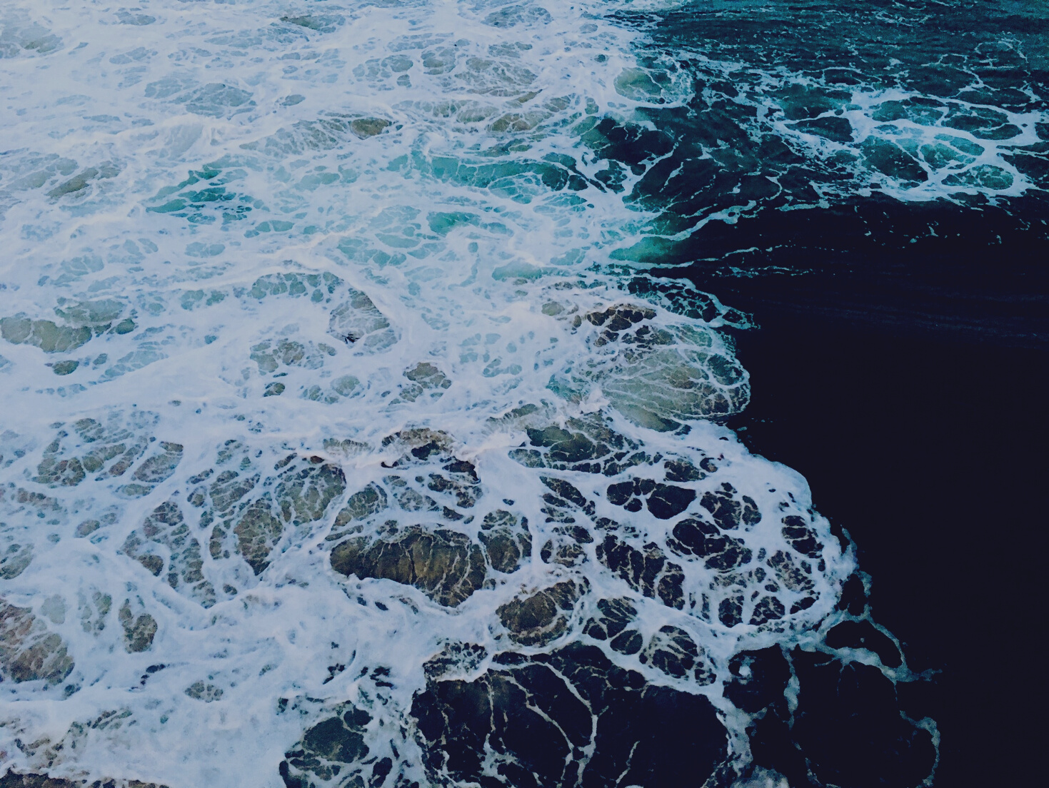
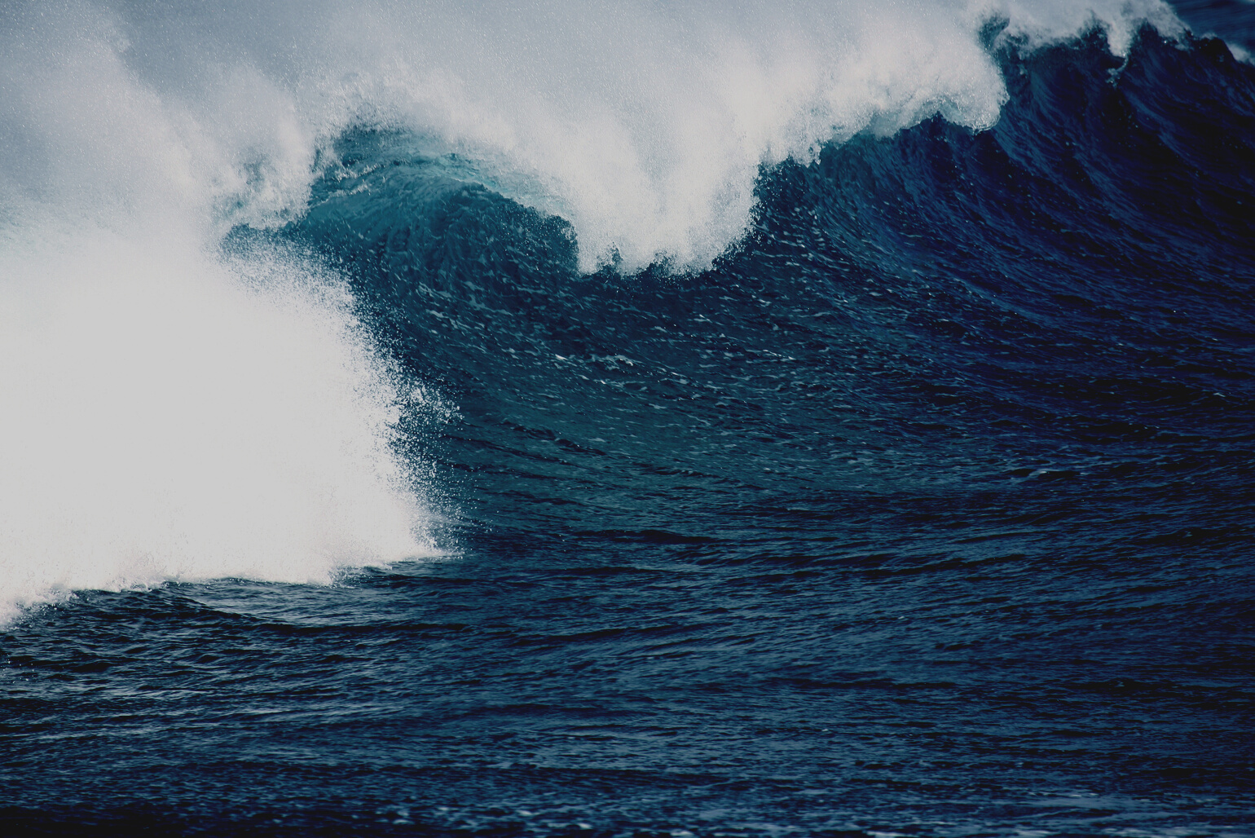
How can international collaboration help?
The Vision: Reciprocity
  Give students a broader, global perspective of research & STEM careers
  Connect secondary students to the international open science community
Accelerating the Pipeline: Building Equitable Global Research Pathways in Secondary Education | Janna Mino, Hathaway Brown School | 2025
Notes:
I mentioned international partnerships, and that brings me to why I am here, why I went looking for a conference like this in the first place, and why I applied to present here.
Generally, I aim to give my students a broader and more global perspective of research & STEM careers. The world - and research world specifically - that they will contribute to, is in reality a global one, and I believe their understanding of this perspective may help to respond to current and future challenges openly and creatively.
However, I am also here because I hope to find real opportunities for connection - I want my students to do more than just learn about open science and international collaboration in research, I want them to participate in it.

Slide 7



Thank you!
Janna Mino
jmino@hb.edu
Accelerating the Pipeline: Building Equitable Global Research Pathways in Secondary Education © 2025 by Janna Mino is licensed under CC BY 4.0
Accelerating the Pipeline: Building Equitable Global Research Pathways in Secondary Education | Janna Mino, Hathaway Brown School | 2025
Notes:
So, we have time for questions and for you to share your thoughts, but I'll leave you with this:
First, I hope that if you weren't already open to working with secondary students in authentic research, that you may consider this - real immersion in open science beyond short-term experiences - as a critical feature of open science.
Finally, I would love to connect if you have ideas for how we might collaborate across borders.
Thank you very much for your time!

