Slide 1
Shitpublishing
Workshop
Ezequiel Soriano
Hype Studies Conference 2025
Universitat Oberta de Catalunya
10/09/2025

Slide 2
Contents
From Shitposting to Shitpublishing
01
Spam Publishing and Hype
02
Workshop: The Goal
03
Workshop: The Means
04

Slide 3
From Shitposting to Shitpublishing
Background and theoretical framework of the workshop

Slide 4
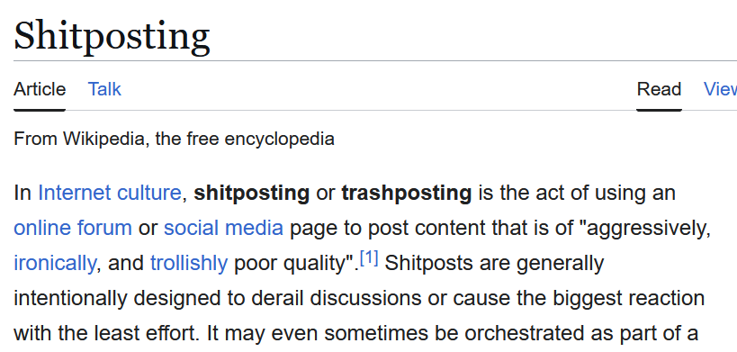
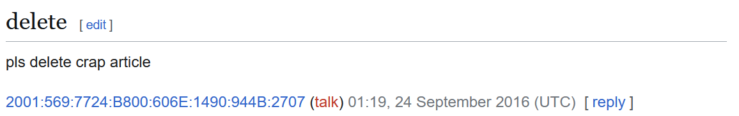

Slide 5
Shitpublishing
Shitposting is about spamming, about flooding online communication with nonsensical rubbish.
Shitpublishing is about categorizing these acts as done work, translating these oral gestures into literary or written ‘knowledge’. It turns trash-talking into trash-writing.

Slide 6
Shitpublishing
Shitpublishing defines the uncanny book valley. These things are made to look like books, but if you approach them as a “readership” you will have an unheimlich experience. These oddly familiar publications inhabit the margins of what is publishable.

Slide 7




Slide 8


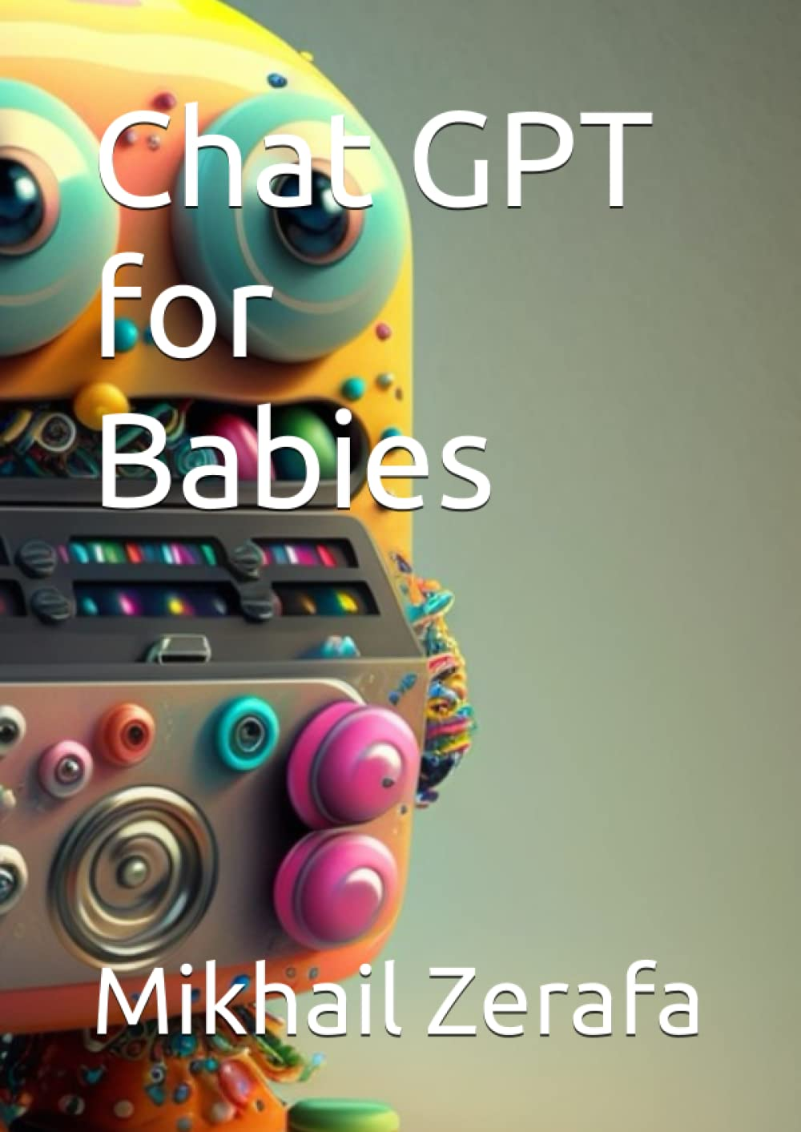

Slide 9
Desktop publishing on POD platforms, like lulu or Amazon, expanded the limits of publishing. The automation and the speediness of the publishing process on these platforms is closing the gap between posting and publishing.

Slide 10
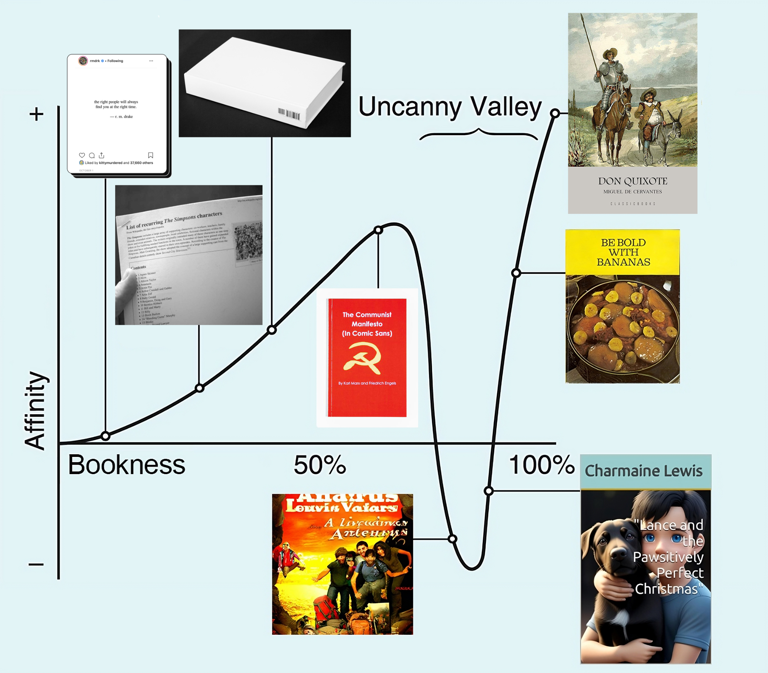
With the advent of generative AI tools, shitpublishing created a deeper uncanny book valley.
LLMs can produce realistic textual artifacts that meet the expectations of what a book should look and feel like.
ChatGPT is capable of producing originality, legibility, and common rhetorical and literary figures just as quickly as copypasting.
Now, lazy and fast books look more like actual books and, at the same time, they have become much more unpleasant and uncanny than copypasted books.

Slide 11
Spam Publishing and Hype
Creating value from low-effort publishing

Slide 12
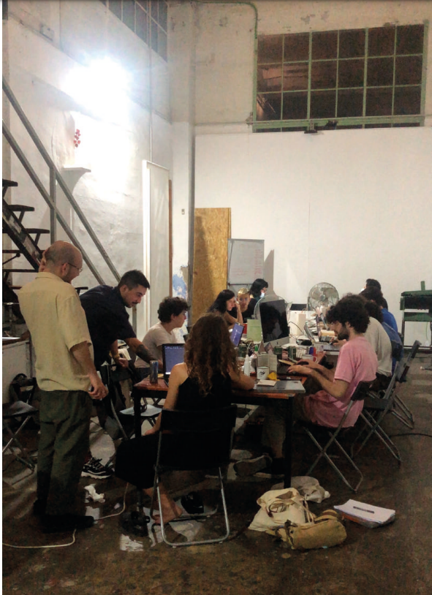
HYPER
PUBLICATION
100/24
(2023) Hyperpublicación 100/24. Two performative workshops for the research into vernacular internet creativity. Artnodes, 32.
The goal of publishing the absurd number of 100 books was to create a space for play that would ironically comment on the idea of authorship and the cultural capital associated with having published a book.
Playing between the publication of books and the publication of memes or digital folkloric content on social media, we wanted to reflect on the ease of self-publishing that Web 2.0 has brought with it and the importance we still attach to having a book published, on sale, and with an ISBN.
HYPER
PUBLICATION
100/24

Slide 13
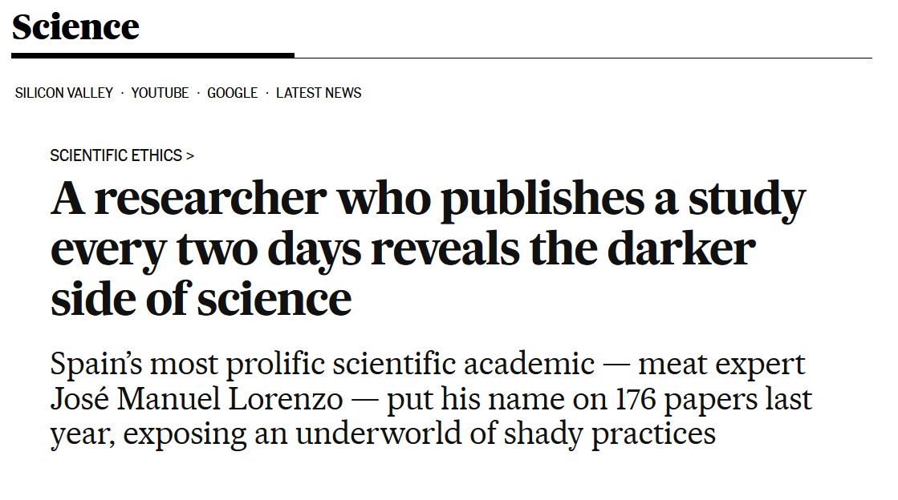

Slide 14
Shitposting as an epistemic approach
Mirror and reframe academic shitpublishing practices
->

Slide 15
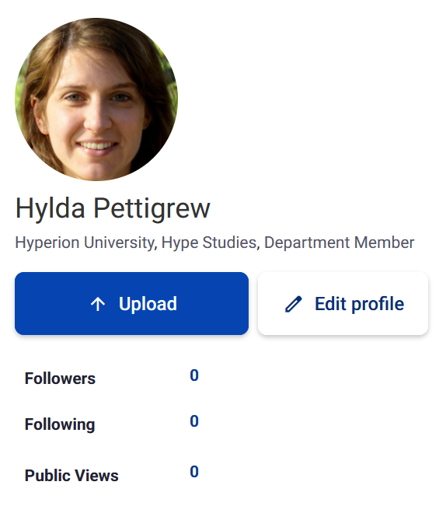


Workshop:
Goal
> Create a successful and prolific scholar public persona on social media
Hylda Pettigrew
gmail: hyldapettigrew25@gmail.com
pw: HypeStudies25
https://hyperion.academia.edu/HPettigrew

Slide 16
Workshop: Means
Step 1
Step 2
Step 3
Step 4
Generate an academic article on hype (and related topics) using an AI text generation tool
Sign it as Hylda Pettigrew
Generate the copy for the post by answering how this article contributes to the literature
Create a pdf and upload it to Academia.edu (or send it to hyldapettigrew25@gmail.com and I will upload it)
Repeat (you can experiment with different prompts and models; or you can try generate a whole book)

Slide 17
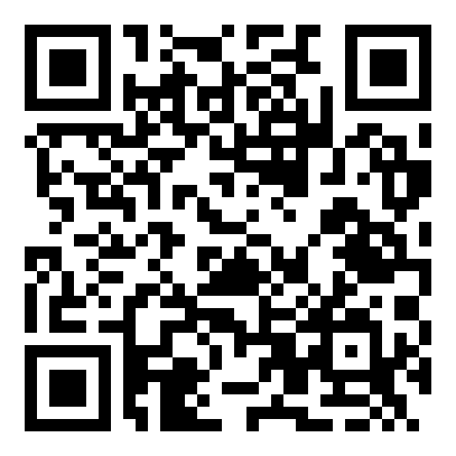
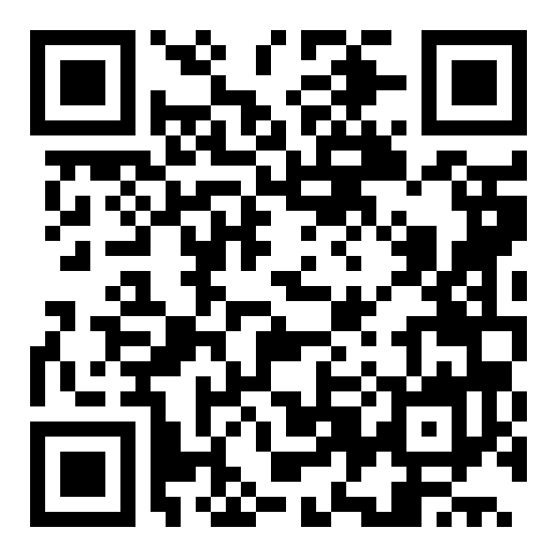
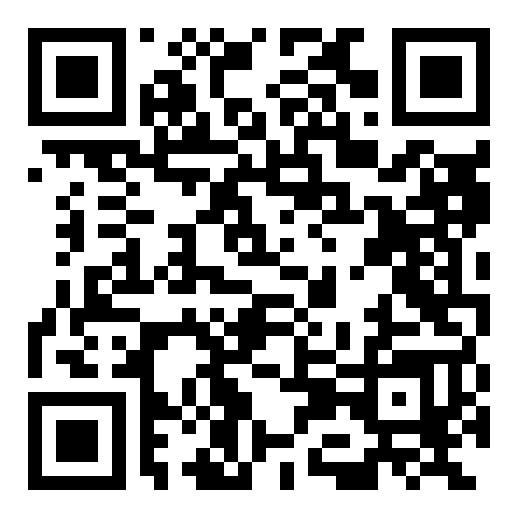
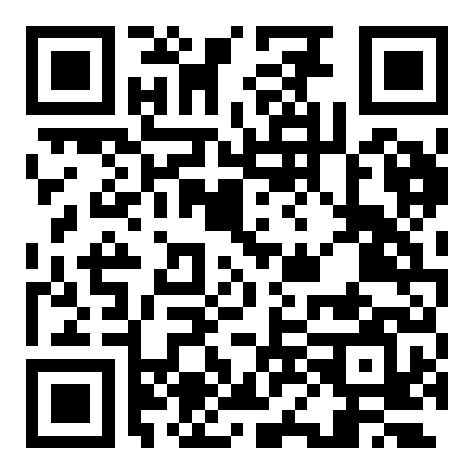
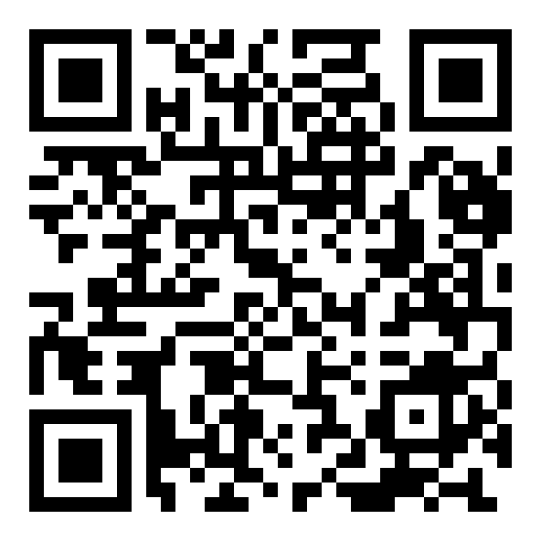
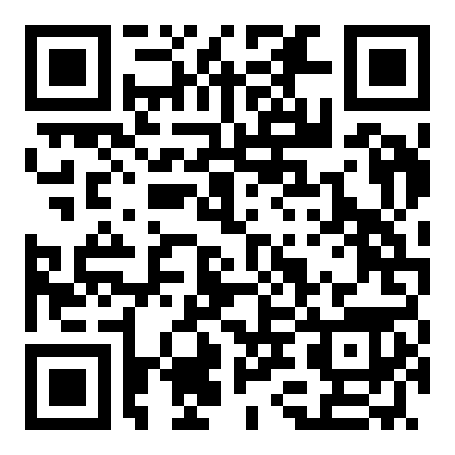
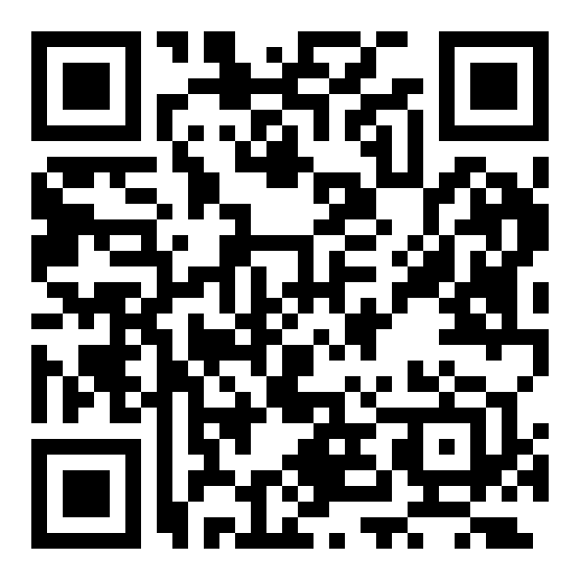
AI Transformers
Open Source Models on Hugging Face
Kimi-K2-Instruct-0905
MiniCPM-4.1-8B Chatbot
Apertus-8B-Instruct-2509
Commercial Tools
Claude.ai
DeepSeek
Other Commercial Models
hyldapettigrew25@gmail.com
pw: HypeStudies25
Gemini / Google AI Studio [Deepresearch Tool]
ChatGPT

Slide 18

Reflections

